Slide 1
TaigiCareNote
Care handover records that people can check
A care worker checks the original statements,
corrects the draft, and approves a specific version.
The exported record shows what was checked.
ASUS UGen AI League 2026 | Stage I proposal
Taigi AI Labs LLC
Taigi AI Labs LLC | ASUS UGen AI League 2026
01
Notes:
Sources: v8 local implementation and evidence; existing public medical-care PoC source audit; organizer reply; official rules; ASUS B70 and OpenVINO references. Fictional care record and controlled draft faults. UGen execution remains planned.

Slide 2
Who needs this?
A care worker handing over to the next shift
Scenario: a worker receives a spoken care report
and prepares a written handover for a colleague.
Taiwanese speech may need Mandarin text.
A fluent draft can still change left to right,
lose a negation, or change a number and its unit.
The next worker needs the checked facts.
Taigi AI Labs LLC | ASUS UGen AI League 2026
02
Notes:
Sources: v8 local implementation and evidence; existing public medical-care PoC source audit; organizer reply; official rules; ASUS B70 and OpenVINO references. Fictional care record and controlled draft faults. UGen execution remains planned.

Slide 3
One handover, one clear check
Fictional example; no patient data
Original statements:
“Today at 9 a.m., the person receiving care
reported pain in the left knee. No dizziness.
Drank 200 mL of water.”
The demo deliberately changes left → right
and 200 mL → 250 mL in the draft.
Taigi AI Labs LLC | ASUS UGen AI League 2026
03
Notes:
Sources: v8 local implementation and evidence; existing public medical-care PoC source audit; organizer reply; official rules; ASUS B70 and OpenVINO references. Fictional care record and controlled draft faults. UGen execution remains planned.

Slide 4
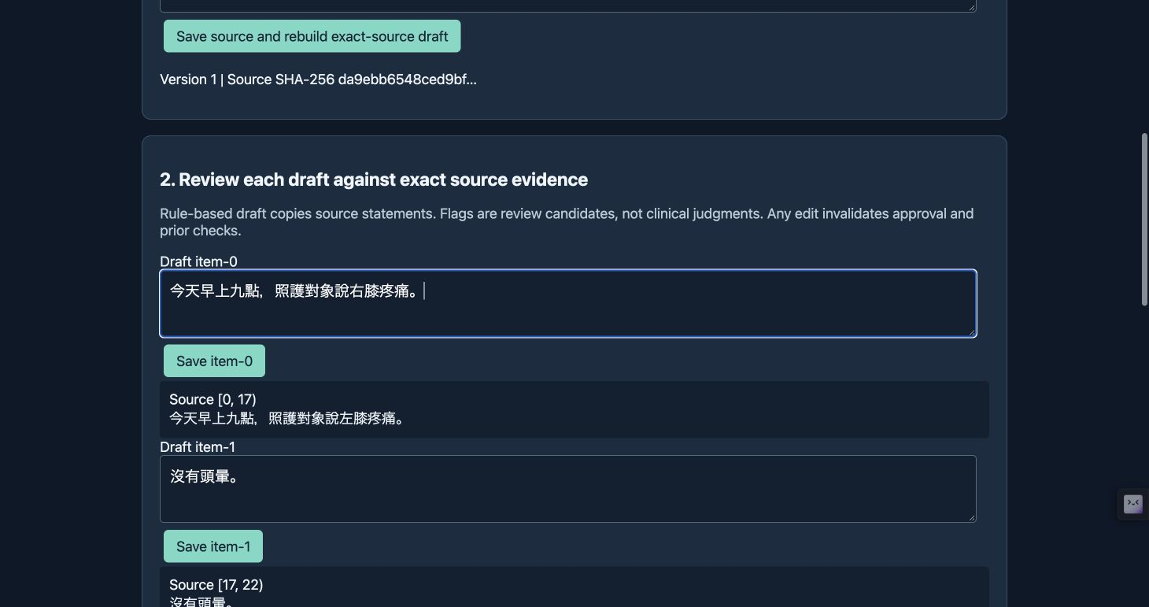
Review the draft against its source
Actual local prototype; controlled test faults
Controlled faults are inserted for the test; they are not measured ASR errors.
Taigi AI Labs LLC | ASUS UGen AI League 2026
04
Notes:
Sources: v8 local implementation and evidence; existing public medical-care PoC source audit; organizer reply; official rules; ASUS B70 and OpenVINO references. Fictional care record and controlled draft faults. UGen execution remains planned.

Slide 5
What the worker does
Check → correct → explain → approve
1. Open each flagged statement beside its source.
2. Correct the side or amount using the original.
3. Record how each check was resolved.
4. Enter the reviewer name and approve.
5. Export that approved version as JSON or CSV.
Editing the record requires another approval.
Taigi AI Labs LLC | ASUS UGen AI League 2026
05
Notes:
Sources: v8 local implementation and evidence; existing public medical-care PoC source audit; organizer reply; official rules; ASUS B70 and OpenVINO references. Fictional care record and controlled draft faults. UGen execution remains planned.

Slide 6
What is inherited, what is added
Existing public PoC is background technology
Existing PoC: source references, review flags,
issue resolution, confirmation, export,
and approval invalidation after changes.
This implementation adds content hashes,
revision-linked approval, export-time checks,
and a readable event history in the output.
Taigi AI Labs LLC | ASUS UGen AI League 2026
06
Notes:
Sources: v8 local implementation and evidence; existing public medical-care PoC source audit; organizer reply; official rules; ASUS B70 and OpenVINO references. Fictional care record and controlled draft faults. UGen execution remains planned.

Slide 7
Approval belongs to an exact version
A content fingerprint links review to export
The approval stores source, draft, and review hashes,
revision number, reviewer, and timestamp.
Export checks those values again.
Changed content or review notes require approval
of the revised version before export.
The event log records corrections and resolutions.
Taigi AI Labs LLC | ASUS UGen AI League 2026
07
Notes:
Sources: v8 local implementation and evidence; existing public medical-care PoC source audit; organizer reply; official rules; ASUS B70 and OpenVINO references. Fictional care record and controlled draft faults. UGen execution remains planned.

Slide 8
Current prototype architecture
Host-side review; existing speech services are background
Input / existing speech APIs
Care text; existing ASR and translation adapters
Host: CareNote review
Split source statements; attach exact text evidence
Worker review
Check side, negation, and quantities; correct draft
Version-linked approval
Store hashes, revision, reviewer, and time
JSON / CSV export
Recheck approval; include evidence and event log
Taigi AI Labs LLC | ASUS UGen AI League 2026
08
Notes:
Sources: v8 local implementation and evidence; existing public medical-care PoC source audit; organizer reply; official rules; ASUS B70 and OpenVINO references. Fictional care record and controlled draft faults. UGen execution remains planned.

Slide 9
What we have demonstrated
Local review and export; evidence is reproducible
17 automated tests passed.
Actual local UI: load → correct → resolve → approve.
JSON and CSV saved from approved revision 3.
After another edit: revision 4, export locked.
Source, draft, and review hashes are recorded.
This proves the local review workflow;
care ASR and UGen performance are not measured.
Taigi AI Labs LLC | ASUS UGen AI League 2026
09
Notes:
Sources: v8 local implementation and evidence; existing public medical-care PoC source audit; organizer reply; official rules; ASUS B70 and OpenVINO references. Fictional care record and controlled draft faults. UGen execution remains planned.

Slide 10
UGen has a specific computation role
Stage II: validate speech recognition on B70
Audio / host interface
Receive consented test audio and manage review
B70 / OpenVINO ASR
Run speech recognition in the designated environment
Host: CareNote review
Keep evidence checks and approval on the host
OpenVINO is a candidate integration path.
Our model compatibility and actual GPU execution are not yet verified.
Taigi AI Labs LLC | ASUS UGen AI League 2026
10
Notes:
Sources: v8 local implementation and evidence; existing public medical-care PoC source audit; organizer reply; official rules; ASUS B70 and OpenVINO references. Fictional care record and controlled draft faults. UGen execution remains planned.

Slide 11
Measure the handover work
Proposed evaluation; results are not assumed
Use consented test speech and fictional records.
Compare manual checking with guided review.
Measure review time, corrections, unresolved flags,
and successful export of the approved version.
For device ASR, record model, precision, memory,
latency, transcript quality, and CPU comparison.
Taigi AI Labs LLC | ASUS UGen AI League 2026
11
Notes:
Sources: v8 local implementation and evidence; existing public medical-care PoC source audit; organizer reply; official rules; ASUS B70 and OpenVINO references. Fictional care record and controlled draft faults. UGen execution remains planned.

Slide 12
Adoption starts with one workflow
A test with a care organization is the next step
Start with one handover form and one review role.
Check whether staff can find and correct differences
without retyping the whole report.
The first output is a reviewed handover record,
not a diagnosis or treatment recommendation.
Facility deployment and clinical quality are unverified.
Taigi AI Labs LLC | ASUS UGen AI League 2026
12
Notes:
Sources: v8 local implementation and evidence; existing public medical-care PoC source audit; organizer reply; official rules; ASUS B70 and OpenVINO references. Fictional care record and controlled draft faults. UGen execution remains planned.

Slide 13
Ownership and references
Background assets remain separately owned
Taigi AI Labs LLC: existing Taiwanese ASR,
translation, TTS, and the existing medical-care PoC.
Public PoC identifier: poc-medical-20261005.
References: organizer reply; competition rules;
ASUS B70 specifications; OpenVINO ASRPipeline;
local implementation, tests, and audit evidence.
Taigi AI Labs LLC | ASUS UGen AI League 2026
13
Notes:
Sources: v8 local implementation and evidence; existing public medical-care PoC source audit; organizer reply; official rules; ASUS B70 and OpenVINO references. Fictional care record and controlled draft faults. UGen execution remains planned.

Slide 14
Submission links
English proposal and narrated prototype demonstration
Public repository
https://github.com/arata-1972/ASUS_UGen
English demonstration video
https://youtu.be/BKMI5votioI
Stage I: local review prototype and design documents.
Stage II: designated-environment ASR validation.
Taigi AI Labs LLC | ASUS UGen AI League 2026
14
Notes:
Sources: v8 local implementation and evidence; existing public medical-care PoC source audit; organizer reply; official rules; ASUS B70 and OpenVINO references. Fictional care record and controlled draft faults. UGen execution remains planned.

