Slide 1
Taiwanese SpeechBridge
Help a Taiwanese visitor and a Mandarin receptionist understand each turn
ASUS UGen AI League 2026 | Workplace AI
Proposed track: Thunderstorm | Two-person individual team
Existing speech technology: Taigi AI Labs LLC
Stage I: local interface and self-hosted API integration demonstrated
UGen / B70 GPU inference is not yet verified
Taigi AI Labs LLC | ASUS UGen AI League 2026
01
Notes:
Sources: v6 implementation/BENCHMARK.md, ARCHITECTURE.md, and reception_demo actual-interface evidence; organizer email and official rules. The reception setting is a hypothesis. HTTP completion is not GPU execution.

Slide 2
Reception needs the next sentence to make sense
Use-case hypothesis: a visitor asks where to go; staff checks the booking
The visitor normally speaks Taiwanese; staff uses Mandarin.
They need to confirm the destination, booking name, and waiting area.
Each person reads or hears the other turn before replying.
We aim to reduce repeated questions and misunderstandings.
This is a use-case hypothesis, not a deployed customer result.
Taigi AI Labs LLC | ASUS UGen AI League 2026
02
Notes:
Sources: v6 implementation/BENCHMARK.md, ARCHITECTURE.md, and reception_demo actual-interface evidence; organizer email and official rules. The reception setting is a hypothesis. HTTP completion is not GPU execution.

Slide 3
Review the words before communicating them
WAV input → ASR → review → translation → speech
1 Select Taiwanese or Mandarin and a WAV file; click to transcribe.
2 Check and correct the original, including names or locations.
3 Translate to the other language and review the translation.
4 Generate speech, play it, or listen again.
5 Switch the source language for the other person’s reply.
The current prototype uses file upload, not microphone recording.
Taigi AI Labs LLC | ASUS UGen AI League 2026
03
Notes:
Sources: v6 implementation/BENCHMARK.md, ARCHITECTURE.md, and reception_demo actual-interface evidence; organizer email and official rules. The reception setting is a hypothesis. HTTP completion is not GPU execution.

Slide 4
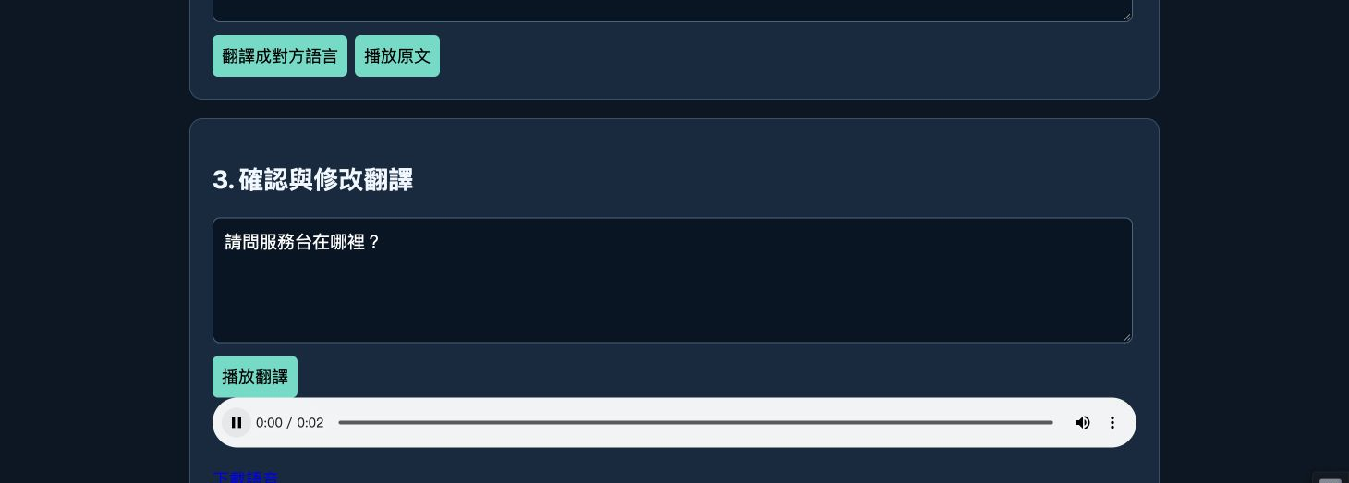
Actual interface: review and play the translation
The browser runs locally; configured self-hosted services run inference
UI controls: translate for the other person / review translation / play translated audio / download audio
Taigi AI Labs LLC | ASUS UGen AI League 2026
04
Notes:
Sources: v6 implementation/BENCHMARK.md, ARCHITECTURE.md, and reception_demo actual-interface evidence; organizer email and official rules. The reception setting is a hypothesis. HTTP completion is not GPU execution.

Slide 5
Show the recognition error, then correct it
The input is Taigi TTS-generated Taiwanese, not a human recording
Input: “請問服務台佇佗位?” — “Where is the service desk?”
Actual ASR: “請問服務代到位去。” — the question was misrecognized.
User correction: “請問服務台佇佗位？”
Translation: “請問服務台在哪裡?”; punctuation edited before Mandarin TTS.
The interface retains both texts and supports review before each step.
This demonstrates correction; it does not establish recognition accuracy.
Taigi AI Labs LLC | ASUS UGen AI League 2026
05
Notes:
Sources: v6 implementation/BENCHMARK.md, ARCHITECTURE.md, and reception_demo actual-interface evidence; organizer email and official rules. The reception setting is a hypothesis. HTTP completion is not GPU execution.

Slide 6
Current architecture: UI and self-hosted speech
ASR, EOLE translation, and TTS. No LLM is required.
Local browser
Select Taiwanese / Mandarin and a WAV file
Local Node bridge
Send audio to the configured self-hosted ASR
User
Review and edit the recognized original
Self-hosted EOLE
Translate, then review and edit the translation
Taiwanese / Mandarin TTS
Generate audio; play or download in the browser
Taigi AI Labs LLC | ASUS UGen AI League 2026
06
Notes:
Sources: v6 implementation/BENCHMARK.md, ARCHITECTURE.md, and reception_demo actual-interface evidence; organizer email and official rules. The reception setting is a hypothesis. HTTP completion is not GPU execution.

Slide 7
Reception demo: hear the corrected question
Synthetic Taiwanese question → ASR → correction → translation → TTS
Question: “請問服務台佇佗位？” / “Where is the service desk?”
Mandarin output: “請問服務台在哪裡？”
UI times: ASR about 803 ms; translation 189 ms; TTS 1,147 ms.
Mandarin audio was generated and played; browser download is unverified.
One API operation per step, including network time; user editing excluded.
This reception demo is separate from CLI tests and is not UGen performance.
Taigi AI Labs LLC | ASUS UGen AI League 2026
07
Notes:
Sources: v6 implementation/BENCHMARK.md, ARCHITECTURE.md, and reception_demo actual-interface evidence; organizer email and official rules. The reception setting is a hypothesis. HTTP completion is not GPU execution.

Slide 8
Stage II: speech recognition on the designated platform
Thunderstorm: validate OpenVINO ASR before evaluating other speech models
Local UI / host
Manage audio, text review, and playback
B70 / OpenVINO ASR
Designated-environment ASR: Stage II validation
Existing EOLE / TTS
Keep services initially; validate porting separately
OpenVINO is a candidate integration path.
Our model compatibility and actual GPU execution are not yet verified.
Taigi AI Labs LLC | ASUS UGen AI League 2026
08
Notes:
Sources: v6 implementation/BENCHMARK.md, ARCHITECTURE.md, and reception_demo actual-interface evidence; organizer email and official rules. The reception setting is a hypothesis. HTTP completion is not GPU execution.

Slide 9
Verified evidence and the next tests
API completion, correct meaning, and GPU execution are separate checks
12 adapter-contract and error-handling tests passed.
The local UI starts; editing and unconfigured-backend errors were checked.
Real API results, generated audio, and failure records are retained.
Next: human speech, corrections, and two-way reception conversations.
Stage II: model compatibility, GPU execution, memory, and latency.
Compare CPU and GPU only with comparable models, settings, and inputs.
Taigi AI Labs LLC | ASUS UGen AI League 2026
09
Notes:
Sources: v6 implementation/BENCHMARK.md, ARCHITECTURE.md, and reception_demo actual-interface evidence; organizer email and official rules. The reception setting is a hypothesis. HTTP completion is not GPU execution.

Slide 10
Separate the new application from existing technology
Existing speech technology belongs to Taigi AI Labs LLC
Existing assets: Taiwanese ASR, translation, TTS, and Mandarin speech.
New work: conversation UI, text review, adapters, tests, and device integration.
Public scope: the new client, integration explanations, and documentation.
Excluded: API keys, private weights, training data, and existing server code.
Model/runtime licences and attribution follow the actual packages selected.
Taigi AI Labs LLC | ASUS UGen AI League 2026
10
Notes:
Sources: v6 implementation/BENCHMARK.md, ARCHITECTURE.md, and reception_demo actual-interface evidence; organizer email and official rules. The reception setting is a hypothesis. HTTP completion is not GPU execution.

Slide 11
Validate one reception workflow before expanding
Goal: the visitor communicates a need, and staff can respond clearly
Start with one reception PC and short alternating Taiwanese/Mandarin turns.
Test whether it reduces mishearing, repeated questions, and retyping.
Later, evaluate an internal server serving multiple PCs or tablets.
Deployment cost, staff use, and adoption interest still need validation.
We make no pricing, paid-customer, or measured business-outcome claim.
Taigi AI Labs LLC | ASUS UGen AI League 2026
11
Notes:
Sources: v6 implementation/BENCHMARK.md, ARCHITECTURE.md, and reception_demo actual-interface evidence; organizer email and official rules. The reception setting is a hypothesis. HTTP completion is not GPU execution.

Slide 12
Project documents, demonstration, and references
Taigi AI Labs LLC | info@ailabs.jp | https://ailabs.jp
Public GitHub
https://github.com/arata-1972/ASUS_UGen
English-narrated actual-interface demo (YouTube unlisted)
https://youtu.be/Iapyx8E_vpM
Competition rules
https://contest.bhuntr.com/en/39jg9vimiynrhlksze/home/
ASUS B70 specifications / Intel OpenVINO ASR
https://www.asus.com/motherboards-components/ai-accelerator/ugen/ugen-arc-pro-b70-32g/techspec/
https://docs.openvino.ai/2026/api/genai_api/_autosummary/openvino_genai.ASRPipeline.html
Taigi AI Labs LLC | ASUS UGen AI League 2026
12
Notes:
Sources: v6 implementation/BENCHMARK.md, ARCHITECTURE.md, and reception_demo actual-interface evidence; organizer email and official rules. The reception setting is a hypothesis. HTTP completion is not GPU execution.

