Slide 1

Twitter Sentiment PREDICTION
Amandeep Rathee
April 14, 2020

Slide 2

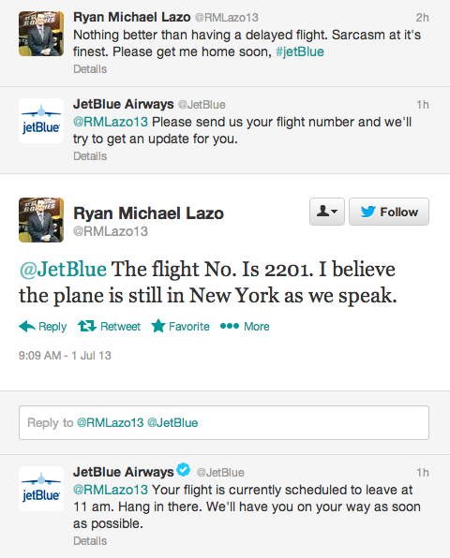
Problem Description
Companies are interested in knowing sentiment of users’ tweet to improve customer satisfaction.
For example, if someone tweets that they are unsatisfied with an airline service, the airline’s social media team can respond in a timely manner.
The task in this project is to predict the sentiment of a tweet as positive, negative or neutral using long short-term memory network.
Source: https://www.socialmediaexaminer.com/exceptional-customer-service-on-twitter/

Slide 3
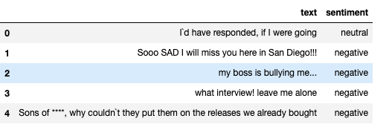
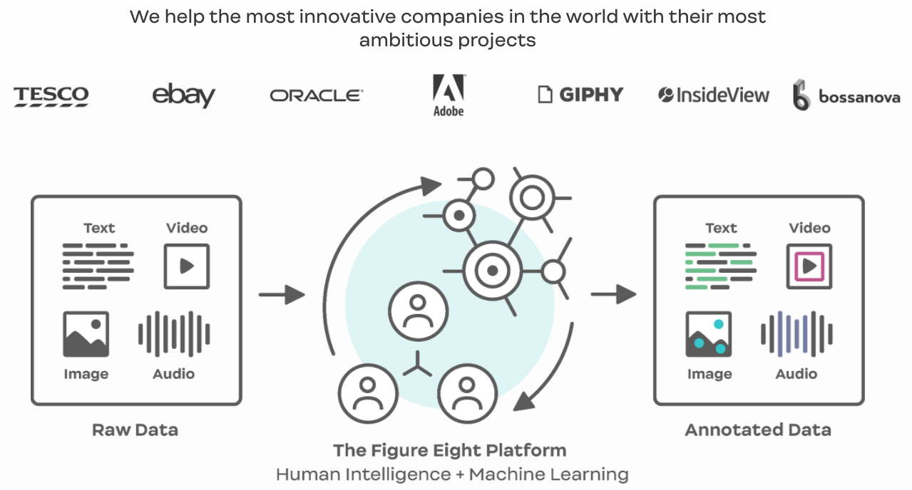
Data Description
Data contains 27,481 tweets with a sentiment tag which is either positive, negative or neutral.
Sample data:
Tweets are collected and annotated by Figure Eight which is a data annotation company.
https://www.figure-eight.com/

Slide 4
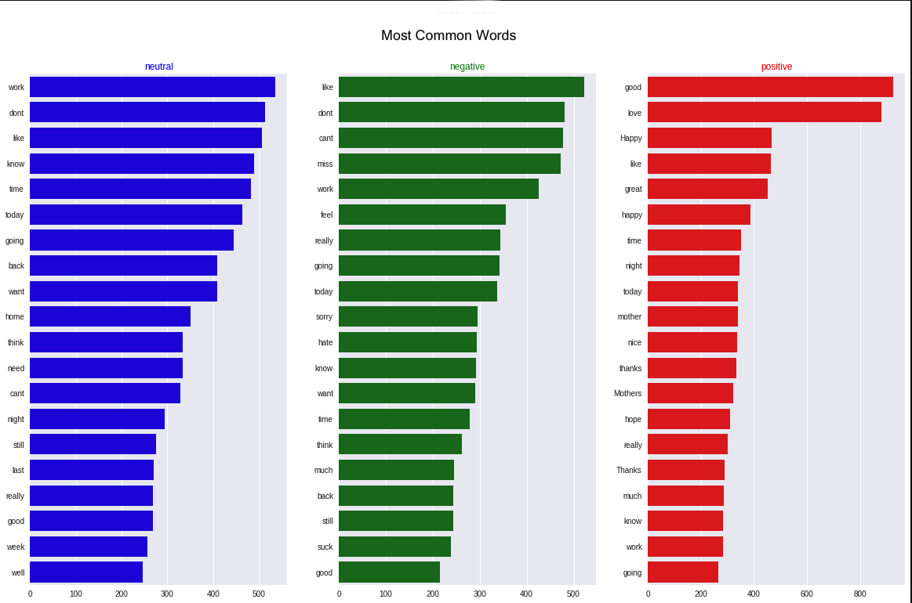
Data Analysis
Top 20 words in each sentiment:

Slide 5
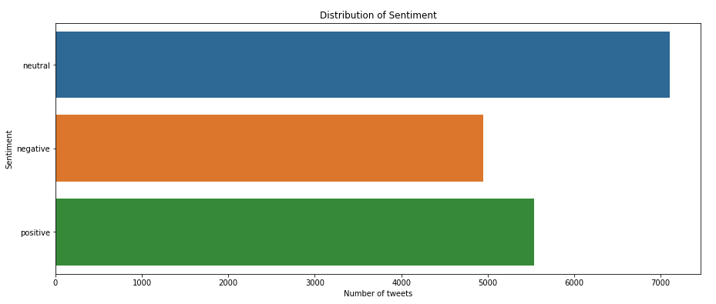
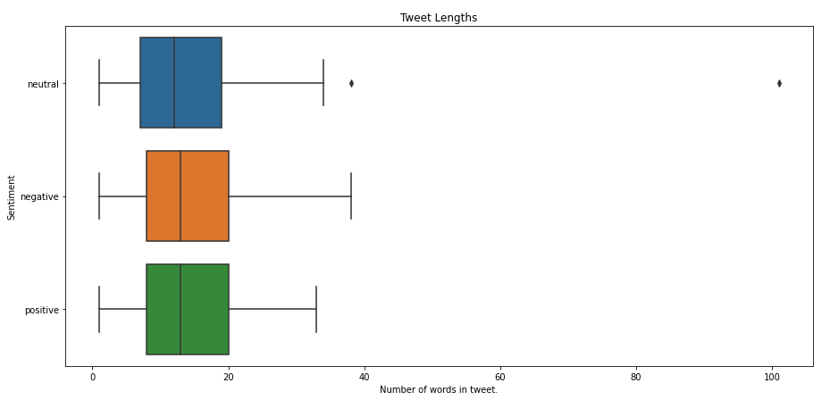
Data Analysis
Sentiment distribution:
Tweet lengths:

Slide 6
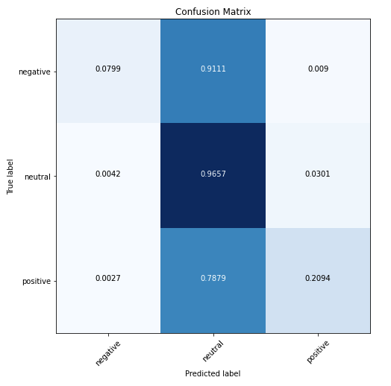
Modeling: VADER
VADER (Valence Aware Dictionary and sEntiment Reasoner) is a lexicon and rule-based sentiment analysis tool that is specifically attuned to sentiments expressed in social media.
Used VADER as baseline model without preprocessing tweets.
Accuracy = 48%
Confusion matrix:

Slide 7
Modeling: LSTM
LSTM is a variant of RNN which incorporates the idea of removing irrelevant information and only keeping new information while processing sequences such as text.
Figure: Many-to-one RNN architecture

Slide 8
Modeling: LSTM
Text preprocessing for LSTM:
Removed URLs.
Removed HTML syntax such as <p> </p>.
Removed punctuations and numbers.
Expanded contractions. E.g.: “I’m” replaced by “I am”.
Lemmatized words.
Each sentences was truncated or padded (with dummy token) to have 30 words.
LSTM architecture:
Used word2vec word embeddings.
3-layer LSTM with 8 neurons in each layer.
Batch normalization after each layer.

Slide 9
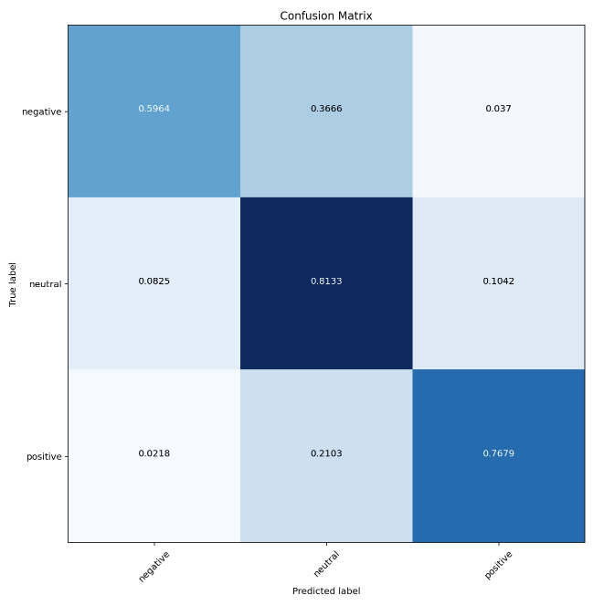
LSTM Results
Accuracy: 0.74
Confusion matrix:

Slide 10
Conclusion
Predicting sentiment in tweets is challenging especially because of misspelled words and inconsistent language use.
Using an efficient spell corrector might overcome this challenge.
The current implementations are extremely slow. To rectify the spelling of a single word, a spell-corrector scans through an entire dictionary.

Slide 11
Thank you!

