Slide 1
Executive summary templates
Use the Layout dropdown menu to select a template or build your own using these layouts as inspiration.

Slide 2
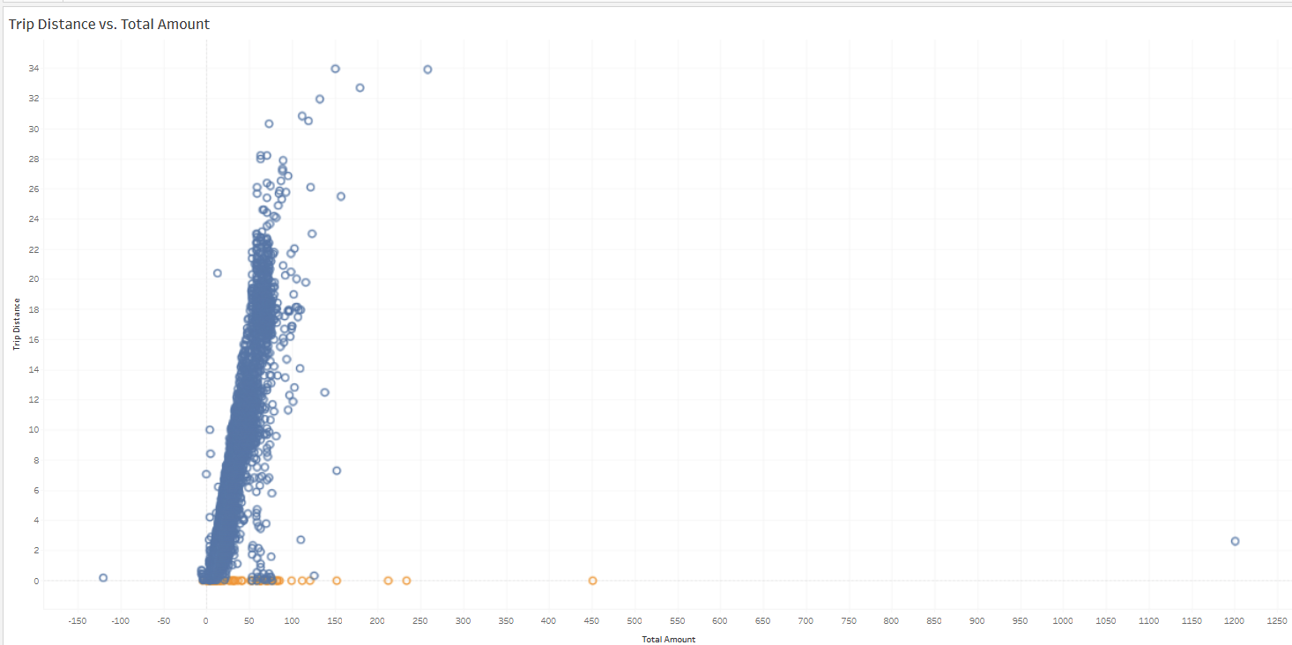
EDA – NYC TLC Data
Executive Summary
Project Overview
Build a regression model to predict taxi fares. We need to analyze, explore, clean and structure the data to create any further models
There are anomalies in the
Trip Distance, Fare Amt and Tip Amt causing Discrepancies in Total fare. There are almost 148 trips with 0 distance and there also 5742 trips with more than 3 miles. This proves that Trip Distance field has anomalies or outliers which needs to be treated.
That said , we will need to treat anomalies And outliers for other features/variables like extreme values for tip amount and Fare amount
Image Alt-Text Here
Determine other variables that have impact on Total
Amount.
Determines and treat anomalies and outliers for key
Variables
Feature Engineering : Analyze the Key impacting/driving
features

