Slide 1
Deploy ELK Stack using Ansible
Elasticsearch, Logstash, Kibana

Slide 2




Deploy ELK Stack using Ansible
Elasticsearch, Logstash, Kibana

Slide 3




Install and configure Elasticsearch logstash Kibana ( ELK STACK)
Logstash
Kibana

Slide 4
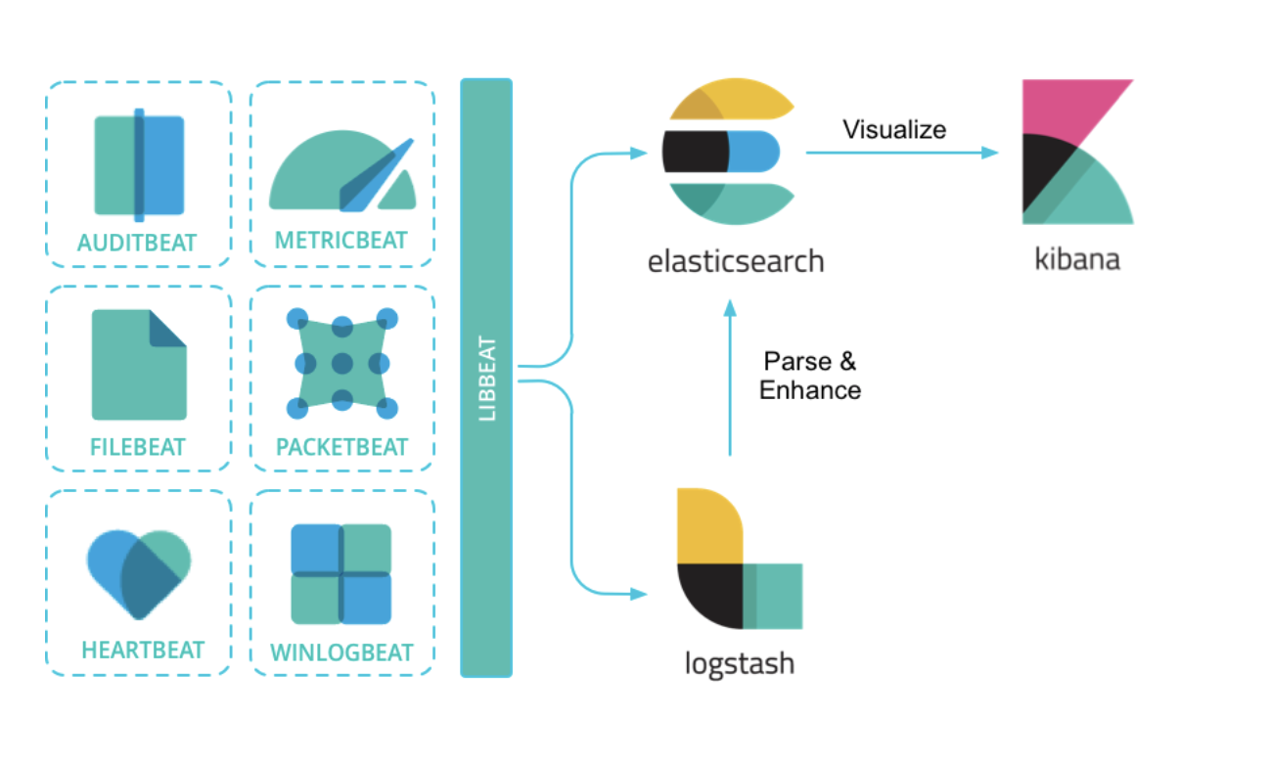
Deploying Elasticsearch with ansible
Logstash
Kibana

Slide 5

Configure x-pack for ELK cluster

Slide 6

Automate Installation of apache webserver using ansible

Slide 7

Setup gcp trial account and Get $300 free trial credit

Slide 8
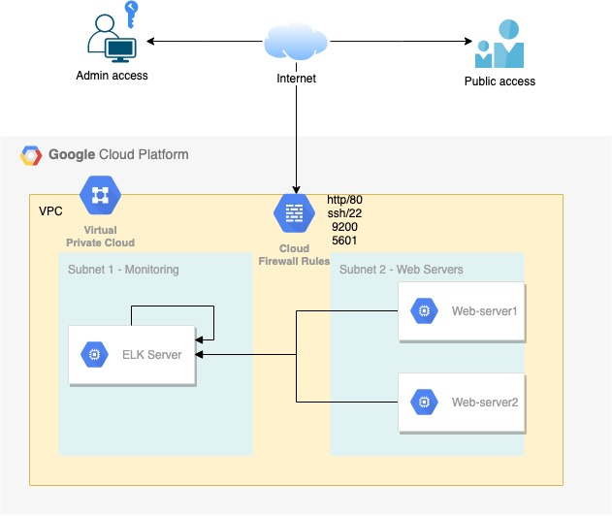
Setup gcp trial account and Get $300 free trial credit

Slide 9

Install openjdk-8 using ansible

Slide 10
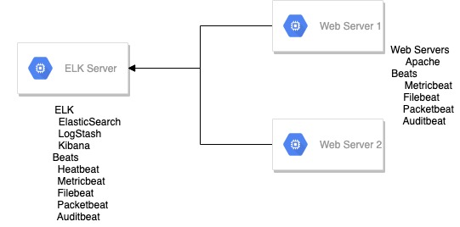
Introduction
Elasticsearch can be used to search on and analyse all types of data, including textual, numerical, geospatial, structured, and unstructured data.

Slide 11
ELK Stack
Elasticsearch
Logstash
Kibana

Slide 12
Beats
Beats are essentially lightweight, purpose-built agents that acquire data and then feed it to elastic search. Beats are built upon libbeat framework and it makes it easy to create customised beats for any type of data you'd like to send to Elasticsearch.
Filebeat
Auditbeat
Metricbeat
Hearbeat
Packetbeat
Journalbeat
winlogbeat
Functionbeat

Slide 13
Lab Architecture
GCP Platform – provides $300 USD free
GCP setup
VPC
Firewall rules
2 Subnets
1 ELK node
2 web servers
Access –
Admin ssh access secured using ssh key
Public access –
ELK – port 9200, 5601 { secured using xpack authentication }
http

Slide 14
Gcp provisioning
Account Setup
Create new project
Create new VPC
Create subnets inside the new VPC
Create firewall rules
Create compute engine instances
Validate connectivity
Generate SSH key
Configure your access key in gcp
Validate ssh access to gcp instances
Validate ansible access for your gcp instances

Slide 15
ROles
Role | Description
WebServer | Install and configures apache webserver
Java | Installs Java( pre-requisite for ELK installation)
Add-elastic-repo | Adds elasticsearch repository on target machines
Elasticsearch | Installs and configure elasticsearch and X-pack security
Kibana | Installs and configures Kibana
Metricbeat | Installs and configures Metricbeat
Filebeat | Installs and configures Filebeat
Auditbeat | Installs and configures Auditbeat
Heartbeat | Installs and configures Heartbeat
Packetbeat | Installs and configures Packetbeat
Config-beats-elatic* | Configure beats modules on elasticsearch servers
Config-beats-web* | Configures beats module on webservers
* non-idempotent roles

Slide 16
Deployment
ELK Server | WebServers
Java add-elastic-repo Elasticsearch Kibana Metricbeat Auditbeat Filebeat Packetbeat heartbeat config-beats-elastic | add-elastic-repo Webserver Metricbeat Auditbeat Filebeat Packetbeat config-beats-apache

Slide 17
Webserver
Install apache webserver
Deploy new config file( index.html )
Start apache server
Test access to sample webpage

Slide 18
Java
Pre-requisite for elasticsearch
Deployed ON: ELK Server

Slide 19
Learn to do Manual deploy before automating it

Slide 20
Elasticsearch – manual install
Openjdk-8
Elasticsearch public signing key
apt-transport-https package
Save elasticsearch repository definitions
System update
Install Elasticsearch, Logstash and Kibana
Configure Elasticsearch and Kibana
Test Access

Slide 21
Configure X-Pack security
Stop Kibana & Elasticsearch
Enable x-pack
Start Elasticsearch
Setup default credentials
Configure Kibana
Start Kibana

Slide 22
Add-ELASTIC-REPO
Tasks
Add Elasticsearch public signing key
Install https transport module
Adding Elasticsearch repository
System update

Slide 23
Elasticsearch
Install Elasticsearch
Configure elasticsearch.yml
Start and enable Elasticsearch service

Slide 24
Configure x-pack security
Generate passwords for default accounts

Slide 25
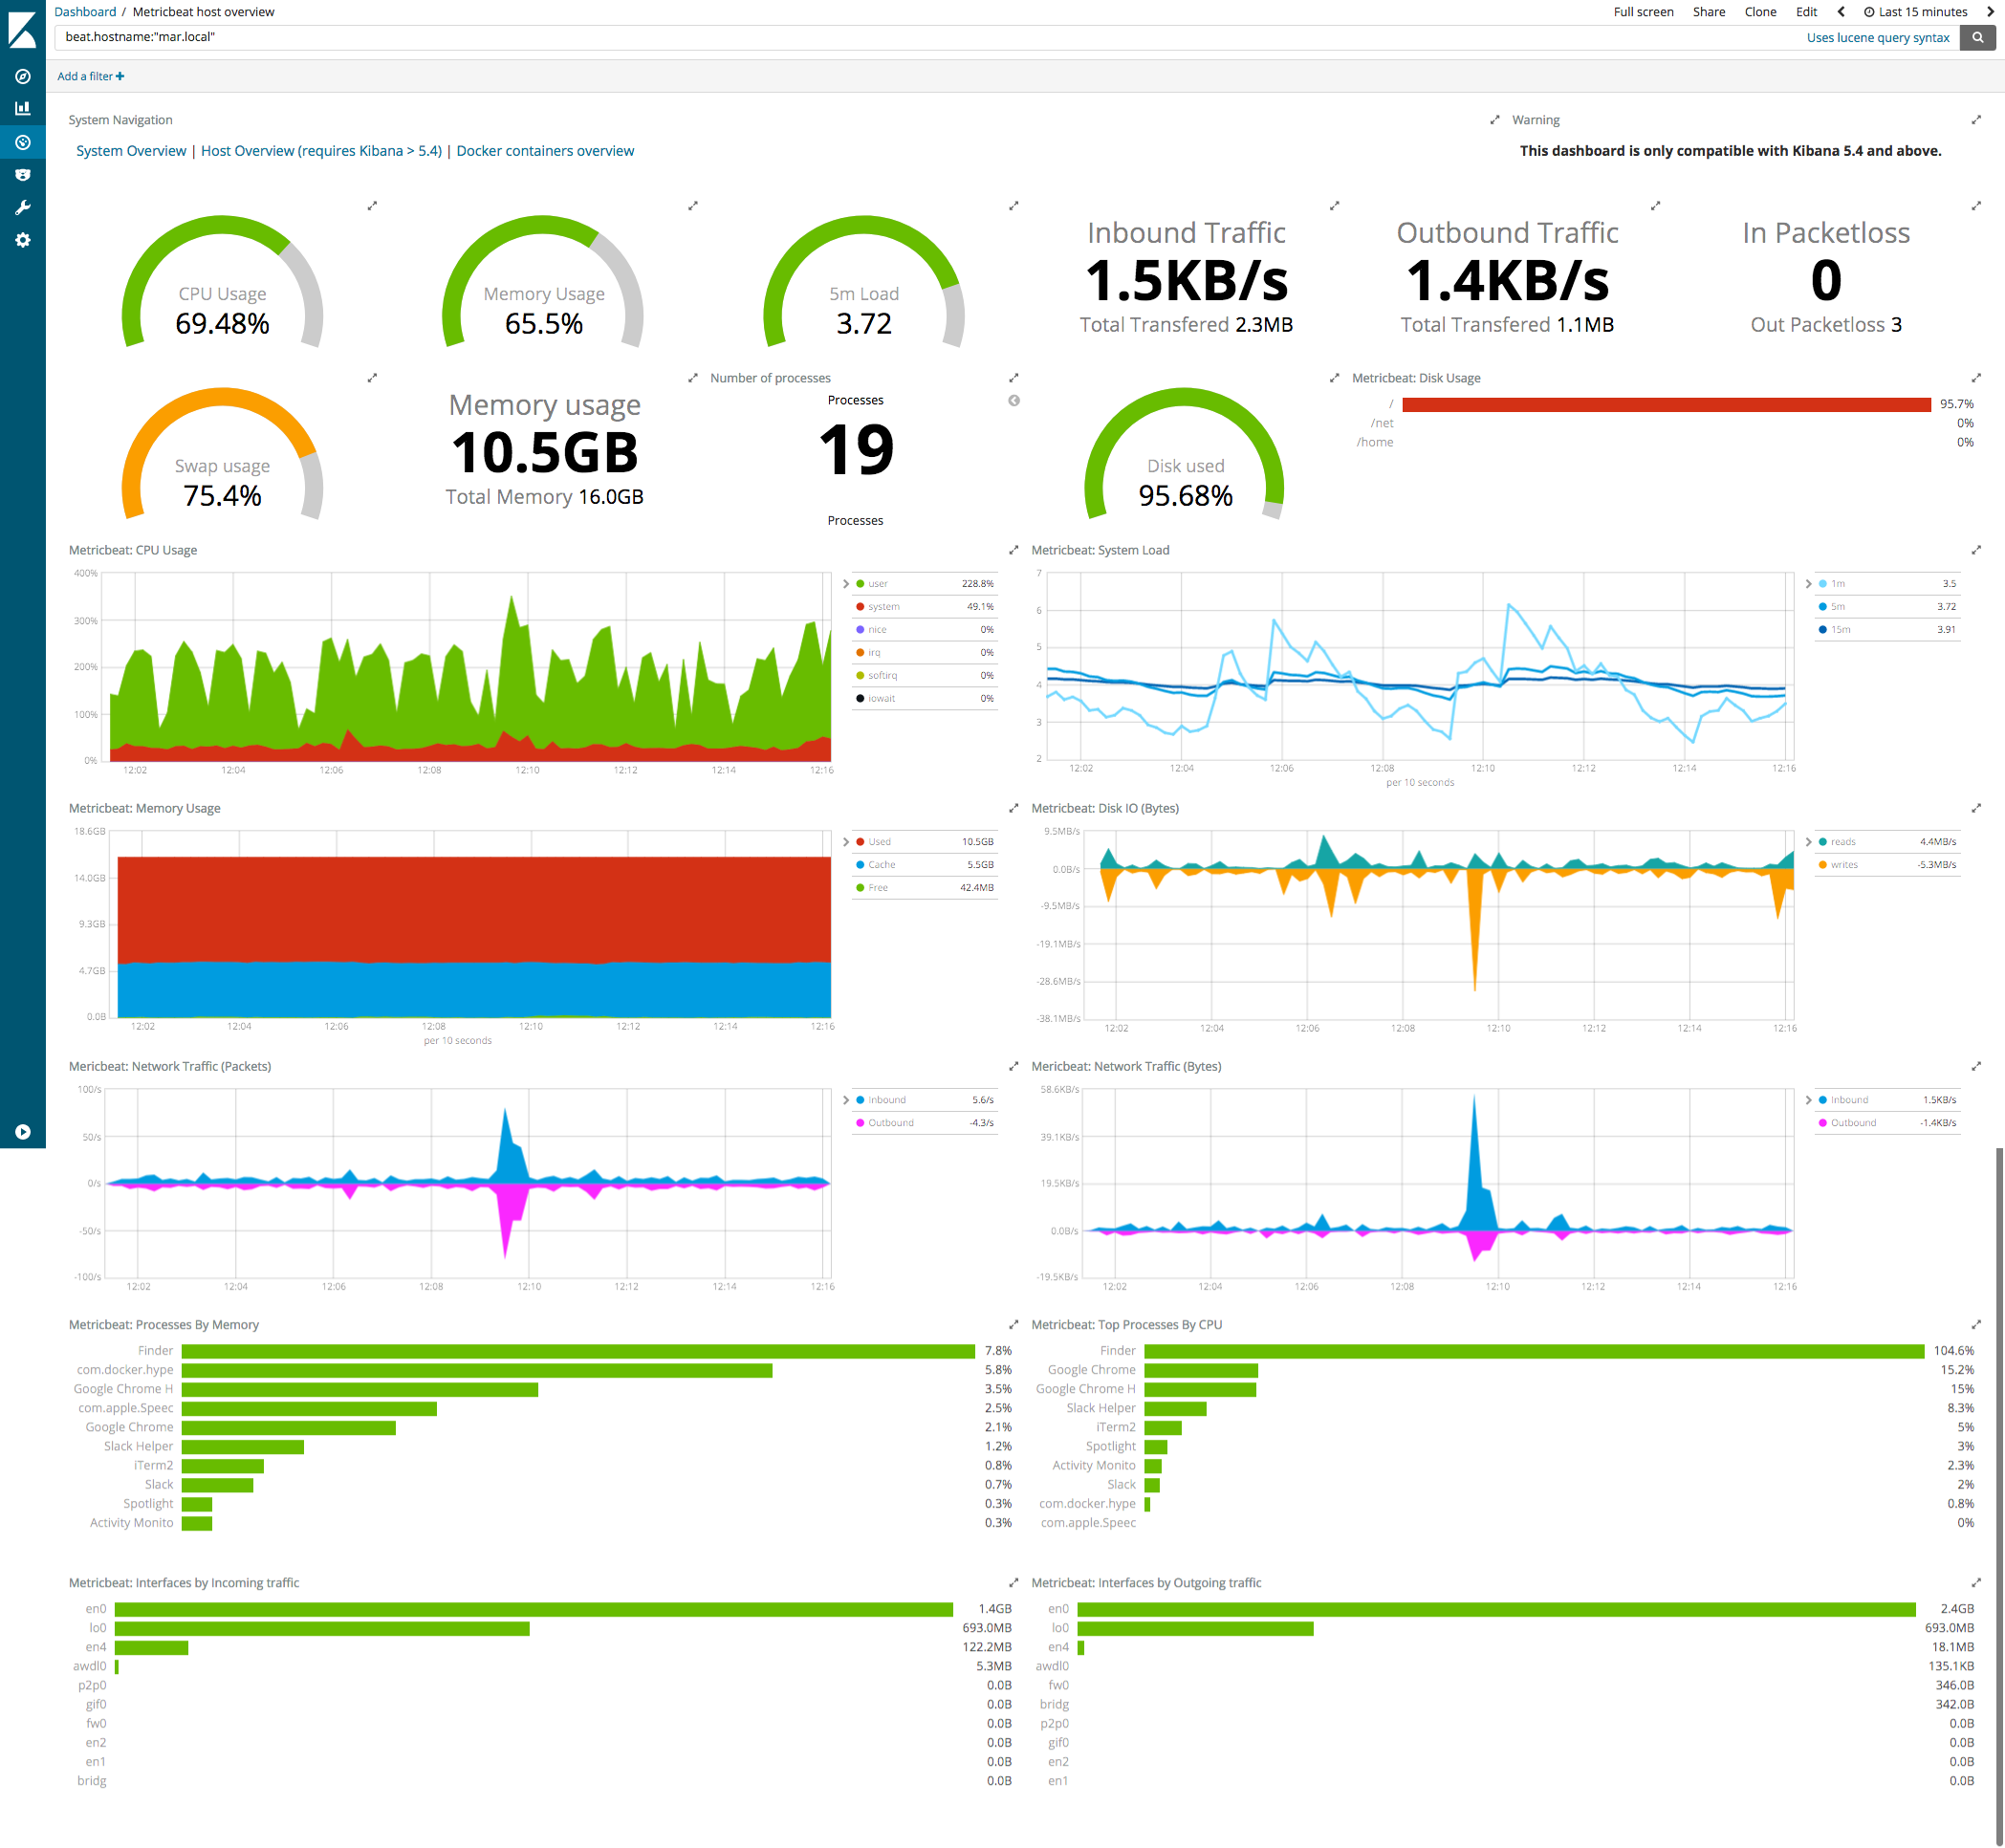

Slide 26
ELK Beats
Light weight shippers installed on target machines
Send operational data to Elasticsearch
User to create reports and dashboards

Slide 27
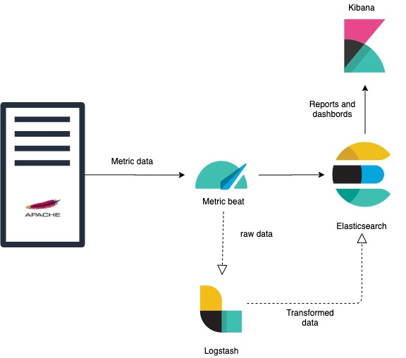
Metric beat
Metric beat is a lightweight shipper that you can install on your servers to periodically collect metrics from the operating system and from services running on the server.
Modules are standard configurations that can be enabled to monitor following
Apache HTTPD servers
System(CPU load, memory) etc.

Slide 28
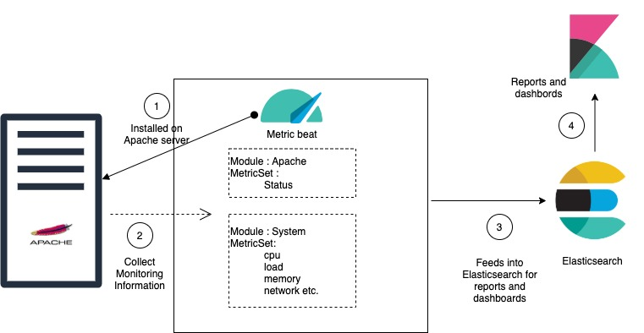
Metric beat - modules and metricset
A Metricbeat module defines the basic logic for collecting data from a specific service, such as apache http webserver and so on.
A metric set is the part of the module that fetches and structures the data for example system module collects
https://www.elastic.co/guide/en/beats/metricbeat/current/metricbeat-modules.html

Slide 29
System module
metricsets: - cpu # CPU usage - load # CPU load averages - memory # Memory usage - network # Network IO - process # Per process metrics - process_summary # Process summary - uptime # System Uptime - socket_summary # Socket summary #- core # Per CPU core usage #- diskio # Disk IO #- filesystem # File system usage for each mountpoint #- fsstat # File system summary metrics #- raid # Raid #- socket # Sockets and connection info (linux only) #- service # systemd service information

Slide 30
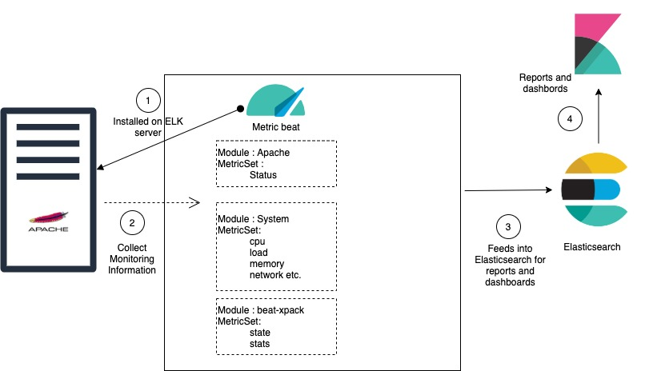
Metricbeat - webserver

Slide 31
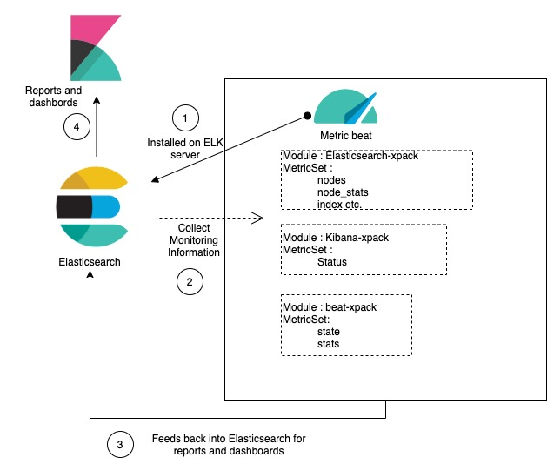
Metricbeat – ELK

Slide 32
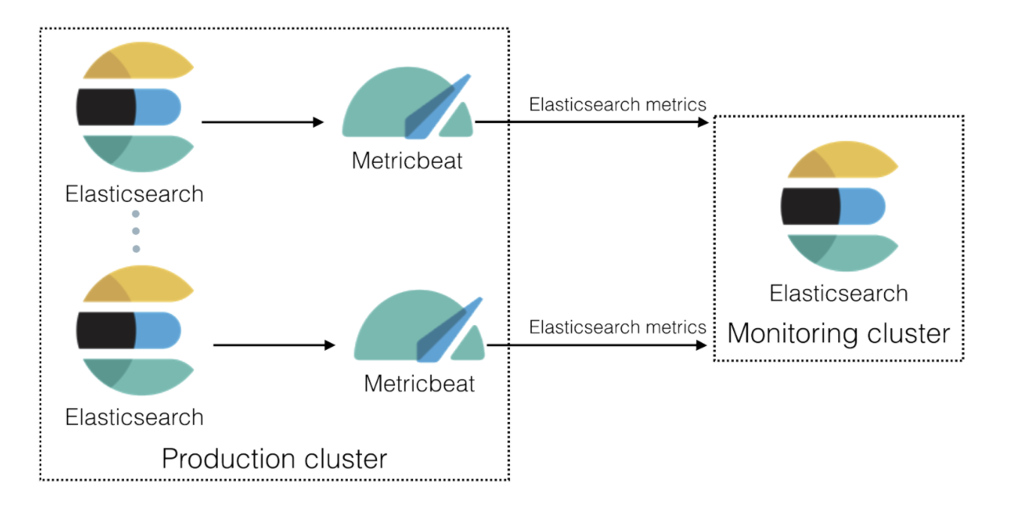
Production monitoring cluster

Slide 33
Metricbeat - config
ELK | Webservers
Elasticsearch-xpack - provides monitoring information for Elasticsearch cluster Kibana-pack - provides monitoring information for kibana Beat-xpack - provides monitoring information about the beat itself System - provides system related information | Apache - provides the status of apache web server System - provides system related information Beat-xpack - provides monitoring information about the beat itself

Slide 34
Metricbeat - elk
Enable Monitoring on cluster
Restart elasticsearch
Install Metricbeat
Configure Metricbeat
Start and enable Metricbeat service
Enable and configure modules
Elasticsearch-xpack
Kibana-xpack
System
Beat-xpack

Slide 35
Metricbeat - webserver
Add elasticsearch repository
Install metricbeat
Configure metricbeat.yml
Start and enable metricbeat service
Enable and configure modules
Apache
System
Beat-xpack

