Slide 1




Deploy ELK Stack using Ansible
Elasticsearch, Logstash, Kibana

Slide 2
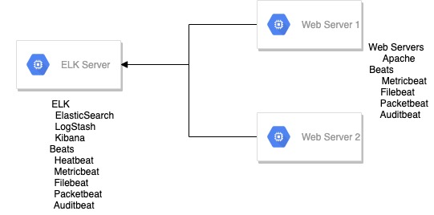
Introduction
Elasticsearch can be used to search on and analyse all types of data, including textual, numerical, geospatial, structured, and unstructured data.

Slide 3
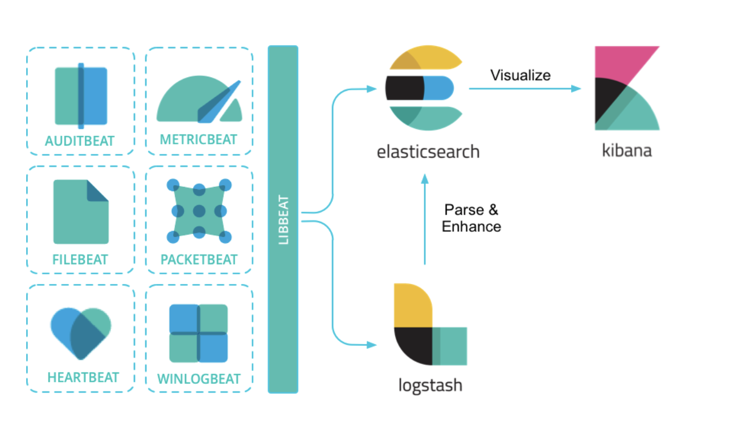
ELK Stack
Elasticsearch
Logstash
Kibana

Slide 4
Beats
Beats are essentially lightweight, purpose-built agents that acquire data and then feed it to elastic search. Beats are built upon libbeat framework and it makes it easy to create customised beats for any type of data you'd like to send to Elasticsearch.
Filebeat
Auditbeat
Metricbeat
Hearbeat
Packetbeat
Journalbeat
winlogbeat
Functionbeat

Slide 5



Setup gcp trial account and Get $300 free trial credit

Slide 6
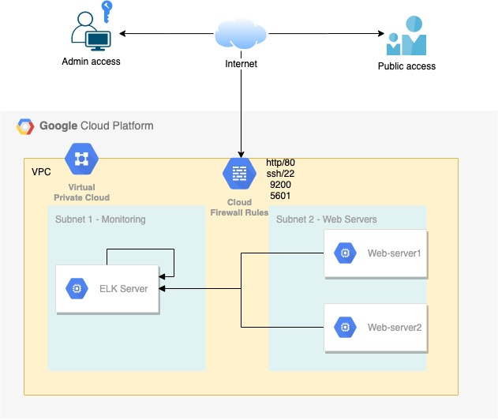
Lab Architecture
GCP Platform – provides $300 USD free
GCP setup
VPC
Firewall rules
2 Subnets
1 ELK node
2 web servers
Access –
Admin ssh access secured using ssh key
Public access –
ELK – port 9200, 5601 { secured using xpack authentication }
http

Slide 7
Setup gcp trial account and Get $300 free trial credit

Slide 8
Gcp provisioning
Account Setup
Create new project
Create new VPC
Create subnets inside the new VPC
Create firewall rules
Create compute engine instances
Validate connectivity
Generate SSH key
Configure your access key in gcp
Validate ssh access to gcp instances
Validate ansible access for your gcp instances

Slide 9
ROles
Role | Description
WebServer | Install and configures apache webserver
Java | Installs Java( pre-requisite for ELK installation)
Add-elastic-repo | Adds elasticsearch repository on target machines
Elasticsearch | Installs and configure elasticsearch and X-pack security
Kibana | Installs and configures Kibana
Metricbeat | Installs and configures Metricbeat
Filebeat | Installs and configures Filebeat
Auditbeat | Installs and configures Auditbeat
Heartbeat | Installs and configures Heartbeat
Packetbeat | Installs and configures Packetbeat
Config-beats-elatic* | Configure beats modules on elasticsearch servers
Config-beats-web* | Configures beats module on webservers
* non-idempotent roles

Slide 10
Deployment
ELK Server | WebServers
Java add-elastic-repo Elasticsearch Kibana Metricbeat Auditbeat Filebeat Packetbeat heartbeat config-beats-elastic | add-elastic-repo Webserver Metricbeat Auditbeat Filebeat Packetbeat config-beats-apache

Slide 11

Automate Installation of apache webserver using ansible

Slide 12
Webserver
Install apache webserver
Deploy new config file( index.html )
Start apache server
Test access to sample webpage

Slide 13

Install openjdk-8 using ansible

Slide 14
Java
Pre-requisite for elasticsearch
Deployed ON: ELK Server

Slide 15
Learn to do Manual deploy before automating it

Slide 16


Install and configure Elasticsearch logstash Kibana ( ELK STACK)
Logstash
Kibana

Slide 17
Elasticsearch – manual install
Openjdk-8
Elasticsearch public signing key
apt-transport-https package
Save elasticsearch repository definitions
System update
Install Elasticsearch, Logstash and Kibana
Configure Elasticsearch and Kibana
Test Access

Slide 18

Automate x-pack configuration for Elasticsearch using ansible

Slide 19
Configure X-Pack security
Stop Kibana & Elasticsearch
Enable x-pack
Start Elasticsearch
Setup default credentials
Configure Kibana
Start Kibana

Slide 20
Deploying Elasticsearch with ansible
Logstash
Kibana

Slide 21
Add-ELASTIC-REPO
Tasks
Add Elasticsearch public signing key
Install https transport module
Adding Elasticsearch repository
System update

Slide 22
Elasticsearch
Install Elasticsearch
Configure elasticsearch.yml
Start and enable Elasticsearch service

Slide 23

Configure x-pack using ansible
Steps
Enable X-pack security on cluster
Setup KeyStore and bootstrap password
Super user elastic can get its password from bootstrap.password key inside keyStore
Generate passwords for other built-in accounts using
create or Update user API
curl -X POST "localhost:9200/_security/user/user_name/_password?pretty" -H 'Content-Type: application/json' -d’
{
"password" : "s3cr3t"
}

Slide 24
Automate Kibana deployment using ansible
Kibana

Slide 25
Install kibana using ansible
Steps
Create new role to install Kibana
Copy Kibana.yml to templates
Templatize Kibana.yml
Tasks
Install Kibana.*
Deploy Kibana.yml
Start and enable Kibana service
* Pre-requisite – Add-elastic-repo role has been run

Slide 26

Install and configure metric beat [7.x]
Elasticsearch, Logstash, Kibana
Metric beat

Slide 27
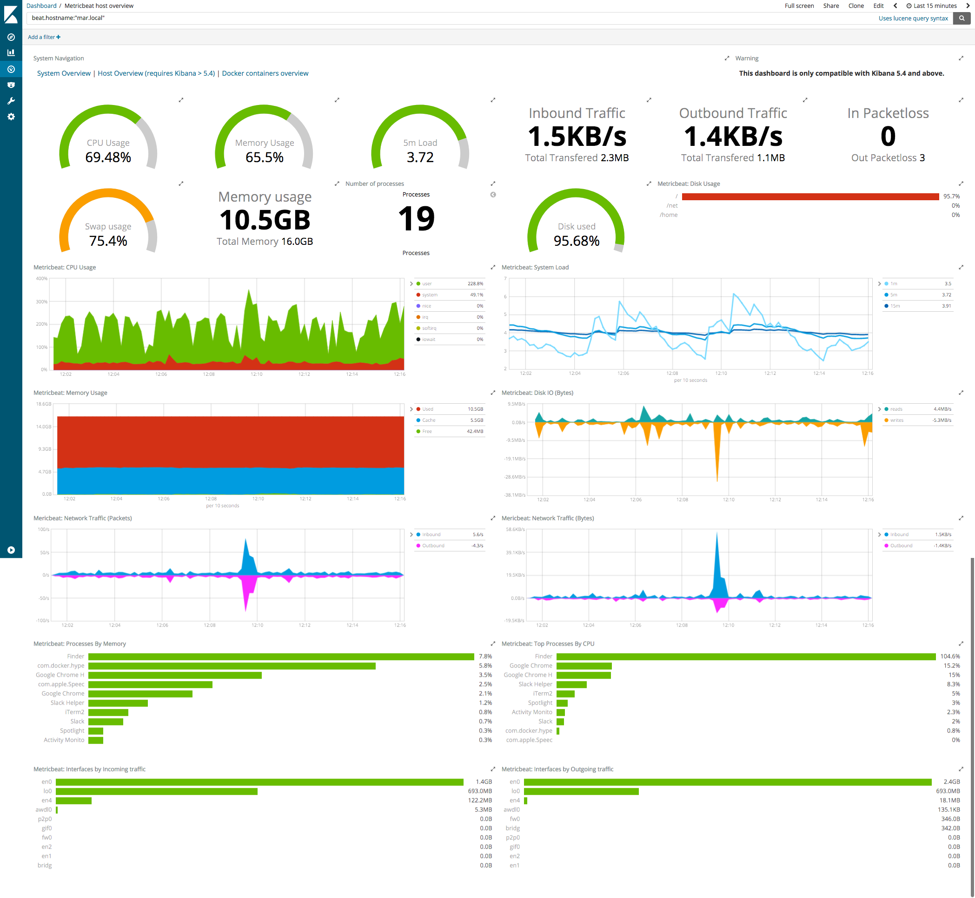

Slide 28
ELK Beats
Light weight shippers installed on target machines
Send operational data to Elasticsearch
User to create reports and dashboards

Slide 29
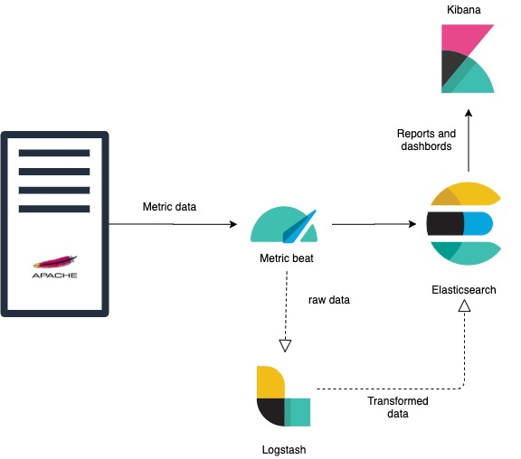
Metric beat
Metric beat is a lightweight shipper that you can install on your servers to periodically collect metrics from the operating system and from services running on the server.
Modules are standard configurations that can be enabled to monitor following
Apache HTTPD servers
System(CPU load, memory) etc.

Slide 30
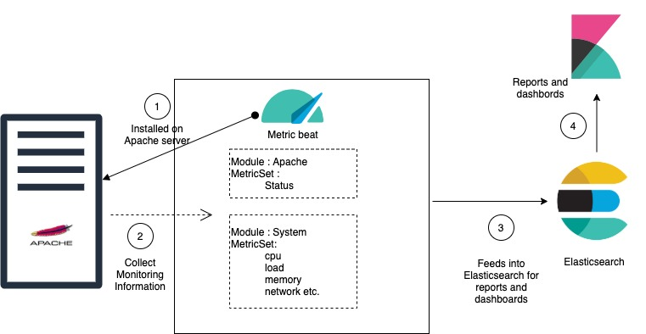
Metric beat - modules and metricset
A Metricbeat module defines the basic logic for collecting data from a specific service, such as apache http webserver and so on.
A metric set is the part of the module that fetches and structures the data for example system module collects
https://www.elastic.co/guide/en/beats/metricbeat/current/metricbeat-modules.html

Slide 31
System module
metricsets: - cpu # CPU usage - load # CPU load averages - memory # Memory usage - network # Network IO - process # Per process metrics - process_summary # Process summary - uptime # System Uptime - socket_summary # Socket summary #- core # Per CPU core usage #- diskio # Disk IO #- filesystem # File system usage for each mountpoint #- fsstat # File system summary metrics #- raid # Raid #- socket # Sockets and connection info (linux only) #- service # systemd service information

Slide 32
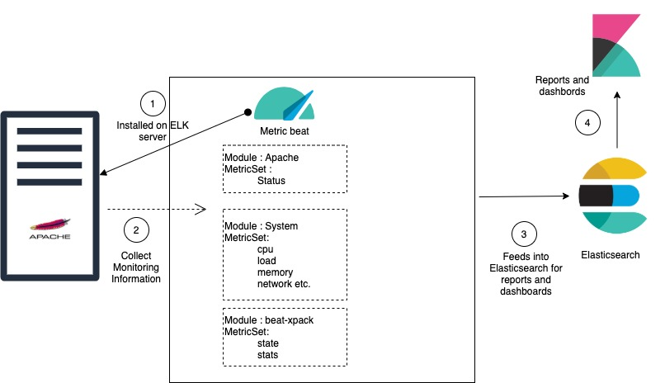
Metricbeat - webserver

Slide 33
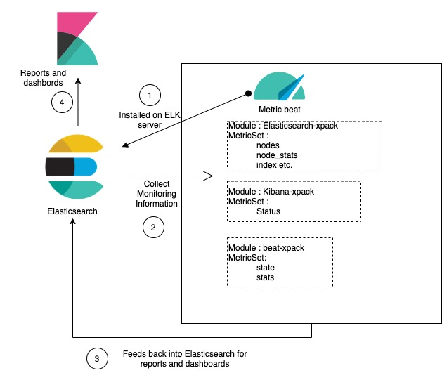
Metricbeat – ELK

Slide 34
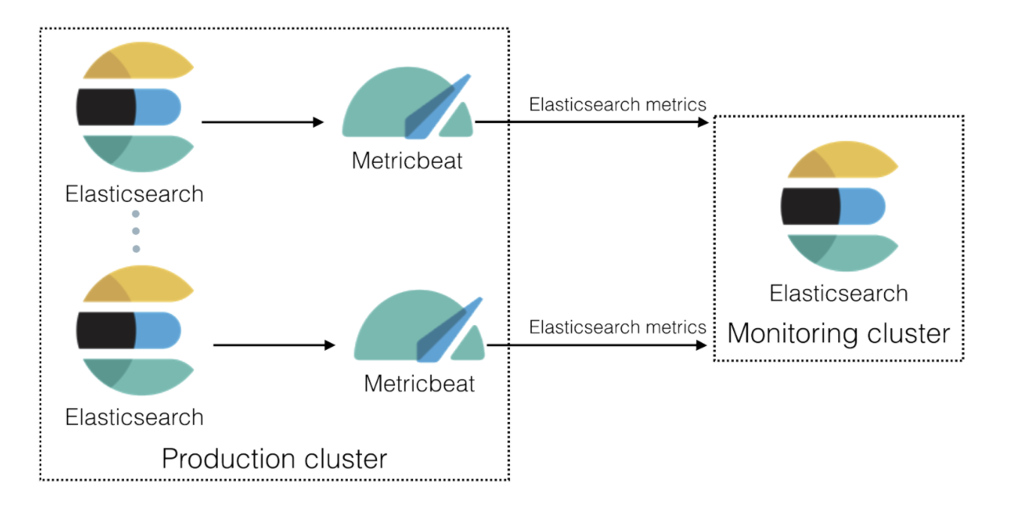
Production monitoring cluster

Slide 35
Metricbeat - config
ELK | Webservers
Elasticsearch-xpack - provides monitoring information for Elasticsearch cluster Kibana-pack - provides monitoring information for kibana Beat-xpack - provides monitoring information about beats | Apache - provides the status of apache web server System - provides system related information Beat-xpack - provides monitoring information about the beat itself

Slide 36
Metricbeat - elk
Enable Monitoring on cluster
Restart elasticsearch
Install Metricbeat
Configure Metricbeat
Start and enable Metricbeat service
Enable and configure modules
Elasticsearch-xpack
Kibana-xpack
System
Beat-xpack

Slide 37
Metricbeat - webserver
Add elasticsearch repository
Install metricbeat
Configure metricbeat.yml
Start and enable metricbeat service
Enable and configure modules
Apache
System
Beat-xpack

Slide 38

Install and configure FILEBEAT [7.x]
Elasticsearch, Logstash, Kibana
File beat

Slide 39
FILEBEAT - OVERVIEW
File beat is a lightweight shipper for forwarding and centralizing log data.
Installed as an agent on your servers, File beat monitors the log files or locations that you specify, collects log events, and forwards them either to Elasticsearch or log stash for indexing.
Two components
Harvester - A harvester is responsible for reading the content of a single file. The harvester reads each file, line by line, and sends the content to the output.
Input - An input is responsible for managing the harvesters and finding all sources to read from.

Slide 40
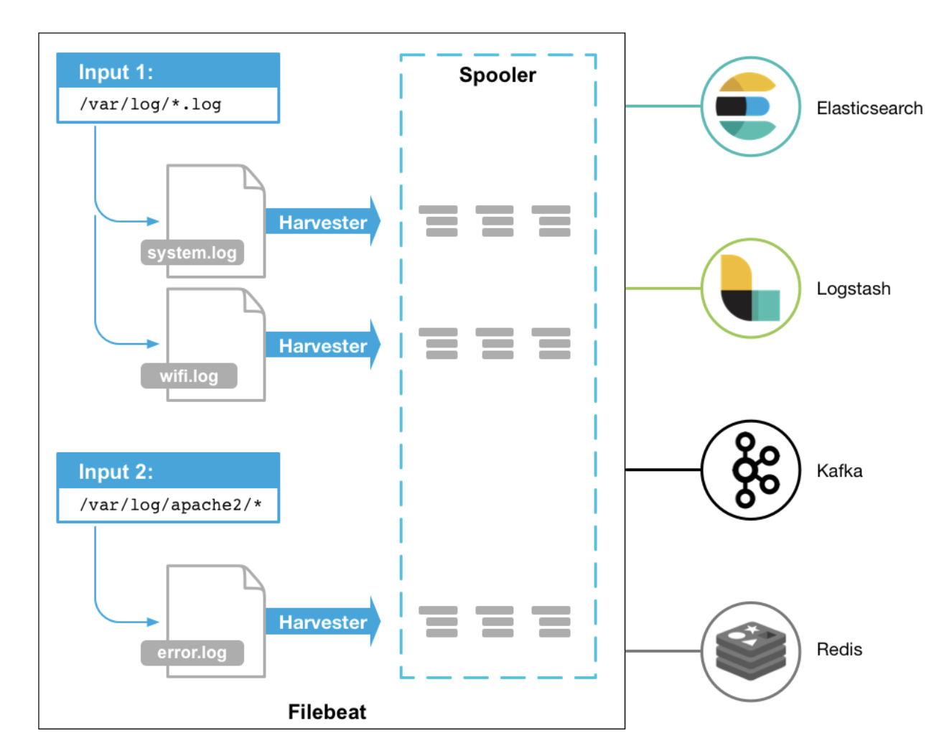
how File beat works
It starts one or more inputs that look in the locations you’ve specified for log data.
For each log that File beat locates, File beat starts a harvester.
Each harvester reads a single log for new content and sends the new log data to lib beat,
Lib beat aggregates the events and sends the aggregated data to the output that you’ve configured for File beat.

Slide 41
FILE beat - elk
Validate logs setup on ELK
Install File beat
Configure File beat
Start and enable File beat service
Enable and configure modules
Elasticsearch
Kibana
System
Configure Metric beat monitoring for File beat

Slide 42
FILE beat - webserver
Install File beat
Configure File beat
Start and enable File beat service
Enable and configure modules
apache
System
Configure Metric beat monitoring for File beat

Slide 43

Install and configure Audit beat [7.x]
Elasticsearch, Logstash, Kibana
Audit beat

Slide 44
Auditbeat overview
Monitor user activity and processes and analyse your event data in the Elastic Stack without touching auditd. Audit beat communicates directly with the Linux audit framework, collects the same data as auditd, and sends the events to the Elastic Stack in real time.
Or, Use your existing audit rules to ingest data

Slide 45
auditbeat- elk
Install Audit beat
Configure Audit beat
Start and enable Audit beat service
Configure Metric beat monitoring for Audit beat
Configure audit beat modules
Auditd
File Integrity
System
Configure audit beat general settings
** There is no live reload option in auditbeat

Slide 46
AuditD Module
auditd module receives audit events from the Linux Audit Framework that is a part of the Linux kernel(Only available for Linux)
establishes a subscription to the kernel to receive the events as they occur ( period configuration is unused)
Might need to stop other services such auditd/journald
File System rule - file watches, allow the auditing of access to a particular file or a directory.
-w path_to_file -p permissions -k key_name
Permission : rwxa
System call rule - allow logging of system calls that any specified program makes
-a action,filter -S system_call -F field=value -k key_name
Action: always/never
Filter: task, exit, user, and exclude
system_call specifies the system call by its name
field=value specifies additional options that furthermore modify the rule to match events based on a specified architecture, group ID, process ID, and others.

Slide 47
File integrity module
file_integrity module sends events when a file is changed (created, updated, or deleted) on disk. The events contain file metadata and hashes.
creates a subscription with the OS to receive notifications of changes to the specified files or directories. Upon receiving notification of a change the module will read the file’s metadata and the compute a hash of the file’s contents.
At startup this module will perform an initial scan of the configured files and directories to generate baseline data for the monitored paths and detect changes since the last time it was run. It uses locally persisted data in order to only send events for new or modified files.

Slide 48
System module
The system module collects various security related information about a system. All datasets send both periodic state information (e.g. all currently running processes) and real-time changes (e.g. when a new process starts or stops).
Each dataset sends two kinds of information: state and events
State information is sent periodically and (for some datasets) on startup.
frequency of state updates can be controlled for all datasets using the state.period
Event information is sent as the events occur (e.g. a process starts or stops).
All datasets are currently using a poll model to retrieve their data. The frequency of these polls is controlled by the period configuration parameter

Slide 49

Install and configure heartbeat [7.x]
Elasticsearch, Logstash, Kibana
Heartbeat

Slide 50
Heartbeat overview
Periodically check the status of your services and determine whether they are available
Heartbeat currently supports monitors for checking hosts via:
ICMP (v4 and v6) Echo Requests. Use the icmp monitor when you simply want to check whether a service is available. This monitor requires root access.
TCP. Use the tcp monitor to connect via TCP. You can optionally configure this monitor to verify the endpoint by sending and/or receiving a custom payload.
HTTP. Use the http monitor to connect via HTTP. You can optionally configure this monitor to verify that the service returns the expected response, such as a specific status code, response header, or content.

Slide 51
Heartbeat - elk
Install heartbeat-elastic
1
Configure heartbeat
2
Configure metric beat to monitor heartbeat
3
Configure monitors
4
http
Icmp
Tcp
Start and enable heartbeat
5

Slide 52

Install and configure packet beat [7.x]
Elasticsearch, Logstash, Kibana
Packet beat

Slide 53
Packet beat - overview
Packetbeat is a real-time network packet analyzer that you can use with Elasticsearch to provide an application monitoring and performance analytics system
Packetbeat works by capturing the network traffic between your application servers, decoding the application layer protocols (HTTP, MySQL, Redis, and so on).
Packetbeat can run on
the same servers as your application processes or
on its own servers.

Slide 54
packetbeat
Install Packet beat
01
Configure Packetbeat
02
Traffic sniffer
flows
Configure Metricbeat to monitor Packet beat
03
Start and enable Packetbeat
04

Slide 55
Deploy elk beats using ansible [7.x]
Elasticsearch, Logstash, Kibana

Slide 56
procedure
Ansible Roles
Metricbeat
File beat
Audit beat
Heartbeat
Packet beat
Config-beats-elastic
Config-beats-apache
Download sample configuration files
Create Ansible roles
Beat Installation and configuration
Install Beat
Templatize configuration files
Replace configuration files
Start and enable beat
Module Configuration
Deploy module configuration file

Slide 57

Securing your sensitive data using ansible vault

Slide 58
Securing your sensitive data using ansible vault
Encrypting credentials.yml
Decrypting credentials.yml
Running Ansible with vault-password encrypted files
Interactively
Using password file

