Slide 1
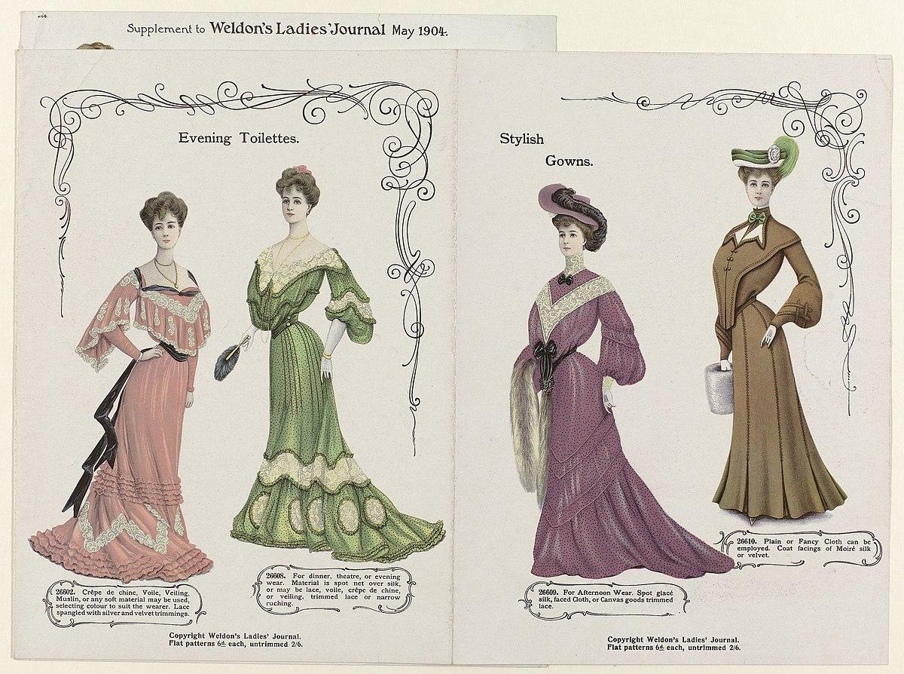


Tidyverse Style Guide
Arati Krishnamoorthy
R-Ladies Philly & D.C Lightning Talks 06.28.2023

Slide 2
“Good coding style is like correct punctuation: you can manage without it, butitsuremakesthingseasiertoread”
Hadley Wickham
Notes:
Google - R tidyverse - Google

Slide 3
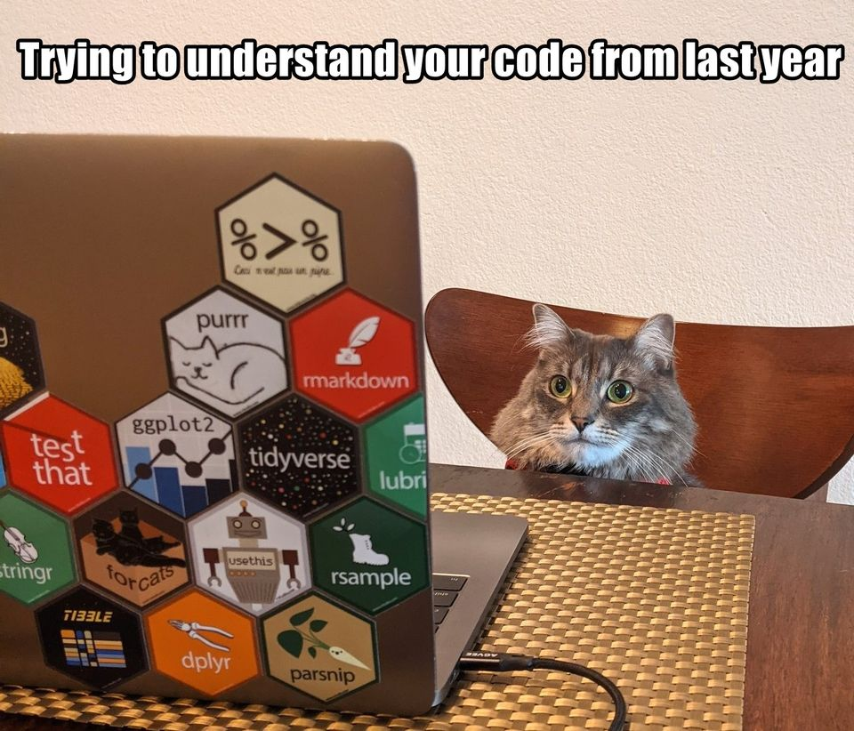
Why do we need a style guide??
Makes code easier to read
Makes code robust and efficient
Easier to reproduce
Easier to collaborate
Easier to maintain
https://twitter.com/Jas_Hughes/status/1428442201403449350
R memes for statistical friends

Slide 4
Consistency is paramount !
Notes:
The golden rule of the tidyverse style guide

Slide 5
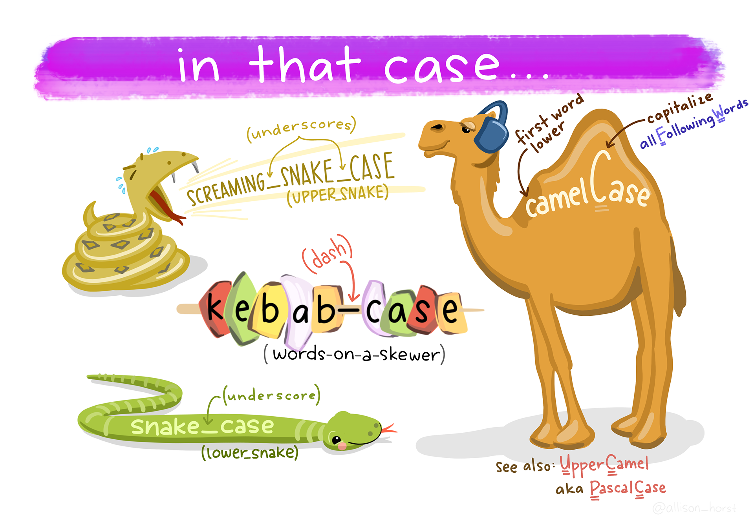
Variable and function names
Use only lowercase letters, numbers, and _ (snake_case)
Be concise and meaningful
Use verbs for function names
# Good
day_one
day_1
# Bad
DayOne
Dayone
# Good
add_row()
permute()
# Bad
row_adder()
permutation()
Artwork by @allison_horst

Slide 6
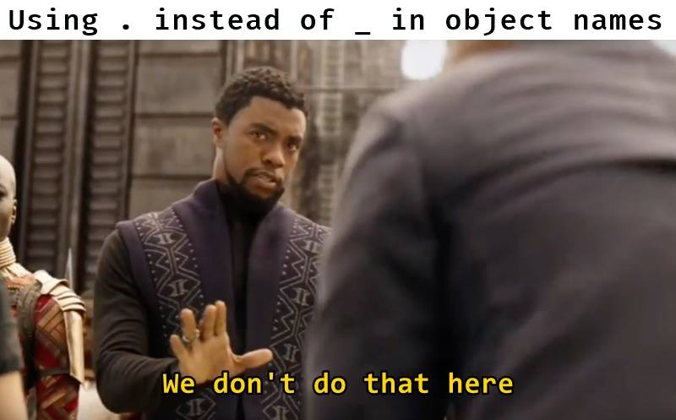
Using . instead of _ in object names
R memes for statistical friends

Slide 7
✅ Load all add-on packages at the start.
❌ library() calls throughout your code
❌ Hidden dependencies that are loaded in a startup file, such as .Rprofile.
Notes:
If your script uses add-on packages, load them all at once at the very beginning of the file. This is more transparent than sprinkling library() calls throughout your code or having hidden dependencies that are loaded in a startup file, such as .Rprofile.

Slide 8
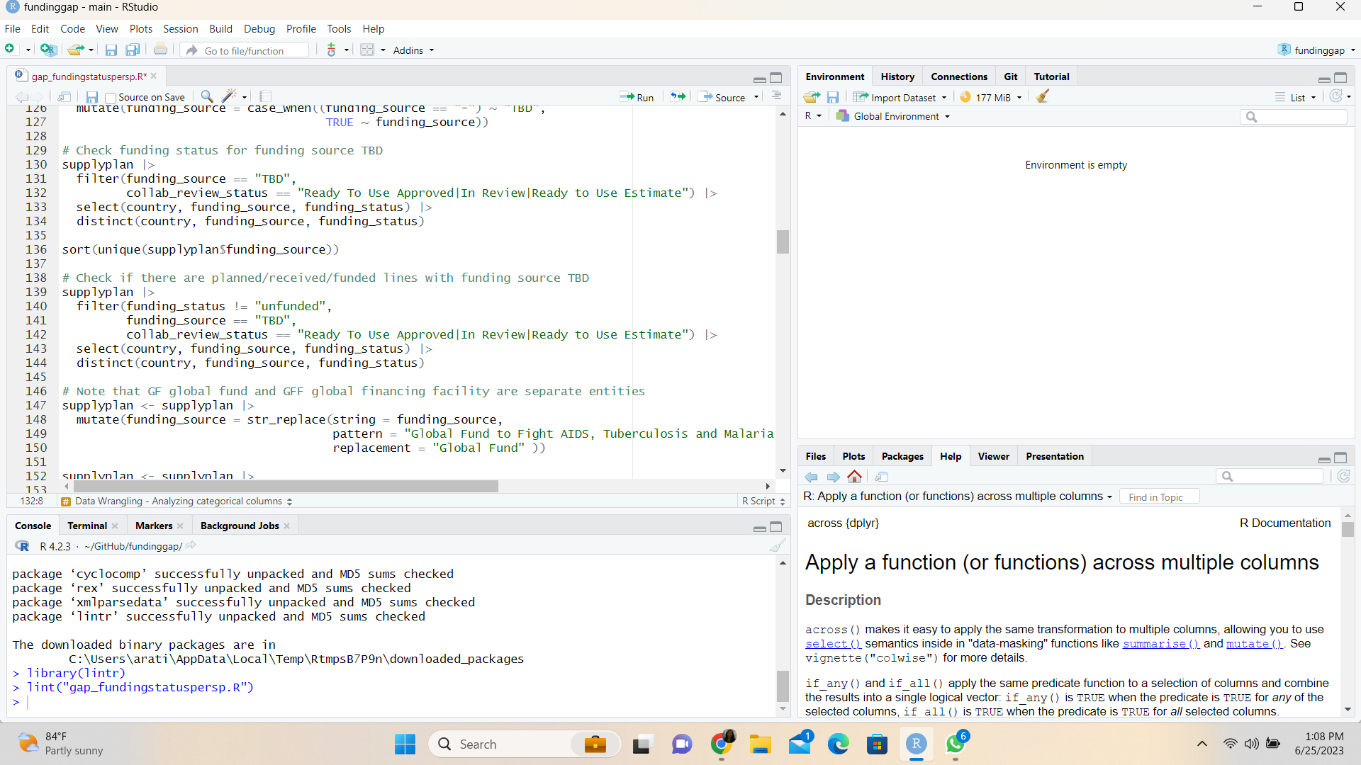
Comments start with a # and space
In code, comments explain the “why” not the “what” or “how”
Limit to 80 characters per line
❌

Slide 9
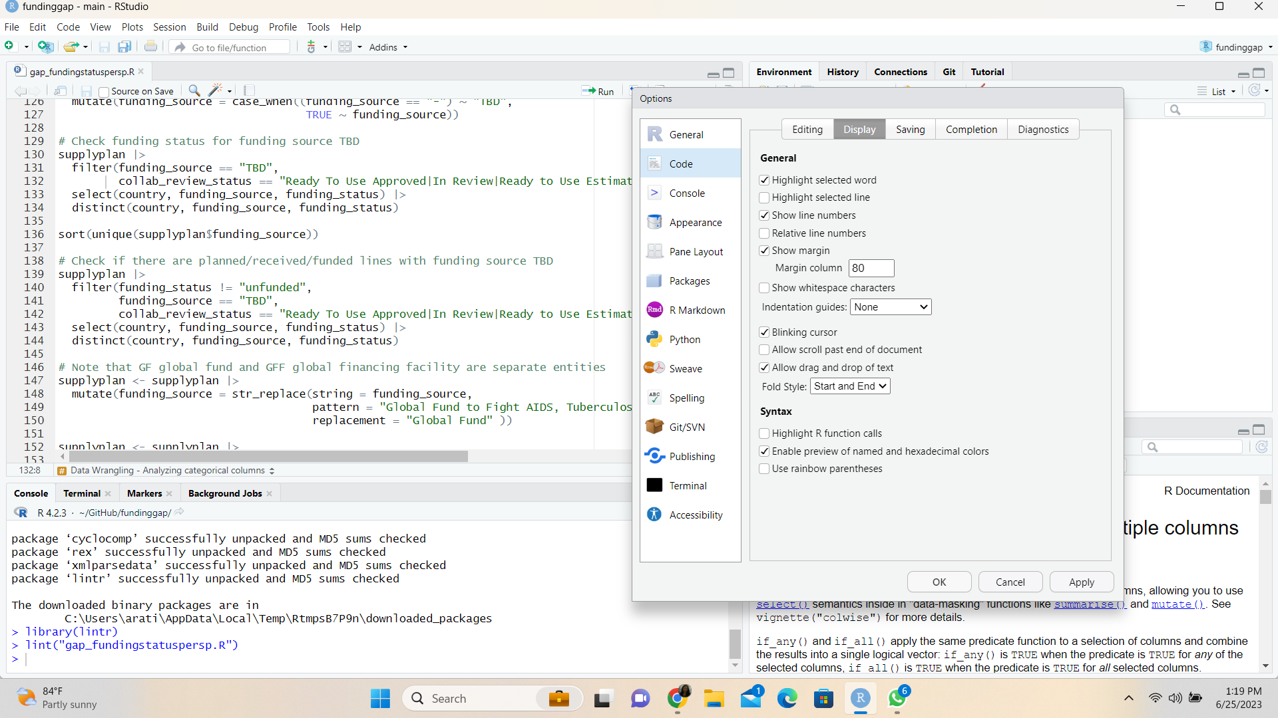

Slide 10
Spaces
Space before and after () when used with if, for, or while.
❌
✅
2)
if(debug){
show(x)
}
Space after a comma, not before
1)
if (debug) {
show(x)
}
1) x[,1]
2) x[ ,1]
3) x[, 1]
4) x[ , 1]
❌
❌
Space after () used for function arguments:
✅
❌
3) function(x) {}
4) function (x) {}
5) function(x){}
✅
❌
❌
Notes:
# Good
x[, 1]
# Bad
x[,1]
x[ ,1]
x[ , 1]
# Good
if (debug) {
show(x)
}
# Bad
if(debug){
show(x)
}

Slide 11
Spaces before and after most infix operators (==, +, -, <-, etc.)
Exceptions, which should never be surrounded by spaces:
The operators with high precedence: ::, :::, $, @, [, [[, ^, unary -, unary +, and :.
Single-sided formulas when the right-hand side is a single identifier: ~foo
When used in tidy evaluation !! (bang-bang) and !!! (bang-bang-bang): call(! !xyz)
The help operator: package?stats
# Good
height <- (feet * 12) + inches
mean(x, na.rm = TRUE)
✅
# Bad
height<-feet*12+inches
mean(x, na.rm=TRUE)
❌
stylr lintr

Slide 12
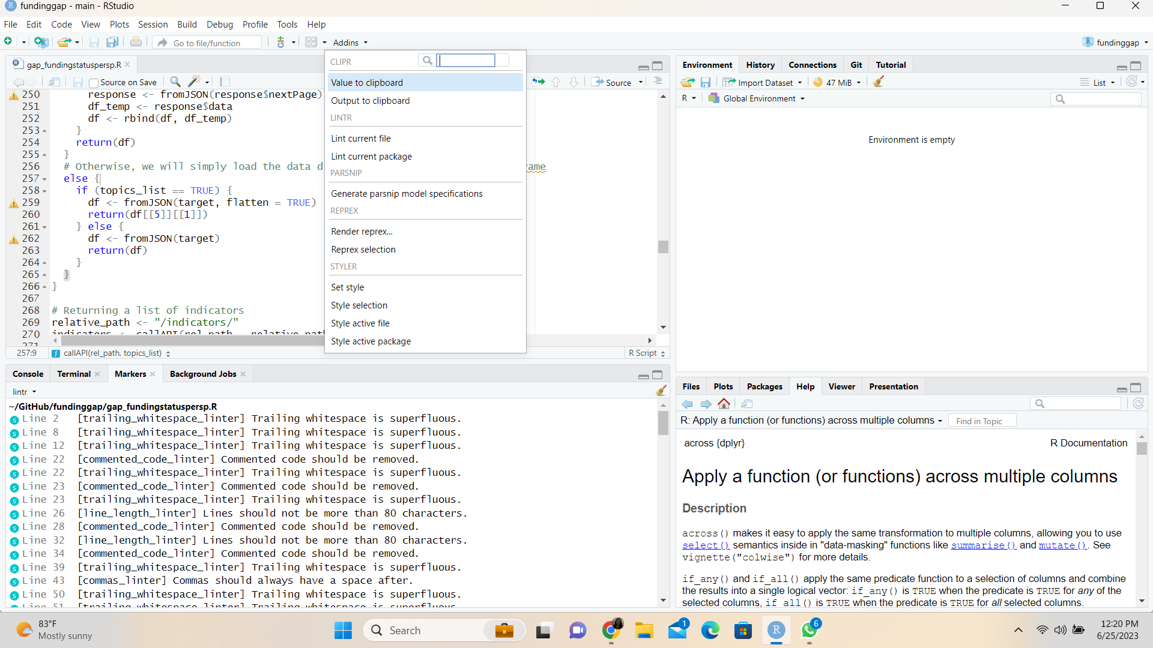

Slide 13
Function calls
# Good
mean(1:10, na.rm = TRUE)
Omit the names of data arguments,
because they are used so commonly.
# Bad
mean(x = 1:10, , FALSE)
✅
If you override the default value of an argument, use the full name.
❌

Slide 14
Double quotes are preferred!
The only exception is when the text already contains double quotes and no single quotes.
# Good
"Text"
'Text with "double quotes"'
"Text with "double" and \'single\' quotes "
# Bad
'Text'
"Text with "double quotes""
'Text with "double" and \'single\' quotes'

Slide 15
Indentation for functions
✅
✅
Double-indent:
long_function_name <- function(
a = "a long argument",
b = "another argument",
c = "another long argument") {
# As usual code is indented by two spaces.
Function-indent:
long_function_name <- function(a = "a long argument",
b = "another argument",
c = "another long argument") {
# As usual code is indented by two spaces.
Prefer function-indent style to double-indent style when it fits.
Consistency is paramount !
Notes:
Function-indent: place each argument on its own line, and indent to match the opening ( of function: Double-indent: Place each argument of its own double indented line.

Slide 16
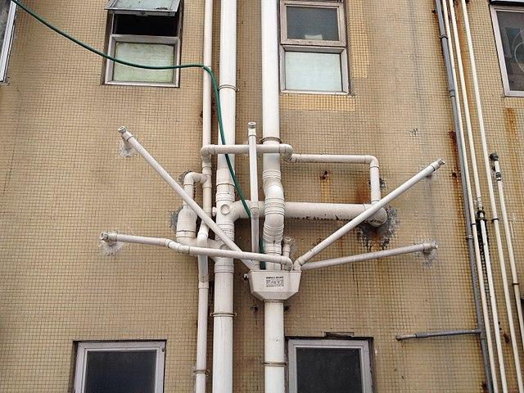
Pipes
A space before the pipe
iris %>%
group_by(Species) %>%
summarize_if(is.numeric, mean) %>%
ungroup() %>%
gather(measure, value, -Species) %>%
arrange(value)
A new line after the pipe
Each line indented by two spaces
Avoid %<>%
https://flickr.com/photos/16925188@N06/8175120867
Notes:
%>% should always have a space before it, and should usually be followed by a new line. After the first step, each line should be indented by two spaces. This structure makes it easier to add new steps (or rearrange existing steps) and harder to overlook a step

Slide 17
And so much more..
Pipes
Code blocks, curly brackets
ggplot
Files
Documentation
Tests
Errors
News
Blog posts
Git/Github
https://style.tidyverse.org/index.html

