Slide 1
UNFPA commodity funding analysis
GH/PRH/CSL
June 2021

Slide 2
Data Sources
March 2021 submissions of supply plans to PSM (20 Priority + Ouagadougou countries)
2020 shipments from RHViz (9 countries)
Priority |  | Ouagadougou | Other
Afghanistan | Mozambique | Benin | Angola
Bangladesh | Nigeria | Burkina Faso | Burundi
DRC | Nepal | Cote dIvore | eSwatini
Ethiopia | Pakistan | Guinea | Zimbabwe
Ghana | Philippines | Mali
Haiti | Rwanda | Mauritania
India | Senegal | Niger
Kenya | South Sudan | Senegal
Liberia | Tanzania | Togo
Madagascar | Uganda
Malawi | Yemen |  | Data from 2021 supply plans
Mali | Zambia |  | Data from 2020 shipments

Slide 3
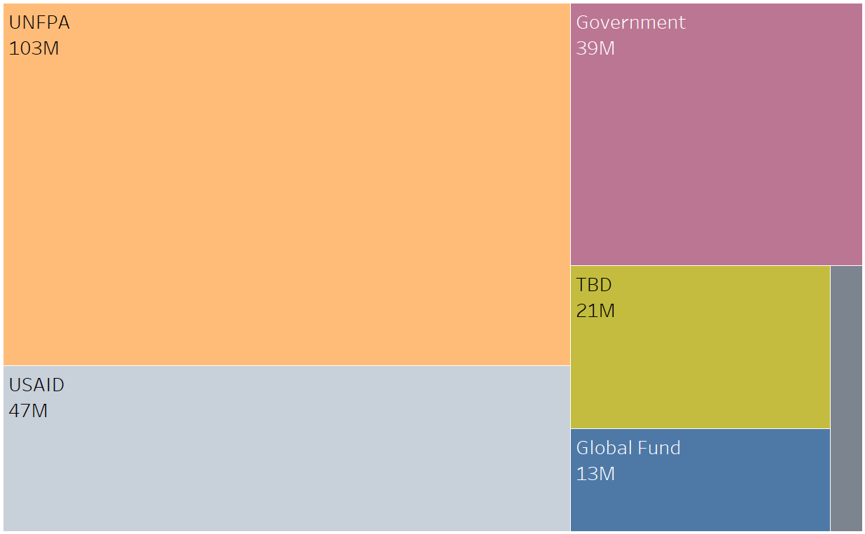
UNFPA is committed to $103M in commodity costs for FY2021 in the 20 Priority & Ouagadougou countries for which we have supply plan data
Note: Supply plans show only MOH planned commodity deliveries in the country.
Ghana, Mali and Rwanda have SMO plans called out separately as well

Slide 4
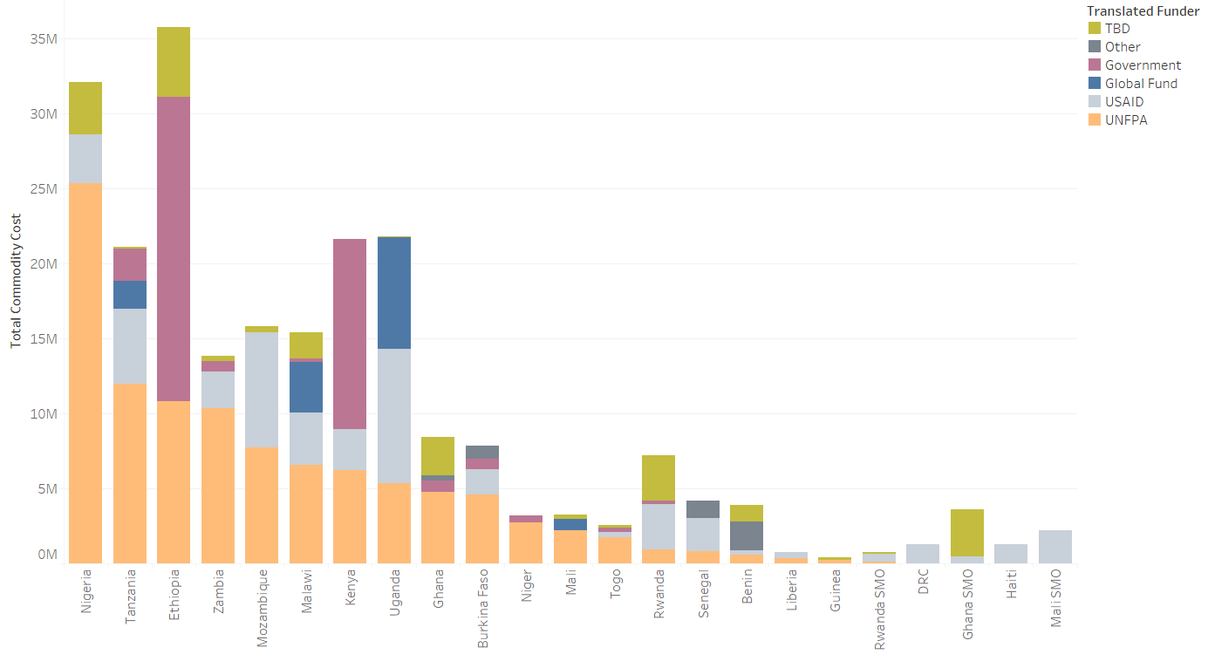
Nigeria has the most funds tagged to UNFPA for FY2021

Slide 5
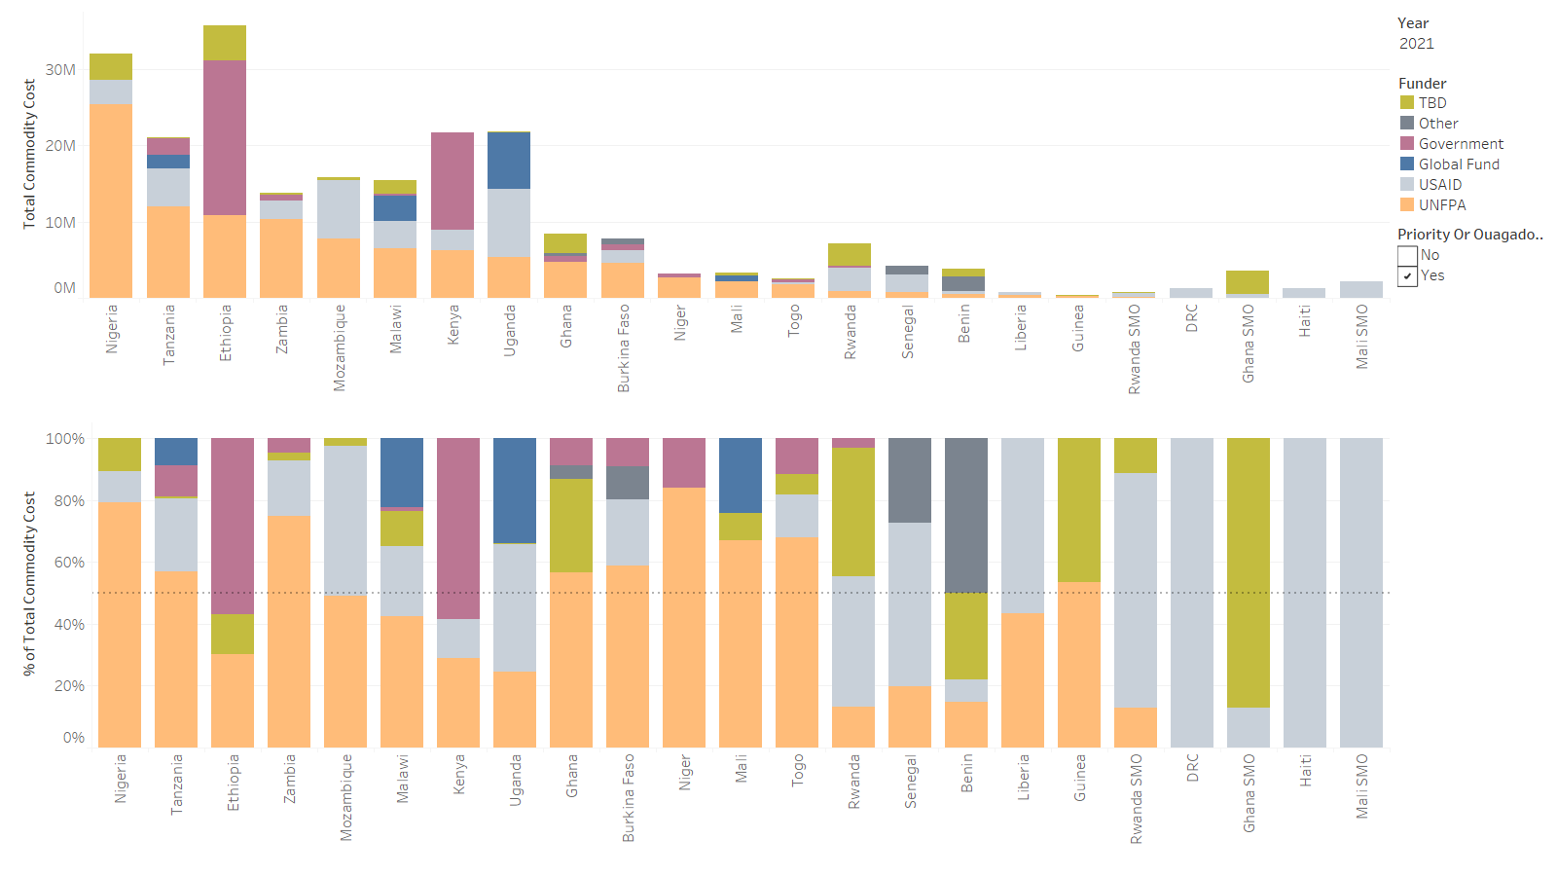
9 of these countries have more than 50% of their commodity funds tagged to UNFPA

Slide 6
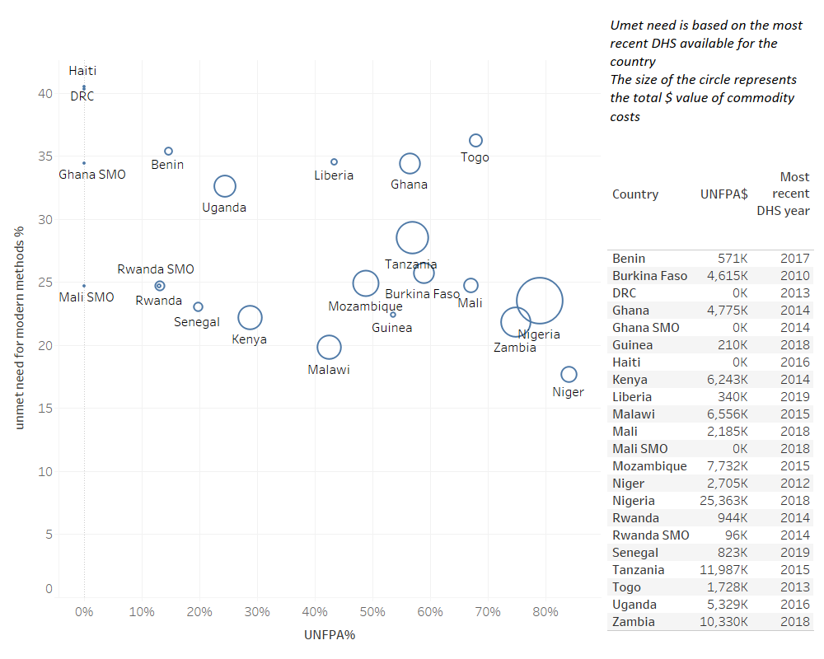
Triangulating unmet need with commodity value tagged to UNFPA for FY2021

Slide 7
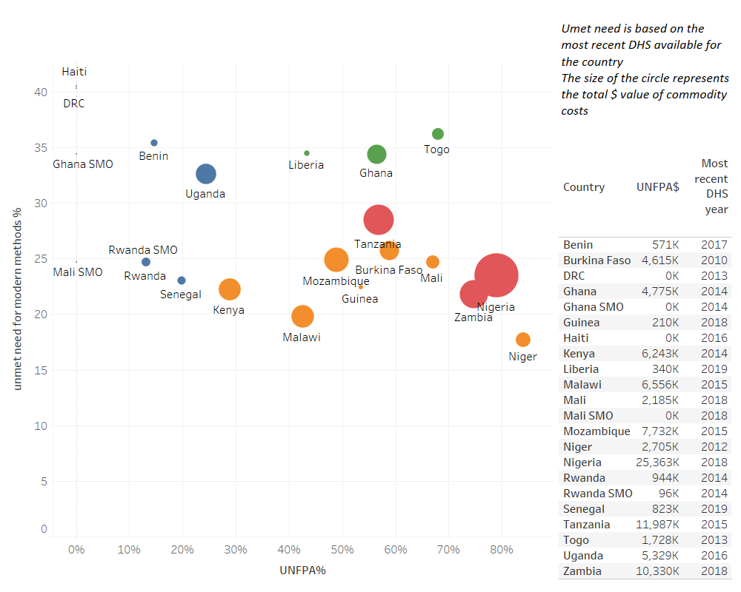
Cluster analysis to group countries based on unmet need, commodity cost $ and % tagged to UNFPA

Slide 8
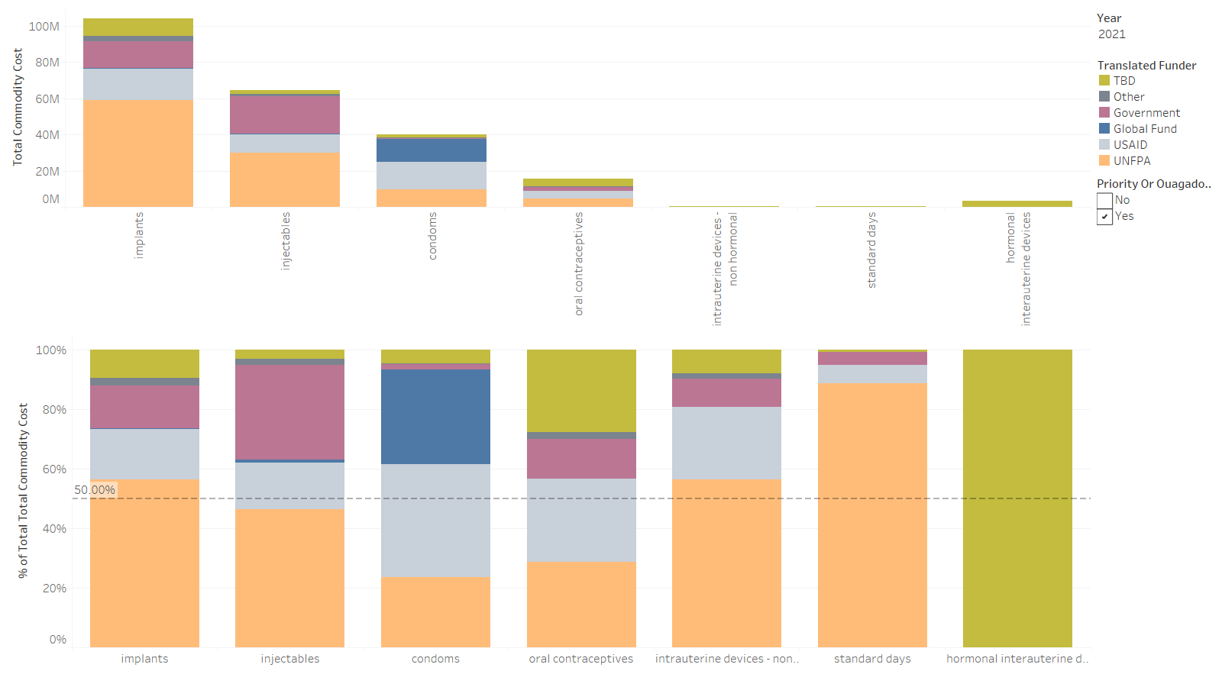
Implants, IUDs and Standard Days have more than 50% of commodity costs tagged to UNFPA in the 2021 supply plans

Slide 9
Data Sources
March 2021 submissions of supply plans to PSM (20 Priority + Ouagadougou countries)
2020 shipments from RHViz (9 countries)
Priority |  | Ouagadougou | Other
Afghanistan | Mozambique | Benin | Angola
Bangladesh | Nigeria | Burkina Faso | Burundi
DRC | Nepal | Cote dIvore | eSwatini
Ethiopia | Pakistan | Guinea | Zimbabwe
Ghana | Philippines | Mali
Haiti | Rwanda | Mauritania
India | Senegal | Niger
Kenya | South Sudan | Senegal
Liberia | Tanzania | Togo
Madagascar | Uganda
Malawi | Yemen |  | Data from 2021 supply plans
Mali | Zambia |  | Data from 2020 shipments

Slide 10
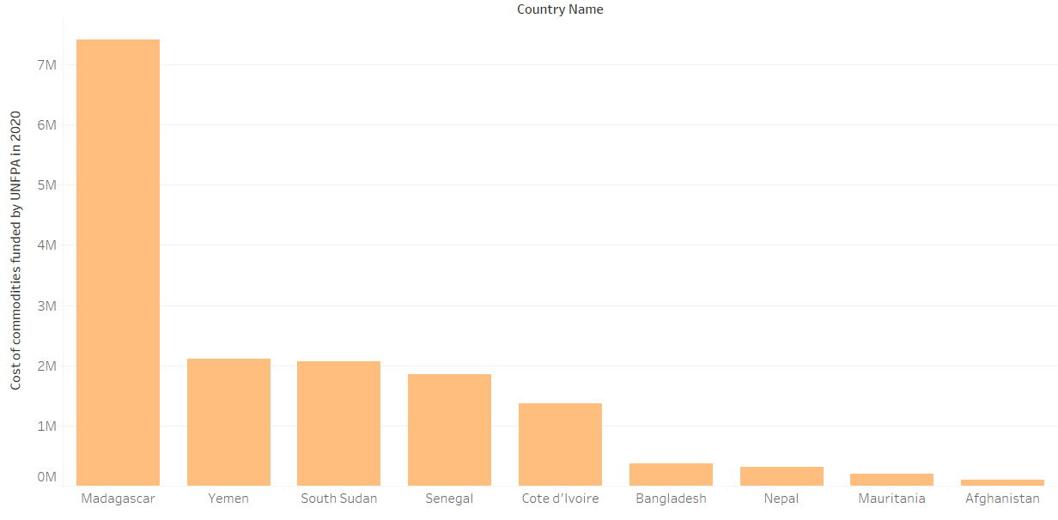
UNFPA donated $16M worth of commodities in 2020 to the 9 countries for whom we do not have 2021 supply plans

Slide 11
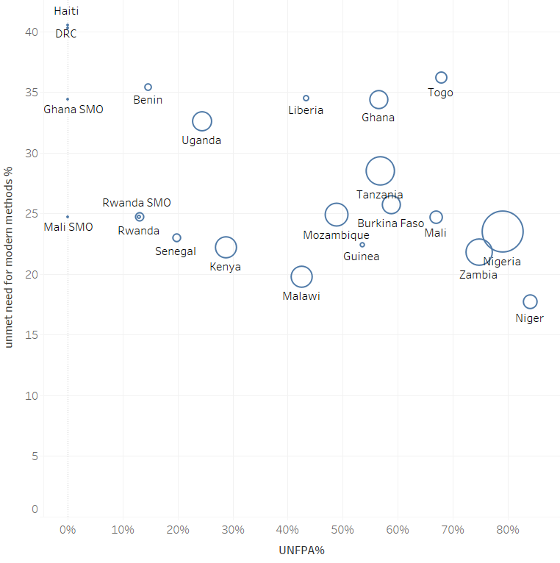
Triangulating unmet need with commodity value tagged to UNFPA for FY2021
Mauritania
Nepal
Yemen
Cote d’Ivore
Madagascar
Afghanistan
Senegal
Bangladesh

