Slide 1
BUS 9430 • FINAL PROJECT
Predicting NYC Residential
Property Appreciation
Can neighborhood factors help predict which NYC residential properties will see stronger appreciation over time?
Shreya Karki • Arati Kalor • Ayushman Shrestha • Chenbin Wu • Ali Adnan
Spring 2026

Slide 2



Data & Modeling Approach
4
760K
22,623
Total NYC sales starting point
Paired sales after cleaning & filters
Property segments modeled separately
Why model property types separately?
Return behavior differs substantially across property types, so combining them into one model would hide meaningful patterns.
TWO-FAMILY
ONE-FAMILY
CONDO
CO-OP
28.3%
23.0%
6.1%
5.9%
Typical annual appreciation
Typical annual appreciation
Typical annual appreciation
Typical annual appreciation
BUS 9430 | Final Project
2 / 9

Slide 3




Target definition & feature set
TARGET VARIABLE
FEATURES USED
Top-performing properties = top 25% within segment
Crime count — Neighborhood crime activity
Annualized return (not raw price change) so a 2-year hold and a 10-year hold compare fairly.
Subway distance — Distance to nearest subway station
Threshold set per segment, not globally — each property is compared against its peers.
Near subway flag — Whether property is within 0.5 km of a station
Borough — NYC borough location
Income was evaluated but excluded due to incomplete neighborhood coverage (~70% missing after merge).
BUS 9430 | Final Project
3 / 9

Slide 4
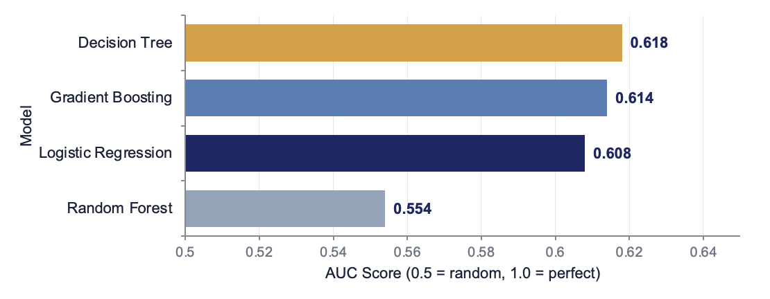
03 • ONE-FAMILY DWELLINGS
Decision Tree leads at AUC 0.62
Model Comparison — AUC
8,744
Properties analyzed
23.0%
High-return threshold
1.14×
Top decile lift
BEST MODEL
WATCH OUT
BUSINESS LIFT
Decision Tree
Gradient Boosting
14% edge
Highest AUC + 64% recall — finds high-return homes without flagging everything.
75% accuracy, but recall of 1% — predicts almost everything as low-return. Useless for screening.
Top-decile predicted properties contain 14% more high-return homes than random selection.
BUS 9430 | Final Project
4 / 9

Slide 5
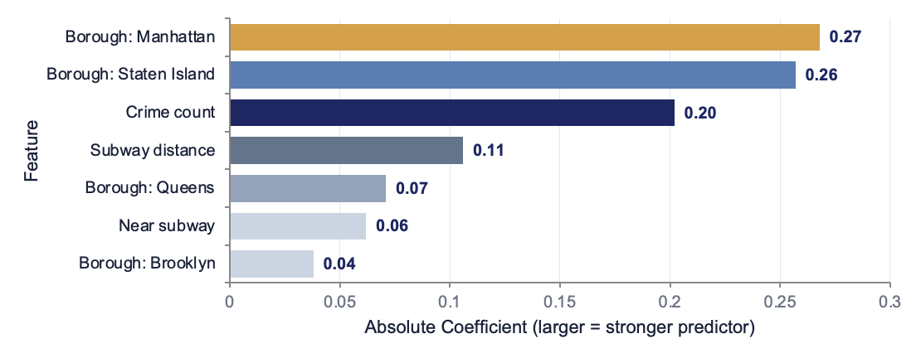
04 • TWO-FAMILY DWELLINGS
Logistic Regression wins; borough dominates
Feature Importance — Logistic Regression (|coef|)
5,675
Properties analyzed
28.3%
High-return threshold
0.76
Recall — catches high-return homes
TOP DRIVER
SURPRISE
USE WITH CARE
Borough
Manhattan lags
Wide net
Where the home is matters more than how close to a subway it is.
Bronx & Brooklyn averaged 20% returns; Manhattan averaged just 6%.
76% recall but 28% precision — best as a screening tool, not a final filter.
BUS 9430 | Final Project
5 / 9

Slide 6
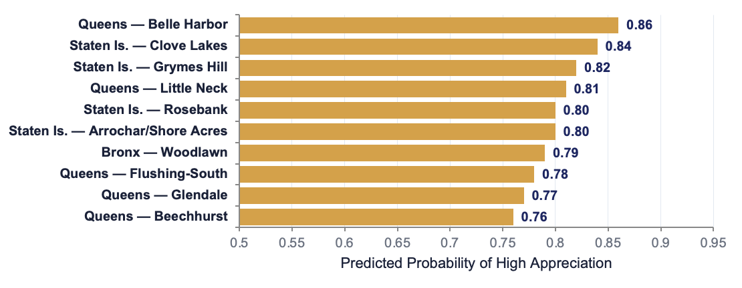
05 • CO-OP DWELLINGS
Where to look — model-ranked neighborhoods
Top 10 Predicted High-Appreciation Co-op Neighborhoods
4,044
Properties analyzed
0.69
AUC — strongest of any segment
Top 10
Neighborhoods ranked for investors
THE PATTERN
WHAT MATTERS
WHAT'S MISSING
Outer boroughs
Crime + borough
Building details
Every top-10 neighborhood is in Queens, Staten Island, or the Bronx. Not a single Manhattan or Brooklyn area made the list.
Safety carries the strongest negative signal. Subway access showed mixed effects — not a clear driver.
Maintenance fees, board rules, and condition aren't in our data — investors still need to do building-level homework.
BUS 9430 | Final Project
6 / 9

Slide 7
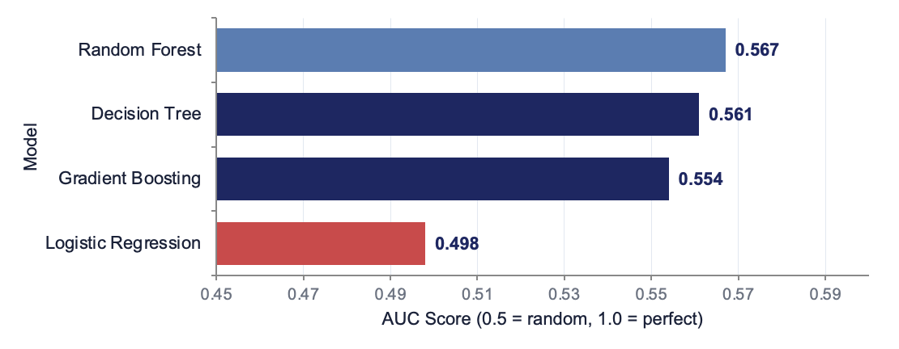
06 • CONDO DWELLINGS
The exception — neighborhood signal breaks down
Model Comparison — All four models near coin-flip baseline
2,899
Properties analyzed
6.1%
High-return threshold
0.567
Best AUC — barely above coin flip
THE FINDING
WHY
STILL USEFUL
No reliable signal
Already priced in
Modest screening
Best AUC = 0.567 — barely better than guessing. Logistic Regression scored 0.498, literally worse than random.
Manhattan ranked LAST for condo appreciation (~1%). Premium neighborhoods have premium entry prices that suppress future gains.
Top 30% by predicted score contains 24–38% more high-return condos than random — a small but real edge.
BUS 9430 | Final Project
7 / 9

Slide 8
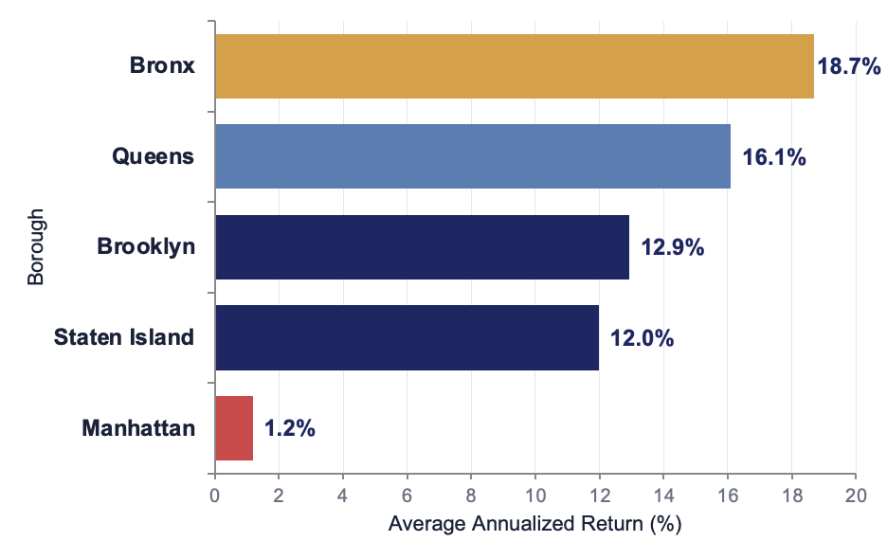
07 • CROSS-SEGMENT PATTERNS
Three findings hold across all models
Average Annualized Return by Borough
01
Outer boroughs win
Bronx, Queens, and Brooklyn all beat Manhattan across every segment. Premium ≠ high-growth.
02
Crime matters more than transit
Crime ranked top-3 in every model. Subway distance — expected to dominate — barely registered.
03
Segments are fundamentally different
Two-family responds to neighborhood; condos don't (already priced in). A 6% return is elite for one, a disappointment for another.
Manhattan averages just 1.2% — outer boroughs deliver 10–18×
BUS 9430 | Final Project
8 / 9

Slide 9



08 • WRAPPING UP
Who benefits, what's missing, what's next
WHO BENEFITS
LIMITATIONS
NEXT STEPS
Decision-support tool
Honest constraints
Path to AUC 0.75+
Investors
Screen 200 candidates down to 50 worth deeper analysis.
Buyers
Challenge assumptions about premium markets.
Lenders & developers
Assess collateral quality and demand patterns.
Crime is borough-level
All of Brooklyn gets one score, regardless of neighborhood.
Income excluded
70% missing values after merging.
Property details missing
No building age, sqft, school quality, or condition.
Granular crime data
Census-tract or ZIP-level instead of borough.
Recover income coverage
Use NTA-level Census data with better matching.
Add property features
Building age, sqft, schools — likely the biggest unlock.
Thank you • Questions?

