Slide 1
A strategy to boost rating and drive new customers
FoodHub aggregator online food delivery
Austin University – Post Graduate Program in Artificial Intelligence
12/07/2025

Slide 2
Contents / Agenda
Executive Summary
Business Problem Overview and Solution Approach
Data Overview
EDA - Univariate Analysis
EDA - Multivariate Analysis
Appendix

Slide 3
Executive Summary - Opening
Usually, when we talk about customer satisfaction in food delivery, we obsess over speed: 'How can we shave two minutes off delivery time?' or 'How can we get the food out of the kitchen faster?
However, our analysis of the latest dataset reveals a critical paradox: Our operations are actually running with incredible consistency. Our delivery times are stable, and our kitchen prep is standardized. But, statistically speaking, speed is no longer moving the needle on our customer ratings. A delivery that arrives in 24 minutes gets the exact same rating as one that arrives in 28.
Instead, the data points to a new driver: Perceived Value. We found that our highest satisfaction scores come exclusively from our highest-priced orders—specifically within our Premium segments like French and Southern cuisine. Conversely, our 'budget' options are where we see satisfaction dropping.

Slide 4
Executive Summary - Conclusions
Conclusions
The FoodHub business is solid; it has a consistent process to prepare and deliver the food to customers on time and with quality. The FoodHub has 5-star ratings on more than 50% of its reviews and an overall rating of 4.34. It shows that customers are overall satisfied with the food quality and delivery.
There is a clear positive correlation between Cost and rating. Customers ordering more expensive means, such as French and Southern, tend to give 5-star ratings. On the other hand, orders with low rate and unrated are basically low price orders. High price is usually associated with higher satisfaction.
Korean, Vietnamese, and Japanese food are the most affordable ranging average $12-$14 and driving the majority of the orders. The French food is the most expensive(median > $20) overall. It propels high ratings, probably as the result, perception, or marketing of the food quality.
Though the Korean food is generally fast to prepare, according to the multi-variable cuisine vs preparation time. There is a particular subset that suffers from significant delays(32,33 ) minutes, which are statistical outliers.

Slide 5
Executive Summary - Recommendations
Based on rates and price correlation
The low-cost orders are associated with lower rates or no ratings. The entry-level menus may be lacking quality or size.
Proposal:
Review and possibly increase portion sizes
Change or remove the menu with options that would better suit your audience(Vegan, Youth, Older)
Review the food presentation
The delivery logistics
Given that the delivery logistics are not affecting the overall rate of the experience, as inferred from the data, since delivery time was not rated separately, restaurants should focus on improving the quality of the food, presentation, and portions. Considering optimizing for faster delivery will not drive customer satisfaction.
Low-engagement customers
Given that more than 700 customers did not rate the experience, it would be interesting to implement a post-order incentive (e.g., rate your experience and get 10% back on your next order). Urated orders are also associated with cheaper orders; getting feedback may be particularly important for determining whether the lower rate for more affordable food persists.
Marketing
Outside of American, Japanese, Italian, Chinese, Mexican, and Indian, the other restaurants received fewer than 30 orders in the period. FoodHub should focus its marketing to expand the offer to communities represented by the other cuisine type. The approach can increase the overall number of orders and customers.
Restaurants such as Five Guys are not doing well; they probably cater to the youth community. Campaigns to address the youth community may also lead to new customers(e.g., University promotions)

Slide 6
Business Problem Overview and Solution Approach
Overview
The food aggregator company has stored the data of the different orders made by the registered customers in their online portal. They want to analyze the data to get a fair idea about the demand of different restaurants which will help them in enhancing their customer experience. Suppose you are hired as a Data Scientist in this company and the Data Science team has shared some of the key questions that need to be answered. Perform the data analysis to answer these questions and help the company improve its business. Please mention the solution approach / methodology
Approach
Approach & Methodology
Objective: To diagnose root causes of customer satisfaction variance and identify revenue optimization opportunities.
Methodology: Applied Exploratory Data Analysis (EDA) to decode the operational dataset.
Techniques:
Univariate Analysis: Audited individual performance metrics (Cost, Time, Ratings) for consistency and outliers
Multivariate Analysis: Examined the correlations between operational variables to isolate the true drivers of 5-star ratings.

Slide 7
Data Overview
Question 1 - How many rows and columns are present in the data? [0.5 mark]
# Check the shape of the dataset
df.shape ## Fill in the blank
(1898, 9)
The .csv file contains 1898 rows and 9 columns. It is a moderately sized dataset suitable for analysis and allow for fast processing.
Question 2 - What are the data types of the different columns in the dataset? [0.5 mark]
df.info()
(1898, 9)
<class 'pandas.core.frame.DataFrame'>
RangeIndex: 1898 entries, 0 to 1897
Data columns (total 9 columns):
# Column Non-Null Count Dtype
--- ------ -------------- -----
0 order_id 1898 non-null int64
1 customer_id 1898 non-null int64
2 restaurant_name 1898 non-null object
3 cuisine_type 1898 non-null object
4 cost_of_the_order 1898 non-null float64
5 day_of_the_week 1898 non-null object
6 rating 1898 non-null object
7 food_preparation_time 1898 non-null int64
8 delivery_time 1898 non-null int64
dtypes: float64(1), int64(4), object(4)
memory usage: 133.6+ KB
The 9 columns follow a basic pattern for column types. It uses int64 for integer numbers and Object to represent String or mixed data types.
The cost is represented as a float, as it should, because it allows fractions of dolar representations.
There are 4 Strings/Objects, 4 integers, and 1 Float number

Slide 8
Data Overview
Question 3 - Are there any missing values in the data? If yes, treat them using an appropriate method. [1 Mark]
# Checking for missing values in the data
def check_missing_values(dataframe):
''' returns te missing values in each column of the dataframe'''
return dataframe.isnull().sum()
missing_values = check_missing_values(df)
print (f"Missing Values of each column:\n{missing_values}")
#Write the appropriate function to print the sum of null values for each column
  Missing Values of each column:
  order_id 0
  customer_id 0
  restaurant_name 0
  cuisine_type 0
  cost_of_the_order 0
  day_of_the_week 0
  rating 0
  food_preparation_time 0
  delivery_time 0
  dtype: int64int64
      There are no columns with null values
The dataset is whole in complete

Slide 9
Data Overview
Question 4 - Check the statistical summary of the data. What is the minimum, average, and maximum time it takes for food to be prepared once an order is placed? [2 marks]
df.describe()
 | order_id | customer_id | cost_of_the_order | food_preparation_time | delivery_time
count | 1.90E+03 | 1898 | 1898 | 1898 | 1898
mean | 1.48E+06 | 171168.4784 | 16.498851 | 27.37197 | 24.161749
std | 5.48E+02 | 113698.1397 | 7.483812 | 4.632481 | 4.972637
min | 1.48E+06 | 1311 | 4.47 | 20 | 15
25% | 1.48E+06 | 77787.75 | 12.08 | 23 | 20
50% | 1.48E+06 | 128600 | 14.14 | 27 | 25
75% | 1.48E+06 | 270525 | 22.2975 | 31 | 28
max | 1.48E+06 | 405334 | 35.41 | 35 | 33
####
#### The minimum time to prepare the food was 20.00 Min
#### The average time to prepare the food was 27.37 Min
#### The max time to prepare the food was 35.00 Min
####

Slide 10
Data Overview
Question 5 - How many orders are not rated? [1 mark]
#df['rating'].value_counts()['Not given'] ## Complete the code
# disregard of capitalization
count = (df['rating'].str.lower() == 'not given').sum()
print(f"Number of 'Not given' ratings: {count}")
Number of 'Not given' ratings: 736
736 orders were not rated out of 1898, meaning 39% of the orders were not rate

Slide 11
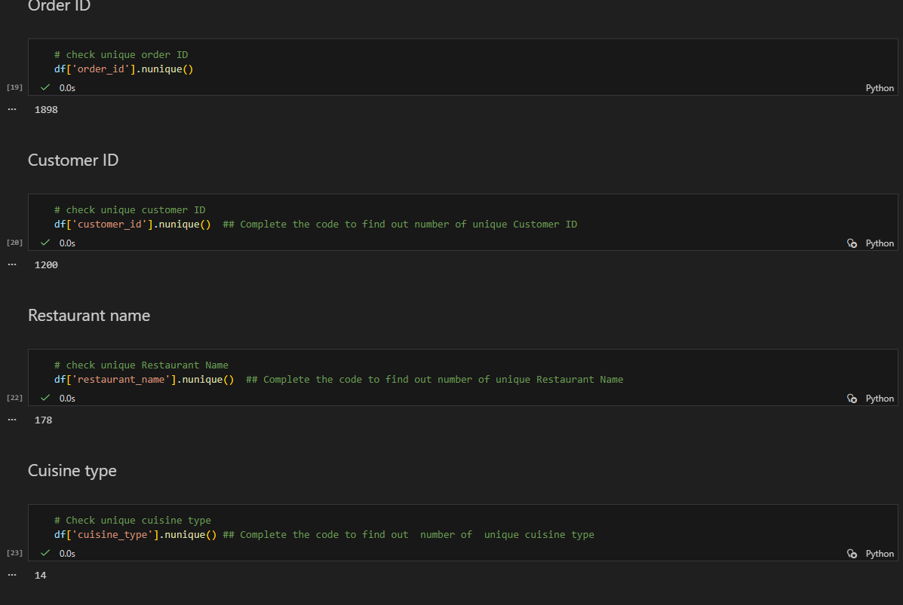
Univariate Analysis
Question 6 - Explore all the variables and provide observations on their distributions. (Generally, histograms, boxplots, countplots, etc. are used for univariate exploration.) [9 marks]
Out of 1898 customer orders there are 1200 unique customers, from 178 Restaurantes providing 14 Cuisine Types.

Slide 12
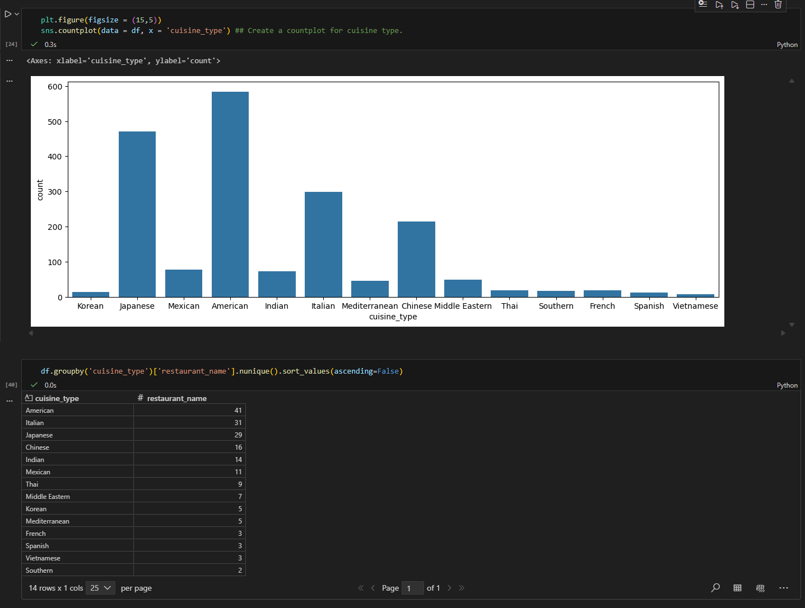
Univariate Analysis
Question 6 - Explore all the variables and provide observations on their distributions. (Generally, histograms, boxplots, countplots, etc. are used for univariate exploration.) [9 marks]
The restaurants that most sell are americans and japaneses, followed by Italians and chinese.
It appears that customer do not prefer Vietnameses, spanishes, and koreans, considering the orders. Despite, there are more Korean restaurants than vietnamese and sourthern.

Slide 13
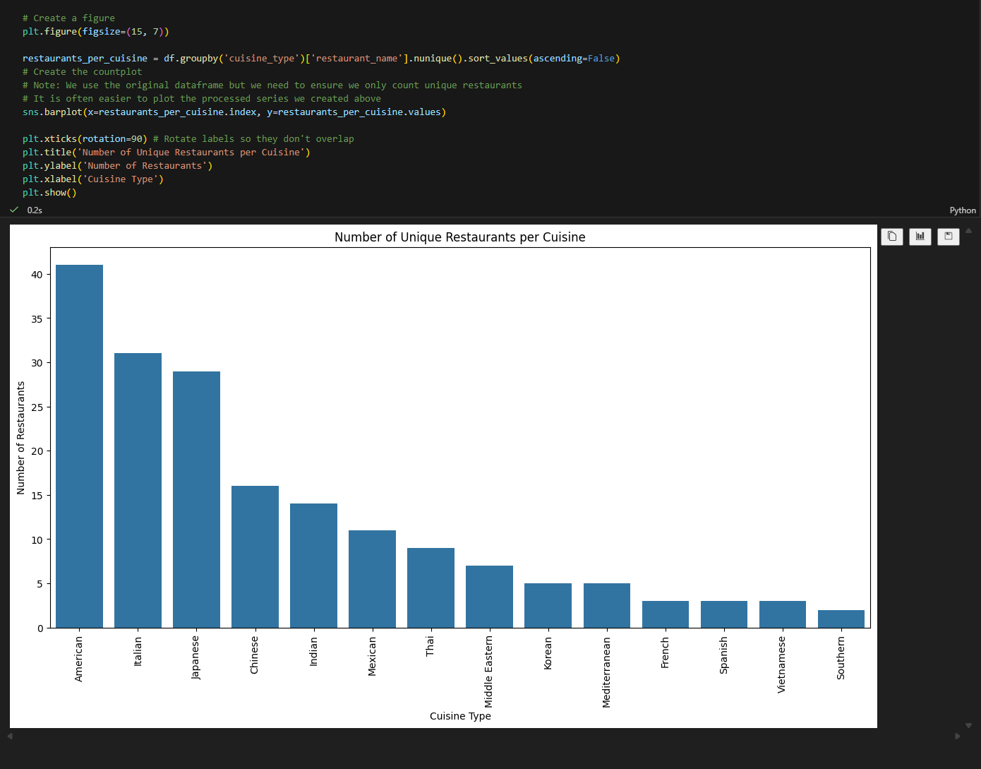
Univariate Analysis
Question 6 - Explore all the variables and provide observations on their distributions. (Generally, histograms, boxplots, countplots, etc. are used for univariate exploration.) [9 marks]

Slide 14
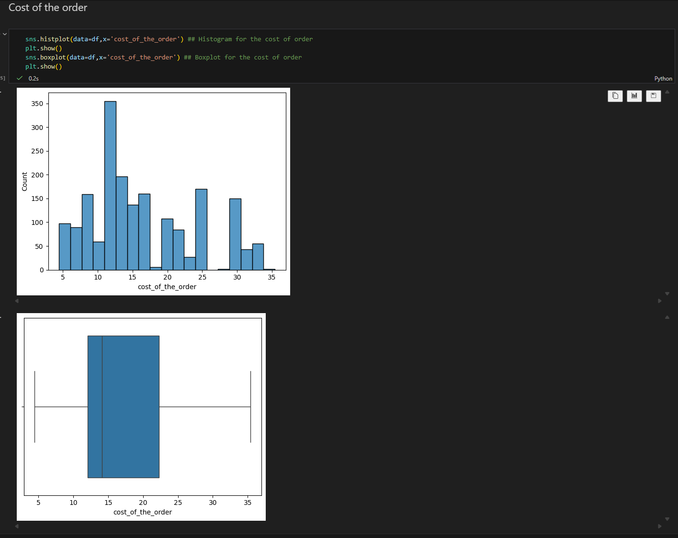
Univariate Analysis
Question 6 - Explore all the variables and provide observations on their distributions. (Generally, histograms, boxplots, countplots, etc. are used for univariate exploration.) [9 marks]
The typical order cost is around 14. While the costs range from roughly 5 to 35
Most people tend to buy cheap below 14
The bulk revenue comes from orders from 12 to 22/23 dolars
There are no visible outliers represented may be for the fact there are no party orders
The higher orders are around 35/36 dolares, probably from families.

Slide 15
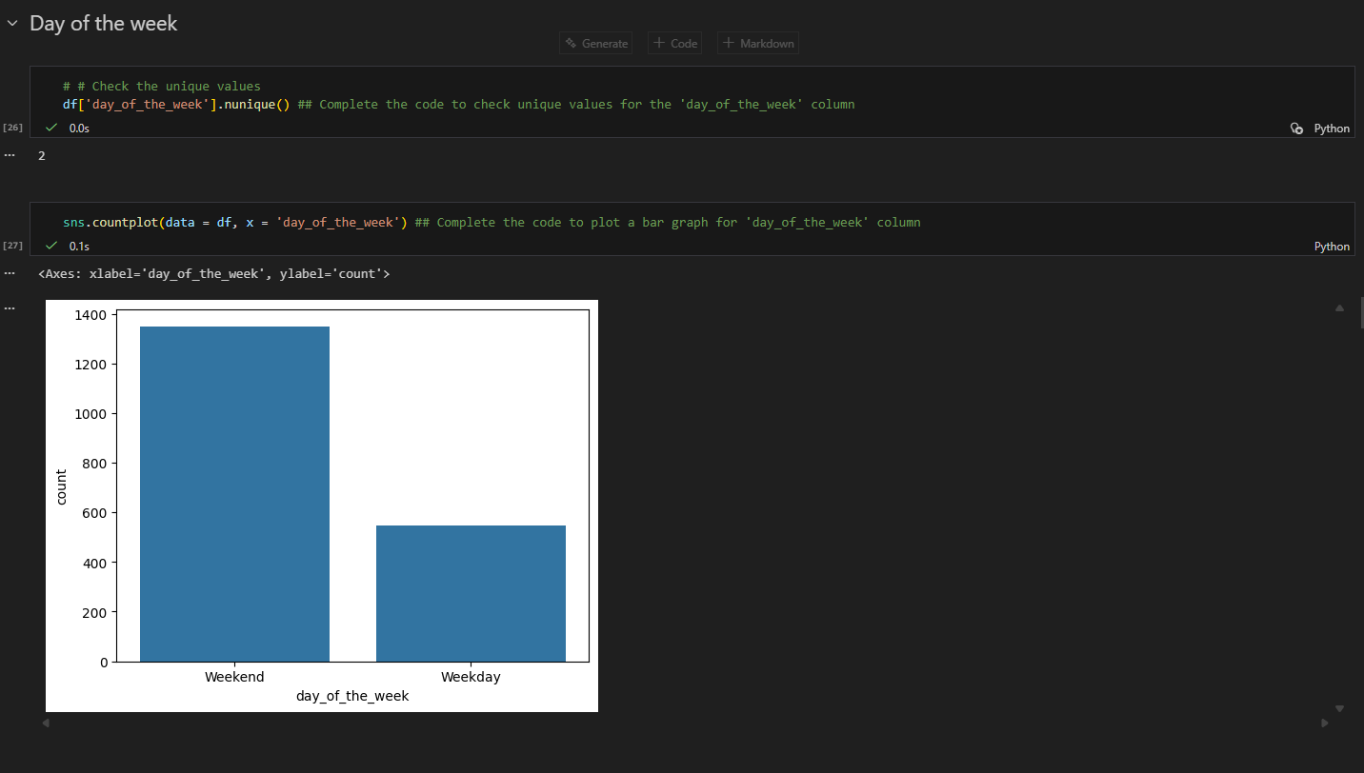
Univariate Analysis
Question 6 - Explore all the variables and provide observations on their distributions. (Generally, histograms, boxplots, countplots, etc. are used for univariate exploration.) [9 marks]
Most customers buy on weekends as opposed to weekdays. Probably, because people want to enjoy the weekend out.

Slide 16
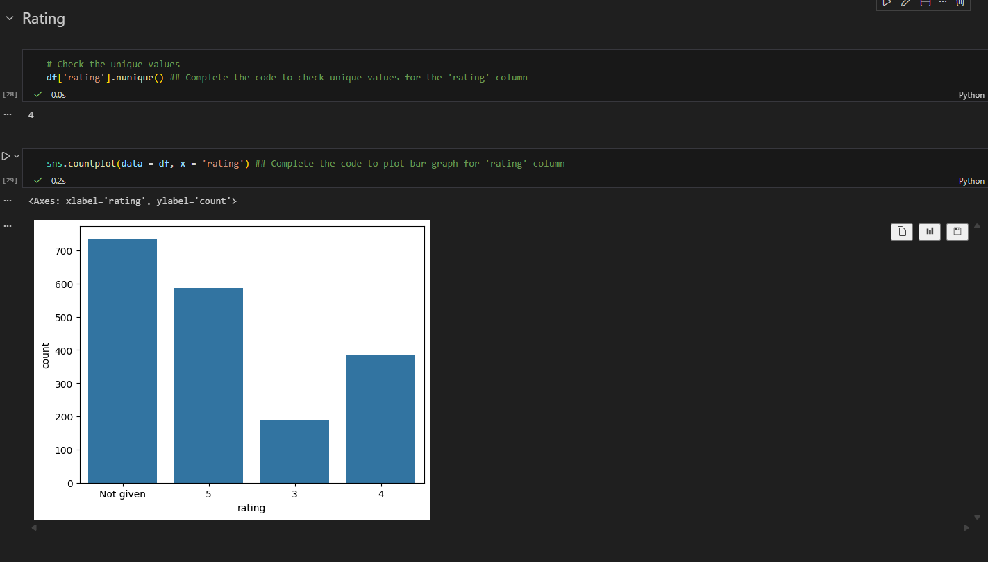
Univariate Analysis
Question 6 - Explore all the variables and provide observations on their distributions. (Generally, histograms, boxplots, countplots, etc. are used for univariate exploration.) [9 marks]
People do not rate all the time. It may happen because of the familiarity with technology or the rush of the day. It seems we do not have bad restaurants or food rated 1 and 2. Most restaurants are well rated 4 and 5. While some restaurants are average they are not the majority.

Slide 17
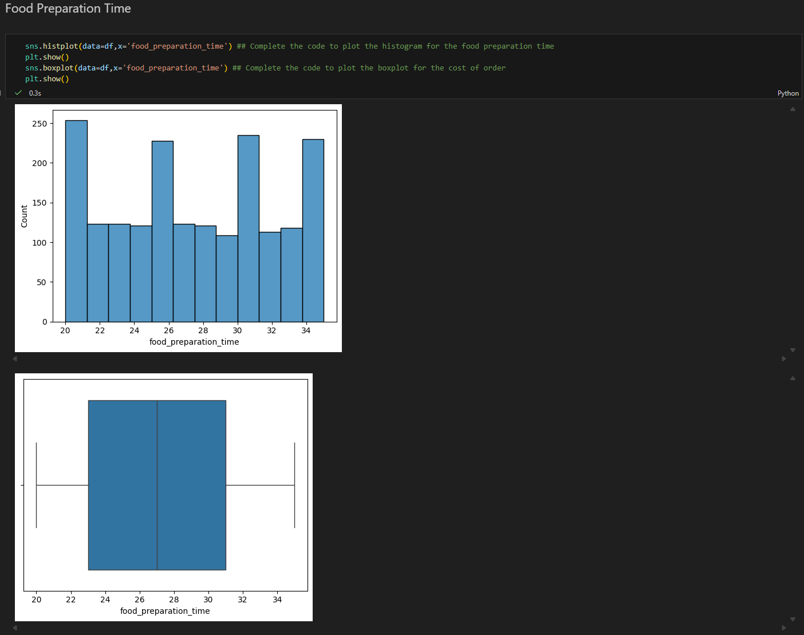
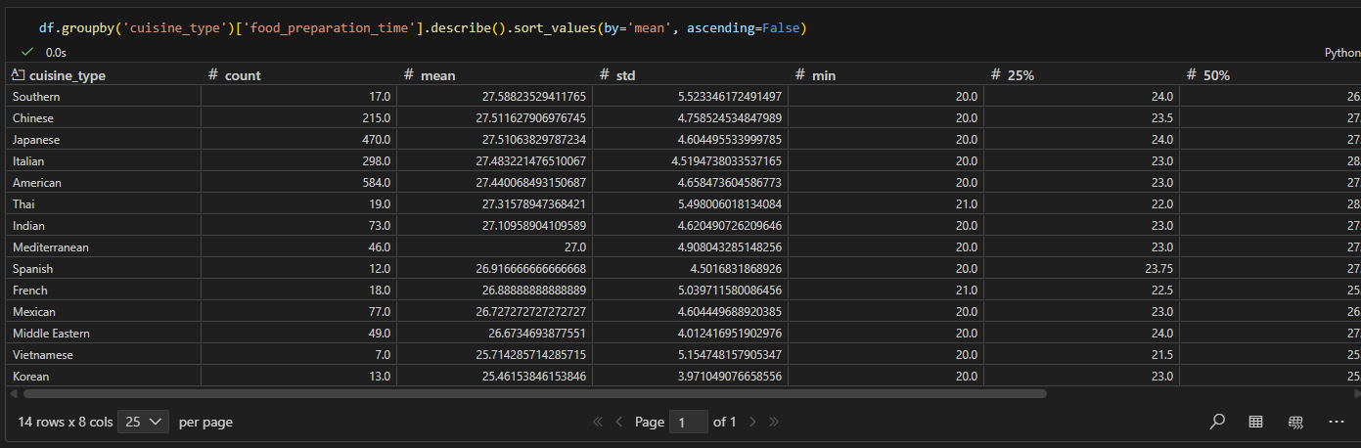
Univariate Analysis
Question 6 - Explore all the variables and provide observations on their distributions. (Generally, histograms, boxplots, countplots, etc. are used for univariate exploration.) [9 marks]
Around 25% of the food took less than 23 min to prepare, being the minimun 20 min
50% of the food took from 23 to 33 min to prepare.
Overall the preparation time for all restaurants/cuisines are the same. Deeper looking at the average, min, and max of all the restaurants there are no outliers. Restaurants probably try to be closer to preparation time of other restaurants to stay competitive.

Slide 18
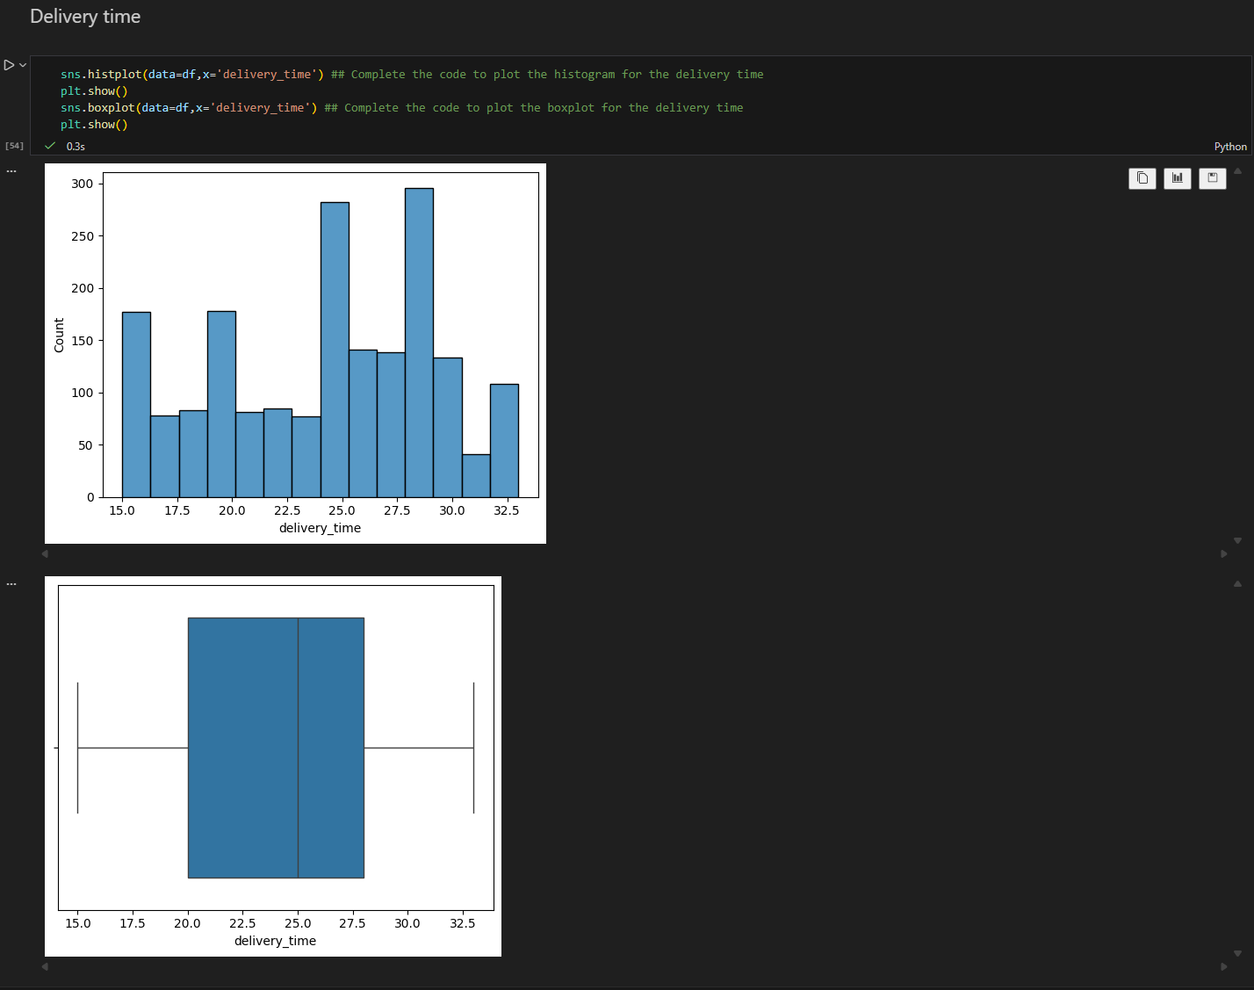
Univariate Analysis
Question 6 - Explore all the variables and provide observations on their distributions. (Generally, histograms, boxplots, countplots, etc. are used for univariate exploration.) [9 marks]
The fastest delivery time is 15 min
The common delivery is 25 min
The longest delivery is 33 min.
Because the median line is slightly closer to the right side of the box. It implies that
most deliveries are around 25-28 min.
Looking from the left skew to the mid skew we can infer that there are more fast deliveries than slow.
Considering cost of order and delivery time it is fair to say the low cost (14) is delivered in average time.
The logistic is predictable for all restaurants types. It may be a good place to improve in the future to attract more customers.

Slide 19
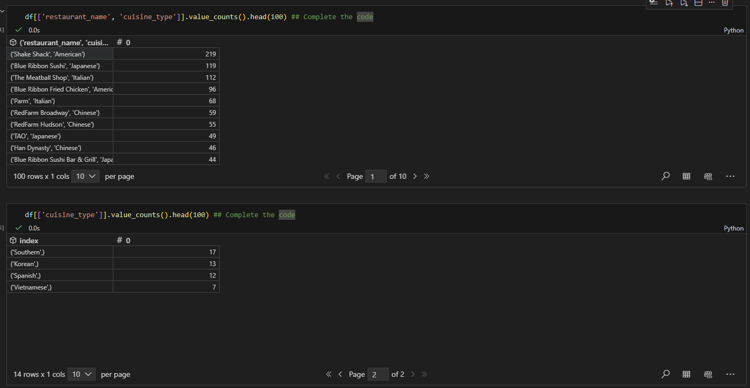
Univariate Analysis
Question 7 - Which are the top 5 restaurants in terms of the number of orders received? [1 mark]
The five restaurants in terms of orders are
restaurant_name cuisine_type
Shake Shack American 219
Blue Ribbon Sushi Japanese 119
The Meatball Shop Italian 112
Blue Ribbon Fried Chicken American 96
Parm Italian 68

Slide 20
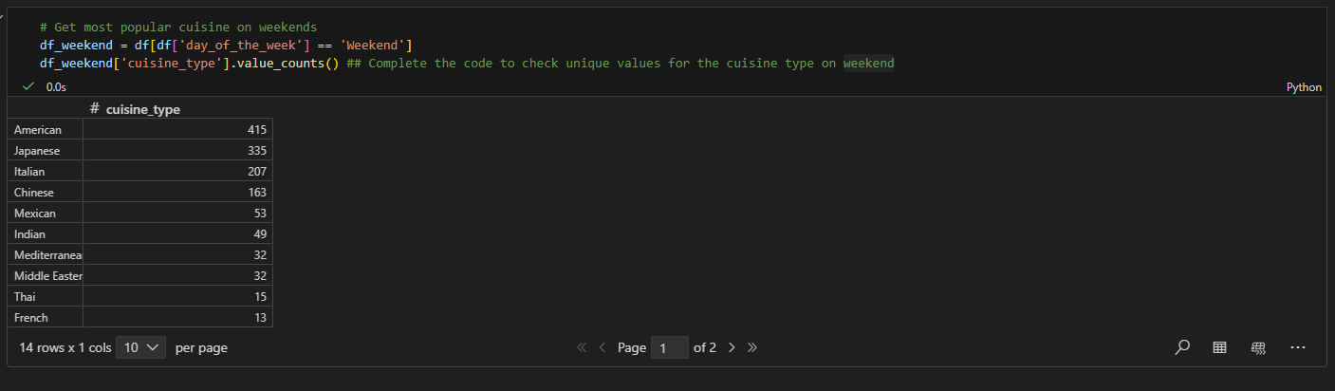
Univariate Analysis
Question 8 - Which is the most popular cuisine on weekends? [1 mark]
The most popular is American with 415 orders
American 415
Japanese 335
Italian 207
Chinese 163
Mexican 53
Indian 49
Mediterranean 32
Middle Eastern 32
Thai 15
French 13
Korean 11
Southern 11
Spanish 11
Vietnamese 4
Name: cuisine_type, dtype: int64

Slide 21
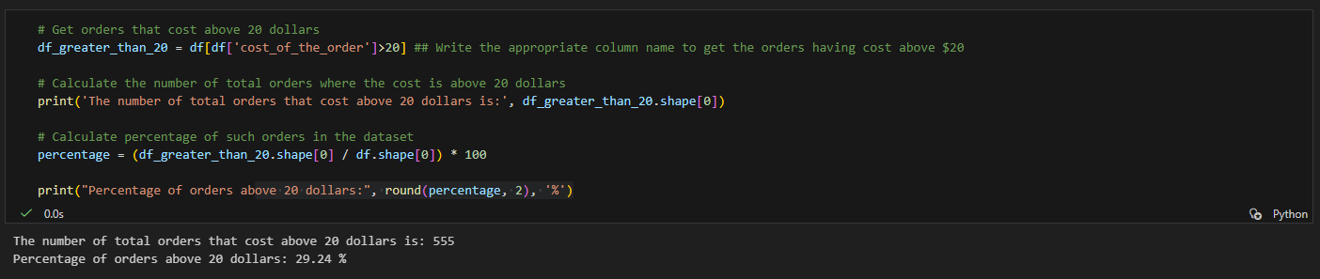
Univariate Analysis
Question 9 - What percentage of the orders cost more than 20 dollars? [2 marks]
]
The number of total orders that cost above 20 dollars is: 555
Percentage of orders above 20 dollars: 29.24 %

Slide 22
Univariate Analysis
Question 10 - What percentage of the orders cost more than 20 dollars? [2 marks]
]
The number of total orders that cost above 20 dollars is: 555
Percentage of orders above 20 dollars: 29.24 %

Slide 23
Univariate Analysis
Question 9 - What percentage of the orders cost more than 20 dollars? [2 marks]
]
The number of total orders that cost above 20 dollars is: 555
Percentage of orders above 20 dollars: 29.24 %

Slide 24
Univariate Analysis
Question 6 - Explore all the variables and provide observations on their distributions. (Generally, histograms, boxplots, countplots, etc. are used for univariate exploration.) [9 marks]

Slide 25
Univariate Analysis
Please mention regarding univariate analysis for all columns
Please add answers for all question from 6 till 11
Note: You can use more than one slide if needed

Slide 26
Multivariate Analysis
Please mention regarding multivariate analysis between various columns
Please add answers for all question from 12 till 16
Note: You can use more than one slide if needed

Slide 27
APPENDIX

Slide 28
Slide Header
Please add any other pointers (if needed)

