Slide 1
Ideas for the boxes “Voices from the field”
The case of one Food & Agriculture

Slide 2
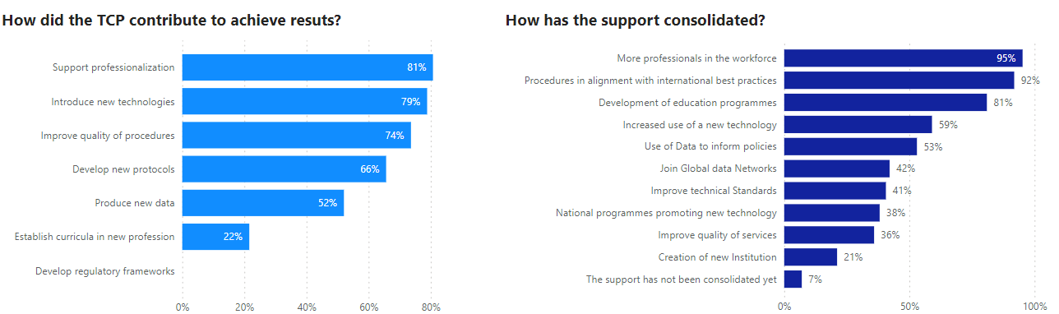
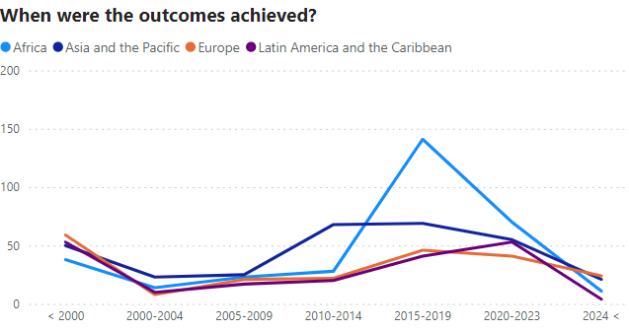
Voices from the field: Food & Agriculture
How does the TCP contributes to achieve results?
The TC programme mainly contributed by supporting the professionalization; facilitating access to new technologies, and improving the quality of procedures. (data: CP)
95% of the CPs consider that the support consolidated in more professionals in the workforce, and 92% that the programme contributed to design procedures in alignment with international best practices. (data: CP)
The contribution of the TCP was more intense in Africa during the period 2015-2019; in 2010-2014 in Asia; and in 2020-2023 in Latin America. (data: NLO)

Slide 3
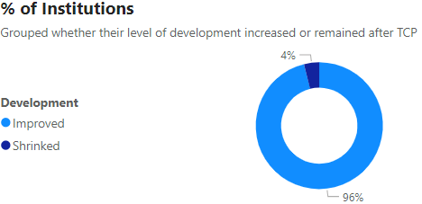
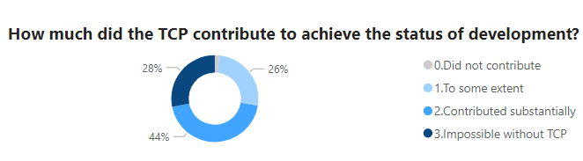
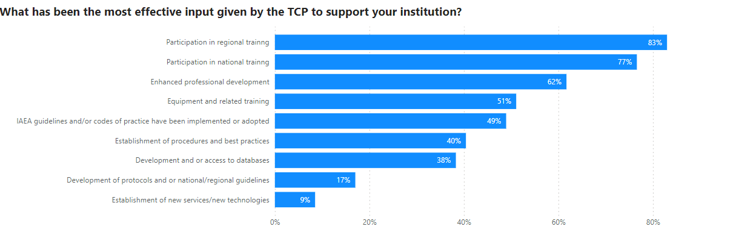
Voices from the field: Food & Agriculture
Contribution of the TCP in the development of new technologies.
96% of the institutions consider that their level of development increased after being supported by the TC programme. (data: CP)
From those, 70% consider that the contribution of the TC programme was substantial or that it would have been impossible without it. (data: CP)
Participation in national and international trainings is perceived as the most effective input given by the TCP to support institutions. (data: CP)

Slide 4
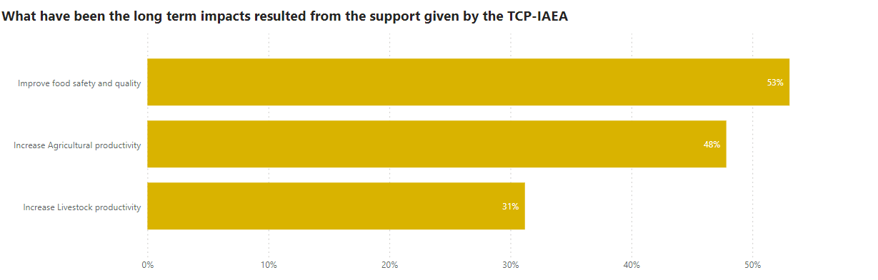
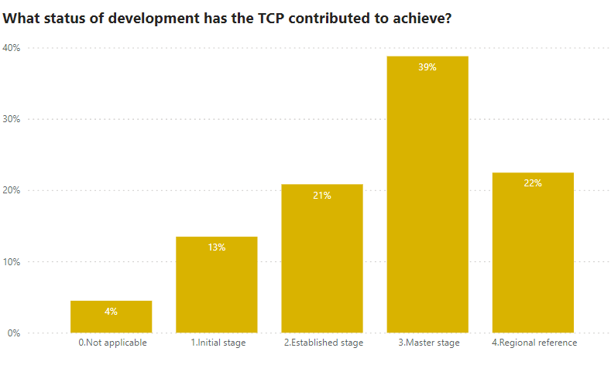
Voices from the field: Food & Agriculture
Long-term impacts resulted from the support given by the TC programme.
Food safety and quality and increase of agricultural productivity is perceived as the main impact of the support provided by the TC Programme.
(data: CP)
The TC programme has contributed for countries to reach a master stage in the use of nuclear technologies. And some have become a regional reference in the field.
(data: NLO)

