Slide 1
MUVA MIS
Conceptual Design
Andres, Dercio, Paul, Kerry
March, 2022

Slide 2
Objectives
Brief description of the current system
Define the conceptual scope of the new MIS
Elements and components
Indicators for dashboard
Map of potential responsibilities
Pilot
Software, Costs, and Team

Slide 3
Current Data System
Software | Mobilization | Registro | Num + Lit | FH | Other tests | *Selection | Turmas | Visitas Dom | Attendance | Transfers | Project Info | Partners | Operational
Survey Solutions |  |  |  | S | S |  |  |  |  | ?
MIS LINK |  |  | S | S | S
Zoho Creator |  |  |  |  |  |  |  |  | R
Paper (?)
Excel & Other |  |  |  |  |  |  |  |  |  | ? | ? | ? | ?
*S or R indicate that the process relies in Stata or R to conduct the analysis

Slide 4
Scope of the new MIS
Unify MUVA’s data management system
Follow participants over time (Unique MUVA ID)
Allow a friendly query of the data
Facilitate ongoing learning via a dashboard (attendance/transfers)
Organize programme’s data (projects, parceiros, financiadores, operational data)
Avoid duplication and conflicts between versions

Slide 5
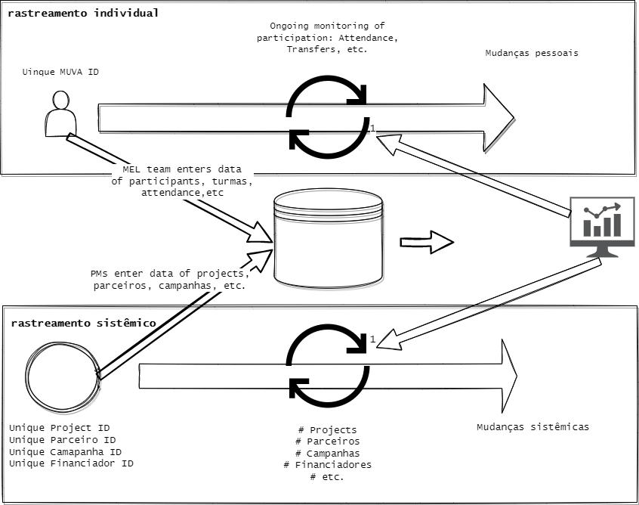
Conceptual Design
Phase 1

Slide 6
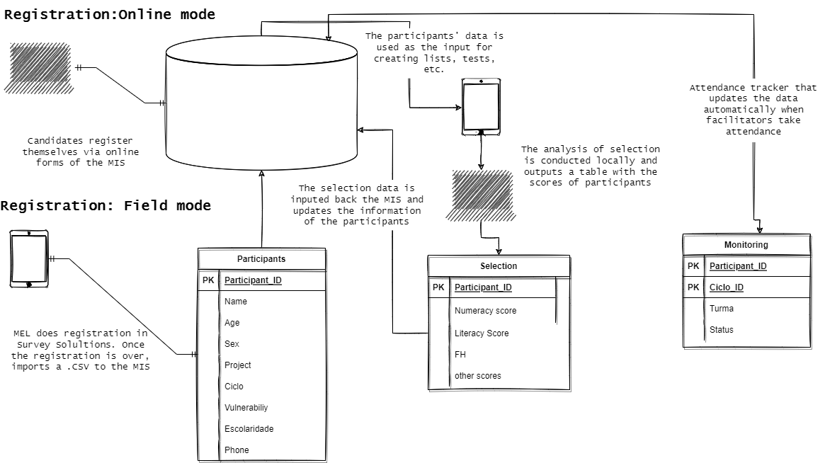
Data Flow

Slide 7
Dashboards
A server with dashboards where the programme can track participation, selection rates, etc.
www.muvadashboards.mz
*Ideally the team builds capacity to produce and mantain these.

Slide 8
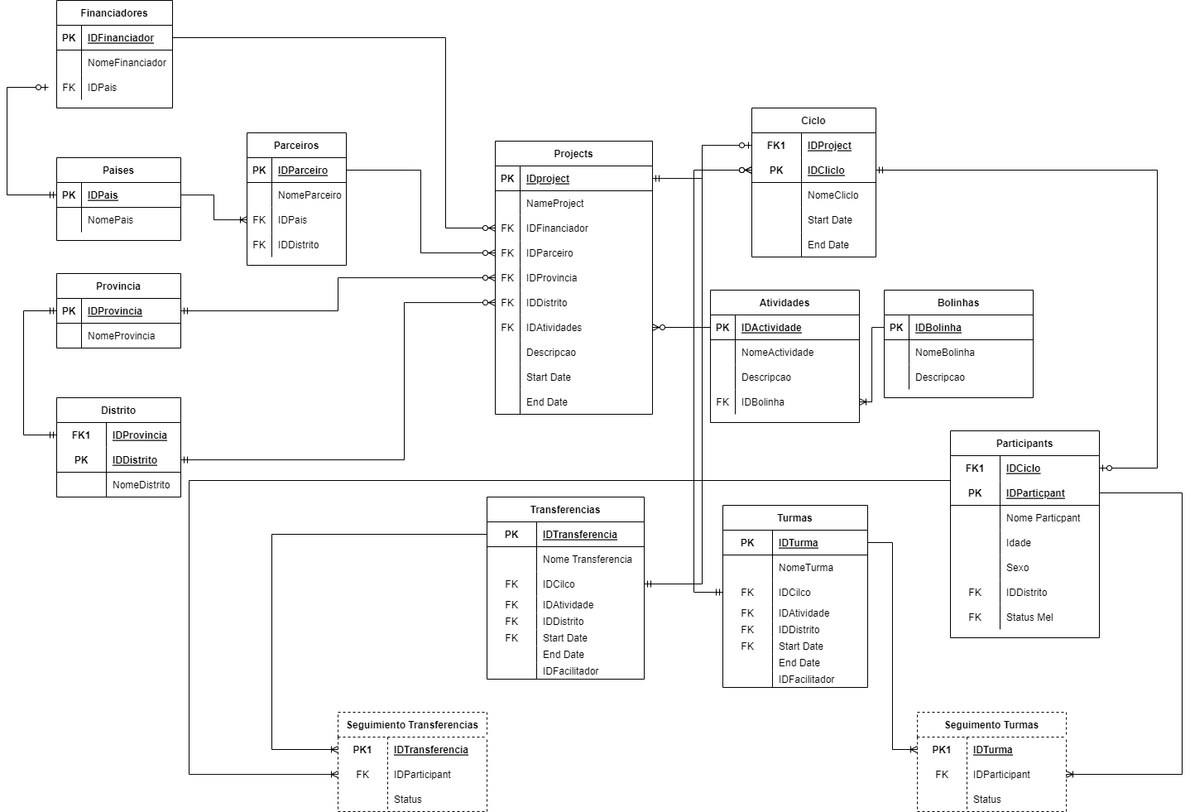
Conceptual Design

Slide 9
Team/responsibilities
Developers: Andres, Dercio, Tercio, Manuel, Paul (who else?)
Enters data for MEL: MEL team, Manuel Qas.
Enters data for sistemico: PM of each project, line managers QA.
Enters data for attendance: facilitators
Audience of dashboards: Implementing teams

Slide 10
Software
Zoho creator: create an account for MUVA and set credentials to allow the creation of users, pages, reports (about 240 EUR/month)
A server to host dashboards and a domain for the data entry.(currently using mine) (about 20 EUR/month)
Survey Solutions server (about 20 EUR /month). Ccurrently using mine
Stata/R

Slide 11
Pilot phase
Log all MUVA projects and test which information is relevant
Choose 2 active projects
Test the unique ID system
Test ongoing monitoring of attendance or transfers
Test process of ongoing learning
Test rastreamiento sistemico

Slide 12
TBD
Process to follow project cycle in the MIS (what to do internally and what externally)
Train users and define data protocols (analysis, storing, updating)
Ideas for rapid follow-ups (?)
If phase 1 works, strategy to escalate and to grow the system

