Slide 1
Tool examples
Abhishek Raut

Slide 2
Code
Please, message me for the code.
http://www.abhishekraut.com/contact

Slide 3
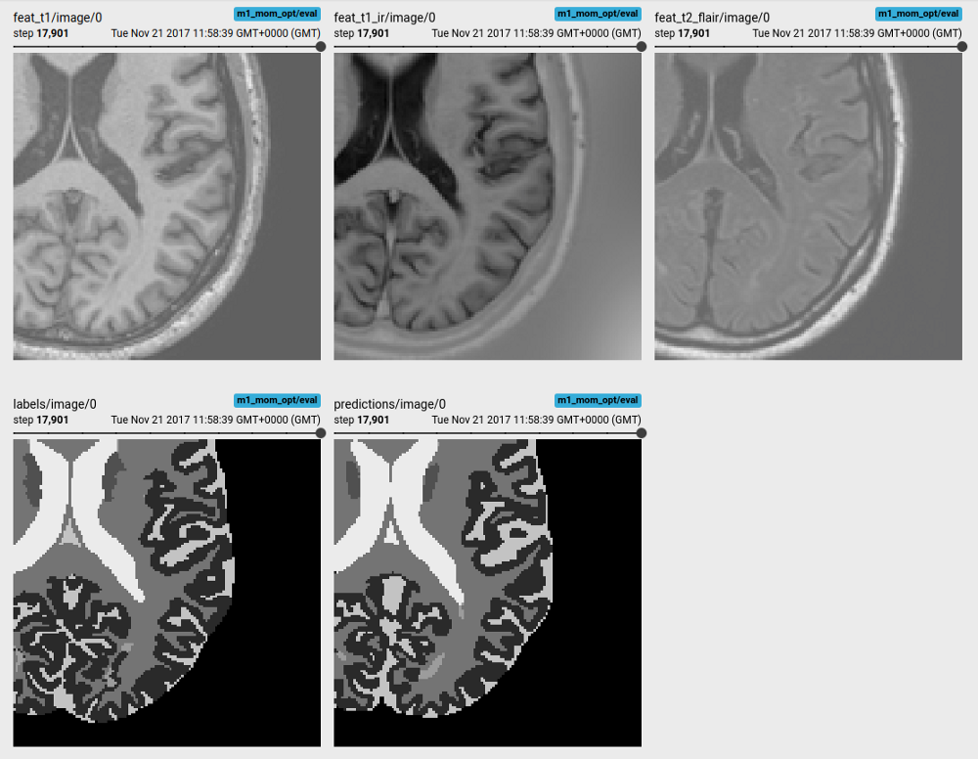
Image segmentation of multi-channel brain MR images
Tensorboard visualisation of multi-sequence image inputs, target labels and predictions

Slide 4
This image segmentation application learns to predict brain tissues and white matter lesions from multi-sequence MR images (T1-weighted, T1 inversion recovery and T2 FLAIR) on the small (N=5) MRBrainS challenge dataset. It uses a 3D U-Net-like network with residual units as feature extractors and tracks the Dice coefficient accuracy for each label in TensorBoard.

Slide 5
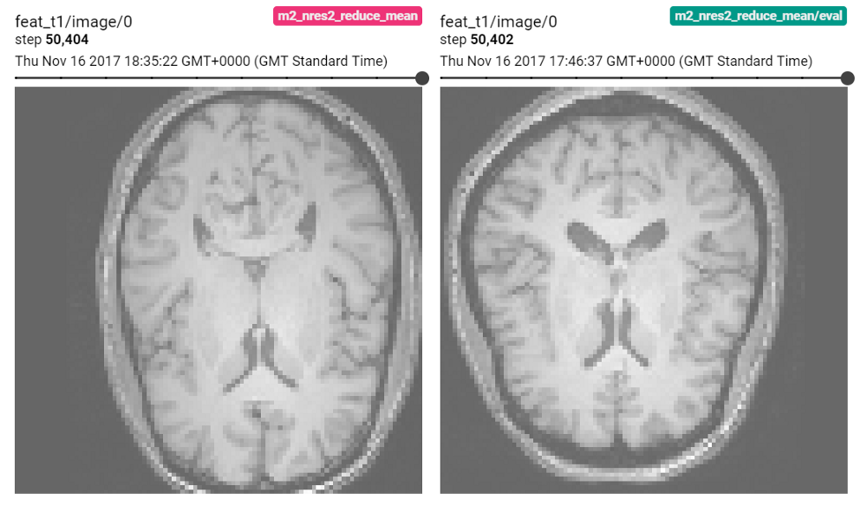
Age regression and sex classification from T1-weighted brain MR images
Example input T1-weighted brain MR images for regression and classification

Slide 6
Two similar applications employing a scalable 3D ResNet architecture learn to predict the subject’s age (regression) or the subject’s sex (classification) from T1–weighted brain MR images from the IXI database. The main difference between this applications is the loss function: While we train the regression network to predict the age as a continuous variable with a L2-loss (the mean squared differences between the predicted age and the real age), we use a categorical cross-entropy loss to predict the class of the sex.

Slide 7
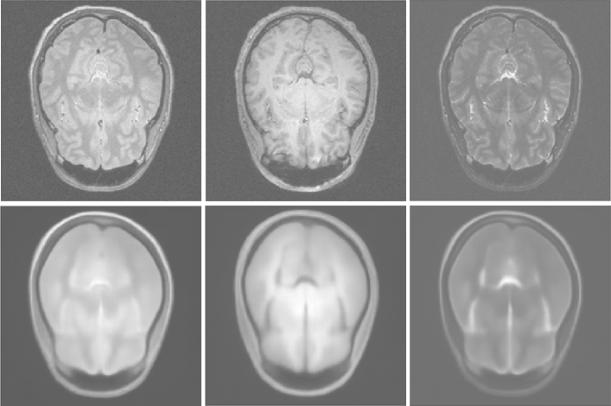
Representation learning on 3T multi-channel brain MR images
Test images and reconstructions using a deep convolutional auto-encoder network

Slide 8
Here we demo the use of a deep convolutional autoencoder architecture, a powerful tool for representation learning: The network takes a multi-sequence MR image as input and aims to reconstruct them. By doing so, it compresses the information of the entire training database in its latent variables. The trained weights can also be used for transfer learning or information compression. Note, that the reconstructed images are very smooth: This might be due to the fact that this application uses an L2-loss function or the network being to small to properly encode detailed information.

Slide 9
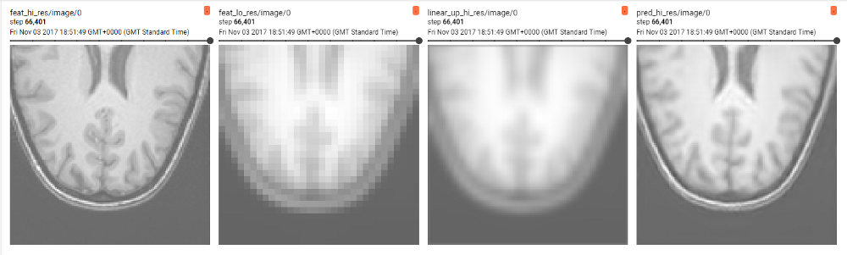
Simple image super-resolution on T1w brain MR images
Image super-resolution: original target image; downsampled input image; linear upsampled image; predicted super-resolution;

Slide 10
Single image super-resolution aims to learn how to upsample and reconstruct high-resolution images from low resolution inputs. This simple implementation creates a low-resolution version of an image and the super-res network learns to upsample the image to its original resolution (here the up-sampling factor is [4,4,4]). Additionally, we compute a linearly upsampled version to show the difference to the reconstructed image.

