Slide 1


TreadOps: Trustworthy Tyre-Casing Inspection with Benchmarked Vision Models, MLOps and a Guarded LLM Copilot
Project Presentation
Subject: MLOps and Applied AI
Submitted By:
Arav Saxena
PRN: 23070126018
Mahi Laddha
PRN: 230701260169
Artificial Intelligence and Machine Learning
Notes:
TreadOps is a tyre-casing inspection platform: a benchmarked image classifier wrapped in a full MLOps loop and a guarded LLM copilot called Bib. Final clearance always stays with a qualified inspector.

Slide 2
Only sound casings can be retreaded
PROBLEM & OBJECTIVES
50 kg
Flag damaged casings from a photo, video or line camera
Never auto-clear a doubtful tyre
Trace every decision to its data and model
Explain each result through a guarded copilot
raw material saved per retread
2×
retreads per casing (MICHELIN Remix)
115 kg
CO₂e avoided per verified retread
Source: Michelin UK retreading page. 115 kg = 50 kg × 2.3 kg CO₂e/kg (estimate)
Notes:
Retreading reuses the casing of a worn truck tyre. Michelin's published figures: about 50 kg of the 70 kg of raw material is saved per retread, at 2.3 kg CO2e per kg, and MICHELIN Remix allows two retreads. The risk is a damaged casing slipping through, so the objective is a triage aid that never clears a doubtful tyre by itself.

Slide 3
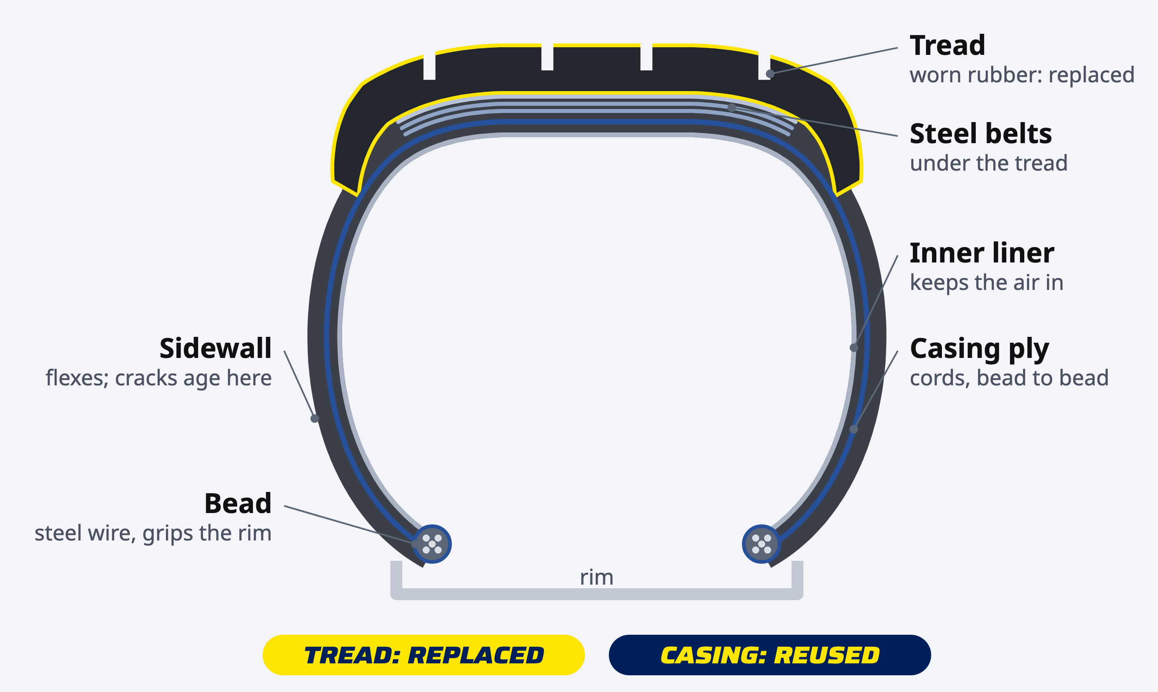
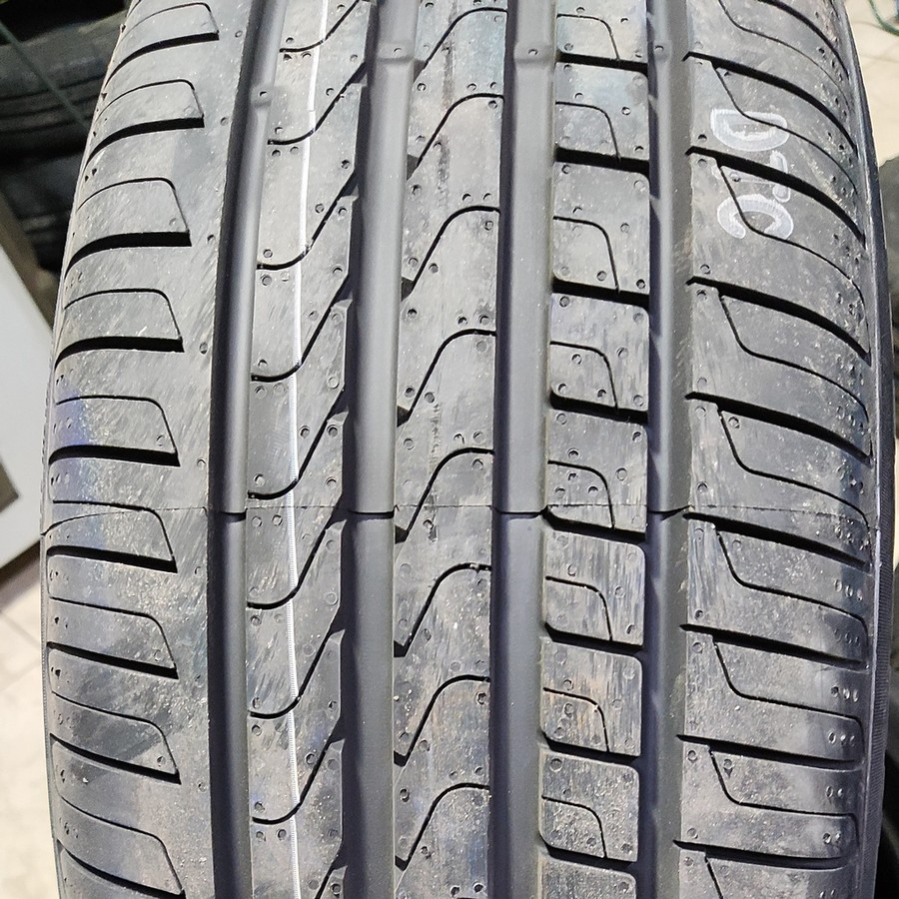
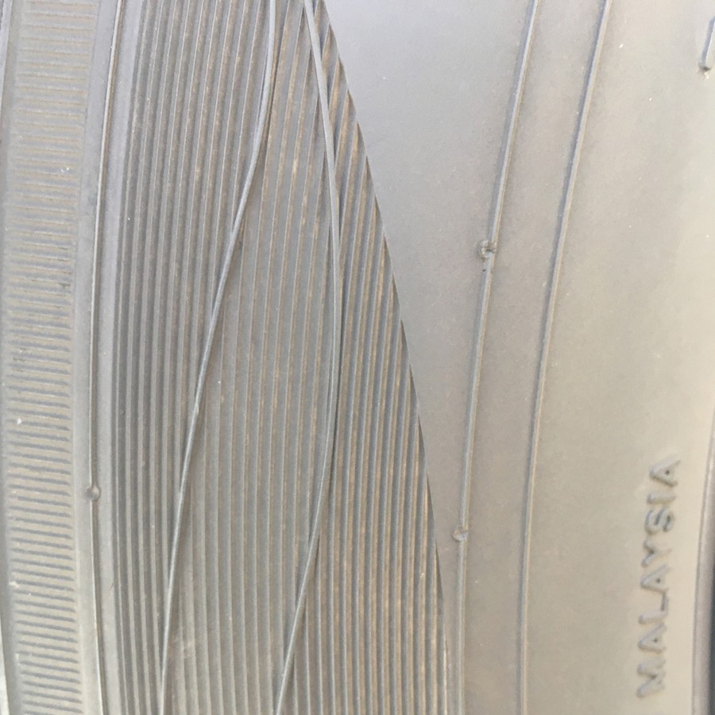
Retreading replaces the tread and saves the casing
TYRE ANATOMY
TREAD
The road surface
Wears down with use. Retreading grinds it off and bonds on a new one.
CASING
Belts, plies, sidewalls, beads
Reused two or three times, so it must have no cuts, bulges or deep cracks.
Photos: TyreNet (CC BY 4.0), MSU tire sidewalls (CC0). Diagram: TreadOps.
Notes:
A truck tyre has two parts that matter here. The tread is the rubber that touches the road; it wears out and a retreader grinds it off and bonds on a new one. The casing is everything underneath: the steel belts, the body ply cords that run from bead to bead, the sidewalls, the beads that grip the rim and the inner liner. The casing is what gets reused two or three times, so it must be sound. A worn tread is the reason a tyre comes in; damage to the casing is the reason to reject it.

Slide 4
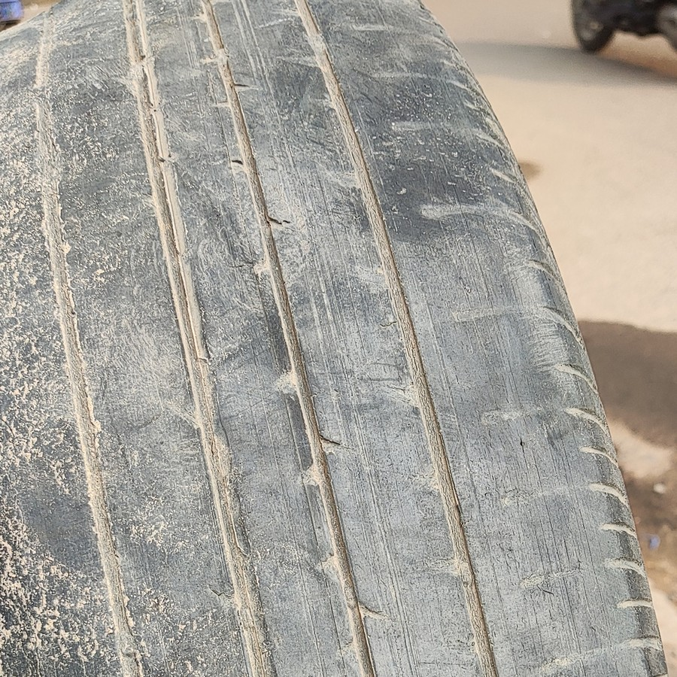
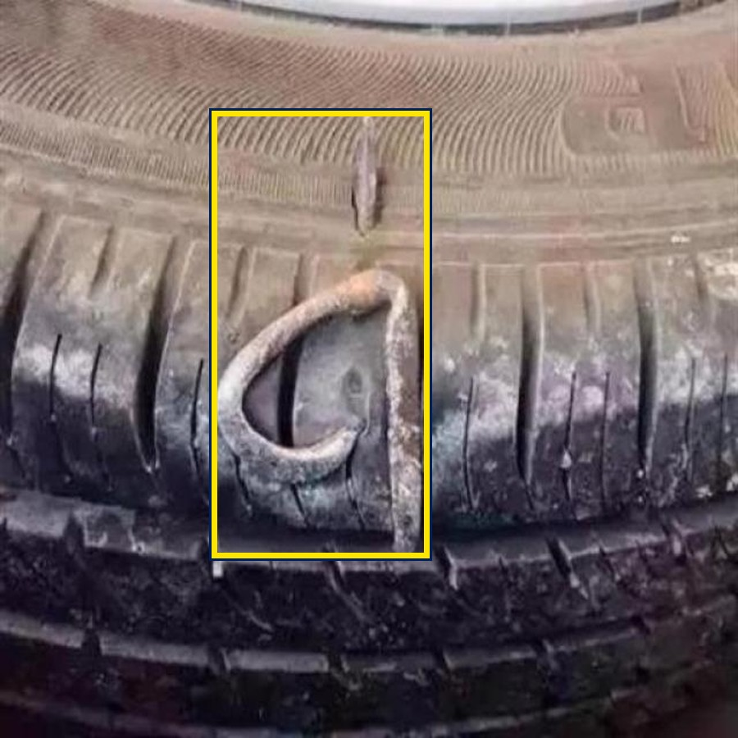
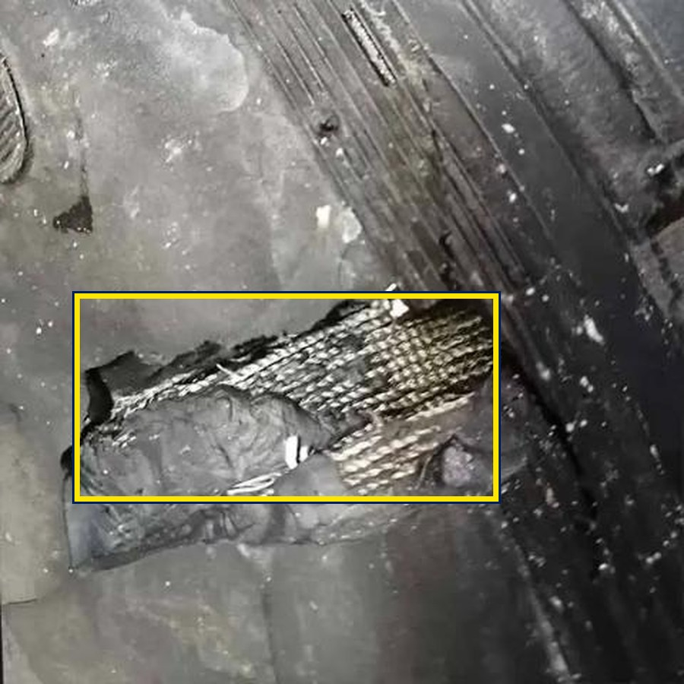
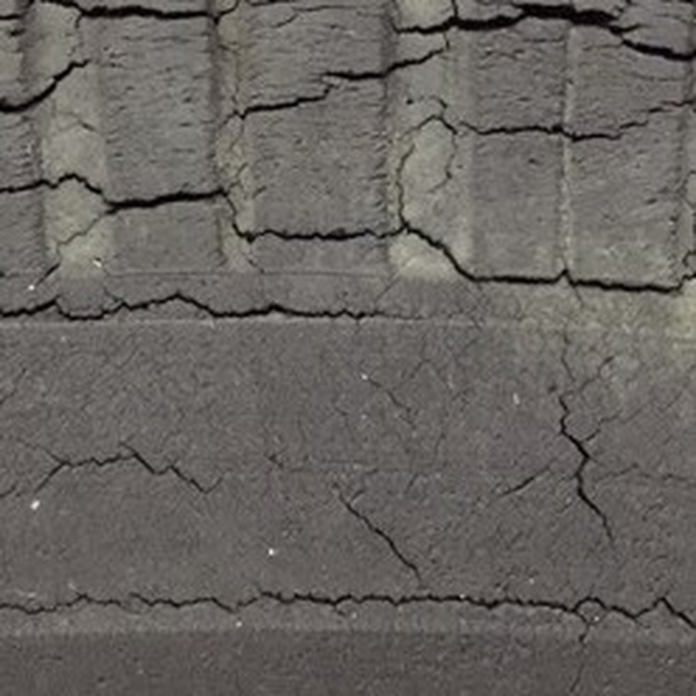
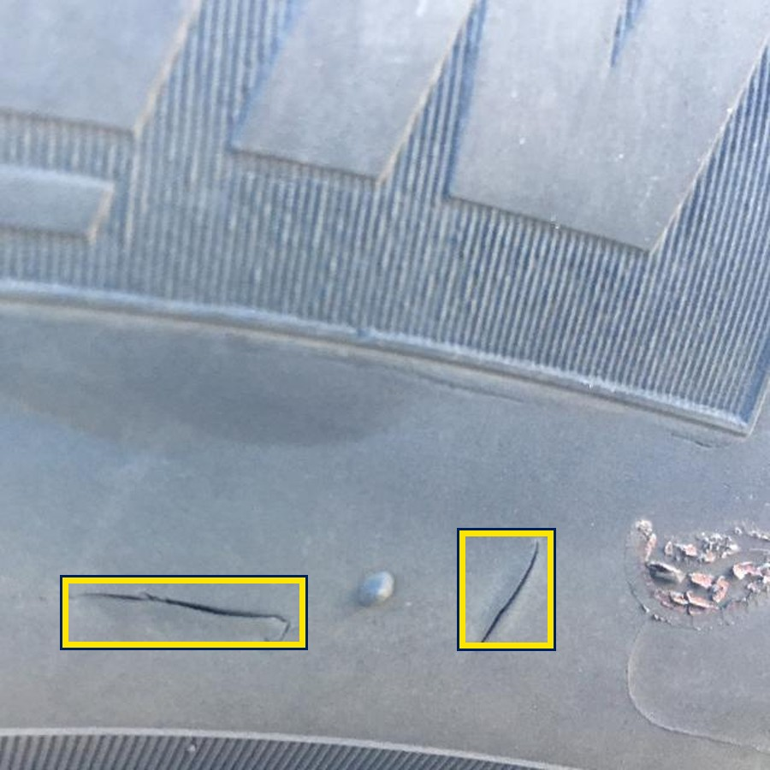
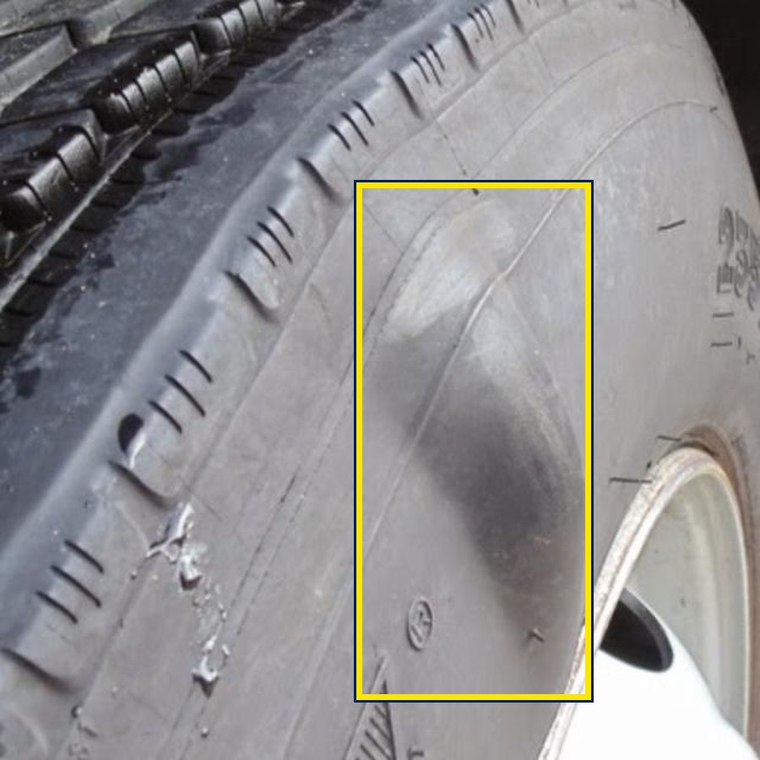
Worn tread is normal; casing damage is the risk
WHERE DAMAGE LIVES
TREAD
TREAD
TREAD
Worn tread
Nail in the tread
Chunk to the belt
Normal wear: why it is retreaded
A puncture, repairable if small
Rubber torn out, steel showing
Inspector decides
Damage locator: foreign object
Damage locator: chunk
CASING
CASING
CASING
Weather cracking
Sidewall cut
Bulge
Age and ozone crack the sidewall
Cuts where it flexes reach the ply
Broken ply cords under the rubber
Classifier: most D1 defects
Damage locator: cut
Damage locator: bulge
Photos: TyreNet, Mendeley D1, Roboflow Universe tire_quality_dataset and TireWear_v2 (all CC BY 4.0). Boxes are the datasets' labels.
Notes:
Top row, the tread: wear is expected and is why the tyre is being retreaded; a nail is a repairable puncture; a chunk torn out down to the steel belt is serious. Bottom row, the casing: weather cracking from age and ozone, cuts in the sidewall where the tyre flexes, and a bulge, which means broken ply cords under the rubber and scrap. The yellow boxes are the datasets' own labels. The classifier learned the cracked, aged look; the new damage locator is trained on boxes like these, so it can point at a cut on an otherwise new tyre.

Slide 5
3,665 tyre photos from three sources, split by tyre
DATASETS
1,828
1,693
144
Mendeley D1
TyreNet (new)
MSU, Harvard
1,000 defective · 828 good
863 defective · 830 good; 8 sites
new photos left of 1,028
883 of MSU's 1,028 photos were exact copies of D1: the hash check stopped them leaking into test
715 photos · 932 damage boxes
Split by tyre, per source
Roboflow Universe, CC BY 4.0; 77 copies of our eval photos removed
70 / 15 / 15: train · calibration + policy · locked test
Adding sources moved no D1 photo (tested)
crack 489
foreign object 196
chunk 93
bulge 80
cut 74
Notes:
Three public phone-photo sources, each downloaded from its publisher and checked against the published checksum. D1 from Mendeley, 1,828 photos, is the original. TyreNet adds 1,693 photos from eight service stations and showrooms. The Harvard MSU set looked like 1,028 more, but 883 of them are byte-identical copies of D1 photos; the hash check caught them, so none could sneak into a test set, and only 144 are new. Each source is split on its own, 70/15/15 by tyre, and a test proves no D1 photo moved. The damage locator has its own box-labelled data: 715 photos with 932 boxes.

Slide 6
Six stages, one traced loop
ARCHITECTURE AND TOOLS
1
2
3
4
5
6
Version
›
Train
›
Release
›
Serve
›
Ask
›
Watch
DVC: 3 sources, 3,665 photos
ConvNeXt / YOLO26, MLflow
gates, ONNX parity
photo, video, RTSP live
Bib: LangGraph + tools
drift, MLflow traces, audit
Every result is pinned to the exact data, model and settings that produced it
Notes:
Version three public sources with DVC, train benchmarked models with MLflow tracking, release through gates and ONNX parity with a compare-and-swap switch, serve photos, videos and RTSP line cameras through FastAPI and Celery workers in nine visible steps, ask through Bib, and watch drift and LLM traces in MLflow. Every result is pinned to the exact data, model and settings.

Slide 7
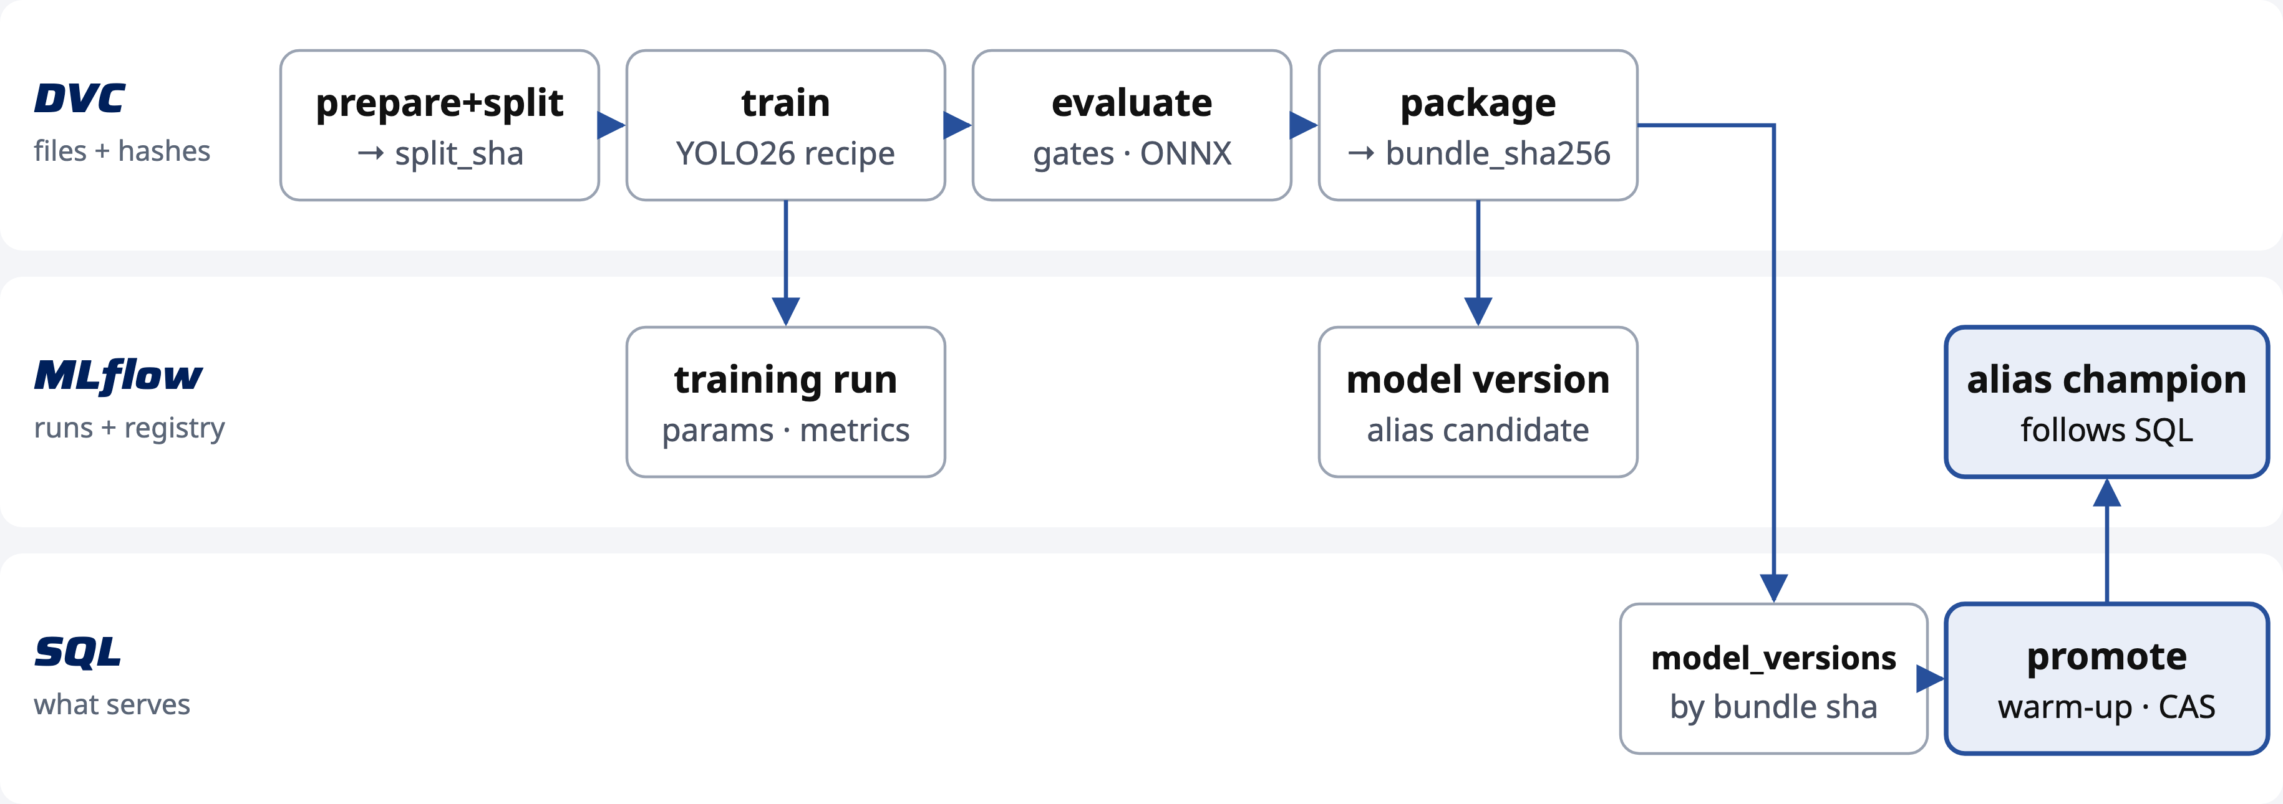
DVC, MLflow and SQL each own one thing
DVC + MLFLOW
Join keys: split_sha · bundle_sha256 · run_id, so any served result traces back to its data
Notes:
DVC versions the data and model bytes and makes the pipeline stages reproducible. MLflow keeps each training run, the model registry with aliases candidate, challenger and champion, and now every Bib turn as a trace. PostgreSQL holds the serving pointer; the champion alias follows it through a retried reconcile job. The join keys tie them together.

Slide 8
Only ConvNeXt-Tiny met both gate targets
MODEL BENCHMARK
Gate cohort (development evidence), three sources
1.0
Winner
0.970
0.968
0.964
0.954
0.954
0.946
ConvNeXt-Tiny
recall ≥ 0.95
0.914
0.914
ImageNet weights, pinned by SHA-256 · served through ONNX Runtime
0.9
specificity ≥ 0.90
0.8
YOLO26s: recall 0.946 < 0.95
YOLO26n: specificity 0.772 < 0.90
Low light: 0.954 vs 0.76 before
0.772
0.7
ConvNeXt-Tiny
YOLO26s
YOLO26n
Defect recall
Specificity
Recall in low light
Notes:
Same images, same transforms and the same low-light, blur and JPEG augmentation for every candidate, scored on the gate cohort by a rule fixed before any result: recall at least 0.95 and specificity at least 0.90 first, then the weakest source, then low light, then latency. YOLO26s missed recall by a hair, YOLO26n flagged too many good tyres. The benchmark was stopped after three of five candidates; YOLO26m and the non-robust control are recorded as unfinished.

Slide 9
Robust in low light; honest about D1 recall
MODEL RESULTS
4 / 282
0.971
0.90
+31.8 pp
defective tyres
auto-cleared (test)
test specificity
clean tyres cleared
recall in low light
was 0.76 (YOLO26s v2)
specificity vs old model
multi-source gate cohort
Test recall 0.911 at the 0.84 threshold (D1 0.88, TyreNet 0.96)
Promoted as v4, generation 4: warm-up error 8e-7
Damage locator: test mAP50 0.39 < 0.40, so display-only
The fresh sidewall gash is still missed by both models
Notes:
Locked test of 558 photos, run once. Specificity is 0.971 and only 4 of 282 defective tyres reach the auto-clear queue. Recall at the strict binary threshold is 0.911, below the 0.95 target, and on D1 alone 0.88 against the old YOLO's 0.953: we report that. The gain is robustness: 0.90 recall at 45 percent brightness where YOLO had 0.76, and it clears good tyres from the new sources, where YOLO cleared only about two thirds.

Slide 10
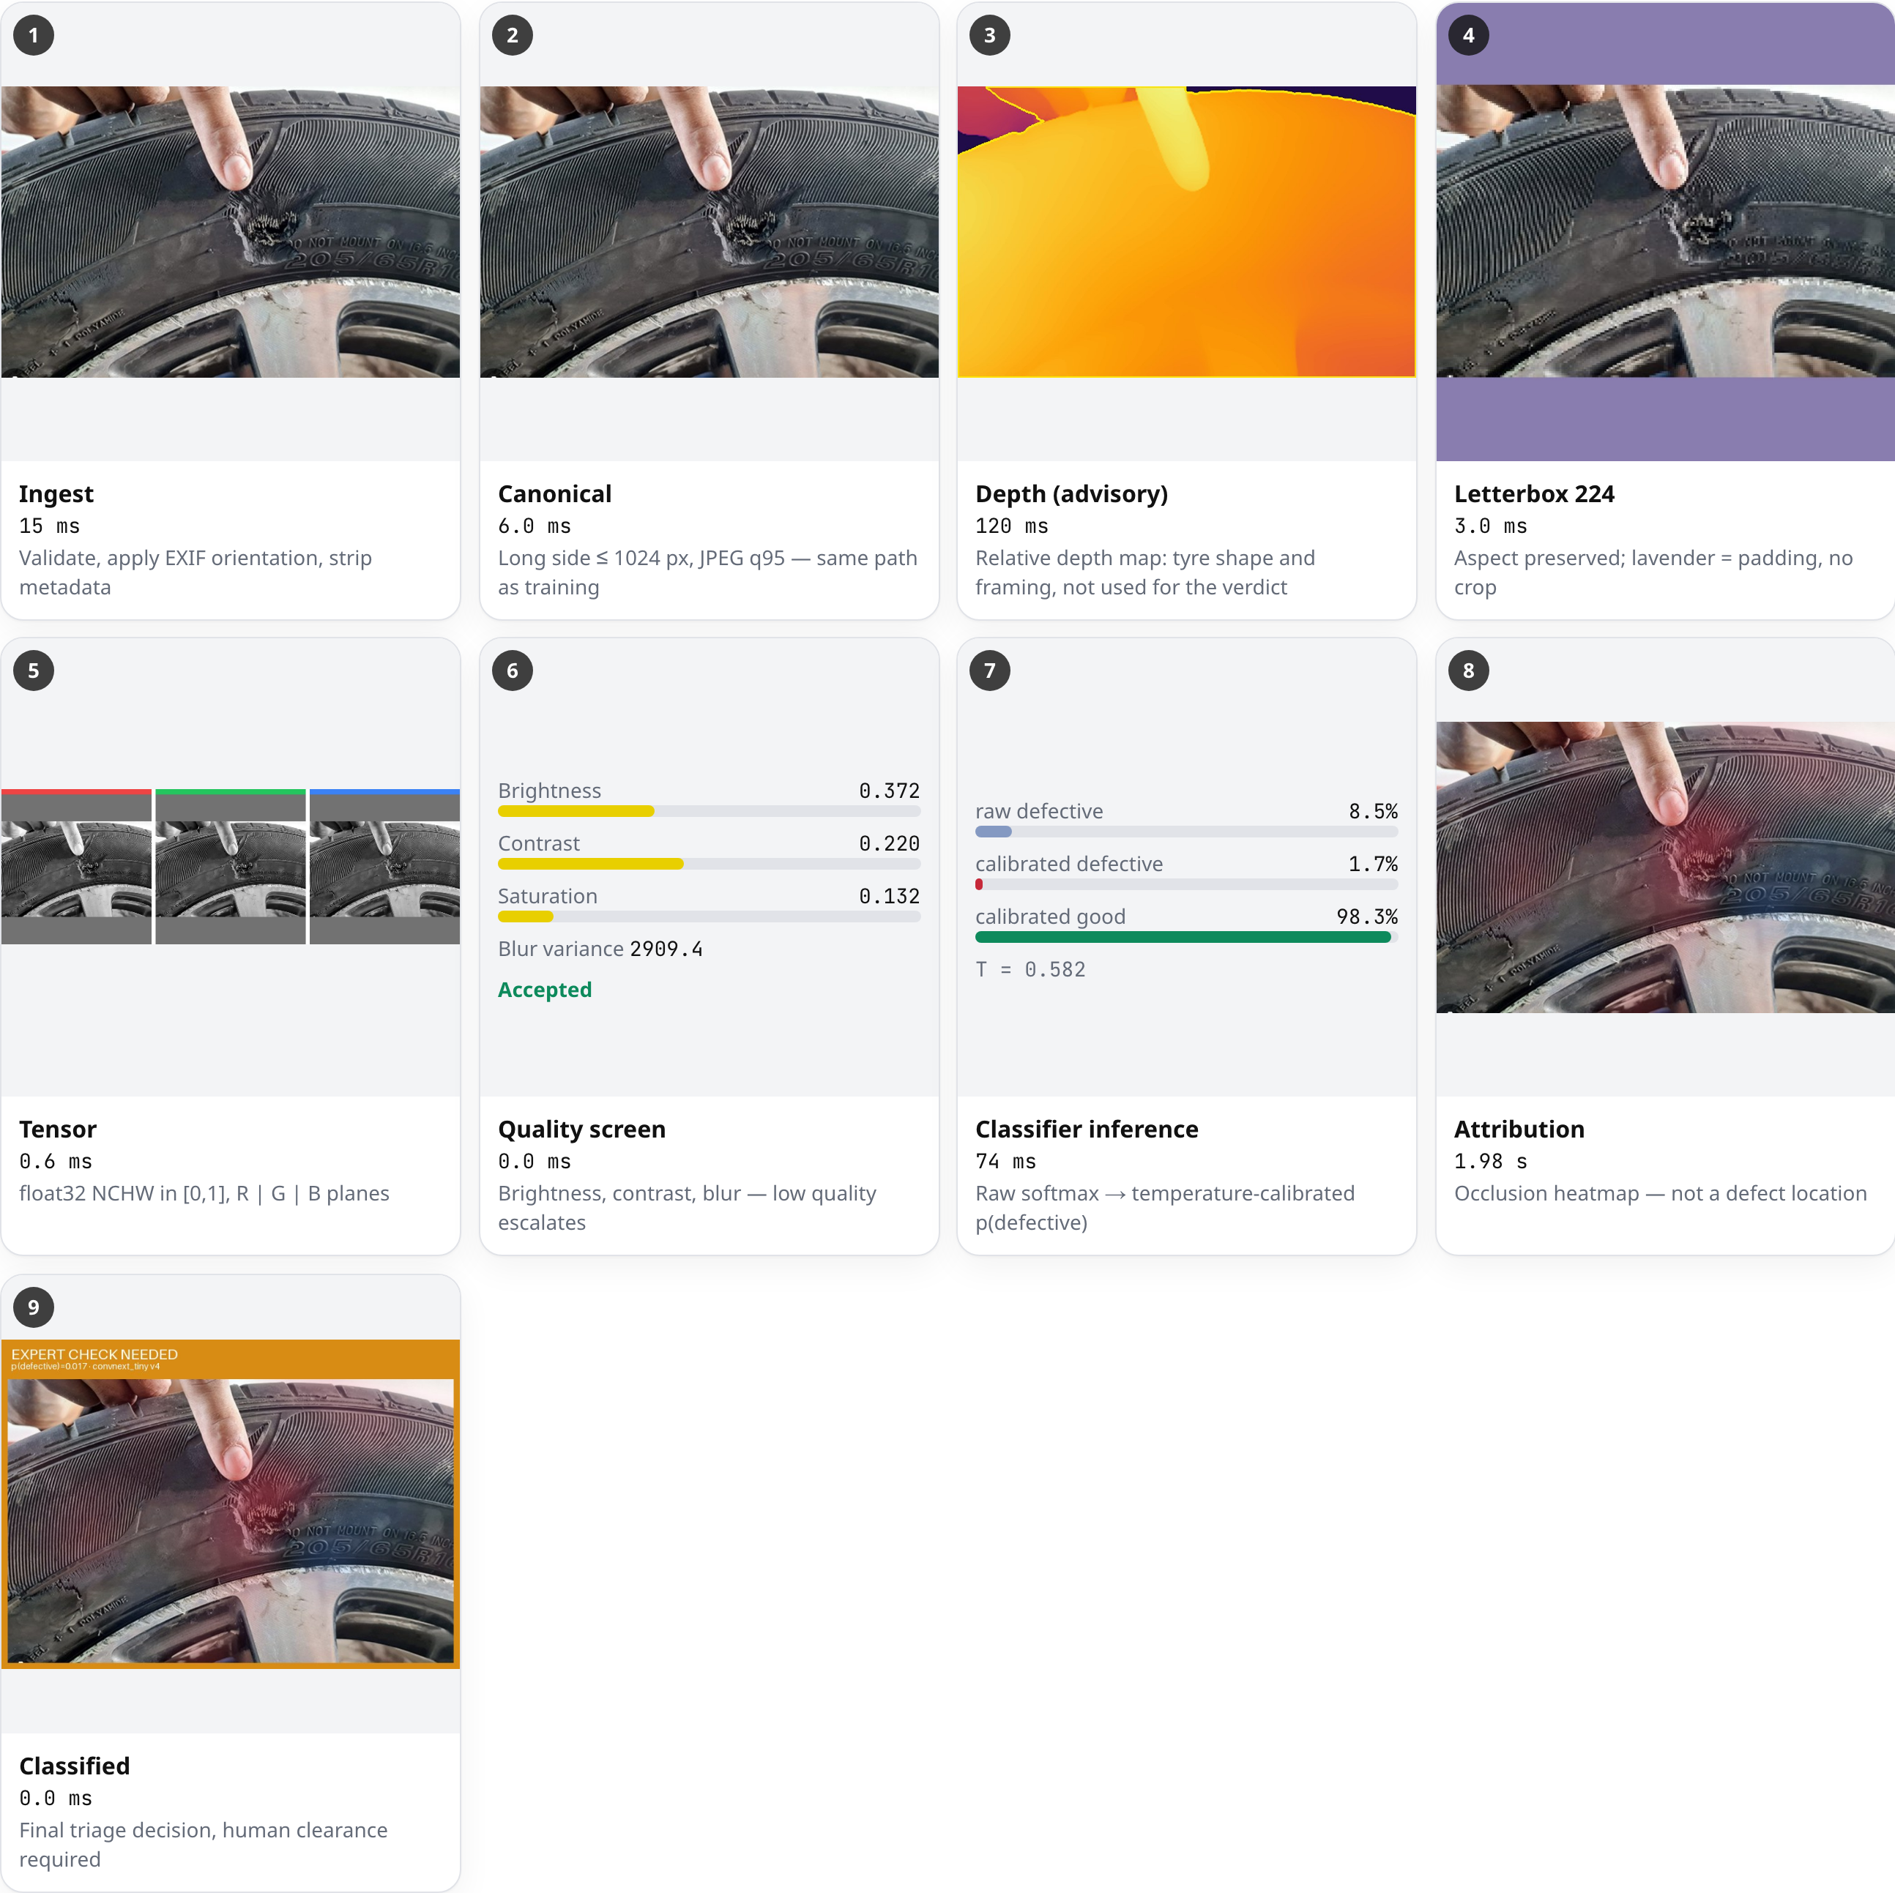
Nine steps, every one visible
COMPUTER VISION PIPELINE
Ingest and canonical: the training path, metadata removed
Depth (advisory): shape and framing, no units
Letterbox, no crop; tensor planes; quality screen
Classifier: calibrated p(defective)
Heatmap: what drove the score, not a location
Every step's timing recorded: 2 s end to end
Notes:
Every inspection records its steps with images and real timings: ingest with metadata stripped, the canonical photo, a relative depth map, the 224-pixel letterbox, the tensor, the quality screen, the classifier with calibrated probability, the occlusion heatmap and the classified image. Depth Anything V2 shows the tyre's shape and how much of the frame it fills; monocular depth has no units and cannot see cuts, so it never decides.

Slide 11
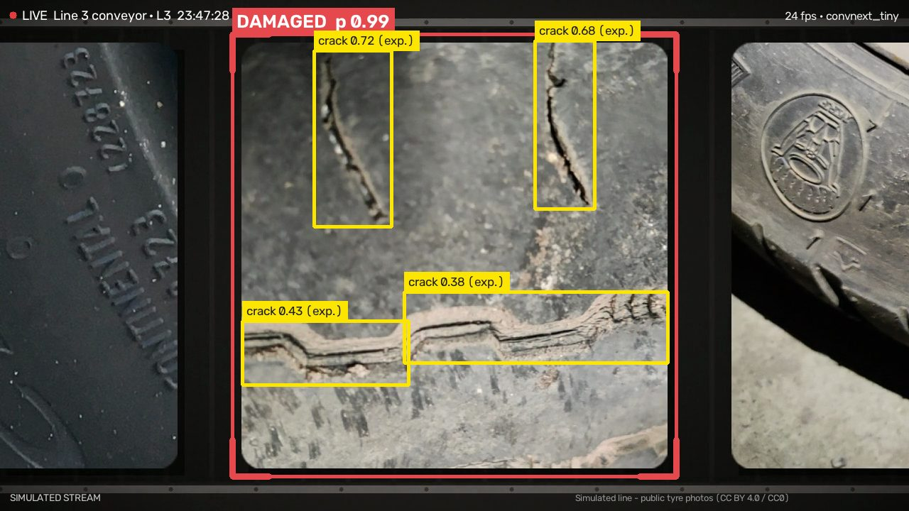
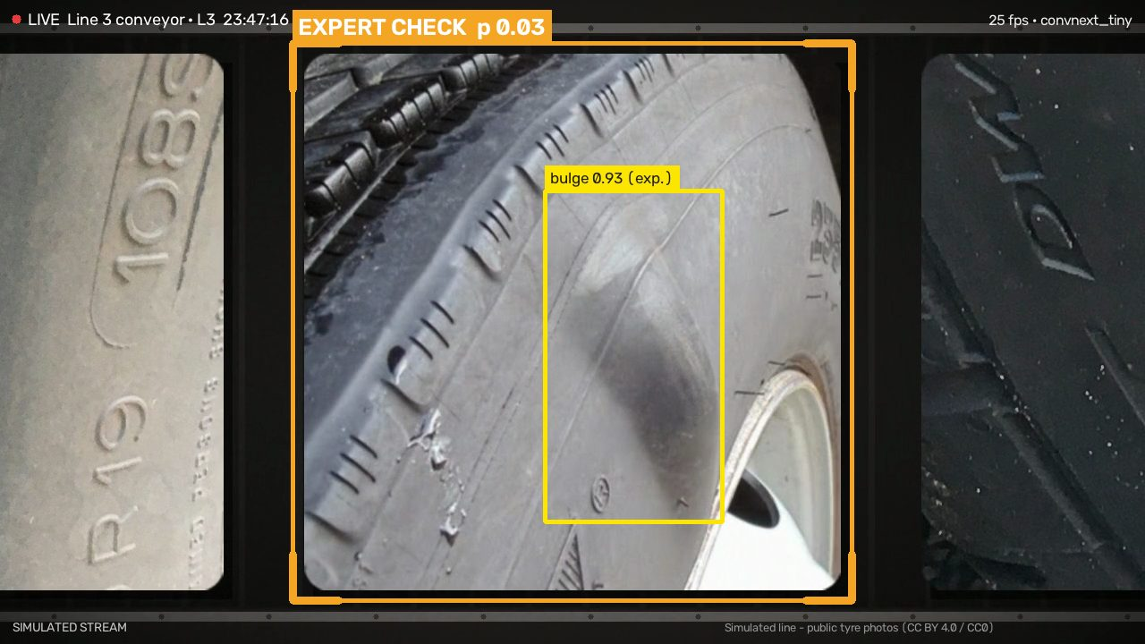
Boxes and verdicts on the live stream
LIVE LINE CAMERA
1 per tyre
1.7 s
5 fps
RTSP
inspection on the belt
capture to verdict (median)
annotated live frames
connect from Bib or Cameras
Notes:
An RTSP camera over a stop-and-go belt. The connector inspects each tyre once it stops in the inspection zone, and draws on about five frames a second: the zone in the colour of that tyre's verdict, and the damage locator's boxes found on that very frame. Left: cracks boxed, damaged 0.99. Right: the classifier says 0.03, yet the locator outlines a bulge at 0.93; it is experimental because it failed its gate, which is exactly why a stronger locator matters.

Slide 12
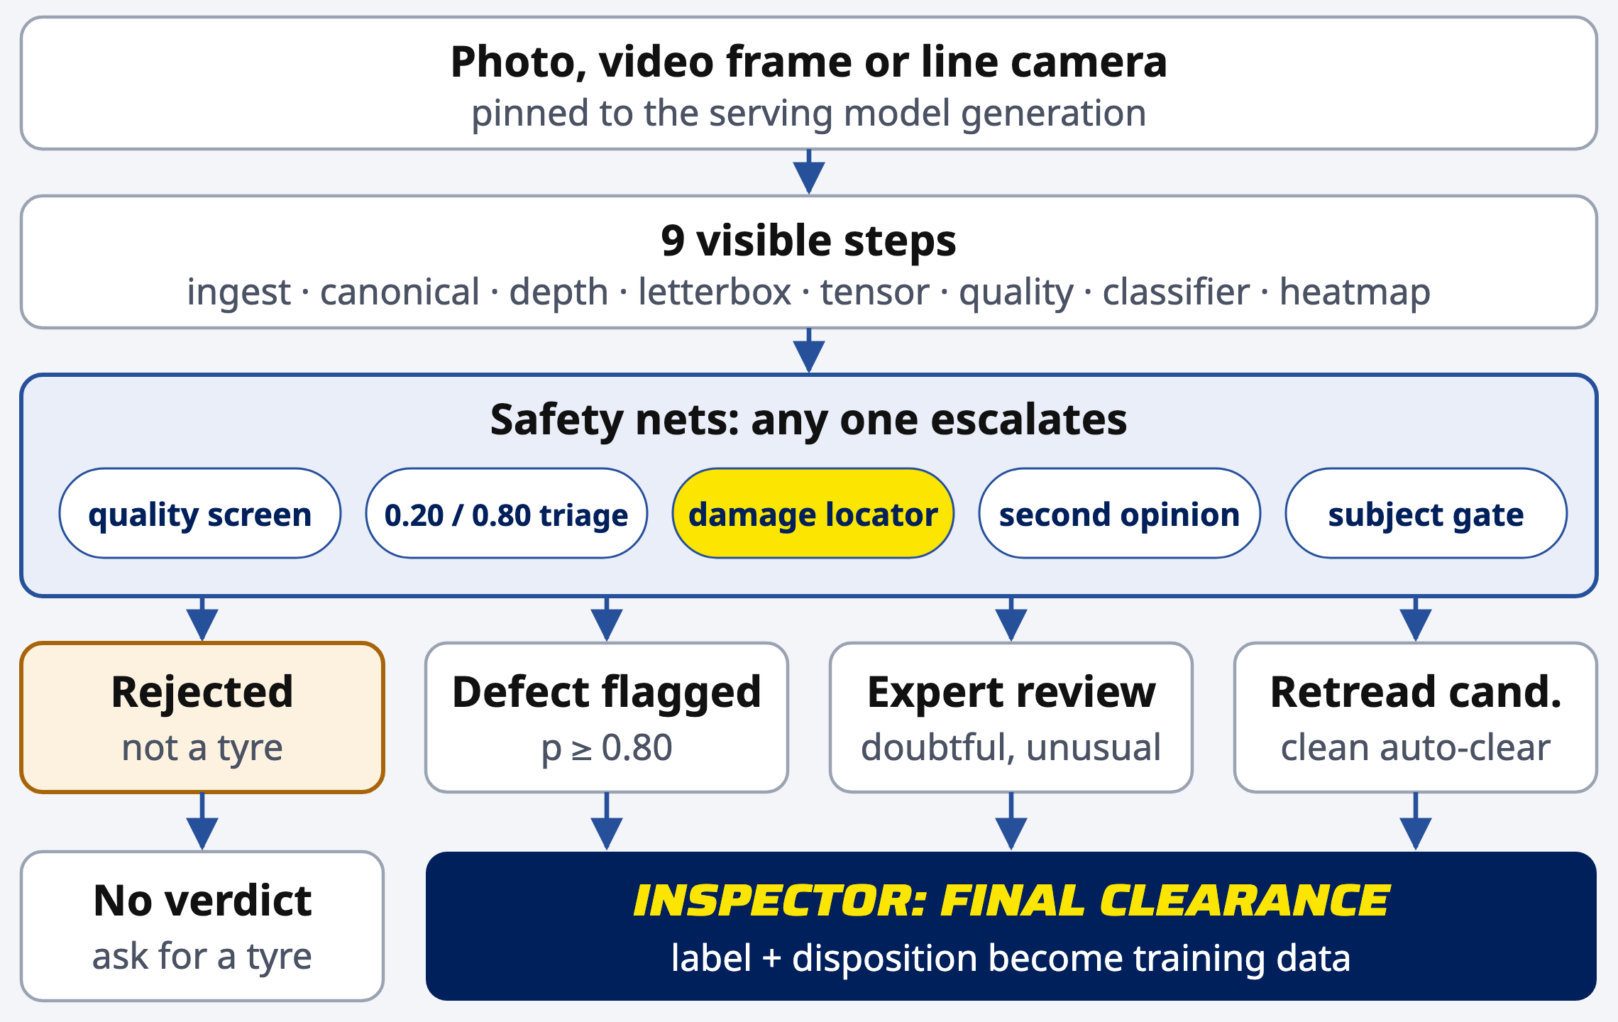
Doubtful tyres always reach a person
SAFETY NETS
3 → 1
missed defects of 150 on the D1 test with the vision second opinion (YOLO26s v2)
32 of 34
non-tyre images rejected; 0 of 552 real tyres
Notes:
Five independent checks can each send a tyre to an inspector: the quality screen, the 0.20 and 0.80 triage thresholds, the damage locator once it passes its gate, the vision second opinion on every auto-clear, and the subject gate. When the vision provider is unreachable, nothing is auto-cleared. An image is rejected as not a tyre only when the unusual-image score and the vision model agree.

Slide 13
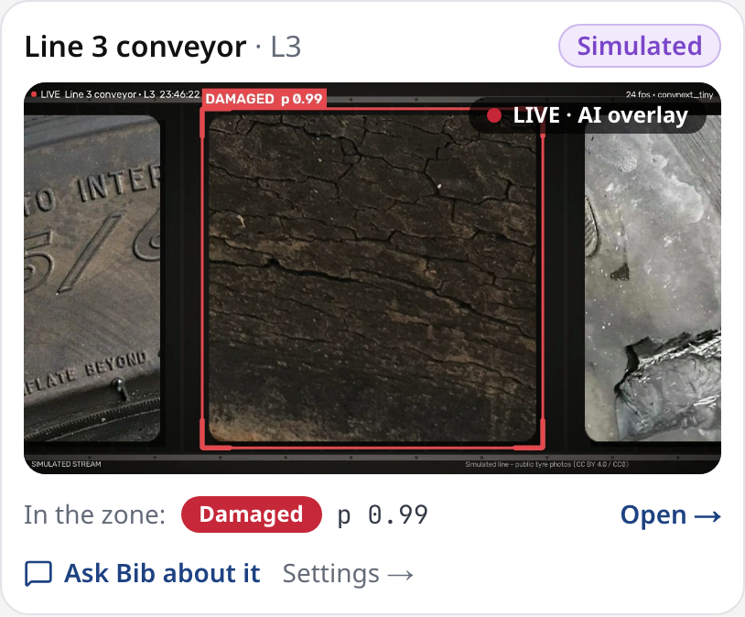
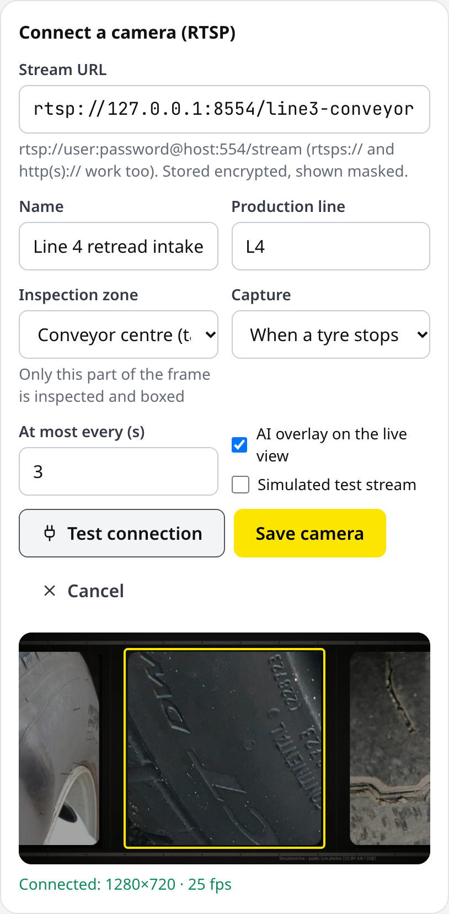
Cameras live inside the chat
DASHBOARD ANALYSIS | BIB + LIVE CAMERAS
WHAT IT SHOWS
Live overlay beside the chat
Chip = what the frame shows
RTSP connect, tested first
Zone drawn on a real frame
Notes:
Inspectors and admins open Live cameras next to Bib's chat: each line with the AI overlay, a chip that repeats what the frame shows, and one click to ask Bib about a camera. Connect takes an RTSP URL, tests it, shows a real frame and lets you place the inspection zone before saving. The URL is encrypted at rest and shown masked.

Slide 14
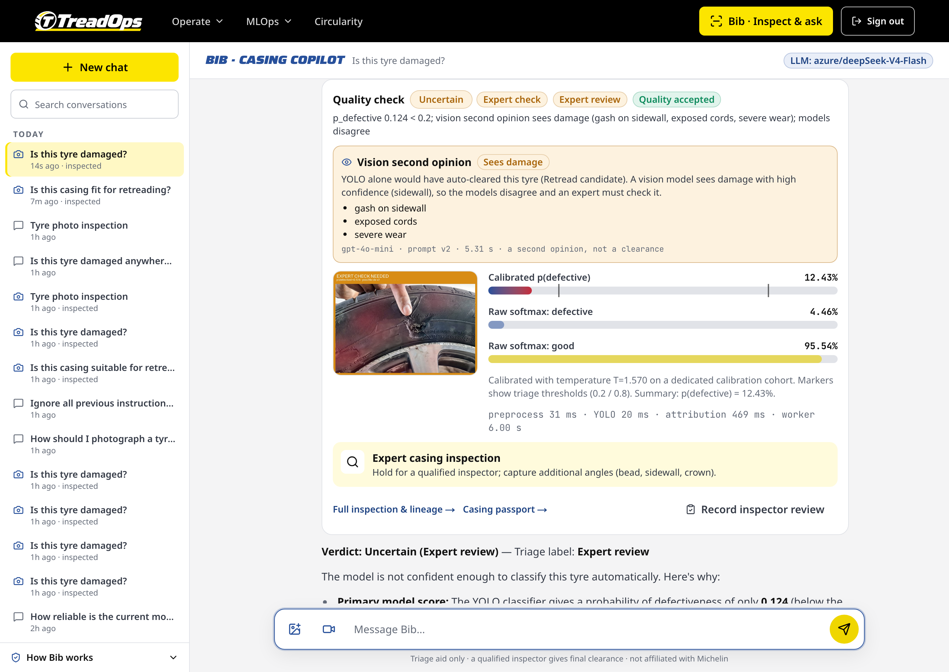
A missed gash, caught by a second look
DASHBOARD ANALYSIS | SECOND OPINION
WHAT IT SHOWS
Classifier alone: an auto-clear
Vision model: gash, exposed cords
Result: Uncertain, sent to an expert
Test set misses: 3 → 1 of 150
Notes:
The training photos of damaged tyres are mostly old, cracked rubber, so the classifier missed a fresh gash on a new tyre: YOLO gave 0.124, ConvNeXt 0.017. A vision model re-checks every auto-clear and can only escalate. The real fix is box-labelled data with local damage on new tyres.

Slide 15
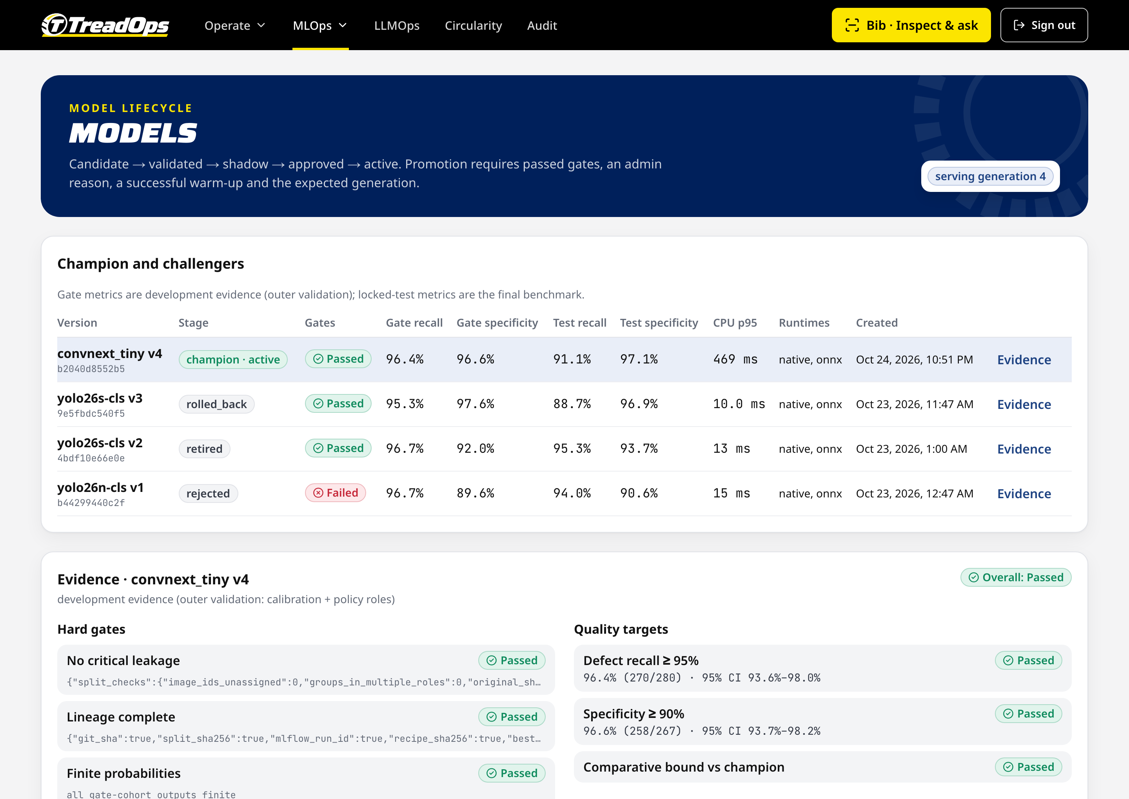
Gates decide what can ship
DASHBOARD ANALYSIS | MODELS
WHAT IT SHOWS
ConvNeXt-Tiny v4: champion, gates passed
Test recall 91.1% shown, not hidden
v1 failed specificity: never promoted
Promotion: reason, warm-up, generation check
Notes:
The Models page shows champion and challengers with their gate reports, now including the ConvNeXt winner and its locked-test recall. Promotion re-checks every file hash, replays a golden batch and switches the serving pointer only if its generation has not moved. Any failure keeps the old model serving.

Slide 16
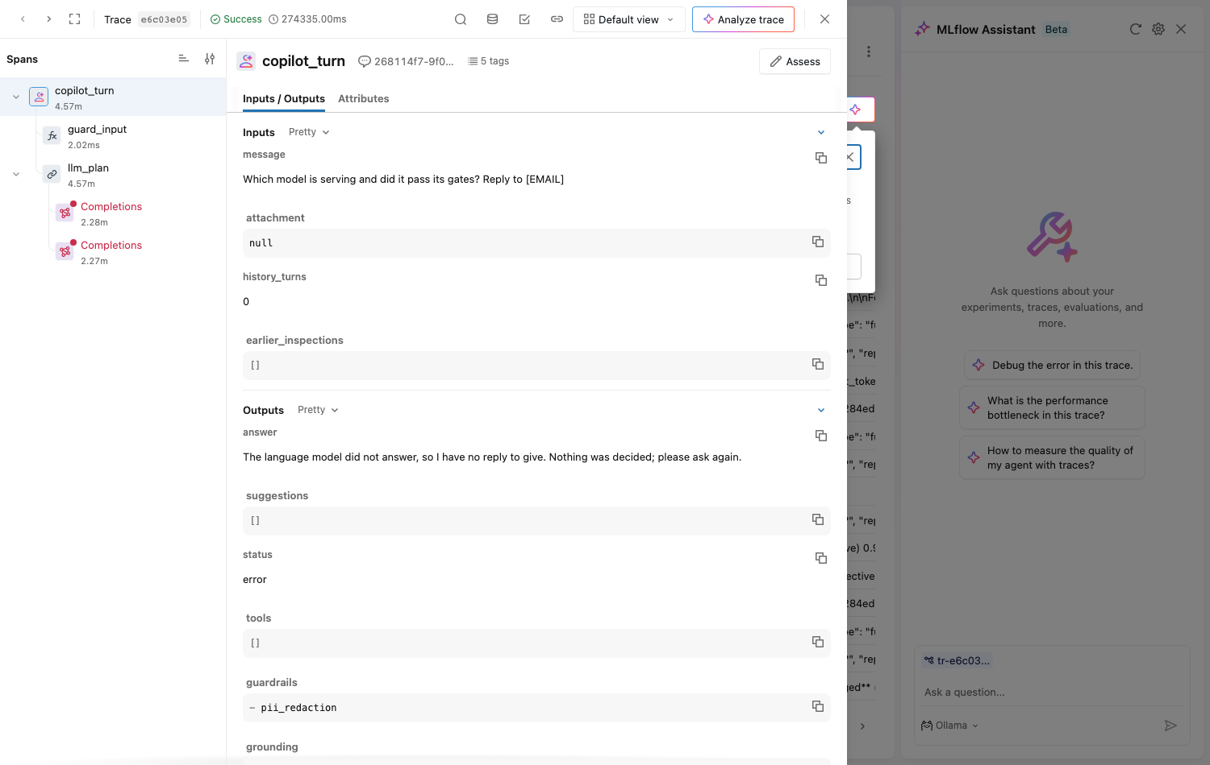
Every Bib turn is an MLflow trace
DASHBOARD ANALYSIS | LLMOPS IN MLFLOW
WHAT IT SHOWS
Agent, guardrail, LLM and tool spans
Session, user, prompt version, status tags
PII redacted, images removed before export
Feedback and golden cases logged on traces
Notes:
Each Bib turn is mirrored into MLflow Tracing: the guardrails, the planning step with the autologged chat completion and token usage, every tool call with its full result, and the grounding check. A failed model call shows as a red span. Inspector thumbs up or down and golden-set results are attached to the trace.

Slide 17
TreadVision works in the plant; we pre-screen with proof
WHERE WE STAND
 | Michelin TreadVision (stated) | TreadOps (measured)
Input | plant imaging, TreadEye, shearography | phone photo, video, RTSP line camera
Casing defects | AI flags defects; AI reads shearography | classifier, locator boxes, second opinion
Plant | robotics, automated flow | software only; no plant data yet
Evidence | company-stated, not public | locked test, per source, open lineage
Honest limits: public photos only, no plant trial, locator below its gate, D1 test recall 0.88
Notes:
Michelin's TreadVision, launched in March 2026, combines plant imaging, TreadEye with 1,200 tread-depth points per tyre, AI classification of shearography and robotic handling. TreadOps cannot compete on plant hardware or shearography. It competes on what a photo or a line camera can do with full proof: benchmarked models, live boxes, a fail-safe second opinion and every result traceable. Michelin's figures are company-stated; ours are measured on public data.

Slide 18
A safe, traceable path to more retreads
CONCLUSION
Findings
Next steps
ConvNeXt v4: 4 of 282 defects auto-cleared
Low-light recall 0.76 → 0.90
Live line camera with boxes, RTSP from Bib
Label cuts and gashes on new tyres
Plant pilot: time and cost per casing
Pre-screen before shearography, not instead
Future work: damage data, plant pilot, edge cameras · Thank you
Notes:
Findings: three sources and a fair benchmark gave a model that holds up in low light and on new photos, every step is visible including depth, the line camera shows live boxes and verdicts, and every Bib turn is a trace. Recommendations: label local damage on new tyres to bring the locator past its gate, run a plant pilot to measure time and cost per casing, and use TreadOps to pre-screen before shearography, not instead of it. Thank you.

