Slide 1

DelayLens: Agentic Big Data Analytics
for Delivery-Delay Intelligence using
Hadoop MapReduce, MongoDB and LangGraph
Continuous Assessment 3 (Big Data Case Study Analysis)
Subject: Big Data Analytics
Submitted By:
Arav Saxena
PRN: 23070126018
Mahi Laddha
PRN: 230701260169
Artificial Intelligence and Machine Learning

Slide 2
PROBLEM & OBJECTIVES
54.8% of DataCo orders arrive late
65,752
Find where and why orders are late
Test which promise changes would fix it
Give staff an AI copilot for instant answers
orders analysed
180,519
order lines
3 years
Jan 2015 to Jan 2018
DelayLens | 2 / 10

Slide 3
DATASET
DataCo Smart Supply Chain data
180,519
469,977
order lines, 53 fields (34 kept)
web access-log lines
Mendeley Data
3,249
public source, three files
duplicate log lines removed
Spanish country and state names translated
Late = actual days above promised days (100% match)
DelayLens | 3 / 10

Slide 4
ARCHITECTURE AND TOOLS
Six tools, one pipeline
1
2
3
4
5
6
Clean
Store
Process
Serve
Ask
See
›
›
›
›
›
pandas
HDFS 3.5.0, 16 MB blocks
MapReduce on YARN
MongoDB 7, FastAPI
LangGraph agent
Next.js 16 dashboard
The copilot can send a new MapReduce job back to the cluster
DelayLens | 4 / 10

Slide 5
HADOOP IMPLEMENTATION
33 MapReduce jobs, one algorithm
33
65,752
2,600x
6.2x
jobs on YARN
orders rolled up from 180,519 lines
smaller shuffle with a combiner
run time for 64x more data
Job A turns order lines into one record per order
25 jobs reuse one map, combine, reduce pattern
Native Java is 14% to 28% faster than Streaming
Hadoop, MongoDB and pandas agree: 0 mismatches
DelayLens | 5 / 10

Slide 6
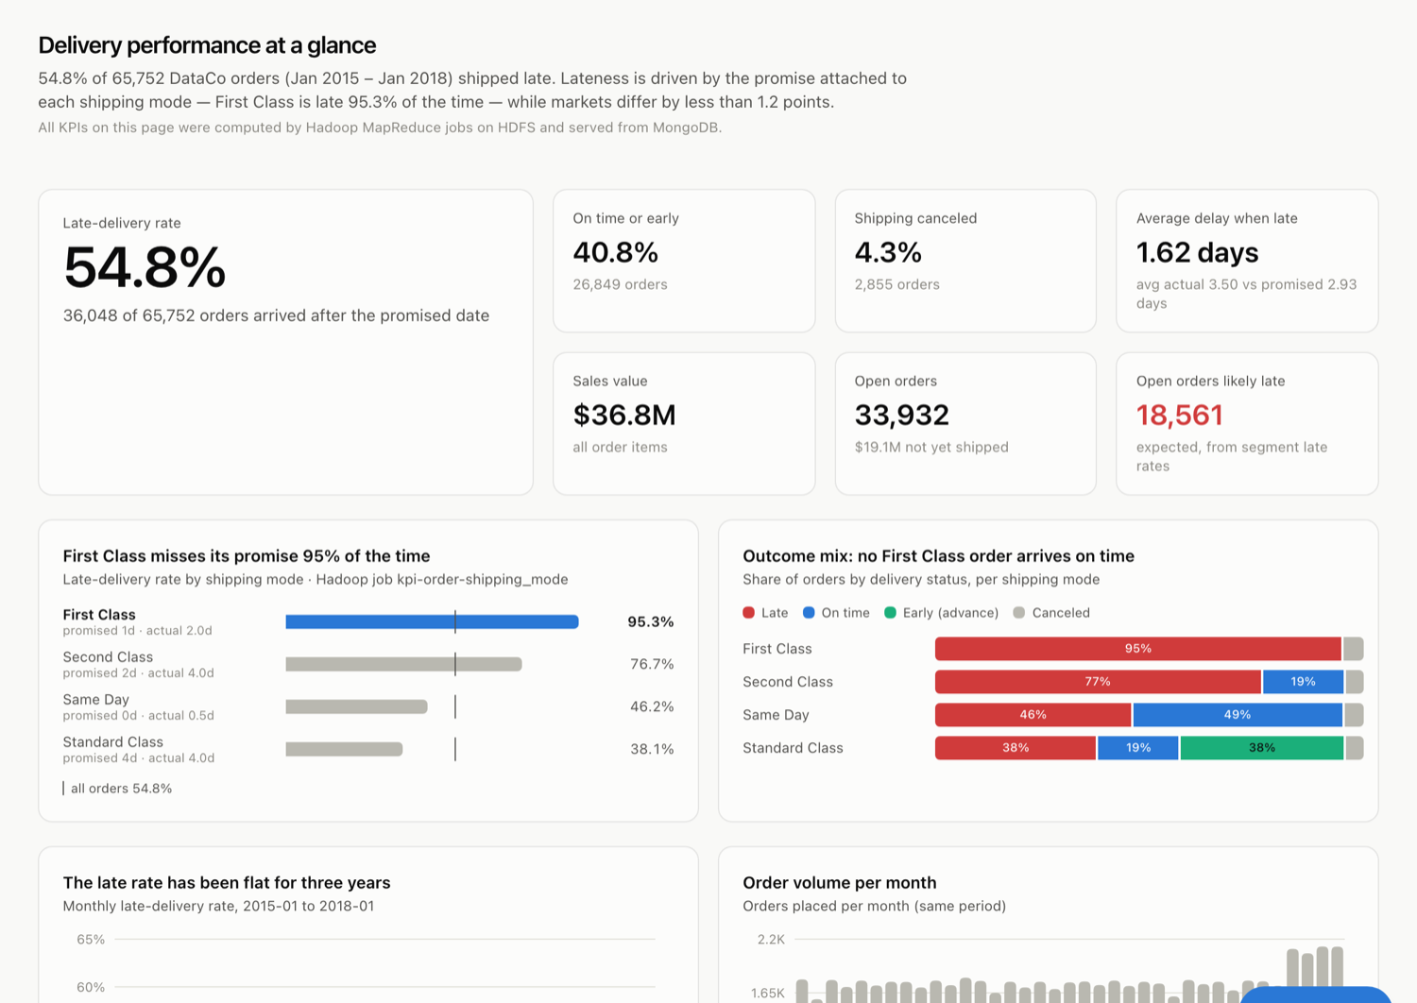
DASHBOARD ANALYSIS | OVERVIEW
54.8% late, flat for 3 years
WHAT IT SHOWS
36,048 of 65,752 orders late
Late rate flat across 37 months
Every market within 2 points of the average
33,932 open orders, 18,561 expected late
DelayLens | 6 / 10

Slide 7
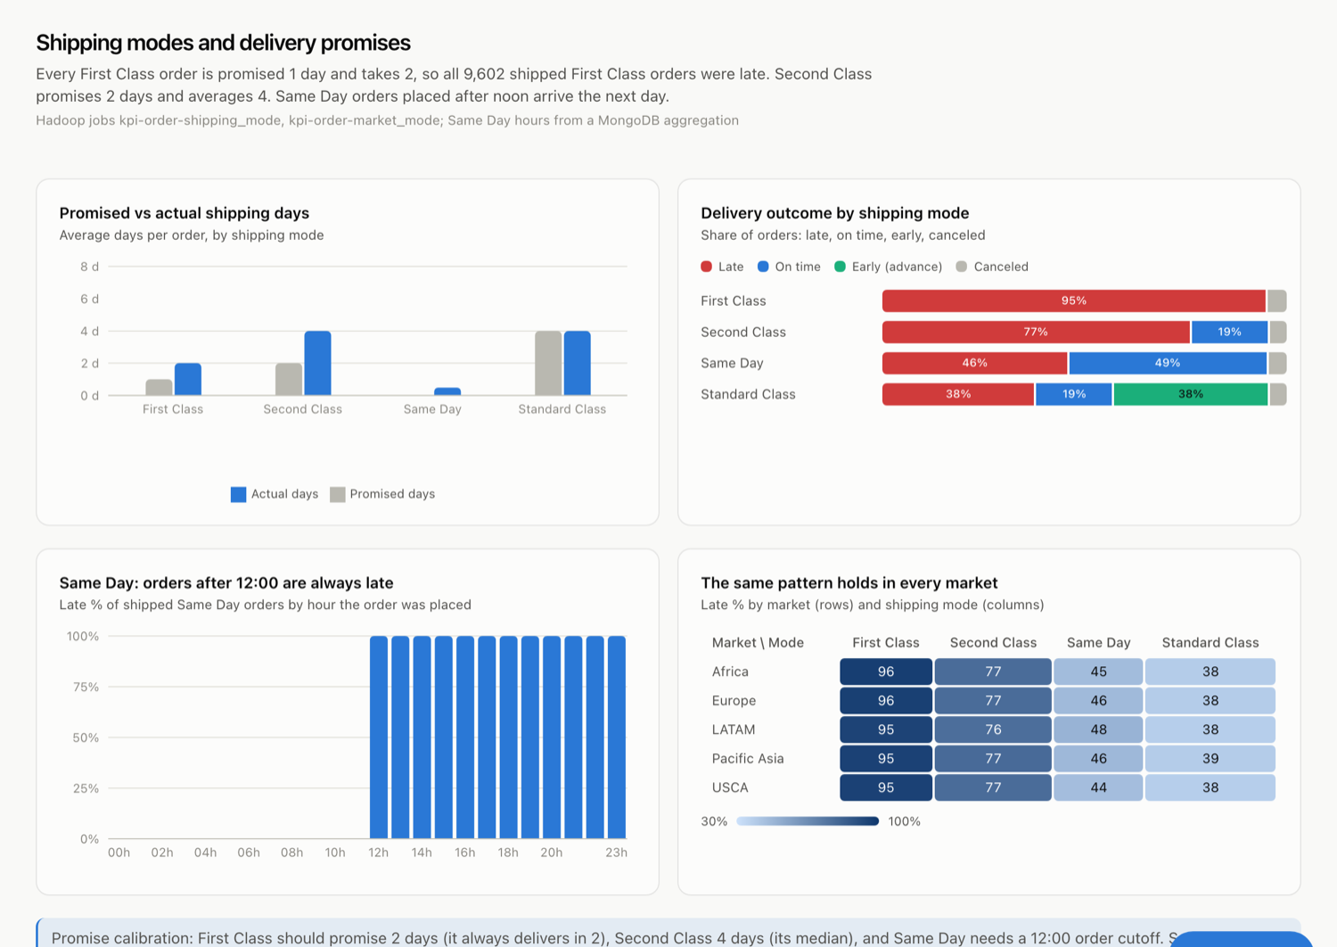
DASHBOARD ANALYSIS | SHIPPING MODES
Shipping mode decides lateness
WHAT IT SHOWS
First Class: promised 1 day, takes 2, 95.3% late
Same Day orders after 12:00 are always late
Same pattern in every market
Standard Class is the most reliable: 38.1%
DelayLens | 7 / 10

Slide 8
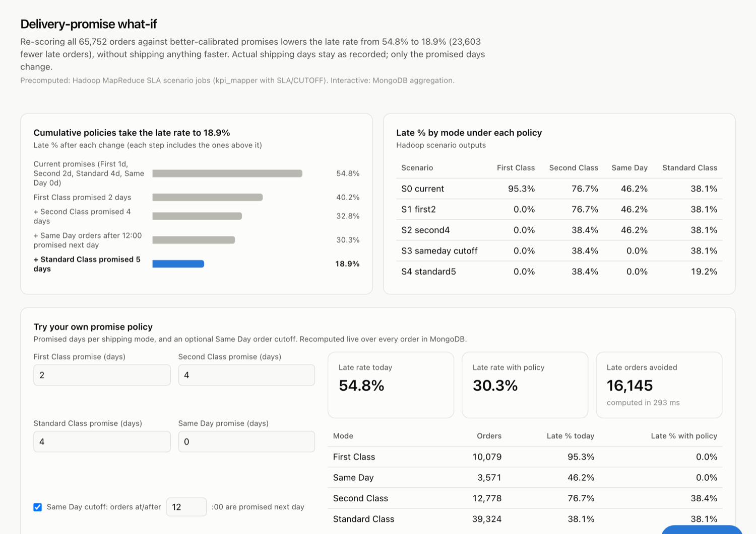
DASHBOARD ANALYSIS | PROMISE WHAT-IF
Better promises: 54.8% to 18.9%
WHAT IT SHOWS
23,603 fewer late orders, no faster shipping
Live simulator: 30.3% in 293 ms
First Class 2 days, Second Class 4 days, Same Day cut-off 12:00
11,674 open orders ($6.58M) at risk
DelayLens | 8 / 10

Slide 9
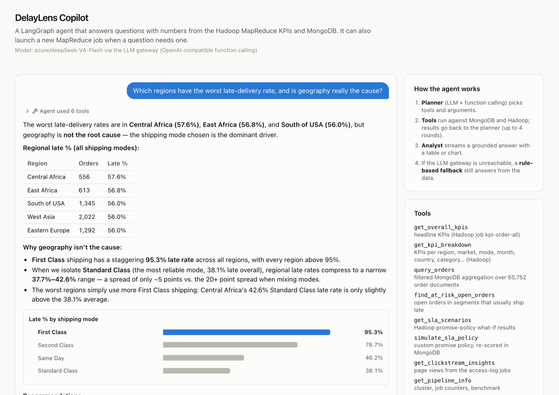
DASHBOARD ANALYSIS | COPILOT
The copilot explains the cause
WHAT IT SHOWS
Asked: is geography the cause?
Agent used 6 tools and drew a chart
Answer: shipping mode, not region
8 of 8 test questions correct, 4 to 7 s each
DelayLens | 9 / 10

Slide 10
CONCLUSION
Fix the promise, not the map
Findings
Recommendations
Delays follow shipping-mode promises
Hadoop + MongoDB + copilot work end to end
Copilot: 8 of 8 answers correct
Promise First Class in 2 days
Promise Second Class in 4 days
Contact the 11,674 at-risk open orders
Future work: multi-node cluster and live data feeds · Thank you
DelayLens | 10 / 10

