Slide 1
New Era of Smart Shops
Implemented by InSight Team: Yuliya Durova U1710104 (002)
Sevara Abdullaeva U1710059 (001)
Mukhammad Valiev U1710172 (004)
Madina Akhmadjanova U1710182 (002)
Javlonkhuja Eshonkhodjaev U1710206 (003)
Bekhzod Aliev U1710270 (004)
Notes:
Юля

Slide 2
The World We Faced Today
Let’s integrate payment system to smartphone
Everything is on a distance of one click
We shift from cash to credit cards
Credit Cards are easy to use. But still we need to carry it.
Notes:
Юля

Slide 3
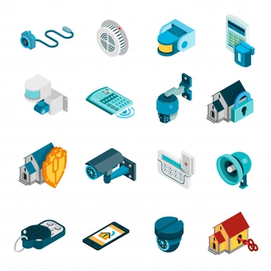
Intelligent digital transformation
[X] + IICT = [Y]
Ordinary shops
Sensors, cameras, gateways, cloud computing, wireless technologies
IoT Smart Shop System
Shop
Notes:
Мадина

Slide 4
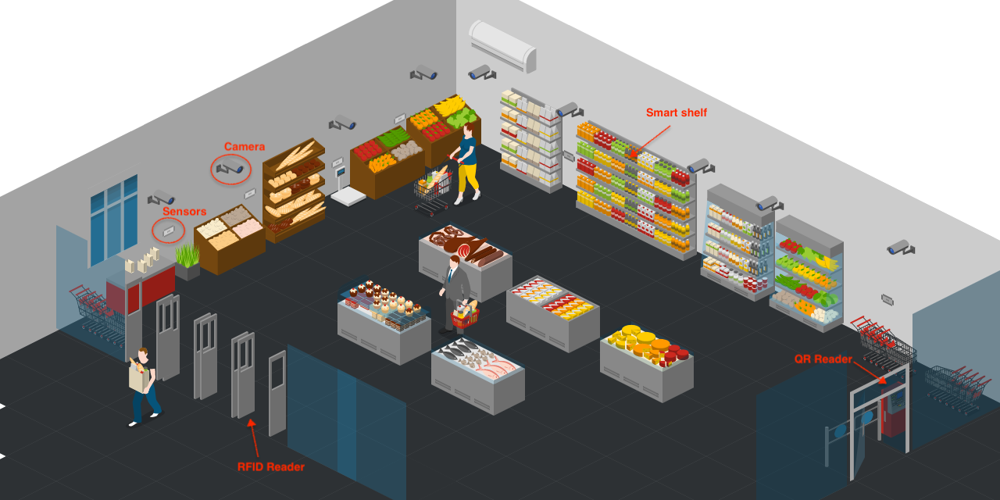
Smart Shop
Notes:
Мадина

Slide 5
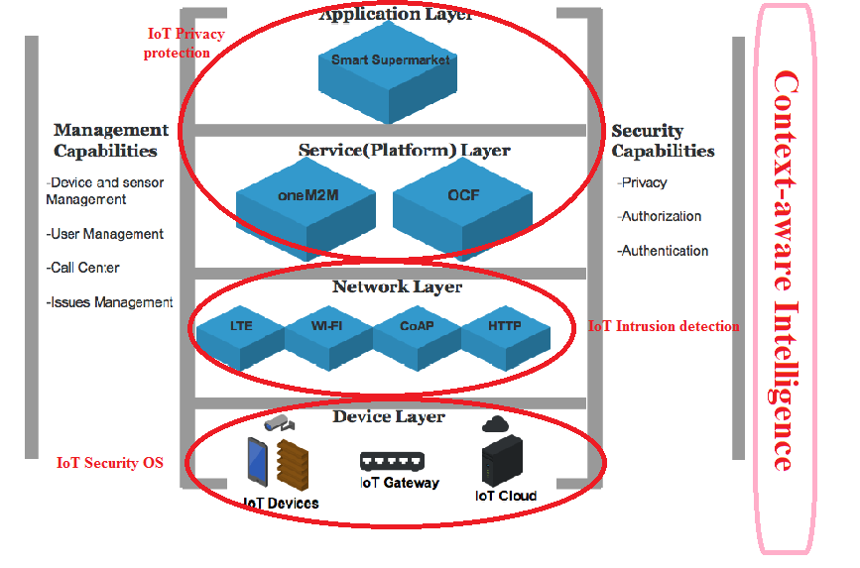
IoT end-to-end network architecture
Device Layer - IoT Security OS
Network Layer - IoT Intrusion detection
Service and Application Layers - IoT Privacy protection
Notes:
Жовик

Slide 6
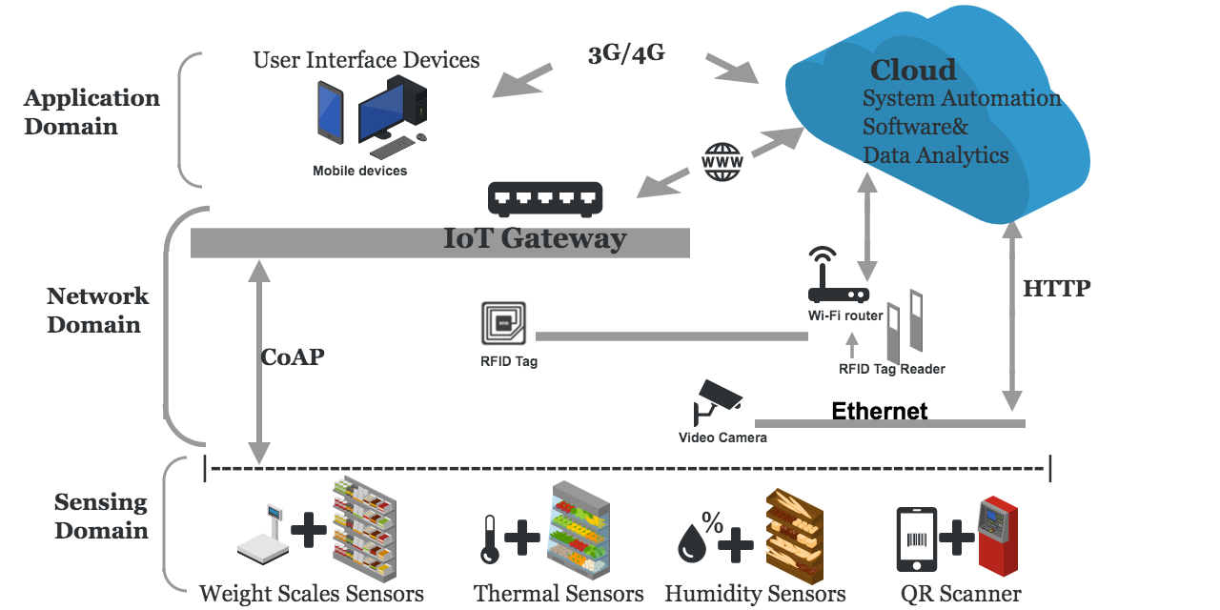
Open Service Platform Architecture
ZigBee connects sensors with gateway
RFID checks tags on RF communication and connects to the cloud through Wi-Fi router
Cameras are connected to local area network and streaming directly to the cloud
Notes:
Юля

Slide 7
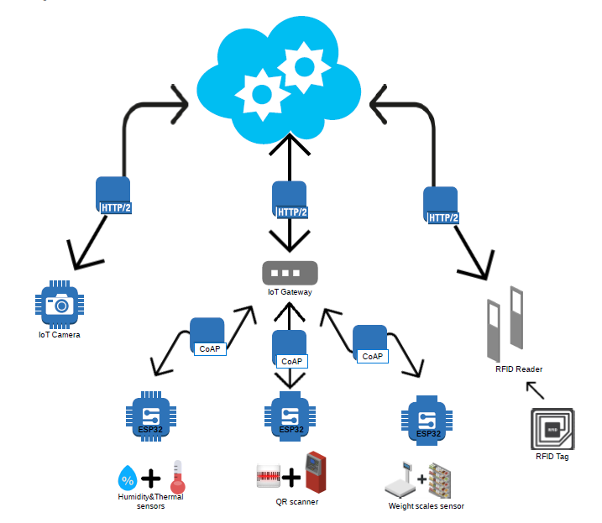
Protocol Stack
HTTP/2.0 for communication with server.
CoAP for communication between sensors and the gateway point .
Notes:
Севара

Slide 8
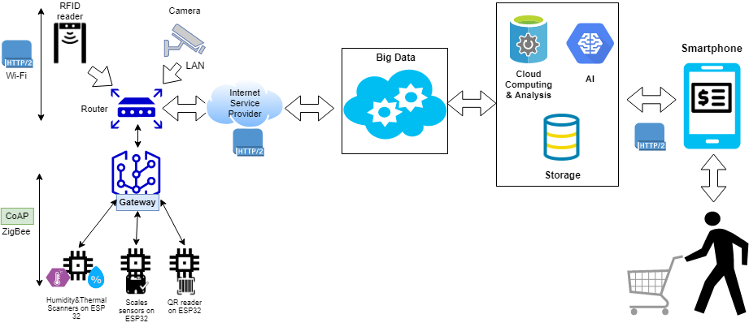
End-to-end IoT service scenario

Slide 9
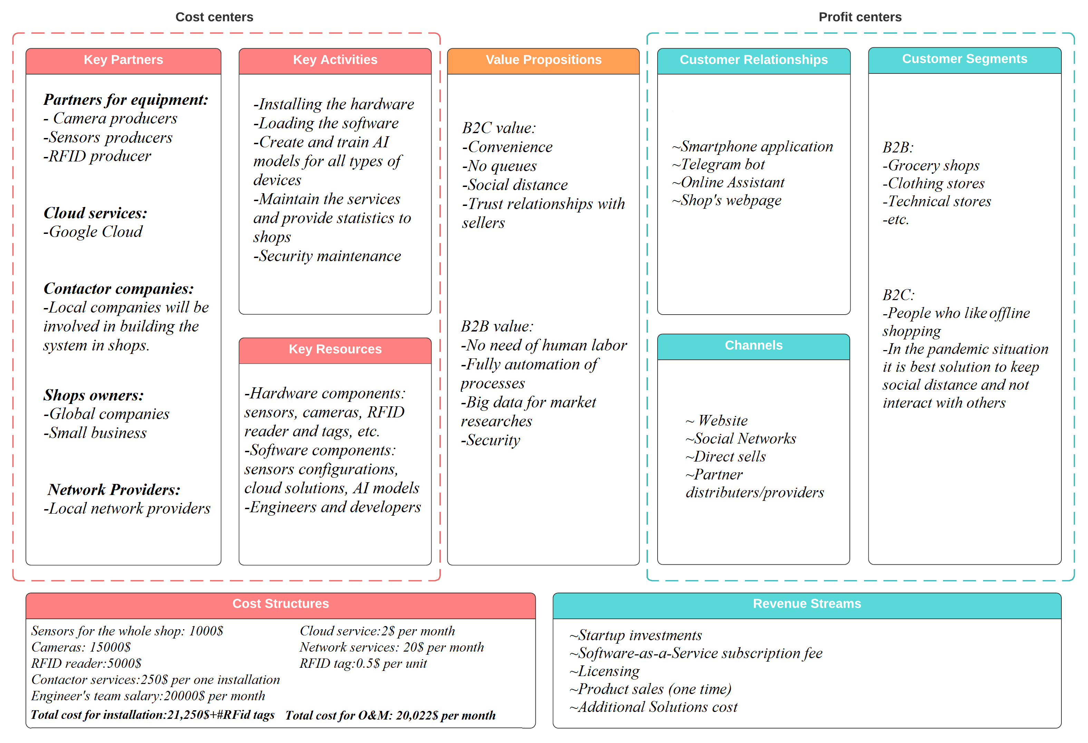
Business model

Slide 10
Service Model
1
Weight Sensors
1
2
AI, ML and DL integration
2
3
IoT-as-a-service
4
Staffless interaction
5
Thermal and humidity sensors

Slide 11
DEMO

Slide 12
Thank you!

