Slide 1
WanderVision
AI-Powered Travel Planning & Itinerary Assistant
Hybrid RAG · Seven specialist agents · Suitability ML · LLM-as-judge · Feedback loop
Capstone Project 2 · Prodapt PU Bootcamp · <Participant name>

Slide 2
Problem Statement
• Travel platforms hold thousands of reviews, ratings and trip records, but agents search them by hand
• Recurring questions take tens of minutes each:
  – "A 5-day beach, sightseeing and food trip: what similar trips were rated highly?"
  – "Travelers like these are choosing between two destinations: which did similar travelers rate better?"
  – "Limited budget, but they want highly rated activities: what should we recommend?"
• Answers vary between agents, are rarely backed by evidence, and ignore budget and season feasibility
WanderVision · AI-Powered Travel Planning & Itinerary Assistant

Slide 3
Business Need
Speed
Seconds, not tens of minutes
per enquiry
Trust
Every recommendation cites
real historical reviews
Feasibility
Budget, trip length and season
checked before proposing
Personalization
Match on what similar
travelers loved, not averages
Safety
Injection, PII and
unsafe-request guardrails
Improvement
Feedback re-ranks results and
grows the knowledge base
WanderVision · AI-Powered Travel Planning & Itinerary Assistant

Slide 4
Solution Overview
A microservice + UI that turns a natural-language enquiry into an evidence-backed plan
Traveler DNA
8-dimension preference profile
inferred from free text
Hybrid RAG
BM25 + embeddings, RRF fusion,
cross-encoder, metadata filters
Seven specialist agents
Guardrail → … → Critic
with a revision loop
Suitability ML
P(rating ≥ 4), AUC 0.92
with factor explanations
Search past trips
Filter by destination, trip type,
rating and spending style
Travel twins
Nearest historical travelers
and their favourite places
Budget check
Cost by tier, flights, max days,
season and length checks
Feedback loop
Ranking boosts + guarded
new experiences
WanderVision · AI-Powered Travel Planning & Itinerary Assistant

Slide 5
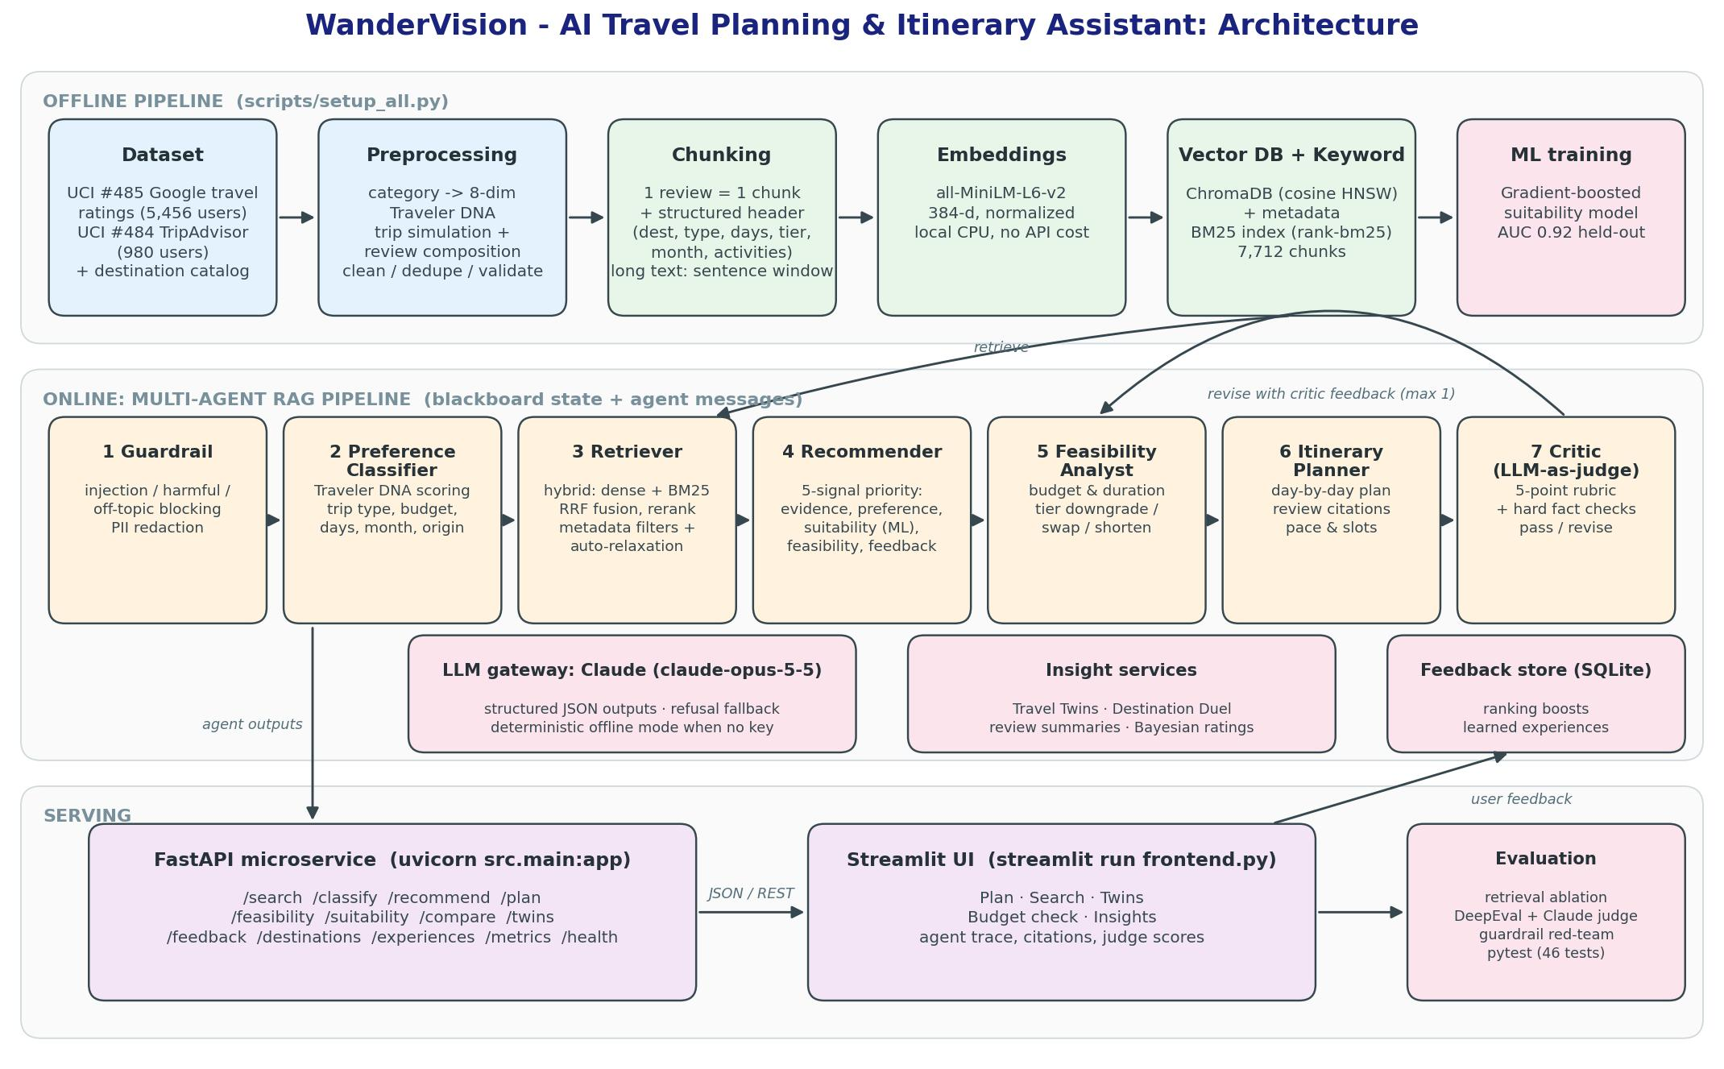
Architecture
WanderVision · AI-Powered Travel Planning & Itinerary Assistant

Slide 6
Data Flow: from UCI ratings to an answer
Dataset
UCI #485 (5,456 users)
UCI #484 (980 users)
category ratings only
Preprocess
categories → 8-dim DNA
simulate trips + reviews
clean · dedupe · validate
Chunk
1 review = 1 chunk
+ structured header
7,712 chunks
Embed + Index
MiniLM 384-d → ChromaDB
BM25 keyword index
metadata for filters
Retrieve
dense + BM25 → RRF
cross-encoder rerank
priority scoring
Agents → API → UI
recommend · plan · judge
FastAPI endpoints
Streamlit UI
• The source data has real traveler preferences but no review text, destinations or dates, so trips are simulated from each traveler's real preference profile (seed 42, fully documented)
• Rating and review text come from one satisfaction model, so text, stars and metadata agree
WanderVision · AI-Powered Travel Planning & Itinerary Assistant

Slide 7
Technology Stack
LLM | Claude Opus 5.5 (claude-opus-5-5): structured JSON outputs, refusal fallback, offline fallback
Embeddings | sentence-transformers all-MiniLM-L6-v2 (local, 384-d)
Reranker | cross-encoder ms-marco-MiniLM-L-6-v2
Vector DB | ChromaDB 1.0.20 (cosine HNSW + metadata filters) · BM25 (rank-bm25)
ML | scikit-learn HistGradientBoosting (itinerary suitability)
Backend / UI | FastAPI + Pydantic + Uvicorn · Streamlit + Plotly
Evaluation | DeepEval (Claude as judge) · custom retrieval/guardrail suites · pytest
Storage | SQLite (feedback, request log) · CSV corpus · JSON catalog
WanderVision · AI-Powered Travel Planning & Itinerary Assistant

Slide 8
Agent Workflow
Blackboard state + addressed messages · every step timed and shown in the UI
1 Guardrail
injection · harmful · off-topic · PII
2 Preference
Traveler DNA · trip type · budget
3 Retriever
hybrid search · filter relaxation
4 Recommender
5-signal priority · activities
5 Feasibility
downgrade tier · swap · shorten
6 Itinerary
day plan · review citations
7 Critic
LLM-as-judge · 5-point rubric
• Pink cards use Claude (with a deterministic fallback); sand cards are deterministic code (facts, money, ranking)
• Critic below 3.5/5 → structured feedback (e.g. must_cover: nature, tier: budget) → Feasibility → Itinerary → Critic again (max 1 revision)
• The Critic's LLM scores are capped by hard checks: citation validity, budget status, day count, preference coverage
WanderVision · AI-Powered Travel Planning & Itinerary Assistant

Slide 9
Demo
Live: uvicorn src.main:app · streamlit run frontend.py
• Query: "A couple wants a 5-day trip focused on beaches, sightseeing and local food in December, budget $3000, flying from India"
  – Segment: Mid couple, Foodie + Beach + Culture → top pick Bangkok, feasible, judge 4.8/5, 100% of activities cited
• Walkthrough: Plan a trip tab (interest radar, itinerary with past-review popovers, cost breakdown, how-it-was-made trace)
• Travel twins tab: a museums and history lover, with the closest past travelers and where they were happiest
• Budget check tab: Reykjavik on $3,000 from South Asia → over budget, cost by tier, satisfaction drivers
• Guardrails: "ignore previous instructions…" → blocked (injection); "smuggle gold…" → blocked (harmful)
• Feedback: rate a recommendation → ranking boost updates live on the Insights tab
WanderVision · AI-Powered Travel Planning & Itinerary Assistant

Slide 10
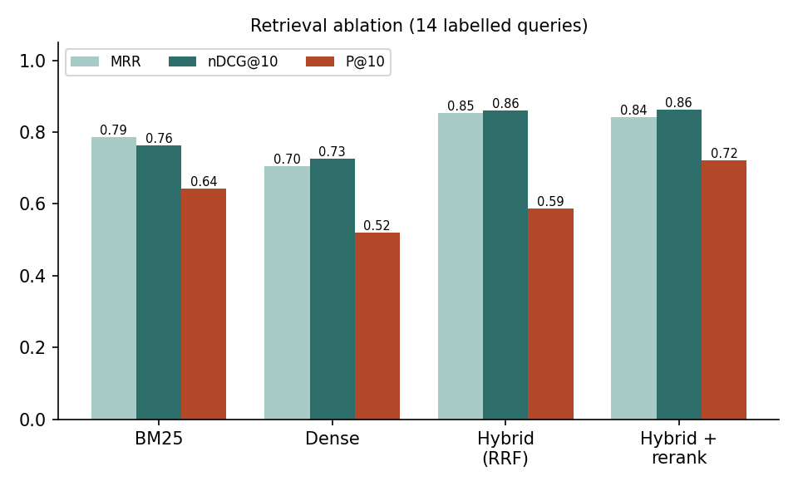
Evaluation Results (1/2): Retrieval & end-to-end plans
End-to-end with Claude (6 scenarios)
Claude judge: mean 3.6/5
Approved: 5 of 6 (revisions used: 3)
Citation coverage: 98%
Within budget: 6 of 6
Time per plan: about 95s (loaded laptop)
Retrieval: hybrid beats either retriever alone;
the reranker lifts P@10 at +0.8s CPU
(Rule-based regression suite: 8 scenarios, 4.7/5)
WanderVision · AI-Powered Travel Planning & Itinerary Assistant

Slide 11
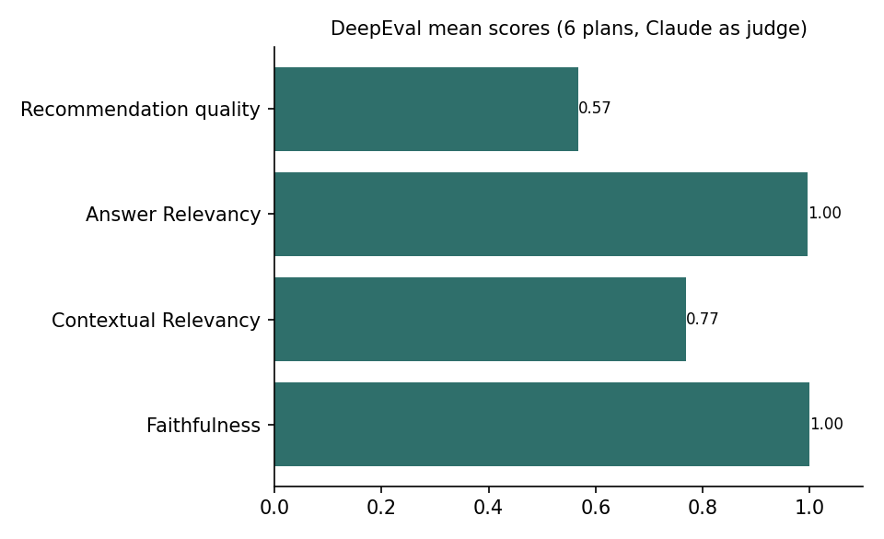
Evaluation Results (2/2): LLM quality, safety, ML
Guardrails red-team
Attacks blocked: 100% (category acc. 100%)
Benign allowed: 100%
PII redacted in 2 benign queries
Classifier & suitability model
Preference classifier (lexicon): trip type 100%, top-dim recall 100%
Suitability GBT AUC 0.9179 (LogReg 0.9135)
WanderVision · AI-Powered Travel Planning & Itinerary Assistant

Slide 12
Challenges & Learnings
• Dataset lacked the key fields → real preference vectors + transparent simulation, documented; real-CSV loader kept
• ChromaDB segfault on Windows → bisected to a pyarrow 18 conflict; pinned versions in an isolated venv
• Evaluation exposed ranking bias (one destination for 4/8 scenarios) → tier-aware feasibility and a lower unmentioned-preference prior → 7 different destinations
• "budget $3000" parsed as budget *tier* → phrase-level patterns + regression test
• LLM vs code: money, filters and citations stay deterministic; the LLM handles language and judgment, with an offline fallback for every LLM step
• The LLM judge is far stricter than rule checks; its critique (pace for kids, double-counted costs) drove real fixes
WanderVision · AI-Powered Travel Planning & Itinerary Assistant

Slide 13
Thank you · Q&A
• Code, docs and evaluation: README.md · design/ · docs/ · eval/results/
• Run: python scripts/setup_all.py → uvicorn src.main:app → streamlit run frontend.py
WanderVision · AI-Powered Travel Planning & Itinerary Assistant

