Slide 1
Chemical Thermodynamics

Slide 2
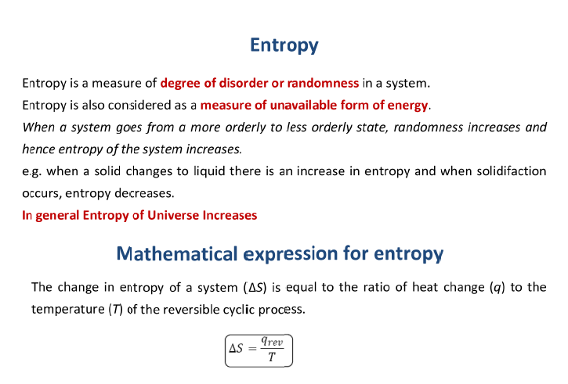
The second law of thermodynamics states that the total entropy of an isolated system can never decrease over time. The total entropy of a system and its surroundings can remain constant in ideal cases where the system is in thermodynamic equilibrium, or is undergoing a (fictive) reversible process

Slide 3
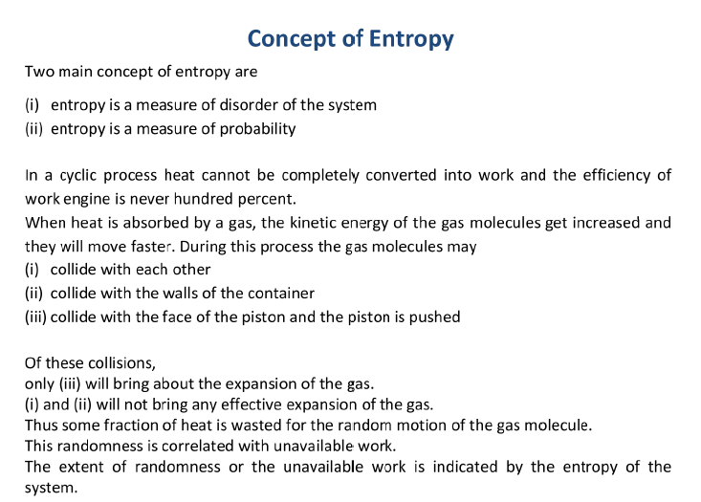

Slide 4
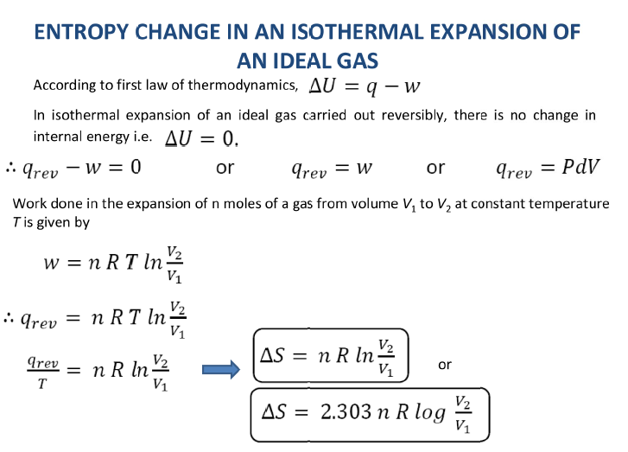

Slide 5
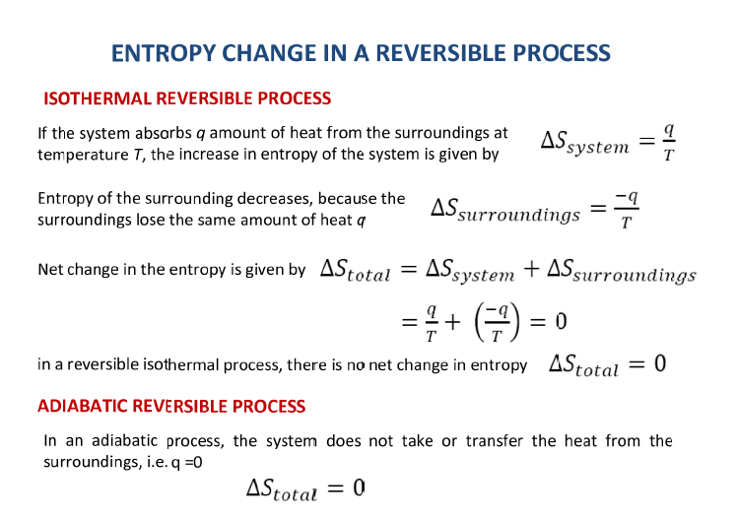

Slide 6
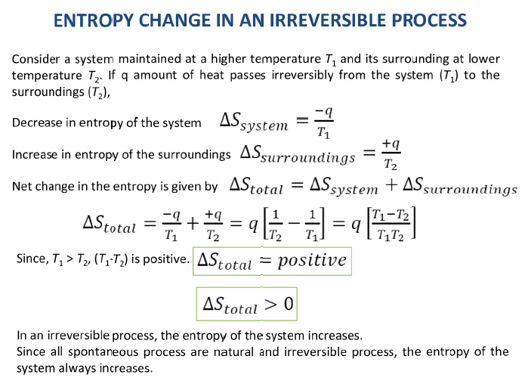

Slide 7
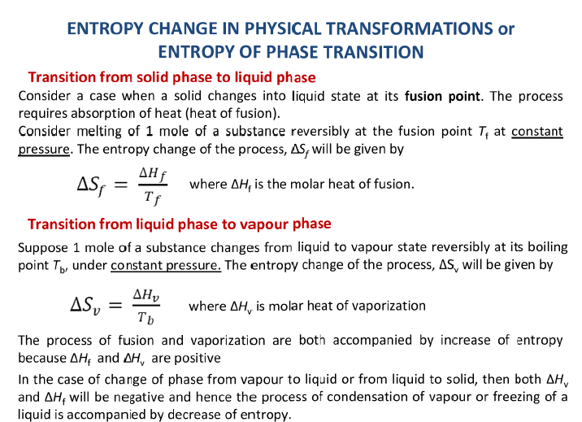

Slide 8
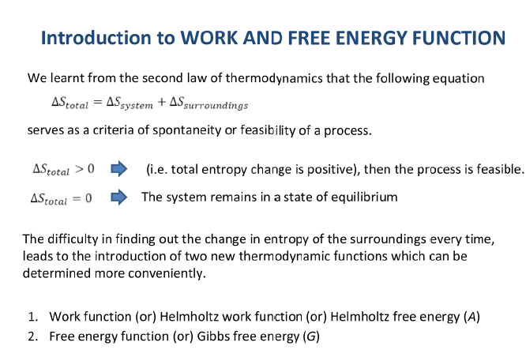

Slide 9
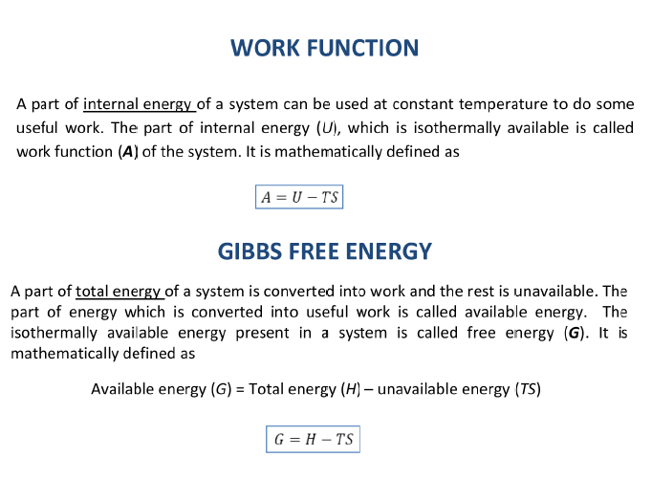

Slide 10
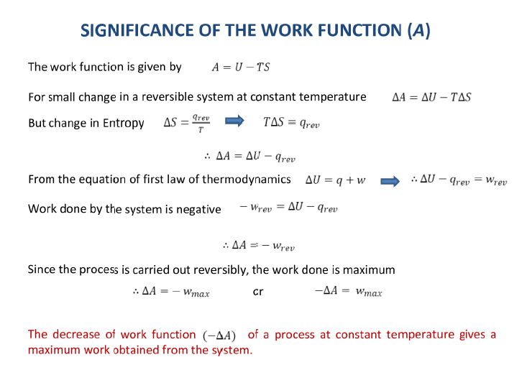

Slide 11
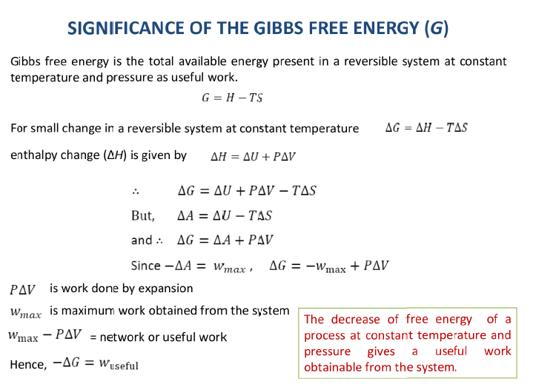

Slide 12
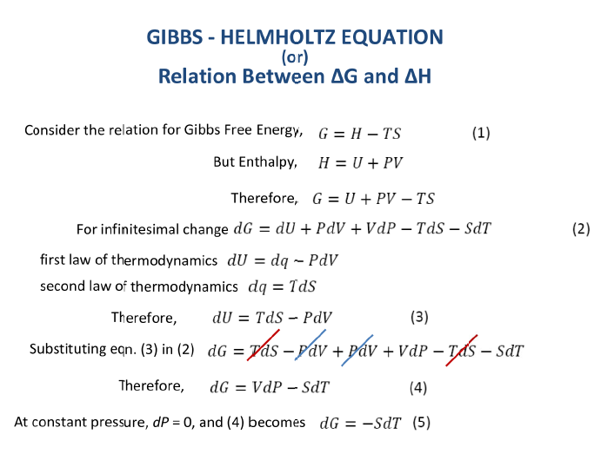

Slide 13
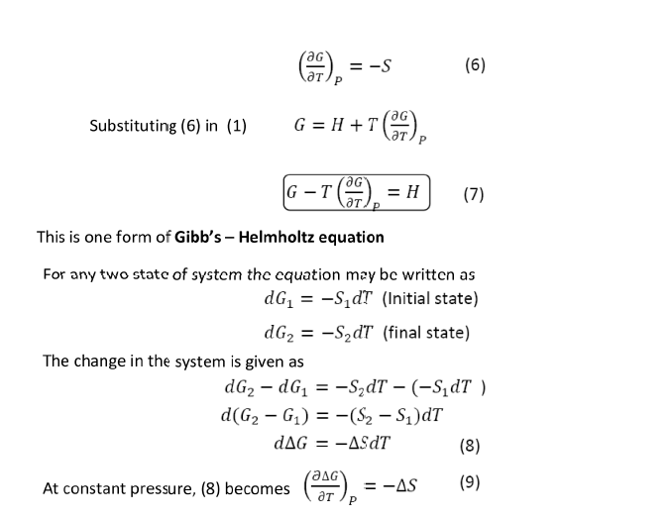

Slide 14
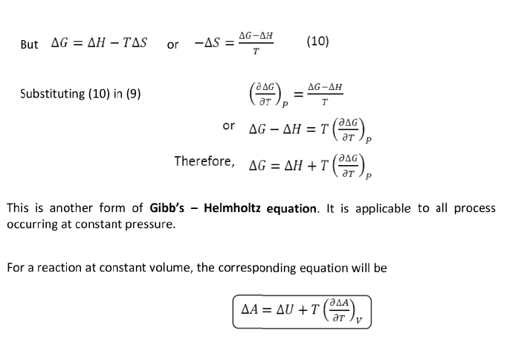

Slide 17
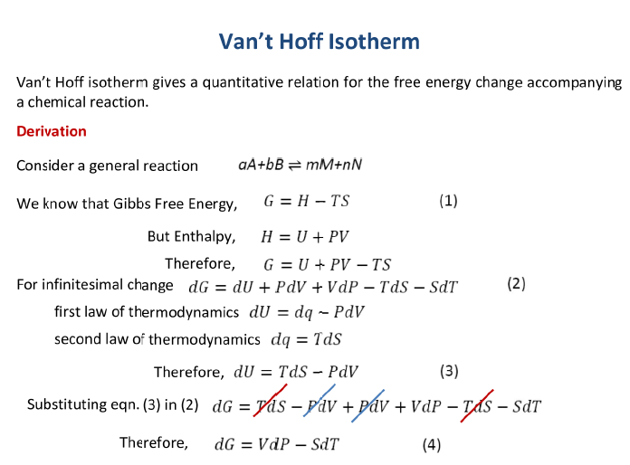

Slide 18
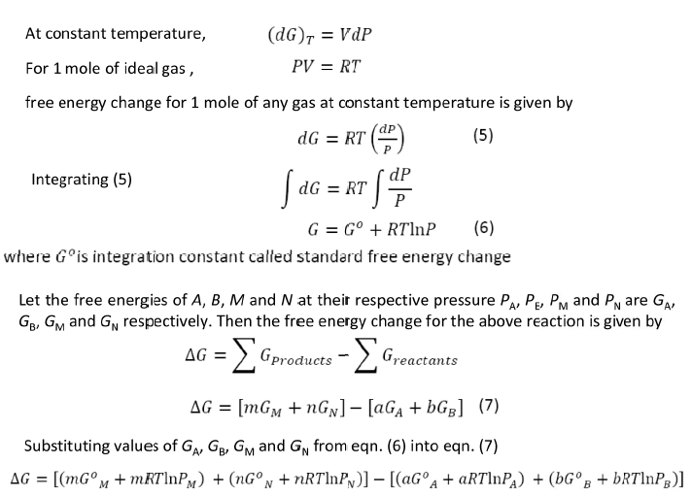

Slide 19
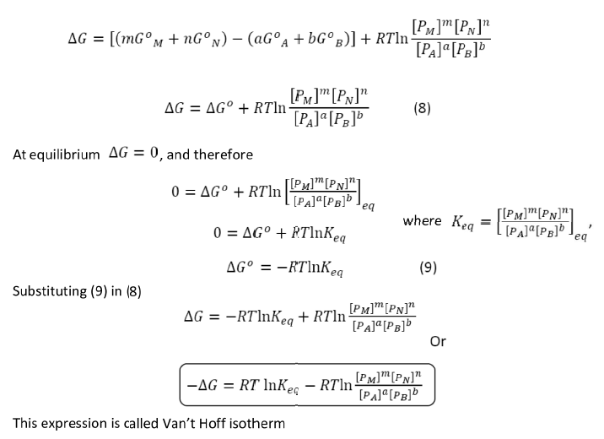

Slide 20
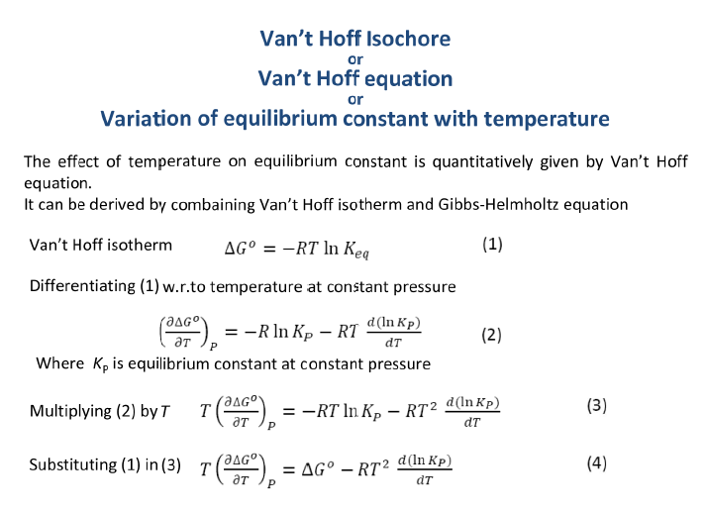

Slide 21
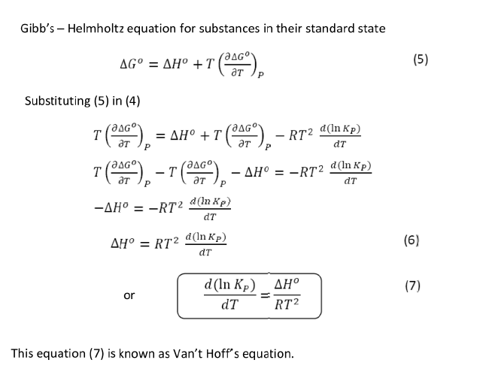

Slide 22
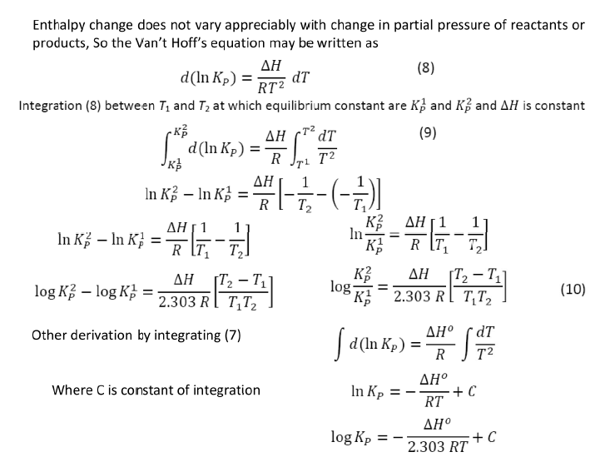

Slide 23
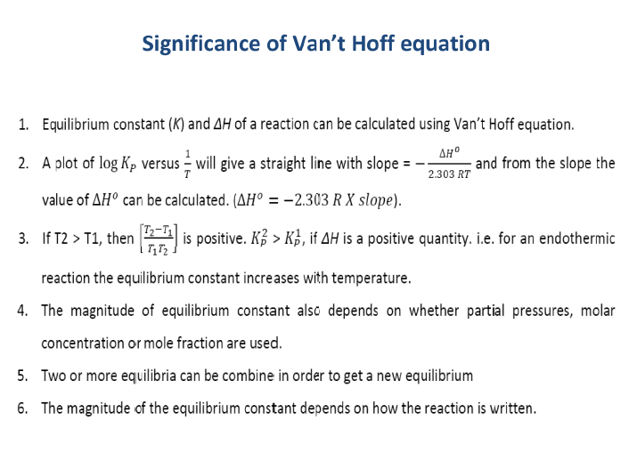

Slide 24
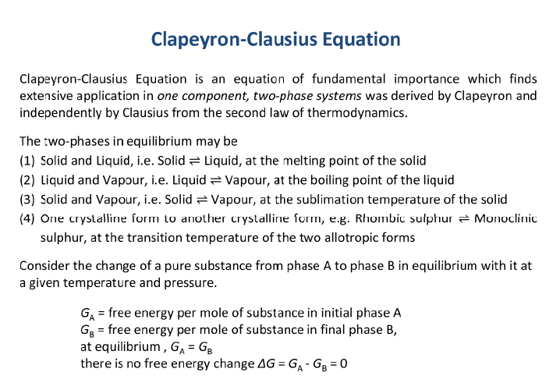

Slide 25
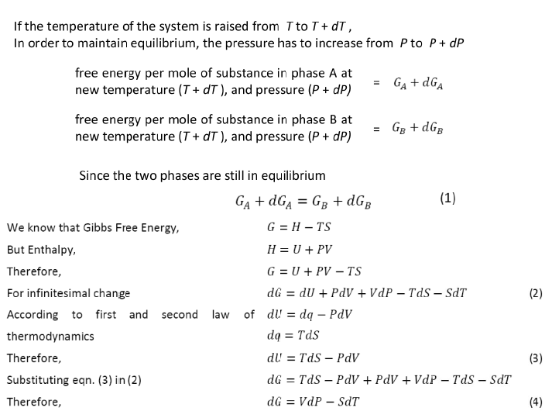

Slide 26
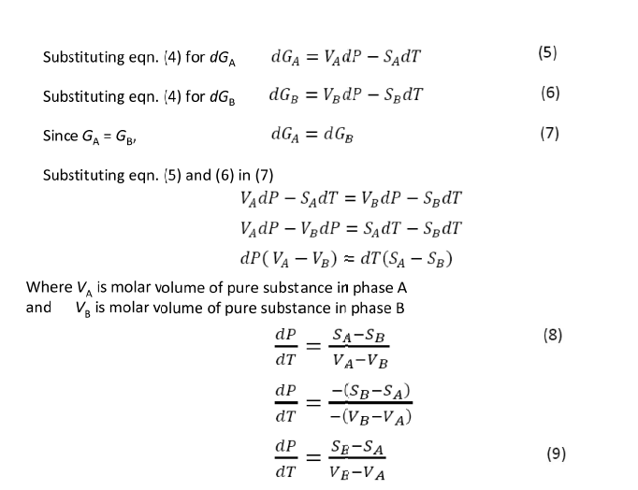

Slide 27
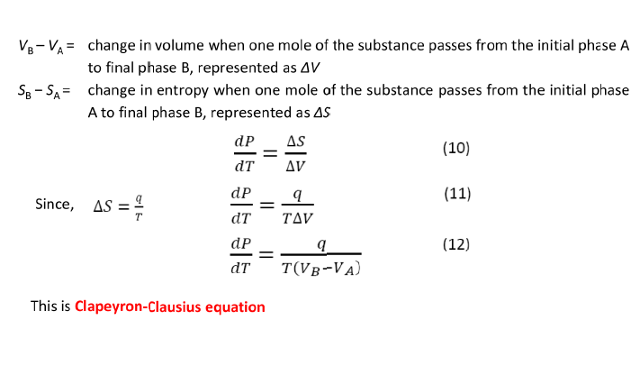

Slide 28
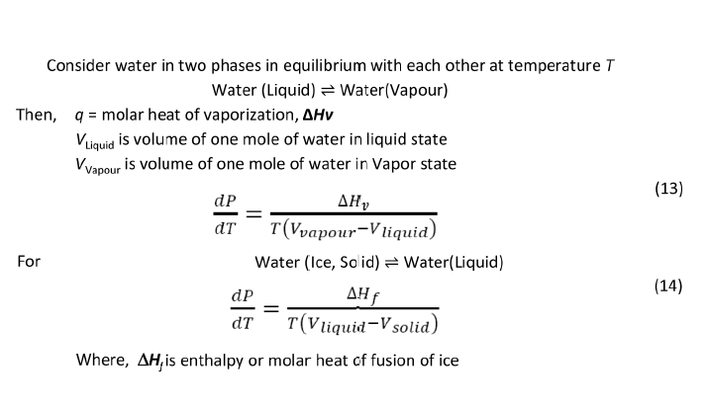

Slide 29
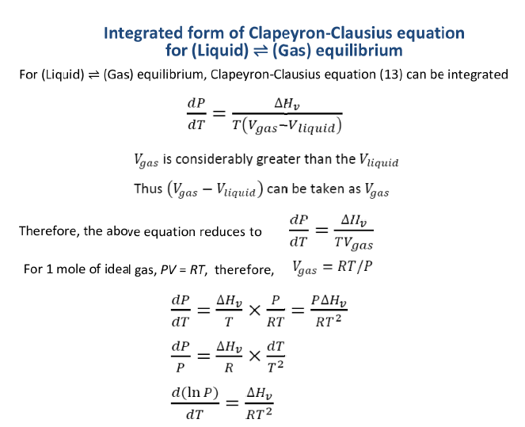

Slide 30
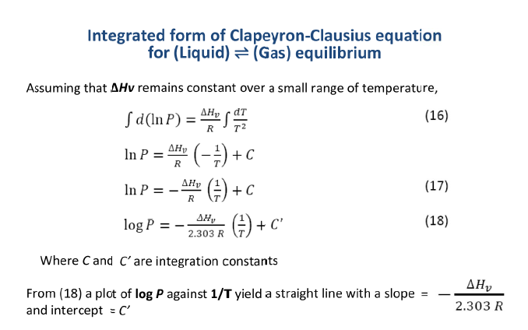

Slide 31
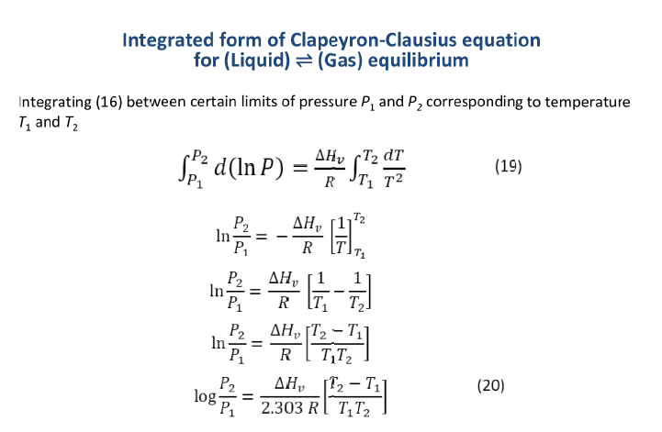

Slide 32
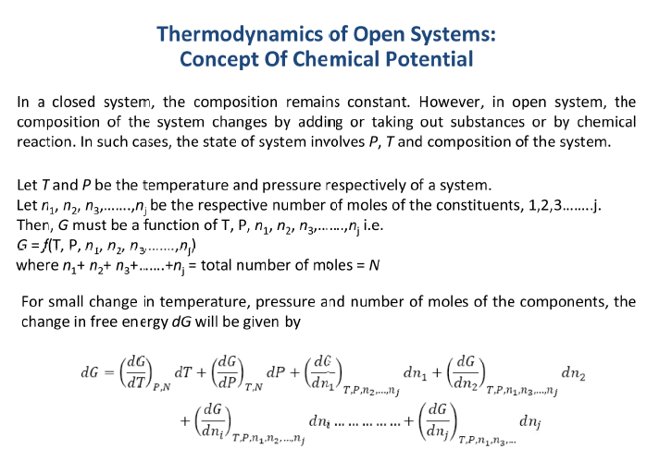

Slide 33
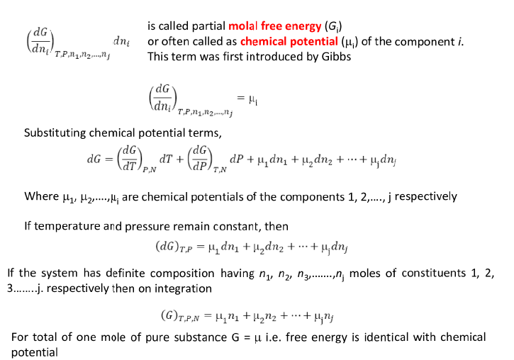

Slide 34
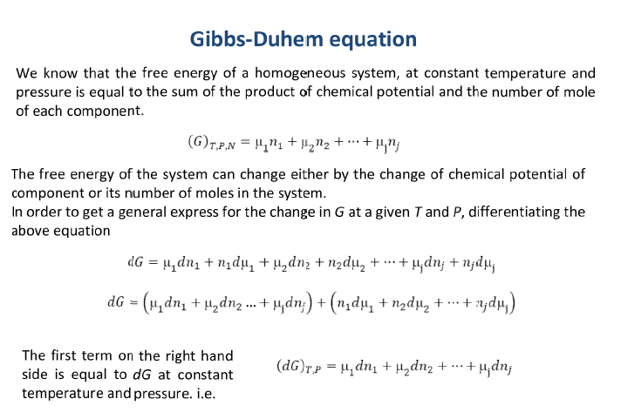

Slide 35
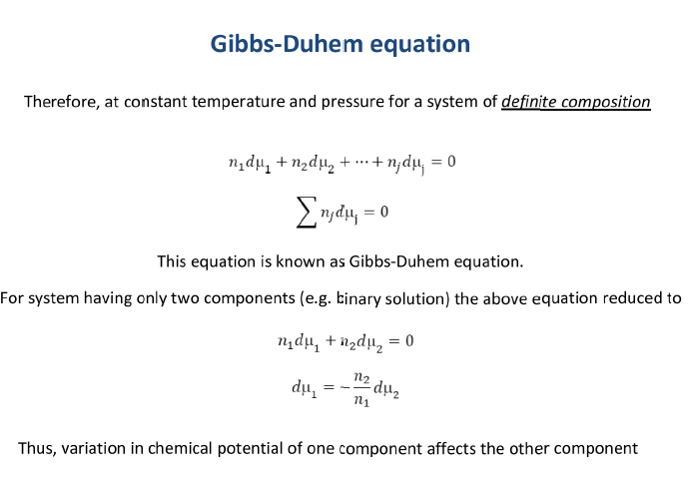

Slide 36
Entropy of mixing

Slide 41
The Third Law of Thermodynamics
A perfect crystal has zero entropy at absolute zero.
S_{sys} = 0 at 0 K
A “perfect” crystal has flawless alignment of all its particles. At absolute zero, the particles have minimum energy, so there is only one microstate.
S = k lnW = k ln 1 = 0
To find the entropy of a substance at a given temperature,
we cool it as close to 0 K as possible.
We then heat in small increments, measure q and T, and calculate ΔS for each increment.
The sum of these ΔS values gives the absolute entropy at the temperature of interest.

Slide 42
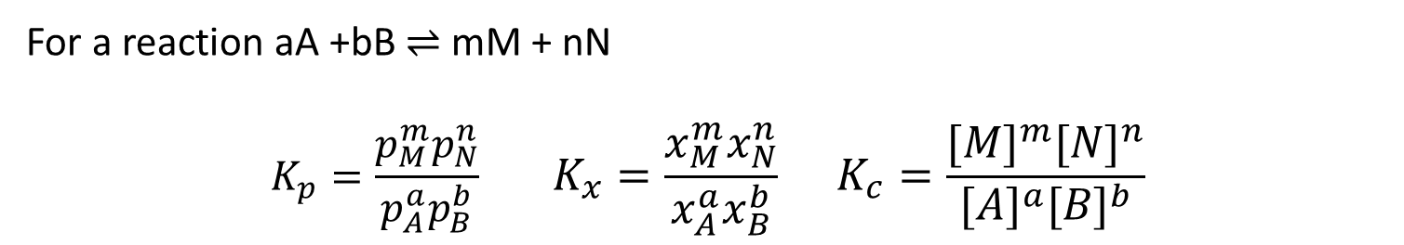
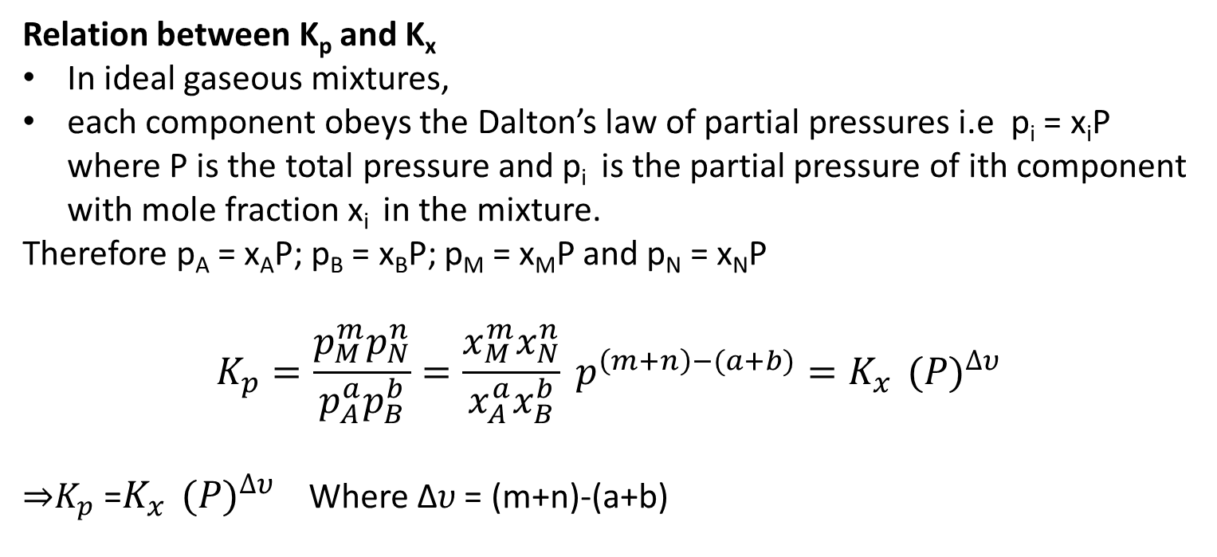
The relation between equilibrium constants
For a reaction aA +bB ⇌ mM + nN
$$K_{p}=\frac{p_{M}^{m}p_{N}^{n}}{p_{A}^{a}p_{B}^{b}} K_{x}=\frac{x_{M}^{m}x_{N}^{n}}{x_{A}^{a}x_{B}^{b}} K_{c}=\frac{{[M]}^{m}{[N]}^{n}}{{[A]}^{a}{[B]}^{b}}$$
Relation between K_{p} and K_{x}
In ideal gaseous mixtures,
each component obeys the Dalton’s law of partial pressures i.e p_{i} = x_{i}P where P is the total pressure and p_{i} is the partial pressure of ith component with mole fraction x_{i} in the mixture.
Therefore p_{A} = x_{A}P; p_{B} = x_{B}P; p_{M} = x_{M}P and p_{N} = x_{N}P
$$K_{p}=\frac{p_{M}^{m}p_{N}^{n}}{p_{A}^{a}p_{B}^{b}}=\frac{x_{M}^{m}x_{N}^{n}}{x_{A}^{a}x_{B}^{b}} p^{\left(m+n\right)−(a+b)}=K_{x}^{}{(P)}^{∆υ}$$
⇒$K_{p}$ =$K_{x}^{}{(P)}^{∆υ}$ Where ∆𝜐 = (m+n)-(a+b)

Slide 43
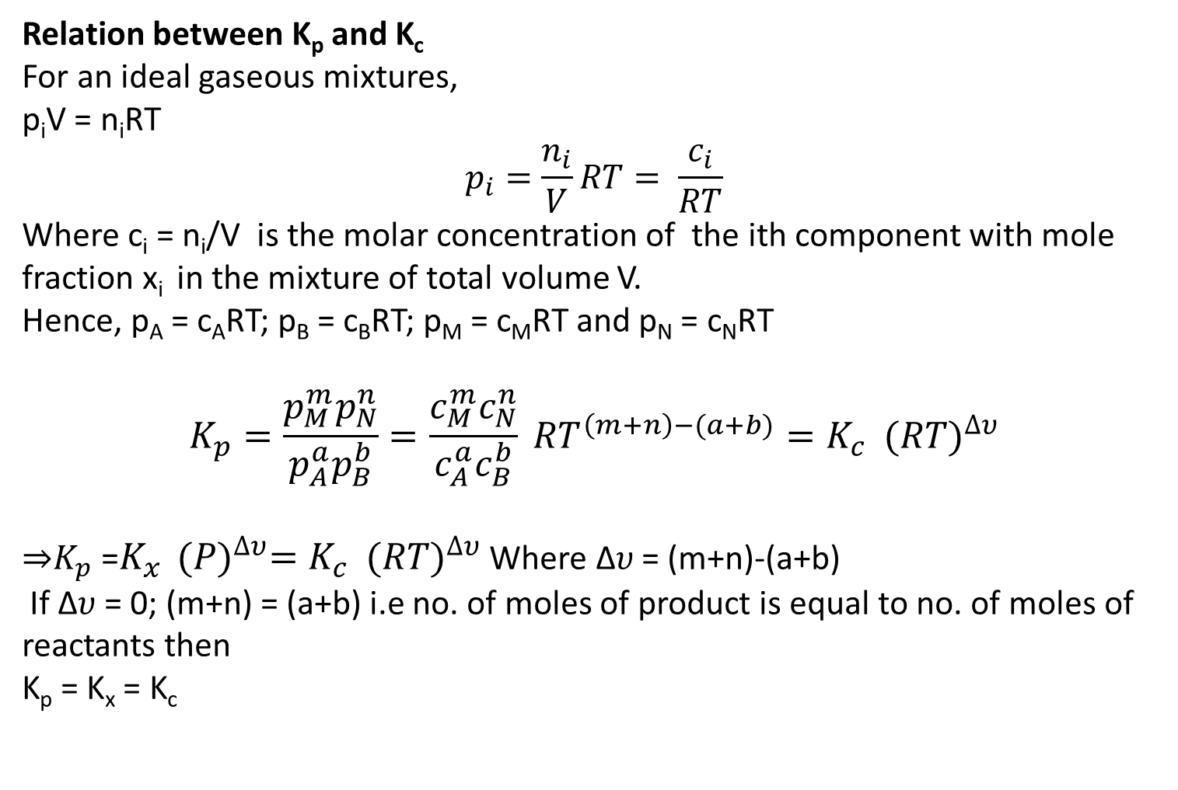
The relation between equilibrium constants
Relation between K_{p} and K_{c}
For an ideal gaseous mixtures,
p_{i}V = n_{i}RT
$$p_{i}=\frac{n_{i}}{V}RT= \frac{c_{i}}{RT}$$
Where c_{i} = n_{i}/V is the molar concentration of the ith component with mole fraction x_{i} in the mixture of total volume V.
Hence, p_{A} = c_{A}RT; p_{B} = c_{B}RT; p_{M} = c_{M}RT and p_{N} = c_{N}RT
$$K_{p}=\frac{p_{M}^{m}p_{N}^{n}}{p_{A}^{a}p_{B}^{b}}=\frac{c_{M}^{m}c_{N}^{n}}{c_{A}^{a}c_{B}^{b}} {RT}^{\left(m+n\right)−(a+b)}=K_{c}^{}{(RT)}^{∆υ}$$
⇒$K_{p}$ =$K_{x}^{}{(P)}^{∆υ}=K_{c}^{}{(RT)}^{∆υ}$ Where ∆𝜐 = (m+n)-(a+b)
If ∆𝜐 = 0; (m+n) = (a+b) i.e no. of moles of product is equal to no. of moles of reactants then
K_{p} = K_{x} = K_{c}

