Slide 1
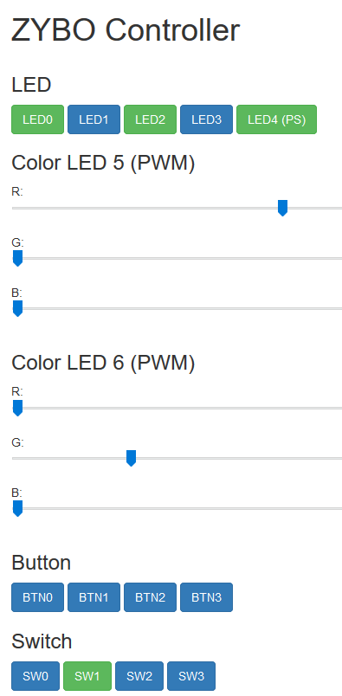
index.html
render
http
ServerIoT (Python)
call
use
main.js
<ajax>
http request
bottle
Client Browser
Named pipe
(LED status
from Python to C)
Named pipe
(Button/SW status
from C to Python)
http://192.168.1.87:8080/setStatus
http://192.168.1.87:8080/getStatus
myip_controller (C)
Linux (system call)
SW
/dev/uio0
/dev/uio1
/sys/class/gpio
HW
PL
PS
myip.v
mypwm.v
Color LEDs
LEDs
Buttons
SWs
LEDs

Slide 2
Vivado
1. design_iot_wrapper.hdf
Application development
2. BOOT.BIN, image.ub
PetaLinux
Xilinx SDK
(C)
TCF
VS Code
(Python)
Debug
ZYBO
SFTP
init.d script
3.
myip_controller.elf
ServerIoT/
4. BOOT.BIN, image.ub

