Slide 1

VIII Semester Major Project Work
( CD481P)
Department of Computer Science,
R V College of Engineering, Bengaluru.

Slide 2

Machine learning based Parasite Recognition
System for automated detection of Plasmodium
falciparum from microscopic images
Anjan Babu K N | 1RV23CD400
Under the Guidance of
Internal Guide Prof. Mekhala V P
Assistant Professor
Dept. of CSE,
RVCE, Bengaluru
Internal Guide Prof.Deepthi L
Assistant Professor
Dept. of CSE,
RVCE, Bengaluru
RV COLLEGE OF ENGINEERING

Slide 3
Agenda
Introduction
Literature Review
Motivation
Problem Statement
Objectives
Specifications
Design Methodology
Implementation and Testing
Results, Analysis and Discussion
Demo of the Project
SDG Mapping/ Outcomes
Online Course Certification
References
Date
RV COLLEGE OF ENGINEERING

Slide 4
Introduction
Malaria is a serious infectious disease that requires early and accurate diagnosis for effective treatment and prevention. Traditional microscopic examination of blood smear images is time-consuming, labour-intensive, and highly dependent on skilled laboratory professionals. To address these challenges, this project proposes an automated malaria parasite recognition system using Deep Learning and Convolutional Neural Networks (CNN) with the VGG16 transfer learning model. The developed framework performs image preprocessing, feature extraction, and binary classification of microscopic blood smear images into parasitized and uninfected categories. A Flask-based web application is integrated to provide real-time prediction results and confidence scores through an interactive interface. The proposed system improves diagnostic efficiency, reduces manual effort, and demonstrates the practical application of Artificial Intelligence in medical image analysis and computer-aided healthcare diagnosis.
Date
RV COLLEGE OF ENGINEERING

Slide 5
Literature Review
Sl. No | Title of the Paper | Authors | Journal/ Conference Details | Inference
1 | Deep Learning-Based Malaria Parasite Detection: CNN Model for Accurate Species Identification | Diego A. Ramos-Briceño et al. | Scientific Reports, 2025 | CNN with image preprocessing achieved for multiclass malaria species classification.
2 | Performance Analysis of Deep Learning Algorithms in Diagnosis of Malaria Disease | K. Hemachandran et al. | Diagnostics, 2023 | Compared multiple DL models; CNN-based approaches showed high detection performance.
3 | Malaria Detection Using Advanced Deep Learning Architecture | W. Siłka et al. | Sensors, 2023 | Advanced CNN architecture improved automated malaria detection accuracy.
4 | Diagnosis of Malaria Using CNN Feature Extraction and Extreme Learning Machine | M.O.F. Goni et al. | IEEE Access, 2023 | Combined CNN and ELM classifier for efficient parasite detection.
5 | Deep Learning Based Automatic Malaria Parasite Detection from Blood | K.M.F. Fuhad et al. | Diagnostics, 2020 | Smartphone-assisted malaria diagnosis with high accuracy and specificity.
Date
RV COLLEGE OF ENGINEERING

Slide 6
Literature Review
Sl. No | Title of the Paper | Authors | Journal/ Conference Details | Inference
6 | Deep Learning for Smartphone-Based Malaria Parasite Detection in Thick Blood Smears | F. Yang et al. | IEEE Journal of Biomedical and Health Informatics, 2020 | Demonstrated mobile-based malaria diagnosis in resource-limited areas..
7 | Transfer Learning for Malaria Cell Classification Using InceptionResNet-V2 | S. Rajaraman et al. | IEEE EMBC, 2019 | Transfer learning achieved very high binary classification accuracy.
8 | Automated Malaria Parasite Detection Using CNN-Based Classification | Vijayalakshmi et al. | International Journal, 2020 | CNN model detected infected and uninfected blood cells effectively.
9 | Computer-Aided Malaria Parasite Detection Using Image Processing and Machine Learning | Dong et al. | Biomedical Signal Processing, 2018 | Traditional image processing required handcrafted feature extraction.
10 | Malaria Cell Image Classification Using Deep Convolutional Neural Networks | Bibin D. Nair et al. | Procedia Computer Science, 2018 | Demonstrated superiority of CNNs over conventional ML methods.
Date
RV COLLEGE OF ENGINEERING

Slide 7
Motivation
The proposed Malaria Parasite Recognition System utilizes Deep Learning and the VGG16 Convolutional Neural Network (CNN) architecture to automatically detect malaria-infected blood cells from microscopic blood smear images. The system performs image preprocessing, feature extraction, and binary classification to distinguish between parasitized and uninfected cells with high accuracy. A Flask-based web application provides a user-friendly interface for uploading blood smear images and obtaining real-time prediction results along with confidence scores. By reducing dependence on manual microscopic examination, the proposed solution improves diagnostic efficiency, supports early disease detection, and demonstrates the practical application of Artificial Intelligence in healthcare and medical image analysis.
Date
RV COLLEGE OF ENGINEERING

Slide 8
Problem Statement
Malaria diagnosis through manual microscopic examination of blood smear images is time-consuming, labor-intensive, and prone to human error, particularly in resource-constrained healthcare settings. The project addresses this challenge by developing an automated deep learning-based system that accurately classifies blood smear images as parasitized or uninfected, enabling faster and more reliable malaria detection.
Date
RV COLLEGE OF ENGINEERING

Slide 9
Objectives
To develop an automated malaria detection system using deep learning.
To classify microscopic blood cell images as parasitized or uninfected.
To reduce the time and effort required in manual malaria diagnosis.
To improve diagnostic accuracy and consistency using a CNN model.
To build a Flask-based web application for easy image upload and prediction.
To demonstrate the practical use of artificial intelligence in healthcare diagnosis.
Date
RV COLLEGE OF ENGINEERING

Slide 10
Specifications
Hardware Requirements
Processor: Intel Core i5 or higher
RAM: 8 GB
Storage: Minimum 20 GB free disk space
Programming Languages Used
Python
HTML
CSS
JavaScript
SQL
Software Requirements
Operating System: Windows 10
Python 3.10
TensorFlow and Keras
Flask Web Framework
MySQL Database Server
Visual Studio Code
Jupyter Notebook (for model development)
Git and GitHub (Version Control)
Date
RV COLLEGE OF ENGINEERING

Slide 11
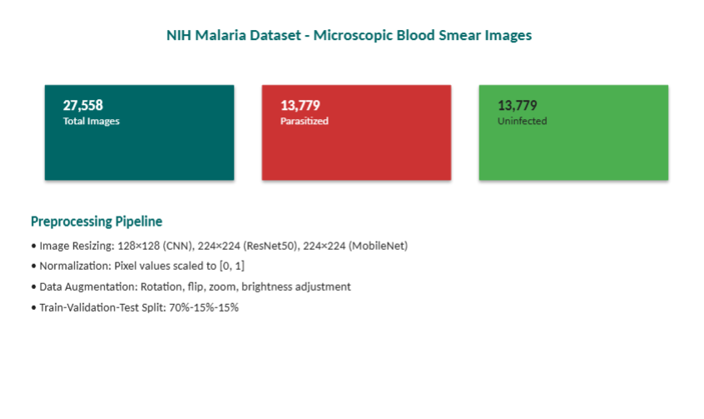
Dataset
Date
RV COLLEGE OF ENGINEERING

Slide 12
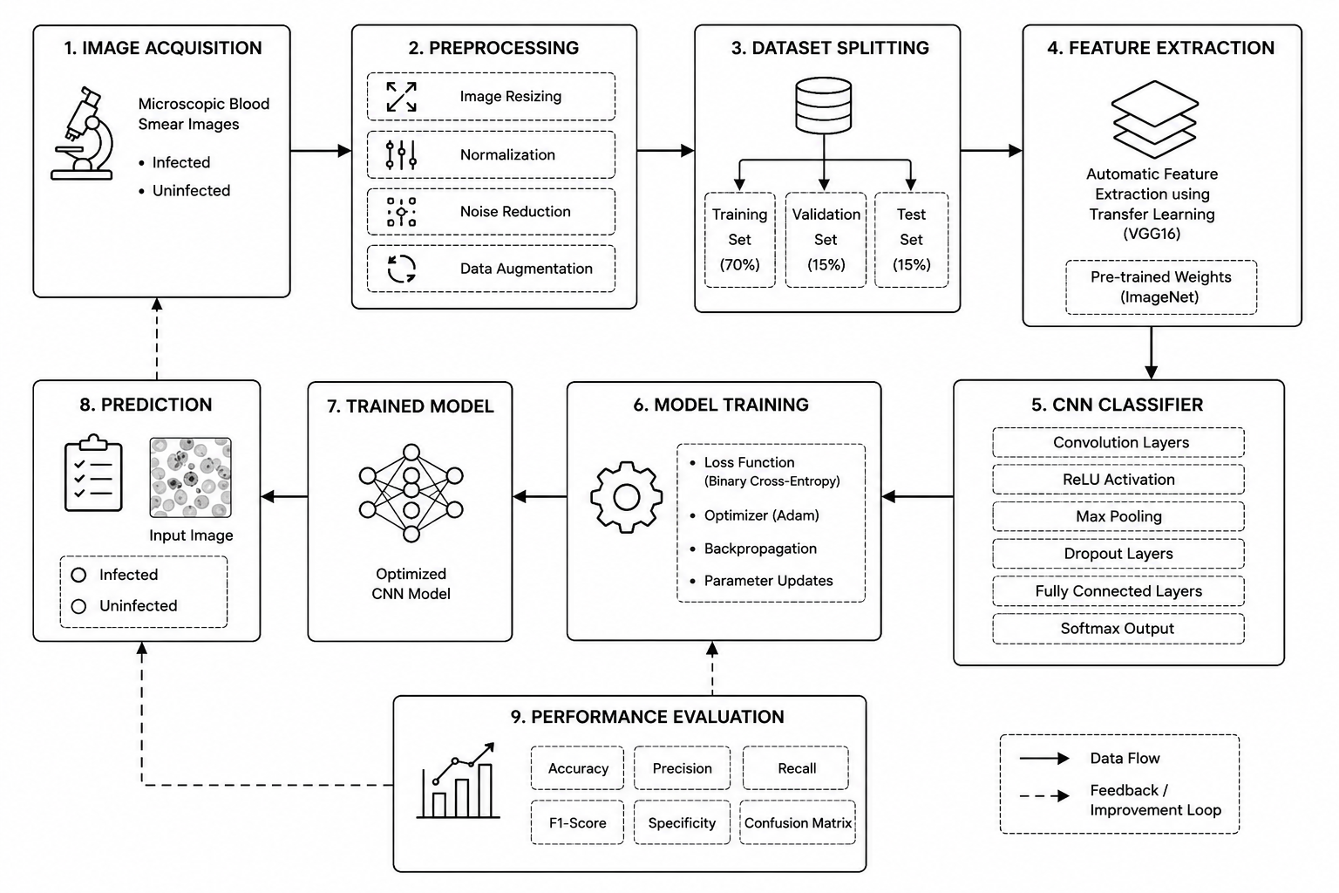
Design Methodology
Date
RV COLLEGE OF ENGINEERING

Slide 13
Design Methodology
1. Explanation of Algorithms Used
The system utilizes Convolutional Neural Networks (CNNs) with Transfer Learning based on the VGG16 architecture. Image preprocessing techniques such as resizing, normalization, and RGB conversion are applied before model training. VGG16 extracts high-level visual features from blood smear images, and custom dense layers perform binary classification between parasitized and uninfected cells. The model is trained using the Adam optimizer and Binary Cross-Entropy loss function to achieve accurate predictions.
2. Justification for Chosen Design Approach
The VGG16 transfer learning approach was selected because it provides powerful feature extraction capabilities while reducing training time and computational requirements. Flask was chosen for its lightweight architecture and seamless integration with machine learning models. MySQL provides reliable data storage for user authentication and application management. The web-based architecture improves accessibility, enabling users to perform malaria diagnosis through an intuitive interface. This design ensures scalability, accuracy, maintainability, and suitability for real-world healthcare applications.
Date
RV COLLEGE OF ENGINEERING

Slide 14
Implementation and Testing
Key modules implemented
User Authentication Module – User registration, login, JWT-based authentication, and access management.
Image Upload Module – Allows users to upload microscopic blood smear images through the web interface.
Image Preprocessing Module – Performs image resizing, normalization, and RGB conversion.
Malaria Prediction Module – Uses the trained VGG16 CNN model to classify images as parasitized or uninfected.
Result Visualization Module – Displays prediction results and confidence scores to users.
Database Management Module – Stores user information and authentication data in MySQL.
Date
RV COLLEGE OF ENGINEERING

Slide 15
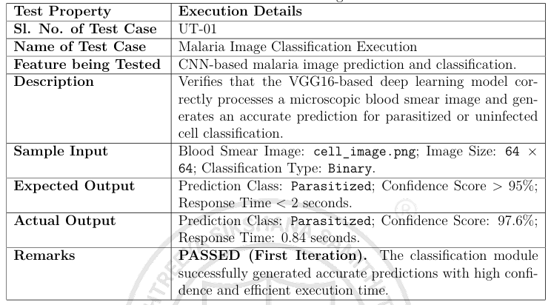
Implementation and Testing
Date
RV COLLEGE OF ENGINEERING

Slide 16
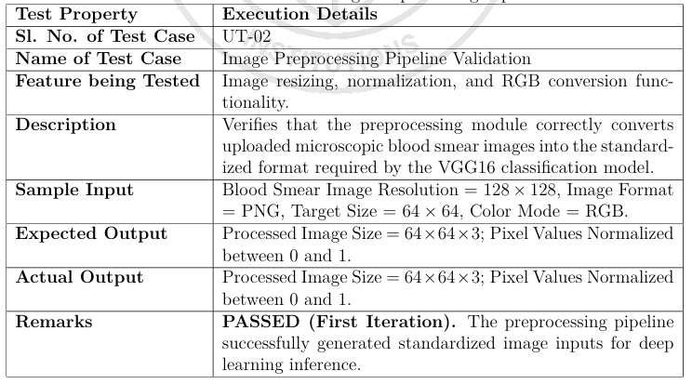
Implementation and Testing
Date
RV COLLEGE OF ENGINEERING

Slide 17
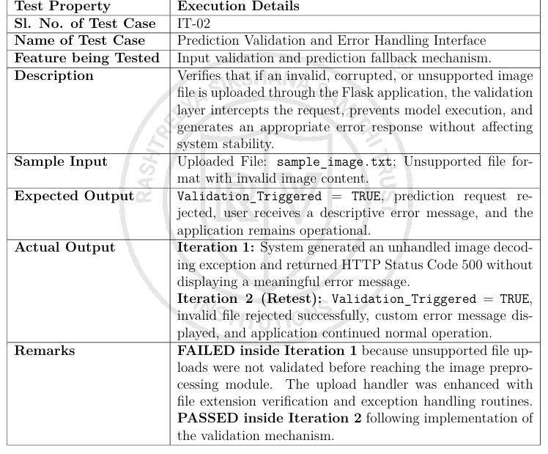
Implementation and Testing
Date
RV COLLEGE OF ENGINEERING

Slide 18
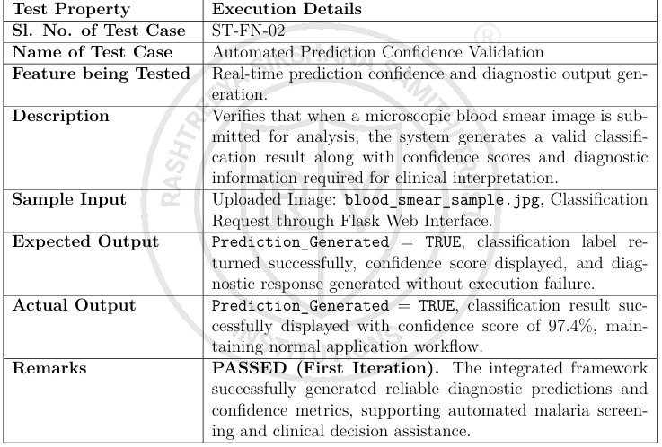
Implementation and Testing
Date
RV COLLEGE OF ENGINEERING

Slide 19
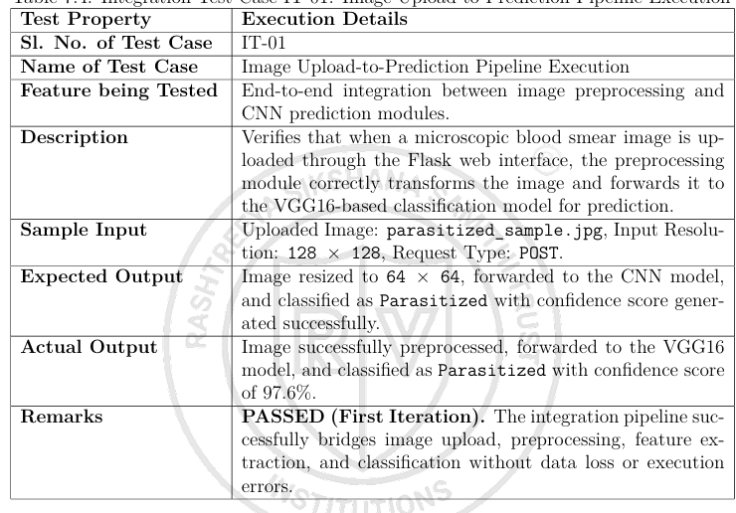
Implementation and Testing
Date
RV COLLEGE OF ENGINEERING

Slide 20
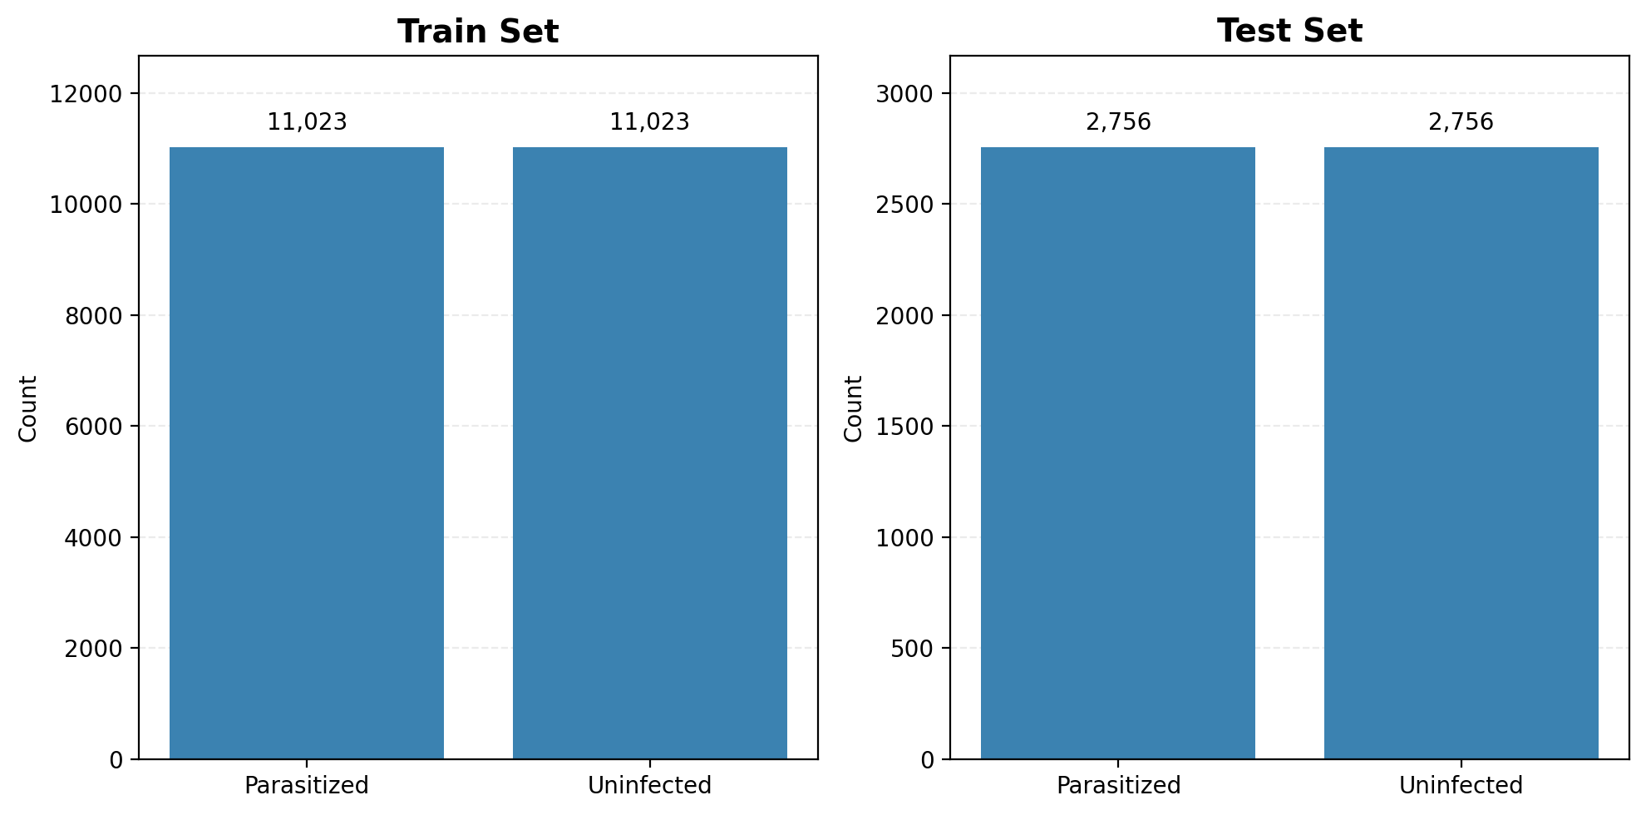
Results, Analysis and Discussion
Date
RV COLLEGE OF ENGINEERING

Slide 21
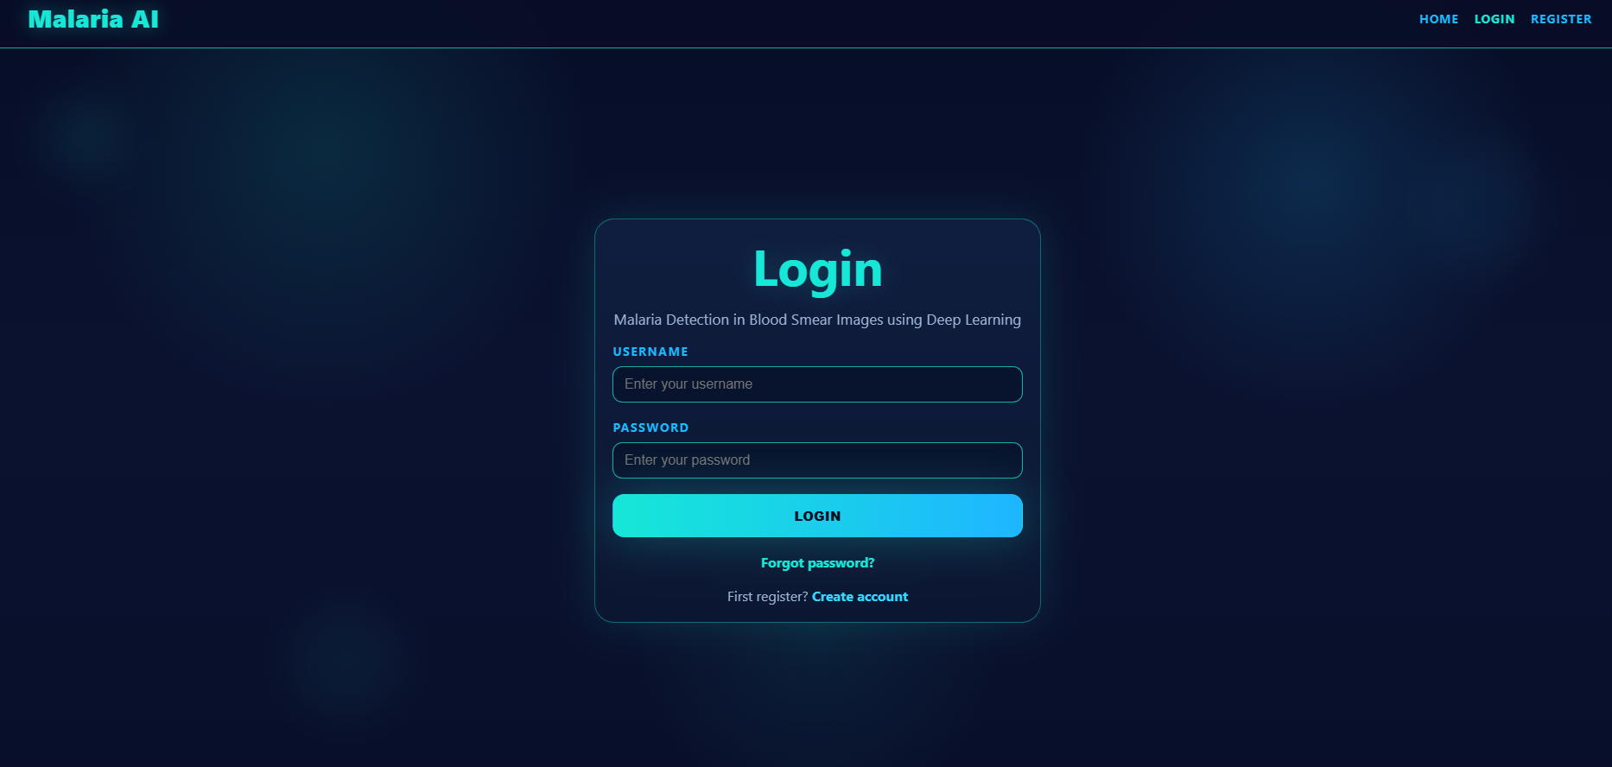
Demo of the Project
Date
RV COLLEGE OF ENGINEERING

Slide 22
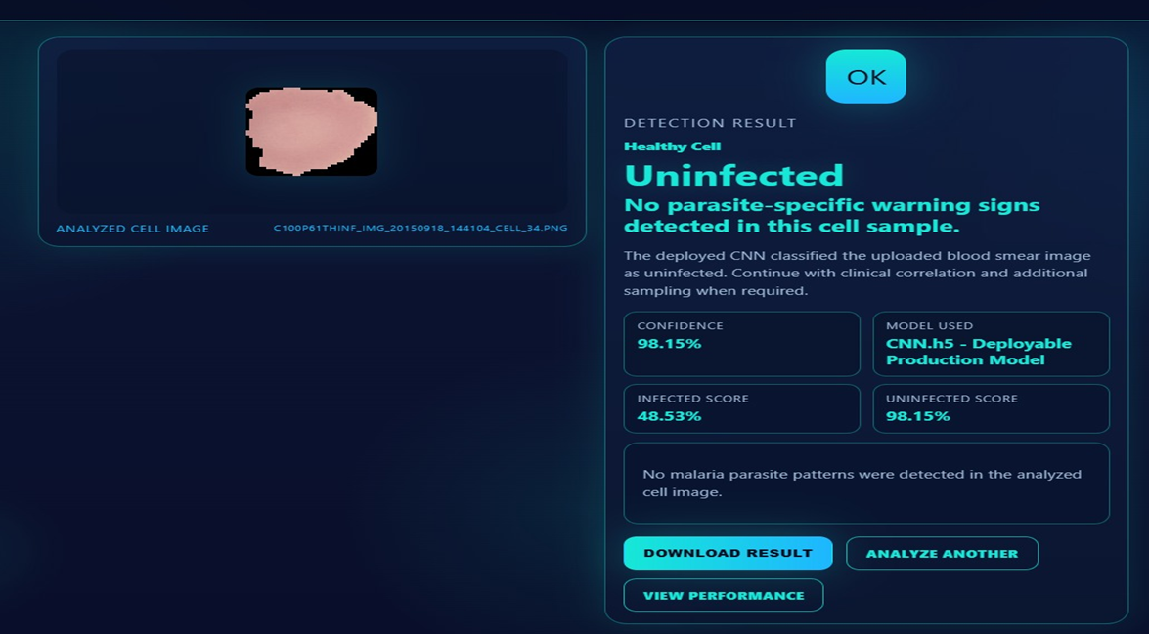
Results, Analysis and Discussion
Date
RV COLLEGE OF ENGINEERING

Slide 23
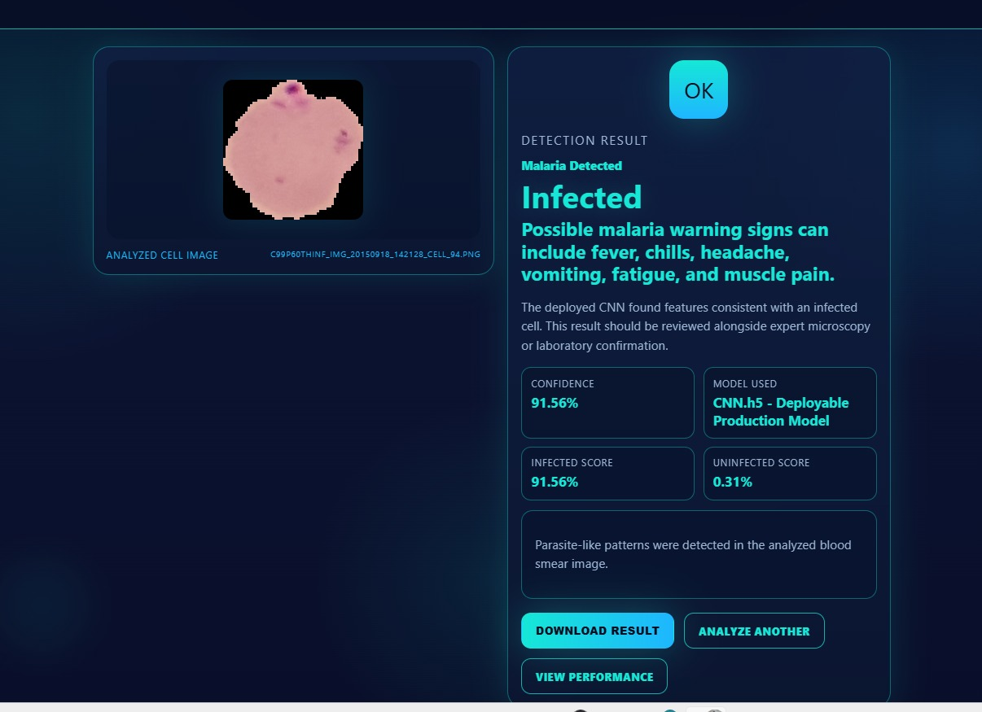
Results, Analysis and Discussion
Date
RV COLLEGE OF ENGINEERING

Slide 24
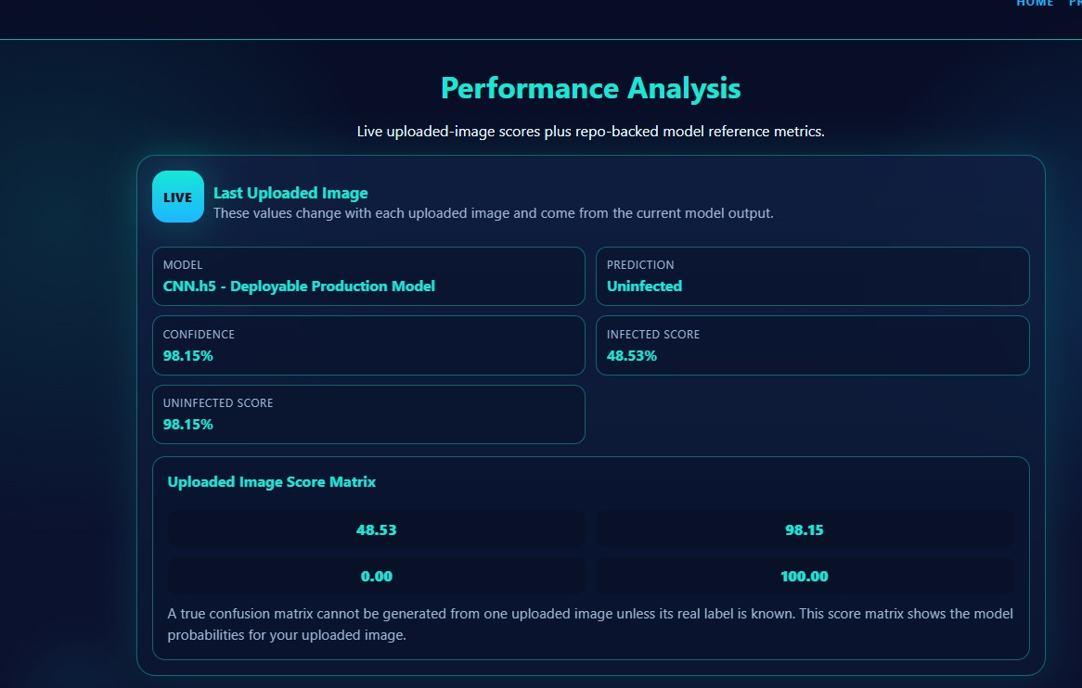
Results, Analysis and Discussion
Date
RV COLLEGE OF ENGINEERING

Slide 25
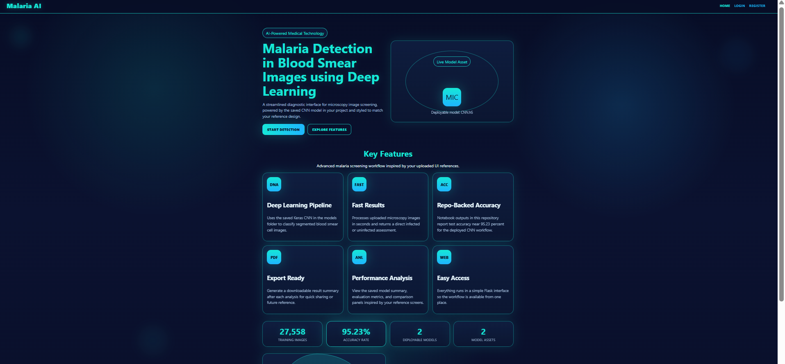
Results, Analysis and Discussion
Date
RV COLLEGE OF ENGINEERING

Slide 26
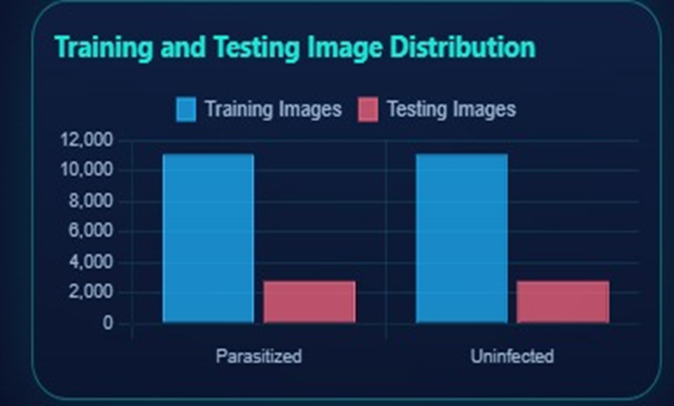
Results, Analysis and Discussion
Date
RV COLLEGE OF ENGINEERING

Slide 27
SDG Mapping
SDG Mapped to the Project | Relevant Sustainable Development Goal(s)
Outcome : Research Paper (Drafted) | SDG 3 – Good Health and Well-being Supports early and accurate malaria diagnosis through Artificial Intelligence. Reduces diagnostic delays and human errors in microscopic examination. Enhances healthcare accessibility in remote and resource-constrained regions. Contributes to disease prevention and improved public health outcomes.
Learning outcomes | Acquired knowledge of Deep Learning and Convolutional Neural Networks (CNNs). Gained practical experience in Transfer Learning using the VGG16 architecture. Learned medical image preprocessing and feature extraction techniques. Developed skills in TensorFlow, Keras, Flask, and MySQL integration.
Date
RV COLLEGE OF ENGINEERING

Slide 28
References
[1] World Health Organization, World Malaria Report 2023, Geneva, Switzerland, 2023.
[2] Oracle Corporation, MySQL Reference Manual, Oracle Documentation, 2023.
[3] R. Sharma and A. Gupta, “Convolutional Neural Networks for Healthcare Image Classification,” International Journal of Medical Informatics, vol. 171, p. 104970, 2023.
[4] Centers for Disease Control and Prevention, Malaria Diagnosis and Treatment Guidelines, CDC Health Reports, 2022.
[5] A. Esteva and A. Robicquet, “A Guide to Deep Learning in Healthcare,” Nature Medicine, vol. 25, no. 1, pp. 24–29, 2021.
[6] C. Tan, F. Sun, and T. Kong, “A Survey on Deep Transfer Learning,” Artificial Neural Networks and Machine Learning, pp. 270–279, 2020.
Date
RV COLLEGE OF ENGINEERING

Slide 29
References
[7] S. Rajaraman and S. Antani, “Pre-trained Convolutional Neural Networks as Feature Extractors Toward Improved Malaria Parasite Detection in Thin Blood Smear Images,” PeerJ, vol. 6, p. e4568, 2018.
[8] D. Bibin, M. S. Nair, and P. Punitha, “Malaria Parasite Detection from Peripheral Blood Smear Images Using Deep Belief Networks,” IEEE Access, vol. 5, pp. 9099–9108, 2017.
[9] K. Simonyan and A. Zisserman, “Very Deep Convolutional Networks for Large-Scale Image Recognition,” International Conference on Learning Representations (ICLR), 2015.
[10] A. Krizhevsky, I. Sutskever, and G. Hinton, “ImageNet Classification with Deep Convolutional Neural Networks,” Advances in Neural Information Processing Systems (NeurIPS), vol. 25, 2012.
Date
RV COLLEGE OF ENGINEERING

Slide 30
Thank you
Date
RV COLLEGE OF ENGINEERING

