Slide 1

VIII Semester Major Project Work (22CSP81)
Department of Computer Science,
R V College of Engineering, Bengaluru.

Slide 2
Machine learning based Parasite Recognition Software for automated detection of Plasmodium falciparum from microscopic image
Aravind V | 1RV22CD011
Likhith A | 1RV22CD027
Anjan Babu KN | 1RV23CD400
Under the Guidance of
Internal Guide Ms. Mekhala V P
Assistant Professor
Dept. of CSE,
RVCE, Bengaluru
External Guide

Slide 3

Knowledge, Skills, and Research Base
Problem Domain: Moving away from manual microscopy-only malaria diagnosis toward an automated deep learning approach that classifies blood smear images as infected or uninfected, reducing dependency on expert availability and improving screening speed.
Relevant Literature: Informed by CNN-based malaria detection research and experimental implementations in Keras, PyTorch architectures, using segmented blood smear datasets from NIH malaria screening studies and image augmentation to improve generalization.
Technical Knowledge: Convolutional Neural Networks (CNNs) for image classification, Image preprocessing such as resizing and normalization,Binary classification with softmax output,Data augmentation to reduce overfitting
Research Problem: State-of-the-art malaria detection models can achieve high accuracy, but many remain difficult to deploy, interpret, or integrate into a usable web application. The research challenge is to build a reliable, fast, and deployable malaria detection system that maintains high accuracy while providing clear prediction outputs for practical use.
Date
RV COLLEGE OF ENGINEERING

Slide 4
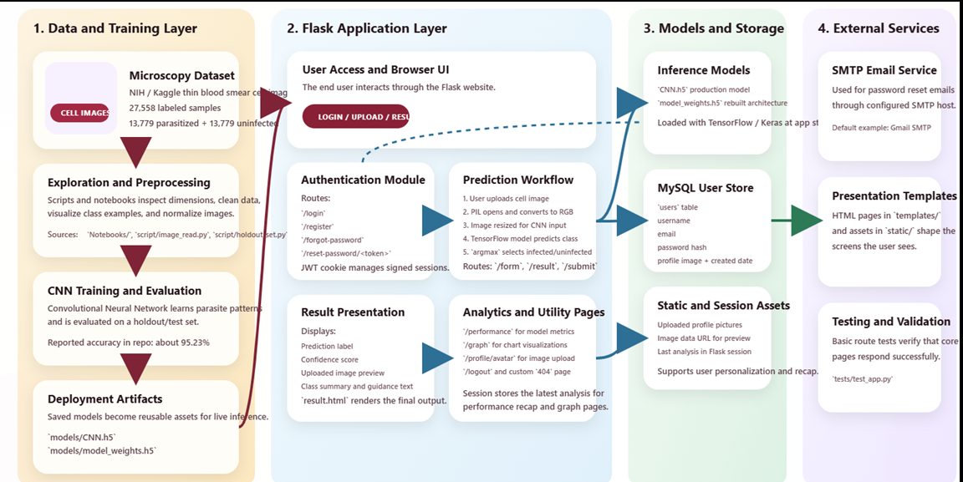
System Architecture
Date
RV COLLEGE OF ENGINEERING

Slide 5
Algorithms
1. Convolutional Neural Network (CNN)
This is the core algorithm used for malaria detection.
CNN is specially designed for image classification.
It learns important image patterns such as edges, shapes, textures, and cell structures.
In your project, it classifies blood smear images into:
Infected
Uninfected
Date
RV COLLEGE OF ENGINEERING

Slide 6
Algorithms
1. CNN Process
Image is resized and normalized → CNN extracts features → pooling reduces size → dense layers classify → output gives prediction.
2. Softmax / Binary Classification
Model outputs probabilities for infected vs uninfected → higher score = final prediction.
3. Train-Test Split
Data is split into training (learning) and testing (evaluation) → ensures fair accuracy.
4. Data Augmentation
Creates modified images (rotate, flip, zoom) → improves accuracy and reduces overfitting.
5. Transfer Learning
Uses deeper CNN → tested to compare performance with basic CNN.
6. PyTorch Experiment
Same CNN implemented in PyTorch → used to compare frameworks and results.
Date
RV COLLEGE OF ENGINEERING

Slide 7
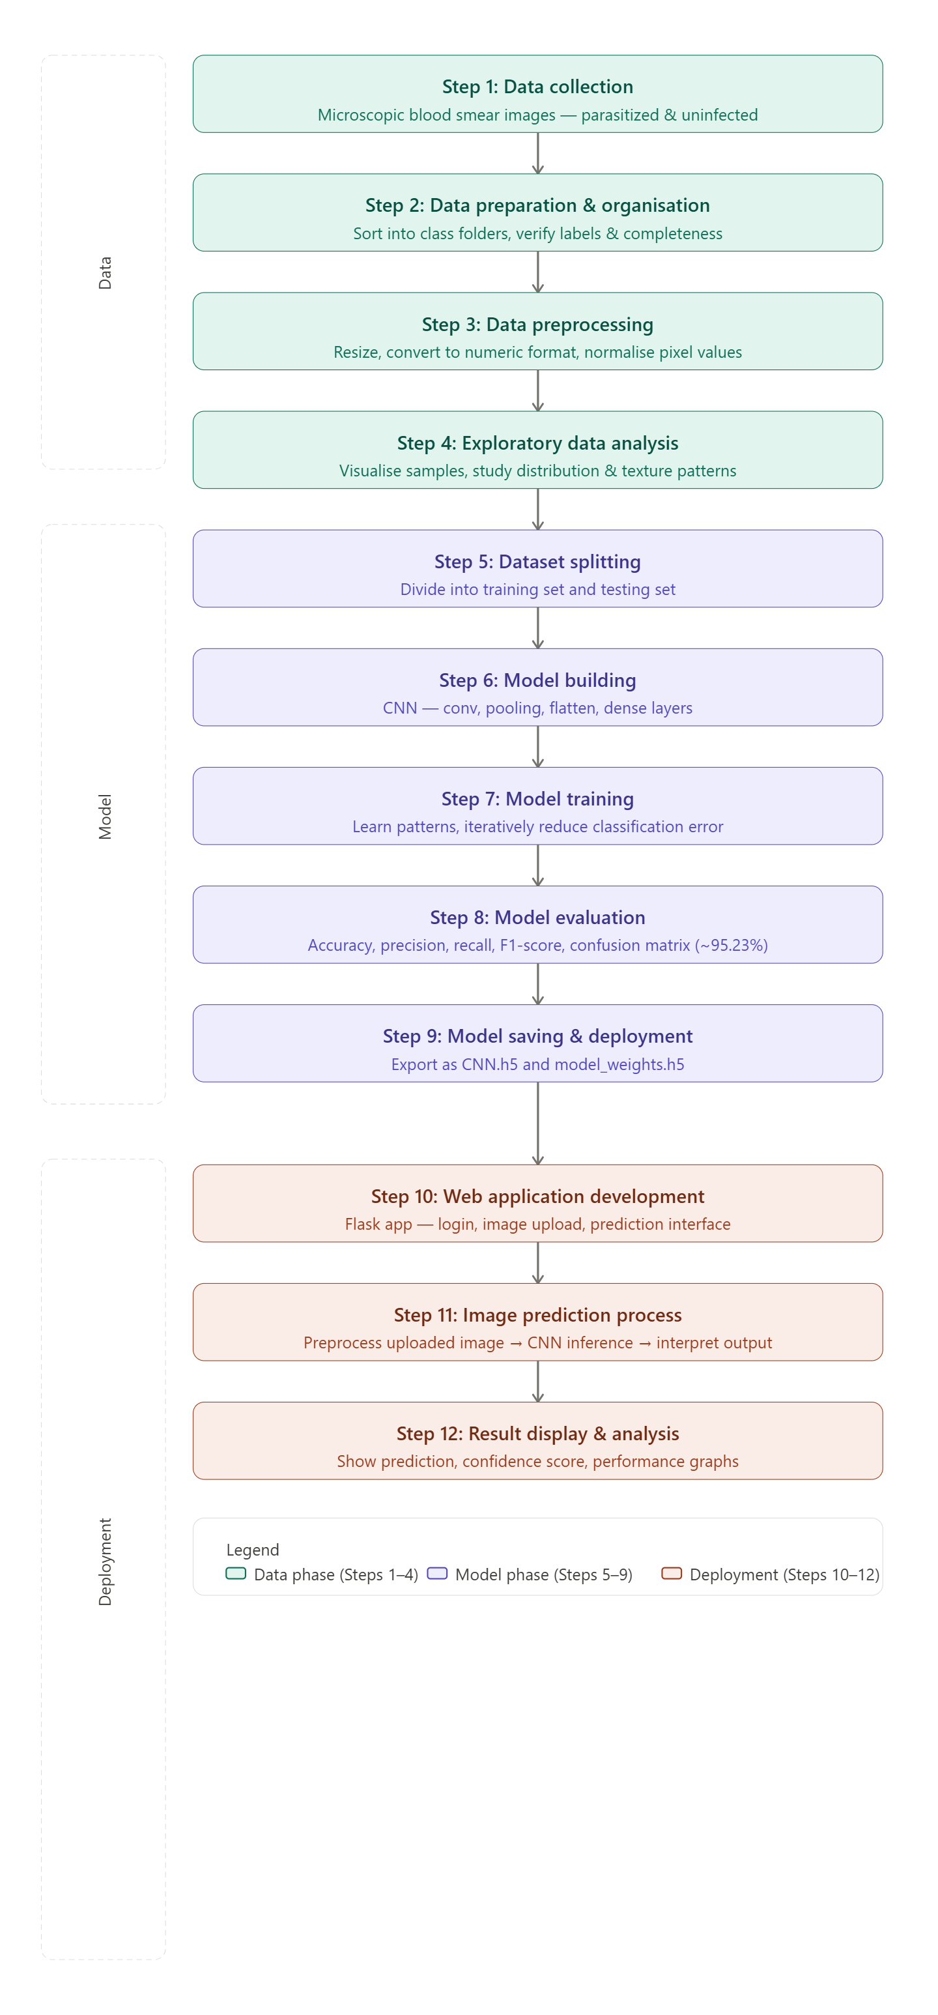
Methodology
Date
RV COLLEGE OF ENGINEERING

Slide 8
Tools and Technologies
Category
Technology
Purpose / Usage
Core Language
Python
Main programming language for model training and web application logic.
ML / AI
TensorFlow / Keras
Build, train, and run the CNN model for malaria classification.
Web Framework
Flask
Web framework used to create the malaria detection web application.
Frontend
HTML, CSS, Bootstrap
Design the user interface and make the application responsive.
Data Processing
NumPy
Numerical operations and handling model output arrays.
Data Processing
Pillow (PIL)
Image loading, resizing, and preprocessing before inference.
Database & Auth
MySQL
Storing user and application-related data persistently.
Database & Auth
JWT
Secure authentication and session handling.
Database & Auth
SMTP / Email
Password reset and email notifications to users.
DevOps & Deploy
GitHub Actions
CI/CD pipeline and automated deployment workflow.
DevOps & Deploy
Render
Cloud deployment and hosting of the Flask application.
Development Tools
Jupyter Notebook
Experimentation, training, testing, and model analysis.
Date
RV COLLEGE OF ENGINEERING
12 technologies across 8 categories

Slide 9
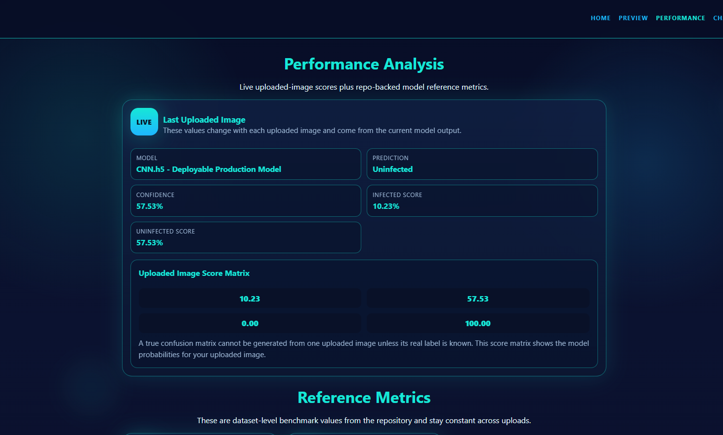
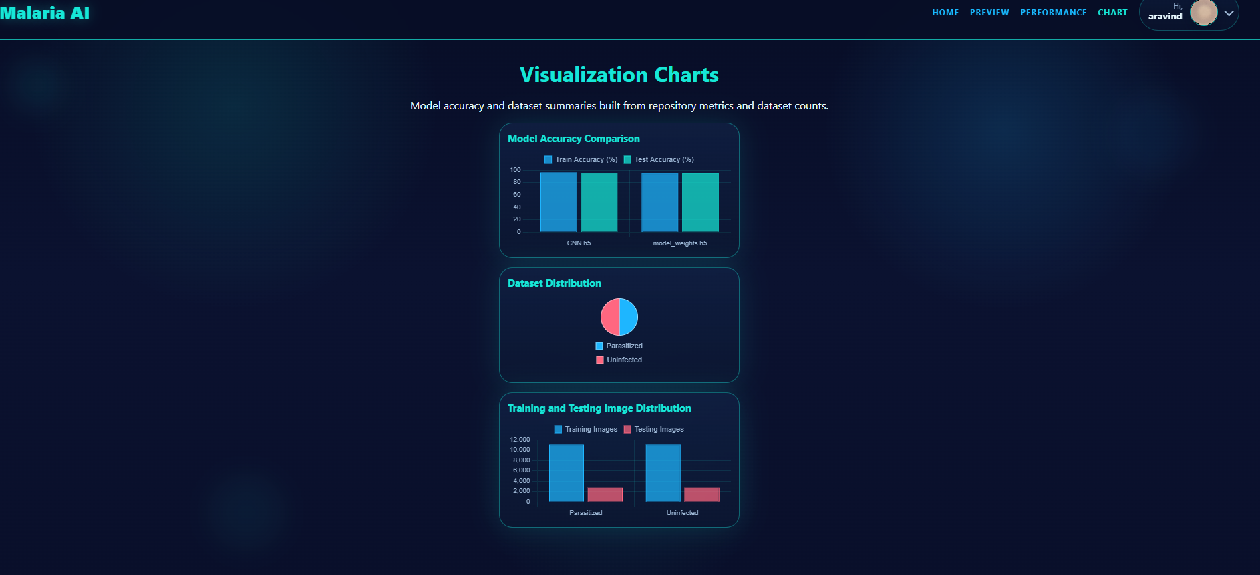
Demonstration
Date
RV COLLEGE OF ENGINEERING

Slide 10
Project Management & Cost
The project is designed as a low-cost academic prototype by using mostly open-source software and existing infrastructure.
Software cost: ₹0 because Flask, Python, TensorFlow/Keras, MySQL, Bootstrap, Chart.js, and GitHub Actions are open-source.
Model development cost: ₹0 if training is done on an existing laptop or institution-provided machine.
Hardware cost: ₹0 for the prototype stage if using a standard laptop with at least 8 GB RAM. For faster training, a GPU-enabled system is helpful but not mandatory for inference.
Deployment cost: low to moderate, depending on hosting. Render/free-tier deployment can be used for demo purposes.
Email service cost: ₹0 to low, depending on SMTP provider usage.
Data storage cost: minimal for profile images and model files.
Date
RV COLLEGE OF ENGINEERING

Slide 11
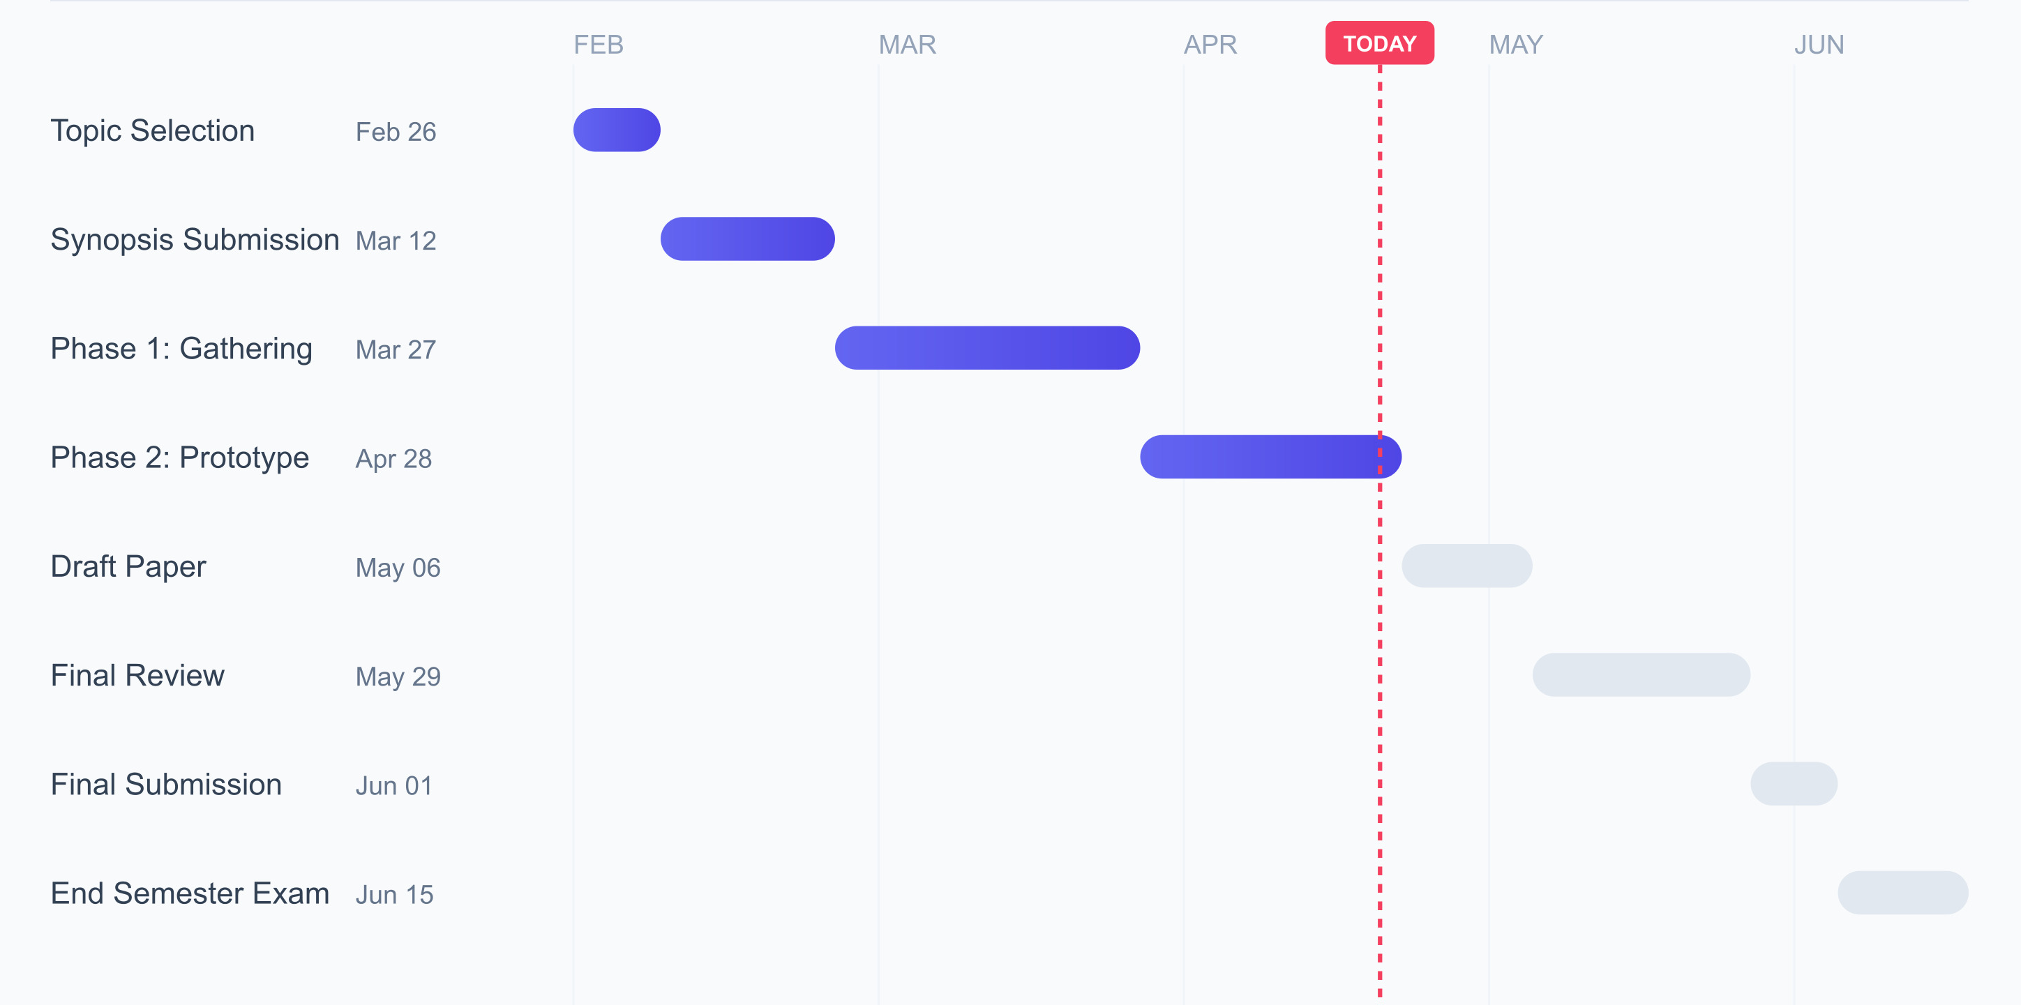
Timeline (Gantt chart or milestones)
Date
RV COLLEGE OF ENGINEERING

Slide 12
Thank you
Date
RV COLLEGE OF ENGINEERING

