Slide 1
EDA Capstone Project
Hotel Booking Analysis
Aravind Dasarapu
Pedagadi Prasanthi

Slide 2
Points to Discuss :
• Data Information
• Missing Values
• Outliers Handling
• Data Wrangling
• Bookings Analysis
• Cancellations Analysis
• Other Miscellaneous Analysis
• Correlation Heatmap
• Some important questions
• Inferences and Conclusions
• References

Slide 3
Data Summary : Given variables description
Hotel - type of hotel
is_cancelled - If the booking was cancelled(1) or not(0)
lead_time - Number of days that elapsed between the entering date of the booking into the PMS and the arrival date
arrival_date_year - Year of arrival date
Arrival_date_month - Month of arrival date
arrival_date_week_number - Week number for arrival date
arrival_date_day- Day of arrival date
Stays_in_weekend_nights - Number of weekend nights (Saturday or Sunday) the guest stayed or booked to stay at the hotel
stays_in_week_nights - Number of week nights (Monday to Friday) the guest stayed or booked to stay at the hotel
adults - Number of adults
children - Number of children
babies - Number of babies
meal- Kind of meal opted for
country - country of origin(code)
market segment - Which segment the customer belongs

Slide 4
distribution_channel- How the customer accessed the stay- corporate booking/Direct/TA.TO
is_repeated_guest - Guest coming for first time or not
previous_cancellation - Was there a cancellation before
previous_bookings - Count of previous bookings
reserved_room_type - Type of room reserved
assigned_room_type - Type of room assigned
booking_changes - Count of changes made to booking
deposit_type - Deposit type
agent - Booked through agent
days_in_waiting_list - Number of days in waiting list
customer_type - Type of customer
required_car_parking - If car parking is required
total_of_special_req - Number of additional special requirements
reservation_status - Status of reservation
reservation_date - Date of reservation
Data Summary continued…

Slide 5
Missing Values :
High Missing Values Columns:
“Agent”
“Company”
Low Missing Values Columns:
“Children”
“Country”
As the columns[“agent,”company”] have high missing values and won’t be relevant for our analysis we drop the columns
As the columns[“children”,”country”] have low missing values we drop respective rows containing missing values of above columns

Slide 6
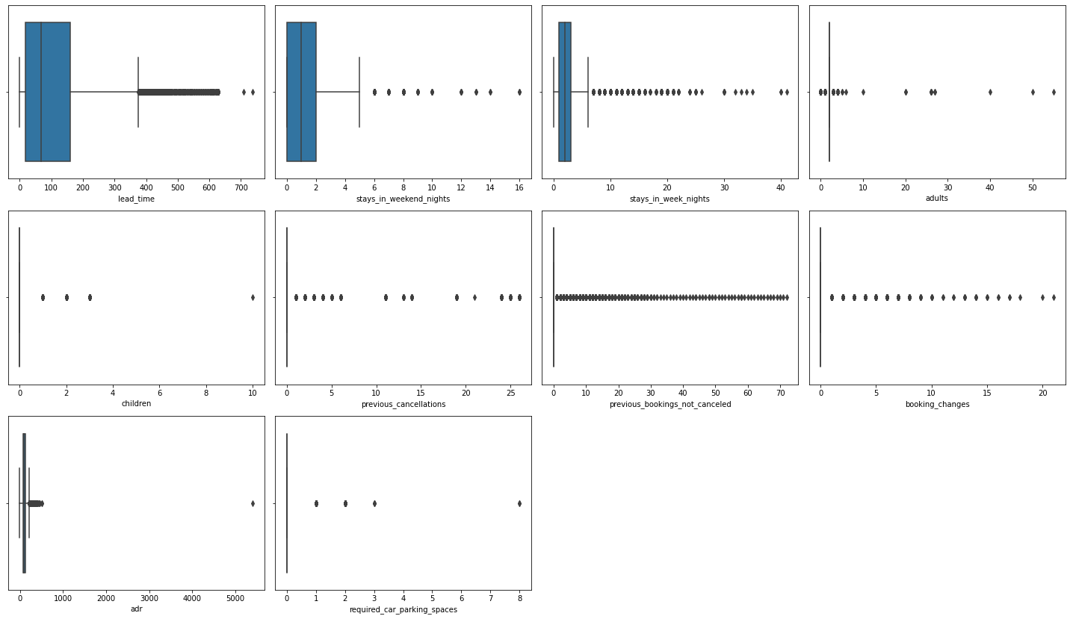
Outliers Handling :
We finally clean the data by updating outliers restricting the domain within some respectives values for each above columns. Now our dataset is ready for some analysis

Slide 7
Data Wrangling :
In the data from Average Daily Rates(“adr”) column we get price per person with respect to stays of nights(week, weekend). From this we add new column “price”.
By adding columns [“adults”, “children”], we get total number of persons staying in the hotel. From this we add new column “total_people”.
By diving column “adr” and “total_people”, we get average daily rates per person. From this add new column “adr_pp”.
Finally we convert the column “arrival_date” to datetime format.

Slide 8
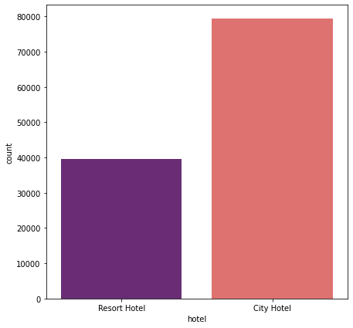
Bookings Analysis:
From this we can infer the following questions :
Which hotel has more bookings ?
Which type of customer has more bookings ?
Which hotel has more cancellations ?
From the plot we can conclude city hotel type has more bookings

Slide 9
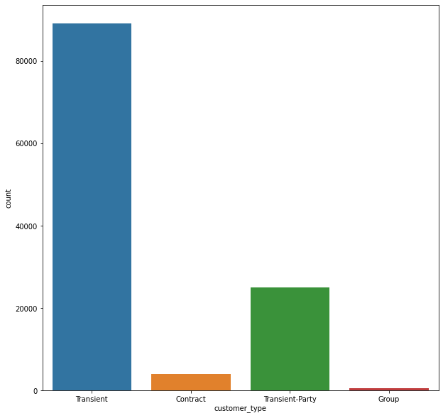
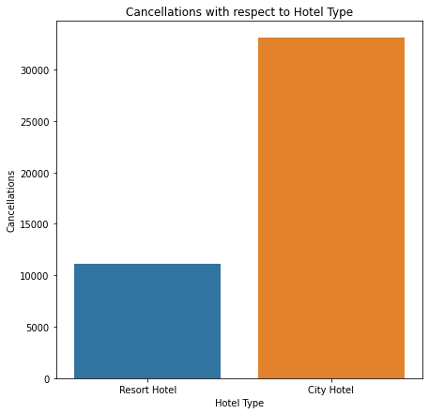
From above plot we can say that more bookings are from transient customers
More cancellations are done in city hotels

Slide 10
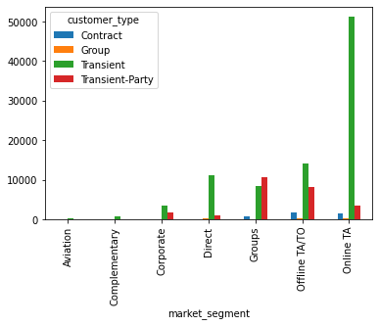
Market Segment and Distribution Channel Analysis :
Which market segment has more bookings ?
Which distribution channel more bookings are made ?
Which distribution channel generates more revenue from hotel ?
From the plot we can say most customers are coming from online travel agents (TA) market segment and customers are mostly of transient type

Slide 11
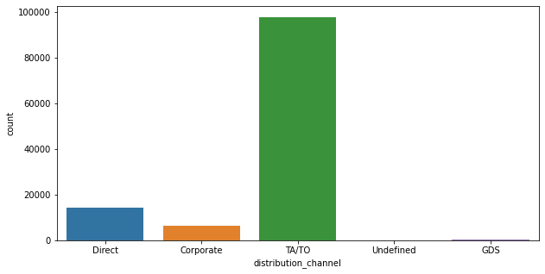
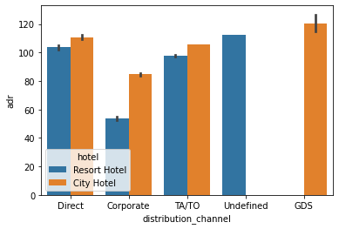
Market Segment and Distribution Channel Analysis continued…
From plot we can say GDS distribution channel generates no revenue for resort hotels, whereas city hotels do not generate revenue from Undefined distribution channel
Most bookings are made through TA/TO distribution channel

Slide 12
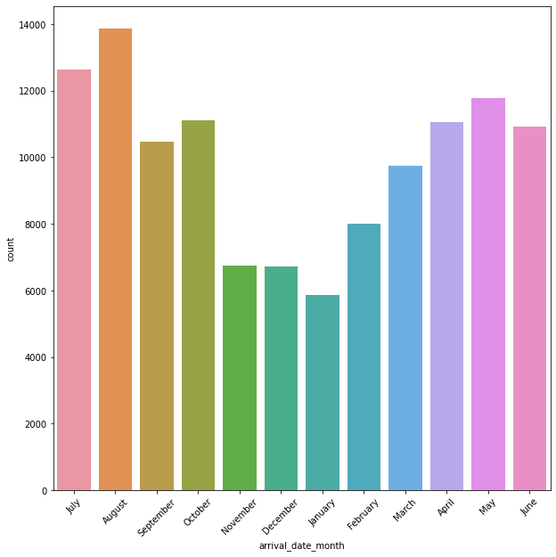
Time Analysis :
Which month has most and least bookings ?
How ADR changes through months ?
How ADR changes in a month ?
From the bar plot we can say that august month has most bookings where as january has least bookings

Slide 13
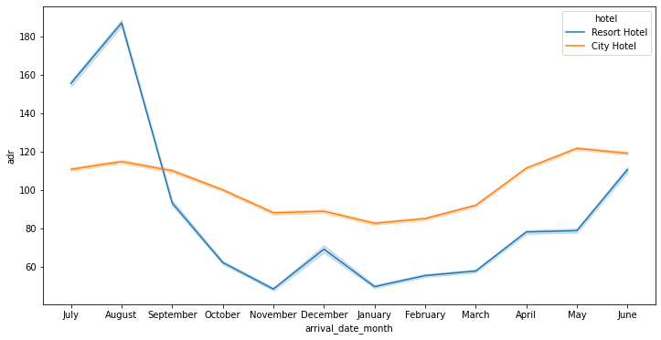
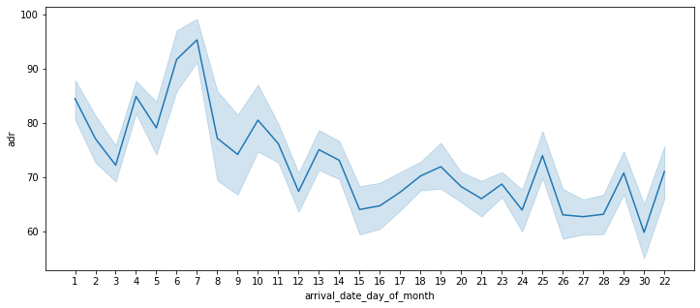
Time Analysis continued …
For resort hotel adr is higher in july, august and adr for city hotel does fluctuate little with changes in months
ADR fluctuation in month November we can see that price changes in starting of month but at the end of the month price decreases overall`

Slide 14
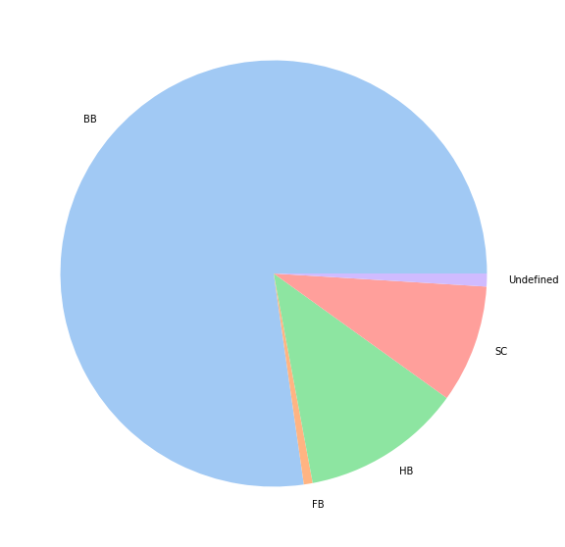
Miscellaneous Analysis :
What is the most preferred meal ?
What is the most preferred room type of guests ?
Which is most guests country of origin ?
From the pie chart we can say that most guests prefer Bed and Breakfast (BB) type of meal

Slide 15
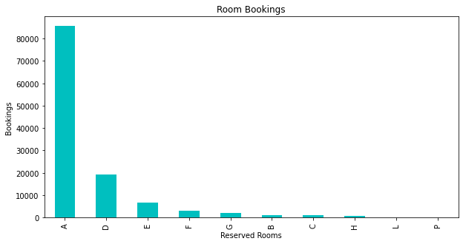
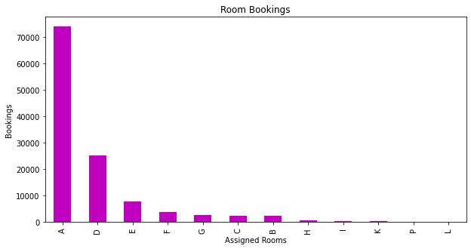
Miscellaneous Analysis continued :
From above bar plots we can say that most guests reserved rooms is of “A” type.Sometimes the assigned room type differs from the reserved room type due to hotel operation reasons (e.g. overbooking) or by customer request

Slide 16
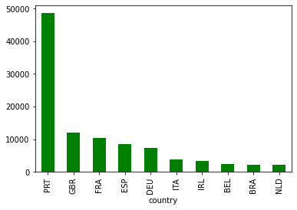
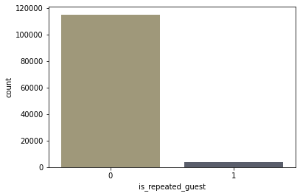
Miscellaneous Analysis continued :
Plot shows that Portugal is where most guests origin.
We can say that repeated number of guests is low

Slide 17
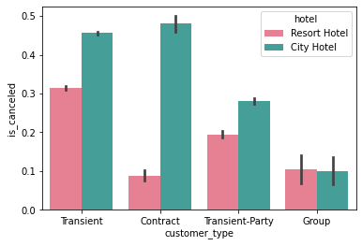
Miscellaneous Analysis continued :
we can say the most guests stay in city hotels compared to resort hotels, but guests of group type is little more in resort hotel than city hotels

Slide 18
Conclusions:
The majority of guests come from western europe countries.
The majority of reservations are for city hotels.
The number of repeated guests is too low.
The majority of reservations converts into successful transactions.
The many bookings are made in 2016 compared to 2015 and 2017
The majority of Bookings are made through Online Travel Agents.
The month of highest occupation is august with 11.65% of the reservations. The month of lest occupation is january with 4.94% of the reservations.
The Bed & Breakfast option is the most popular, with a frequency of 77.26%.
Transients are the most common customer type, they represent 75% of the total customers.
More guests are staying at city hotel in week days.

Slide 19
Thank You

