Slide 1
Git & Github
Timothy McRoy

Slide 2
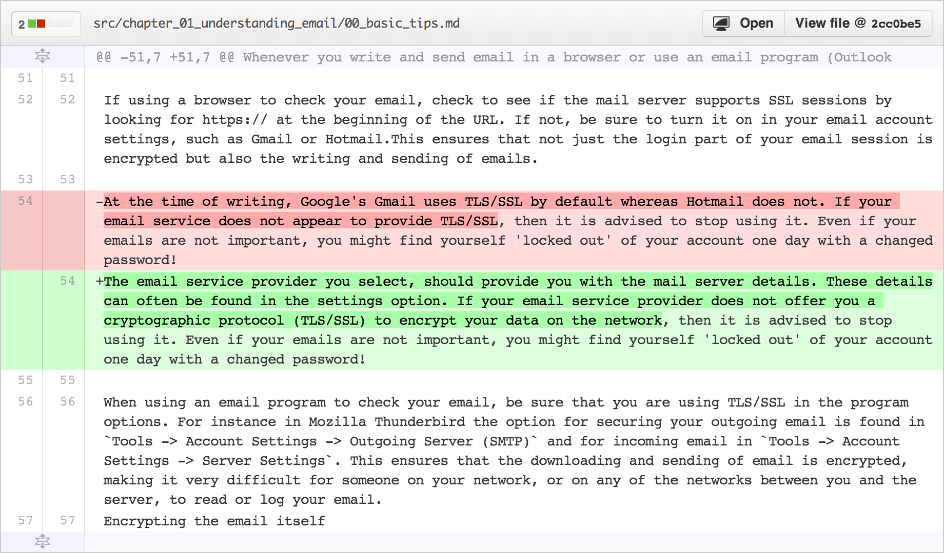
Git
Version Control System
Allows you to track changes in a project
Old Line
New Line
Modified from slides
Of Timothy McRoy
https://github.com/blog/1707-soft-wrapping-on-prose-diffs

Slide 3
Git: Can download and run on your own computer.
Not a backup system
A backup system is used to recover files in case something bad happens to the original copy
Git tracks changes locally in a directory called .git
If that directory was deleted, git would lose all of the previous versions
Modified from slides
Of Timothy McRoy

Slide 4
Github: Web-based collaboration
Github is a website which will help visualize some of the features of git
Github, like many code hosting websites, allows for public hosting of programs
This allows for interested programmers to take part in furthering development
Modified from slides
Of Timothy McRoy

Slide 5
For the free version of Github (where all repositories are public):
File and repository size limitations
We recommend repositories be kept under 1GB each. This limit is easy to stay within if large files are kept out of the repository.
If your repository exceeds 1GB, you might receive a polite email from GitHub Support requesting that you reduce the size of the repository to bring it back down.
In addition, we place a strict limit of files exceeding 100 MB in size. For more information, see "Working with large files.“
https://help.github.com/articles/what-is-my-disk-quota/

Slide 6
Github
Github will store your work, but it is not a backup system
It may be somewhere other than your computer
Limited file size (100MB)
Not part of the design of Git or Github
Encryption, distributed copies, guarantee of uptime, etc.
Modified from slides
Of Timothy McRoy

Slide 7
Share and collaborate
Easy to distribute work
clone
Easy to improve on the work of others
fork
Easy to take help from others
pull
Modified from slides
Of Timothy McRoy

Slide 8
Résumé pad
A Github profile is a great way to showcase your work
Link to LinkedIn, but it’s not a LinkedIn replacement
Modified from slides
Of Timothy McRoy

Slide 9
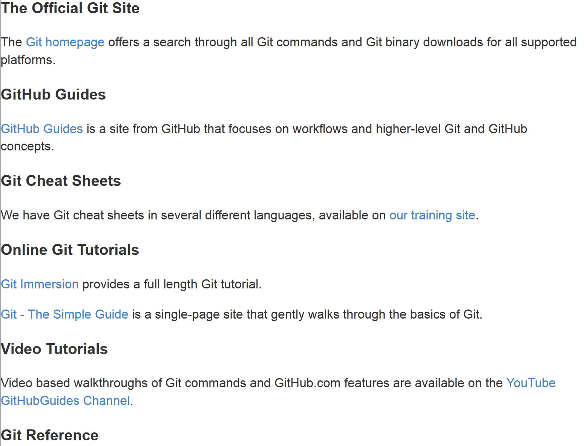
https://help.github.com/articles/good-resources-for-learning-git-and-github/

Slide 10
Getting software from Github
Open up a terminal and change your current directory to the one where you would like the repository (Program) to be saved.
Navigate to the repositories Github page in a web browser
For this example, we’ll use
https://github.com/timothy-mcroy/mapper
Modified from slides
Of Timothy McRoy

Slide 11
Getting software from Github
If you decide that you like the repository, you can
Copy the URL of the page
Type “git clone ” into the terminal
Paste the URL in to the terminal
Press enter
This will download the entire repository in a directory named after the repository. In the case of the example, the directory would be called mapper.
https://github.com/timothy-mcroy/mapper
Hosting site Author Repository
hawkid@serv1234[~]% git clone https://github.com/timothy-mcroy/mapper
Modified from slides
Of Timothy McRoy

Slide 12
Don’t forget to install it
Check the Github wiki page for installation instructions
Sometimes, a package has several dependencies that need to be installed and that won’t necessarily be mentioned
Occasionally, those instructions require administrator privileges.
For the mapper repository, the CSG administrators have already installed everything that you wouldn’t be able to install. You will still need to get the other things installed, as they work on a per-profile basis.
Modified from slides
Of Timothy McRoy

Slide 13
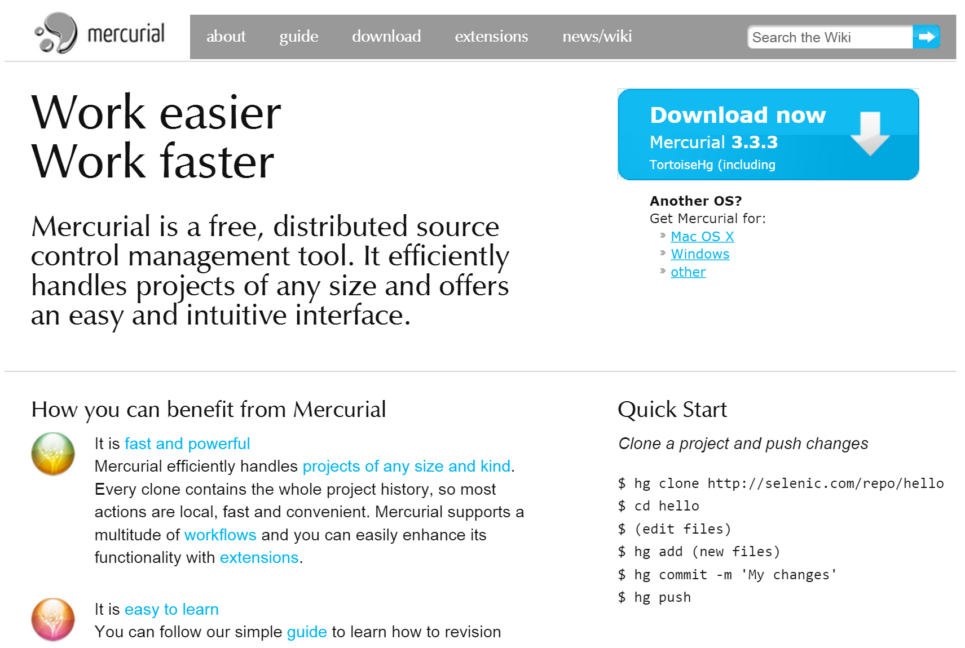
Another Distributed Version Control System

