Slide 1
Statistical analysis on Speed dating
By
Aravinda Reddy Dandu(ad1452)
Rithvik Reddy Ananth(ra830)
Soumya reddy(sa1607)
Srikaavya Toodi(st938)

Slide 2
Understanding the data from Visual Analytics
Opinion of participants in the survey of what they want, what theirs peers are looking for, and what they think their opposite gender is looking for.
Demographics of the data.
Career field of the participants.
Correlation between habits of men and women.
Analysis of top men and women (people who got a second date).

Slide 3
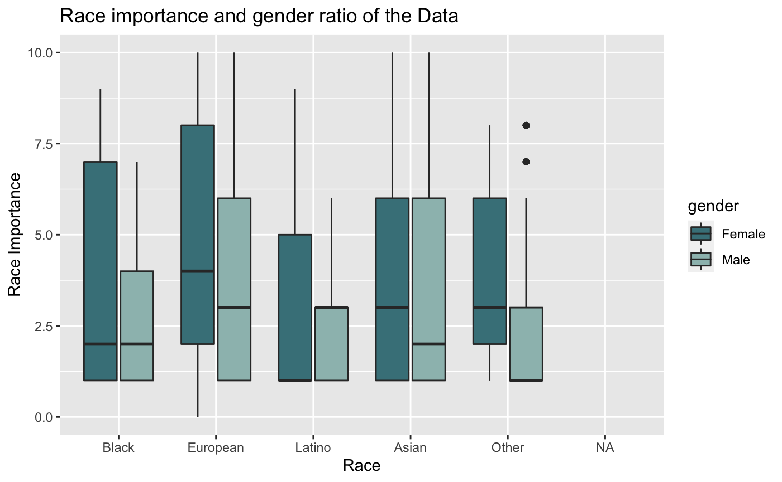
In the given data set we can see that Europeans are the highest among all the races.
In this survey apart from Asians, the number of females are more compared men.
There are twice as many as Latino and Black females compared to males.

Slide 4
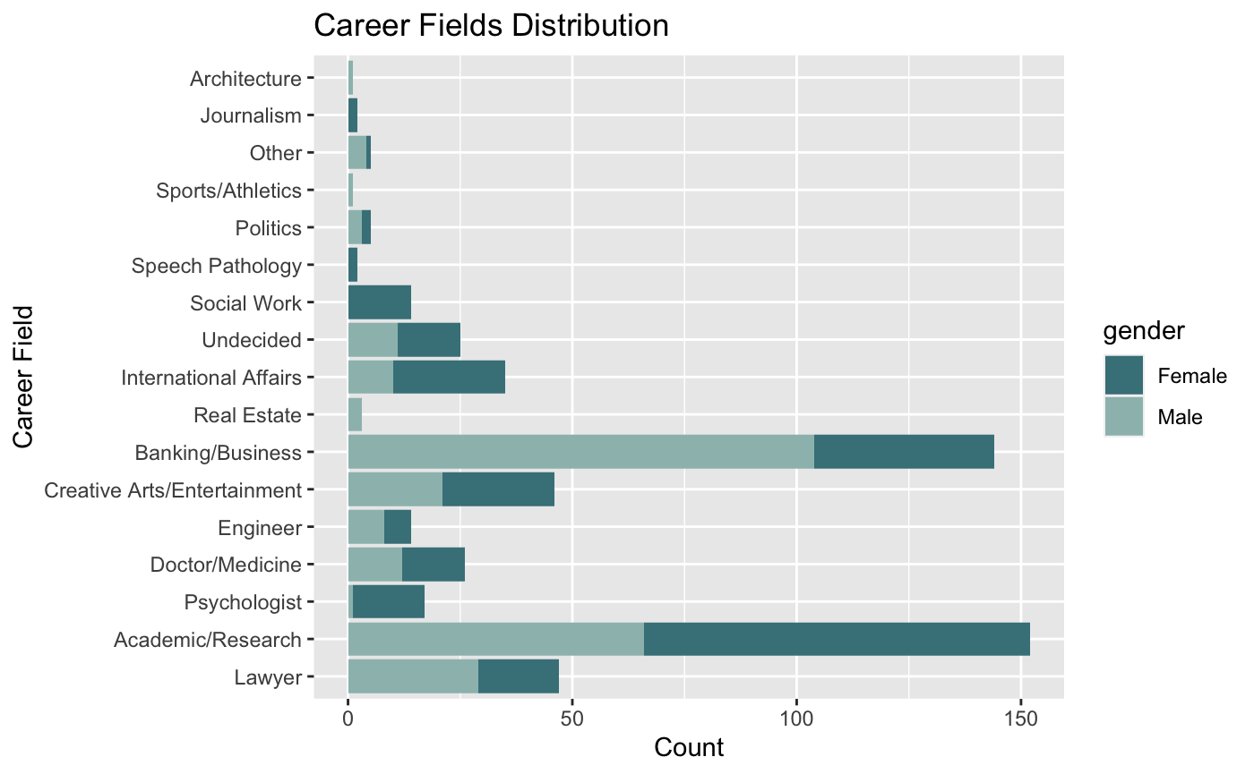
More number of people are into academic research, followed by business/ banking and lawyers.
Females dominate in academic research and males in business/banking.
Few interesting observations: there are no females who are pursuing a career in architecture, real estate and sports in our data set. Vice-versa, there are no males in journalism, speech pathology.

Slide 5
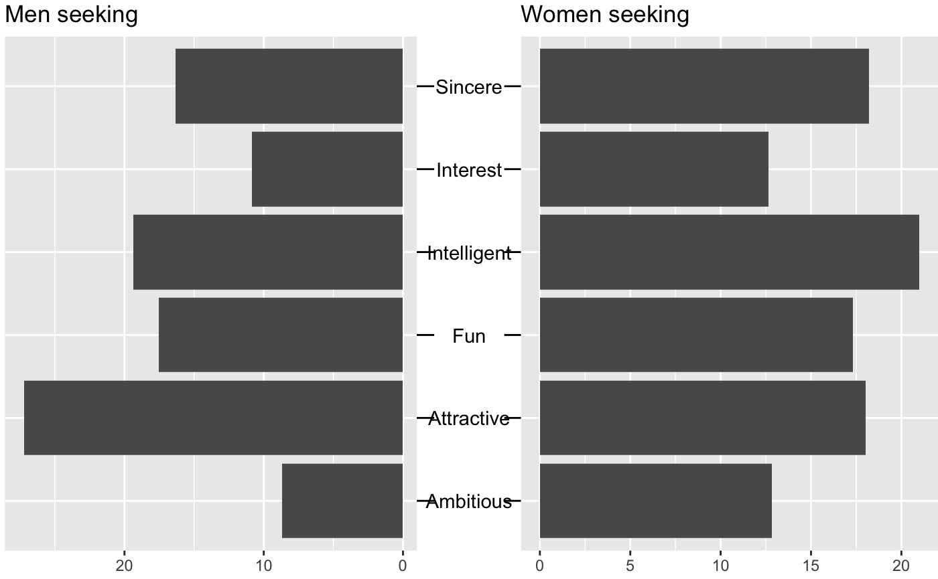
What people are looking for in the opposite gender

Slide 6
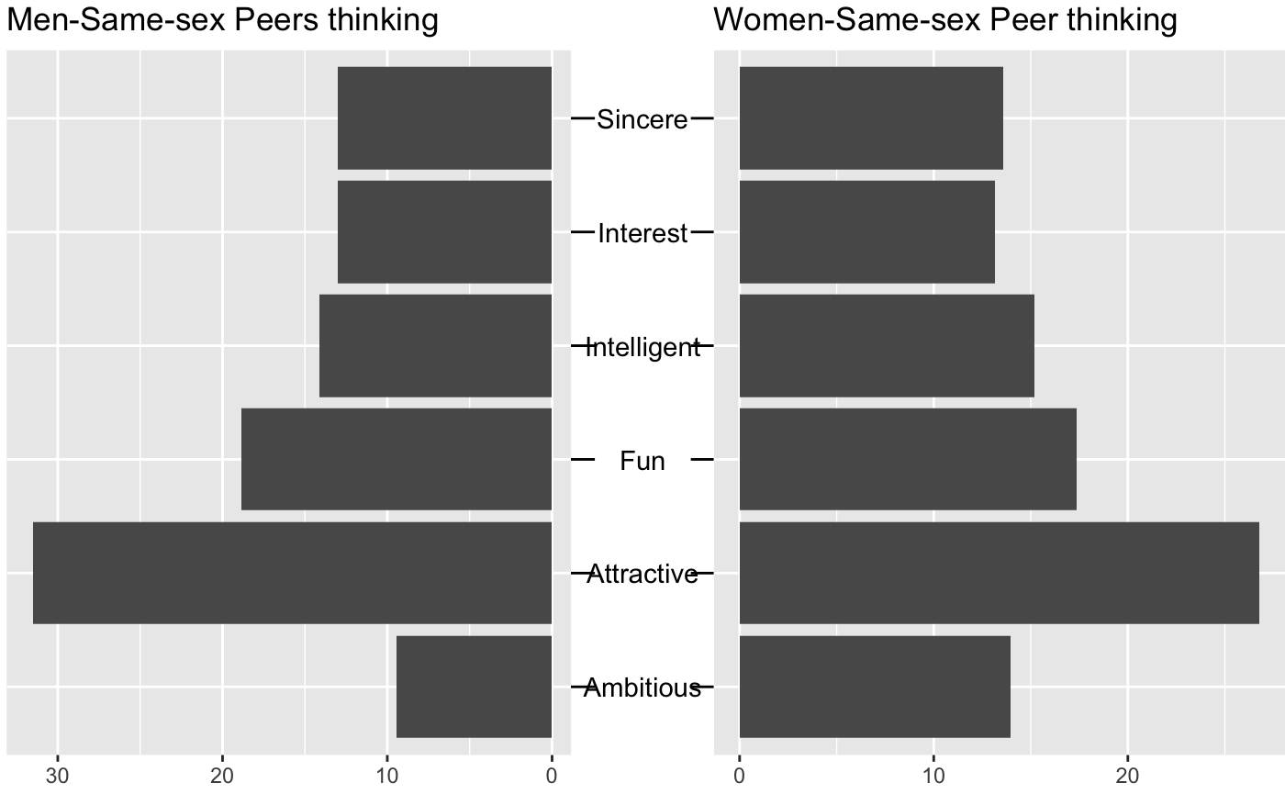
What people think their peers are looking for in the opposite gender

Slide 7
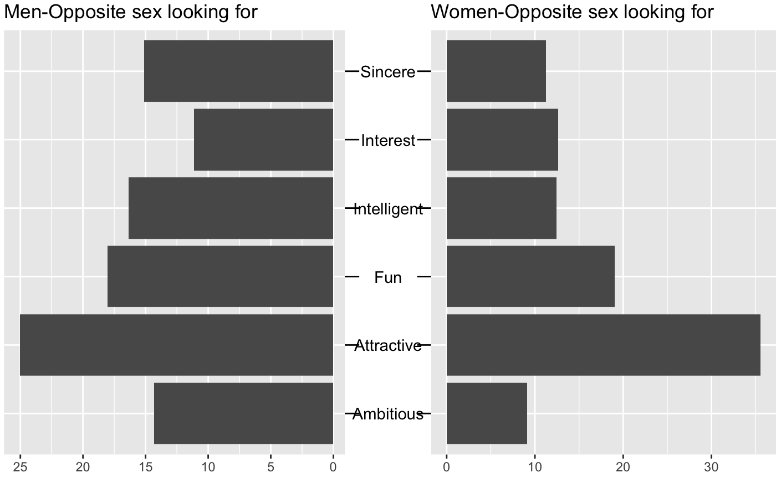
What people think their opposite gender are looking for in their partner

Slide 8
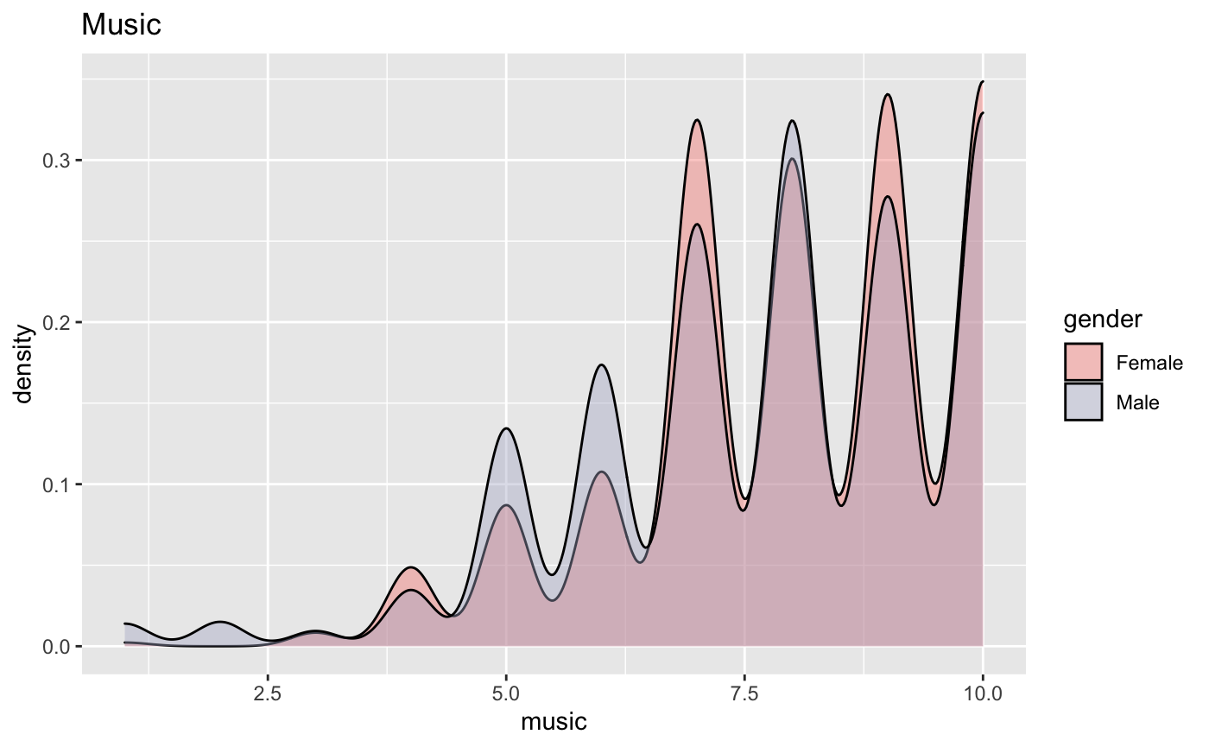
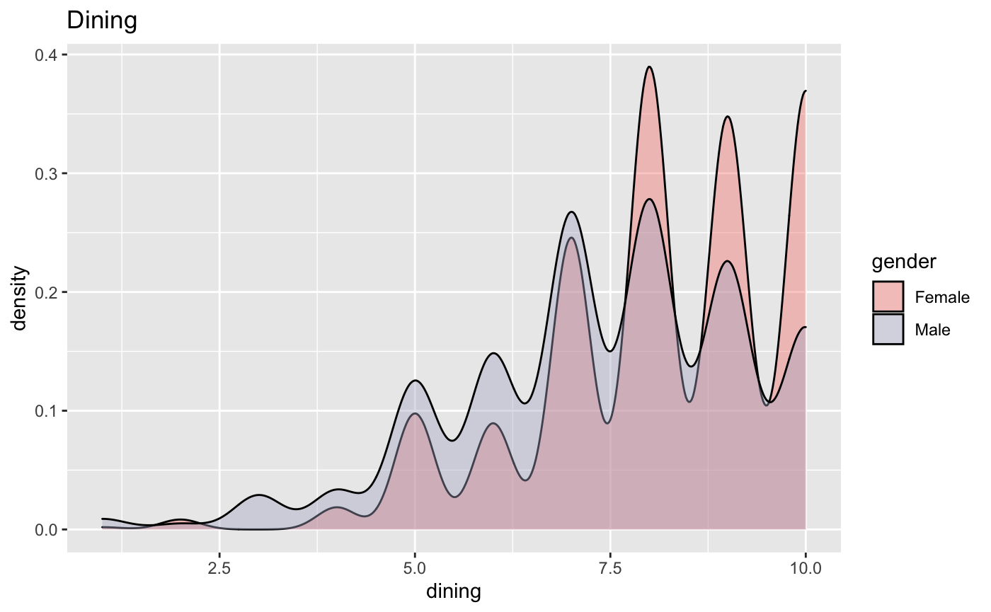
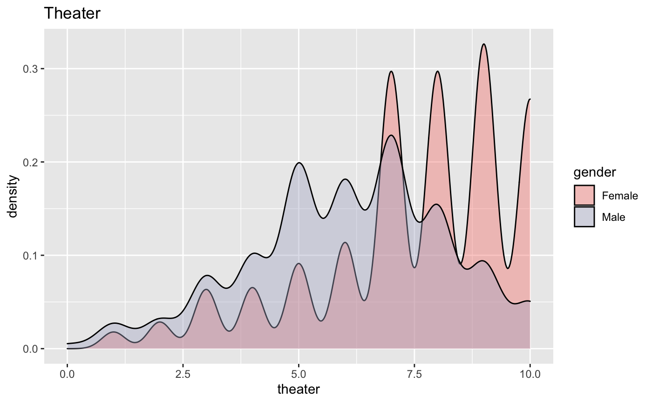
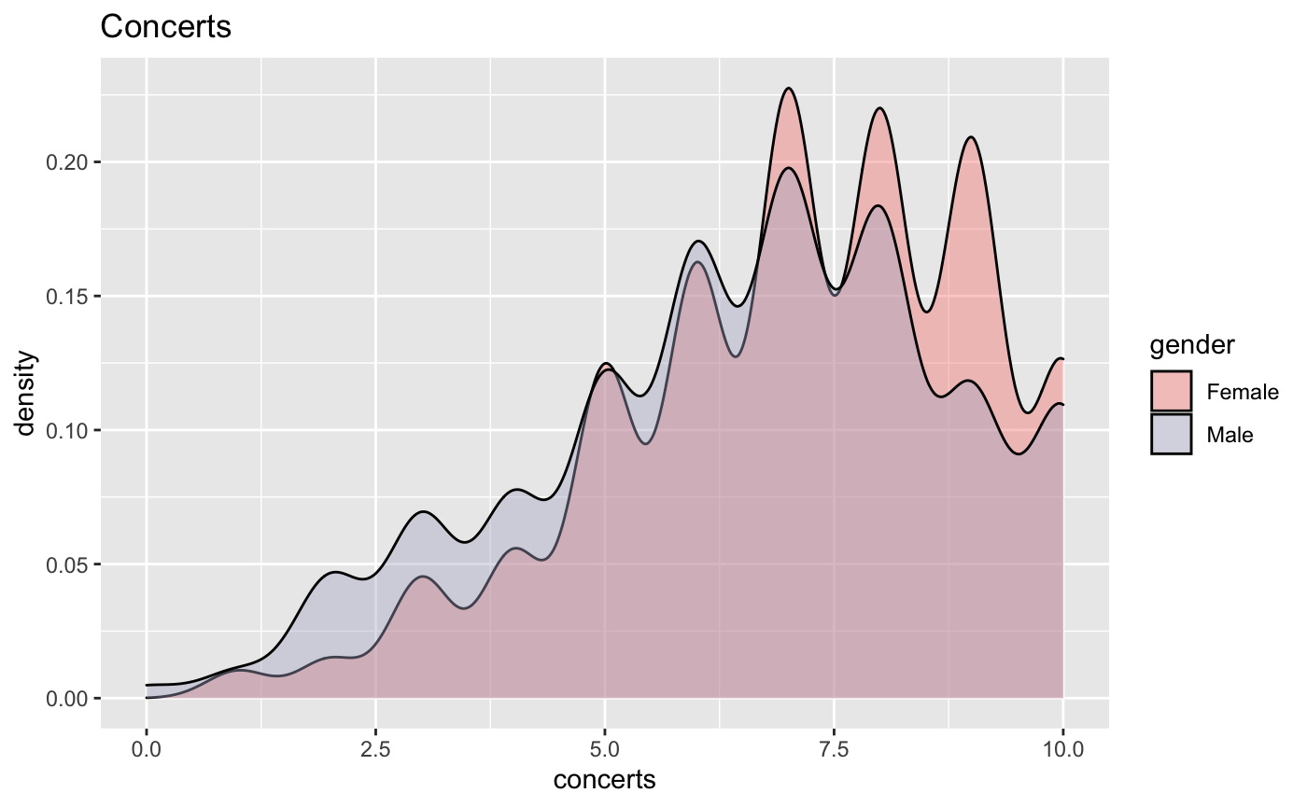
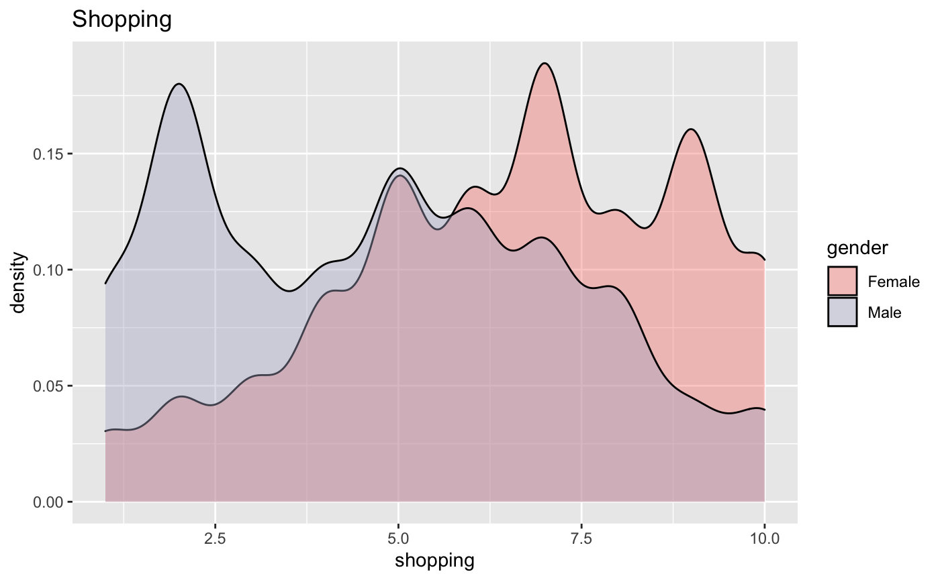
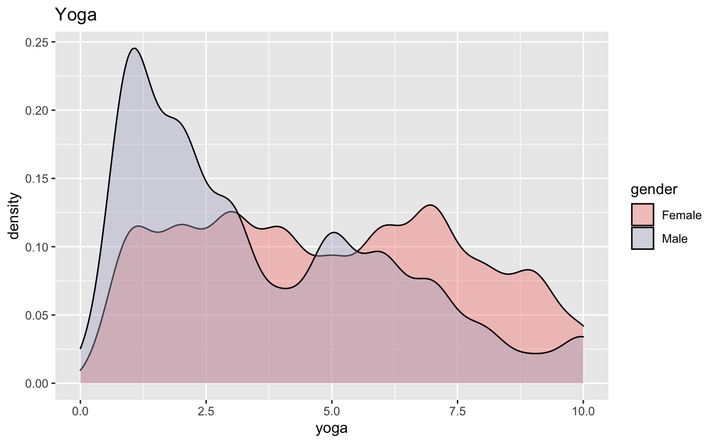
We can see that there are many similarities in habits such as music, dining, and concerts.
The contrast is seen clearly in shopping, yoga, theater habits for male and female.

Slide 9
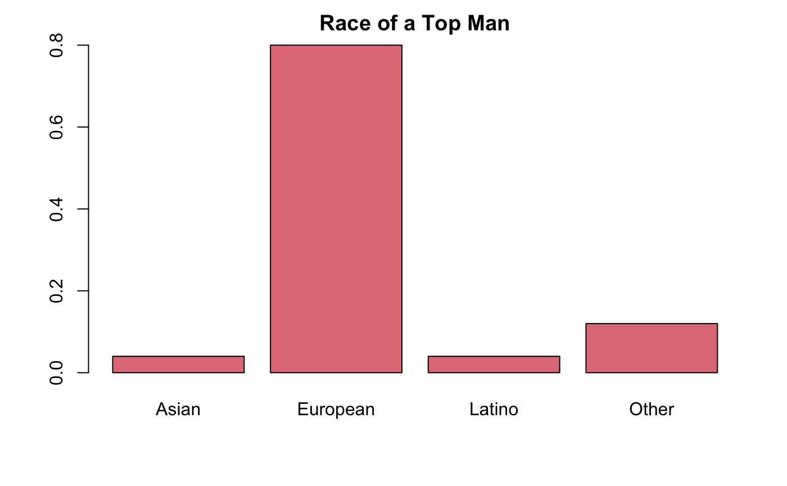
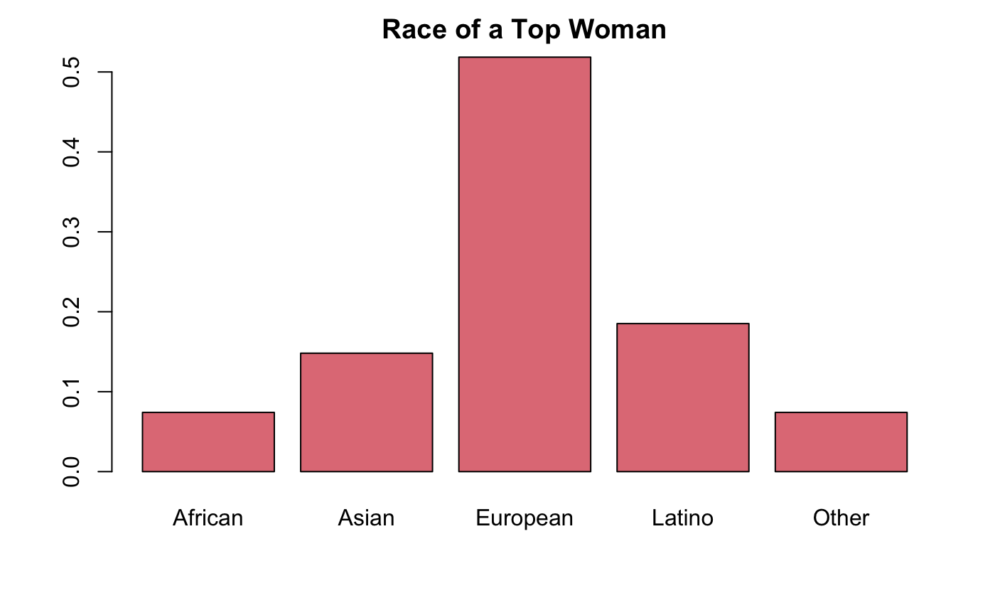
European men are most desired and Asian men are least desired.
European women are most desired and African women are least desired.

Slide 10
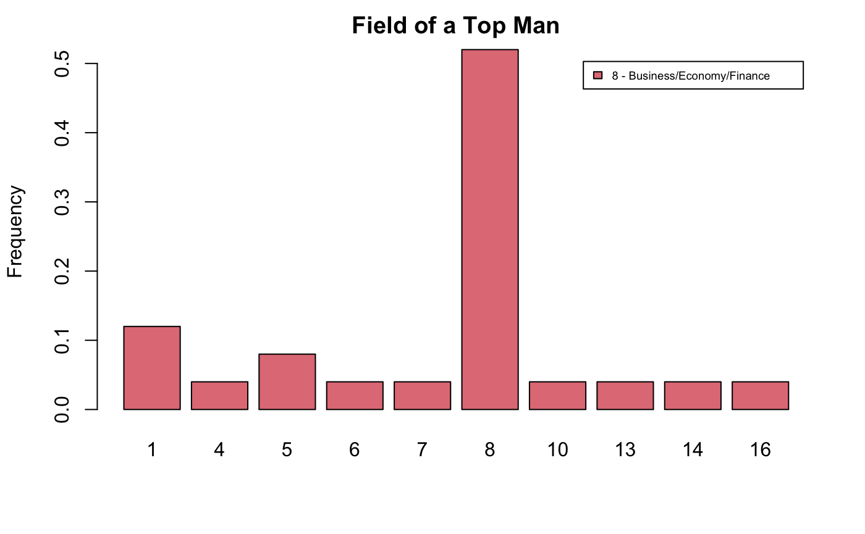
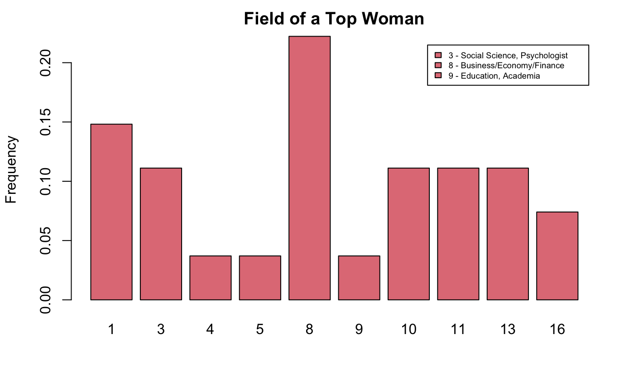
Top women are pursuing a career in business/finance/banking and Top men are also pursuing a career in business/finance/banking by large margin.
Top women are almost equally distributed in different type of career fields, but top men are predominantly into business/finance/banking.

Slide 11
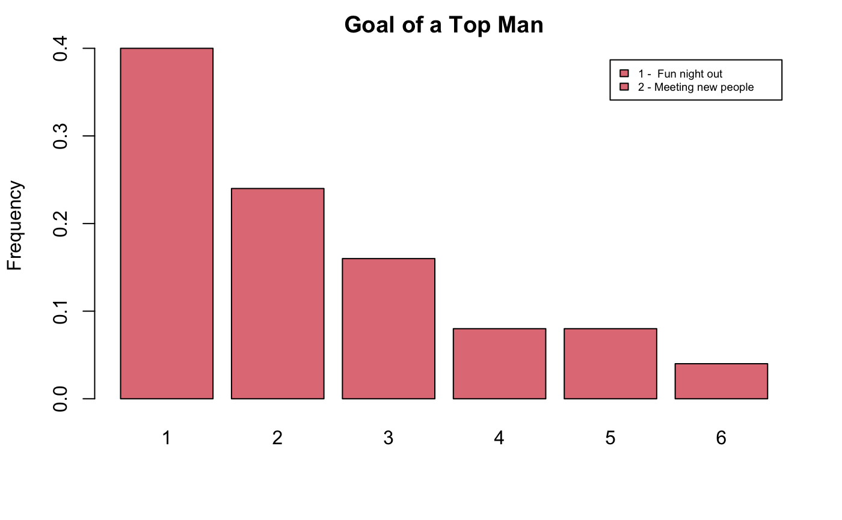
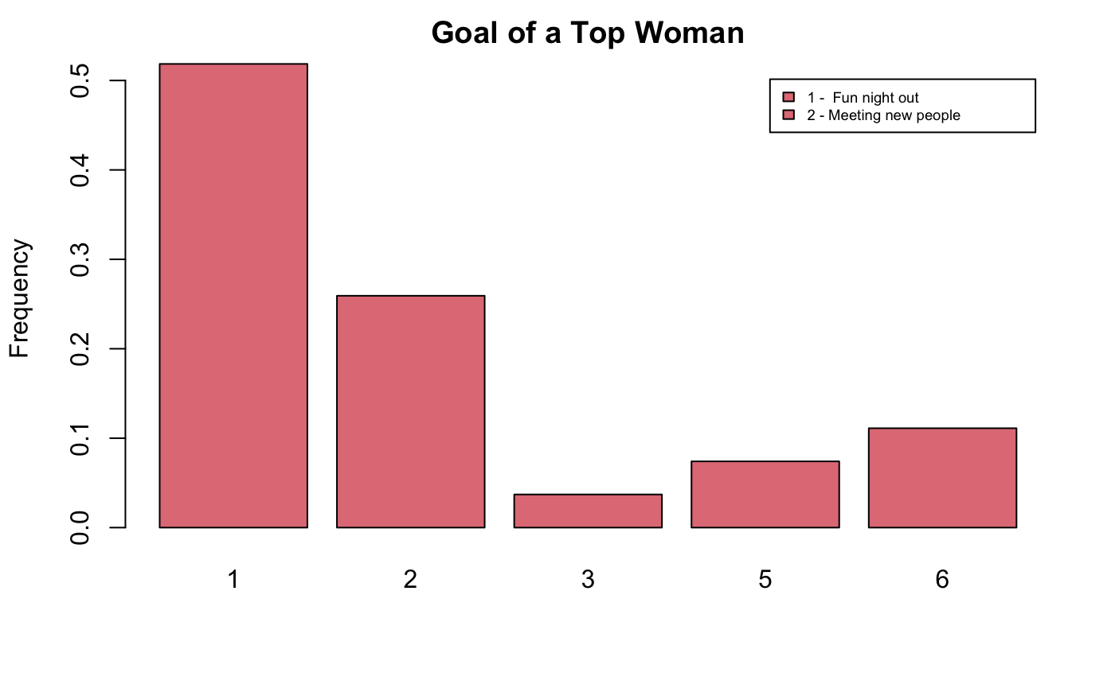
The goal of top men and women are to have a fun night out and to meet new people.

Slide 12
EM clustering to find patterns in correlations
How are interests, race and age co-related with positive decision from a person?
To answer this, we have constructed a correlation map between interests, race of the person and their partner along with their positive response percentage.
Now to identify if there are any patterns or similarities between them, we have used EM algorithm to classify the data into 3 cluster. Expectation–maximization (EM) algorithm is an iterative method to find (local) maximum likelihood or maximum a posteriori (MAP) estimates of parameters in statistical models, where the model depends on unobserved latent variables. Under interests I have taken “ goal, date, sports, tv sports, dining, museums, art, hiking, gaming, clubbing, reading , tv, theater, movies, concerts, music, shopping, yoga” fields of the data on a scale of 1 to 10 a person rates their interest in each field.

Slide 13
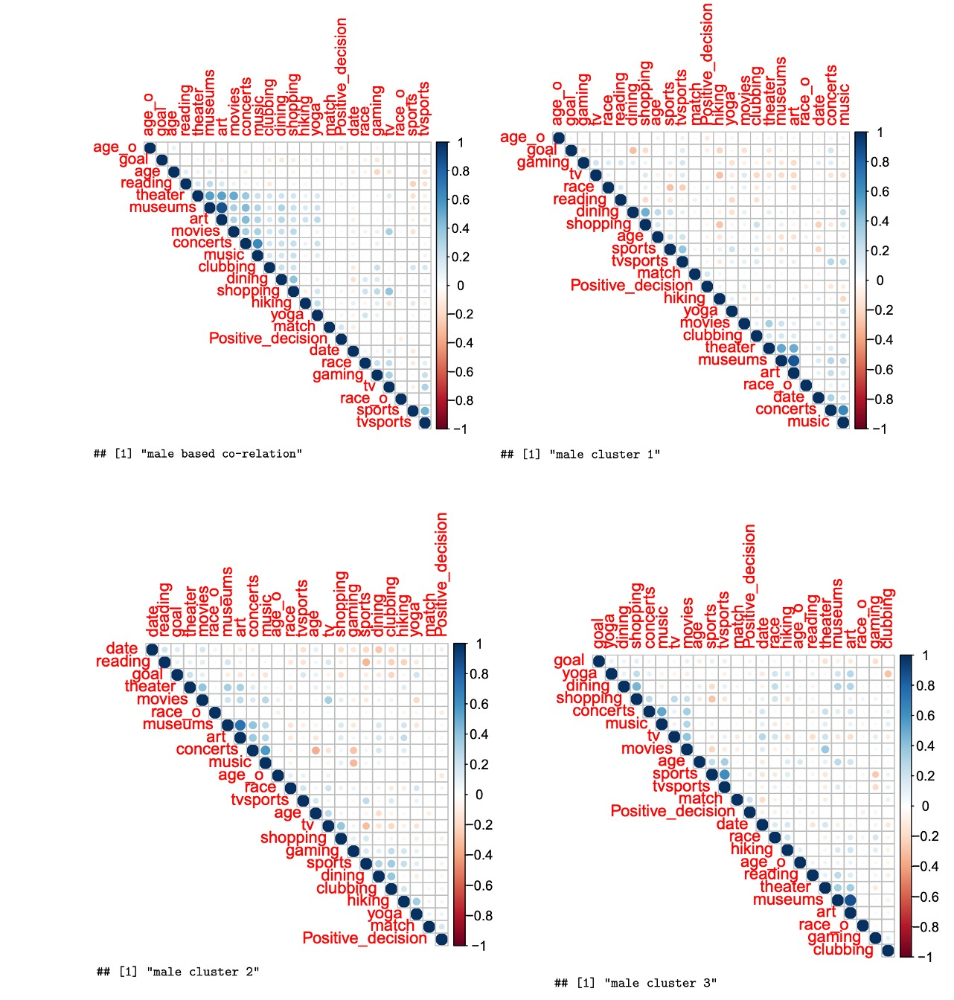
Male data correlation plots

Slide 14
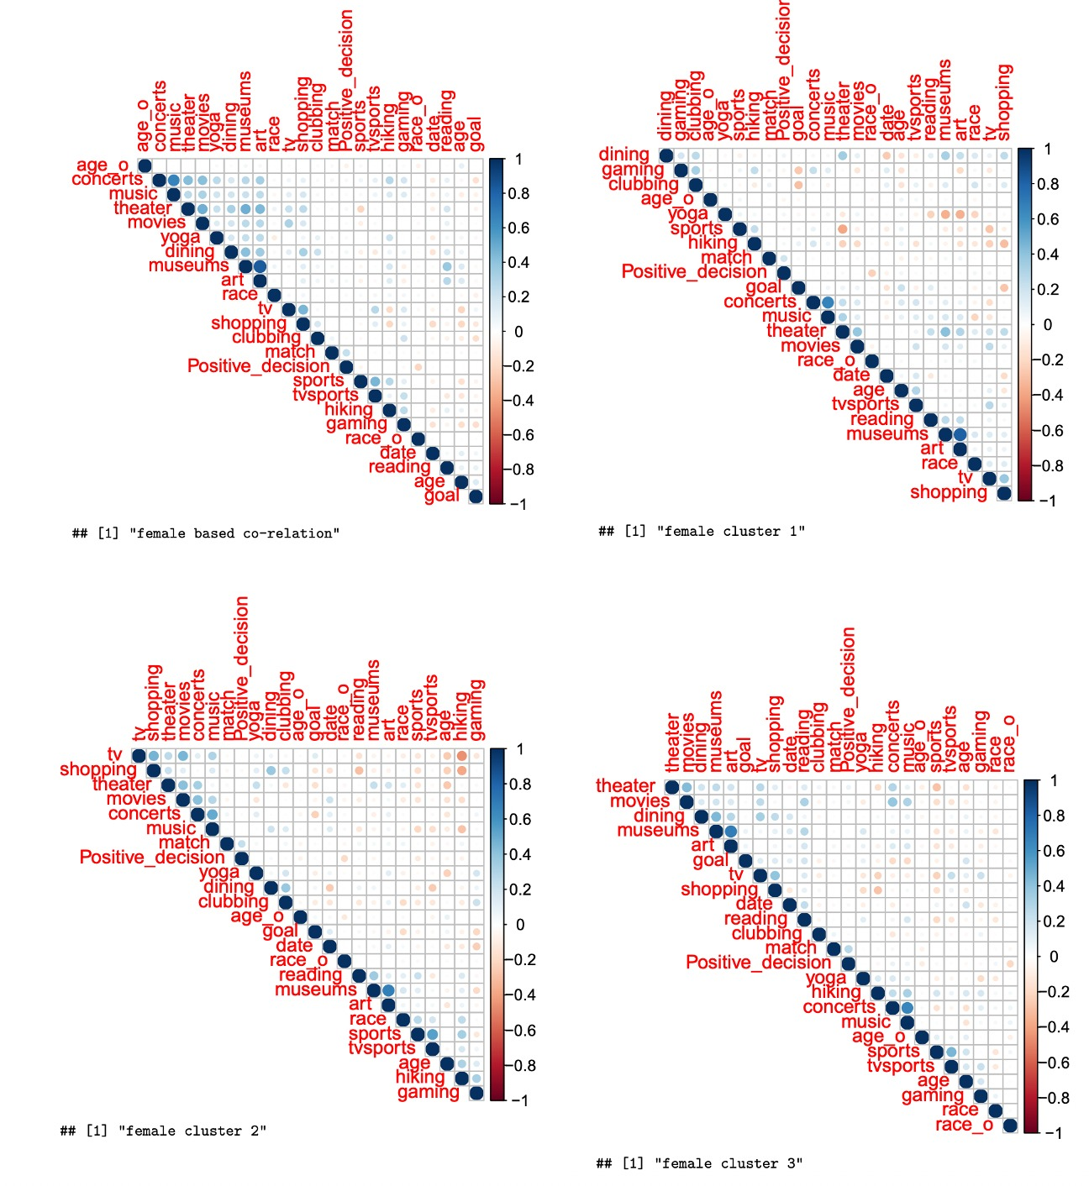
Female data correlation plots

Slide 15
Inferences:
Although, all the 3 clusters have varied interest co-relation between them, we can see for women race of the opposite gender(race_o) has the highest negative correlation with positive decision from their partner. This means that they are more interested in people of other races.
Men in general have negative co-relation with their partners age and gender. We can see that the data with common interests have been clustered together. For instance, cluster 3 in males has people who are more interested in concerts, music, reading, art, museum and theater. While cluster 2 has people more interested in shopping and dining.

Slide 16
Do men or women over-estimate themselves?
We have plotted a radar chart for both men and women based on how they rate themselves and how they rate their partners.
This analysis essentially tells us where our self-evaluation is compared to what their partners think of them.
After analyzing the data, we have found attractiveness, sincerity, ambitiousness, intelligence and fun to be some of the import data to decide on an individual’s perception.

Slide 17
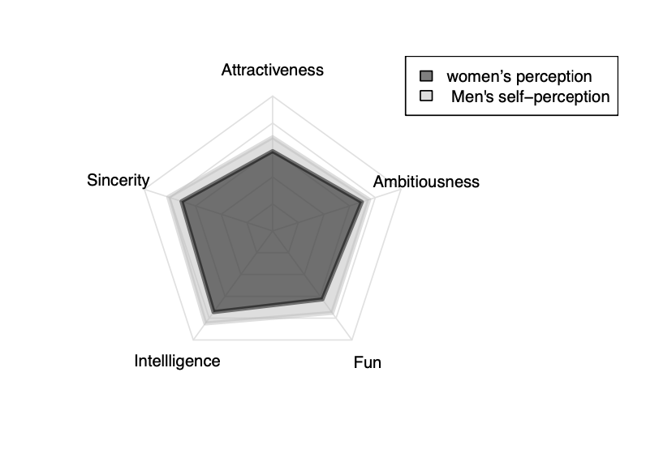
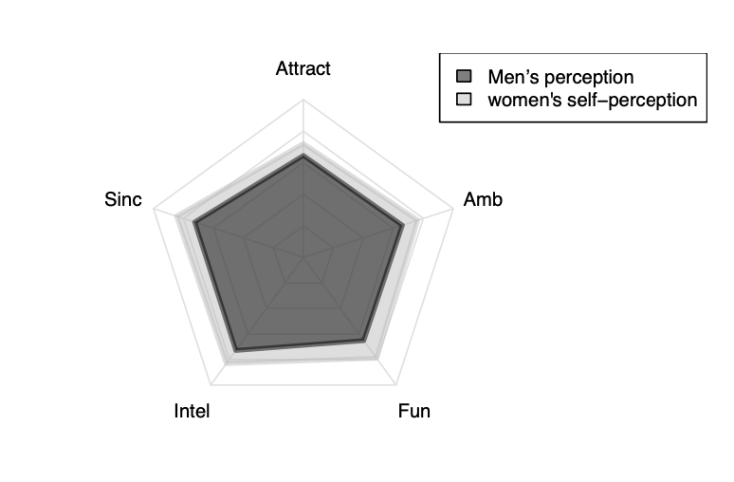

Slide 18
Inferences :
We can see that both men and women over-estimate themselves in all the attributes.
Women over-estimate themselves mostly in fun and least in attractiveness attributes.
Surprisingly, men also over-estimate their fun aspect the most, however they over-estimate themselves least in ambitiousness.

Slide 19
Predicting match between two persons:
Here our goal is to predict match between two persons for given set of attributes between them.
In the experiment, we have data of match between persons and qualities of the persons involved in match.
Pairs data is generated using pid(partner ID) and iid(own ID). For every row, attributes of male and female are added. End column will be ‘match’
We used Logistic Regression and Gradient boosting classifier to predict match between two persons.

Slide 20
MODELLING:
In Logistic regression model, input will be attributes of both men and women and Output will be Match.
By using Logistic regression Although the prediction accuracy is good, as there are few matches, logistic regression is not able to predict match properly. So, we tried different methods.
By using Gradient boosting classifier to predict match between two persons the predicting accuracy is good.
Confusion matrix for XGB test
Z 0 1
0 654 12
1 20 130

Slide 21
Conclusion:
From Results we can see that XGB classifier predicts well and has a nice confusion matrix.
Important attributes to determine a match are:
1) Fun1_1_f - How funny a female wants male to be?
2) Clubbing - How interested is a male in clubbing is?
3) Exercise_f - How interested in exercise is the female?
4) att2_1_f - How much does the female wants the male to be?
5) intel1_1 - How much intelligent does the male wants female to be? While these are the top 5 features, few other contribute to the successful prediction as well.
Least important attributes as analysed using this dataset are:
race: Race of the male participant
2) go_out: How interested is male in going out
intel3_1 and intel3_1f: How intelligent does a person think of themselves
4) goal_f: Primary goal of female participant
5) samerace: Whether participants are of the same race

Slide 22
How likely to get a second date?
Here our goal is to Predict Likelihood of getting a second date.
During the speed dating session ,the attendees would have a four minute “first date” with every other participant of the opposite gender.
After the session ,all participants were asked to rate their date on six attributes:Attractiveness,Sincerity,Intelligence,Fun,Ambition,Shared Interests and also asked would they like to see their date again.
By considering the ratings given by participant to the date we can predict the probability of getting a chance for second date using logistic regression.

Slide 23
Matches and Non-matches count in our data are about:
From table, we can observe that only 20% of people found a match . It is likely that only 20% of people will get a chance for second date.
o (Non-matches) | 1 (Matches)
6998 | 1380

Slide 24
MODELLING:
We used logistic regression to predict how likely a person can get second date by training the model based on ratings given by partner in first date.
By passing certain set of attribute ratings for some unknown person we can predict probability to secure a date.
the output will be the probability to get a second date.

Slide 25
Output:
Output for this particular set of attribute ratings attr = seq(6, 9), sinc = 7, intel_o = 8, fun = 9, amb = 8, like = seq(6,9), shar= 6 look like:
0.1219409
0.1431970
0.1674517
0.1948802
0.1718418
0.1998169
0.2310754
0.2656008
0.2366594
0.2717243
0.3098755
0.3508031
0.3165798
0.3579336
0.4015157
0.4467123

Slide 26
Conclusion:
From results we can observe that for different combination of attributes the probability to get a second date changes.
based on results we can conclude that being likeable is more important for securing a second date and even we can observe that maintaining good ratings for every attribute increases the chances to secure second date.
Therefore, we cannot conclude that based on which attribute a person’s second date completely depends on, All the attributes play a key role.

