Slide 1

MCP Model Context Protocol
Aravind Daram

Slide 2

Table of Contents
1. Understanding LLMs
2. Tools – Enabling Action
3. Agent & Agentic Applications
4. Agentic Workflow & Examples
5. Key Takeaways
6. Introduction to MCP
7. Why Standardization is Needed
8. MCP Components & Architecture
9. End-to-End Workflow with MCP
10. Key Benefits of MCP

Slide 3
Understanding Large Language Models (LLMs)
What are LLMs?
LLMs like GPT (used by ChatGPT), Google's Gemini, or Deep Seek are trained models.
They are developed by companies and require significant computational power and vast amounts of data for training.
Core Capability:
LLMs are excellent at answering questions and natural language processing (NLP).
They can understand and respond to queries in natural language, like English.
Key Limitation:
An LLM cannot perform any task other than answering questions. It cannot send emails, buy/sell stocks, or interact with other applications directly.

Slide 4
Why LLMs Became Prominent Now
Historical Context:
The underlying technology, like neural networks, has existed for decades.
However, LLMs became famous only in the last few years.
Three Major Reasons for Recent Emergence:
Computational Power: GPUs/TPUs and specialized chips enabled large-scale training..
Availability of Data: Social media & web provided massive training data.
Transformer Architecture :
Introduced by “Attention is All You Need”.
Uses attention to capture long-range dependencies.
Highly parallelizable → faster training vs. RNN/LSTM.
Scales efficiently with more data + compute (scaling laws).

Slide 5
Introducing "Tools" – Enabling Action
The Problem: LLMs generate text but can’t act.
The Solution: Tools
Tools = logic/code to perform tasks. (REST APIs, SOAP services , GRAPH QL APIs, DB As service….etc)
These are actions that an application can perform but an LLM cannot understand or execute on its own.
Examples of Tools:
Send email, add to Google Docs, trade stocks, web search.

Slide 6

What is an "Agent" / "Agentic Application"?
Agent:
LLM(good at NLP, no actions) + Tools (can perform actions, no natural language understanding).
Agentic Applications:
An "Agentic Application" is an application = LLM + Tools , to perform a specific task.
Why ?
LLM Understands ; Tools Act

Slide 7
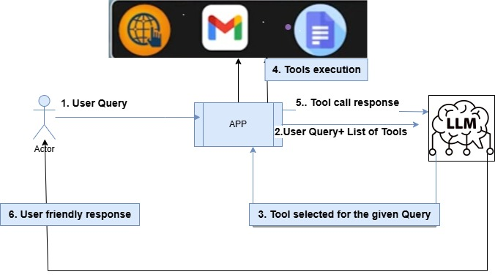
The Agentic Application Workflow

Slide 8

The Agentic Application Workflow: Decision-Making
User Query: Host (e.g., “Chat GPT, Claude desktop app").
Application's Role: user Query + list of all available tools (that the application can use).
LLM's Intelligence: decides which specific tool (or tools) should be called.

Slide 9
The Agentic Application Workflow: Action & Response
Tool Execution: Host calls tool via client/server. (The LLM cannot directly call tools).
Result Feedback: The outcome (e.g., mail sent, web search results, data from Google Sheet) or result to LLM.
LLM's Final Output: The LLM, frames a "good answer"
User Notification: Answer back to the user.

Slide 10

Why do LLMs need tools ?
To make text longer.
To access real-world actions (e.g., send email, fetch data)
To replace GPUs.
To avoid training data limits.

Slide 11
Workflow Example: Web Search for Current Information
LLM Limitation: LLMs are trained on data up to a specific date (e.g., 2023) and lack current, real-time information.
User Query: "Who won US Open 2025?"
Application to LLM: Sends the query + list of tools (including a "web search tool").
LLM Decision: Decides tool as "web search tool" is needed.
Application Action: Calls the "web search tool".
Tool Result to LLM: Search results to the LLM.
LLM Frames Answer: The LLM frames final answer, e.g., "This person won US open 2025".
Application to User: Sends answer to the user.

Slide 12
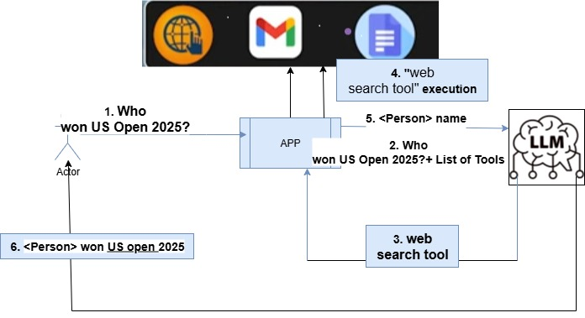
Web Search for Current Information

Slide 13
Workflow Example: Sending an Email
User Query: "Write a mail for me and send the mail."
Application to LLM: Sends the query + list of tools (including a "send mail tool").
LLM Decision: Recognizes the request involves writing and sending an email. It can write the content of the mail and identifies the "send mail tool" as necessary.
Application Action: Calls the "send mail tool" with the mail content provided by the LLM.
Tool Result to LLM: The mail tool confirms if the mail was sent successfully or if an error occurred.
LLM Frames Answer: Based on the tool's status, the LLM generates a human-readable response, e.g., "The mail was sent congratulations" or "The mail was not sent because of so and so reason".
Application to User: Sends the LLM's framed answer to the user.

Slide 14
Workflow Example: Web Search for Current Information
LLM Limitation: LLMs are trained on data up to a specific date (e.g., 2023) and lack current, real-time information.
User Query: "Who won US Open 2025?"
Application to LLM: Sends the query + list of tools (including a "web search tool").
LLM Decision: Decides tool as "web search tool" is needed.
Application Action: Calls the "web search tool".
Tool Result to LLM: Search results to the LLM.
LLM Frames Answer: The LLM frames final answer, e.g., "This person won US open 2025".
Application to User: Sends answer to the user.

Slide 15
Key Takeaway: Endless Automation Possibilities
Synergy: LLM + Tools = Powerful automation.
Seamless User Experience: Multiple steps happen fast → seamless to user.

Slide 16
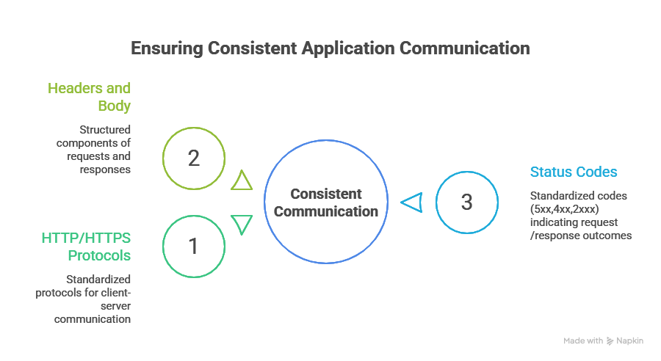
Traditional HTTP/HTPPS – Client Server
Traditional Application Communication (HTTP/HTTPS)
For years, client-server communication has relied on standardized protocols like HTTP/HTTPS.
Requests and responses follow a defined structure, including headers, body, and standardized status codes (e.g., 200 for successful, 404 for not found, 500 for server error).
This standardization ensures consistent interaction across all applications and servers (e.g., google.com, robinhood.com, weather.com).

Slide 17
Model Context Protocol (MCP): Empowering LLM-based Applications with Tools
Standardizing Tool Usage for Agentic AI
What is MCP?
MCP stands for Model (LLMs) Context (Extra Context) Protocol (Set of rules).
It is a standardization framework specifically for using tools with LLM-based (agentic) applications.
Introduced by Anthropic, the company behind the Claude LLM.
Why is it needed?
LLMs need "extra context" (i.e., tools) to perform actions beyond basic language generation.
It addresses the new complexities of integrating diverse external tools into applications driven by Large Language Models.
Aims to bring standardization, similar to how HTTP/HTTPS standardized traditional web communication, for the new era of agentic applications.

Slide 18
What is the primary purpose of the Model Context Protocol (MCP)?
To limit the data used to train AI models.
To enable AI models to connect with external data sources, tools, and environments
To replace prompting when using large language models (LLMs)
To create a new programming language for AI agents

Slide 19
What Do Tools mean in MCP
Tools = external capabilities that the agent can call.
Tools can exist at any layer (SaaS, PaaS, IaaS, Enterprise, Infra, Custom APIs).
Without tools → LLMs are limited to text reasoning only.
With tools → LLMs become agentic applications (they can act, transact, and automate).
MCP = the standard protocol that defines how these tools are described, discovered, and called safely

Slide 20
Tools in AI Agents vs MCP Tools
Conceptually yes both are same:
Both “AI agent tools” and “MCP tools” mean external actions the LLM can use.
Practically different:
AI Agent Tools → Defined in each framework (LangChain, LlamaIndex, etc.), not standardized.
MCP Tools → Standardized across clients/servers with a protocol (like USB-C for AI apps).
Analogy
AI Agent Tools = random charging cables → each brand has its own.
MCP Tools = USB-C → one standard cable that works everywhere.

Slide 21
Tools in AI Agents vs MCP Tools
AI Agent Tools | MCP Tools
Framework-specific (LangChain, LlamaIndex, etc.) | Protocol-standardized across clients/servers
Defined ad-hoc by developers | Schema-defined (typed inputs/outputs, metadata)
Integration is manual, often repetitive | Plug-and-play (discovery & capability negotiation)
Security is framework-dependent | Built-in approval flows, permissions, sandboxing
Analogy: Random charging cables | Analogy: USB-C universal standard
Conceptually same: both = external actions for LLMs
Key Takeaway:
AI Agent Tools = Local & Custom
MCP Tools = Universal & Reusable

Slide 22
What’s the main difference between AI Agent tools and MCP tools?
Both are identical, no difference.
AI Agent tools are ad-hoc; MCP tools are standardized
MCP tools are faster models.
AI Agent tools only work on cloud.

Slide 23
Why a New Standardization Now?
LLMs + Tools need extra context.
Problem: Each company exposes tools differently.
Solution: Standard protocol = MCP (like HTTP for the web).

Slide 24
Key Components & Architecture of MCP
MCP Host: The Agentic Application
This is your LLM-based application (e.g., mobile app, website) that you are building.
MCP Servers: Tool Providers
Companies that offer tools (e.g., Google for web search, Weather.com for weather) expose their functionalities through MCP Servers.
A single server can expose multiple tools (e.g., get_list_of_stocks, buy_stock, sell_stock).
The tool's underlying logic can run either on the same machine as the MCP host or on a separate, remote machine.
Clients: Bridging the Host and Servers
Within the MCP Host, specific clients are created to establish one-to-one connections with individual MCP servers.
Each client facilitates communication with its respective MCP server, allowing the host to access its exposed tools.

Slide 25
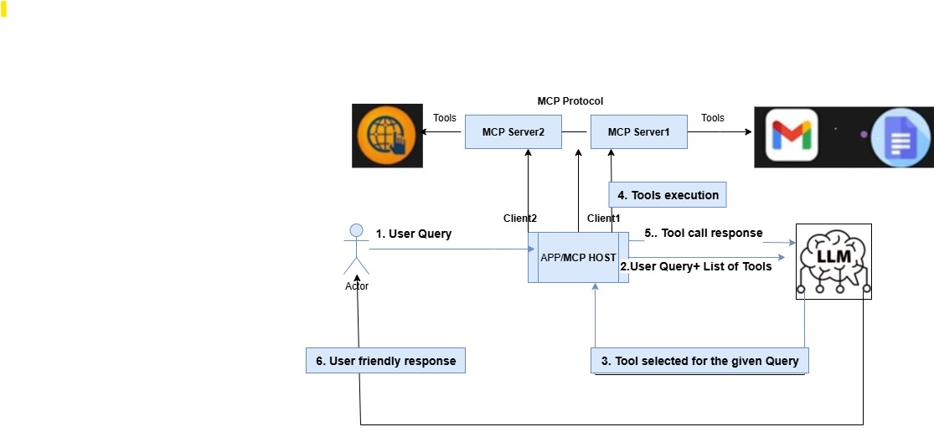
End-to-End Workflow with MCP

Slide 26
What’s the main difference between AI Agent tools and MCP tools?
Both are identical, no difference.
AI Agent tools are ad-hoc; MCP tools are standardized
MCP tools are faster models.
AI Agent tools only work on cloud.

Slide 27
How does an AI agent typically differ from an MCP-based architecture?
AI agents only respond without planning; MCP allows planning.
Agents include planning, memory, reasoning, and tool use; MCP provides a standard interface for models to access tools and data.MCP tools are faster models.
MCP replaces agents entirely.
AI agents are simpler and more limited than MCP-enabled models.

Slide 28
End-to-End Workflow with MCP
User Query to Application (MCP Host): The MCP Host.
Host Prepares for LLM: The application itself doesn't understand natural language commands for tool execution.
Host Sends Query & Tools to LLM: User's query + List of all available tools (from all connected MCP servers via its clients) to the LLM.
LLM Determines Tool Usage: LLM Decide the Tool(s) .
Host Calls Tools: The application (MCP Host) calls tool(s) via client. The tool code might be running locally or on a remote server.
Tools Execute & Respond: The called tool executes its function (e.g., performs a web search, write email, check weather) and returns a response, including status codes (e.g., 200 for success, 400/500 for error) and a response body.
Host Sends Tool Response to LLM: The application sends the raw response to LLM.
LLM Frames User-Friendly Response: LLM generates final response.
Host Sends Final Response to User: The application delivers this final response.

Slide 29
Key Benefits of Adopting MCP
Standardization
Common protocol across industry.
Simplified Tool Integration
Less dev effort.
Reduced Development Effort & Redundancy
Developers don't have to write the tool logic themselves for common services (e.g., web search, stock trading). Instead, they rely on tools readily exposed by companies via MCP servers.
Enhanced Interoperability
Ecosystem growth drastically.
Focus on Core LLM Logic
Developers focus on logic, not plumbing..
Enables Advanced Agentic Applications
MCP is fundamental for building sophisticated "agentic applications" that can leverage external "context" to perform complex, multi-step, real-world tasks.

Slide 30
What is the "M×N Integration Problem" that MCP primarily aims to solve?
The difficulty of training M models with N datasets.
Managing M features across N different user segments.
The complexity of connecting M AI applications to N external tools without a standard.
Developing M new AI algorithms for N use cases.

Slide 31
MCP's Role in the Future of LLM Applications
Catalyst for the "True New Trend": Enables shift to agentic apps..
Accelerated Ecosystem Growth: Easier for companies to expose tools.
Enhanced AI: LLMs focus on reasoning & orchestration.

Slide 32
Advanced MCP Topics: Security Considerations
Challenge: MCP servers/tools can access sensitive external data.
Risk: Cross-server data exfiltration if trust boundaries are weak.
Solution Approaches:
Access control & authentication (OAuth, API keys).
Tool sandboxing & isolation.
Monitoring & audit logs for tool usage.

Slide 33
Advanced MCP Topics: Error Handling
Why Important? Tools may fail (timeouts, 400/500 errors).
MCP Mechanisms:
Standardized status codes (200 = success, 404 = not found, 500 = server error).
Clear error messages → LLM can frame meaningful responses.
Retries, fallback tools, or human-in-the-loop escalation

Slide 34
Multi-Agent Workflows with MCP
Today: One Host ↔ One or More MCP Servers.
Future: Multiple MCP-enabled agents collaborating.
Example: Finance Agent + Legal Agent + HR Agent.
Benefits:
Division of expertise.
Faster, more scalable problem-solving.
Complex enterprise workflows possible.

Slide 35
Feedback & Q&A

