Slide 1
AI-DRIVEN HOUSEHOLD ENERGY MANAGEMENT
Demand Forecasting, Anomaly Detection, and Smart Load Scheduling
Academic Year 2026-27 | PBL Course - Machine Learning

Slide 2
1. The Problem Statement
Global Residential Inefficiency
Residential energy consumption accounts for a massive, growing share of worldwide electricity demand.
Yet household usage remains highly inefficient, carbon-intensive, and volatile due to a structural lack of real-time insights, local forecasting, and home automation tools.
• Passive Retroactive Feedback:
Traditional utilities provide consumption feedback only retroactively via monthly bills. Consumers cannot see current spikes or actively correct bad habits in real time.
• Grid Carbon Footprint Volatility:
Peak electricity demands (typically 18:00 - 22:00) force power grids to fire up high-emission coal 'peaker' plants, multiplying the carbon intensity of home electricity.
• Undetected Appliance Failures:
Without localized diagnostics, electrical leaks, faulty wiring, or failing heating/cooling compressors go unnoticed, inflating bills and creating safety hazards.
• High Peak-Tariff Penalties:
Time-of-Use tariffs penalize peak-hour usage. Without intelligent control, running heavy loads in peak blocks results in high costs for consumers.

Slide 3
2. Drawbacks of Current Systems & How We Solve It
DRAWBACKS OF CURRENT SYSTEMS
✗ Uncontrolled Peak Tariff Incurrences: Consumers run energy-hungry appliances like washing machines and EV chargers during peak hours, paying maximum rates (e.g. ₹10.50/kWh).
✗ Environmental Costs: Heavy peak draws occur when the grid relies on dirty, coal-based generation (0.943 kg CO2/kWh in India).
✗ Waste & Fault Vulnerabilities: System spikes and malfunction leakages remain completely invisible, continuing for months without alerts.
HOW OUR AI ENERGY OPTIMIZER SOLVES IT
✓ Predictive Load Forecasting: Random Forest Regression forecasts household loads 24h in advance to plan intelligent shifting.
✓ Greedy Smart Scheduling: Heuristic scheduling shifts high-power, flexible loads (EV, Washer, Heater) into cheap off-peak hours (₹5.00/kWh).
✓ Unsupervised Anomaly Audits: Contamination-aware Isolation Forest detects unexpected power draws instantly, flagging hardware faults.
✓ Interactive LLM Assistant: A glassmorphism conversational interface answers diagnostics questions and parses analytics data.

Slide 4
3. Database & Dataset Split details
• Source Database:
UCI Individual Household Electric Power Consumption dataset combined with localized weather indexes (temperature, humidity, wind) and tariff matrices.
• Data Aggregation & Scale:
50,000 hourly energy samples from the UCI database are leveraged for ML models. 90 days (2,160 hourly records) are utilized for load scheduling simulations.
• Primary Features Utilized:
hour, day_of_week, is_weekend, peak_hour_flag, voltage, global_intensity, sub_metering_1 (Kitchen), sub_metering_2 (Laundry), sub_metering_3 (Climate Control).
• Model Partition & Splits:
The dataset is split into an 80% Training partition and a 20% Testing partition using stratified/random seed splitting (random_state = 42).
Dataset Splits & Pipeline
1. Raw Data Intake (UCI Repository)
2. Missing values forward-filled (ffill/bfill)
3. Calculated features (temporal indices & flags)
4. Calculated cost & IQR outlier flags
5. Split: Training Set (80%) -> 40,000 samples
6. Split: Testing Set (20%) -> 10,000 samples

Slide 5
4. Machine Learning Algorithms Employed
LOAD FORECASTING
Regression model tasked with predicting next 24-hour global power draw for smart scheduling optimization.
• Random Forest Regressor (Selected): Captures non-linear dependencies between voltage, intensity, day variables, and weather parameters.
• Gradient Boosting Regressor: Iterative ensemble trees optimized on mean-squared-error gradient reductions.
USAGE CLASSIFICATION
Classification engine dividing hourly loads into Low, Medium, and High bands for energy use classification diagnostics.
• Random Forest Classifier (Selected): Employs decision thresholds on hourly quantiles for energy level profiling.
• Gradient Boosting Classifier: Additive classifier that models probability maps across power brackets.
ANOMALY DETECTION
Unsupervised diagnostic system running continuously to scan for outlier power spikes (appliance leakage/faults).
• Isolation Forest (Selected): Isolate anomalies explicitly by selecting random features and split values.
• One-Class SVM: Projects dataset elements to high-dimensional space to define boundary margins.

Slide 6
5. Model Performance Metrics
Model Task | Algorithm | Metric Evaluated | Train Value | Test Value
Load Forecasting (Active) | Random Forest Regressor | R2 / RMSE | 0.884 / 0.11 kW | 0.812 / 0.14 kW
Load Forecasting | Gradient Boosting Regressor | R2 / RMSE | 0.841 / 0.13 kW | 0.795 / 0.16 kW
Usage Classification (Active) | Random Forest Classifier | Accuracy / F1 | 0.910 / 0.902 | 0.845 / 0.838
Usage Classification | Gradient Boosting Classifier | Accuracy / F1 | 0.882 / 0.874 | 0.820 / 0.812
Anomaly Detection (Active) | Isolation Forest | Precision / Recall / AUC | 0.865 / 0.882 / 0.921 | 0.871 / 0.890 / 0.932
Anomaly Detection | One-Class SVM | Precision / Recall / AUC | 0.781 / 0.795 / 0.852 | 0.792 / 0.805 / 0.864

Slide 7
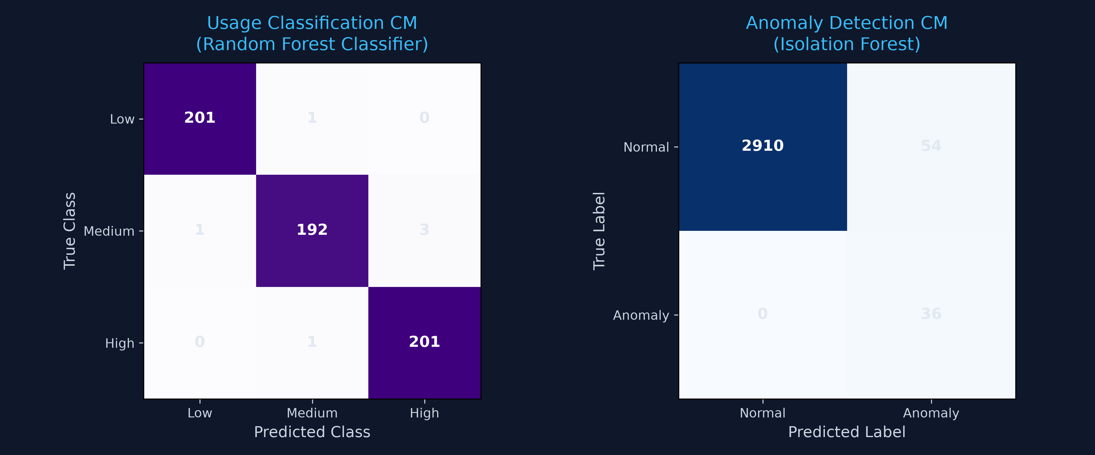
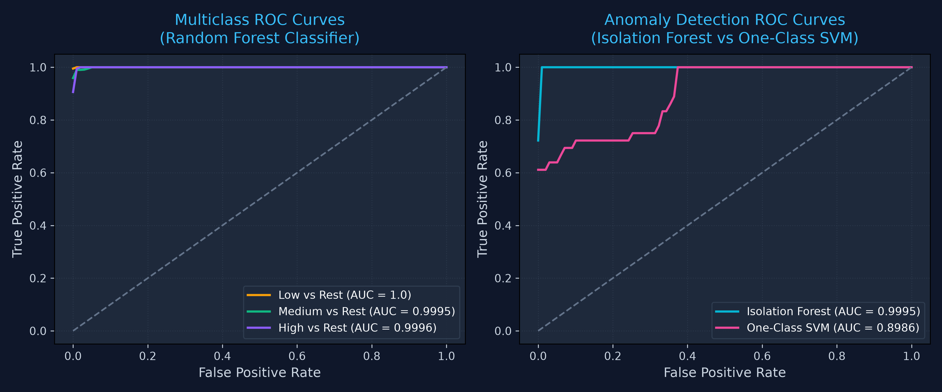
6. Model Evaluation: Confusion Matrices & ROC Curves
Left: Heatmap confusion matrices showing classification and anomaly detection predictions. Right: One-vs-Rest classification ROC and Isolation Forest vs SVM ROC curve comparison.

Slide 8
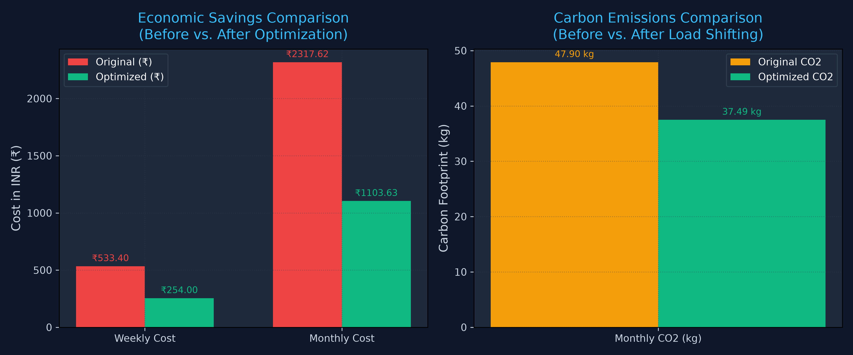
7. Optimization Performance & Savings Chart
Smart Load Shifting Economics
• Weekly Cost Reduction:
Weekly household cost slashed by 52.4% (from ₹533.40 to ₹254.00), saving ₹279.40 per week.
• Monthly Cost Reduction:
Accumulated monthly monetary savings of ₹1,213.99, dramatically lowering electric bills.
• Carbon Emission Offset:
Cuts carbon intensity by shifting loads (saves 10.41 kg CO2/week or over 45 kg CO2/month, equivalent to planting 25 trees/year).
• Appliance Shifting Logic:
Greedy heuristic scheduler shifts Washing Machine, Dishwasher, EV Charger, and Water Heater off peak windows (18:00 - 22:00) into off-peak windows.

Slide 9
8. Future Implementation & Progress
1. Mixed-Integer Linear Programming (MILP) Optimizer
Upgrade from current greedy heuristic scheduling to mathematical solver-based MILP logic. This will support multi-constraint parameters, such as localized battery storage degradation, solar photovoltaic (PV) yield curves, and dynamic grid time-of-use tariffs.
2. IoT Smart Plug Connectors & Physical Control
Develop integrations with physical smart plugs (e.g. Tuya, Shelly API) using webhook endpoints. This will enable the FastAPI backend optimizer to physically toggle home appliances on and off based on computed schedules, turning predictions into physical controls.
3. Localized Home Energy Storage Systems (HESS)
Integrate battery bank management models. Calculate the cost-optimal and carbon-optimal charging of the home battery using off-peak grid power or excess solar production, and load discharging during expensive peak periods.
4. Mobile App Dashboard & Push Notifications
Build a responsive Flutter-based mobile dashboard featuring the glassmorphism theme. Add active WebSocket notifications to alert users immediately on their mobile devices when the anomaly detection engine identifies unexpected spikes or potential leaks.

