Slide 1
CAR DEALERSHIP
MCA 172
Presented by:
ARVIND N-2347214
LAHARI R-2347233
RAJENDRAN M S-2347248
Evaluated By:
Dr.Helen K Joy

Slide 2
ABSTRACT
In our car dealership website, CarDealer, we have created a user friendly interface, where the customers can choose from a variety of cars based on their features and pictures , compare the features of car of their choice with features of other cars, select a car dealer according to their convenience , read the experience of other customers and share their experience. Customers can resolve their queries with respect to navigating the website from the FAQ page, they can contact us either by filling out the form or reaching out to us from our mail or phone number.
The purpose of this system is to implement computerization of car dealership. This application is created on ReactJS and uses MySQL server Database.

Slide 3
CONTENTS
INTRODUCTION
HARDWARE-SOFTWARE REQUIREMENTS
PROJECT DESCRIPTION
SCREENSHOTS
CONCLUSION

Slide 4
INTRODUCTION
Car Dealership is a software application design to add and manage customer information, keep their personal records, manage and add car details and provide car dealers to customers
There are a number of car dealership sites across the web but a dealership site where the customers can choose from a variety of cars of different brands is less, a website where the customer can choose a dealer based on their convenience is much lesser and a website where the customer can compare different cars based on their preference is very slim. We have designed a car dealership site that holds all these features in a single site.
We have made a website which is simple enough for the visitors of the page to navigate through it. From the navigation bar, users are able to navigate through the whole page. To view the cars , you have the “Cars” section. To have a comparison between 2 cars, we have the “Compare” section. “Locate A Dealer” will have the locations of the dealers within Bengaluru and has a form to get in contact with a dealer of their choice. To get in touch with us, you can select the “Contact Us” section. “Customer Stories” section has all the fun stuff and the joyous experience they had from using our page.

Slide 5
HARDWARE REQUIREMENTS
• Hardware :Processor Intel dual core and above
• Clock speed :3.0 GHz
• RAM size :512 MB
• Hard Disk capacity :400 GB
• Monitor type :15 inch colour monitor
SOFTWARE REQUIREMENTS
• Operating System :Windows XP, Windows 7 and above
• Application : ReactJS
• IDE :Visual Studio Code
• Database :MySql Server
• Browser : Chrome, Edge, Firefox, etc.

Slide 6
PROJECT DESCRIPTION
HOME PAGE
The home page consists of specifics about car dealership and our site, CarDealer.
ADMIN LOGIN PAGE
The admin login page consists of username and password and is accessed from a set of pre-defined password and user name.
ADMIN PANEL
Once logged in, the admin can access the user details, reviews, contact mail and dealer mails.
CONTACT US PAGE
The contact us page holds a map from which the customers can reach to CarDealer and it also contains a form the customers can fill to reach out to CarDealer.

Slide 7
CAR DETAILS PAGE
In this page, the customers can view all necessary car details like features, pictures from a number of cars.
COMPARE CAR PAGE
In this page, the customers can compare features of two cars of their desire at a given time by choosing cars from the dropdown list where all the cars in the dealership are listed.
LOCATE A DEALER PAGE
In this page, the customers can find a dealer. They can either choose dealer directly from the pinned locations on the map or they can fill the form present on the site and choose a dealer based on their convenience.
CUSTOMER STORIES PAGE
In this page, the customers can view stories of other customers about using CarDealer for locating a dealer or checking out cars. Customers can also add their own stories about using CarDealer .

Slide 8
FAQ PAGE
The FAQ page holds the information about how to navigate through the website.
ADMIN PANEL
Once the admin login is completed, the admin can access all the details, reviews and emails submitted by the customers while filling the forms. Admin can also access the dealer emails. Admin has the access to view, update and delete the details.
A nav bar is added to every page for easy navigation through the website
The user, user reviews, contact mail and dealer mail are connected to MySQL Database.

Slide 9
CONCLUSION
Choosing the right place for a car dealership is super important. CarDealer makes it simpler, we have created a website that makes the complicated job of choosing the right car piece of a cake.
CarDealer gives the customer the option of choosing dealers based on their convenience like location nearest to them, the car details page and car compare pages makes sure the customers know the major and important features required and whether it reaches their requirements.
We have tried to develop a system that can be a great help to the modern technological world to register the requirements and needs from people. We have left all the options open so that if there is any other future requirement in the system by the user for enhancement of the system then it is possible to implement them.

Slide 10
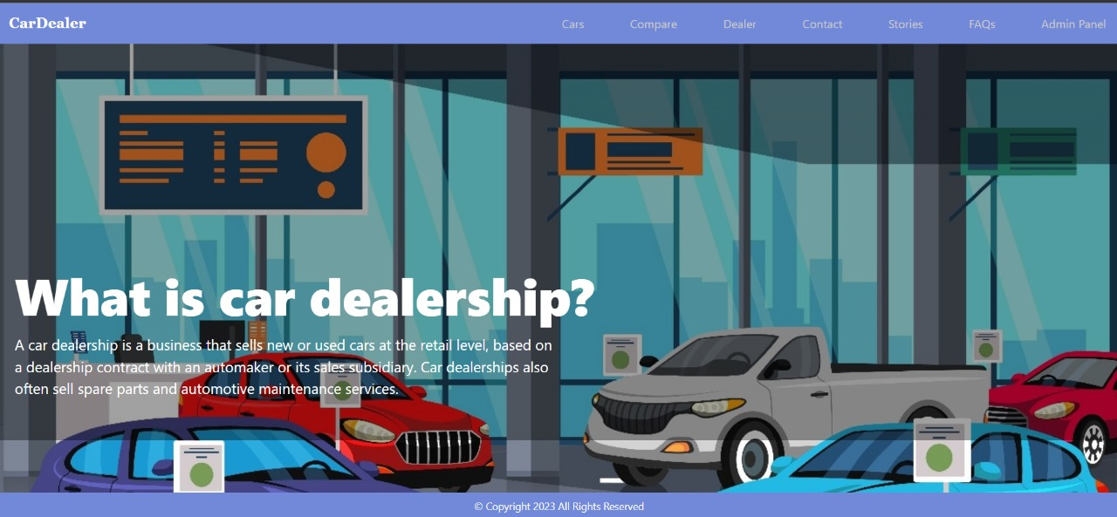
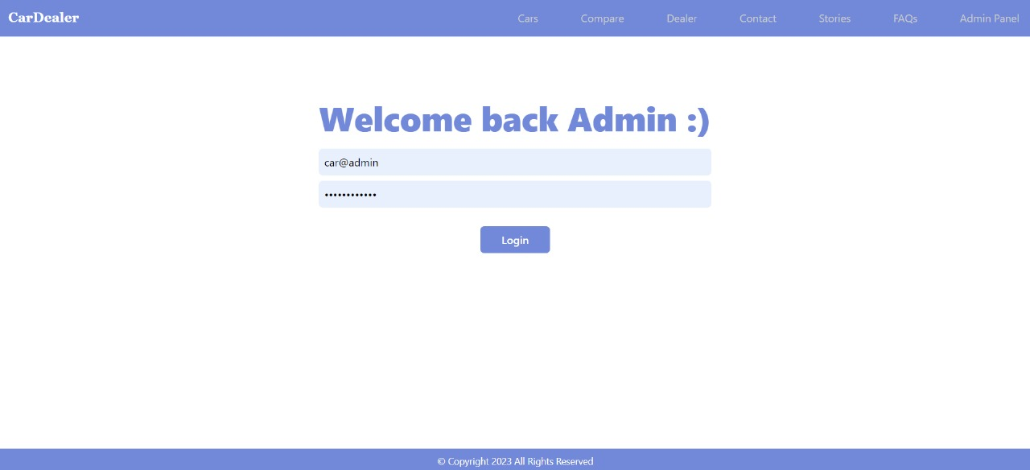
SCREENSHOTS
1. HOME PAGE
2. ADMIN LOGIN PAGE

Slide 11
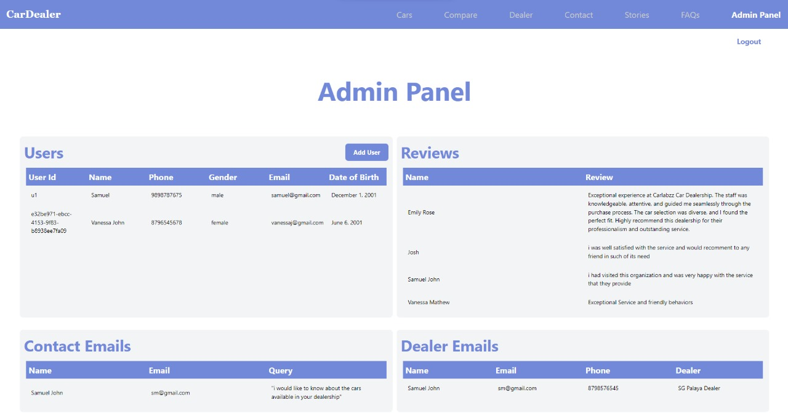
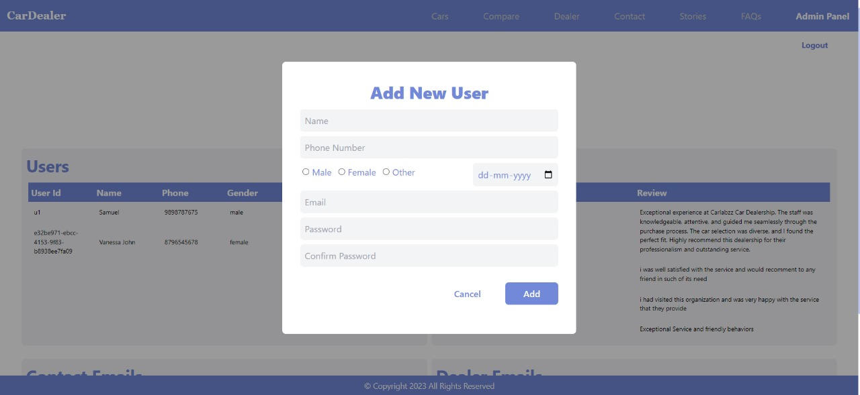
3. ADMIN PANEL
4. ADD USER PAGE

Slide 12
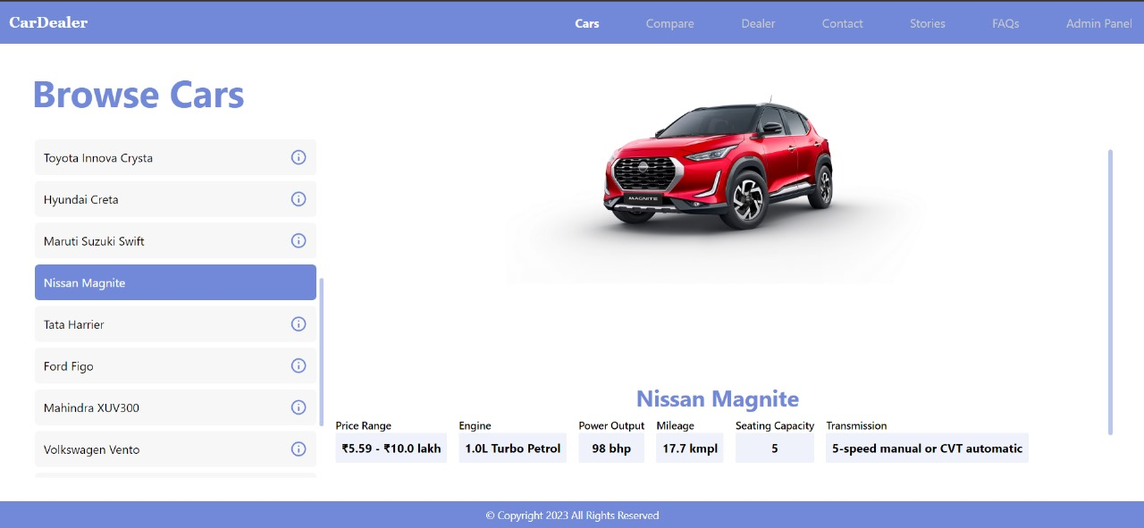
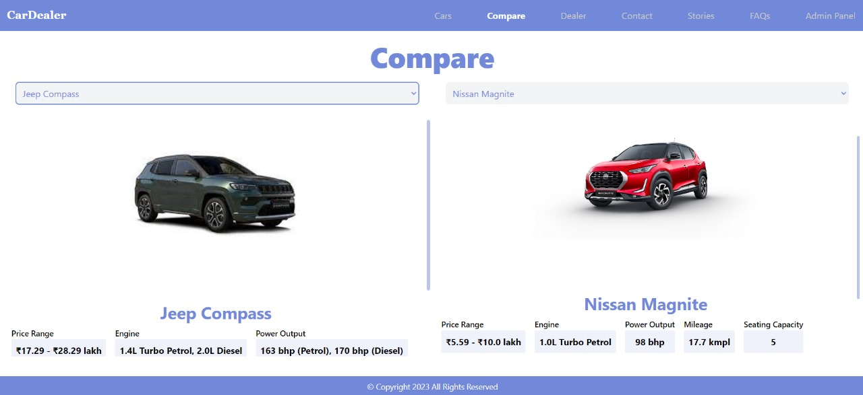
5. BROWSE CAR PAGE
5. COMPARE CAR PAGE

Slide 13
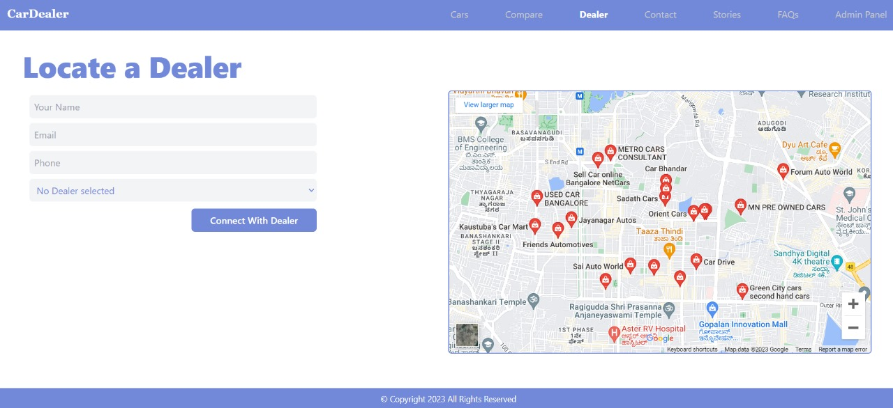
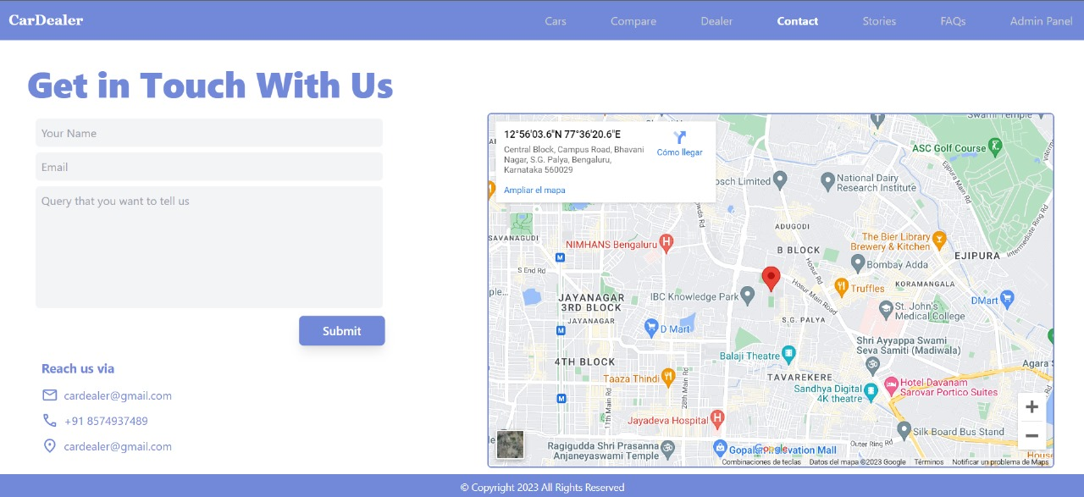
7. LOCATE A DEALER PAGE
8. CONTACT US PAGE

Slide 14
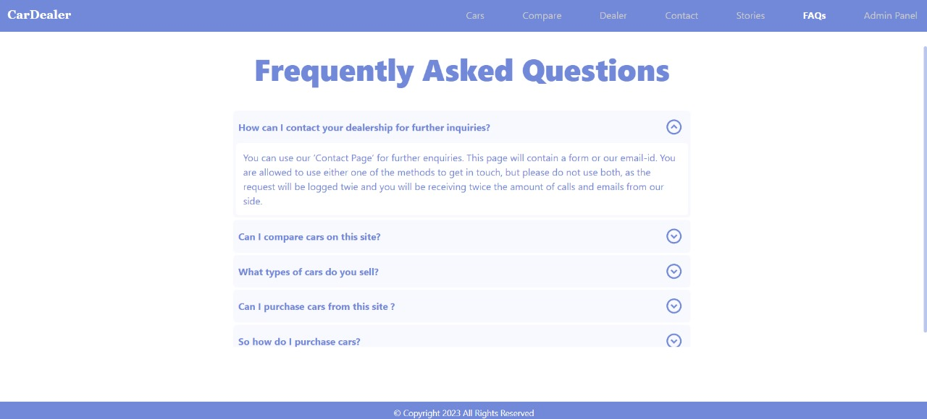
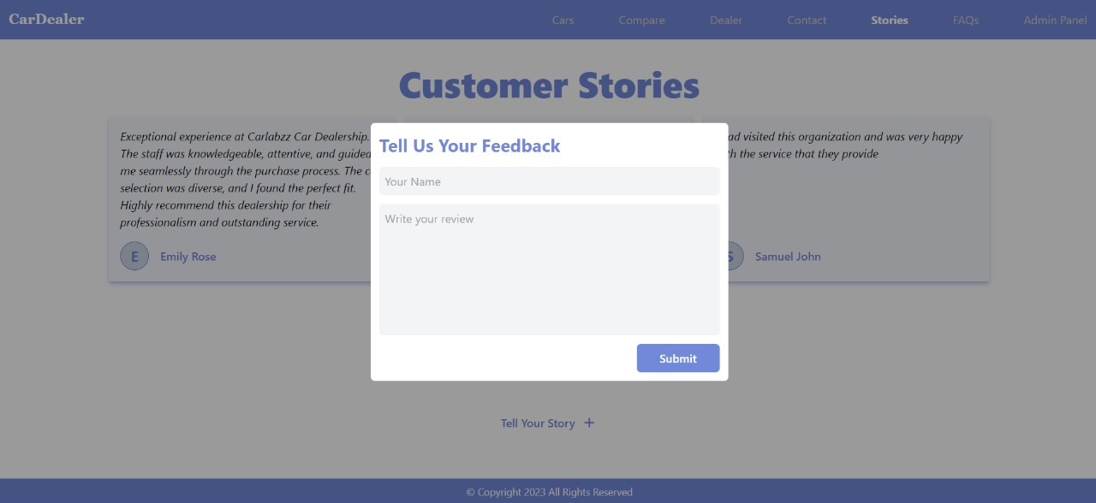
9. FAQ PAGE
10. CUSTOMER STORIES PAGE

Slide 15
THANK YOU!

