Slide 1
DISTRIBUTED COMPUTING MINI PROJECT | 23MCCE11
R
C
D
MiniSwiggy
How Swiggy delivers food at scale, and a socket-level Java model of its key distributed ideas
GW
N1
N2
Registration number: 23MCCE11
September 2026
Notes:
Title slide. MiniSwiggy is my mini project for Distributed Computing. Part one studies how Swiggy is built, using Swiggy's own engineering blog. Part two is a small Java version using only TCP sockets, which demonstrates load balancing, replication, failure detection with failover, publish/subscribe, and ordered messages. The drawing shows the idea: customer, restaurant and delivery clients, one gateway, and two replicated order nodes.

Slide 2
Swiggy: a real-time, three-sided system
Every order links a customer, a restaurant and a delivery partner, live
1
Customer
400+
130+
browses nearby restaurants, orders, tracks the order live
microservices in production
services in the order path
2
Restaurant
receives the order, accepts it, prepares the food
3x
10,000+
3
Delivery partner
lunch traffic swing, 100K to 300K req/min
containers on AWS
is assigned the trip, picks up, delivers; phone sends location
Numbers as reported by Swiggy: Swiggy Bytes [1], [3]; Orca Security case study [37]. Reference list in the Phase 1 document.
Notes:
Swiggy is a good distributed-systems example because three groups act on the same order at the same time, and traffic has sharp peaks. Swiggy's engineers report over 400 microservices, more than 130 of them in the order path, traffic tripling at lunch time, and more than 10,000 containers. These numbers come from Swiggy's own blog and an official case study.

Slide 3
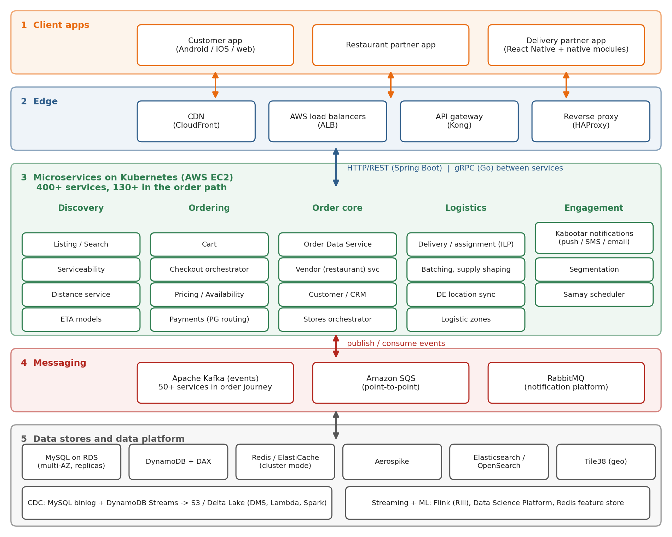
Architecture at a glance
Five layers, all on AWS
Apps customer, restaurant and delivery-partner apps
Edge AWS load balancers; Kong + HAProxy for web
Services 400+ microservices (Java, Go, Scala) on 10 Kubernetes clusters
Messaging Kafka events; SQS and RabbitMQ queues
Data MySQL (RDS), DynamoDB, Redis, Aerospike, Tile38; CDC to a data lake
Diagram: my summary of Swiggy's published posts and case studies (Phase 1 references); grouping simplified. Swiggy has no single official diagram.
Notes:
This is my summary diagram built from Swiggy's published posts. Apps connect through an edge layer of AWS load balancers, and for the web front-end Kong and HAProxy. Behind it run hundreds of microservices on Kubernetes. Kafka carries events between them. Each service picks a suitable data store: MySQL, DynamoDB, Redis, Aerospike, Tile38 for geo data. Change data capture copies data into a data lake for analytics.

Slide 4
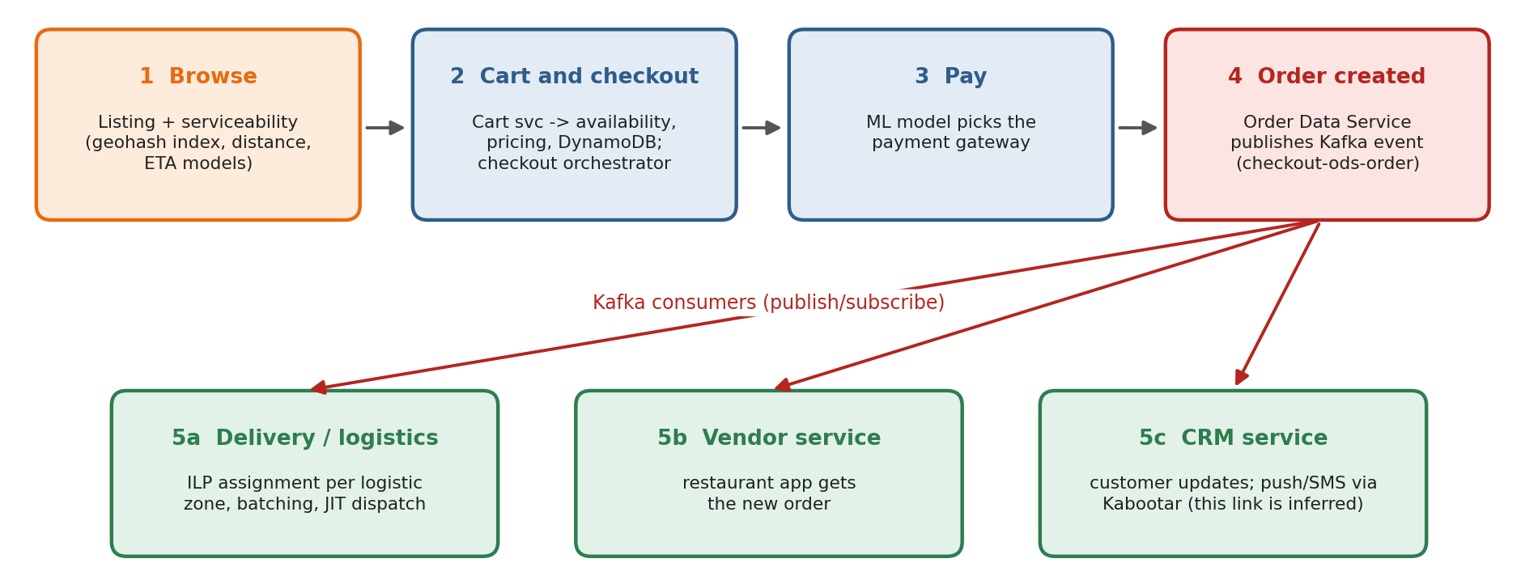
The life of an order
Checkout is orchestrated; everything after it is event-driven
Orchestration the checkout orchestrator calls cart, pricing, availability and payment in order, so the customer gets one clear yes/no [12].
Choreography the Order Data Service publishes to Kafka; Delivery, Vendor and CRM react on their own [14], [15].
Sources: Swiggy Bytes [12], [14], [15], [26]. The Kabootar notification link is my inference.
Notes:
An order goes through browse, cart and checkout, payment, and creation. Checkout is orchestrated: one service calls the others step by step. Once the order exists, the Order Data Service publishes a Kafka event, and the delivery, vendor and CRM services consume it independently. That is choreography. Delivery then runs an optimisation to assign a partner, per logistic zone.

Slide 5
Distributed paradigms found in Swiggy
Each one backed by a published source
1
Client-server
2
Microservices
3
Publish / subscribe
apps call backend APIs through load balancers and gateway
400+ services; logistics rebuilt as a multi-tier platform
Kafka; 50+ services on the order-journey cluster
Direct evidence [10], [11]
Direct evidence [1], [5]
Direct evidence [14], [15]
4
Message queues
5
Orchestration + choreography
6
Stream processing + CDC
SQS for point-to-point jobs; RabbitMQ for notifications
checkout orchestrator plus Kafka event reactions
Flink jobs; MySQL binlog and DynamoDB Streams to a data lake
Direct evidence [14], [7]
Direct evidence [12], [15]
Direct evidence [31], [16]
Peer-to-peer: not found in any source. Swiggy is a central platform; Tile38 clones are multi-master replication, not P2P [20].
Notes:
These six paradigms each have direct evidence in Swiggy's posts. Client-server between apps and backend, microservices, publish-subscribe with Kafka, point-to-point queues with SQS and RabbitMQ, both orchestration and choreography, and stream processing with change data capture. I also checked peer-to-peer, but found no evidence; Swiggy is a central platform.

Slide 6
Algorithms for scale and fault tolerance
What Swiggy publishes, and how strong the evidence is
Technique | Where in Swiggy | Evidence
Caching | serviceability in-memory index, Aerospike distance cache, DAX, Redis | Direct
Partitioning / sharding | DynamoDB partition keys, Kafka partitions, city split into logistic zones | Direct
Replication | Kafka min in-sync replicas, failover cache cluster, multi-AZ databases | Direct
Timeouts, circuit breaker, rate limits | gRPC deadlines, brownout handling, two-layer limits for IPL traffic | Direct
Geo-hashing + zone-wise ILP assignment | serviceability index; assignment per logistic zone | Direct
Load balancing | ALB, Kong, HAProxy; algorithm not published | Partial
Leader election | Kafka partition leaders only | Partial
Heartbeat failure detection | implied by failover designs; not described | Inference
Consistent hashing, gossip, vector clocks | no Swiggy source found | Not found
Details and quotes: ParadigmsandAlgorithms_23MCCE11, sections 4-5. Sources [1], [2], [11], [15], [18]-[22], [26].
Notes:
For algorithms, I separated what is proven from what is guessed. Caching, partitioning, replication, timeouts and circuit breakers, and geohash-based partitioned assignment all have direct evidence. Load balancing is documented, but not the algorithm. Leader election appears only as Kafka partition leaders. Heartbeat failure detection is only implied. Consistent hashing, gossip and logical clocks were not found, so I do not claim them.

Slide 7
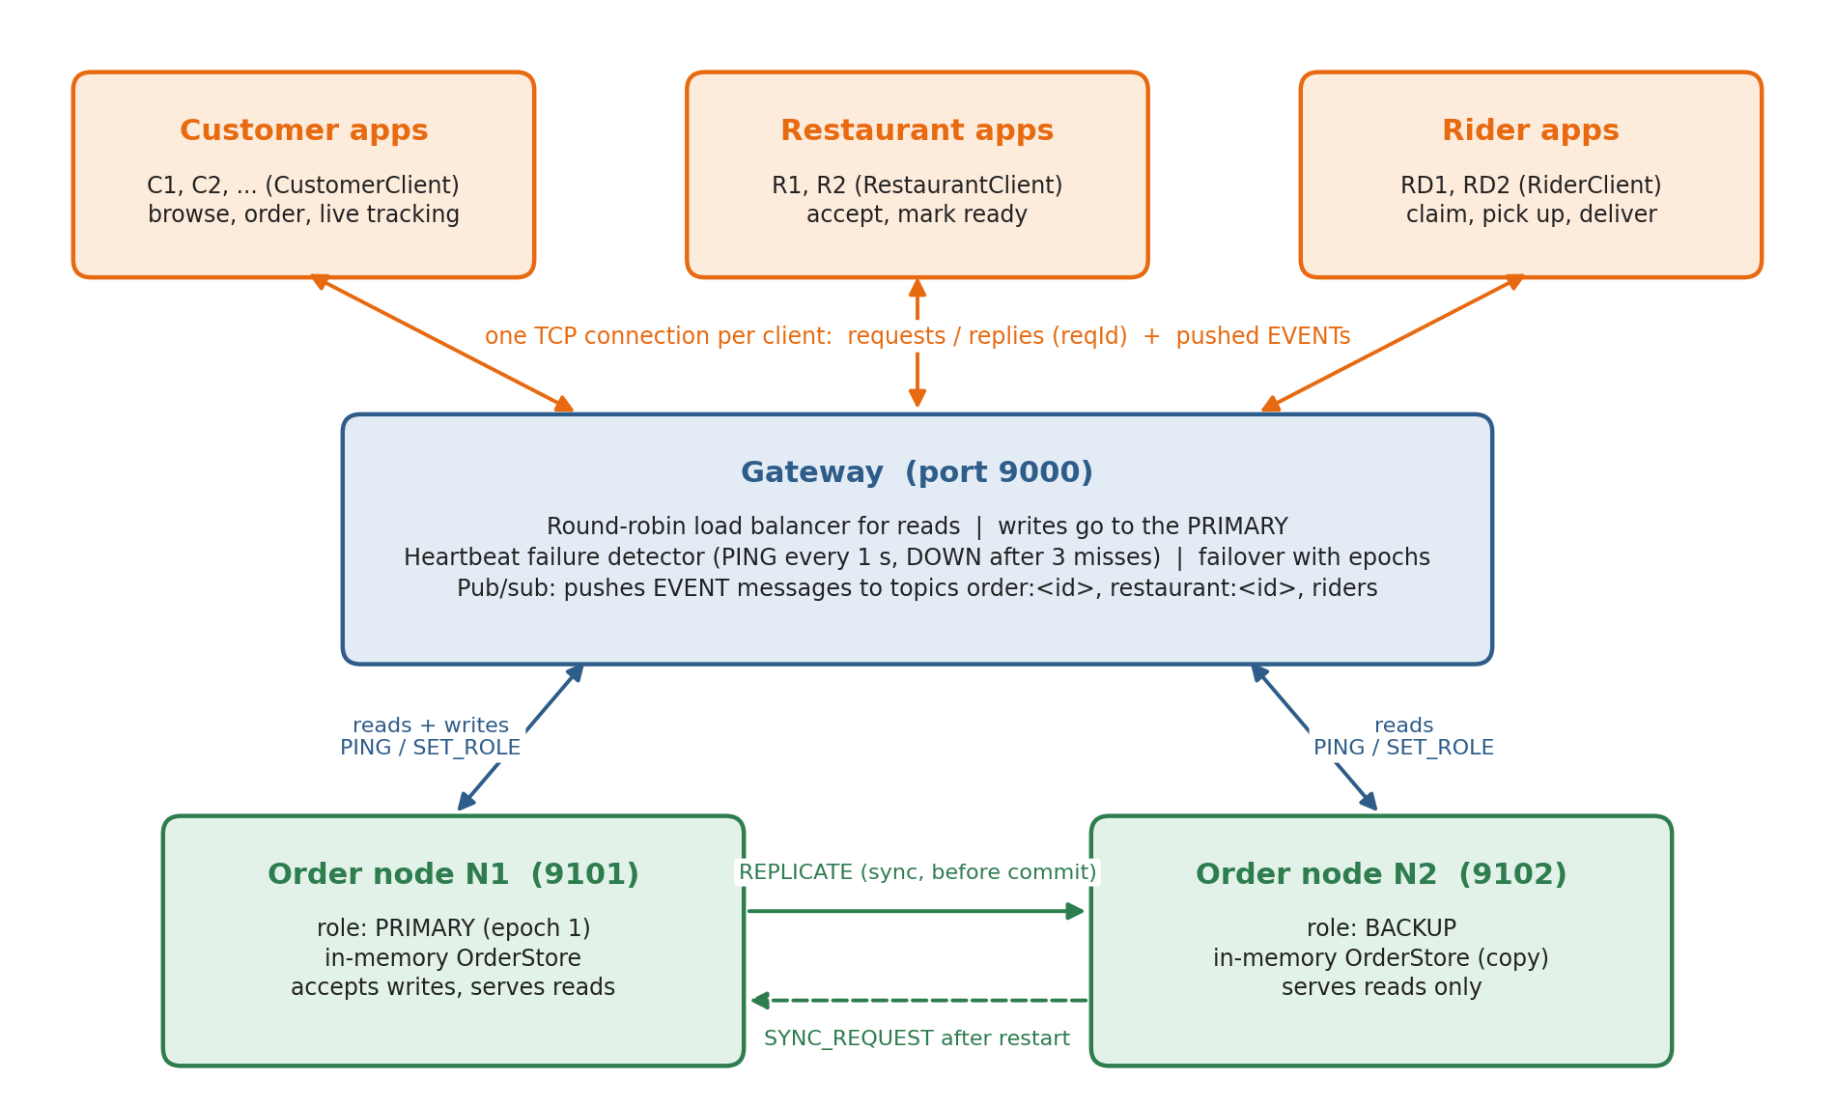
MiniSwiggy: the simplified design
Raw TCP sockets, Java 17, zero dependencies
Kept
3 client roles, full order life cycle, live tracking
Gateway
one entry point: load balancer, failure detector, pub/sub broker
2 order nodes
in-memory store, primary + backup
Dropped
payments, maps, ETA, disk storage, login
Size
20 source files (about 2,700 lines) plus a 460-line test suite
Notes:
MiniSwiggy keeps the three roles and the full order life cycle, but drops payments, maps and persistence. There is one gateway, which is the only entry point, and two order nodes that replicate each other. Everything is plain Java 17 sockets and threads with no libraries: 20 source files, about 2,700 lines, plus a test suite.

Slide 8
Protocol: one line of text per message
TYPE|key=value|key=value (values URL-encoded)
>> HELLO|role=CUSTOMER|id=RAW1|reqId=2
<< OK|reqId=2
>> PLACE_ORDER|restaurant=R2|items=R2-M1x1%2C
R2-M3x1|reqId=4
<< EVENT|event=PLACED|orderId=O-1|seq=1|...
<< OK|servedBy=N1|role=PRIMARY|orderId=O-1|
version=1|...|reqId=4
>> UPDATE_STATUS|orderId=O-1|status=DELIVERED|
reqId=5
<< ERROR|code=INVALID_TRANSITION|...|reqId=5
Reads
LIST_RESTAURANTS, GET_MENU, GET_ORDER, LIST_ORDERS go to any live node, round-robin
Writes
PLACE_ORDER, UPDATE_STATUS, CLAIM_ORDER go only to the primary
Push
EVENT has no reqId, so one socket can carry replies and pushed updates
>> sent by the client << received from the gateway
Captured from a real raw-TCP session with the gateway (logs/raw-protocol.txt), shortened.
Notes:
The protocol is one line of text per message, with URL-encoded values, so it can be read in logs and typed by hand. This is a real session with a plain TCP client. Notice the EVENT arriving before the OK of the same request: the client tells them apart because only replies carry the request id. Illegal steps get a clear error code.

Slide 9
Five distributed concepts, running in code
Each one has an automated test and a demo step
1
Round-robin load balancing
Gateway spreads reads over live nodes; skips a failed node
Gateway.forwardRead
2
Primary-backup replication
Primary copies each write to the backup before it commits and replies
OrderNode.replicate
3
Heartbeats + failover
PING every 1 s; 3 misses = DOWN; backup promoted with a new epoch
Gateway.reconcileRoles
4
Publish / subscribe
Topics order:<id>, restaurant:<id>, riders; events pushed after each write
PubSub
5
Ordered delivery
Per-order sequence numbers; client hold-back queue re-orders late events
OrderedEventBuffer
Also: fencing with epoch numbers | re-sync after restart | idempotent retries | order state machine
Notes:
The brief asked for at least two distributed concepts; MiniSwiggy runs five. Reads are load-balanced round-robin. Writes are replicated to the backup before they are acknowledged. The gateway detects failures with heartbeats and promotes the backup, using epoch numbers so an old primary cannot overwrite data. Order updates are pushed with publish-subscribe, and clients put them back in order using sequence numbers. Supporting ideas are fencing, re-sync after restart, and safe retries.

Slide 10
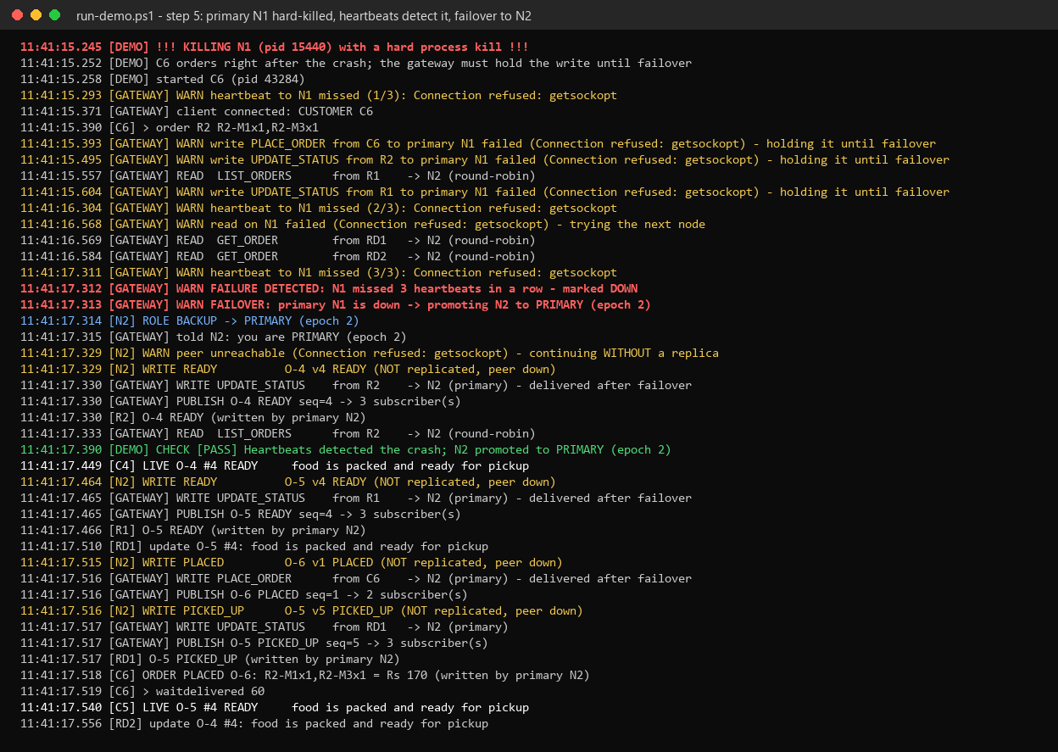
Failure demo: hard-kill the primary
Real output from the scripted demo, step 5
~3 s
writes held while heartbeats detect the crash (3 misses)
0
acknowledged orders lost
epoch 2
N2 promoted; N1 re-syncs 6 orders and rejoins as backup
In every automated test run the held write waited 3.04-3.12 s. Full demo output: logs/demo-transcript.txt.
Notes:
This is the key demo. The demo runner kills N1's process in the middle of orders. The gateway misses three heartbeats, marks N1 down and promotes N2 in epoch 2. Writes that arrive in between are held and then delivered to N2, so a customer only sees a delay of about three seconds. N2 keeps working without a replica until N1 is restarted; N1 then pulls all orders from N2 and rejoins as backup.

Slide 11
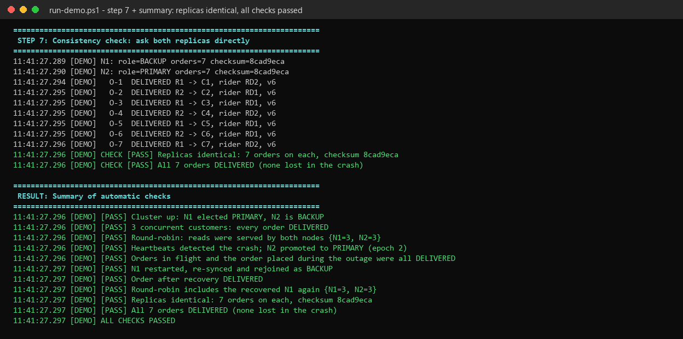
Testing and results
Everything below was run, not assumed
14 / 14
10 / 10
automated tests pass
demo checks pass
11
20
separate JVM processes in the demo
concurrent customers, 20 unique orders
Bugs found by testing, then fixed
invisible byte-order mark broke the first piped command; retry keys were not scoped per customer
On the final code: test suite passed 4 of 4 runs, full demo 3 of 3 runs (Windows 11, JDK 25.0.2).
Notes:
I ran the tests and the demo repeatedly. All 14 automated tests pass, and the demo's 10 automatic checks pass, including identical checksums on both replicas after the crash. Testing also found two real bugs, which I fixed: a hidden byte-order mark in piped input, and retry keys that could clash between two customers.

Slide 12
Conclusion
What I learned
Limits and next steps
Swiggy scales by splitting work: services, partitions, zones
Reliability comes from redundancy plus isolation, not from any one algorithm
Replicating before acknowledging makes a crash cost seconds, not data
Sequence numbers are enough to order one order's events
Gateway is a single point of failure: replicate it and elect a leader with Raft
Data is in memory only: add a write-ahead log
One backup: move to 3 replicas with quorum writes
Partition orders by city, like Swiggy's logistic zones
Thank you
Notes:
To conclude: Swiggy scales by splitting work into services, partitions and zones, and stays reliable through redundancy and isolation. MiniSwiggy shows the core of that on a small scale: with replication before acknowledgement, a crash costs a few seconds instead of data. Its limits are clear: the gateway is a single point of failure, data is only in memory, and there is only one backup. The next steps would be a replicated gateway using Raft, a write-ahead log, and three replicas with quorum writes.

