Slide 1















Digital Portfolio
STUDENT NAME
:Aravind.C
REGISTER NO AND NMID : 212403845/C11208738525D8C9CF5457290EC3979B
DEPARTMENT
: Computer Application
COLLEGE/UNIVERSITY
: Tagore College Of Art & Science Chrompet, Chennai
Madras University
1

Slide 2


PROJECT TITLE
PERSONAL PORTFOLIO
2

Slide 3





AGENDA
1. Problem Statement
2. Project Overview
3. End Users
4. Tools and Technologies
5. Portfolio design and Layout
6. Features and Functionality
7. Results and Screenshots
8. Conclusion
9. Github Link
3/21/2024 Annual Review
3

Slide 4

PROBLE STATEMENT
Many students and professionals
struggle to present their skills,
achievements, and projects in a
structured and accessible format. A
personal portfolio solves this by
providing a centralized platform to
display one’s work effectively.
4

Slide 5
POTFOLIO DESIGN AND LAYOUT
Clean and professional interface
Sections: Home, About, Skills, Projects,
Certificates, Contact
Easy navigation with responsive design
5

Slide 6

PROJEC OVERVIEW
This project is a responsive
portfolio website built to highlight
educational details, skills,
certifications, and projects. It
serves as a digital resume and an
interactive way to showcase
personal growth.
6

Slide 7

WHO ARE THE END
USERS?
Students creating digital resumes
Job seekers showcasing skills to recruiters
Developers & designers displaying projects
Employers/recruiters evaluating candidates
7

Slide 8
TOOLS AND TECHNIQUES
HTML5, CSS3, JavaScript – for structure,
design, and interactivity
Bootstrap – for responsive layout
GitHub Pages – for hosting
8

Slide 9
FEATURES AND FUNCTIONALITY
Responsive across devices
Interactive navigation bar
Skills representation with progress indicators
Contact section for communication
Project and certificate showcase

Slide 10

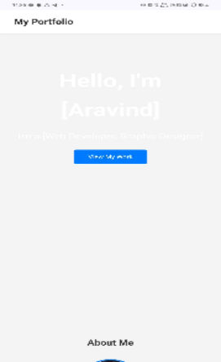
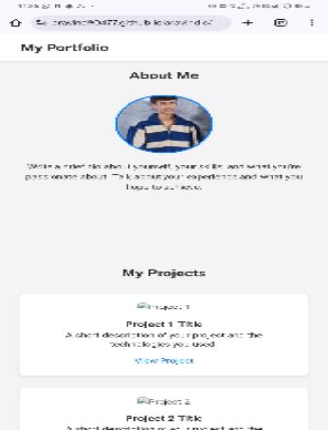
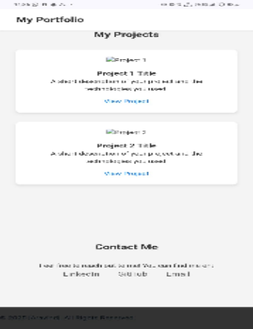
RESULTS AND SCREENSHOTS
3/21/2024 Annual Review
10

Slide 11
CONCLUSION
The portfolio website provides a
professional way to showcase
personal achievements and skills. It
enhances career opportunities by
giving recruiters a clear overview of
the candidate’s profile.
11

Slide 12
GITHUB LINK
/https://aravind90477.github.io/aravind.c

