Slide 1

WELLNESS-WISE
CSE 5320-001 : Special Topics in Software Engineering
By Team - 7,
Syed Saboor Ahmed – 1002153699
Rohit Sajjan – 1002169816
Praveen K. Rimmalapudi – 1002086462
Y. Amulya – 1002114896
Aravind Yalla – 1002038759

Slide 2

Introduction
Wellness Wise: Your Path to Personal Well-Being
Build your profile
Create and Track Your custom goals
Strive to be at the top of the leaderboard
Improve your lifestyle with a group of like minded individuals

Slide 3
Existing System
All these apps are well established but are a little different from our goals.
FitOn: Personalized Training Classes (Little customization)
Loseit: User food consumption tracker and personalized nutrition plans
School Planner: Homework and Assignment tracker, Class Schedule etc.
FitOn, Calibre
Lose It!
School planner

Slide 4
Proposed App
All these apps are really good but they focus on only one aspect of users life. Our app focus on a bigger picture allowing users to Set their own Goals.
Scoring: Our app offers a Scoring system that motivates the user to gain more app and push their limits.
App Category: Productivity.
Wellness-Wise

Slide 5

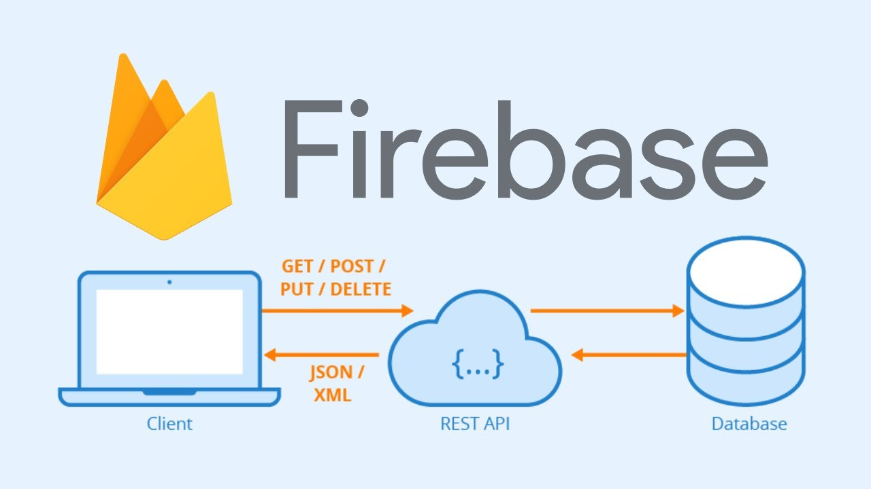
React Native and Expo and Firebase
Technology used
Developed using React Native and Expo CLI, which allowed to create a cross-platform app that works on
both iOS and Android devices &
Firebase to store and manage data.

Slide 6
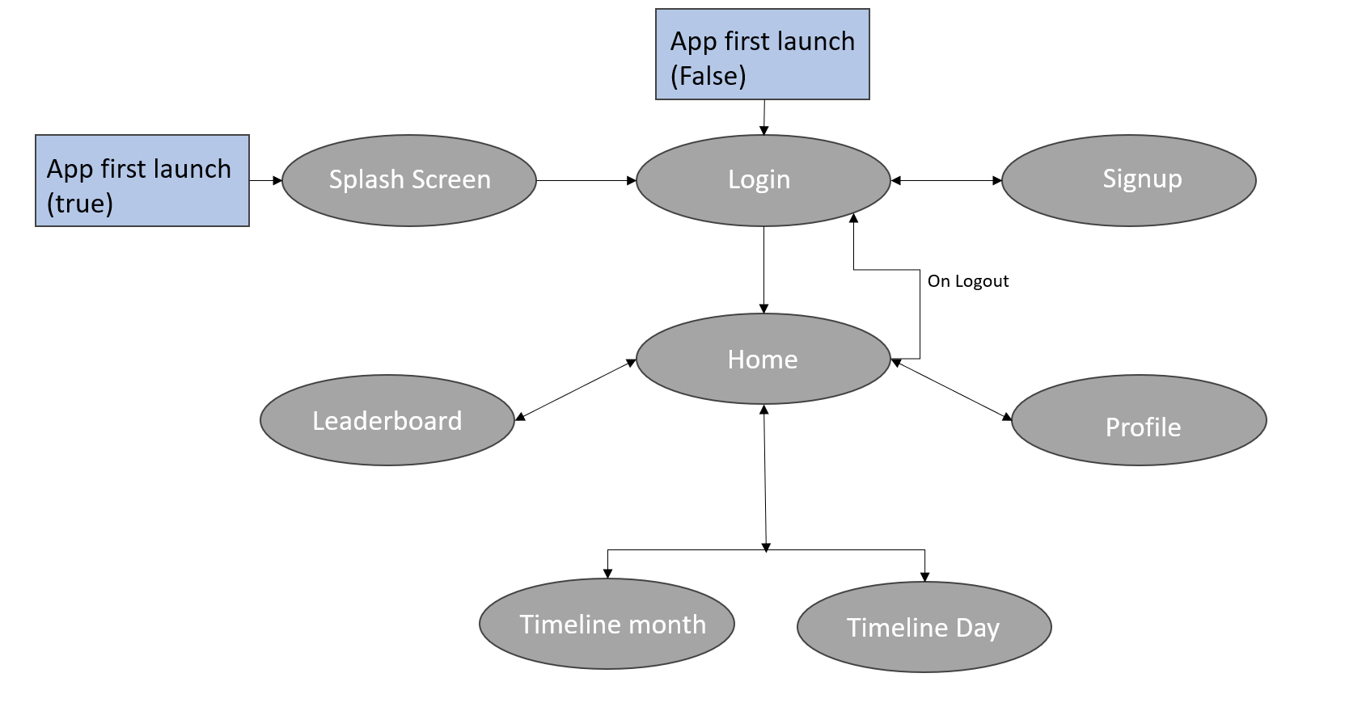
App layout
Wellness-Wise

Slide 7
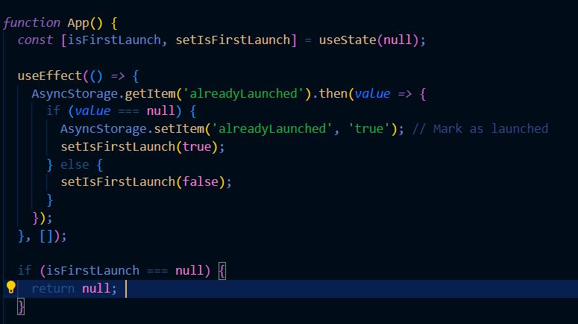
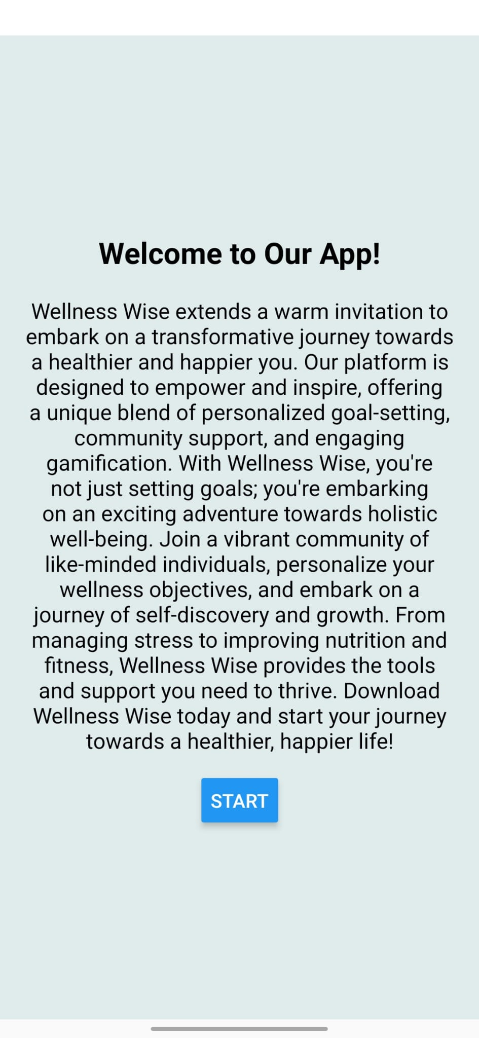
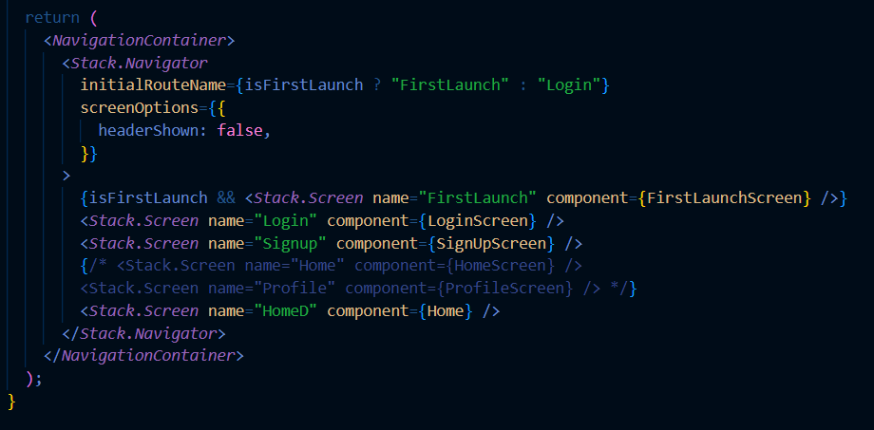
Splash Screen

Slide 8
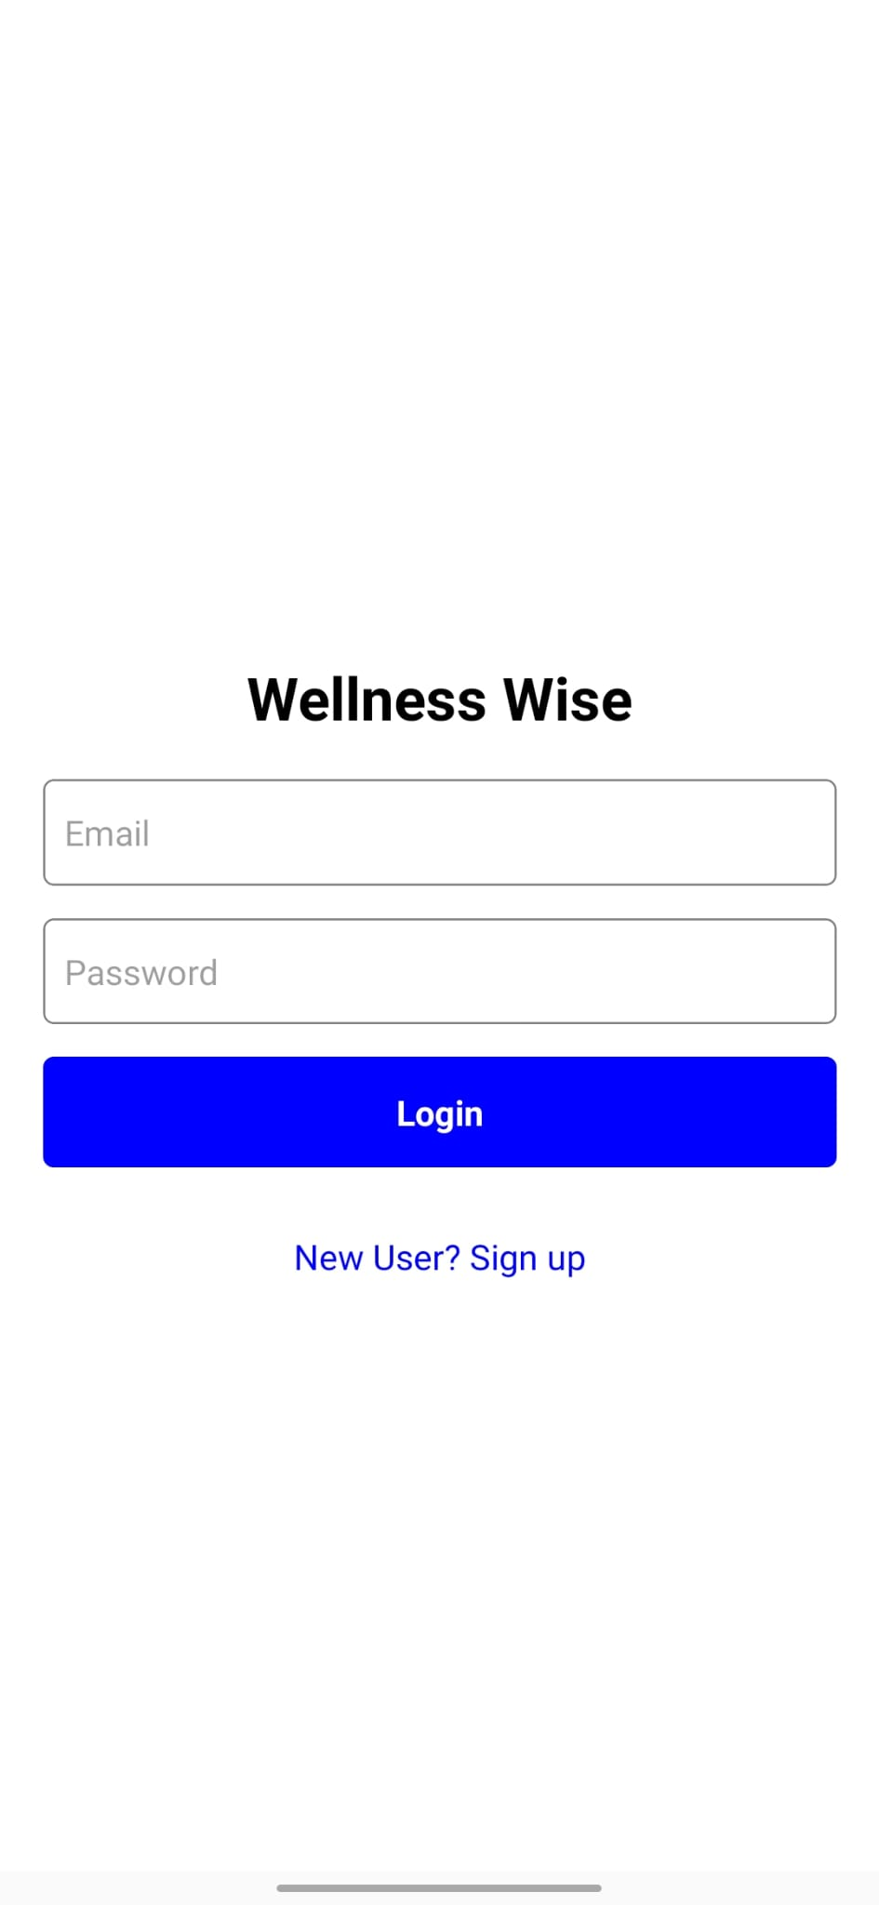
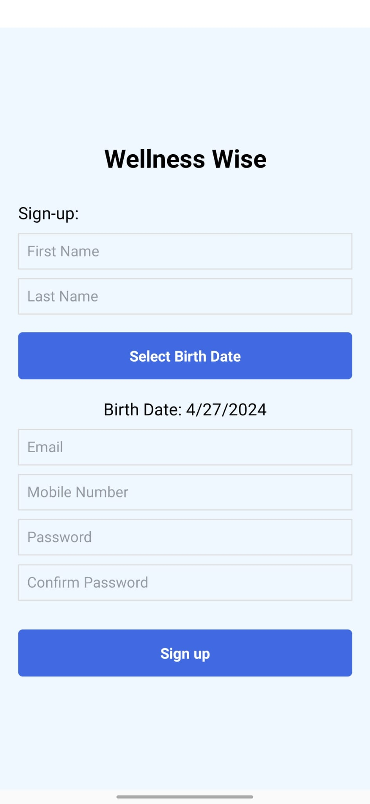
Login & SignUp Screen
This screens handle the logic and sign up of the our app.
This is required as our app have personalization based for each user.
Firebase authentication is used to handle the login and signup.

Slide 9
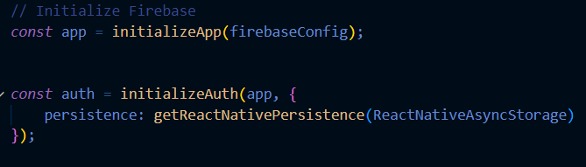
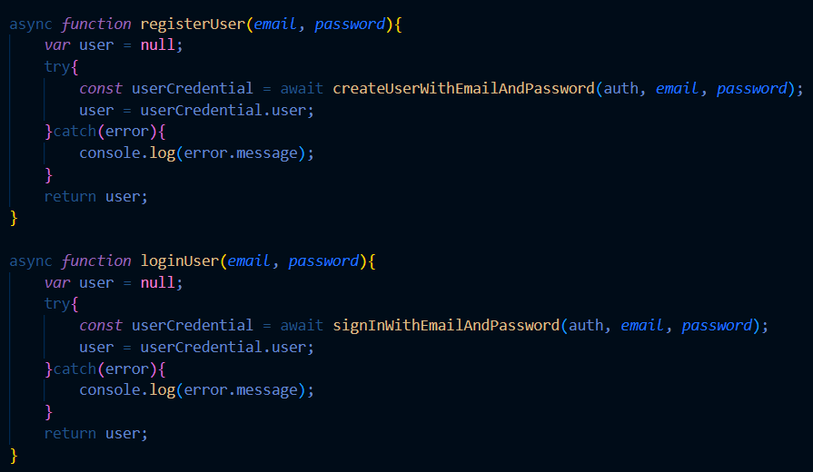
Login & SignUp
from "firebase/auth";

Slide 10
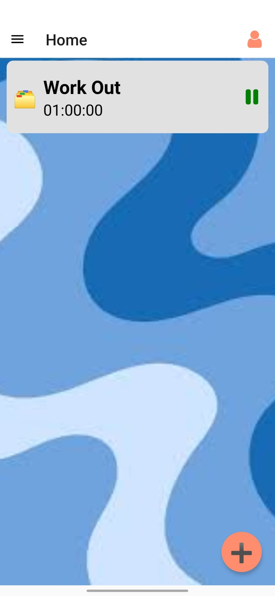
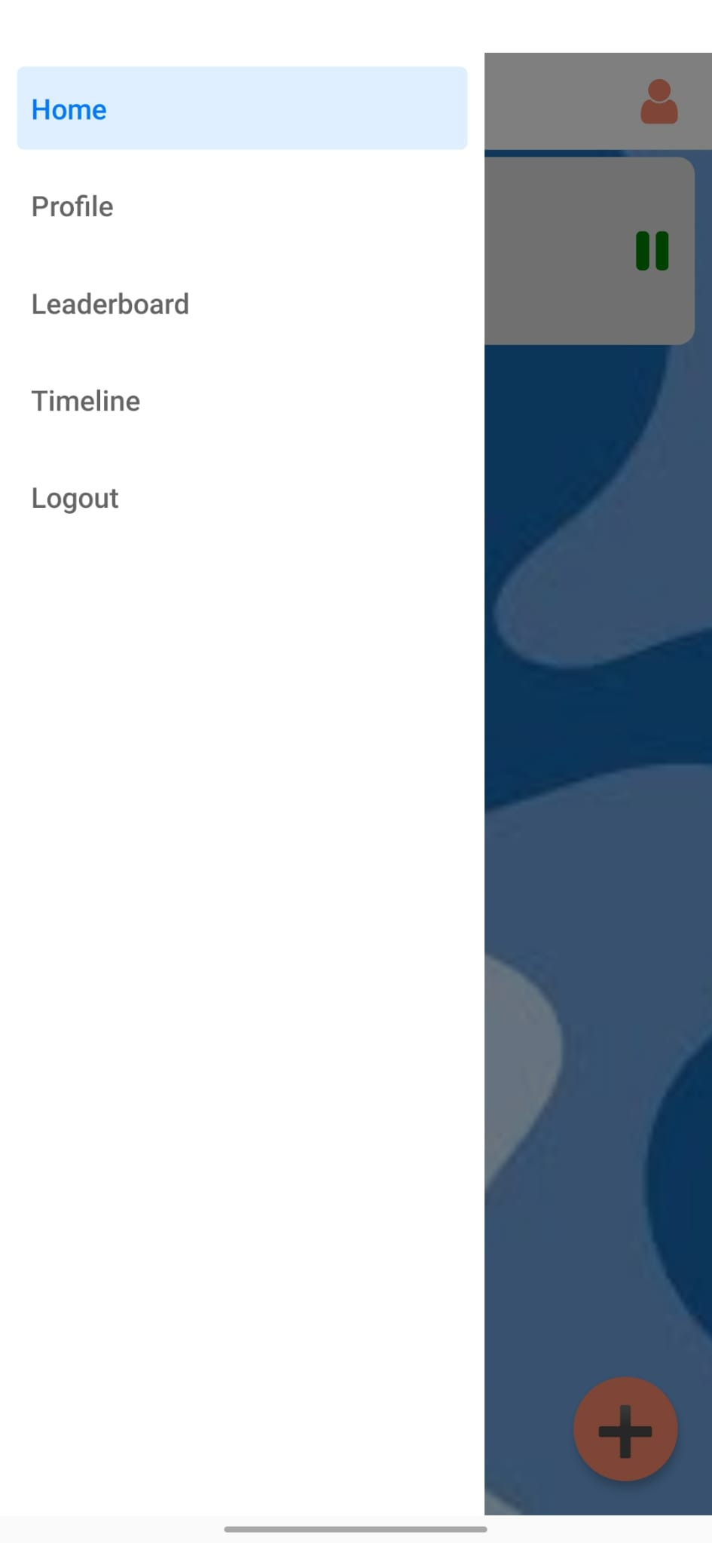
Home Screen & Navigation
Navigation is done using Drawer Navigation.
Home Screen renders tasks, and add button for adding new tasks.

Slide 11
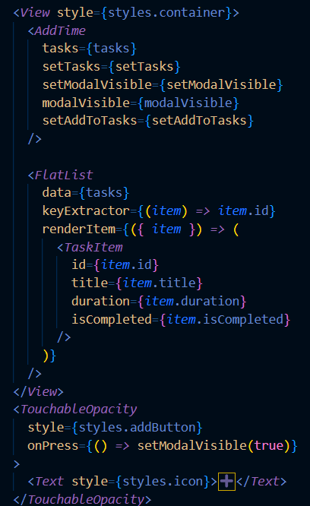
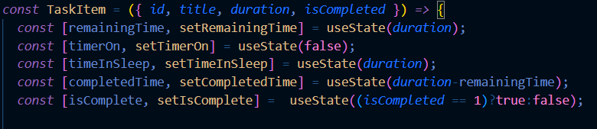
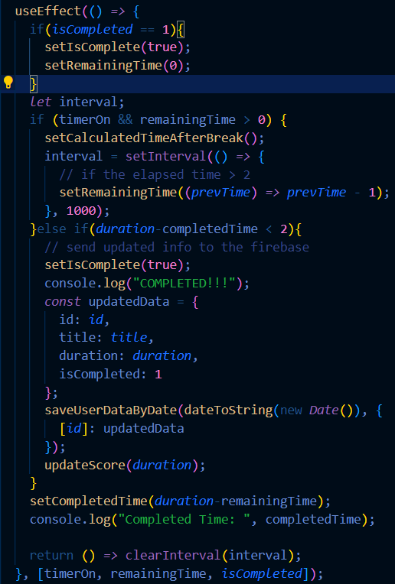
Home Screen & navigation

Slide 12
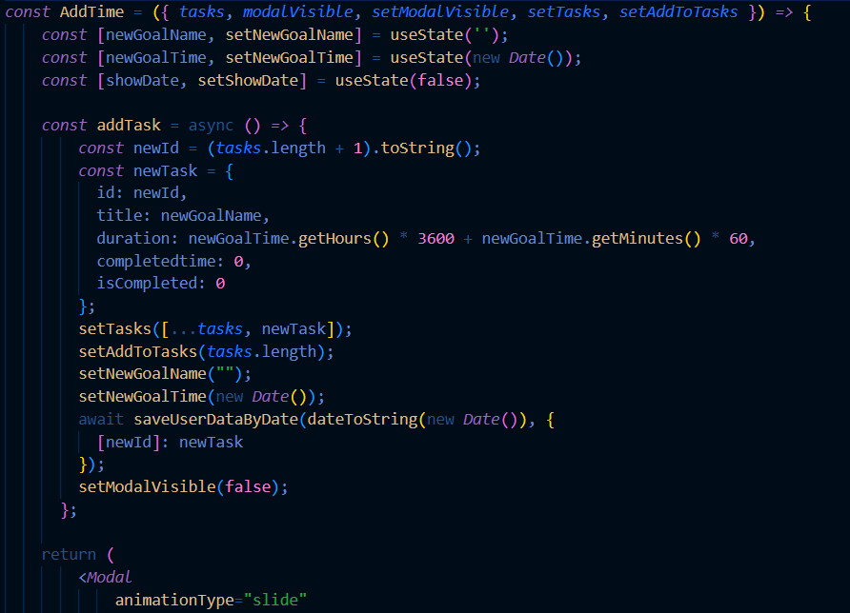
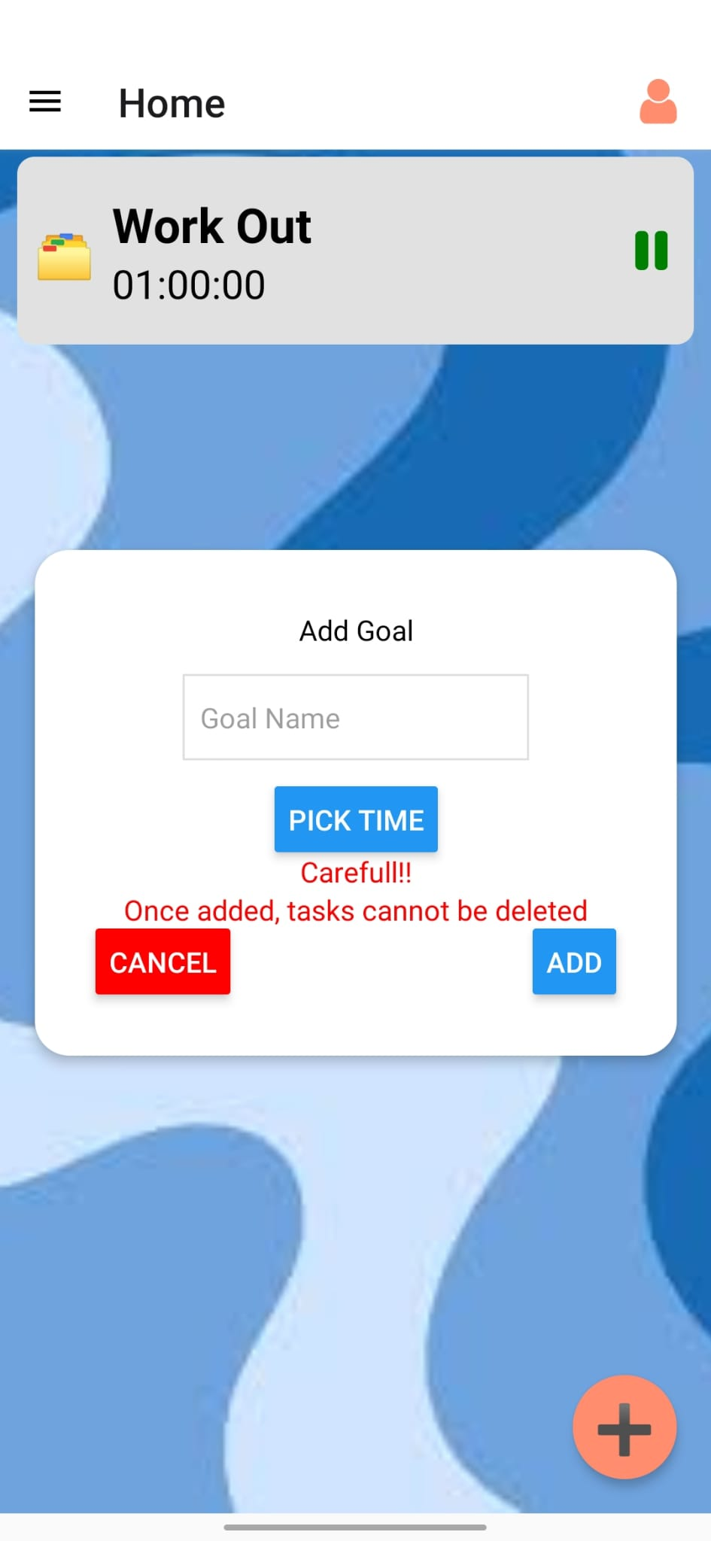
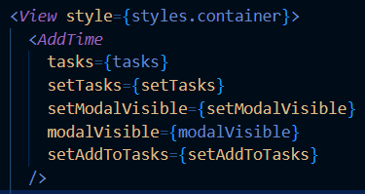
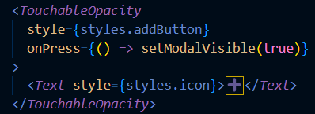
Add Item

Slide 13
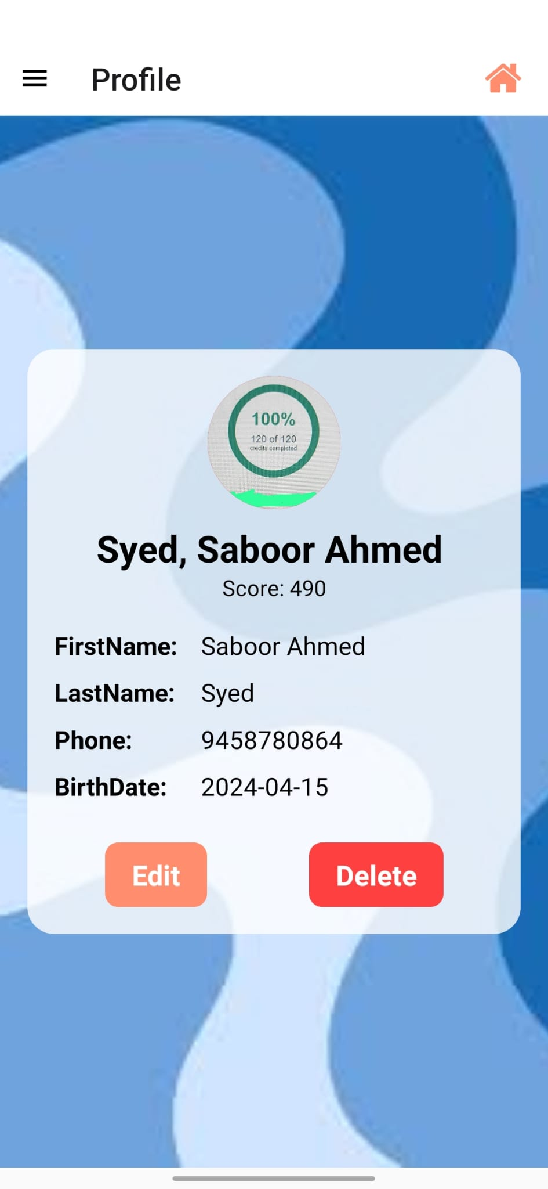
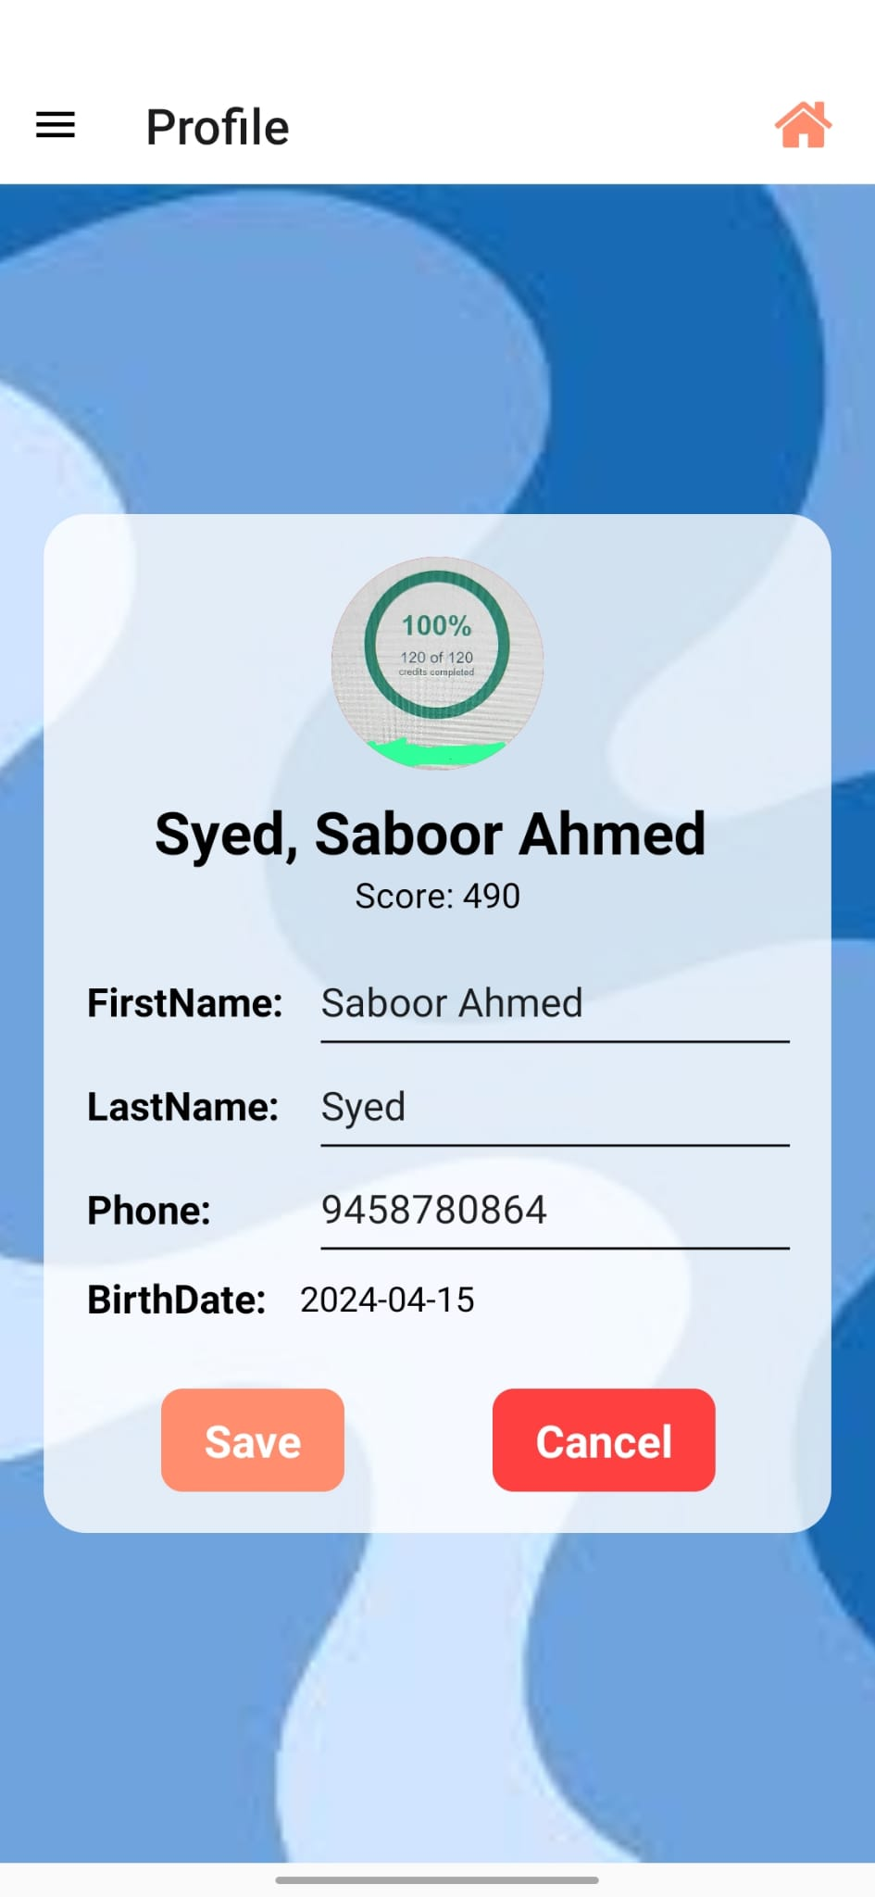
Profile Screen
Profile screen is Editable, It also allows user to change birth date and their profile picture.

Slide 14
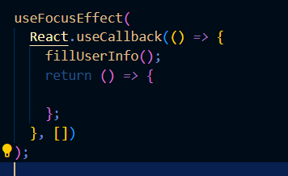
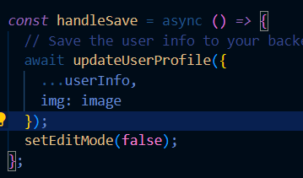
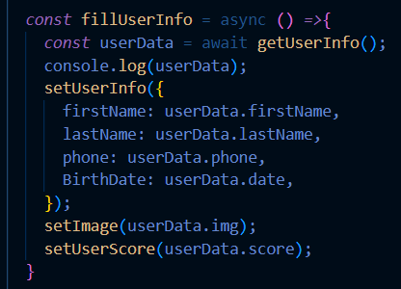
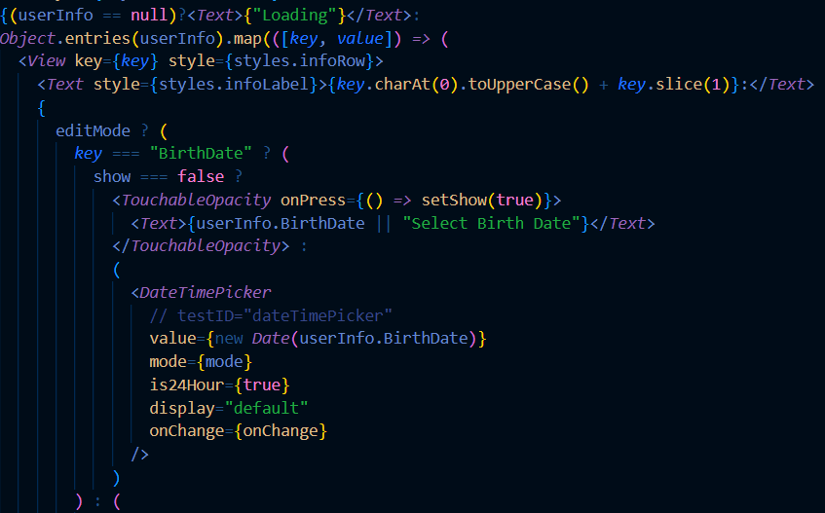
Profile Screen

Slide 15
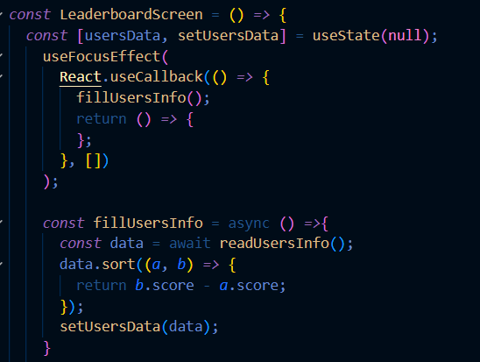
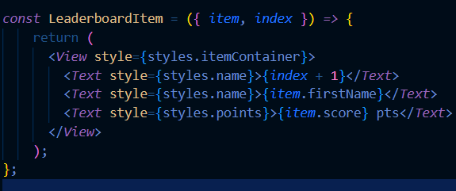
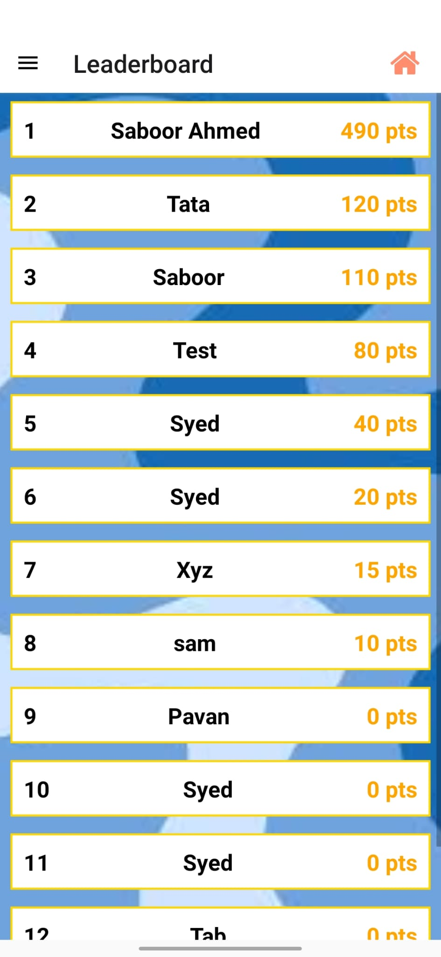
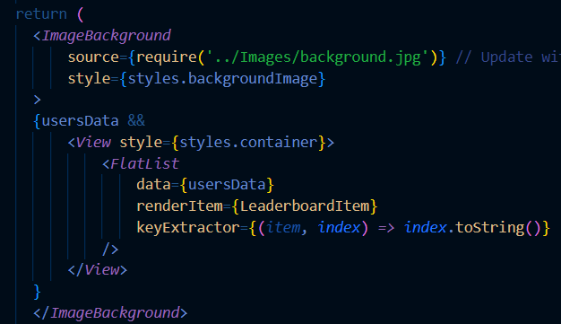
Leaderboard

Slide 16
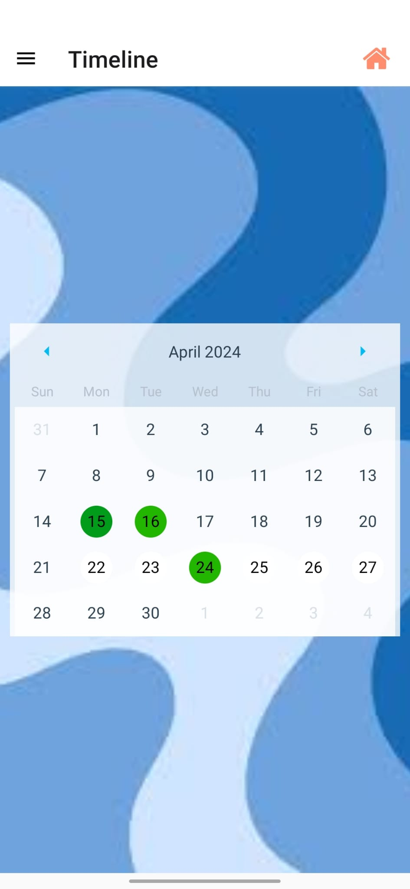
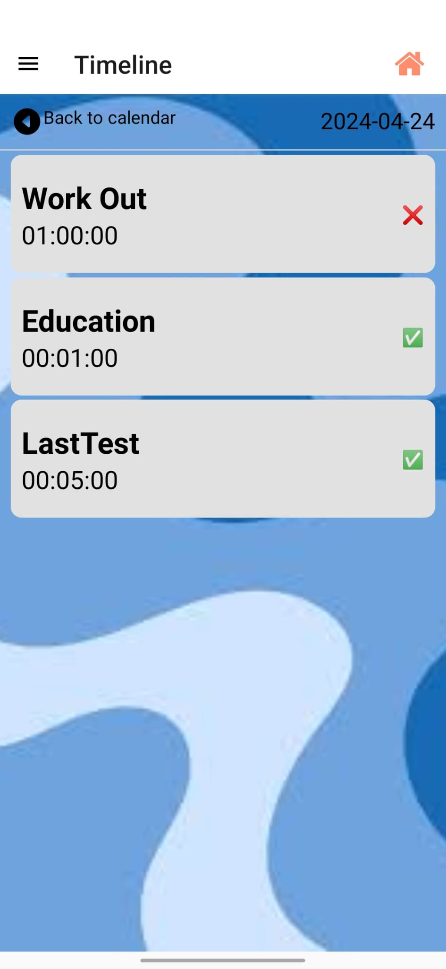
Timeline
User time line screen is divided into two parts Calendar time line and day time line

Slide 17
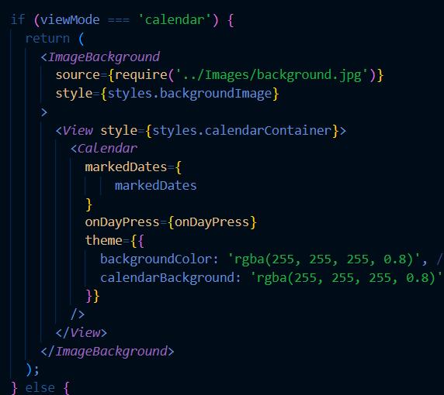
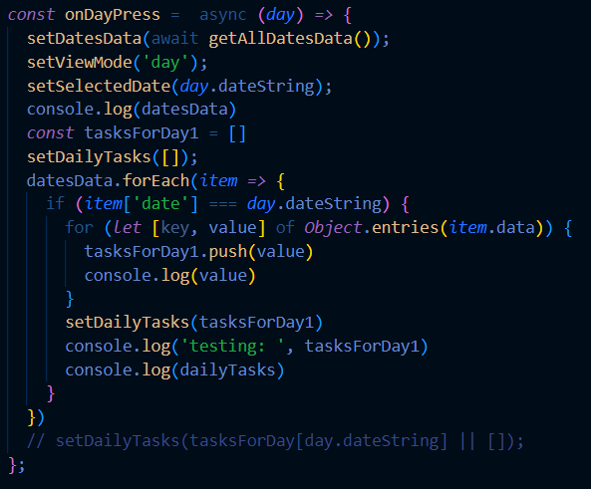
Timeline

Slide 18
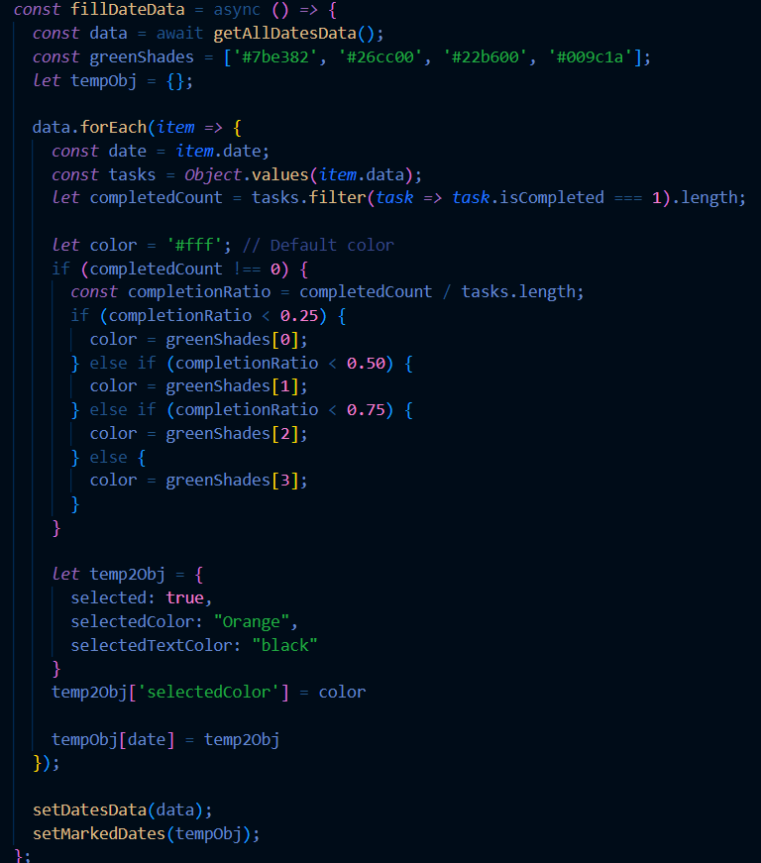
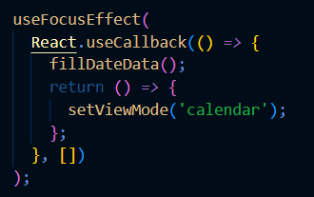
Timeline

Slide 19
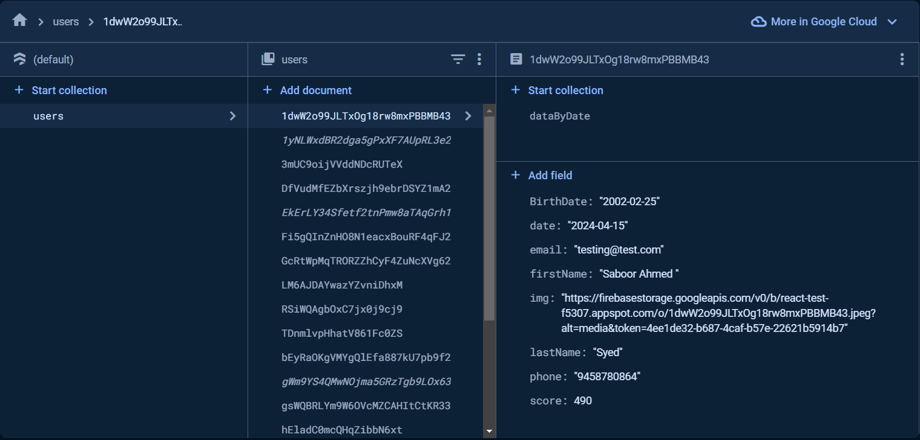
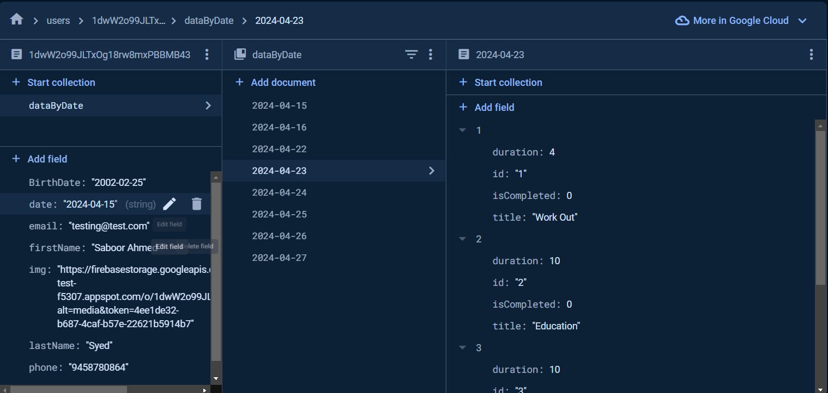
Database

Slide 20
Conclusion
Tracking and managing your daily tasks made easy.
Customized task and Personalized profile.
Scoring System that Motivates users.
Leader board for healthy competition.

