Slide 1
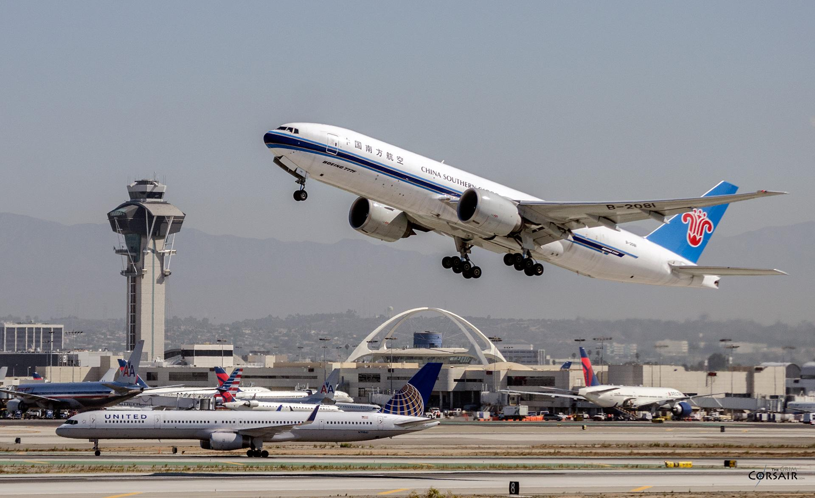
Deciphering Air Travel Disruptions: A Machine Learning Approach
Authors:
Aravinda Jatavallabha, Aadithya Naresh, Jacob Gerlach
North Carolina State University, Raleigh
Notes:
ARAVINDA

Slide 2
Introduction
Flight punctuality is a critical aspect of airport and airline service quality, but flight delays, both in arrival and departure, pose substantial challenges impacting operational efficiency and customer satisfaction [1].
The FAA estimated that flight delays cost the aviation industry $33 billion annually in 2019, highlighting the substantial economic impact [2].
Delays also contribute to environmental concerns through increased fuel emissions.
Predicting flight delays is essential for proactive planning and resource allocation.
Considering the intricacies of flight delay factors, it's clear that traditional methods may fall short in accurate predictions.
Notes:
ARAVINDA

Slide 3
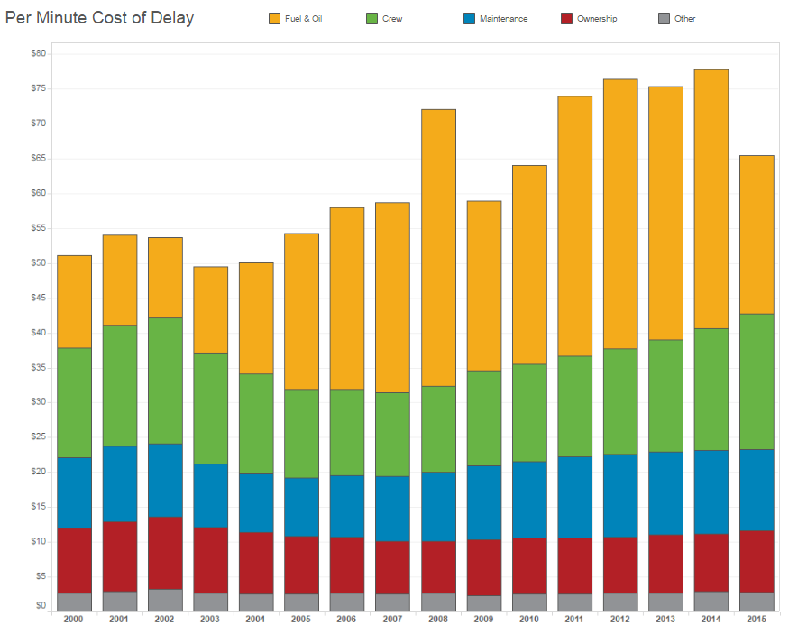
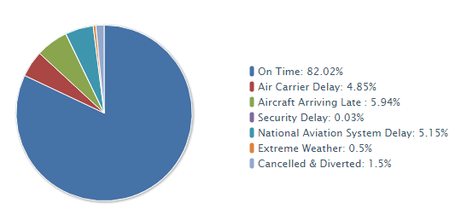
Understanding Flight Delay Factors and Costs
Delay due to various components [3]
Per Minute Cost of Delay [3]
Notes:
ARAVINDA
These are some graphs which illustrate the contribution of each component to delays and the associated costs per minute, including factors such as crew, fuel, and more
Therefore, predicting flight delays is super important. But it's not easy. There are so many factors at play – like weather, security, and air traffic – that traditional methods just can't keep up with.
That's where machine learning comes in. Instead of relying on old-school methods, we can use machine learning to analyze tons of data and spot patterns that humans might miss. It's like having a super-smart assistant helping us make better predictions.
NAS Delay: National Aviation System is a broad term for a set of situations that can affect flight times. These include airport operations, non-risky weather conditions, high air traffic volume, and air traffic control delays.

Slide 4

Understanding of the Project
Goal
The goal of this project is to develop machine learning models that can individually predict the contribution of various factors, such as weather conditions, security issues, etc.
Usefulness
Enable airlines, airports, and stakeholders to address specific issues effectively
Accurately predict the contribution of each factor to flight delays
Implement targeted strategies for delay mitigation and operational efficiency improvement
Notes:
ARAVINDA
The goal of this project is to develop machine learning models that can individually predict the contribution of various factors, such as weather conditions, security issues, etc.,
Overall, our study aims to provide a granular understanding of these delay factors, empowering airlines, airports, and stakeholders to address them effectively. By accurately predicting each factor's contribution, we can implement targeted strategies to mitigate delays and improve overall operational efficiency. Additionally, insights from this research can inform the development of customized solutions and policies, ultimately enhancing the reliability and resilience of air travel systems.

Slide 5
Related works
Authors | Work | Description
Tang, Y | Airline Flight Delay Prediction Using Machine Learning Models [4]. | The study evaluated machine learning models using JFK airport data, achieving high accuracy rates of 97.78% with Decision Trees, 92.40% with Random Forest, and 93.34% with Gradient Boosted Trees. Future research aims to refine data imbalance and explore alternative ensemble techniques for improved precision.
Dou, X. | Flight arrival delay prediction and analysis using ensemble learning [5]. | Introduced a method using Support Vector Regressor (SVR) to predict flight delays at U.S airports. By organizing and sampling data month by month, they identified 15 key features using cat-boost and employed regression models to predict specific delay times.
Notes:
ARAVINDA

Slide 6
Related works
Authors | Work | Description
Esmaeilzadeh, E., & Mokhtarimousavi, S. | Machine Learning Approach for Flight Departure Delay Prediction and Analysis [6]. | In this study, authors used Support Vector Machine (SVM) to explore factors influencing air traffic delays at three major New York City airports. They analyzed various explanatory variables to uncover relationships with departure delays, airport operations, and flow management, gaining deeper insights into delay causes.
Li, Q., Guan, X., & Liu, J. | A CNN-LSTM framework for flight delay prediction [7]. | Authors proposed a CNN-LSTM deep learning framework to address flight delay prediction complexities. Integrating Convolutional Neural Network (CNN) and Long Short-Term Memory (LSTM) architectures, their model captured spatial and temporal correlations, achieving 92.39% accuracy on U.S. domestic flights in 2019.
Notes:
ARAVINDA

Slide 7
Related works
Authors | Work | Description
Nathalie Kuhn & Navaneeth Jamadagni | Application of Machine Learning Algorithms to Predict Flight Arrival Delays [8]. | In this study, authors used Decision Tree, Logistic Regression and Neural Network model to classify the data of U.S. domestic flights in 2017 and predict flight delay. An F1-score of 0.91 was obtained for all the models.
A. Anusha, B. Ratna Kumar, D. Naga Ganesh Reddy, D. Sandeep Kumar, K. Shankar Nayak | Prediction Of Flight Delay using machine learning [9]. | The authors have performed a classification task utilizing machine learning algorithms like Random Forest, Multi Layer Perceptron, Naive Bayes Classifier, KNN. The performance of the Random Forest algorithm surpasses other algorithms used achieving an accuracy of 83%.
Notes:
ARAVINDA

Slide 8
Novelty
Regression techniques
Individual Delay Components
Factors: Security delay, Weather delay, NAS Delay, Carrier Delay, Aircraft Delay.
Application of Time-Series Architectures to utilize temporal dependencies in the data.
Notes:
ARAVINDA
In contrast to previous studies, which primarily focused on classification techniques, our research emphasizes regression methods to predict the precise delay value in minutes. While some prior works have addressed predicting total delay, to our knowledge, none have specifically targeted individual delay components. To accomplish this, we employed time series models, which will be elaborated upon in subsequent discussions.

Slide 9
Method
Selection of advanced time series models: LSTM, Bi-LSTM, and LSTM+CNN chosen for their proficiency in capturing complex temporal patterns.
Incorporation of baseline regression models: Multiple Regression, Random Forest Regression, Decision Tree Regression, XGBoost, and Artificial Neural Network for benchmarking.
Advantages of LSTM and Bi-LSTM: adeptness in handling vanishing gradient problems and capturing long-term dependencies.
Mitigation of vanishing gradient issue: employment of techniques like gradient clipping and batch normalization in LSTM models.
Expected superiority of time series models, especially LSTM and its variants, in predicting flight delays due to their capacity to capture temporal dependencies, offering valuable insights into machine learning approaches for flight delay prediction.
Notes:
Aadithya.
We aim to use time-series models like LSTM, Bi-LSTM to understand the temporal dependencies and patterns from the input data.
Compare them to baseline regression models like Multiple Regresssion, Random Forest Regression, Decision Tree Regression, XGBoost, and Artificial Neural Network.

Slide 10






Tools and Technologies used
Notes:
Aadithya

Slide 11
Dataset Description
Data Source:
We’ve used data obtained from the US Department of Transportation, Bureau of Transportation Statistics from January 2019 – August 2023 [10]
It contains 32 attributes related to planned flight date-time, airline, planned origin and destination, cancellation and diversion status, overall delay, and delay due to individual components (carrier, weather, NAS, security, late aircraft)
Notes:
Aadithya

Slide 12
Understanding the Data
FL_DATE | AIRLINE | ORIGIN | DEST | CRS_DEPT_TIME | TAXI_IN | TAXI_OUT | CRS_ARR_TIME | DISTANCE
2019-01-09 | United Air Lines Inc. | FLL | EWR | 1155 | 19.0 | 4.0 | 1501 | 1065.0
2022-11-19 | Delta Air Lines Inc | MSP | SEA | 2120 | 9.0 | 38.0 | 2315 | 1399.0
2022-07-22 | United Air Lines Inc. | DEN | MSP | 954 | 20.0 | 5.0 | 1252 | 680.0
2020-02-23 | Spirit Air Lines | MCO | DFW | 1840 | 15.0 | 14.0 | 2041 | 985.0
Notes:
Aadithya

Slide 13
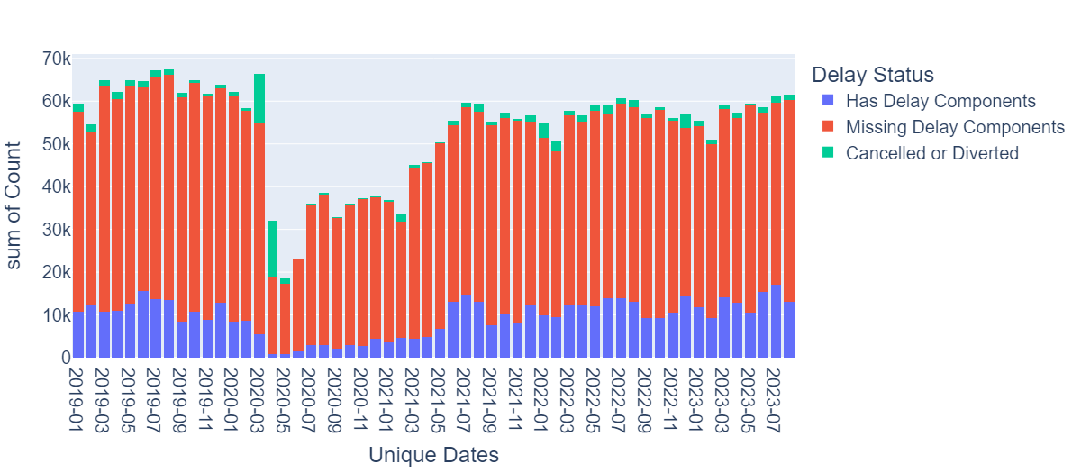
Pre-Processing: Removing NULLs
The majority of the data was removed for having NULL values for all individual delay components. Leaving us with 533,863 records.
Flight Record Counts
Notes:
JACOB we verified that each flight component added to arr_delay

Slide 14
Pre-Processing: Feature Selection
Pearson’s Correlation between 6 non-categorical independent attributes: CRS_DEP_TIME, TAXI_OUT, CRS_ARR_TIME, TAXI_IN, CRS_ELASPED_TIME DISTANCE and dependent variable: ARR_DELAY
PCA on normalized data did not help increase correlation
NON-CATEGORICAL ATTRIBUTE | PEARSON’S CORRELATION
CRS_DEP_TIME | 0.0704
TAXI_OUT | 0.0541
CRS_ARR_TIME | 0.0500
TAXI_IN | 0.0235
*CRS_ELAPSED_TIME | -0.0122
DISTANCE | -0.0229
*Removed (redundant)
Notes:
JACOB tried pca, similar orders of correlation

Slide 15
Pre-Processing: Feature Selection
Eliminated redundancies in categorical attributes. Verified using The Kruskal-Wallis H-test
ORIGIN / DEST had more unique values than ORIGIN_CITY / DEST_CITY
ORIGINAL CATEGORICAL ATTRIBUTE | KEPT CATEGORICAL ATTRIBUTE
AIRLINE | AIRLINE
AIRLINE_CODE
DOT_CODE
AIRLINE_DOT
ORIGIN | ORIGIN
ORIGIN_CITY
DEST | DEST
DEST_CITY
Notes:
JACOB tried pca, similar orders of correlation

Slide 16
Pre-Processing: Data Transformation
Independent Vars. | Description | Initial Format | Transformed format | Var. Type
CRS_DEP_TIME | Scheduled departure, local time | hhmm | Minutes past midnight | Discrete, Ratio
TAXI_OUT | Taxi out time | Minutes past midnight | Minutes past midnight | Discrete, Ratio
CRS_ARR_TIME | Scheduled arrival, local time | hhmm | Minutes past midnight | Discrete, Ratio
TAXI_IN | Taxi in time | Minutes past midnight | Minutes past midnight | Discrete, Ratio
DISTANCE | Distance between airports | Miles | Miles | Discrete, Ratio
FL_DATE | Flight date | yyyymmdd | 3 Vars.: Year (label encoded), Month, Day | 3 * Discrete, Ordinal
AIRLINE | Reporting airline | Name of airline | Label encoded | Discrete, Nominal
ORIGIN | Origin airport | 3 digit code | Label encoded (with DEST) | Discrete, Nominal
DEST | Destination airport | 3 digit code | Label encoded (with ORIGIN) | Discrete, Nominal
Notes:
JACOB
The dataset consists of 32 attributes, out of which we choose 9 independent attributes based on our domain knowledge and correlation with the overall delay.

Slide 17
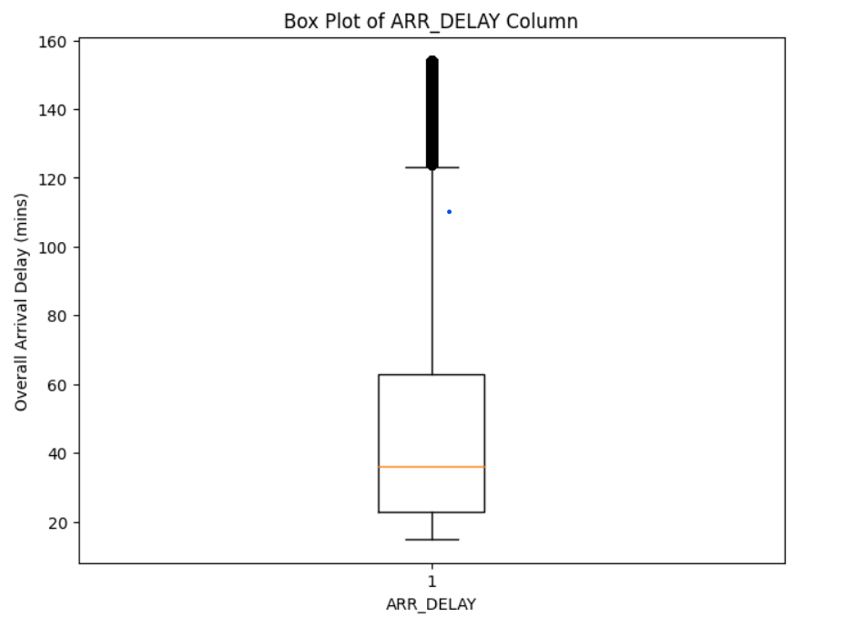
Pre-Processing: Outlier Pruning
Lower Bound: Q1 - 1.5*IQR
Upper Bound: Q3 + 1.5*IQR
 | Pre-Outlier Removal | Post-Outlier Removal
# of Records | 533,863 | 489,828
Mean | 67.526 | 47.828
Standard Dev. | 93.909 | 32.869
Minimum | 15 | 15
Maximum | 2934 | 154
Notes:
JACOB

Slide 18
Pre-Processing: Split and Normalization
75%/25% train/test split
Recall: Categorical attributes were encoded into integer labels
ORIGIN and DEST were encoded together to ensure consistent relationship
Non-categorical attributes were Z-Score normalized
Fitted on train, applied to test
Notes:
JACOB

Slide 19
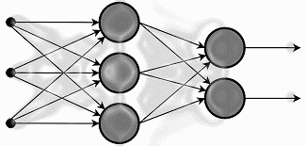
Modeling
The baseline machine learning algorithms used in this study are:
Random Forest Regressor
Multiple Regression
Decision Tree Regression
XGBoost Regressor
Artificial Neural Network (ANN)

Slide 20
Modeling
The time-series machine learning algorithms used in this study are:
Long Short-Term Memory (LSTM)
Bidirectional Long Short-Term Memory (BiLSTM)
LSTM + CNN Hybrid Model

Slide 21
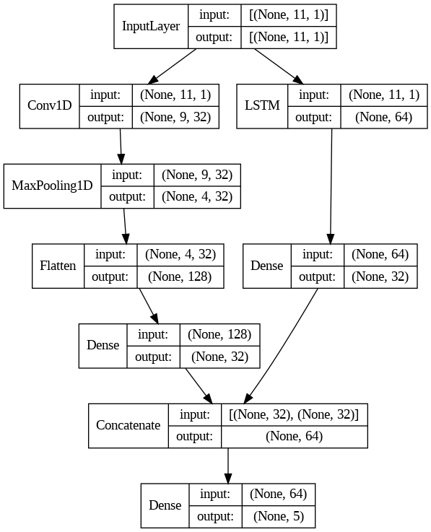
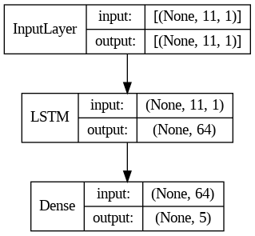
Time-Series Architecture
LSTM/CNN Hybrid
LSTM
Hand tuned batch size (265) and LSTM hidden nodes (64)
Notes:
The illustrated LSTM CNN hybrid architecture combines Convolutional Neural Network (CNN) and Long Short-Term Memory (LSTM) components. The CNN segment convolves over input data, extracting spatial features through one-dimensional operations, followed by max-pooling and flattening layers for temporal pattern extraction. Simultaneously, the LSTM processes the same data, capturing temporal dependencies. Both pathways undergo dense layers for feature refinement before their outputs are concatenated, creating a unified feature space for accurate prediction or classification.
The LSTM CNN hybrid architecture illustrated above integrates both Convolutional Neural Network (CNN) and Long Short-Term Memory (LSTM) components to leverage their respective strengths in capturing spatial and temporal patterns from input time-series data. The CNN segment initiates by convolving over the input data, extracting relevant spatial features through one-dimensional convolutional operations, followed by max-pooling and flattening layers to distill significant patterns along the temporal dimension. These spatial features are then further refined through a densely connected layer, augmenting their representational capacity. Simultaneously, the LSTM component processes the same input data, specializing in capturing temporal dependencies across sequential observations. Comprising of an LSTM layer, this segment adeptly captures sequential information, with the layer capturing information from the past, and this is followed by a densely connected layer that refines the extracted features from the LSTM pathway. Finally, the outputs from both the CNN and LSTM pathways are concatenated, merging spatial and temporal insights into a unified feature space. This concatenated feature vector encapsulates a comprehensive representation of the input sequence, empowering the model to discern intricate spatial and temporal patterns crucial for accurate prediction or classification tasks

Slide 22
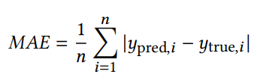
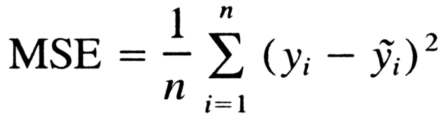
Training and Evaluation Metrics
MAE quantifies the average magnitude of errors between predicted and actual values
Useful for interpreting our results because it is measured in minutes
MSE quantifies the average squared magnitude of errors between predicted and actual values
Useful for training models because it gives higher weighting to lower frequency values, and we have a lot of zeros
Mean Absolute Error (MAE)
Mean Squared Error (MSE)

Slide 23
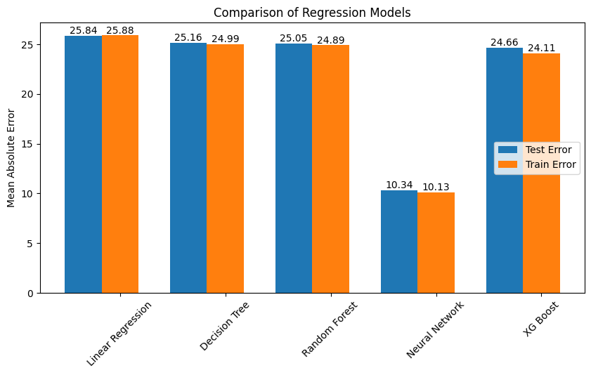
Results for Baseline Models

Slide 24
Time-Series Results
LSTM Test Results
Delay Component | True Mean | Mean of Predictions | Mean Absolute Error
Carrier | 15.877 | 16.288 | 17.050
Weather | 1.978 | 2.246 | 3.979
Security | 0.130 | 0.141 | 0.270
NAS | 10.914 | 11.512 | 9.475
Late Aircraft | 19.374 | 18.031 | 19.338
Total Model Error
 | Mean Squared Error | Mean Absolute Error
LSTM | 361.833 | 10.022
Bidirectional LSTM | 365.645 | 10.296
LSTM + CNN Hybrid | 367.868 | 9.684
*Neural Network | 371.4737 | 10.340
*Best non-time-series model
Notes:
JACOB

Slide 25
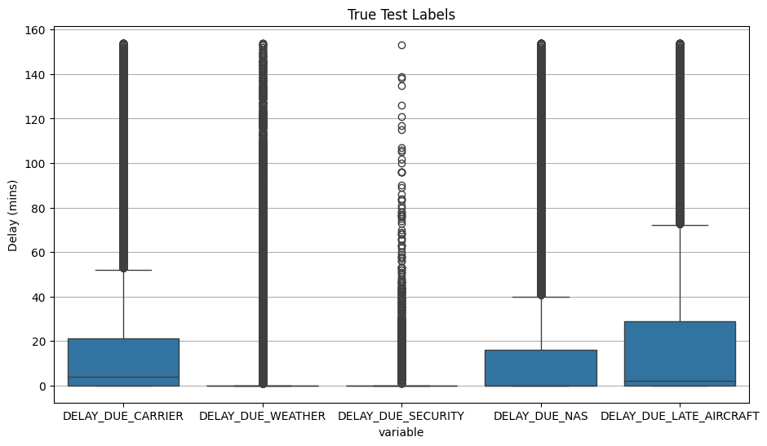
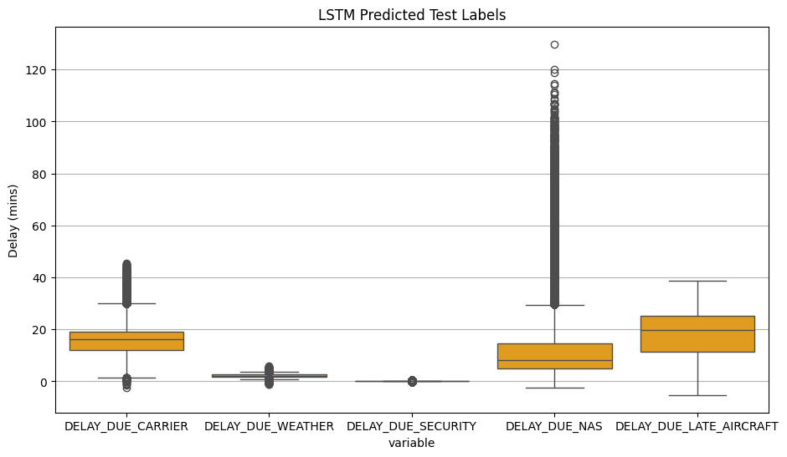
LSTM: Test True vs. Predicted
 | Carrier | Weather | Security | NAS | Late Aircraft
True Std. | 25.567 | 11.406 | 2.423 | 19.660 | 29.453
Predictions Std. | 6.164 | 0.618 | 0.060 | 10.536 | 8.720
Notes:
JACOB

Slide 26
Discussion and Future Scope
Although all of our time-series approaches performed better than our baseline regression models, they do not provide meaningful predictions.
Possible issues
Effect of COVID-19 on data
Outlier values
Prior work involved classification on overall delay, our work involved regression on delay components
Future
Handling COVID-19 data
Different Outlier removal methods
Delay components may be too complicated of a task, maybe consider total delay
Notes:
JACOB

Slide 27
References
[1] Carvalho, A. Sternberg, L. Maia Gonc ̧alves, A. Beatriz Cruz, J.A. Soares, D. Brandao, D. Carvalho, e E. Ogasawara, 2020, On the relevance of data science for flight delay research: a systematic review, Transport Reviews
[2] F. Wieland. Limits to growth: results from the detailed policy assessment tool [air traffic congestion]. In 16th DASC. AIAA/IEEE Digital Avionics Systems Conference. Reflections to the Future. Proceedings, volume 2, pages 9.2–1–9.2–8 vol.2, Oct. 1997.
[3] Team, T. (2016, August 31). What is the impact of flight delays? Trefis. https://www.trefis.com/stock/dal/articles/375013/what-is-the-impact-of-flight-delays/2016-08-31
[4] Tang, Y. (2022). Airline Flight Delay Prediction Using Machine Learning Models. In Proceedings of the 2021 5th International Conference on E-Business and Internet (ICEBI ’21) (pp. 151–154). Association for Computing Machinery, New York, NY, USA. https://doi.org/10.1145/3497701.3497725
[5] Dou, X. (2020). Flight arrival delay prediction and analysis using ensemble learning. In 2020 IEEE 4th Information Technology, Networking, Electronic and Automation Control Conference (ITNEC) (pp. 1-4). New York: IEEE. https://doi.org/10.1109/ITNEC48623.2020.9084929

Slide 28
References
[6] Esmaeilzadeh, E., & Mokhtarimousavi, S. (2020). Machine Learning Approach for Flight Departure Delay Prediction and Analysis. Transportation Research Record, 2674(8), 145-159. https://doi.org/10.1177/0361198120930014
[7] Li, Q., Guan, X., & Liu, J. (2023). A CNN-LSTM framework for flight delay prediction. Expert Systems with Applications, 227, 120287. https://doi.org/10.1016/j.eswa.2023.120287
[8] Nathalie Kuhn, Navaneeth Jamadagni (2017). Application of Machine Learning Algorithms to Predict Flight Arrival Delays, Stanford University.
[9]A. Anusha,B. Ratna Kumar,D, et al., (2022). Prediction of Flight Delay Using Machine Learning. IRJMETS e-ISSN: 2582-5208.
[10] https://www.kaggle.com/datasets/patrickzel/flight-delay-and-cancellationdataset-2019-2023?select=flights_sample_3m.csv

Slide 29
THANK YOU

Slide 30
APPENDIX

Slide 31
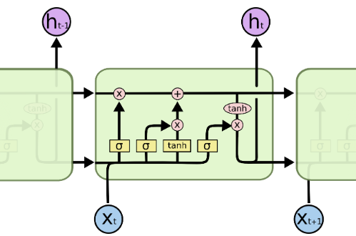
LSTM Model
Long Short-Term Memory (LSTM) models provide a powerful framework for modeling sequential data, such as time series prediction tasks like flight delay prediction.
LSTMs are a type of recurrent neural network (RNN) architecture designed to address the vanishing gradient problem and capture long-term dependencies in sequential data effectively.
The repeating module in an LSTM contains four interacting layers. [7]

Slide 32
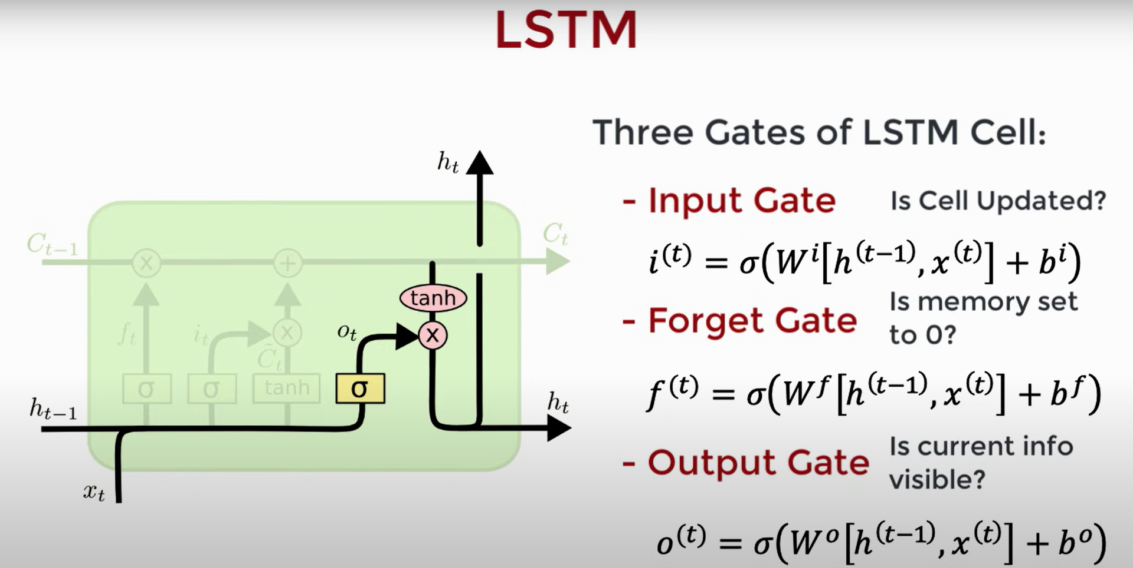
Notes:
In addition to the hidden state vector found in traditional RNN architectures, each LSTM cell maintains a cell state vector. At each time step the next LSTM can choose to read, write or reset the cell using an explicit gating mechanism. Each unit has 3 gates: Input gate - whether memory cell is updated. Forget gate - whether memory cell is reset to 0, Output gate: info of current cell state is visible to the next one. All have sigmoid act as we want the model to be differentiable and constitute of smooth curve. Each of the states takes the current input x and the hidden state h and concatenates the vector and applies a sigmoid.

Slide 33
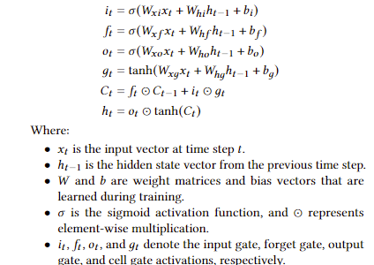
Equations for LSTM

Slide 34
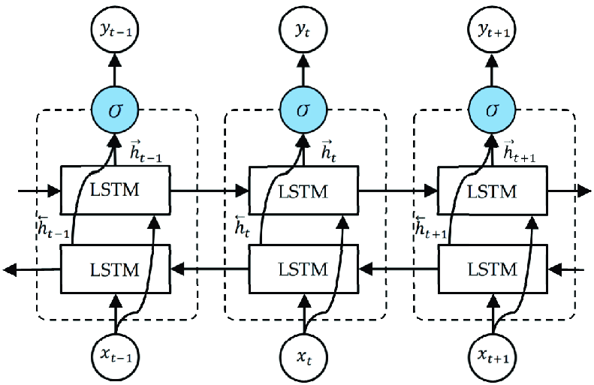
BiLSTM Model
Bidirectional Long Short-Term Memory (BiLSTM) models extend the capabilities of LSTM by processing input sequences in both forward and backward directions.
This allows the model to capture contextual information from both past and future time steps, making it particularly effective for tasks requiring a comprehensive understanding of sequence data.
The unfolded architecture of Bidirectional LSTM (BiLSTM) with three consecutive steps.
Notes:
Bi-LSTM (Bidirectional Long Short-Term Memory) is a type of recurrent neural network (RNN) that processes sequential data in both forward and backward directions. It combines the power of LSTM with bidirectional processing, allowing the model to capture both past and future context of the input sequence.

