Slide 1


AZ-300 - Microsoft Azure Architect Technologies
Jordan Radkov
Cloud Solution Architect

Slide 2
Create and Deploy Apps (5-10%)

Slide 3
Agenda
1
Series Agenda
2
Speaker Introduction
3
Feedback Loop
4
Objective Review
5
Open Mic

Slide 4
Series Agenda
1 | Deploy and Configure Infrastructure (25-30%)
2 | Implement Workloads and Security (20-25%)
3 | Create and Deploy Apps (5-10%)
4 | Implement Authentication and Secure Data (5-10%)
5 | Develop for the Cloud (20-25%)
https://aka.ms/azurecsg

Slide 5
Series Agenda
Deploy and Configure Infrastructure (25-30%)
Implement Workloads and Security (20-25%)
3
Create and Deploy Apps (5-10%)
https://aka.ms/azurecsg
4
Implement Authentication and Secure Data (5-10%)
5
Develop for the Cloud (20-25%)

Slide 6

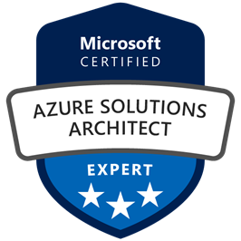
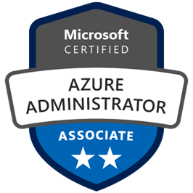
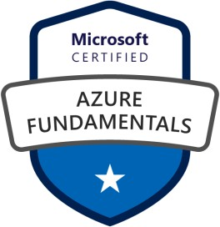



Jordan Radkov
Cloud Solution Architect based in the Munich
10+years in the industry in infrastructure administration , automation and now cloud
Constant learner - Ancora Imparo

Slide 7
Objectives
Create web apps by using PaaS
May include but not limited to: Create an Azure App Service Web App; create documentation for the API; create an App Service Web App for containers; create an App Service background task by using WebJobs; enable diagnostics logging
Design and develop apps that run in containers
May include but not limited to: Configure diagnostic settings on resources; create a container image by using a Docker file; create an Azure Container Service (ACS/AKS); publish an image to the Azure Container Registry; implement an application that runs on an Azure Container Instance; manage container settings by using code

Slide 8

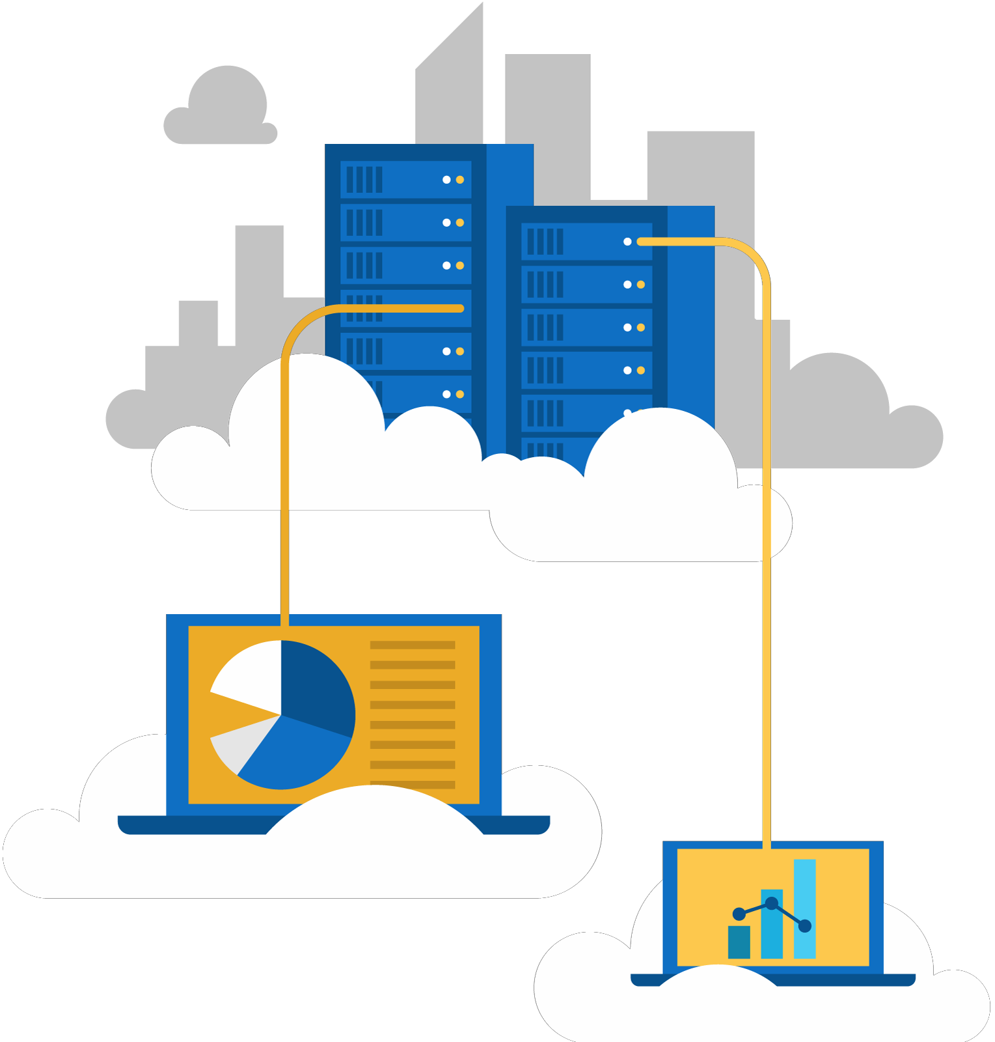
Create web apps by using PaaS
Create an Azure App Service Web
App
create documentation for the API
create an App Service Web App for containers
create an App Service background
task by using WebJobs
enable diagnostics logging

Slide 9



Slide 10
Azure Service Fabric overview
A distributed systems platform that:
Simplifies building, deploying, and managing distributed and scalable applications consisting of microservices and containers running on managed multi-node clusters.
Provides runtime for stateless and stateful microservices running in containers:
Stateless microservices (such as protocol gateways and web proxies) do not maintain a mutable state outside a request and its response from the service.
Stateful microservices (such as user accounts, databases, devices, shopping carts, and queues) maintain a mutable, authoritative state beyond the request and its response.
Powers many existing Microsoft cloud services (e.g. Azure SQL Database, Azure Cosmos DB,
Cortana, Power BI, Intune, Event Hubs, IoT Hub, Dynamics 365)

Slide 11
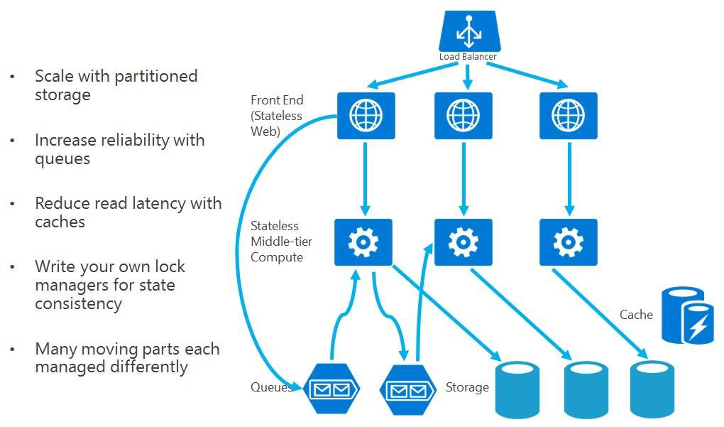
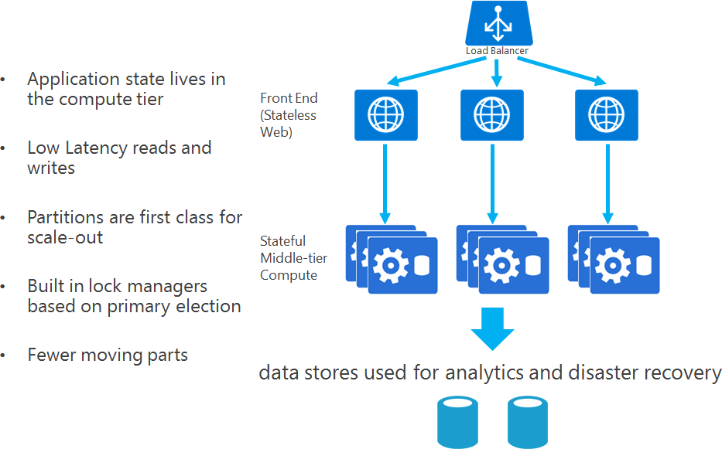
Service Fabric app scenarios
Applications composed of stateful and stateless microservices:
Commonly encountered scenario includes:
stateless web apps (ASP.NET, Node.js, etc.) stateless and stateful business middle-tier services
Each services is independent with regard to scale, reliability, and resource usage The use of stateful services reduces complexity:
by leveraging Reliable Services and Reliable Actors programming models By eliminating the need queues and caches
A sample application built using stateless services
A sample application built using stateful services

Slide 12
Reliable Services concepts
Service type:
This is your service implementation. It is defined by the class you write that extends StatelessService and any other code or dependencies used therein, along with a name and a version number.
Named service instance:
To run your service, you create named instances of your service type, much like you create object instances of a class type. A service instance has a name in the form of a URI using the “fabric:/” scheme, such as "fabric:/MyApp/MyService".
Service host:
The named service instances you create need to run inside a host process. The service host is just a process where instances of your service can run.
Service registration:
Registration brings everything together. The service type must be registered with the Service Fabric runtime in a service host to allow Service Fabric to create instances of it to run.

Slide 14
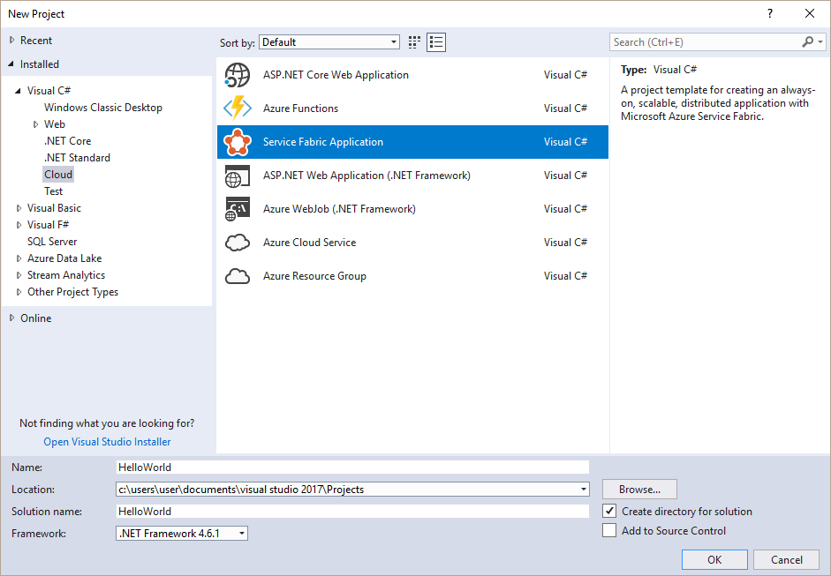
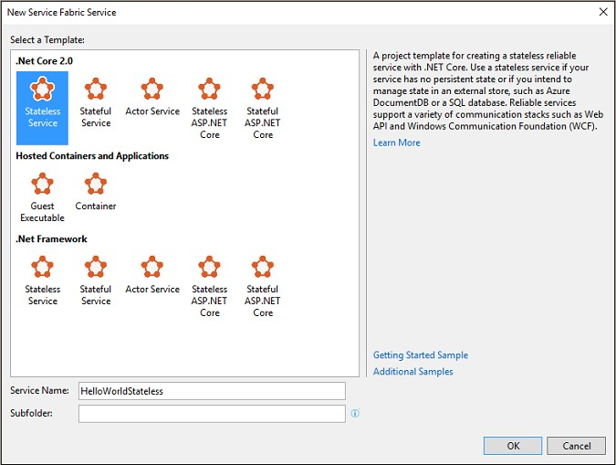
Creating a stateless service in Visual Studio
Prerequisites:
A computer running supported version of Windows
Visual Studio 2017 with Azure Service Fabric Tools and Azure Service Fabric SDK
Implementation steps:
From Visual Studio:
Create a new Service Fabric Application project:
Named HelloWorld
Intended to host services, application manifest, and scri Create a stateless service project using .NET Core 2.0 Named HelloWorldStateless
Intended to host implementation of a stateless service
pts

Slide 15
Implement the service
Implementation steps:
Open the HelloWorldStateless.cs file in the service project. Note that the service API provides two entry points:
An open-ended entry point method, called RunAsync, where you can begin executing any workloads.
A communication entry point where you can plug in your communication stack of choice, such as ASP.NET Core. This is where you can start receiving requests from users and other services.
Review the RunAsync() entry point method:
The platform calls this method when an instance of a service is placed and ready to execute.
The project template includes a sample implementation of RunAsync() that increments a rolling count.
Problem:
In this stateless service example, the count is stored in a local variable. But because this is a stateless service, the value that's stored exists only for the current lifecycle of its service instance. When the service moves or restarts, the value is lost.

Slide 16
Creating a stateful service in Visual Studio
Objective:
Use a stateful service to convert a counter value from stateless to highly available and persistent, even when the service moves or restarts.
Implementation steps:
From Visual Studio:
Add a stateful service project using .NET Core 2.0
Named HelloWorldStateful
Intended to host implementation of a stateful service
Note that the service API provides the same entry points as the stateless service:
The main difference is the availability of a state provider that can store state reliably. Service Fabric comes with a state provider implementation called Reliable Collections, which lets you create replicated data structures through the Reliable State Manager. A stateful Reliable Service uses this state provider by default. Review the RunAsync() entry point method:
RunAsync() operates similarly in stateful and stateless services. However, in a stateful service, the platform performs additional work on your behalf before it executes RunAsync(). This work can include ensuring that the Reliable State Manager and Reliable Collections are ready to use.

Slide 17
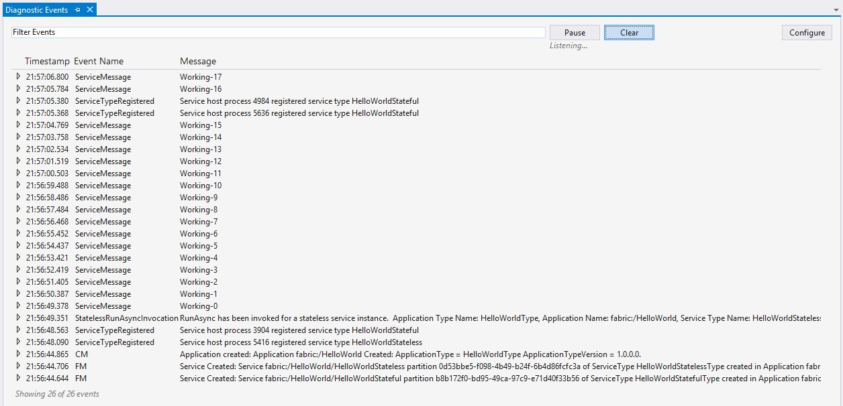
Run the application
Build and deploy the application from Visual Studio To monitor its execution, examine Diagnostic Events: Event Tracing for Windows (ETW) events
From both the stateless service and the stateful service in the application

Slide 19
Introduction to Service Fabric Reliable Actors
Application framework based on the Virtual Actor pattern:
Provides a single-threaded programming model built on guarantees of Service Fabric. Leverages the concept of an Actor:
An actor is an isolated, independent unit of compute and state with single-threaded execution. A large number of actors can execute simultaneously and independently of each other
Actors can communicate with each other and they can create more actors.
Each Service Factor Reliable Actor service is a partitioned, stateful Reliable Service. Service Fabric actors are virtual:
Their lifetime is not tied to their in-memory representation, so they do not need to be explicitly created
or destroyed.
An actor is automatically activated (and its objects constructed) the first time a message is sent to its actor ID.
If an actor is not used for a period of time, the Reliable Actors runtime garbage-collects the in-memory object.
Applies to a number of scenarios:
The problem space involves thousands (or more) of small, independent, and isolated units of state and
logic.
The work involves single-threaded objects that do not interact heavily with external components. Actor instances will not block callers with unpredictable delays by issuing I/O operations.

Slide 20
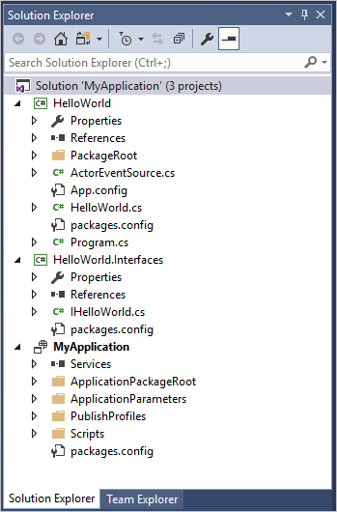
Creating the project in Visual Studio
Implementation steps:
In Visual Studio, create a new Service Fabric Application project.
Choose .NET Core 2.0 Actor Service template and provide a name for the service.
Examine the project structure consisting of three projects:
The application project (MyApplication): packages all of the services together for deployment and contains:
ApplicationManifest.xml
PowerShell scripts for managing the application. The interface project (HelloWorld.Interfaces): contains the interface definition for the actor.
The actor service project (HelloWorld): defines the service that will host the actor and contains:
the implementation of the actor, HellowWorld.cs, which, in turn, implements the interfaces defined in the MyActor.Interfaces project.
Program.cs, which registers actor classes with the Service Fabric runtime using ActorRuntime.RegisterActorAsync<T>().

Slide 21

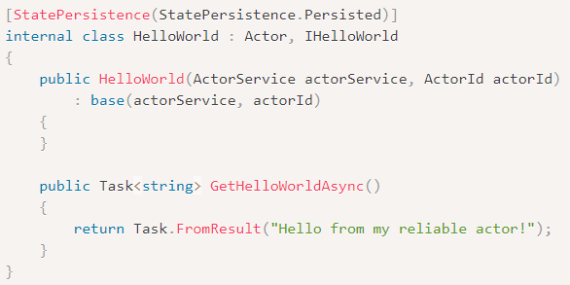
Customizing the actor
Implementation steps:
1. The project template defines methods in the IHelloWorld interface and implements them in the HelloWorld actor implementation. Replace those methods so the actor service returns a simple “Hello World” string:
In the HelloWorld.Interfaces project, in the IHelloWorld.cs file, replace the interface definition In the HelloWorld project, in HelloWorld.cs, replace the class definition

Slide 22
Adding a client
Implementation steps:
In Visual Studio, add a new project.
Choose the .NET Core Console App (.NET Core) project type and name the project
ActorClient.
In Solution Explorer, set the Platform target of the ActorClient project to x64:
The console application must be 64-bit to maintain compatibility with the interface project.
From Package Manager Console of NuGet Package Manager, add the reliable actors package and its dependencies.
In the ActorClient project dependencies, add reference to the HelloWorld.Interfaces.
In the ActorClient project, replace the entire contents of Program.cs.

Slide 23





Slide 25
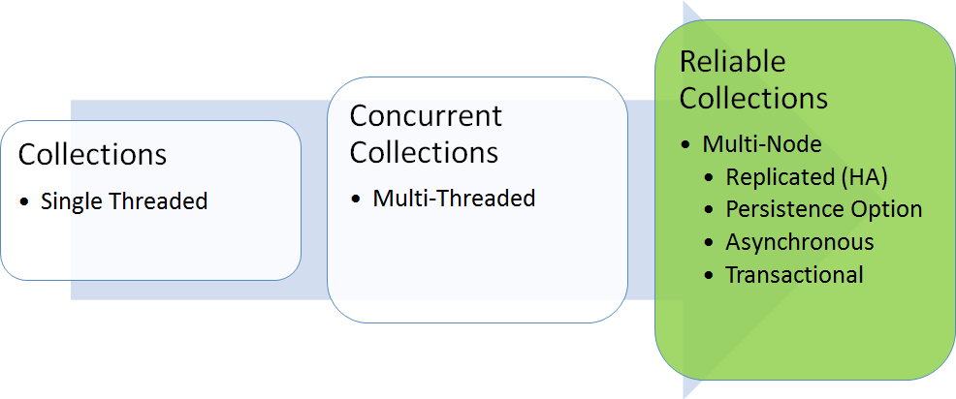
Reliable Collections overview
Constitute an evolution of the System.Collections classes:
Implement a set of collections that automatically make your state highly available.
Rely on Reliable Collection APIs to manage the replicated and local state. The state is kept
locally in the service instance while also being made highly available:
All writes incur the minimum number of network IOs, resulting in low latency and high-throughput writes. All reads are local, resulting in low latency and high-throughput reads.
Are inherently:
Replicated Persisted Asynchronous Transactional
Offer three collection types:
Reliable Dictionary Reliable Queue
Reliable Concurrent Queue

Slide 26
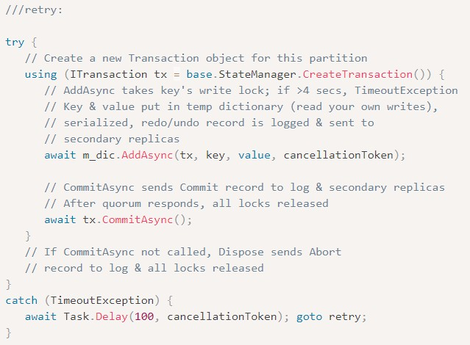
Working with Reliable Collections
Reliable Collections offers a stateful .NET-based programming model:
Based on the reliable dictionary and reliable queue classes: Providing automatic state management to ensure: Partitioning (for scalability)
Replication (for availability)
Transaction support (for ACID semantics)
A typical usage of reliable dictionary objects:
All operations (except ClearAsync) require ITTransaction object. The object is passed to a reliable dictionary’s AddAsync method. If AddAsync modifies the key, the key’s write lock is taken.
Any other threads attempting to modify the key are blocked, resulting in a TimeoutException.
The code retries the operation (after exponential back-off). After acquiring a lock, AddAsync adds the key object references to a dictionary associated with the ITransaction object.
A call to CommitAsync commits all transaction’s operations.

Slide 27






Slide 29
About Azure Kubernetes Service
Managed Kubernetes cluster hosted in Azure with a range of benefits:
Flexible deployment options Identity and security management Integrated logging and monitoring Cluster node scaling
Cluster node upgrades HTTP application routing GPU enabled nodes
Development tooling integration Virtual network integration Private container registry

Slide 30
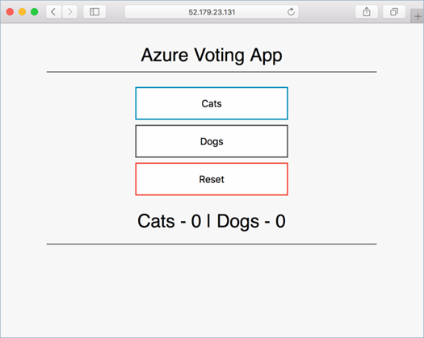
Deploy an AKS cluster using Azure CLI
Implementation steps:
Create a resource group:
az group create --name myAKSCluster --location eastus
Create an AKS cluster:
az aks create --resource-group myAKSCluster --name myAKSCluster --node-count 1 --enable-addons monitoring --generate-ssh-keys
Connect to the AKS cluster:
az aks get-credentials --resource-group myAKSCluster \
--name myAKSCluster
Create a Kubernetes manifest file (azure-vote.yaml)
Run the containerized application:
kubectl apply -f azure-vote.yaml
Monitor the progress of the deployment:
kubectl get service azure-vote-front –watch
Monitor health and logs (from the Azure portal)

Slide 31
Deploy an AKS cluster using Azure Portal
Implementation steps:
Create a resource > Kubernetes Service:
Basics: Project details, Cluster details, Scale
Authentication: A new or existing service principal and RBAC settings
Networking: Http application routing and Network configuration (Basic or Advanced) Monitoring: A new or existing Log Analytics workspace.
Connect to the cluster:
az aks get-credentials --resource-group myAKSCluster \
--name myAKSCluster
Create a Kubernetes manifest file (azure-vote.yaml)
Run the containerized application:
kubectl apply -f azure-vote.yaml
Monitor health and logs (from the Azure portal)

Slide 33








Slide 34












































Slide 36








Slide 37




















Slide 38




Questions?

Slide 39

Homework Assignment
https://aka.ms/AZ300

Slide 40

Open
Mic …

