Slide 1


AZ-300 - Microsoft Azure Architect Technologies
Jordan Radkov
Cloud Solution Architect

Slide 2

Implement Authentication and Secure Data (5-10%)

Slide 3
Series Agenda
1 | Deploy and Configure Infrastructure (25-30%)
2 | Implement Workloads and Security (20-25%)
3 | Create and Deploy Apps (5-10%)
4 | Implement Authentication and Secure Data (5-10%)
5 | Develop for the Cloud (20-25%)

Slide 4
Series Agenda
Deploy and Configure Infrastructure (25-30%)
Implement Workloads and Security (20-25%)
3
Create and Deploy Apps (5-10%)
4
Implement Authentication and Secure Data (5-10%)
5
Develop for the Cloud (20-25%)

Slide 5

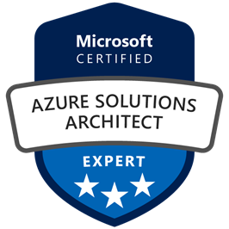
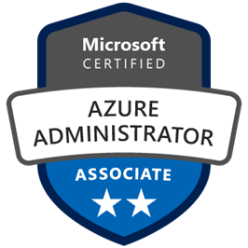
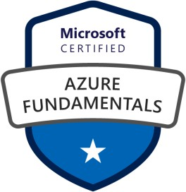



Jordan Radkov
Cloud Solution Architect based in the Munich
10+years in the industry in infrastructure administration , automation and now cloud
Constant learner - Ancora Imparo

Slide 6
Objectives
Implement authentication
May include but not limited to: Implement authentication by using certificates, forms-based authentication, tokens, or Windows-integrated authentication; implement multi-factor authentication by using Azure AD; implement OAuth2 authentication; implement Managed Service Identity (MSI) Service Principal authentication
Implement secure data solutions
May include but not limited to: Encrypt and decrypt data at rest and in transit; encrypt data with Always Encrypted; implement Azure Confidential Compute and SSL/TLS communications; create, read, update, and delete keys, secrets, and certificates by using the KeyVault API

Slide 7
Implement Authentication

Slide 8
Implementing Authentication in Applications

Slide 9




Certificate-based authentication
Establishes identity by using a digital certificate:

Slide 10
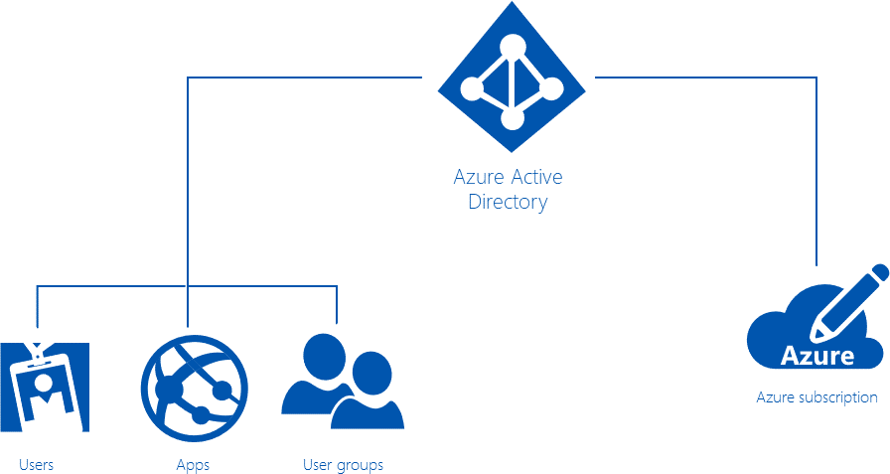




Azure Active Directory (Azure AD)
Microsoft’s cloud-based directory and identity management service:
AD DS vs. Azure AD:

Slide 11
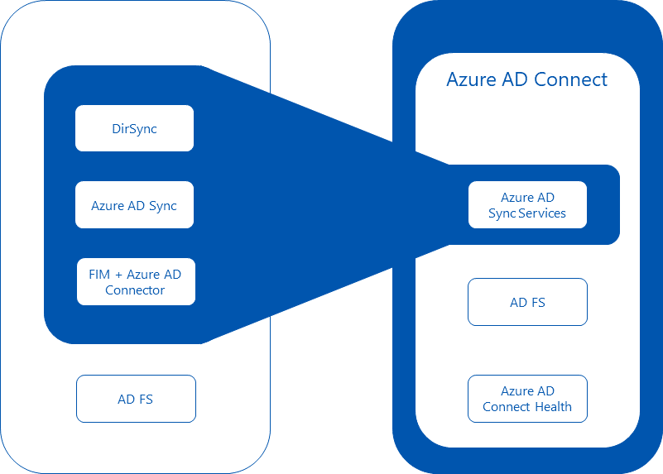




Azure AD Connect
Integrates AD DS with Azure AD:
Provides support for:

Slide 12
Legacy authentication methods
Example:
If you are moving an ASP.NET forms-based auth application to Azure, change connection string pointing to your on- premise SQL Server database used to store forms auth data to Azure SQL Server.
Forms-based authentication:
Requires use of a browser client
Requires extra measures to prevent cross-site request forgery
Sends user credentials in plaintext
Windows-based authentication:
Not suitable for internet applications
Does not support BYOD scenarios
Relies on Kerberos or NTLM
Requires domain-joined computers

Slide 13
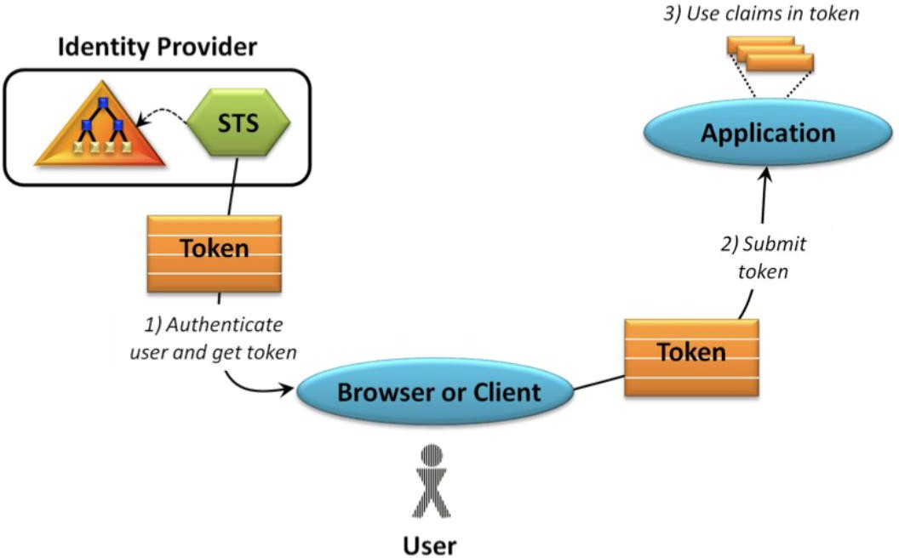
Token-based authentication
Claims-based authentication in .NET:
ASP.NET Identity provides a unified identity platform for ASP.NET applications
Can be used with web, phone, store and hybrid
applications
Ideal for token-based auth
because:
Provider model for logins
Supports claims-based
authentication

Slide 14
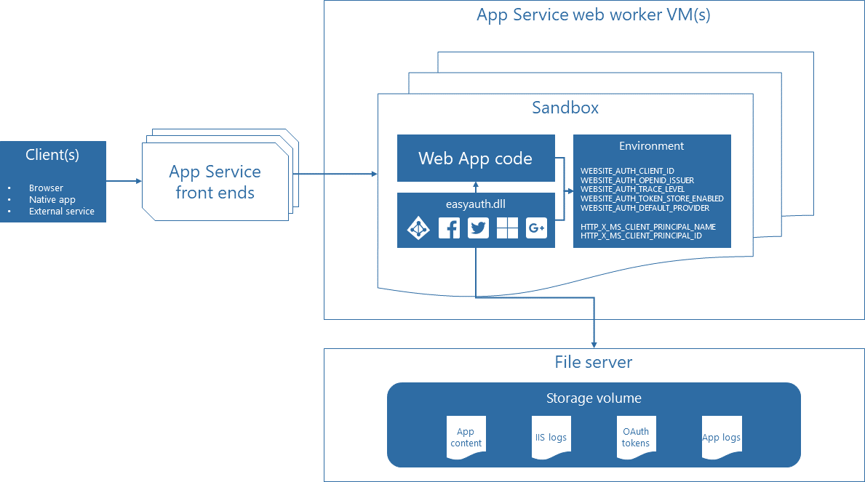
Token-based authentication
Azure App Service authentication and authorization:
Runs in the worker sandbox and outside of the web app code
Available with minimal or no custom code
Configurable by using app settings
Injects claim into request headers
Provides built-in token store

Slide 15
Implement Multi-factor Authentication

Slide 16
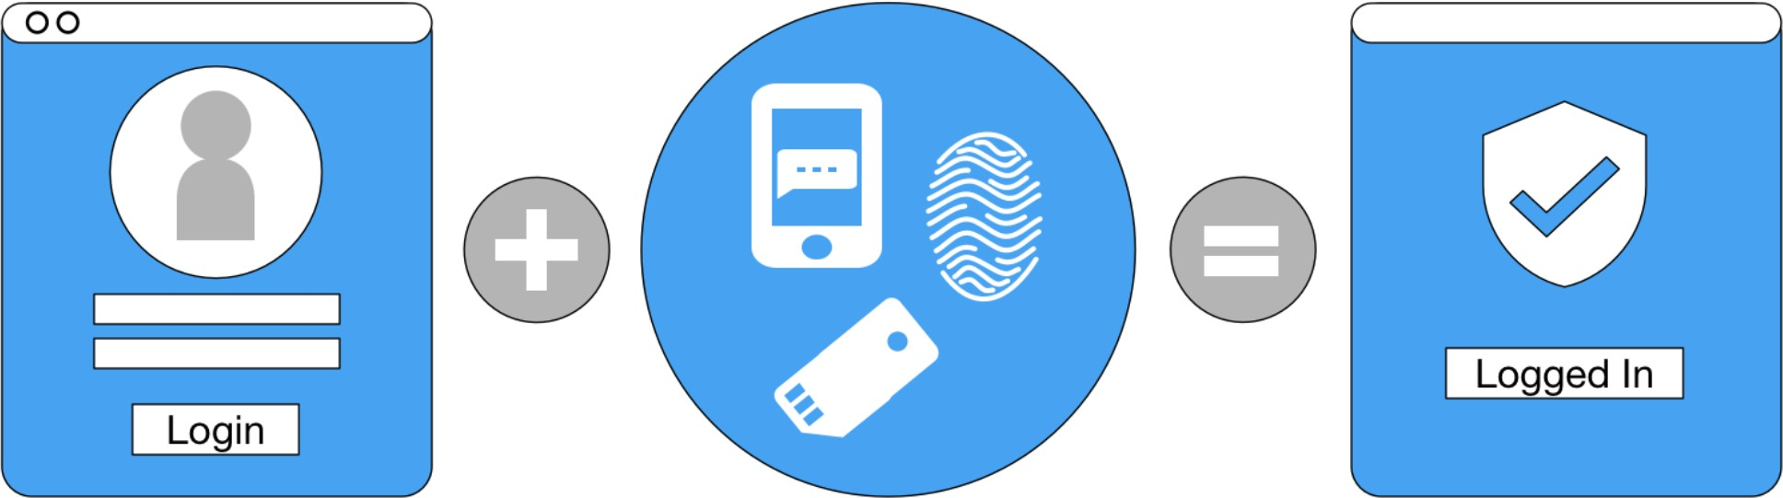
Multi-factor authentication
Enforces two or more factors when authenticating users:
Knowledge: something that only the user knows (security questions, password, or PIN).
Possession: something that only the user has (corporate badge, mobile device, or security token).
Inherence: something that only the user is (fingerprint, face, voice, or iris).

Slide 17
Multi-factor authentication with Azure AD
Can be enabled by:
Enabling users for MFA to trigger two-step verification each time they sign in:
Setting up a conditional access policy requiring two-step verification
Offers several authentication methods:
Call to phone
Text message to phone
Notification through mobile app
Verification code from mobile app (Microsoft Authenticator app)
Can be customized by using the Multi-Factor Authentication SDK:
Allows building MFA into the sign-in or transaction processes of applications
Supports C#, Visual Basic (.NET), Java, Perl, PHP, and Ruby

Slide 18
Claims-based Authorization

Slide 19
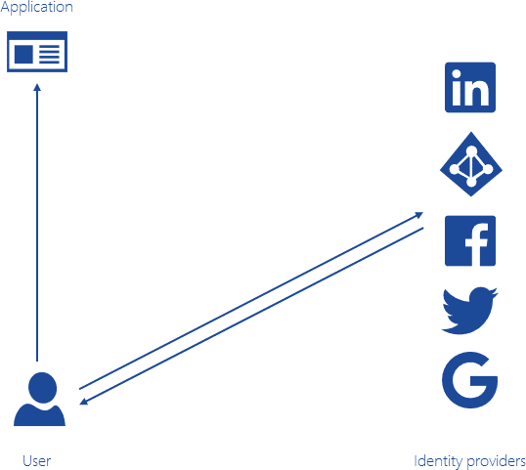
Claims
A name/value pair representing an identity and its properties
Generated by an identity provider:
Azure AD, Facebook, Google, LinkedIn, Twitter, etc.
Serves as the basic for authorization:
Handled by a resource provider
Determines access to resources

Slide 20
Claims-based authorization
To implement claims-based auth in ASP.NET:
Build and register the policy:
Apply the policy:
Probably good to know the formatting of this type of claim
public void ConfigureServices(IServiceCollection services)
{
services.AddMvc(); services.AddAuthorization(options =>
{
options.AddPolicy("EmployeeOnly", policy => policy.RequireClaim("EmployeeNumber"));
});
}
[Authorize(Policy = "EmployeeOnly")] public IActionResult VacationBalance()
{
return View();
}

Slide 21
Role-based access control (RBAC) authorization

Slide 22
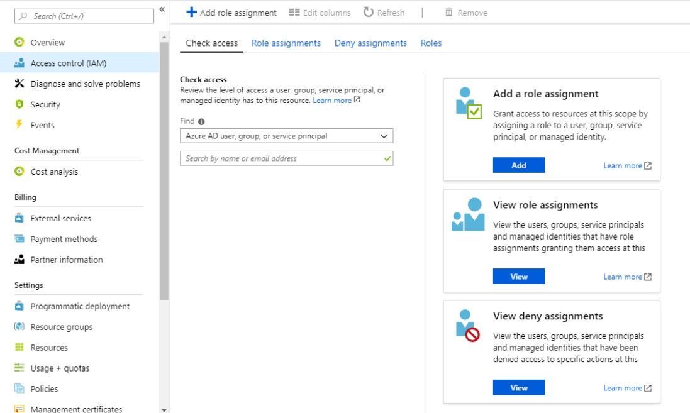
Role-based authorization
Manages and enforces permissions based on user roles:
An identity may belong to one or more roles

Slide 23
Role-based authorization
In ASP.NET-based implementation:
[Authorize(Roles = "Administrator, PowerUser")] public class ControlPanelController : Controller
{
public ActionResult SetTime()
{
} [Authorize(Roles = "Administrator")] public ActionResult ShutDown()
{
}
}
public void ConfigureServices(IServiceCollection services)
{
services.AddMvc(); services.AddAuthorization(options =>
{
options.AddPolicy("RequireAdministratorR ole", policy => policy.RequireRole("Administrator")); });
}
Members of either the Administrator role or the PowerUser role can access the controller and the SetTime action, but only members of the Administrator role can access the ShutDown action.
Role requirements can be expressed using the Policy syntax, where a developer registers a policy at startup as part of the authorization service configuration. This normally occurs in ConfigureServices() in your Startup.cs file:

Slide 24
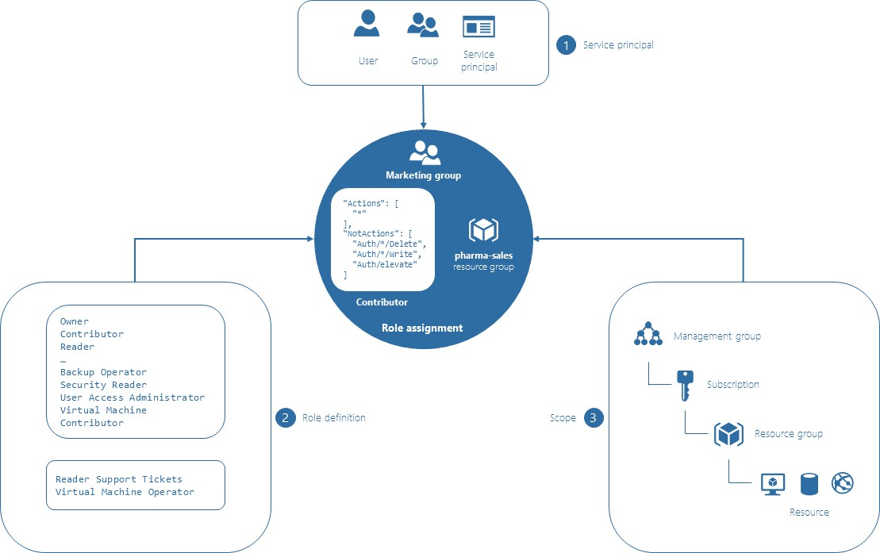
Role-based access control (RBAC)
Provides fine-grained access management of resources in Azure
Facilitates segregation of duties
Role assignments bind a role
definition to a security principal,
at a specific scope (or boundary)
for the purpose of granting
access.
Supports four scope types:
•
•
•
•
A management group
A subscription
A resource group
A resource
Includes built-in roles

Slide 25
Secure Data Solutions

Slide 26
Encrypt and decrypt data at rest

Slide 27
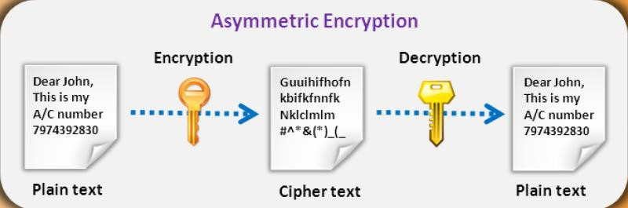
Encryption
The process of translating plain text into ciphertext:
Uses an encryption algorithm and one or two keys:
In symmetric encryption:
The same key is used for encryption and decryption
Intended for encryption of large amounts of data
In asymmetric encryption:
Different key for encryption (public) and decryption (private)
Intended for small amounts of data or for encryption of a symmetric key

Slide 28
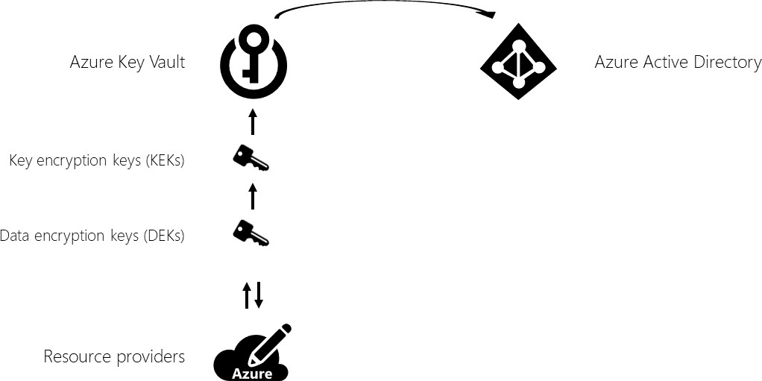
Encryption at rest
Encryption of data when it is persisted
Protects against attempts to obtain access to data when you have physical access to the hardware
Used in scenarios with compliance and security requirements
• Encryption at rest in Azure:
Dynamically encrypts/decrypts during writes/reads
Uses symmetric encryption keys
Uses different keys across partitions
Stores keys in a secure location
Includes:
Azure Storage encryption
Azure SQL Database encryption
Azure Cosmos DB encryption

Slide 29
Encrypt Data with Always Encrypted

Slide 30
Encrypt data with Transparent Data Encryption (TDE)
Primary TDE characteristics:
Encryption at rest for data and log files of:
SQL Server
Azure SQL Database
Azure SQL Data Warehouse
Real-time I/O encryption and decryption on the page level
The use of a database encryption key (DEK):
Watch for key words in questions that would indicate a requirement for TDE
The key is stored in the database boot record for availability during recovery.
The key is implemented in one of two ways:
Symmetric key secured by using a certificate stored in the master database of the server
Asymmetric key protected by an Extensible Key Management (EKM) module.

Slide 31
Encrypt data with Always Encrypted
Encryption technology in Azure SQL Database and SQL Server:
Ensures that sensitive data never appears as plaintext inside the database system.
Allows clients to encrypt sensitive data inside client applications
Helps protect sensitive data:
At rest on the server
In transit between client and server
While the data is in use
Provides a separation between:
Who owns the data (and can view it)
Who manages the data (but should have no access).
Requires a specialized driver installed on client computers to automatically encrypt and decrypt sensitive data in the client application

Slide 32
Implement Azure Confidential Compute and SSL/TLS Communications

Slide 33
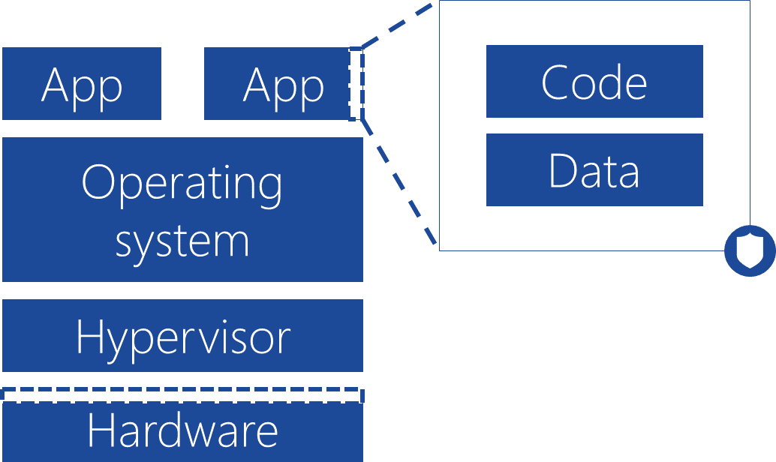
Azure confidential computing
Refers to features of many Azure services that encrypt data in use
Designed for scenarios where sensitive data needs to be processed in the cloud.
Ensures that when data is decrypted, it is protected inside a Trusted Execution Environment
TEE provides additional layer of protection:
Ensures that there is no way to view data or operations
from the outside, even with a debugger
Ensures that only authorized code is permitted access
Automatically disables the environment if it detects signs of tampering
TEE is implemented by a combination of:
Hardware
Software
Services
Framework

Slide 34
SSL and TLS overview
TLS and SSL are cryptographic protocols
TLS is a successor of SSL
Support for TLS 1.2 is integrated into majority of Azure services, including:
Azure SQL Database
Azure Database for MySQL
Azure Storage
Azure Application Gateway
Azure App Service
To take advantage of TLS 1.2, you need to enable it on the client side
Microsoft.NET: System.Net.ServicePointManager.SecurityProtocol = System.Net.SecurityProtocolType.Tls12;
PowerShell: [System.Net.ServicePointManager]::SecurityProtocol = [System.Net.SecurityProtocolType]::Tls12;

Slide 35
Manage cryptographic keys in the Azure Key Vault

Slide 36

Azure key vault
Cloud service that works as a security- enhanced secrets store:
Allows you to create multiple security- enhanced containers, called vaults
Main vault characteristics:
Support for secrets, such as a password, keys, and certificate.
The use of hardware security modules (HSMs) for
key storage and cryptographic operations
The ability to request and renew TLS certificates
Logging of all operations.

Slide 37
Accessing Key Vault in Azure CLI
To create a vault by using the Azure CLI, run:
az keyvault create --name contosovault --resource-group SecurityGroup --location westus
To add a secret to the vault, run:
az keyvault secret set --vault-name contosovault --name
DatabasePassword --value 'Pa5w.rd‘
To view the secret value, run:
az keyvault secret show --vault-name contosovault --name DatabasePassword

