Slide 1
mahabharat
Characters involved in Mahabharat
Bonding between Krishna and arjuna

Slide 2
10 greatest warriors in mahabharata
Lord Krishna. Lord Krishna even though he promised not to fight in the battle, yet he is the greatest and he most powerful warrior in the whole tale of Mahabharata.
Karna. ...
Arjuna. ...
Bhishmapitamah. ...
Dronacharya. ...
Bheema. ...
Ghatotkacha. ...
Yudhishthira.

Slide 3
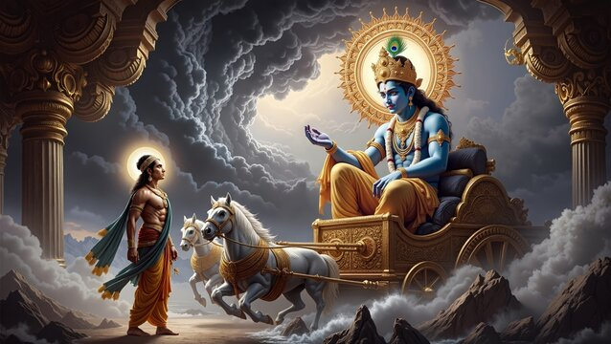
Krishna and arjuna

Slide 4
Characters involved in mahabharat
The great Krishna
The pandavas
Kauravas

