Slide 1
Arrays

Slide 2
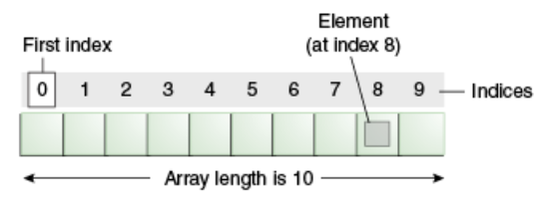
Java Array
Normally, array is a collection of similar type of elements that have contiguous memory location.
Java array is an object that contains elements of similar data type. It is a data structure where we store similar elements. We can store only fixed set of elements in a java array.
Array in java is index based, first element of the array is stored at 0 index.

Slide 3
Advantage of Java Array
Code Optimization: It makes the code optimized, we can retrieve or sort the data easily.
Random access: We can get any data located at any index position.
Disadvantage of Java Array
Size Limit: We can store only fixed size of elements in the array. It doesn't grow its size at runtime. To solve this problem, collection framework is used in java.

Slide 4
Types of Array in java
There are two types of array.
Single Dimensional Array
Multidimensional Array

Slide 5
Single Dimensional Array in java
Syntax to Declare an Array in java
dataType arr[];
Instantiation of an Array in java
datatype RefVar=new datatype[size];

Slide 6
Declaration, Instantiation and Initialization of Java Array
We can declare, instantiate and initialize the java array together by:
int a[]={33,3,4,5};//declaration, instantiation and initialization

Slide 7
Multidimensional array in java
In such case, data is stored in row and column based index (also known as matrix form).
Syntax to Declare Multidimensional Array in java
dataType[][] arrayRefVar; (or)
dataType [][]arrayRefVar; (or)
dataType arrayRefVar[][]; (or)
dataType []arrayRefVar[];

Slide 8
Example to instantiate Multidimensional Array in java
int[][] arr=new int[3][3];//3 row and 3 column

Slide 9
Collections

Slide 10
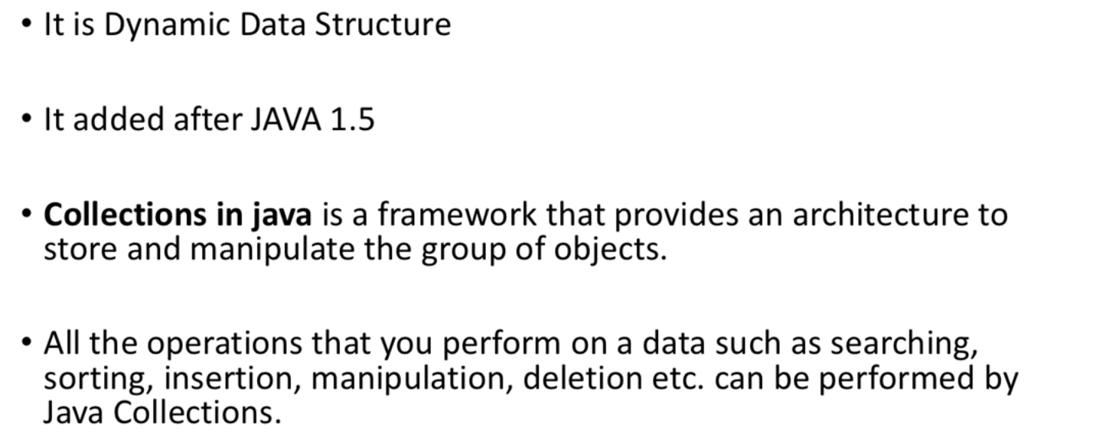
What is collections?

Slide 11
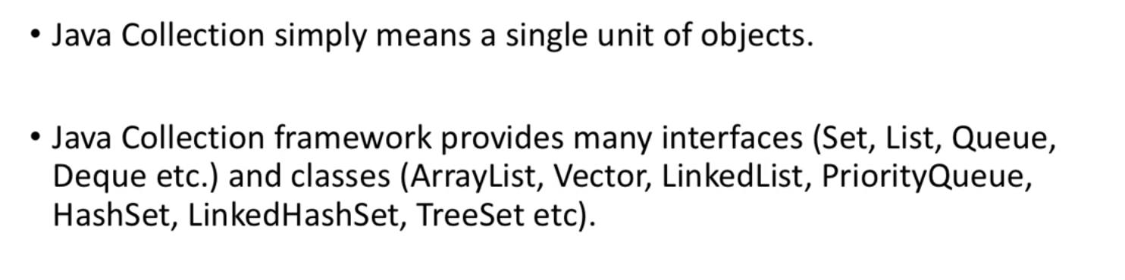
What is collections?

Slide 12
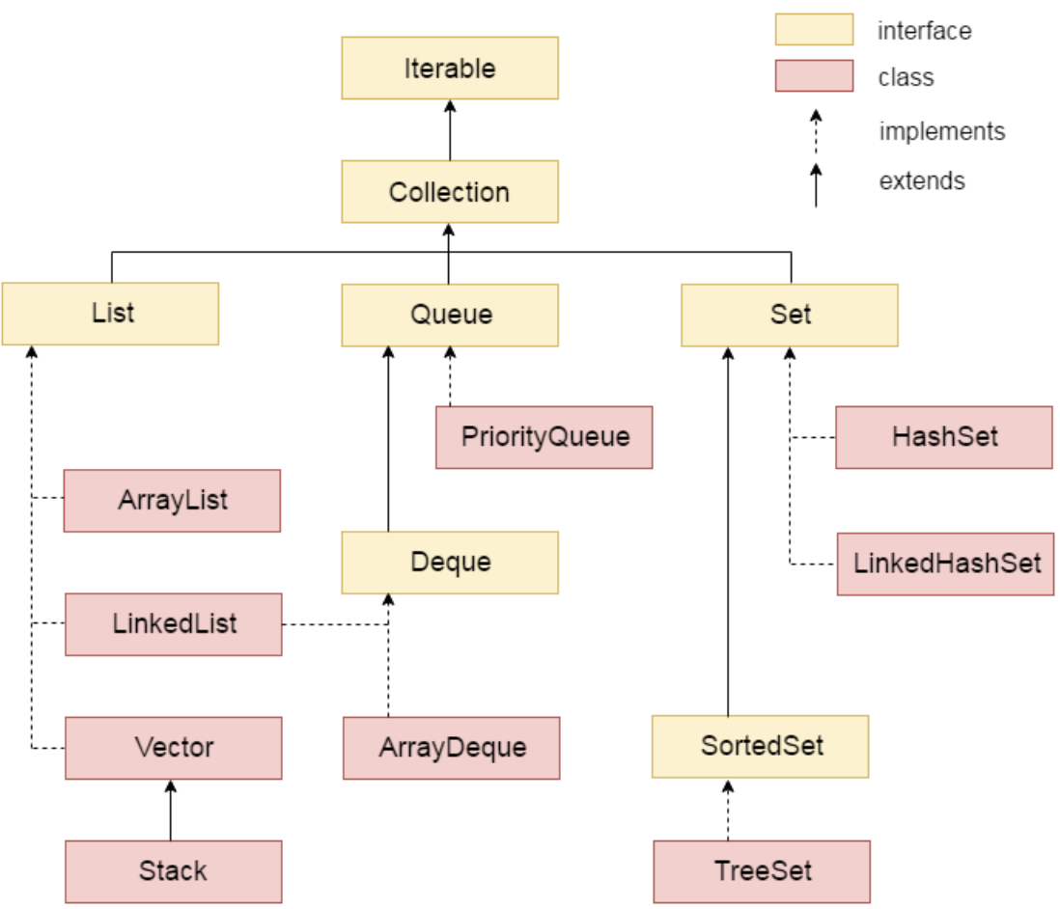
Hierarchy of Collection Framework
Let us see the hierarchy of collection framework.The java.util package contains all the classes and interfaces for Collection framework.

Slide 13
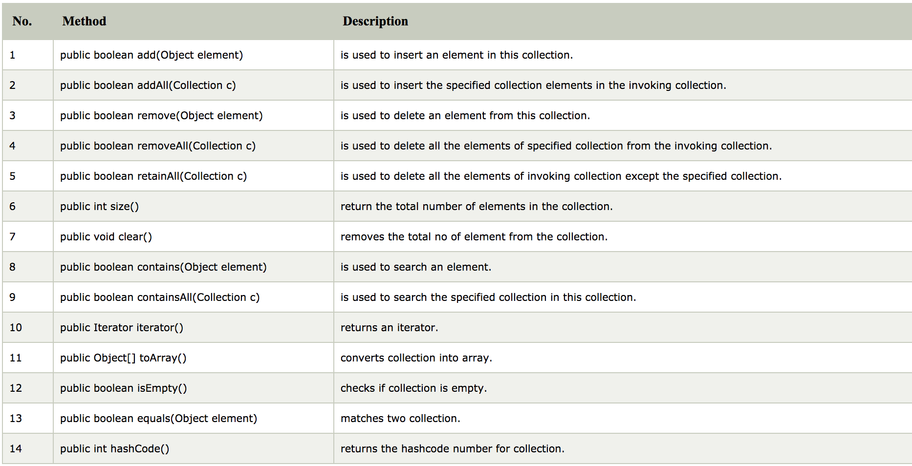
Methods of Collection interface

Slide 14
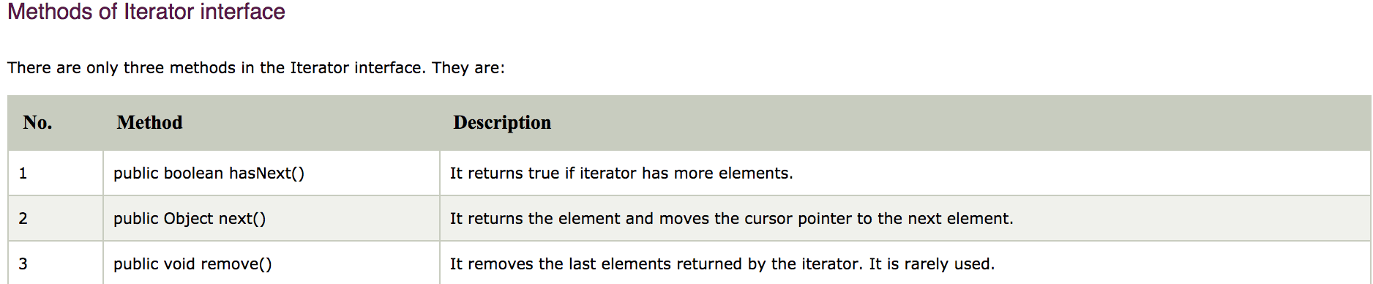
Iterator interface
Iterator interface provides the facility of iterating the elements in forward direction only.

Slide 15
Java ArrayList class
Java ArrayList class uses a dynamic array for storing the elements. It inherits AbstractList class and implements List interface.
Java ArrayList class can contain duplicate elements.
Java ArrayList class maintains insertion order.
Java ArrayList allows random access because array works at the index basis.

Slide 16
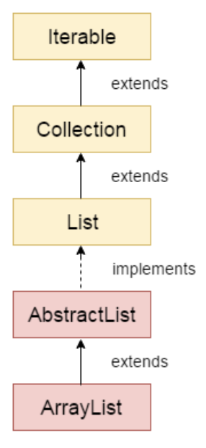
Hierarchy of ArrayList class

Slide 17
Java List Interface
List Interface is the subinterface of Collection.It contains methods to insert and delete elements in index basis.It is a factory of ListIterator interface.
It is the child interface of Collection.
If we want to represent a group of individual objects as a single entity where duplicates are allowed and insertion order is must be preserved then we should go for list.
We can differentiate duplicates by using index.
We can preserve insertion order by using index, hence index play very important role in the list interface.
public interface List<E> extends Collection<E>

Slide 18
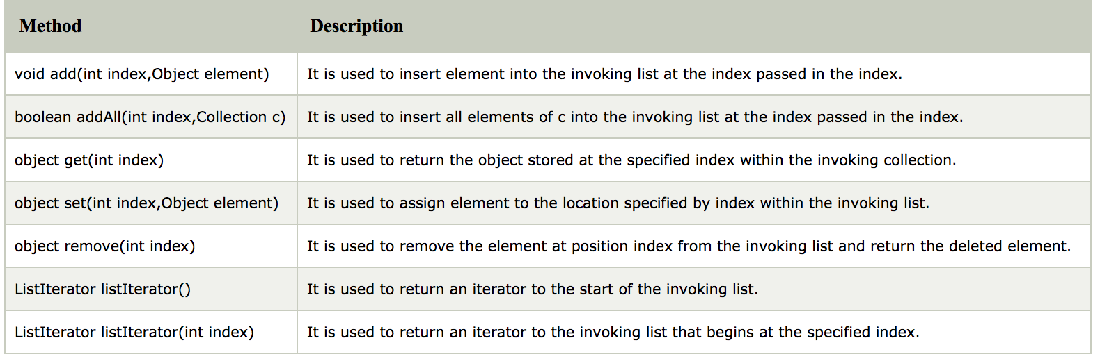
Methods of Java List Interface

Slide 19
Java ListIterator Interface
ListIterator Interface is used to traverse the element in backward and forward direction.
ListIterator Interface declaration
public interface ListIterator<E> extends Iterator<E>

Slide 20
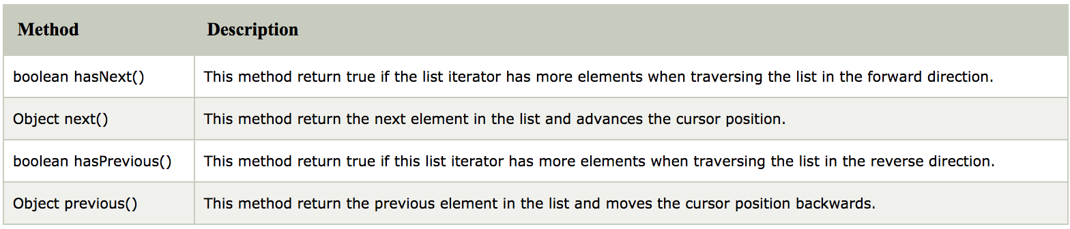
Methods of Java ListIterator Interface:

Slide 21
Java Map Interface
A map contains values on the basis of key i.e. key and value pair. Each key and value pair is known as an entry. Map contains only unique keys.
Map is useful if you have to search, update or delete elements on the basis of key.

Slide 22
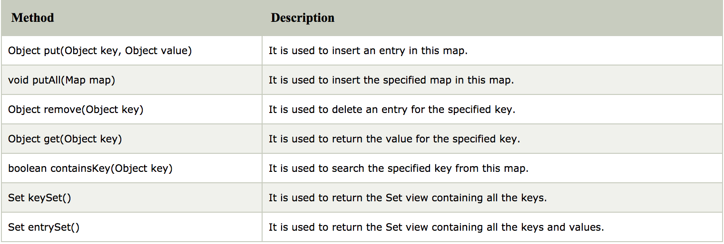
Useful methods of Map interface

Slide 23
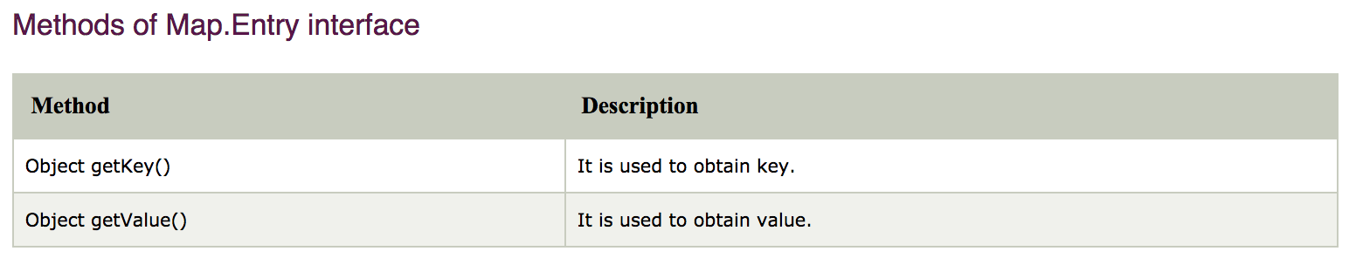
Map.Entry Interface
Entry is the sub interface of Map. So we will be accessed it by Map.Entry name. It provides methods to get key

Slide 24
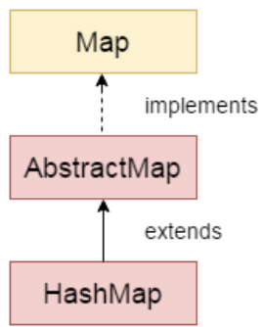
Java HashMap class
Java HashMap class implements the map interface by using a hashtable. It inherits AbstractMap class and implements Map interface.
The important points about Java HashMap class are:
A HashMap contains values based on the key.
It contains only unique elements.
It may have one null key and multiple null values.
It maintains no order.

Slide 25
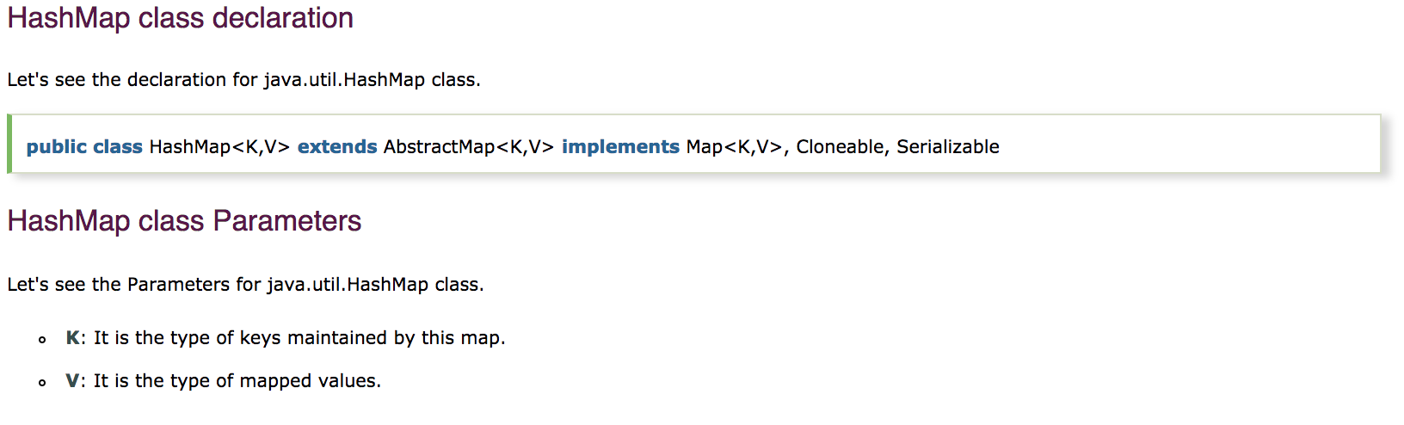

Slide 26
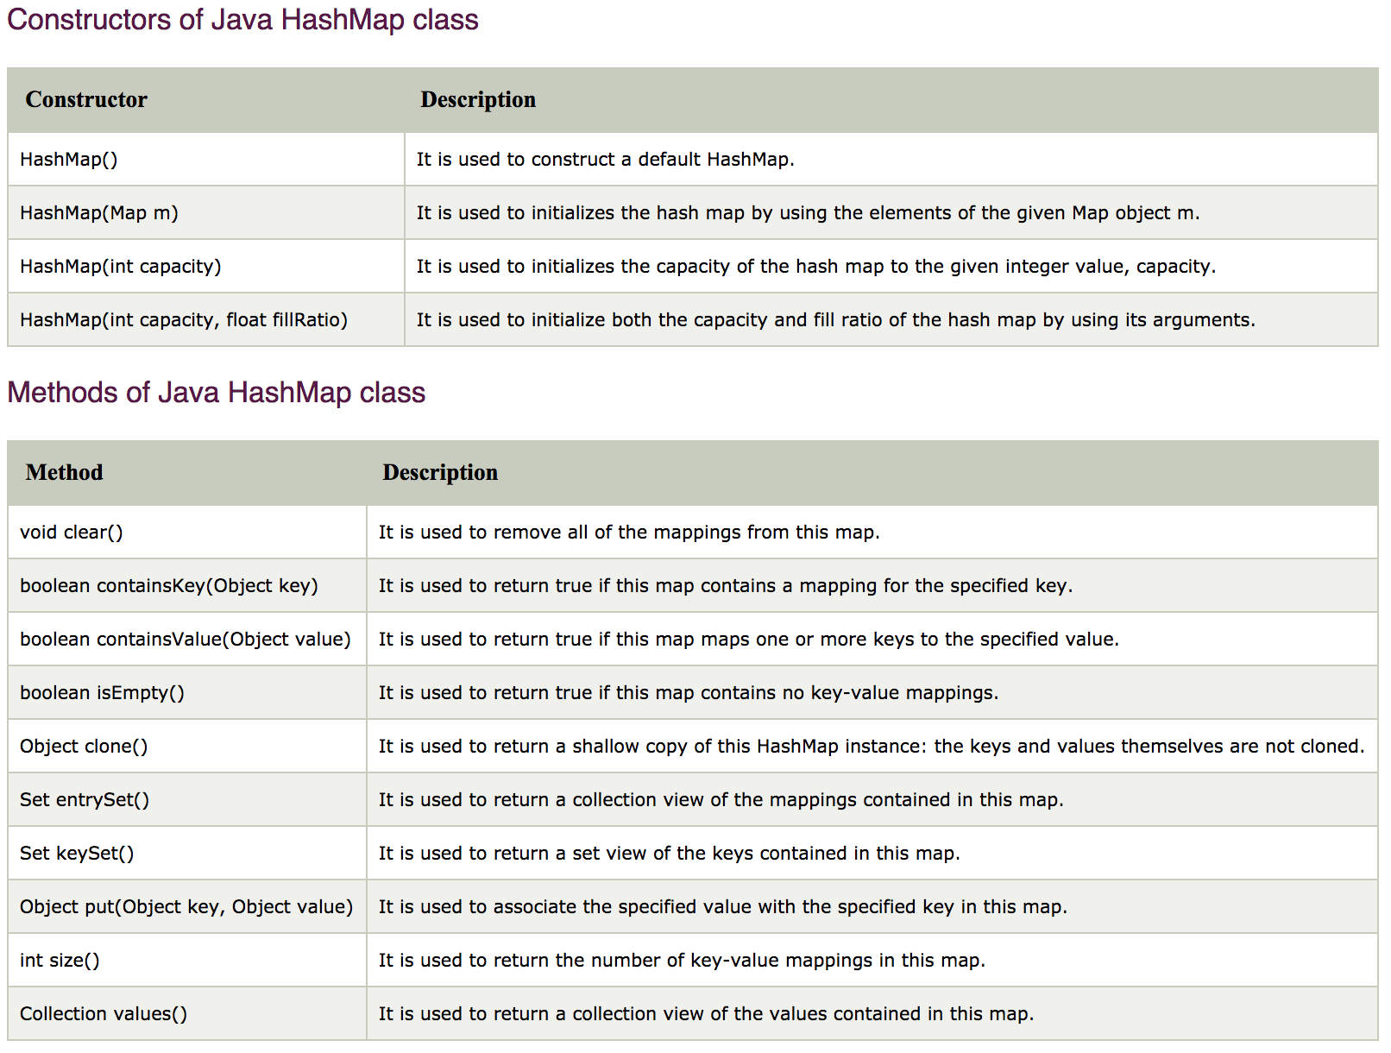

Slide 27
Java Hashtable class
Java Hashtable class implements a hashtable, which maps keys to values. It inherits Dictionary class and implements the Map interface.
The important points about Java Hashtable class are:
A Hashtable is an array of list. Each list is known as a bucket. The position of bucket is identified by calling the hashcode() method. A Hashtable contains values based on the key.
It contains only unique elements.
It may have not have any null key or value.

Slide 29
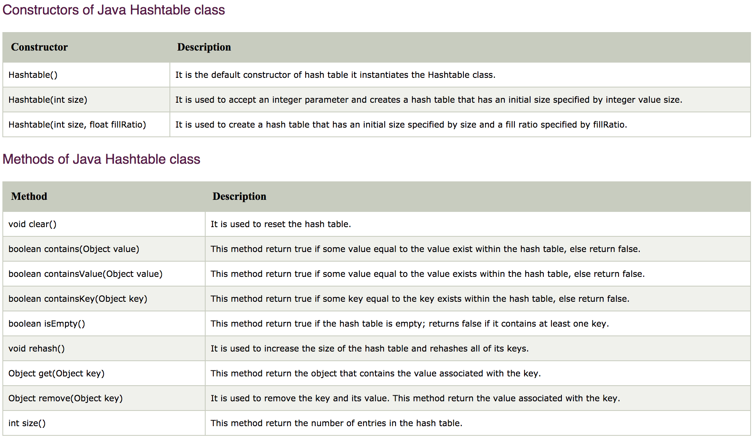

Slide 30
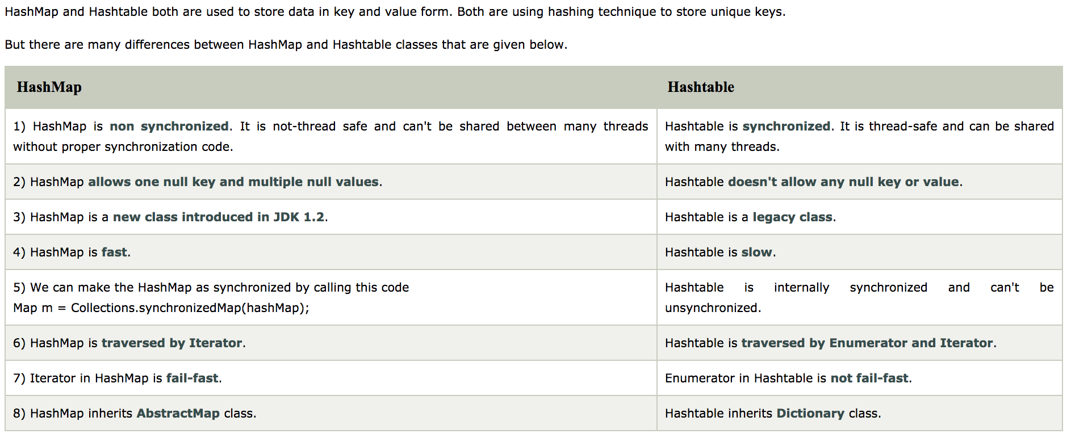
Difference between HashMap and Hashtable

