Slide 1
Selenium Locating Strategy

Slide 2
Type of Locators
ID Locator
Name Locator
Class name
Link Text Locator
Partial Link text
Tag Name
XPath Locator
CSS

Slide 3
id Select element with the specified @id attribute.
Name Select first element with the specified @name attribute.
Linktext Select link (anchor tag) element which contains text matching the specified link text
Partial Linktext Select link (anchor tag) element which contains text matching the specified partial link text
Tag Name Locate Element using a Tag Name .
Class name Locate Element using a class Name ..
Css Select the element using css selectors. You can check here for refer W3C CSS Locatros
Xpath Locate an element using an XPath expression.

Slide 4
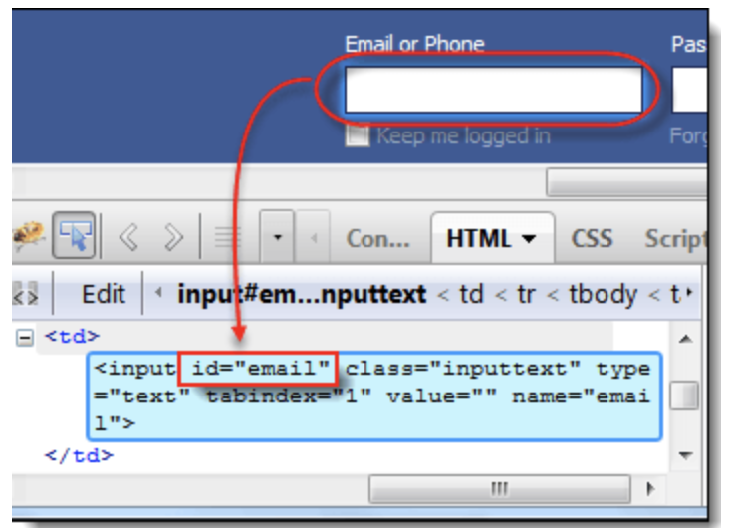
Locating by ID
Target Format: id=id of the element

Slide 5
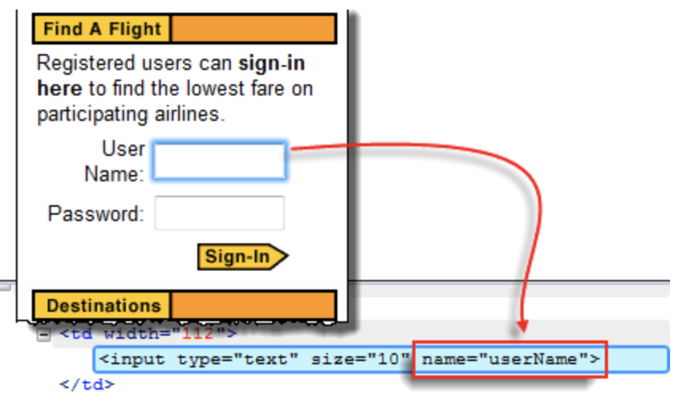
Locating by Name
Target Format: name=name of the element

Slide 6
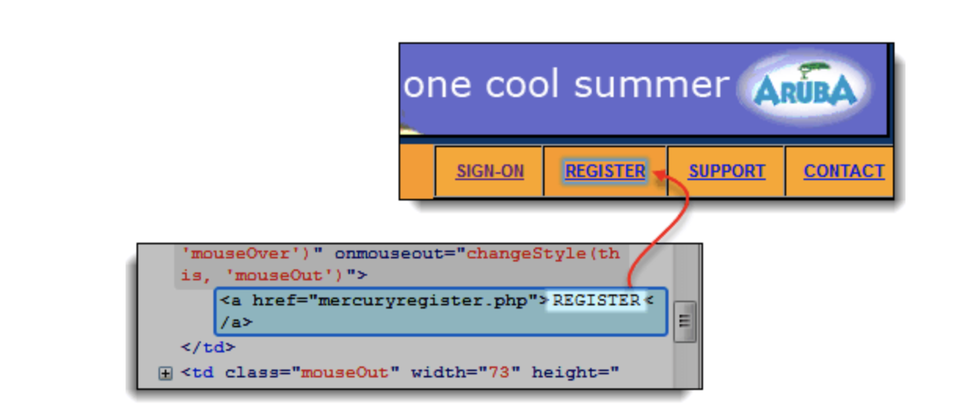
Locating by Link Text
Target Format: link=link_text

Slide 7
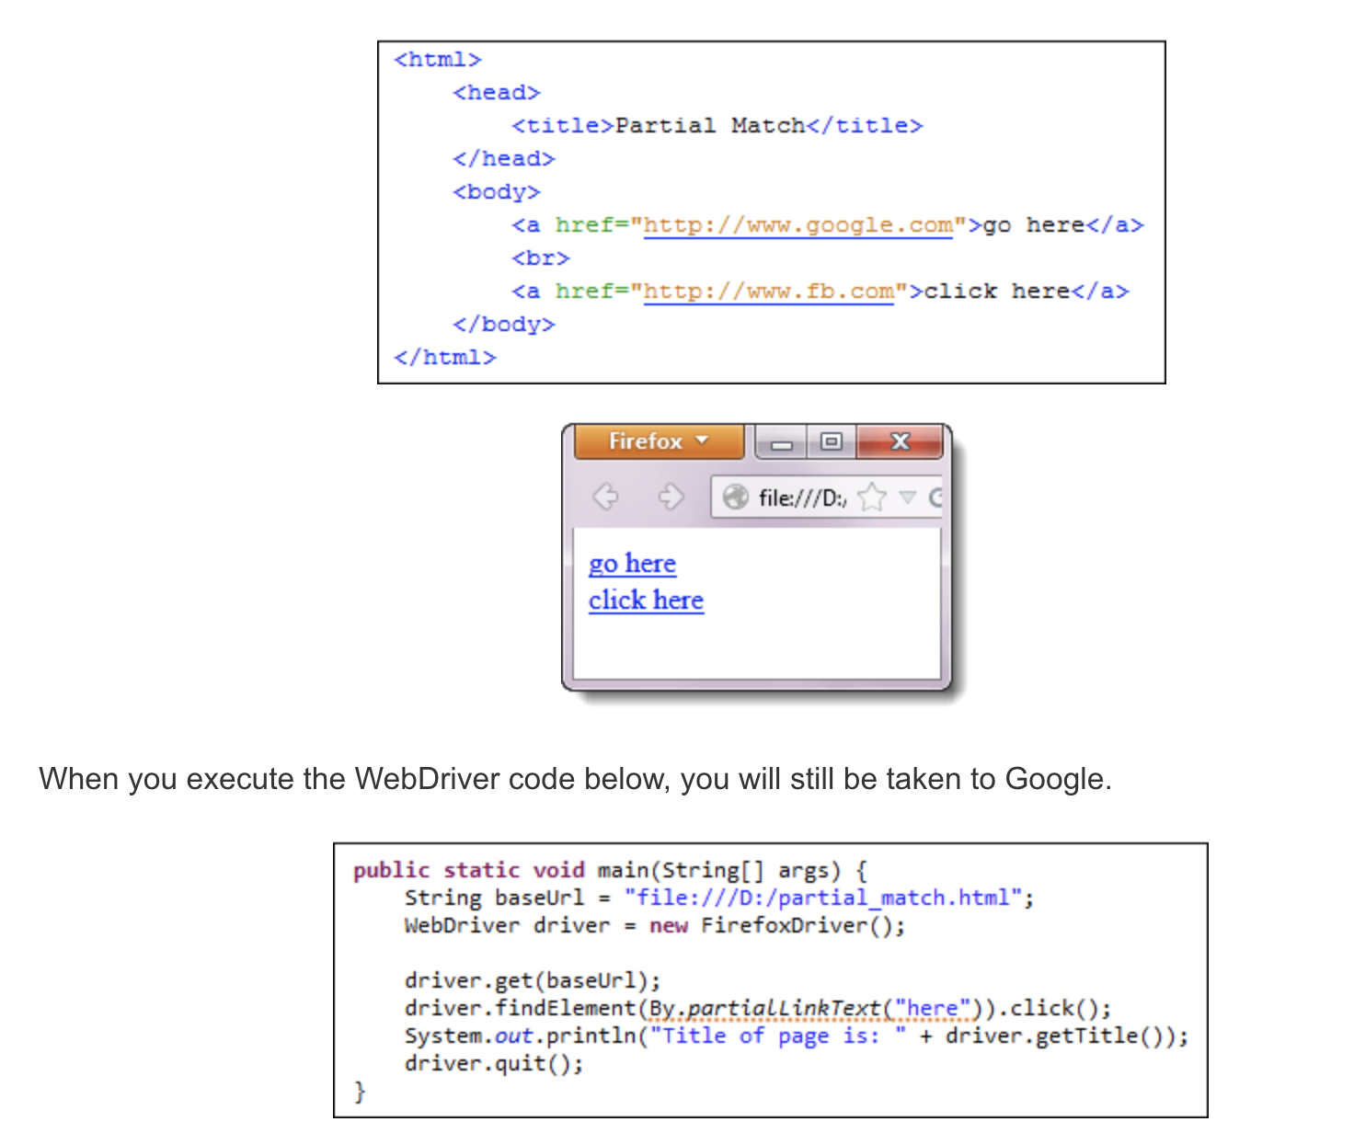
Locating by Partial Link Text

Slide 8
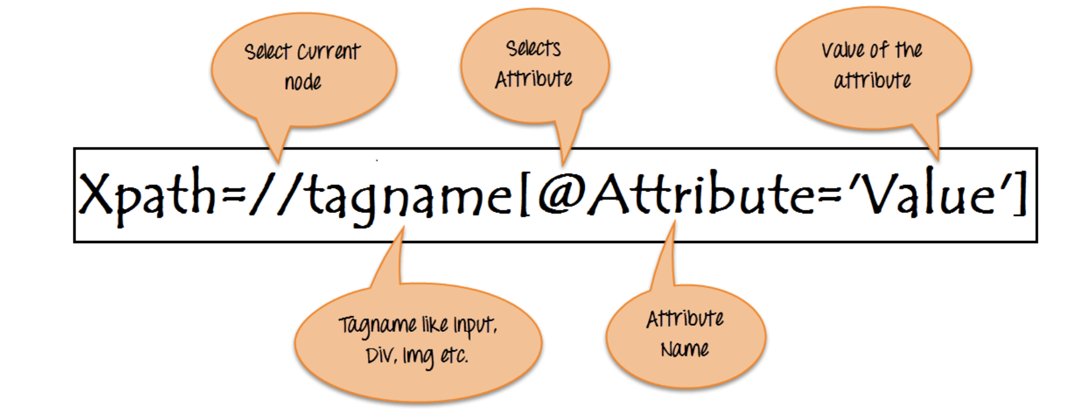
Locating by XPath
Syntax for Xpath : Xpath=//tagname[@attribute='value']

Slide 9
Types of X-path
There are two types of XPath:
1) Absolute XPath .
2) Relative XPath .

Slide 10
Absolute XPath :
It is the direct way to find the element, but the disadvantage of the absolute XPath is that if there are any changes made in the path of the element then that XPath gets failed.
The key characteristic of XPath is that it begins with the single forward slash(/) ,which means you can select the element from the root node.
Absolute xpath: /html/body/div[1]/section/div[1]/div/div/div/div[1]/div/div/div/div/div[3]/div[1]/div/h4[1]/b

Slide 11
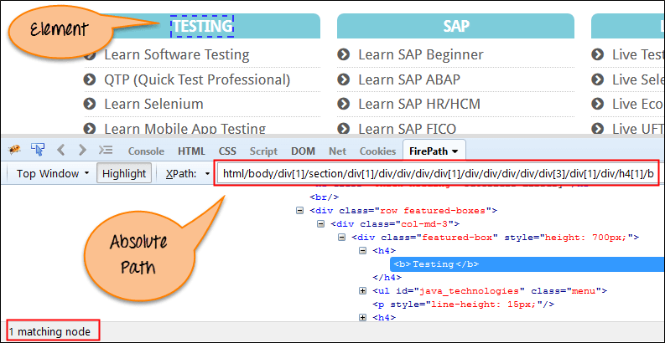
Absolute xpath:

Slide 12
Relative xpath:
For Relative Xpath the path starts from the middle of the HTML DOM structure. It starts with the double forward slash (//), which means it can search the element anywhere at the webpage.
You can start from the middle of the HTML DOM structure and no need to write long xpath.
Relative xpath: //*[@class='featured-box']//*[text()='Testing']

Slide 13
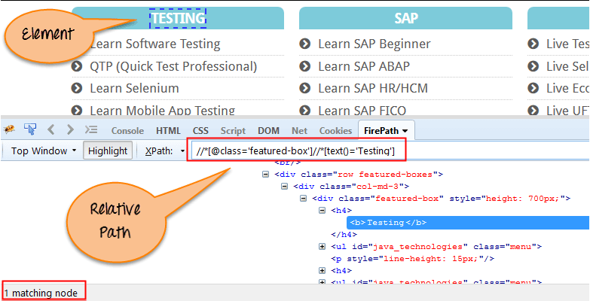
Relative xpath:

Slide 14
Using XPath Handling complex & Dynamic elements in Selenium
What are XPath axes.
XPath axes search different nodes in XML document from current context node. XPath Axes are the methods used to find dynamic elements, which otherwise not possible by normal XPath method having no ID , Classname, Name, etc.
Axes methods are used to find those elements, which dynamically change on refresh or any other operations. There are few axes methods commonly used in Selenium Webdriver like child, parent, ancestor, sibling, preceding, self, etc.

Slide 15
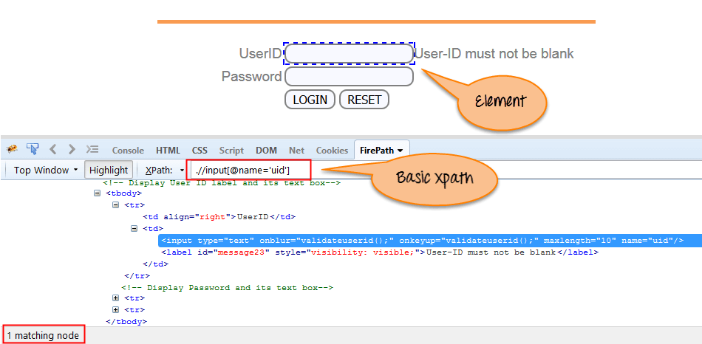
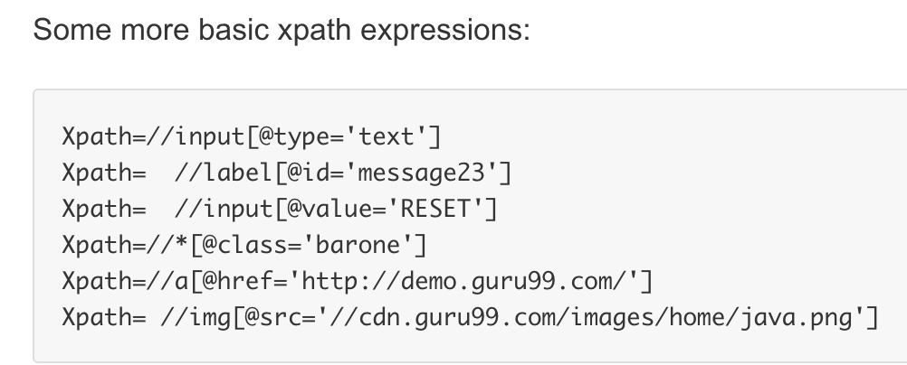
1. Basic XPath:
XPath expression select nodes or list of nodes on the basis of attributes like ID , Name, Classname, etc. from the XML document as illustrated below.
Syntax: Xpath=//input[@name='uid']

Slide 16
2. Contains()
Contains() is a method used in XPath expression. It is used when the value of any attribute changes dynamically, for example, login information.
The contain feature has an ability to find the element with partial text as shown in below example.
In this example, we tried to identify the element by just using partial text value of the attribute. In the below XPath expression partial value 'sub' is used in place of submit button. It can be observed that the element is found successfully.
Complete value of 'name' is 'btnLogin' but using only partial value 'btn’.
Xpath=.//*[contains(@name,'btn')]
Complete value of 'Type' is 'submit' but using only partial value 'sub'.
Xpath=//*[contains(@type,'sub’)]

Slide 17
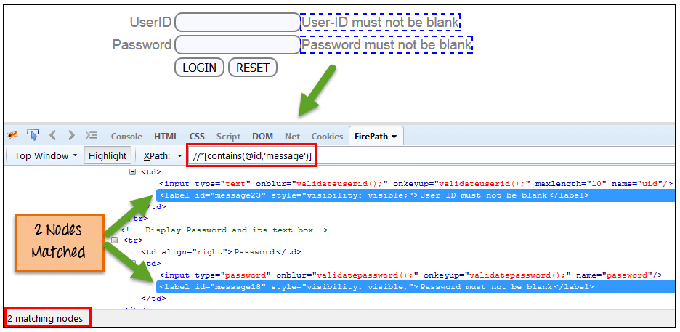
Xpath=//*[contains(@id,'message')]

Slide 18
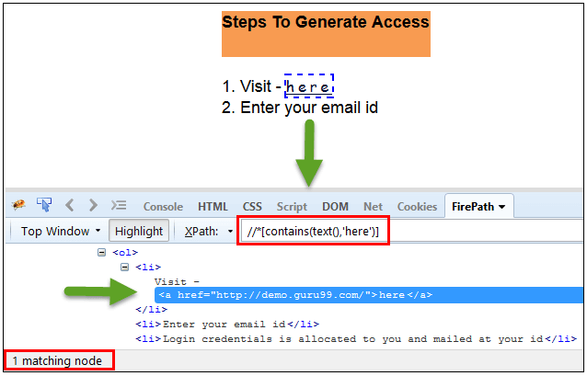
In the below expression, we have taken the "text" of the link as an attribute and 'here' as a partial value as shown in the below screenshot. This will find the link ('here') as it displays the text 'here’.
Xpath=//*[contains(text(),'here’)]
Xpath=//*[contains(@href,'guru99.com')]

Slide 19
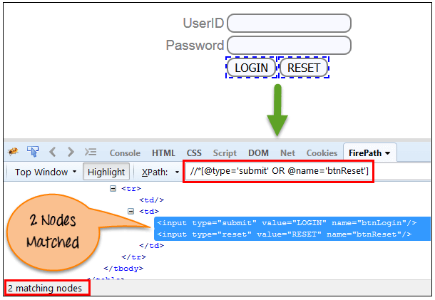
3. Using OR & AND:
In OR expression, two conditions are used, whether 1st condition OR 2nd condition should be true. It is also applicable if any one condition is true or maybe both. Means any one condition should be true to find the element.
In the below XPath expression, it identifies the elements whose single or both conditions are true.
Xpath=//*[@type='submit' OR @name='btnReset']
Highlighting both elements as "LOGIN " element having attribute 'type' and "RESET" element having attribute 'name'.

Slide 20
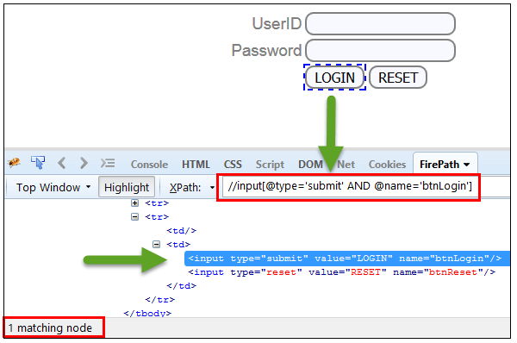
AND
In AND expression, two conditions are used, both conditions should be true to find the element. It fails to find element if any one condition is false.
Syntax Xpath=//input[@type='submit’ and @name='btnLogin']

Slide 21
4. Start-with function:
Start-with function finds the element whose attribute value changes on refresh or any operation on the webpage. In this expression, match the starting text of the attribute is used to find the element whose attribute changes dynamically. You can also find the element whose attribute value is static (not changes).
For example -: Suppose the ID of particular element changes dynamically like:
Id=" message12"
Id=" message345"
Id=" message8769"
and so on.. but the initial text is same. In this case, we use Start-with expression.

Slide 22
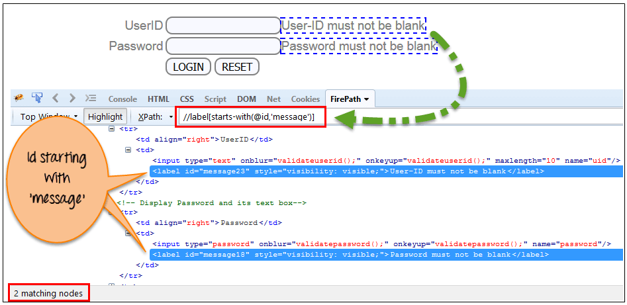
In the below expression, there are two elements with an id starting "message"(i.e., 'User-ID must not be blank' & 'Password must not be blank'). In below example, XPath finds those element whose 'ID' starting with 'message’.
Syntax: Xpath=//label[starts-with(@id,'message')]

Slide 23
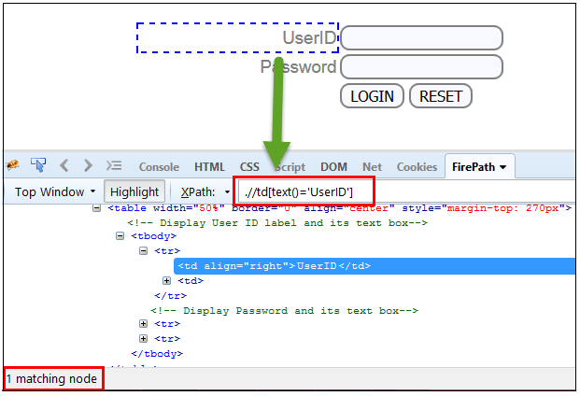
5. Text()
In this expression, with text function, we find the element with exact text match as shown below. In our case, we find the element with text "UserID".
Syntax: Xpath=//td[text()='UserID']

Slide 24
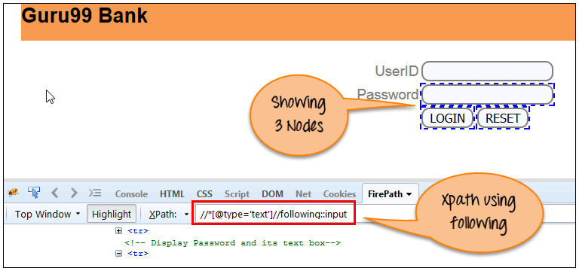
6.XPath axes methods
These XPath axes methods are used to find the complex or dynamic elements. Below we will see some of these methods.
a) Following: Selects all elements in the document of the current. node( ) [ UserID input box is the current node] as shown in the below screen.
Syntax: Xpath=//*[@type='text']//following::input

Slide 25
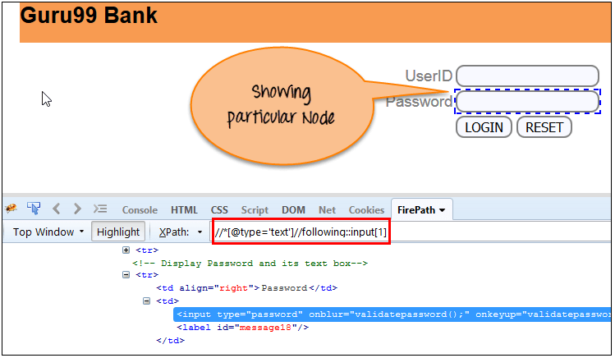
There are 3 "input" nodes matching by using "following" axis- password, login and reset button. If you want to focus on any particular element then you can use the below XPath method:
Syntax: Xpath=//*[@type='text']//following::input[1]
You can change the XPath according to the requirement by putting [1],[2]…………and so on.

Slide 26
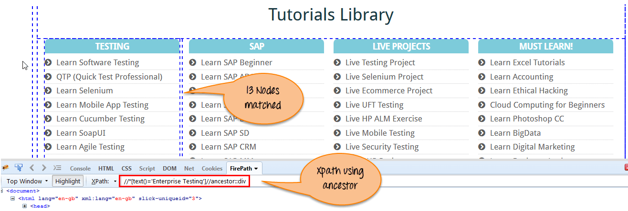
b. Ancestor:
The ancestor axis selects all ancestors element (grandparent, parent, etc.) of the current node as shown in the below screen.
In the below expression, we are finding ancestors element of the current node("ENTERPRISE TESTING" node).
Syntax: Xpath=//*[text()='Enterprise Testing']//ancestor::div

Slide 27
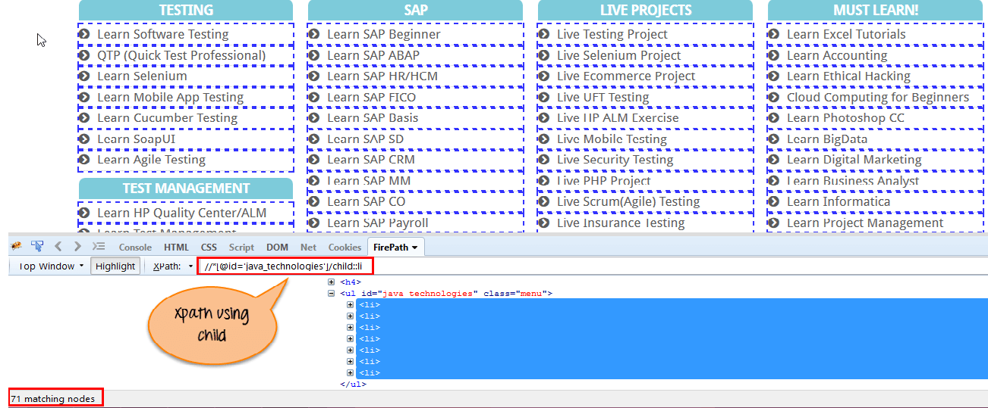
c.Child
Selects all children elements of the current node (Java) as shown in the below screen.
Syntax: Xpath=//*[@id='java_technologies']/child::li

Slide 28
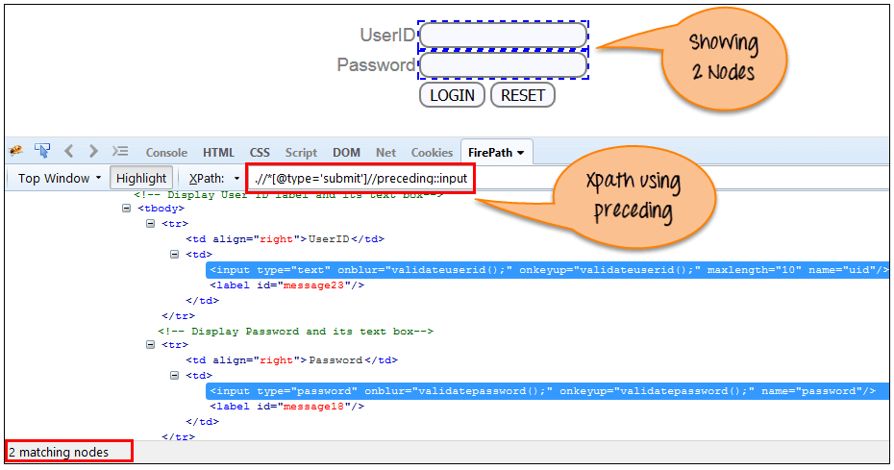
d. Preceding:
Select all nodes that come before the current node as shown in the below screen.
Syntax: Xpath=//*[@type='submit']//preceding::input

Slide 29
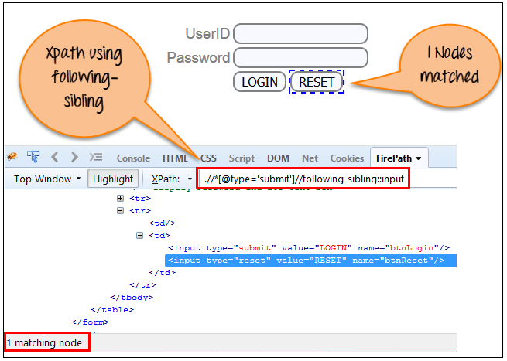
e. Following-sibling:
Select the following siblings of the context node. Siblings are at the same level of the current node as shown in the below screen. It will find the element after the current node.
Syntax: xpath=//*[@type='submit']//following-sibling::input

Slide 30
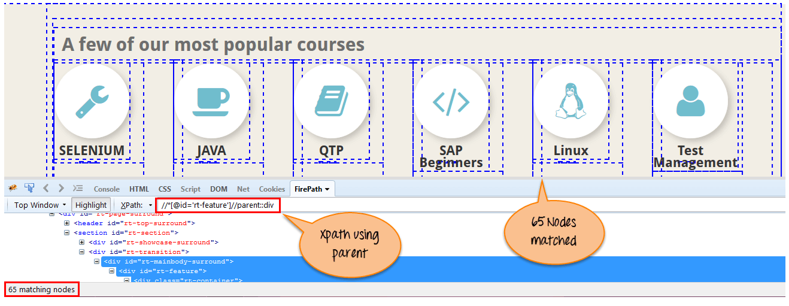
f.Parent:
Selects the parent of the current node as shown in the below screen.
Synatax: Xpath=//*[@id='rt-feature']//parent::div

Slide 31
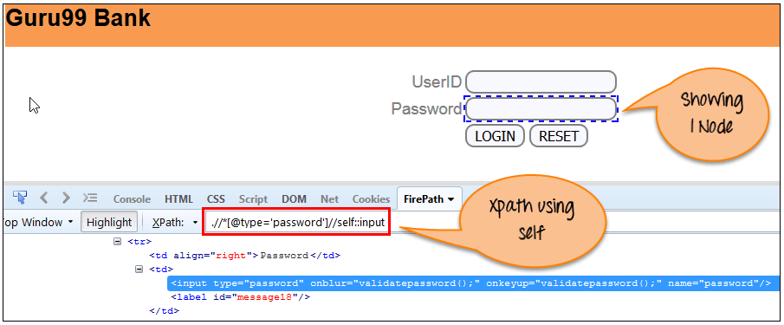
g. Self:
Selects the current node or 'self' means it indicates the node itself as shown in the below screen.
Syntax: Xpath =//*[@type='password']//self::input

Slide 32
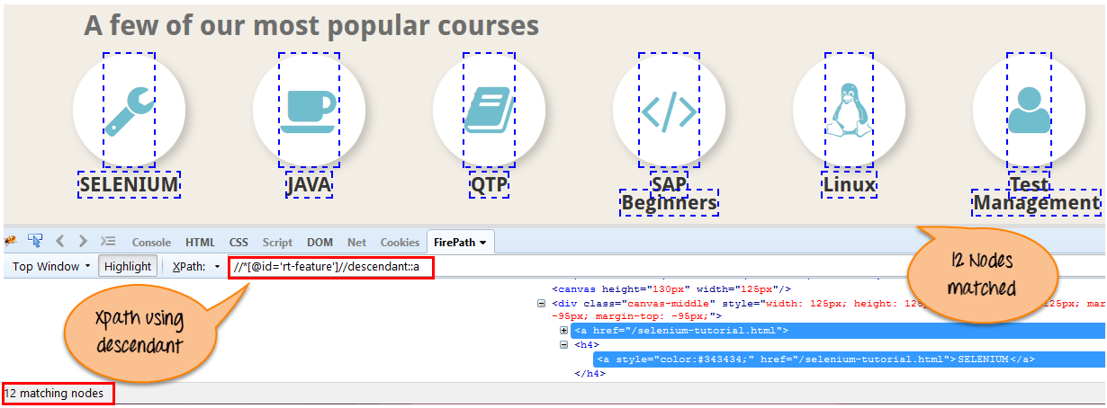
h. Descendant:
Selects the descendants of the current node as shown in the below screen.
In the below expression, it identifies all the element descendants to current element ( 'Main body surround' frame element) which means down under the node (child node , grandchild node, etc.).
Syntax: Xpath=//*[@id='rt-feature']//descendant::a

Slide 33
Locating by CSS Selector
CSS Selectors are string patterns used to identify an element based on a combination of HTML tag, id, class, and attributes. Locating by CSS Selector is more complicated than the previous methods, but it is the most common locating strategy of advanced Selenium users because it can access even those elements that have no ID or name.
CSS Selectors have many formats, but we will only focus on the most common ones.
Tag and ID
Tag and class
Tag and attribute
Tag, class, and attribute
Inner text

Slide 34
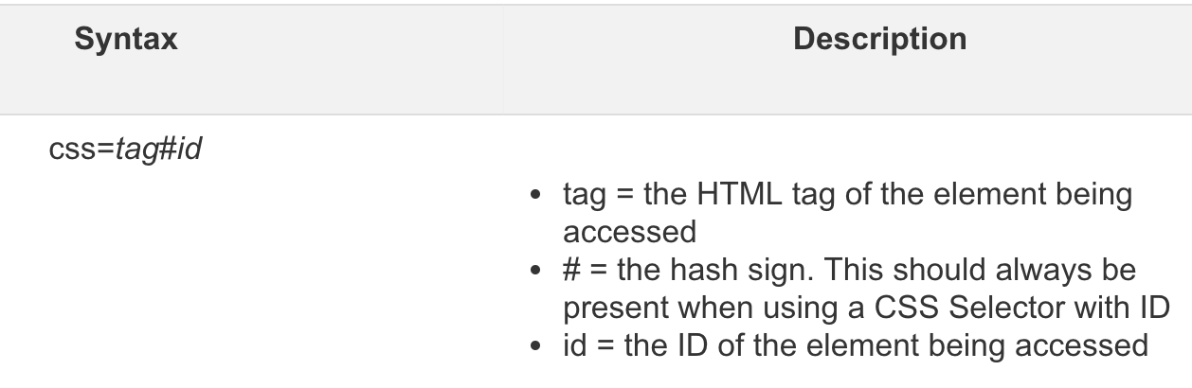
Locating by CSS Selector - Tag and ID
Again, we will use Facebook's Email text box in this example. As you can remember, it has an ID of "email," and we have already accessed it in the "Locating by ID" section. This time, we will use a CSS Selector with ID in accessing that very same element.
Syntax: d.findElement(By.cssSelector("#twotabsearchtextbox"))
Keep in mind that the ID is always preceded by a hash sign (#).

Slide 35
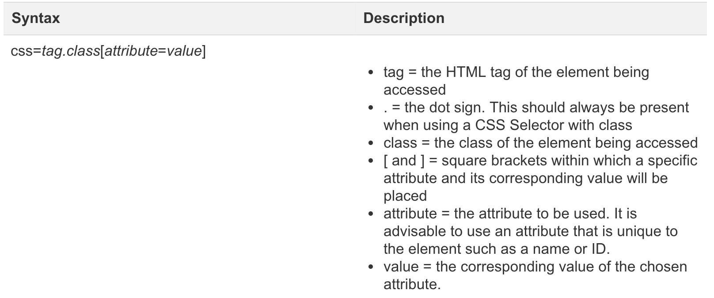
Locating by CSS Selector - tag, class, and attribute

Slide 36
Locating by CSS Selector - tag, class, and attribute
TAGNAME[attribute=‘value’][attribute=‘value’]
Input[id=‘email’][type=‘text’]

Slide 37
Locating by CSS Selector - Class
Syntax: d.findElement(By.cssSelector(”.twotabsearchtextbox"))
To find unique element by using more attributes
Input.formBtn[name=go]

Slide 38
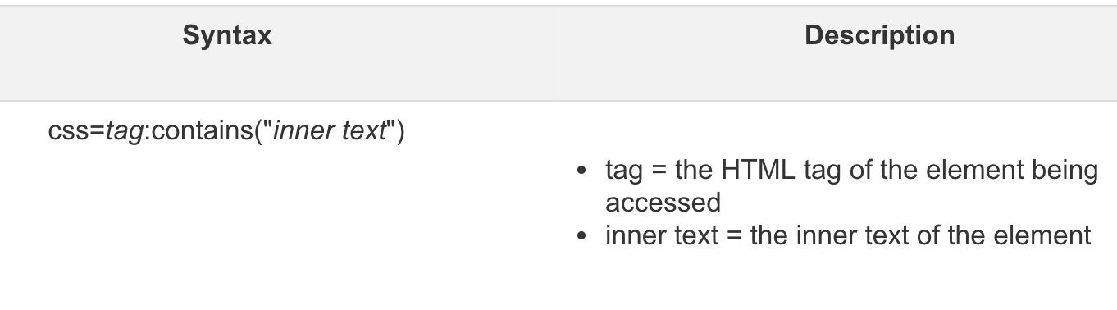
Locating by CSS Selector - inner text
As you may have noticed, HTML labels are seldom given id, name, or class attributes. So, how do we access them? The answer is through the use of their inner texts. Inner texts are the actual string patterns that the HTML label shows on the page.

Slide 39
There are there important special characters:
1. '^' symbol, represents the starting text in a string.
Syntax: css=input[id^='ema'] 2. '$' symbol represents the ending text in a string.
Syntax: css=input[id$='mail'] 3. '*' symbol represents contains text in a string.
Syntax: css=input[id*='mai']

Slide 40
CSS with Cascading classes part 1
Syntax:
Tagname.classname.classname.classname
Example1:input.form-control.private-form_control.login-email
Example2:.form-control.private-form_control.login-email

Slide 41
CSS with Cascading classes part 2
Syntax:
Tagname.classname.classname.classname (any one class can also be used)
Example:input.login-email

Slide 42
CSS with Cascading classes with id
Syntax:
Tagname#id.classname.classname.classname
Example:input#username.form-control.private-form_control.login-email

Slide 43
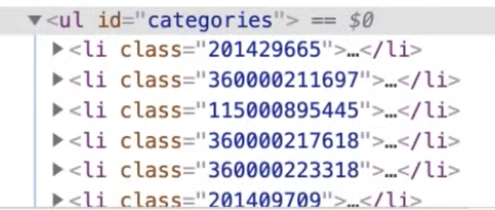
CSS to find List of values
ul#categories>li → list of elements 1 of 14
ul#categories>li:nth-of-type(n) → list of elements 1 of 14

Slide 44
CSS to find specific element in list of values using nth-of-type
ul#categories>li:nth-of-type(2) → list of elements 1 of 1

Slide 45
CSS to find FIRST value in list of values using first-of-type
ul#categories>li:first-of-type → list of elements 1 of 1

Slide 46
CSS to find LAST value in list of values using last-of-type
ul#categories>li:last-of-type → list of elements 1 of 1

