Slide 1


K.RAMAKRISHNAN COLLEGE OF TECHNOLOGY
(AUTONOMOUS), TRICHY.
TEXT – BASED ADVENTURE GAME
PRESENTED BY
ARAVINDAN K
2303811710421008
SUPERVISOR
Mr. M. Saravanan, M.E.,
AP/CSE.

Slide 2
PRESENTATION OVERVIEW
Objective
Project Introduction
Problem Statement
Methodologies (Programming concepts relevant to problem statement)
Architecture of the proposed system
List of Modules
Merits
Results and Discussion
Queries

Slide 3
OBJECTIVE
The HauntedHouseGame is a Java Swing-based text adventure game with a graphical user interface. Players explore interconnected rooms, each with unique items, descriptions, and challenges, using navigation buttons. Items like keys and swords are collected to unlock doors or defeat monsters. The game emphasizes strategy and problem-solving, with logical constraints ensuring progression through exploration. Combat requires effective use of inventory, while the GUI features a JTextArea for updates and buttons for actions like movement and combat. Save/load functionality, implemented using Java serialization, allows progress to be preserved. The modular design supports scalability for new rooms or features.

Slide 4
PROJECT INTRODUCTION
The HauntedHouseGame is an interactive text-based adventure game developed in Java using Swing for a graphical user interface. It immerses players in a haunted house where they explore rooms, collect items, and face challenges like locked doors and monsters. The game emphasizes strategic problem-solving, requiring players to utilize collected items effectively to progress. Navigation is facilitated through directional buttons, and game updates are displayed in a text area. The inclusion of save/load functionality allows players to preserve their progress. Designed with modularity, the project enables scalability for adding new features. This game blends logic, exploration, and creativity for an engaging gaming experience.

Slide 5
PROBLEM STATEMENT
Interactive Exploration: Create a haunted house game where players can navigate through interconnected rooms using directional buttons.
Room Challenges: Include obstacles like locked doors requiring specific items (e.g., keys) to proceed.
Item Collection: Enable players to collect items such as keys, weapons, and spells to help in their progression.
Combat Mechanism: Implement a system where players can encounter and defeat monsters using collected weapons or spells.
5. Save/Load Feature: Allow players to save their game state and reload it later to continue their adventure.

Slide 6
METHODOLOGIES
The proposed work for the Haunted House Game project involves developing a text-based adventure game with a graphical interface using Java Swing. The system will allow players to navigate rooms, collect items, and fight monsters. Key components include classes like Room, Monster, and HauntedHouseGame, utilizing HashMap for room connections and HashSet for inventory management. Game interactions include movement, item collection, and combat. The save/load functionality will be implemented using object serialization. The user interface will feature buttons for game actions like movement and combat. Testing will include unit and integration tests to ensure functionality. Upon completion, the game will be deployed with clear documentation for users.

Slide 7
ARCHITECTURE OF THE PROPOSED SYSTEM
Haunted House
Game Engine
Room 1 (Foyer)
User Interface
Game State
Room 2 (Library)
Room n (Basement)
Inventory System

Slide 8
LIST OF MODULES
MODULE DESCRIPTON
GUI Module
Game Logic Module
Room Management Module
Monster Module
Inventory Management
Save and Load ModuleModule
Game Setup Module
Event Handling Module

Slide 9
MERITS
Engaging Gameplay : Combines exploration, puzzle-solving, and combat for an interactive experience.
Modularity : Clearly separates GUI, game logic, and data management, enhancing maintainability.
Scalability : Easily expandable with new rooms, items, or features.
Save/Load Feature : Implements serialization for preserving player progress.
User-Friendly Interface : Intuitive buttons and text-based feedback for seamless interaction.
Object-Oriented Design : Effectively uses classes and objects for room and monster management.

Slide 10
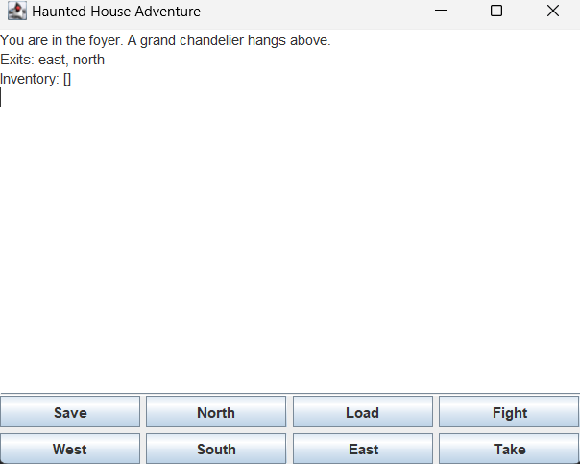
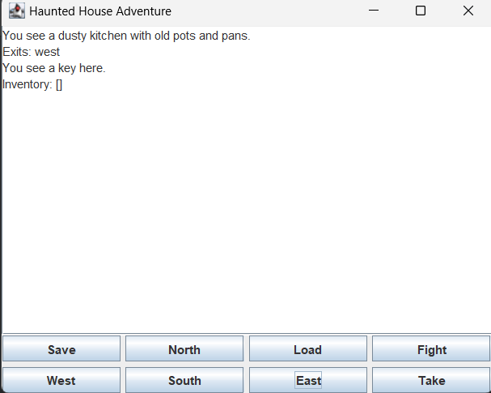
RESULTS AND DISCUSSION

Slide 11

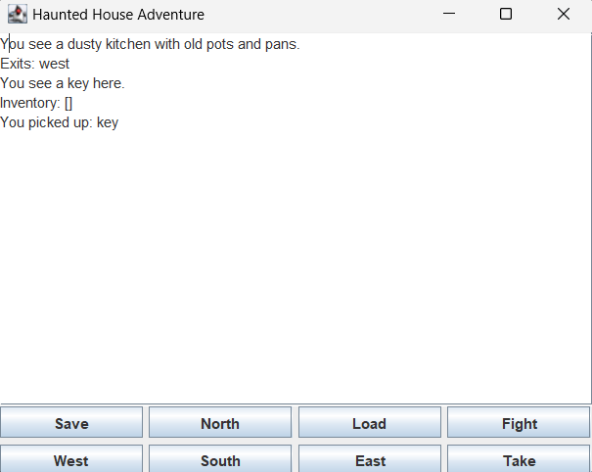
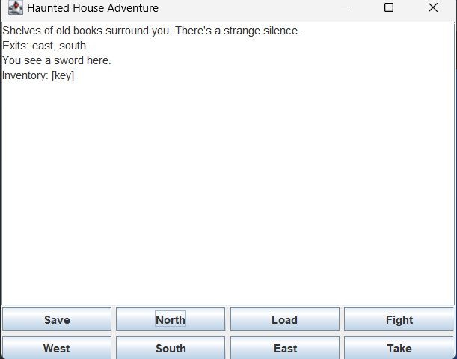

Slide 12
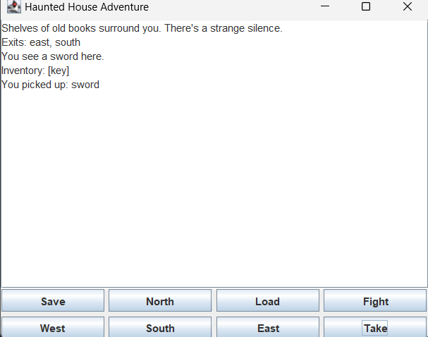
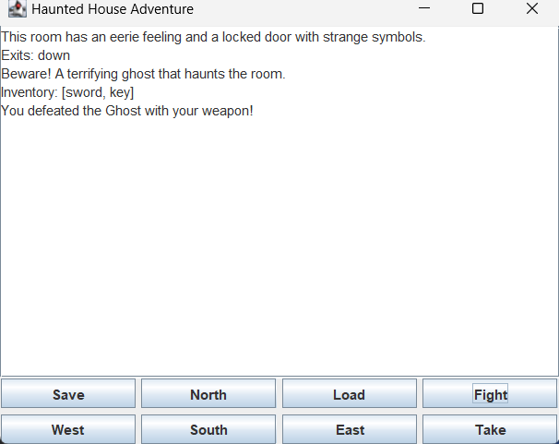

Slide 13
QUERIES ?

