Slide 1



SURFACE DEFECT DETECTION IN MANUFACTURING USING CONVOLUTIONAL NEURAL NETWORKS
DEPARTMENT OF ARTIFICIAL
INTELLIGENCE AND DATA SCIENCE
HCL PROJECT
PROJECT MEMBER ARAVINDANV - 24ADR011
DIVYA T - 24ADR043

Slide 2
INTRODUCTION
Manufacturing industries generate massive volumes of product images daily across high-speed production lines, making it practically impossible to monitor surface quality manually with consistent accuracy. This project focuses on using deep learning and computer vision techniques to automatically detect and classify surface defects such as cracks, scratches, dents, and other irregularities in manufactured components. It aims to create a smarter and more reliable quality control system through intelligent visual inspection, reducing human error, minimizing production waste, and ensuring that only defect-free products reach the end customer.

Slide 3
PROBLEM STATEMENT
Manual visual inspection in manufacturing is prone to human fatigue and inconsistency
Rule-based computer vision systems fail under varying lighting, texture, and complex defect patterns
High-precision industries (steel, automotive, semiconductor) demand zero-defect tolerance
Need for an automated deep learning system to detect and classify surface defects from product images
System must classify defect type: Crack, Scratch, Dent, or Defect Other
Model should output class probabilities and highlight defect regions using activation maps
Must balance detection accuracy while minimizing false positives in real-time inspection

Slide 4
OBJECTIVE
To develop a CNN-based deep learning system that automatically detects and classifies surface defects in manufactured product images with high accuracy.
To implement and compare a Custom Baseline CNN and Transfer Learning models (ResNet18, ResNet50, VGG16) for multi-class defect classification.
To preprocess and augment the NEU-DET dataset by mapping six defect categories into four unified classes: Crack, Scratch, Dent, and Defect Other.
To visualize defect-affected regions on product images using Grad-CAM heatmap activation maps for better model interpretability.
To evaluate model performance using Accuracy, Precision, Recall, F1-Score, and Confusion Matrix for reliable quality assessment.
To deploy a real-time inference application using Streamlit that allows quality control engineers to upload images and instantly receive defect predictions with confidence scores.

Slide 5
LITERATURE SURVEY
Author & Year | Paper Title | METHODOLOGY | METRICS
IEEE Access. (2021) | Surface Defect Detection Using Deep CNNs | Custom CNN, Data Augmentation | Accuracy: 93%
Elsevier (Pattern Recognition). (2022) | Transfer Learning for Industrial Defect Classification | ResNet50, VGG16, Fine-tuning | Accuracy: 96%
Springer (Neural Computing). (2023) | Grad-CAM Based Defect Localization in Steel Surfaces | ResNet18, Grad-CAM Visualization | Accuracy: 97%

Slide 6
EXISTING SYSTEM
Traditional surface defect detection relies on manual visual inspection by human operators, which is time-consuming and inconsistent.
Rule-based computer vision systems using handcrafted features like edge detection and texture analysis fail to generalize across complex defect patterns.
Conventional ML methods like SVM and Random Forests require manual feature engineering and struggle with varying lighting and surface textures.
These systems are not scalable for high-speed production lines and produce high false positive rates affecting overall product quality.

Slide 7
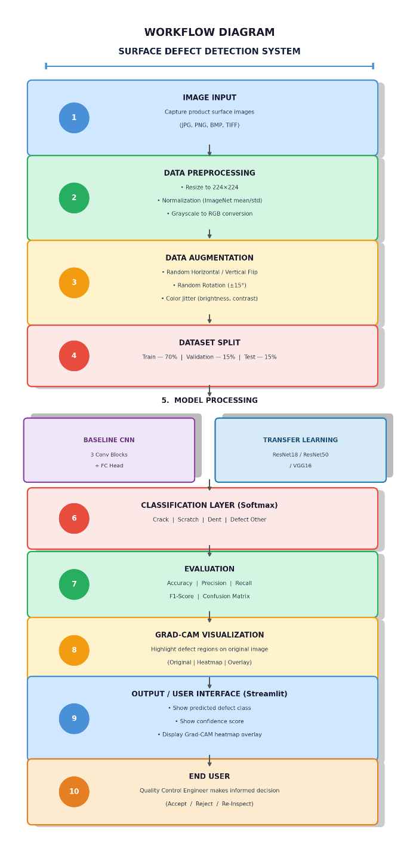
Work flow Diagram

Slide 8
SOFTWARE / HARDWARE REQUIREMENTS
Hardware Specifications:
Processor: Intel Core i5 or above
RAM: 8 GB minimum (16 GB recommended)
GPU: NVIDIA CUDA-compatible GPU (recommended for training)
Storage: 10 GB free disk space
Software Requirements:
Python — Backend and model development
PyTorch / TorchVision — CNN and Transfer Learning models
Streamlit — Interactive inference web application
OpenCV / Pillow — Image preprocessing and visualization
Scikit-learn — Model evaluation and metrics
Grad-CAM (pytorch-grad-cam) — Defect region visualization
TensorBoard — Training monitoring and logging
Pandas / NumPy — Data handling and statistics
Seaborn / Matplotlib — Confusion matrix and training curve plots

Slide 9
MODULES WITH DESCRIPTION
Data Organization Module — Maps NEU-DET dataset's 6 raw classes to 4 training classes and splits into train/val/test folders automatically
Preprocessing Module — Verifies dataset structure, computes per-channel mean/std, generates class distribution charts
Data Loader Module — Builds augmented training transforms and normalized validation transforms, returns DataLoader objects
Baseline CNN Module — Custom 3-stage convolutional network with BatchNorm, MaxPool, and Dropout for defect classification
Transfer Learning Module — Pretrained ResNet18 / ResNet50 / VGG16 backbones with frozen layers and custom classifier head
Training Module — Full training loop with LR scheduling, best-model checkpointing, and TensorBoard logging
Evaluation Module — Computes accuracy, precision, recall, F1-score, saves confusion matrix and model comparison charts
Grad-CAM Module — Generates gradient-weighted activation heatmaps to localize defect regions on original images
Inference / Streamlit App Module — Upload image, select model, view prediction, confidence score, and Grad-CAM visualization

Slide 10
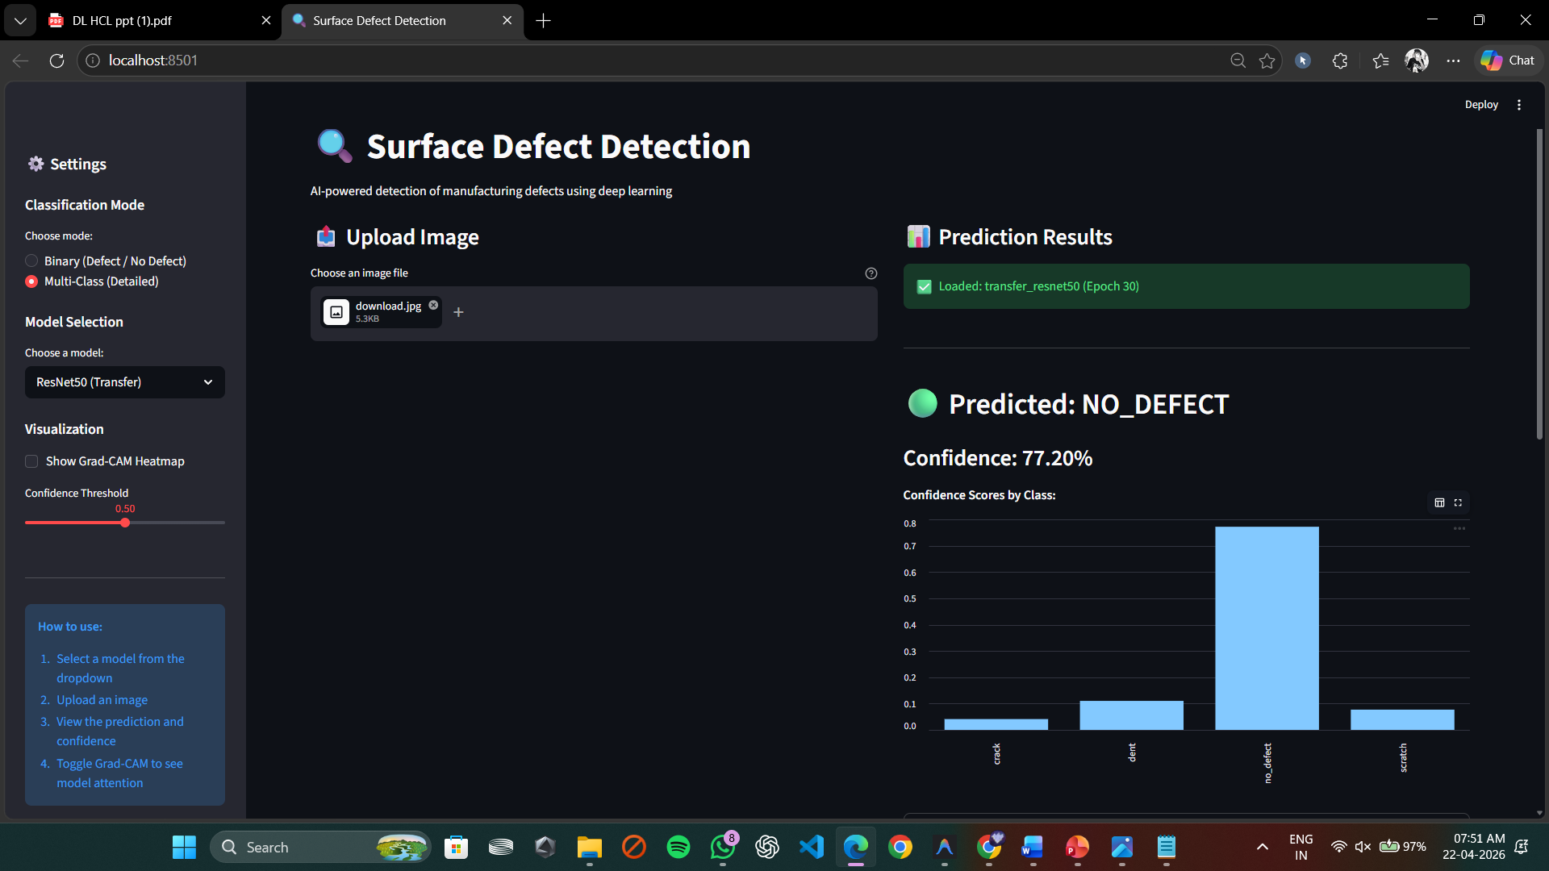
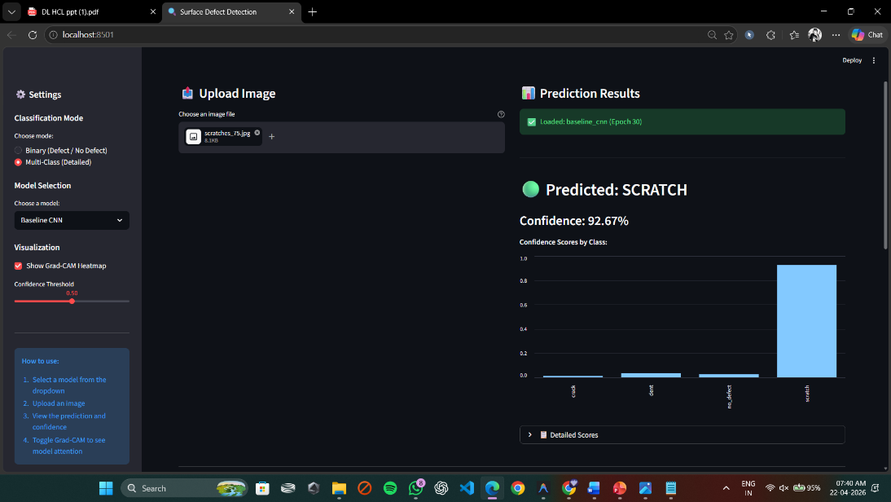
PROJECT SCREENSHOT

Slide 11
REFERENCES
https://www.mdpi.com/2076-3417/13/5/3022
https://arxiv.org/abs/2307.09520
https://arxiv.org/abs/2208.07119
https://arxiv.org/abs/2304.02583
https://arxiv.org/abs/2212.07242
https://arxiv.org/abs/2309.01836

Slide 12
THANK YOU

