Slide 1


Ants!

Slide 2
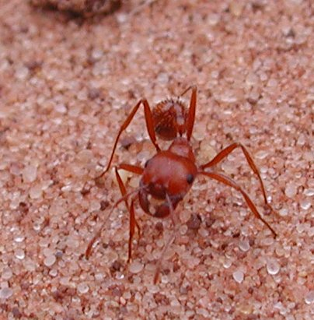
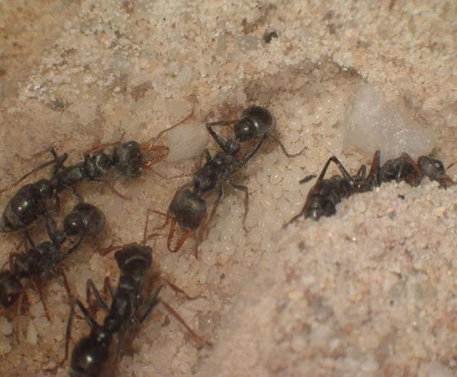
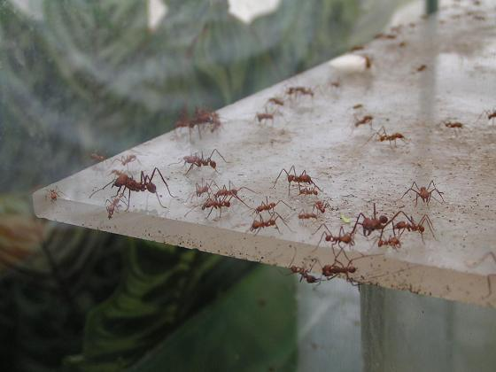
Ants are everywhere!
Can you think of anywhere
You won’t see an ant?

Slide 3


If you said the Antarctic…
You’d be wrong.
There are spiny ants and sugar ants there

Slide 4
So you are bound to find ants at every LTER Site
(You don’t have to know every species though)

Slide 5

Imagine seeing the world from an ant’s point of view

Slide 6
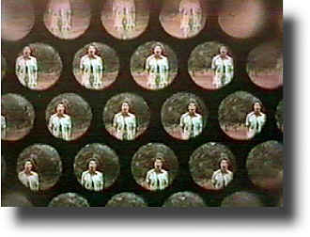
Ants have compound eyes
(Lots of little eyes working together)

Slide 7
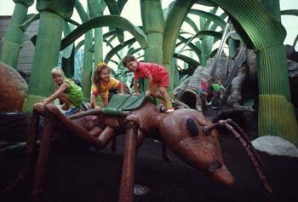
Imagine yourself the size of an ant

Slide 8
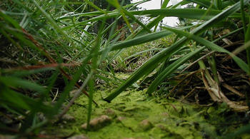
How would your surroundings look to you?

Slide 9
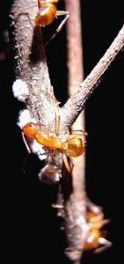
Some people think ants are like us…why?
They keep livestock…
They tend aphids to milk
them for nectar

Slide 10
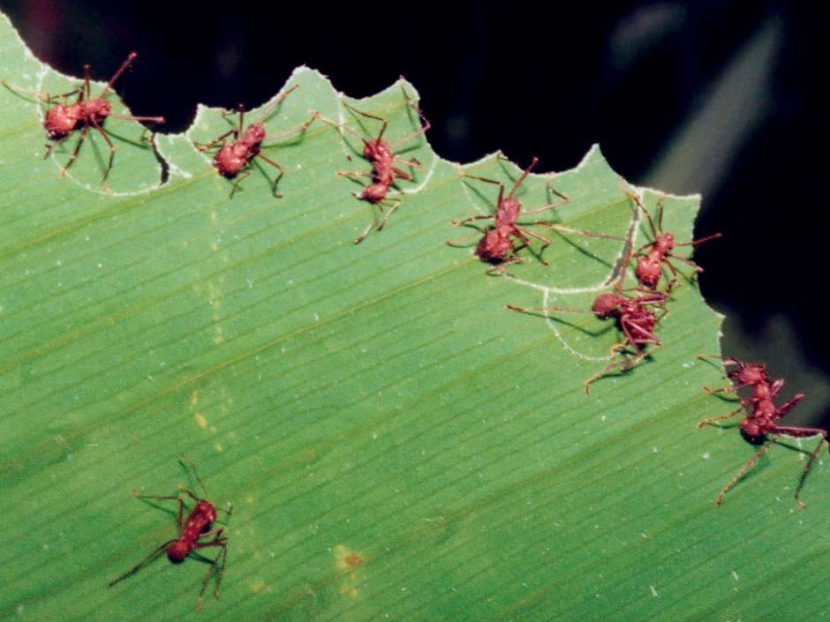
They farm …
Leafcutter ants use vegetation to grow fungus in their “gardens” to feed their colony…

Slide 11
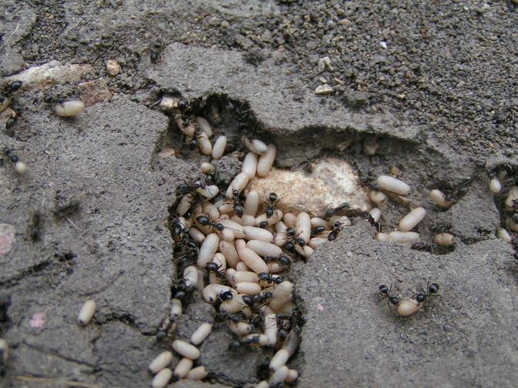
Childcare…
Ants look after their young in large nurseries

Slide 12

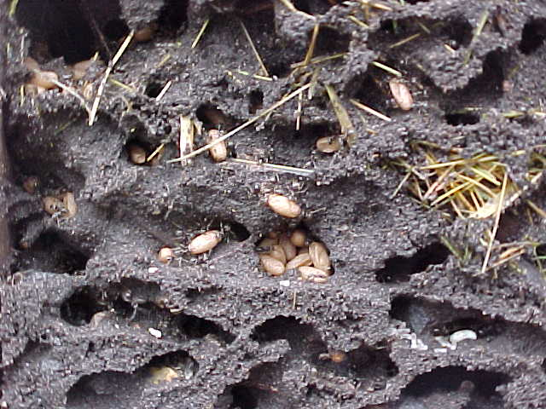
Climate control…
They build nests with inbuilt air circulation channels to keep the nest at 77 degrees

Slide 13
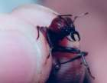
Career specialization
Ants have specific social roles to play in their colony…soldiers, nurses, workers, queens
Whoa! Big chompers!!

Slide 14

Flood Control
Their nests have built in water traps to prevent rain from flooding the nurseries

Slide 15
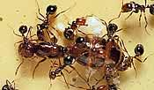
Education…
They teach young ants the tricks of the trade

Slide 16
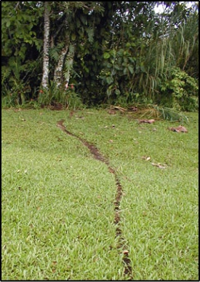
Communication
Ants leave chemical traces that pass messages to their comrades about location of food.

Slide 17
So, ants were here long before humans
They have adapted to their environment
Then along came humans
Hunting
Farming
Irrigating
Burning
Building homes

Slide 18

How would we like it if it was the other way round?

Slide 19
Ant Music by
Adam and the Ants

