Slide 1


CLASS- V
ENGLISH

Slide 2
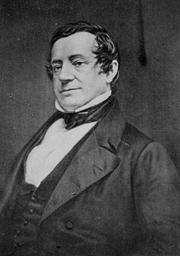

RIP VAN WINKLE
THIS STORY WAS TAKEN FROM THE LEGEND OF RIP VAN WINKLE BY WASHINGTON IRVING.

Slide 3

ELO
    THE PUPILS READ AND
COMPREHEND THE STORY
  THEY GRASP THE MEANINGS OF NEW WORDS
THEY ENJOY THE STORY

Slide 4
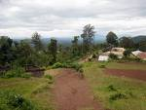
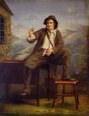
Long ago ,at the foothills of Catskill mountains lived a simple good natured man called Rip Van Winkle.

Slide 5
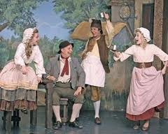
Rip Van Winkle was a kind neighbour and very helpful. Everyone in the village liked him.

Slide 6


Children screamed with joy when they saw him. He played with them.

Slide 7
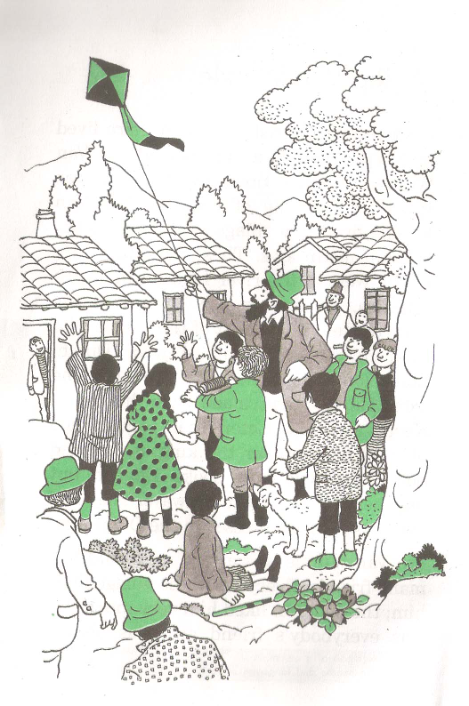
He taught them to fly kites, shoot marbles and told them stories.

Slide 8

One person was always angry with Rip and that was his wife.
Rip didn’t look after his own family and didn’t keep his own farm in order.

Slide 9
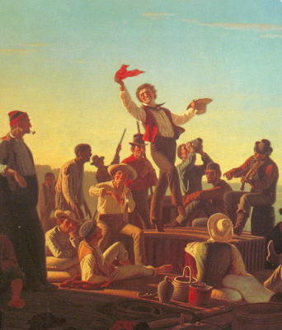
Rip Van Winkle was lazy. He did no work on his farm. He idled away his time.

Slide 10



His fence were falling to pieces. His cow was going astray. Weeds grew on his farm

Slide 11
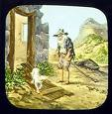
His constant companion was his dog, wolf.

Slide 12
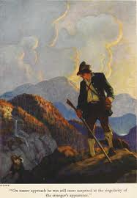
To avoid work
he would walk away into the forest with Wolf.

Slide 13
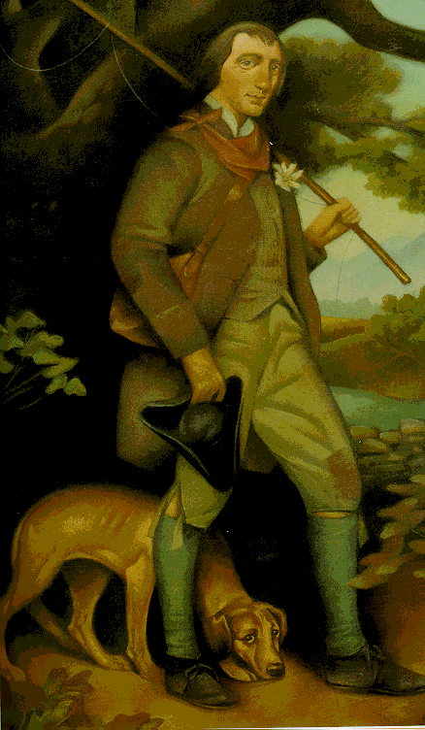
ONE DAY HE WALKED ON AND ON TO THE MOUNTAIN TOP.IT WAS LATE IN THE AFTERNOON WHEN HE REACHED THERE.

Slide 14

He lay down and began to day dream. When he woke up he realized it was too late to return home. It would be evening by the time he reach home.

Slide 15

Suddenly, Rip heard an old ,short man with thick hair calling out his name. The man was walking towards him with a barrel.
Rip Van Winkle….
Rip Van Winkle….

Slide 16
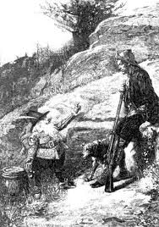
He made signs to Rip to help him carry the barrel.

Slide 17
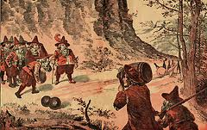

When Rip tried to help him the old man caught his hand tightly, and took him to a place where some more men were playing the game of nine pins.

Slide 18
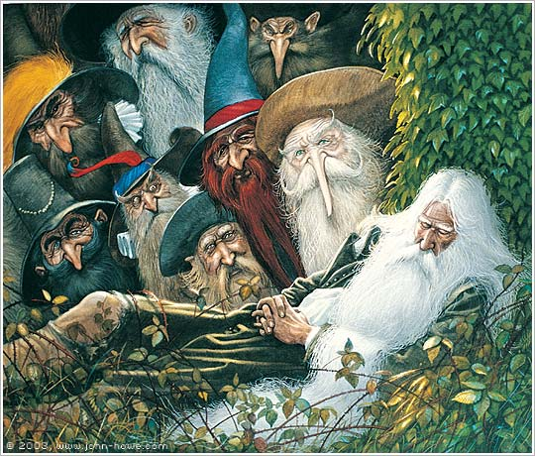
The old men who were playing nine pins looked alike but they had beard of different colours and shapes.

Slide 19
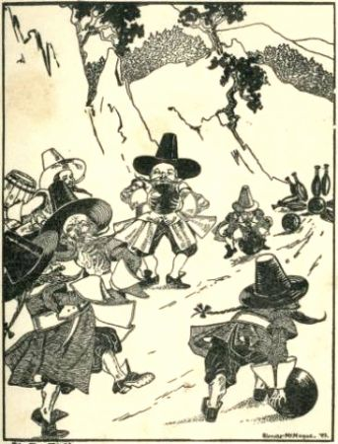
Although they were playing a game, they were silent and serious. The only sound
that was heard was of the balls.

Slide 20
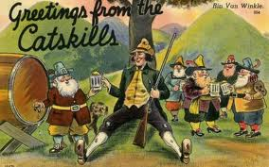
When they saw Rip and his companion they stopped playing and stared at Rip with a fixed gaze. Rip was frightened.
The old man with the barrel, emptied the contents from it into glasses and
asked Rip to drink it.

Slide 21
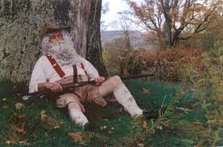
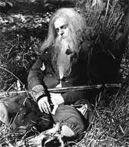
Rip was so frightened and thirsty that he drank as many glasses as the old man gave him. After that Rip went into a deep sleep.

Slide 22
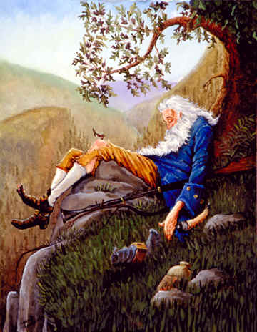
Zzzz….When Rip woke up he wondered if he had slept the whole night.

Slide 23
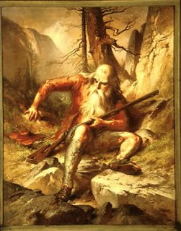
He called out for wolf but he was not found anywhere. He was surprised to see a long gray beard. He started descending the mountain to return to his village.
Wolf..
Wolf..

Slide 24
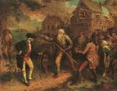

Do you think the villagers recognized him?

Slide 25
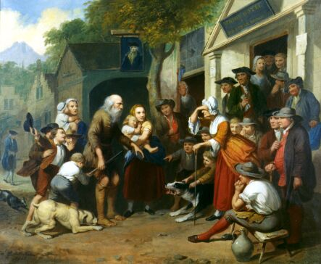
At last an old woman recognized him.

Slide 26
Answer the questions
What kind of a man was Rip Van Winkle?
Why did the children cry with joy when they saw Rip Van Winkle?

Slide 27
To avoid work where did he go away?
Who did he meet there?
What made him sleep ?How long did he sleep?
How was he when he woke up?

Slide 28
FUN WITH
NEW WORDS AND PHRASES
IDLED AWAY
CONSTANT
COMPANION
REALISE
BARREL
CONTENTS
DESCEND

Slide 29
INSERT THE RIGHT WORDS
RAJU ____________ THE HOLIDAYS WITHOUT DOING MUCH WORK.
A DOG IS A GOOD ___________.IT NEVER LEAVES ITS MASTER.
HER PUP IS HER ___________
COMPANION

Slide 30
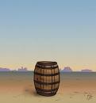
I _______________ I SHOULD NOT WASTE MY TIME.
THE __________ OF THE ___________ MADE EVERYONE CURIOUS.
I ____________ from the hill and went into the village.

