Slide 1

Customer Behavior Project Report
An end-to-end analysis of customer shopping behavior using Python for data cleaning, SQL for business analysis, and Power BI for interactive dashboard visualization.

Slide 2
Problem & Objectives
The company seeks to understand consumer shopping behavior across demographics, product categories, sales channels, and seasonal patterns to improve satisfaction and business performance.
01
02
03
Analyze purchasing patterns
Identify top-performing categories
Study discount impact on sales
04
05
Compare online vs. offline sales
Build an interactive Power BI dashboard

Slide 3

Dataset & Tools
Dataset Overview
3,900 transaction records covering customer demographics, purchase amounts, product categories, discounts, payment methods, sales channels, and ratings.
Tools Used
Python (Pandas, NumPy) — Data cleaning
SQL — Business query analysis
Power BI — Dashboard visualization
Jupyter Notebook — Development environment

Slide 4
Data Cleaning & Preprocessing
Structure & Stats
Missing Values
Used df.head() and df.describe() — mean purchase $59.76, avg rating 3.79, age range 18–70.
Only 37 nulls in Review Rating — replaced with median value.
Standardization
Feature Engineering
Column names lowercased with underscores; redundant promo_code_used removed (identical to discount_applied).
Created age_group via pd.qcut() (Young Adults, Adults, Middle-aged, Seniors) and converted purchase frequency to day-based values.

Slide 5
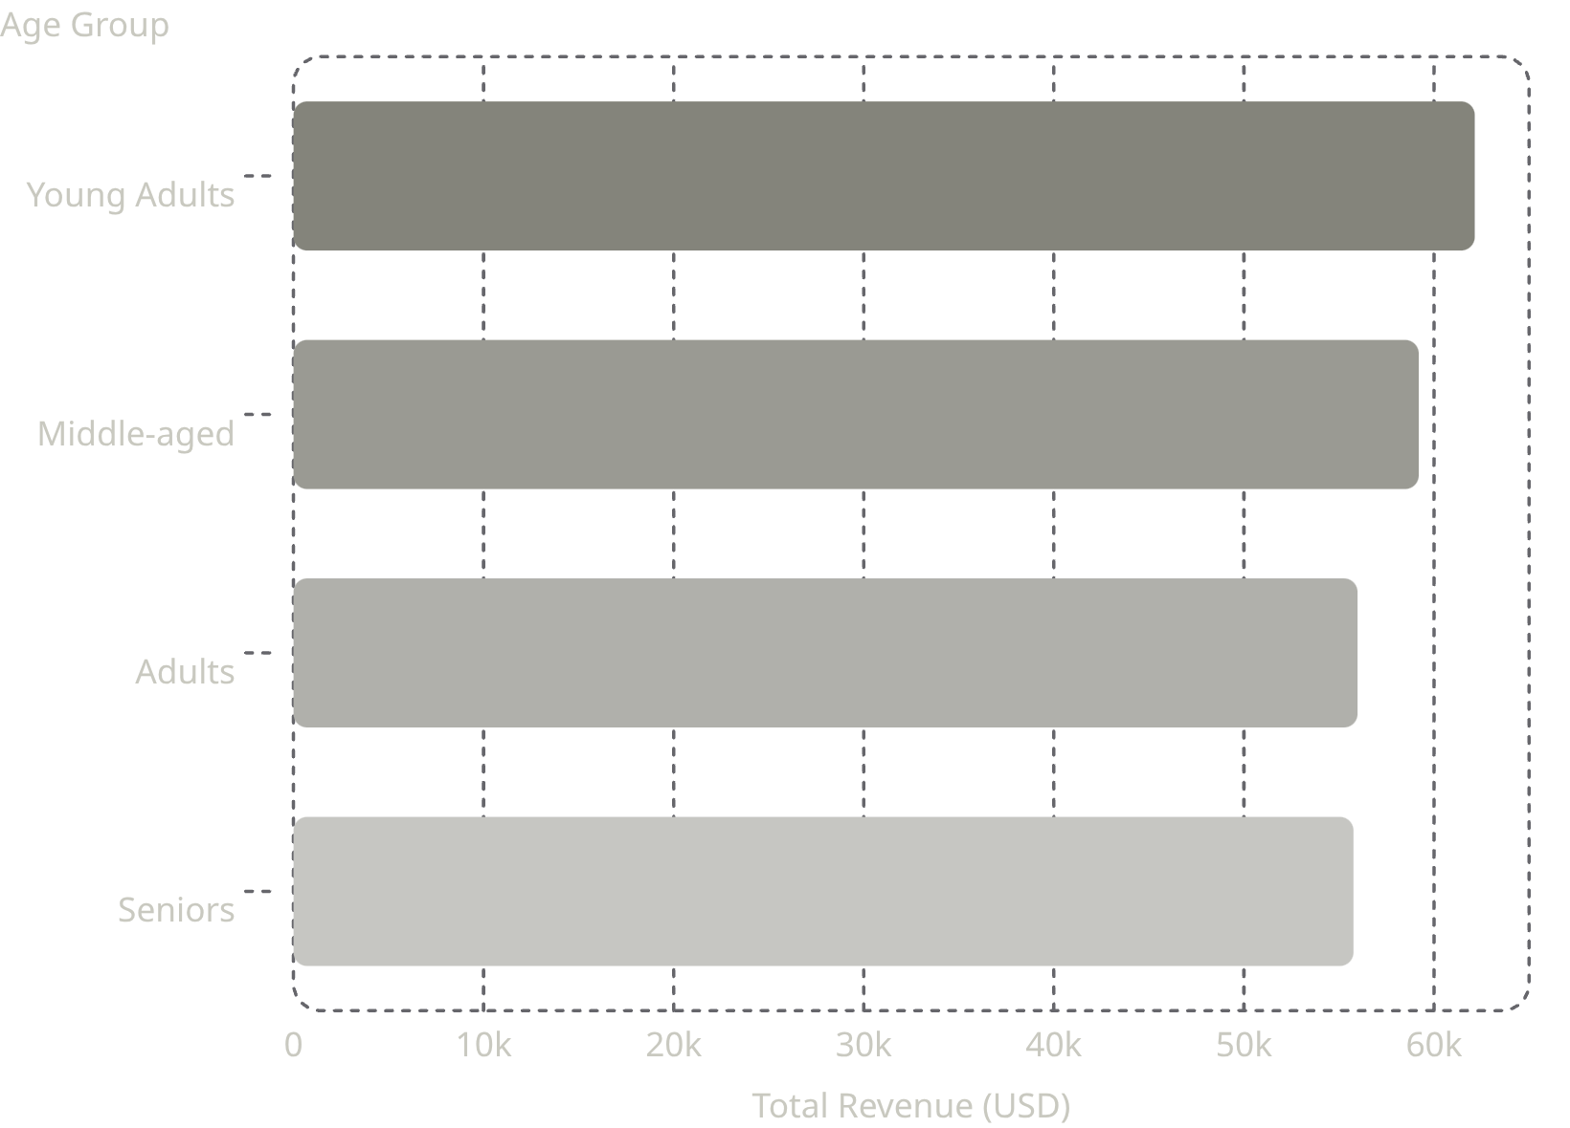
SQL Analysis: Key Findings
Top Insights
Young Adults generated the highest revenue ($62,143)
Clothing was the top category by purchase amount
Only 1,053 subscribers vs. 2,847 non-subscribers
3,116 loyal customers (5+ previous purchases)
Express shipping averaged $60.48 vs. Standard $58.46

Slide 6
Top Products & Categories
Highest-Rated Products
Most Discounted Products
Product
Avg Rating
Product
Discount Rate
Gloves
3.86
Hat
50.00%
Sandals
3.84
Sneakers
49.66%
Boots
3.82
Coat
49.07%
Hat
3.80
Sweater
48.17%
Skirt
3.79
Pants
47.37%
Clothing dominated top purchases across all categories — Blouse, Pants, and Shirt led with 169–171 orders each.

Slide 7

Power BI Dashboard
3.9K
$59.76
Avg Purchase
Total Customers
3.75
Avg Rating
Interactive filters for Gender, Age Group, and Subscription Status enable dynamic, segment-level analysis with cross-visual filtering.

Slide 8



Dashboard Visualizations
Subscription Distribution
Purchase by Category
Revenue by Age Group
Donut chart showing subscribed vs. non-subscribed customer proportions.
Bar charts comparing total spend across Clothing, Accessories, Footwear, and Outerwear.
Horizontal bar chart revealing Young Adults as the top revenue-contributing demographic.

Slide 9
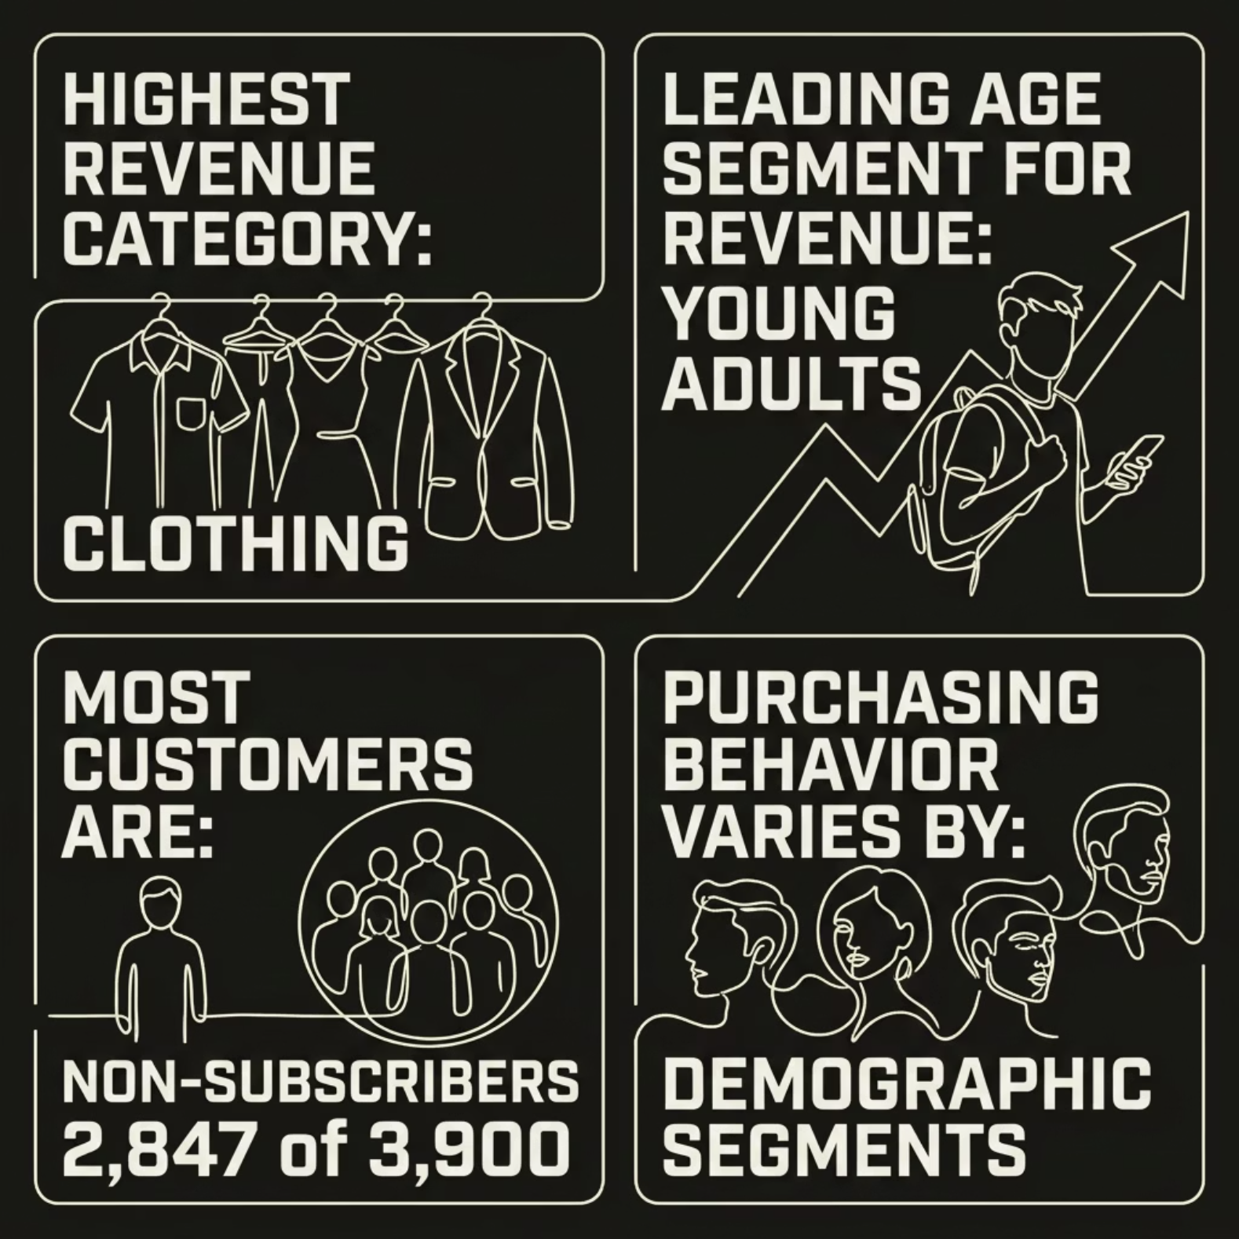

Key Insights
What the Data Reveals
Clothing led all categories in total purchase amount
Young Adults outpaced all age groups in revenue
73% of customers are non-subscribers — a major growth opportunity
Accessories and Footwear showed moderate but consistent performance

Slide 10

Recommendations & Conclusion
Prioritize Clothing
Focus marketing and inventory on the highest-revenue category.
Target Young Adults
Launch personalized campaigns and offers for this top-spending segment.
Boost Subscriptions
Introduce loyalty rewards and membership benefits to convert non-subscribers.
Improve Low Performers
Use discounts and promotions to lift Accessories and Footwear sales.
This project successfully combined Python, SQL, and Power BI to uncover actionable trends in demographics, categories, and purchasing patterns — enabling data-driven business decisions.

