Slide 1
Design and Verification of Asynchronous FIFO
Spring 2025
ECE-593 Fundamentals of Pre-silicon Validation
GROUP 10
Aravindh Nanjaiya Latha – aravindh@pdx.edu
Rishi Gunda – rgundapdx.edu
Rohit Bonigala – rohit@pdx.edu
Shreya Umesh Shetty – shreyau@pdx.edu
Instructor : Venkatesh Patil

Slide 2
Table of contents
Contributions of the Team
Asynchronous FIFO
DUT Specification and Design
Verification Environment
Tools
Verification components
Simulation and Coverage results
Test matrix
Bug Injection
Challenges
Conclusion
Future work
References

Slide 3
Contributions of the Team
Name | Contribution
Aravindh Nanjaiya Latha | UVM driver, sequencer and sequence item coding. RTL code modification. UVM reporting and bug injection.
Rishi Gunda | UVM monitor, environment and scoreboard development. RTL code binary to gray code implementation.
Rohit Bonigala | UVM agent, transactions and coverage classes. RTL write and read pointers, increment logic implementation.
Shreya Umesh Shetty | UVM top, interface and test development. Flags for write_full, write_halffull, write_threefourths_full, read_empty development with logic.

Slide 4
Asynchronous FIFO
An asynchronous FIFO (First-In-First-Out) system is designed to handle data transfer between different clock domains, ensuring correct data transmission even when the input and output devices operate at different clock speeds.
The design typically involves a memory array, write pointer, and read pointer, each managed in separate clock domains to prevent timing issues and ensure data integrity.

Slide 5
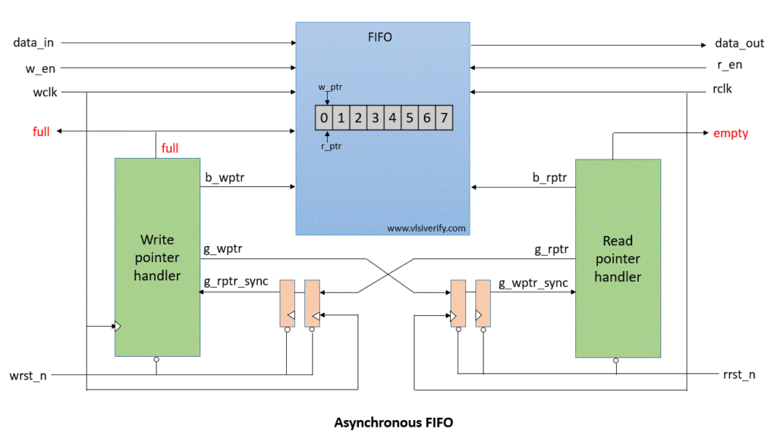
BLOCK DIAGRAM

Slide 6
DUT Specification
Write clk1 freq = 250MHz
Read clk2 freq = 125Mhz
Write Burst size = 256 Bytes
FIFO Depth = 128 (2^7)
Data width = 8 - bit

Slide 7
Design
In an asynchronous FIFO, the write pointer always points to the next word to be written, while the read pointer always points to the current FIFO word to be read. This setup allows the receiver logic to read data without multiple clock periods to fetch the data word.
Use of Gray code and then compare the pointers MSB bit to check the condition
On reset, both write and read pointers are set to zero
After writing the to the memory location that is pointed, write pointer will be incremented to point next location
After reading from the memory location that is pointed, read pointer will be incremented to point next location

Slide 8
Full & Empty Conditions
The FIFO is empty when the read and write pointers are both equal.
A FIFO is FULL when the pointers are again equal, that is, when the write pointer has wrapped around and caught up to the read pointer.

Slide 9
Tools Used
Questa-SIM 64 -2024.2
UVM library - UVM_ROOT.SVH files

Slide 10
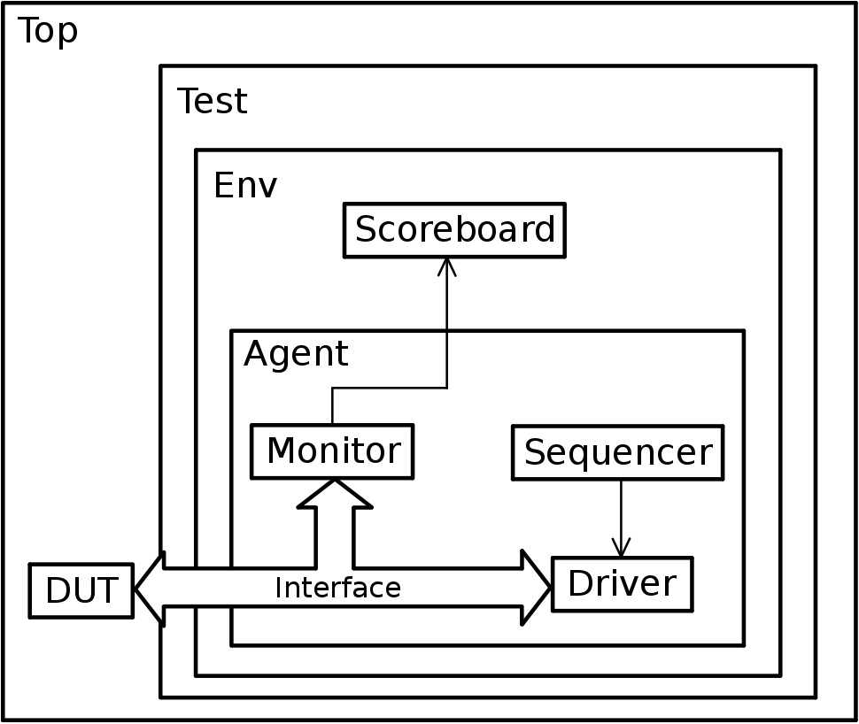
Verification Environment

Slide 11
Transaction
Transactions are data objects in UVM that represent the information exchanged between the testbench and the DUT.
They are typically implemented as SystemVerilog classes, encapsulating fields like data, address, or control signals.
Sequence_item
A sequence is a UVM component that generates a series of transactions to stimulate the DUT.
It defines the high-level test scenarios or patterns, often using randomization to create varied stimulus.
Sequencer
A sequencer is a UVM component that generates a series of transactions to stimulate the DUT.
It defines the high-level test scenarios or patterns, often using randomization to create varied stimulus.
Driver
The driver is a UVM component that translates transactions into signal-level activity on the DUT’s interface.
It drives the DUT’s inputs by applying the transaction data to the interface signals according to the protocol timing.
Monitor
The monitor observes the DUT’s interface signals, captures activity, and converts it into transactions or events for analysis.
It operates passively, meaning it does not drive the DUT but only collects data.

Slide 12
Agent
The agent is a container class in UVM that encapsulates the driver, monitor, and sequencer (which manages sequence execution).
It can operate in active mode (with driver and sequencer) or passive mode (monitor only).
Scoreboard
The scoreboard is a UVM component that checks the correctness of the DUT’s behavior by comparing expected results (from a reference model or prediction logic) with actual results (from the monitor).
Coverage
Coverage in UVM refers to the collection of metrics that measure how thoroughly the DUT has been tested.
This includes functional coverage (verifying design intent, such as state transitions or scenarios) and code coverage (ensuring all lines, branches, or expressions in the RTL code are exercised).
Environment
The environment is a UVM container class that encapsulates multiple agents, scoreboards, and other components to form a complete testbench.
It provides a centralized structure for configuring and connecting verification components.
Interface
The interface in UVM is a SystemVerilog construct that encapsulates the physical connections between the testbench and the Design Under Test (DUT).
It defines signals, clocks, and communication protocols, providing a clean abstraction for connecting the testbench to the DUT.

Slide 13
Test
The test is a UVM component that defines the specific verification scenario to be executed.
It configures the environment, selects sequences, and sets parameters like randomization constraints or test duration.
Top Module
The top module is the highest-level module in the UVM testbench, connecting the DUT, interfaces, and the UVM test environment. It instantiates the DUT, binds interfaces, and starts the UVM test.

Slide 14
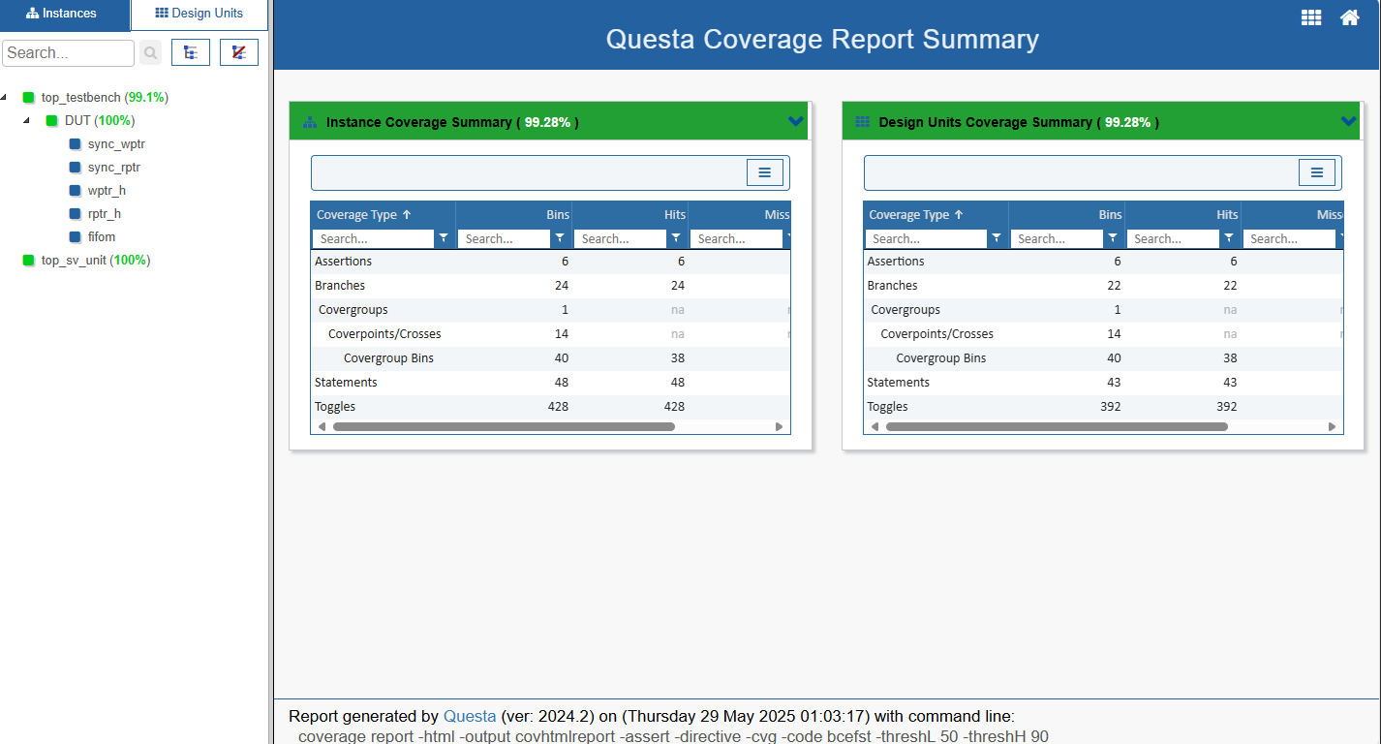
Coverage Results:

Slide 15
Test Matrix
Testing Strategies Testing Methods:
Whitebox testing will be used to ensure comprehensive coverage, focusing on internal logic and code paths.
PROs and CONs:
White-box testing PROs: Allows testers to examine the internal structure and logic of the code, ensuring all paths are tested
White-box testing CONs: Requires detailed knowledge of the codebase, leading to longer testing times.
Test case scenarios
Testing Methodology: A mix of directed and constrained-random testing will be employed. Constrained-random testing will focus on exploring corner cases and potential boundary conditions.
Driving Methodology: Test generation methods will include a combination of directed testing for specific scenarios and constrained-random testing for broader coverage.
Checking Methodology: Checking will involve comparing expected outputs with simulated results. coverage metrics will be used to ensure the design meets specified criteria.

Slide 16
Challenges
Comparison of read pointer and write pointer to check the empty and full conditions.
Implementing the Whalf_full and Wthree_fourths_full
Synchronization of transactions in the test bench
Improving Functional Coverage after it stagnated.
Integrating the classes and maintaining hierarchy.

Slide 17
Conclusion
This project designed and tested an asynchronous FIFO with accurate status flags.
All features were thoroughly verified using assertions and UVM testbench methods.
The FIFO works reliably across different clock domains and is easy to integrate.
Overall, the project met its goals and is ready for use in digital systems.

Slide 18
Future work
Verification Enhancements and including machine learning-based verification, to enhance the effectiveness and efficiency of the verification process.
Using more assertions to get certainty that the design is functioning correctly.

Slide 19
References
S. Cummings, "FIFOs: Fast, predictable, and deep (Part II)," in Proceedings of SNUG, 2002.
http://www.sunburst-design.com/papers/CummingsSNUG2002SJ_FIFO2.pdf
2.ASIC-World FIFO Examples
http://www.asic-world.com/examples/verilog/fifo.html
3. VLSI Verify
https://vlsiverify.com/verilog/verilog-codes/asynchronous-fifo/

Slide 20
Thank You

