Slide 1
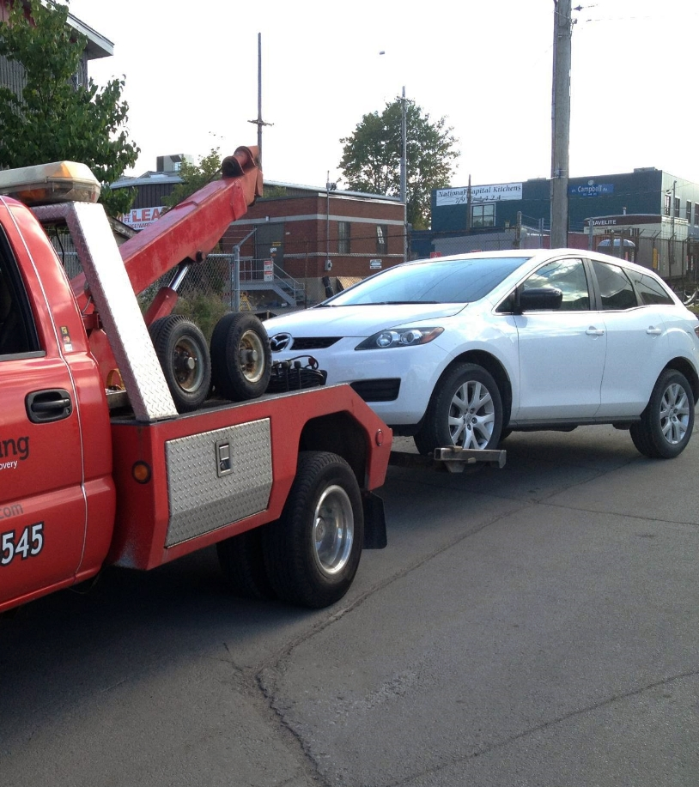
HARISH KUMAR. M - 18MIS1031
HARSHIT. D - 18MIS1038
BHUVANESWARAN. B - 18MIS1043
ARAVINDHAN. V - 18MIS1052
DHANUSH. S - 18MIS1083
Technical Answers for Real World Problems
SWE3999
ROAD SIDE ASSISTANCE
APPLICATION

Slide 2
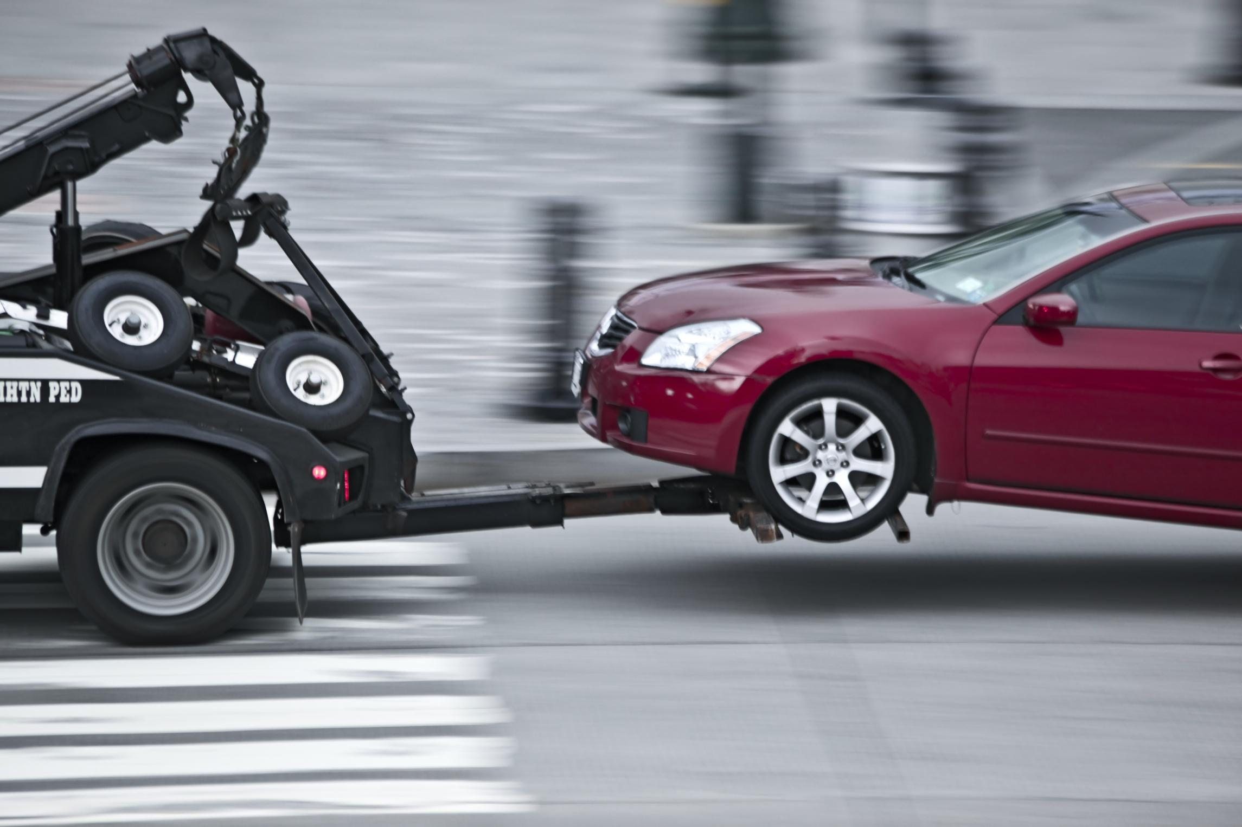
Introduction
Road trip is always fun and enjoyable by you get to know many things. You might also plan and make all precaution to make the journey safe and smooth. However, in the unfortunate & unforeseen event of a breakdown or road accidents what is needed is immediate help. Our goal is to ensure that you get prompt assistance during such a situation. To make this possible we are doing an Android Application for user assistance purpose which provides assistance to the passengers during their road trips. We already know Android is the Trending Technology. In our application we are integrating many possible assistances that can be provided during the trip. People with android phones and tablets can install our application and can have access to our assistance service when needed.

Slide 3

Abstract
Our Road side assistance application is going to be a good solution for the people who seek help in the remote locations with mechanical issues of their vehicle. Users of the On Road Vehicle Breakdown Application will be the registered public and they will be getting connected with the particular mechanic through the trustworthy application system. In an existing system there are users who have their own mechanic database which is very minimal. And also, they have no idea if their vehicles are broke down or had any mechanical issue in remote locations or any long distant locations from their known mechanic shops. In a proposed the users of Road side assistance system can search for list of mechanic at any location or the nearby locations which will help them in an unexpected situation raised by the mechanical issues of their vehicles.

Slide 4

Modules
User needs to register himself/herself to use our Roadside assistance application. We are using 12 modules in our application;
Login
Sign up
Home
Services Provided
About us
Testimonials
Contact us
Affordable and Efficient Towing Services
24x7 Roadside Assistance
Lost/Locked Keys
Fuel Problems
Tire Assistance

Slide 5
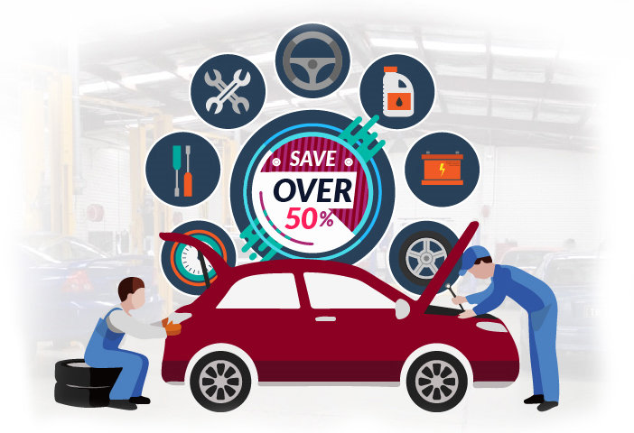
Services Provided
Users can see our services that we will provide solution to our problems in emergency situation. They can enquire to us during such situations:
24 x 7 Roadside Assistance
Lost / Locked keys
Fuel Problems
Tyre Assistance

Slide 6
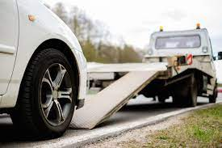
24 x 7 Roadside Assistance
Car breakdown is never planned, and during any roadside emergency the car owner is helpless in terms of getting his car repaired to get it moving.
Our Roadside Assistance Application provides 24x7 emergency support in the event of any mechanical/electrical breakdown or traffic accident of the vehicle. This ensures service to the customer in the event of a car-breakdown. Roadside Assistance package provides a range of services and solutions during unforeseen events of breakdown or emergencies. We will be providing Towing Vehicle in case is not solved at that situation.

Slide 7
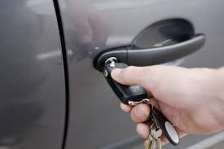
Lost/Locked Keys
Lost keys is not major problem that every users face. In case user get locked in or out of your car or lose your car keys, If we could replace key or we offer towing service to user till their destination. With our expertise in this domain, we are engaged in offering the best and reliable towing services. Our Towing vehicle will arrive immediately to customers location and provide solution as soon as possible.

Slide 8
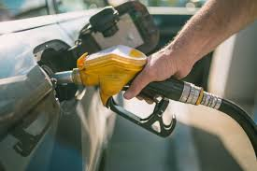
Fuel problems
In case there is any fuel leakage or run out of fuel in user’s vehicle and find any solution at the emergency situations. Users can contact us through our application. Problems we can solve immediately;
Out of fuel in a remote location
Out of fuel and stuck on a busy highway
Out of fuel and the weather is very bad
We will arrange fuel for you to help you drive to the nearest fuel station and get to your destination as soon as possible.

Slide 9
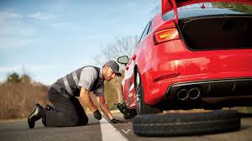
Tyre Assistance
Flat tyre repair or Puncture repair is a key service for our roadside assistance application. If user’s vehicle tyre is puncture, they can contact us through our application we will provide help as soon as possible. We will provide nearby mechanic’s location. We will replace your vehicle’s flat tyre with our spare ones in case you do have enough spare tyres. If you don’t have flat tyres we will send towing vehicle to user location.

Slide 10

Conclusion
Road assistance system application can be added with more features like live weather reports and availability ambulance services, hotel services based on the user’s location will ease. By adding more inputs for the services like Tow and Flat tyre providers, the precision and availability of the data for requested details can be improved. Current system is designed and developed in android technology, which can be done in other technologies like Macintosh and windows will make more reach to users.

Slide 11

THANK YOU

