Slide 1
Border Alert System for Fishermen
S. Aravindha Shiva(13BCS110)
A. Murali Krishnan(13BCS117)
T. Siva Prasanna(13BCSL18)
Guided by
Mr. C.Balasubramanian
Assistant Professor (Sr.Grade) / CSE
CSE

Slide 2
PROBLEM STATEMENT
The sea border between the countries is not easily identifiable, which is the main reason for this cross border cruelty. There are systems in place to track and monitor the ships but when it comes to boat, a system has to be created to track and give alert to fisherman to prevent them from crossing the border saving their lives.
CSE

Slide 3
OBJECTIVES
To track the position of fisherman who venture out into the sea.
To give timely alert to them before they cross their country border and thus saving them from being caught.
To reduce the speed of the engine while the boat nears the restricted zone and to stop the engine on entering the restricted zone.
CSE

Slide 4
OUTCOMES
Fishermen can now know the location through GPS when they go into the sea.
The fishermen can now feel safe as they get alerts when they cross the restricted region
The loss of life due to the border violation can be avoided and the relationship between countries is improved
The tracking of boat in shore through radio communication between boat and shore gives central tracking of all the boats.
Help can be sought in case of emergency through shore which can give details about nearby boats.
CSE

Slide 5
EXISTING SYSTEM
GPS tracks the real time location of boats and displays them on electronic map but it doesn’t compare latitude and longitude and gives the alert messages. So in the existing system, the border of the country is not distinguished and hence there is a possibility for fishermen to cross the boundary.

Slide 6
PROPOSED SYSTEM
The proposed system includes base features of the existing system that retrieves the current location of boat using GPS.
The region is divided into 3 zones- Safe zone, restricted zone and danger zone.
The speed of the boat is controlled and it gradually reduces in restricted zone and the engine is stopped inside danger zone that is close to maritime boundary.
Using mobile signals the location is continuously broadcasted to shore where central monitoring of all boats is done. So in case of any mishap in sea in predicted fisherman can be alerted and made to come back.

Slide 7
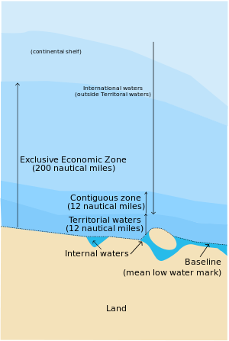
PROPOSED SYSTEM
Fig 1.1 International Maritime Boundary in nm
Courtesy: https://en.wikipedia.org/wiki/Maritime_boundary

Slide 8
PROPOSED SYSTEM
Safe zone
(11 nm)
Restricted
Zone
(0.5nm)
Danger zone
(0.5nm)
1 Nautical mile= 1.15078 mile
In the danger zone, the boat is allowed to travel 500meters taking into account the turning radius of boat and its length
A tablet installed on the boat gives the position of fishermen graphically using a electronic map that is divided into above zones.

Slide 9
BASE PAPER
Design of border alert system for fishermen using gps (March-April 2014)
D. Arunvijay, E. Yuvaraj
The GPS Modem will continuously give the signal which determines the latitude and longitude and indicates the position of the fishermen to them.
An EEPROM is used to store the data, received by GPS receiver.
The region is divided into 4 layers. Alarm is generated on entering the restricted zone and it continues until the fisherman comes back to safe zone.
An LCD display is used to display the latitude and longitude and GSM module sends alert message to phone.
CSE

Slide 10
LITRARURE SURVEY
GPS-Based Vessel Position Monitoring and Display System (July 1990)
- James C.Reynolds, Robert P. Denaro and Rudolph M. Kalafus
The vessel monitoring workstation is configured with a variety of digital maps, which displays any one map based on operator on shore command or based on the selected vessel.
The workstation provides navigation status, range, geographic locations, map manipulation, data archival and current date and time.
The database of operator entered navigation hazards used aboard the vessel allows the hazard proximity alerts independently.
The workstation database consists of every ship entry, nearest coast guard station, harbour etc.
INMARSAT is used for ship to shore communication.
CSE
Notes:
10

Slide 11
LITRARURE SURVEY (Contd.)
Merits:
It presents a global view
Every ship whether monitored or not has an entry in database.
Demerits:
Communication is costly

Slide 12

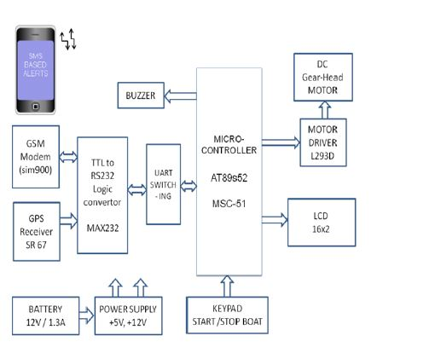
LITERATURE SURVEY
Fishermen nautical border alert system (March 2016)
- Aishwarya Dalvi, Ridhee Borad, Nidhi Dawda, Niraj Bangera
GPS is used to retrieve location. Latitudes and longitudes are compared and alert message is displayed.
GSM modem is used to transmit messages to shore which can be used to manage the traffic.
Fig 1.2 System design for border alert system
CSE

Slide 13
LITERATURE SURVEY
Location Based System Using GPS-Fishermen SMS Alert System (September 2015)
M.Vivekanadan, Dr. S.Kanaga Suba Raja, V.Balaji
Border is pre defined and stored in the micro controller memory.
This system provides an indication to both fisherman and to coastal guard.
Website monitors global earthquake activity in real time and delivers vital information.
The arrival of other natural disaster is also monitored.
CSE

Slide 14
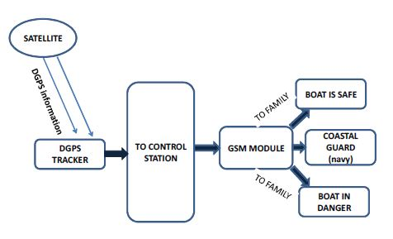
LITERATURE SURVEY
Border alert and smart tracking System with alarm using dgps and Gsm (April 2014)
NaveenKumar.M, Ranjith.R
This system uses a DGPS instead of GPS for improved location tracking with greater accuracy.
In addition to transmitting messages to base station, this system also gives information and alerts to family members.
Fig 1.3 System design for border alert and tracking system
CSE

Slide 15
LIST OF MODULES
Identification of location of boat through GPS.
Latitude longitude comparison for various zones (Tracker module).
Connecting tablet to get location ( Bluetooth module).
App in tablet ( E-map, Seek help, Notification module).
Web site on central station to track and alert all the boats.
CSE

Slide 16
SYSTEM DESIGN
Boat Details
Tablet
Location, Time
E map
Help message
Base Station
Update loc
Location
forward
Seek Help
Service help module
Notifications
Warning, Notification
Bluetooth module
Alert Service
Arduino
Location
Map boats module
GPS Module
Lat,Lon
Tracking Module
Boat info
Location
Alert
Engine
Alarm Module
Alert
Buzzer

Slide 17
Database Design
Tracking_details :
Boat_id | Boat_name | Boat_type | Latitude | Longitude | Fishermen_id
Fishermen_details :
Fishermen_id | Fishermen_name | Phone | Address | State | Alt_phone

Slide 18
Hardware Requirements
Approximate cost estimation as follows
GPS Module
Bluetooth Module
Tablet/ Smart phone
Microcontroller
CSE
18

Slide 19
Definition and Description
Module 1:Current Location Tracking
Definition:
This module is used for the tracking of the motion of the boat and giving continuous location co-ordinates to the fisherman.
Description :
The GPS module gets the current position latitude and longitude co-ordinates by a triangular algorithm .
The output from the GPS module consists of the different header formats(NMEA standards) which contains the latitude and longitude of the current position.

Slide 20
Definition and Description (contd.,)
Displaying the position
Definition:
This module is used by the fisherman for knowing their current location in a display device.
Description :
The arduino receives the data from the GPS module as input.
The arduino separates the latitude and longitude from the different header data and displays the location to the user.
By knowing the current location the fisherman gets accurate information whether he has crossed the border or not.

Slide 21
Definition and Description (contd.,)
Module 2 : Connecting tablet to get the location(Bluetooth module)
Definition:
Communication between arduino and the phone.
Description:
The latitude and longitude are transferred from arduino board to phone of the fisherman through Bluetooth.
The received co-ordinates are displayed in E-map.

Slide 22
Definition and Description (contd.,)
Module 3 :Latitude and Longitude comparison for various zones
Definition:
This module compares the current position co-ordinates with the boundary location.
Description:
The maritime boundary of each country is stored in database.
The received latitude and longitude from the Bluetooth module is checked against the one stored in database.
This comparison will be used for controlling purposes.

Slide 23
Definition and Description (contd.,)
Module 4 : App in tablet (E-map, seek help, Notification module)
Definition:
An app is built for the fisherman to get his location information displayed in a map, also he can ask for help from the central station and get notified about the nearby boat information.
Description:
The current position is displayed in E-map for easy reference also the various zones like safe, restricted and danger zones are indicated.
In case of any need for the fisherman he can send message to the central station to seek help.

Slide 24
Definition and Description (contd.,)
Module 5 : Website on central station to track and alert all the boats
Definition:
A website is created showing the location of all the registered boats and any message can be sent to those boats in case of any natural calamities.
Description:
A website is created using PHP for tracking the information about the registered boats.
Also information can be sent to these boats in case of any natural calamities.

Slide 25
Modules in the System
Identification of location of boat through GPS.
Website on central station to register the boats.
Alert all the boats from the base station.
App in tablet ( E-map, Notification module-Message).
Bluetooth to interface Arduino and phone.

Slide 26
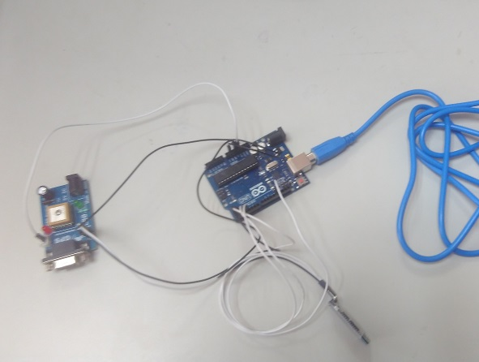
IMPLEMENTATION
Fig 1.3 Design of system in boat

Slide 27
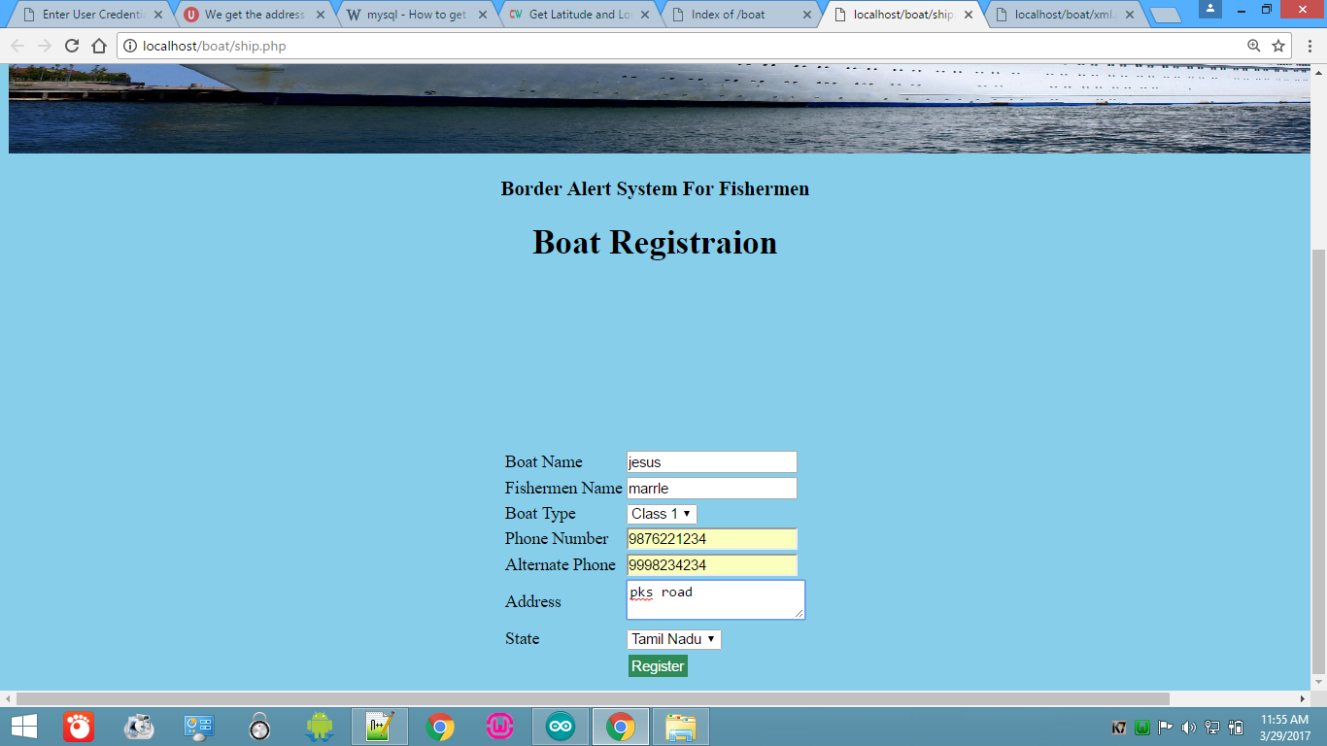
RESULTS
Fig 1.4 Registration page for fishermen

Slide 28
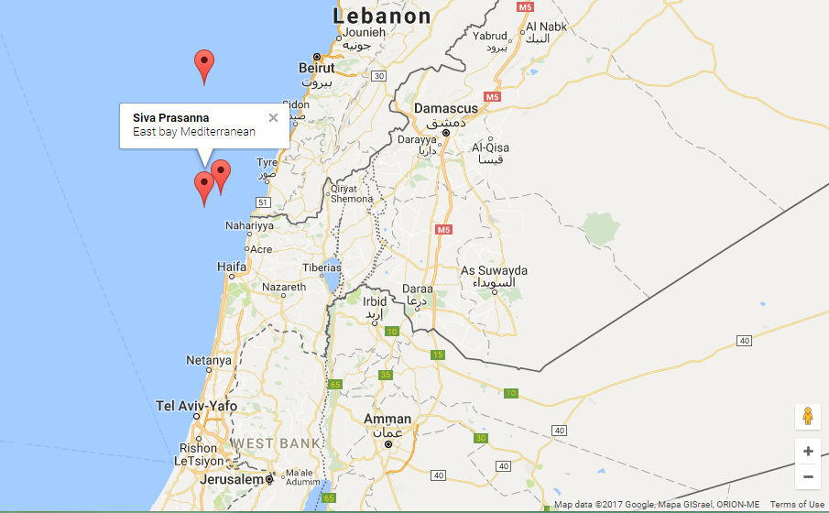
RESULTS(CONTD.,)
Fig 1.5: Displaying Location of boat in base station

Slide 29
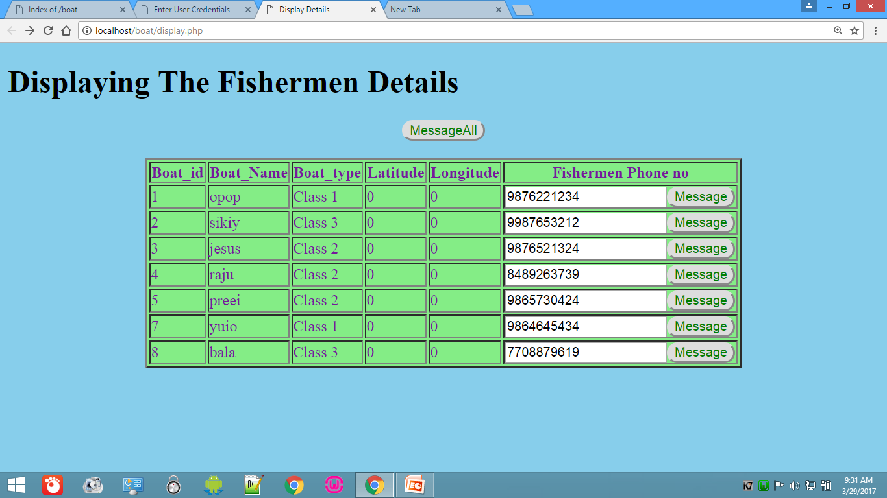
RESULTS (CONTD.,)
Fig 1.6: Base station tracking all fishermen

Slide 30
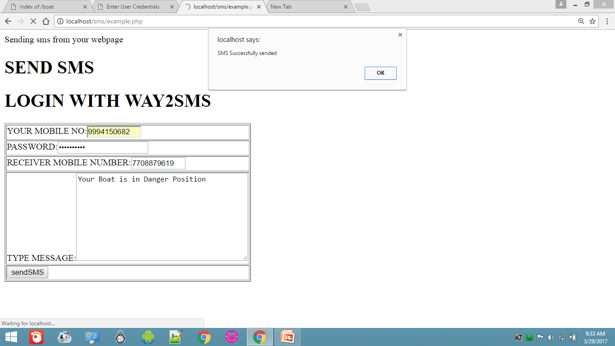
RESULTS (CONTD.,)
Fig 1.7: SMS portal to alert the fishermen

Slide 31
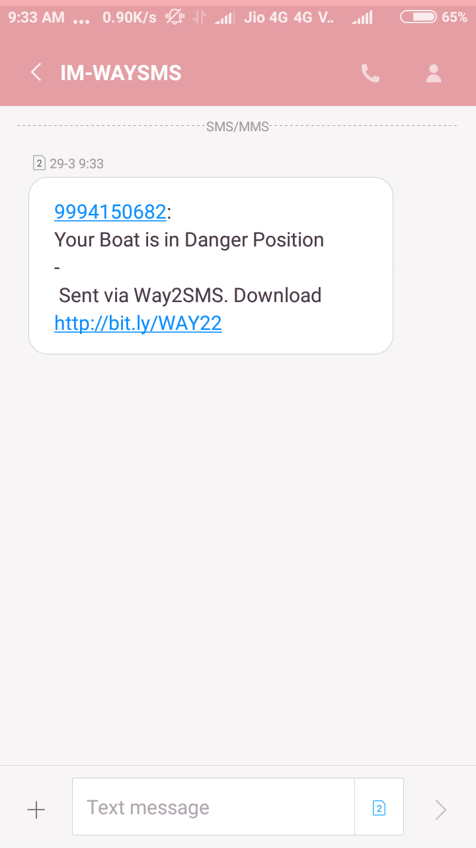
RESULTS (CONTD.,)
Fig 1.8: Fishermen getting alert message

Slide 32
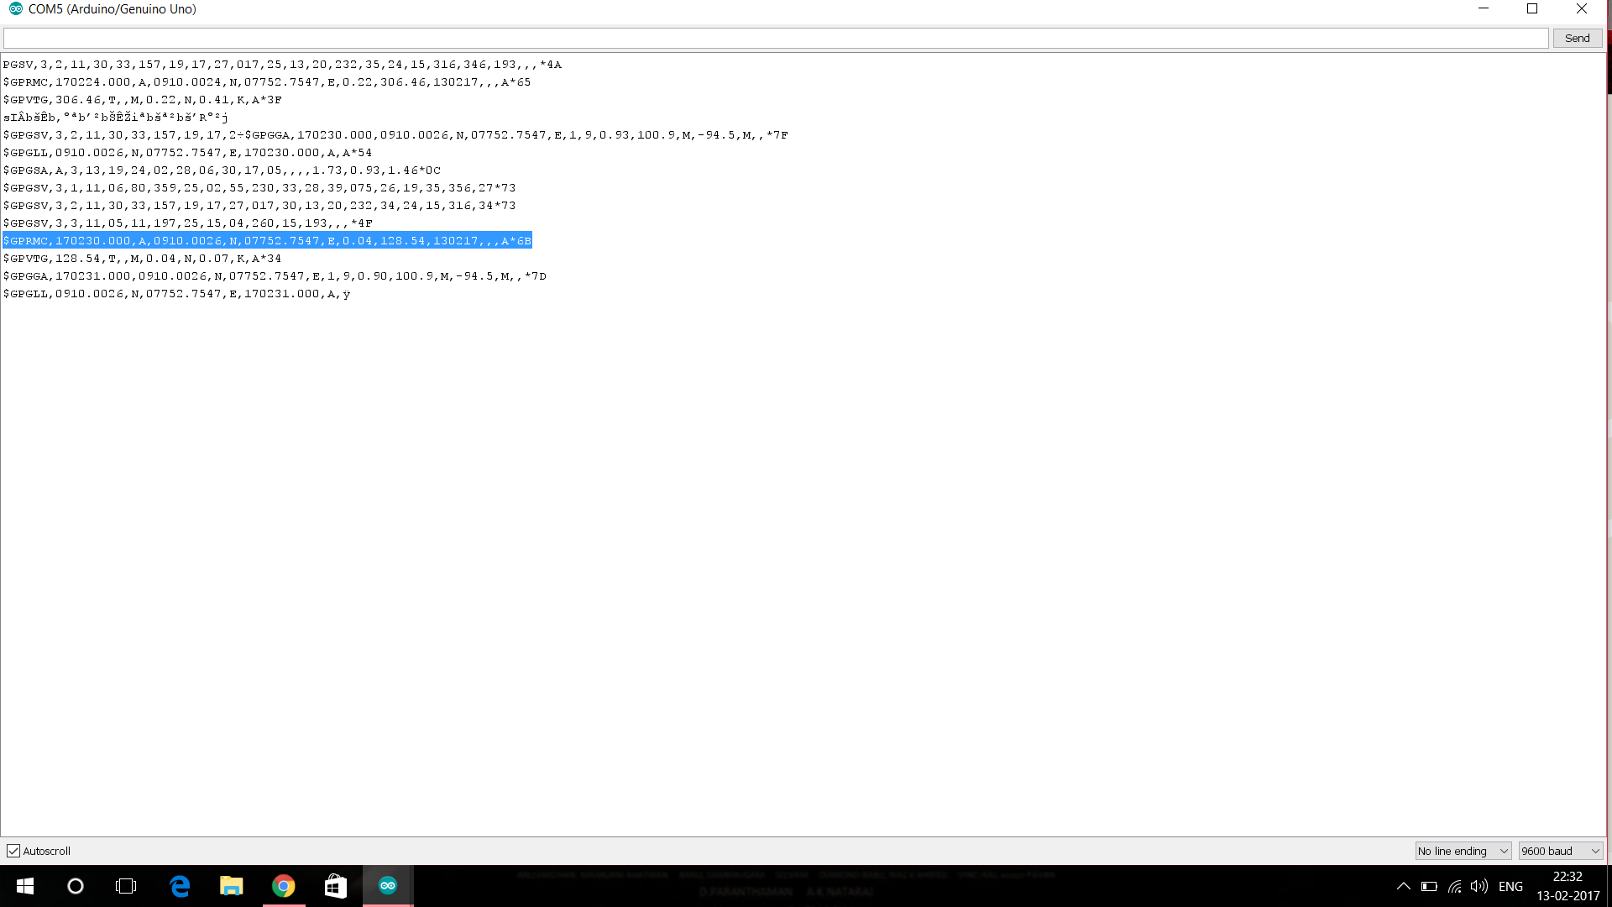
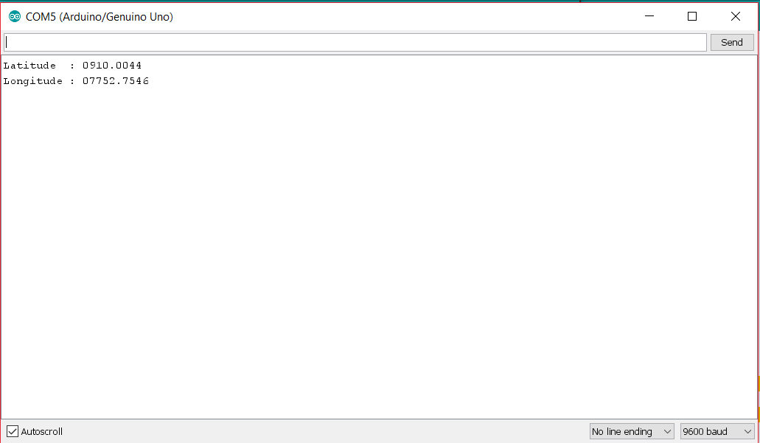
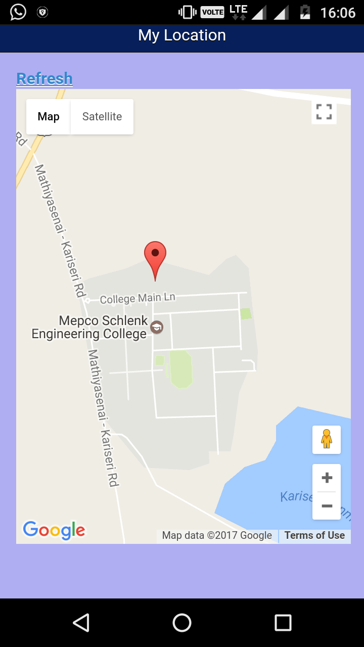
RESULTS (CONTD.,)
Fig 1.9: Latitude and longitude from GPS
Fig 1.10: Extracted latitude and longitude
Fig 1.11: E-map displaying the position of fishermen

Slide 33
CONCLUSION
Thus the valuable life of fisherman is saved by tracking his location.
In case of any emergencies base station alerts the fishermen making him to retreat saving him from danger.
Fishermen can monitor their position real time.

Slide 34
FUTURE SCOPE
The efficiency of the system can be increased by using differential GPS which provides more accurate information on the location.
Web services that tracks the hazards in sea and that monitors the weather can be integrated that can send alerts to fishermen real time.
Weather API
Weather Info
Base station
Notification
Fishermen alerted

Slide 35
Economy
Component Price
Arduino Uno 450
GPS module 1200
Bluetooth 300
------------
1950
-----------

Slide 36
REFERENCES
Fishermen nautical border alert system (March 2016)
Aishwarya Dalvi, Ridhee Borad, Nidhi Dawda, Niraj Bangera
International Journal of Advanced Research in Computer Engineering & Technology (IJARCET)
Location Based System Using GPS-Fishermen SMS Alert System (September 2015)
M.Vivekanadan, Dr. S.Kanaga Suba Raja, V.Balaji
International Journal of Innovative Research in Science, Engineering and Technology
Border alert and smart tracking System with alarm using dgps and Gsm (April 2014)
NaveenKumar.M, Ranjith.R
International Journal of Emerging Technology in Computer Science & Electronics (IJETCSE)
CSE
36

Slide 37
REFERENCES
GPS-Based Vessel Position Monitoring and Display System (July 1990)
James C.Reynolds, Robert P. Denaro and Rudolph M. Kalafus
IEEE AES Magazine
Design of border alert system for fishermen using gps (March-April 2014)
D. Arunvijay, E. Yuvaraj
International Journal of Students Research in Technology & Management
CSE
37

Slide 38
Thank You
CSE

