Slide 1
CONCRETE CRACK DETECTION USING DEEP LEARNING TECHNIQUES

Slide 2
Introduction
The project is build on three basic pillars for detecting cracks and we need to understand them to understand the working the project.
The three basic pillars are:
Image Processing
Deep Neural networks
Types of Cracks

Slide 3
Image Processing
Image processing is a method to convert an image into digital form and perform some operations on it, in order to get an enhanced image or to extract some useful information from it.
It is a type of signal dispensation in which input is image, like video frame or photograph and output may be image or characteristics associated with that image.
Usually Image Processing system includes treating images as two dimensional signals while applying already set signal processing methods to them.

Slide 4
Deep Neural Network
A deep neural network is a neural network with a certain level of complexity, a neural network with more than two layers. Deep neural networks use sophisticated mathematical modeling to process data in complex ways.
Many experts define deep neural networks as networks that have an input layer, an output layer and at least one hidden layer in between.
Each layer performs specific types of sorting and ordering in a process that some refer to as “feature hierarchy.”

Slide 5
Concrete Crack
A Crack is a line on the surface of concrete along which it has a split without yet breaking apart.
Hairline, Stepped, Vertical , Horizontal are various kinds of cracks having its own impact on the structure under consideration and can arise due to different kinds of factors like drought, weak foundation, uneven load distribution, ground movement, structure deformation under load ,expansion or contraction of underlying material etc.

Slide 6
Proposed Work
Convolutional Neural Networks:
CNNs, like neural networks, are made up of neurons with learnable weights and biases. Each neuron receives several inputs, takes a weighted sum over them, pass it through an activation function and responds with an output. The whole network has a loss function and all the tips and tricks that we developed for neural networks still apply on CNNs.
Recurrent Neural Networks:
A recurrent neural network (RNN) is a class of artificial neural network where connections between nodes form a directed graph along a sequence. This allows it to exhibit temporal dynamic behavior for a time sequence. Unlike feedforward neural networks, RNNs can use their internal state (memory) to process sequences of inputs.

Slide 7
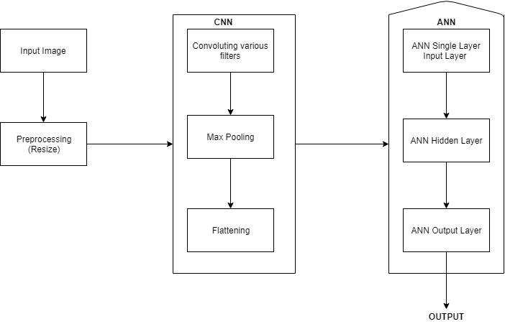
Convolution Neural Networks

Slide 8
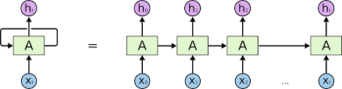
Recurrent Neural Networks

Slide 9
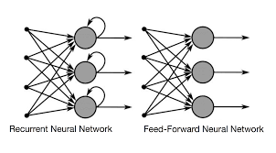
ANN VS RNN

Slide 10
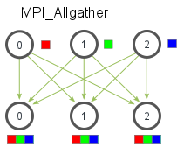
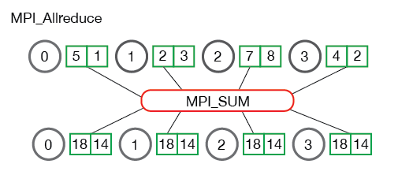
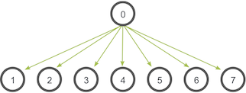
Distributed Training Using Horovod

Slide 11
Result and Discussion
About the Dataset
Performance Analysis
Comparative Analysis
Dataset:
The dataset contains concrete images having cracks. The data is collected from various METU Campus Buildings. The dataset is divided into two as negative and positive crack images for image classification. Each class has 20000 images with a total of 40000 images with 227 x 227 pixels with RGB channels. The dataset is generated from 458 high-resolution images (4032x3024 pixel) with the method proposed by Zhang et al (2016). High resolution images have variance in terms of surface finish and illumination conditions. No data augmentation in terms of random rotation or flipping is applied.

Slide 12
Performance Analysis
We apply two different Neural networks to see which performs better and the thing we notice is that CNN outperforms the RNN by huge margin because the RNN tries to overfit the image dataset.
Performance in all three scenario’s:
ACCURACY | CNN | RNN
Training | 95% | 100%
Testing | 95% | 50%
Prediction | 95% | 45%

Slide 13
Conclusion
This work introduced the implementation of a machine learning-based model to detect cracks on concrete surfaces.
Considering the analysis carried out in our experiments, the use of the convolutional neural network approach proved suitable to train a model with a limited dataset size.
The developed model is limited to a binary classification.
We get a 95% accuracy for prediction and it would be suitable for real-time prediction of cracks in the building if we do an inspection using drone or other means.

Slide 14
Future Work
The present system is designed to classify whether there is crack or not but in future we can design a system which would identify the length and the type of crack the given input belongs.
The application takes a little extra time to process the given image and that wouldn’t be the case if we wish run it in drone which can carry less amount of computational power.
We can build a system which would identity the exact location the crack is present during the inspection of the building.

Slide 15
Reference
[1] Methods for Long-Distance Crack Location and Detection of Concrete Bridge Structures - Youfa Cai, Xing Fu, Yanna Shang, Jingxin Shi
[2] Robust image-based crack detection in concrete structure using multi-scale enhancement and visual features - Xiangzeng Liu, Yunfeng Ai, Sebastian Scherer
[3] A new image-based method for concrete bridge bottom crack detection - Xuhang Tong, Jie Guo, Yun Ling, Zhouping Yin
[4] Concrete Crack Images for Classification - Lei Zhang , Fan Yang , Yimin Daniel Zhang, and Y. J. Z., Zhang, L., Yang, F., Zhang, Y. D., & Zhu, Y. J. (2016)
[5] Deep Learning-Based Crack Damage Detection Using Convolutional Neural Networks by Young-Jin Cha* & Wooram Choi.
[6] Concrete Cracks Detection using Deep Learning Image Classification.Wilson Ricardo Leal da Silva and Diogo Schwerz de Lucena.
[7] AAOSHAT (2008), Bridging the Gap—Restoring and Rebuilding the Nation’s Bridges, American Association of State Highway and Transportation Officials, Washington DC.
[8] Abdel-Qader, I., Abudayyeh, O. & Kelly, M. E. (2003), Analysis of edge-detection techniques for crack identification in bridges, Journal of Computing in Civil Engineering, 17(4), 255–63.
[9] Horovod Distributed Training: https://github.com/horovod/horovod/tree/v0.9.0
[10] Collaborative Filtering as a Case-Study for Model Parallelism on Bulk Synchronous Systems by Ariyam Das, Ishan Upadhyaya, Xiangrui Meng, Ameet Talwalkar.
[11] Wei Tan, Liangliang Cao, and Liana Fong. 2016. Faster and Cheaper: Parallelizing Large-Scale Matrix Factorization on GPUs. In Proceedings of the 25th ACM International Symposium on High-Performance Parallel and Distributed Computing (HPDC ’16). 219–230
[12] Janis Keuper and Franz-Josef Pfreundt. 2015. Asynchronous Parallel Stochastic Gradient Descent: A Numeric Core for Scalable Distributed Machine Learning Algorithms. In Proceedings of the Workshop on Machine Learning in HighPerformance Computing Environments (MLHPC ’15). 1:1–1:11.
[13] Qirong Ho, James Cipar, Henggang Cui, Jin Kyu Kim, Seunghak Lee, Phillip B. Gibbons, Garth A. Gibson, Gregory R. Ganger, and Eric P. Xing. 2013. More Effective Distributed ML via a Stale Synchronous Parallel Parameter Server. In Proceedings of the 26th International Conference on Neural Information Processing Systems (NIPS’13). 1223–1231.
[14] David Clarke. 2014. Design and Implementation of Parallel Algorithms for Modern Heterogeneous Platforms Based on the Functional Performance Model. Ph.D. Dissertation. University College Dublin

