Slide 1

DIYguru Data Science & Engineering
Analytics Batch - 2025
Engineering Materials – A Data-Driven Approach to Mechanical, Physical & Chemical Properties.
Selection of materials for the EV vehicle chassis.
Project Submitted by,
Aravindh G
aravindhkrishnan09@gmail.com
May 6th, 2025

Slide 2
Introduction
Engineering Materials Analysis for EV Chassis Selection
Data-driven approach to evaluate mechanical, physical & chemical properties.
Two datasets analyzed: Detailed Properties (Dataset 1) and Simplified View with Use Flag (Dataset 2)
Goal: Identify materials with balanced strength, ductility, and weight characteristics.
12 analytical tasks performed to gain comprehensive insights.

Slide 3
Task 1 - Initial Exploration & Summary
Dataset Composition & Cleaning
1,552 total material entries with 1,225 unique materials across 44 heat treatment types.
Key cleaning outcomes:
Ultimate strength (Su): 2220 → 1252 (max), 572 → 559 (mean)
Yield strength (Sy): 2048 → 867 (max), 387 → 364 (mean)
Elongation (A5): 70% → 37% (max), 19.3% → 17.4% (mean)
Data cleaning reduced standard deviation, producing more reliable insights

Slide 4
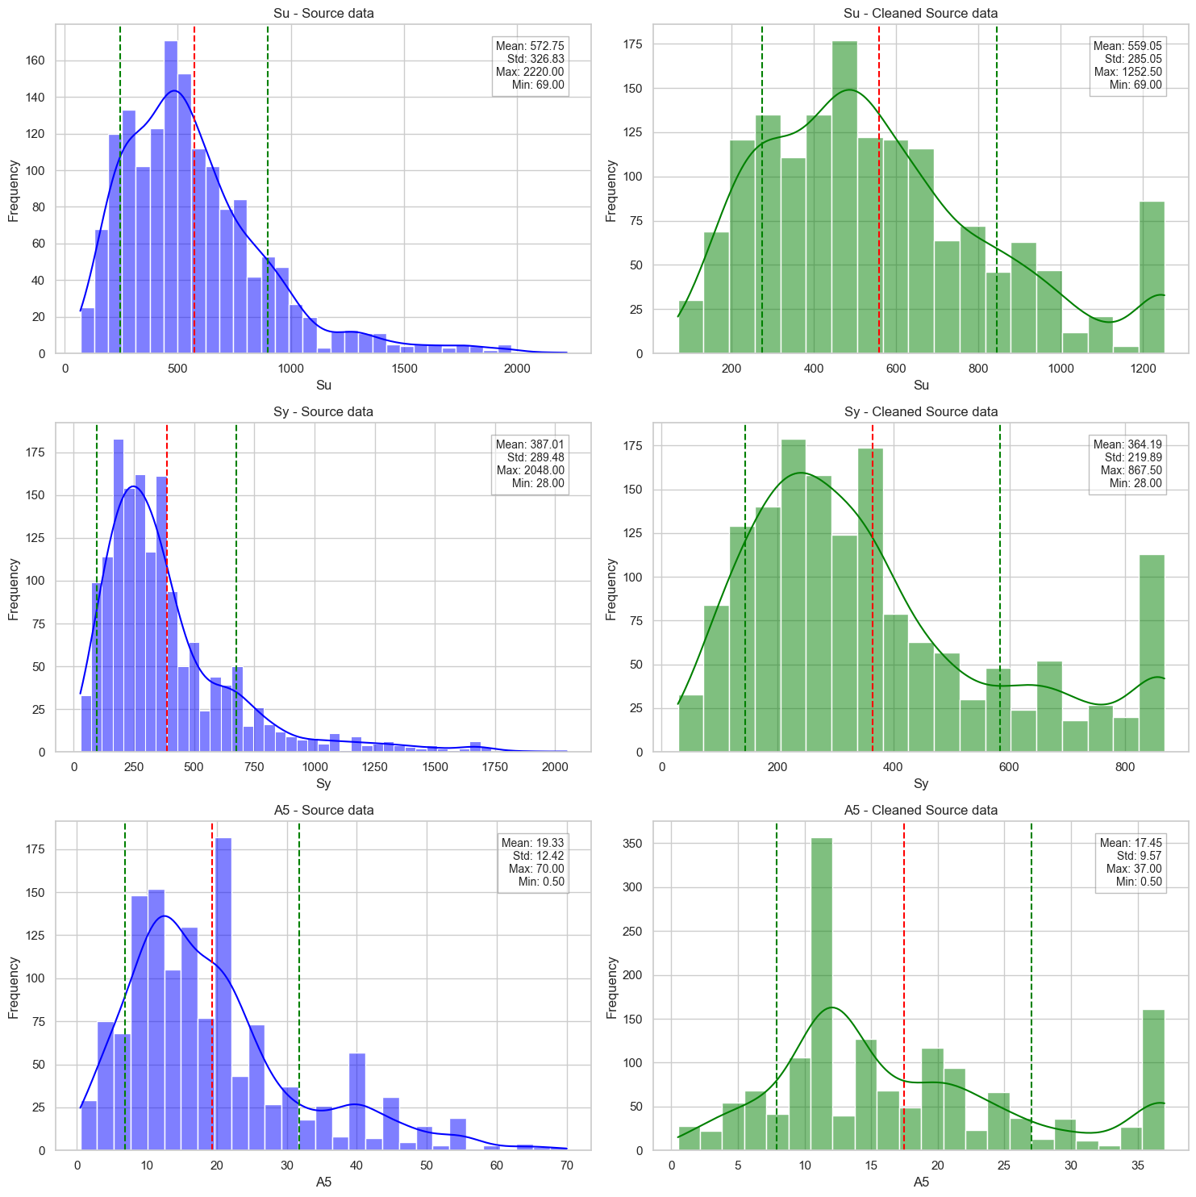
Before/after data cleaning (Su, Sy, A5).

Slide 5
Task 2 – Group wise Comparison
Material & Heat Treatment Performance
Highest Combined Efficiency Materials:
Strength Efficiency: Steel SAE 51410 - tempered at 400°F (85,530)
Ductility Efficiency: DIN X6CrNiTi1810 - Unknown (37.0)
Hardness Efficiency: Yellow brass C26800 - Unknown (223.5)
Individual evaluation showed Steel SAE 51431 with highest efficiency (57,011)
Full-hard heat treatment yielded best performance among treatment methods (55,892)

Slide 6
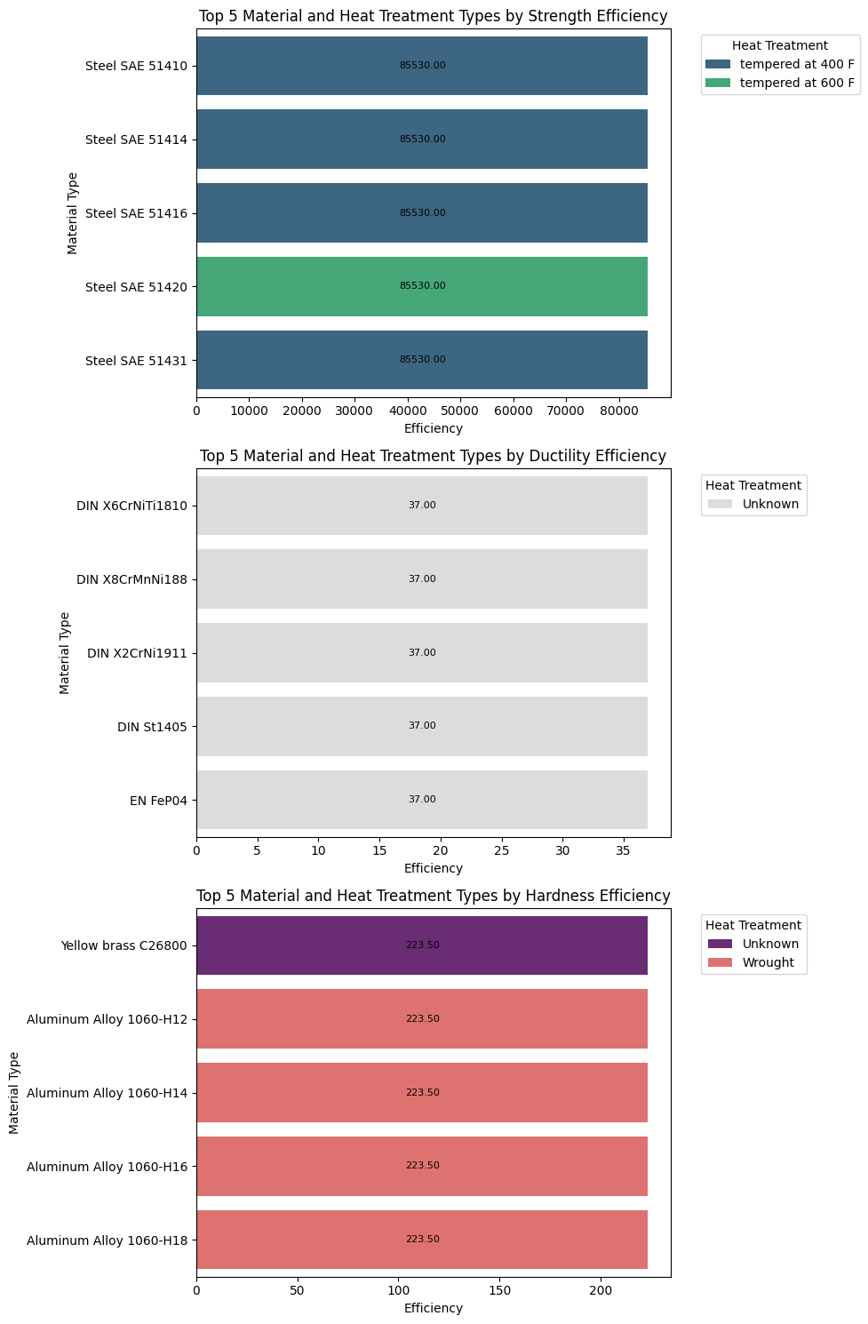
Bar chart of top materials by Efficiency

Slide 7
Task 3 – Design Ratio Analysis
Strength-to-Hardness: Steel SAE 1141 (5.77) → Ideal for chassis parts and suspension arms that need strength with machinability.
Strength-to-Ductility: Steel SAE 30201 (29,341) → Perfect for crumple zones and bumper reinforcements requiring energy absorption.
Strength-to-Weight: Steel 20ChGNR (0.16) → Critical for maximizing strength while minimizing vehicle weight.

Slide 8
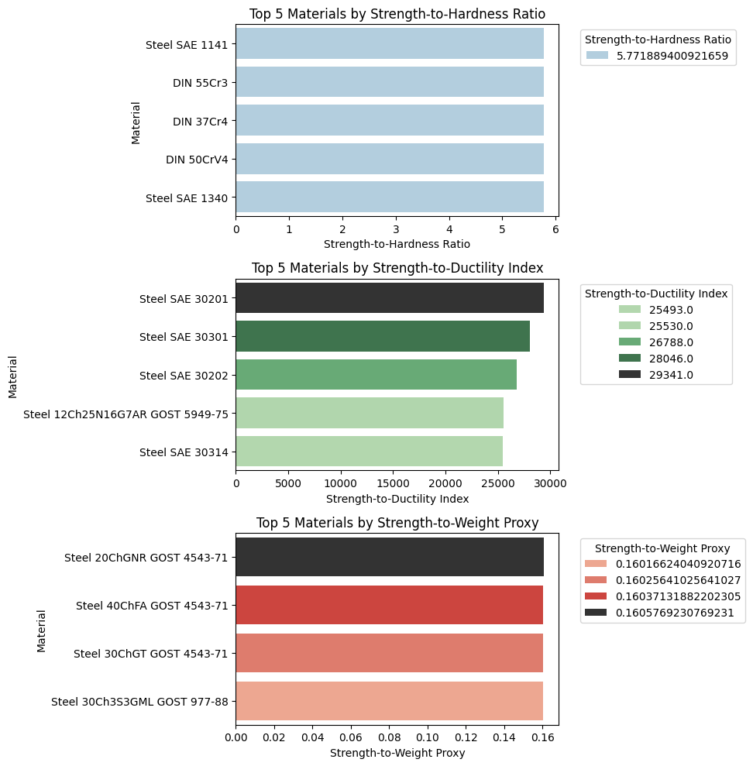
Bar chart of top materials by Design Ratio

Slide 9
Task 4 - Hardness Scale Correlation
All materials showed identical Brinell (Bhn = 217) and Vickers (HV = 230) hardness values.
Consistent 13-point difference between HV and Bhn across all materials.
This suggests that the materials are with harder surfaces than cores (good for wear resistance).

Slide 10
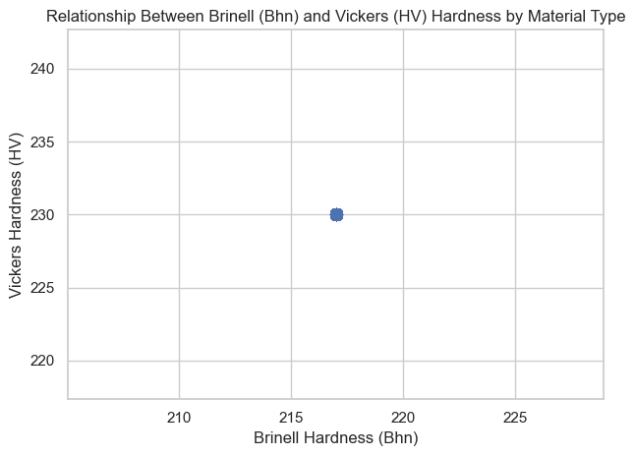
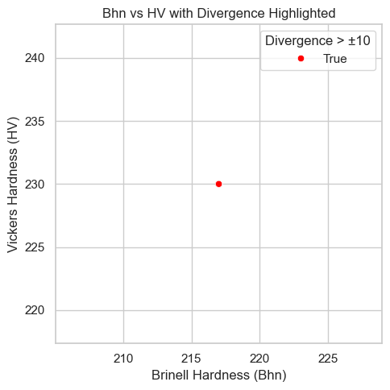
Hardness scale Correlation and Divergence

Slide 11
Task 5 - Elasticity and Deformability
Linear relationship between Elastic Modulus (E) and Shear Modulus (G)
Most materials exhibit isotropic behavior (uniform stiffness in all directions)
No clear correlation between Elastic Modulus (E) and Poisson's Ratio (μ)

Slide 12
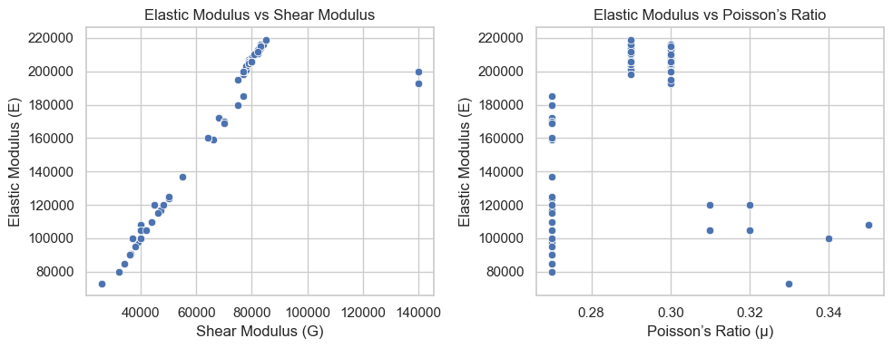
E-G and E-μ scatter plots

Slide 13
Task 6 - Environmental Compatibility
All materials were basic (pH > 7) → Alkaline-resistant (marine/chemical uses).
Strong positive correlation between tensile strength (Su) and yield strength (Sy).
Negative correlation between elongation (A5) and strength metrics.

Slide 14
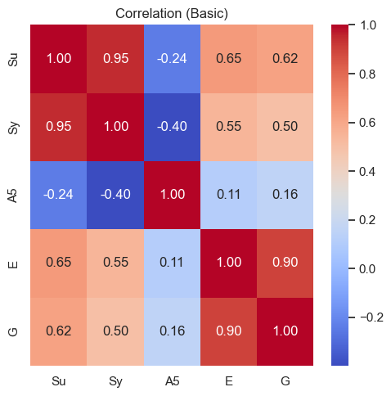
Heatmap of mechanical properties of materials

Slide 15
Task 7 - Material Identifier Matching
Successfully mapped 1,548 materials between datasets using created 'Material_Alias’
Created consistent ID mapping to enable reliable cross-dataset analysis.
Four duplicate materials removed:
NF NF XC42TS, NF NF XC55H1, NF NF Z15CN2413, NF NF Z12CNS2520
Outliers identified and handled in Su, Sy, G, mu, and Ro columns

Slide 16
Task 8 - Discrepancy Audit
Data Consistency Check
1,461 of 1,548 materials (94.4%) have identical Su, Sy, E, G values across datasets.
After handling outliers, minimal difference in statistical properties between datasets.
Mean, standard deviation, maximum and minimum values highly consistent.

Slide 17
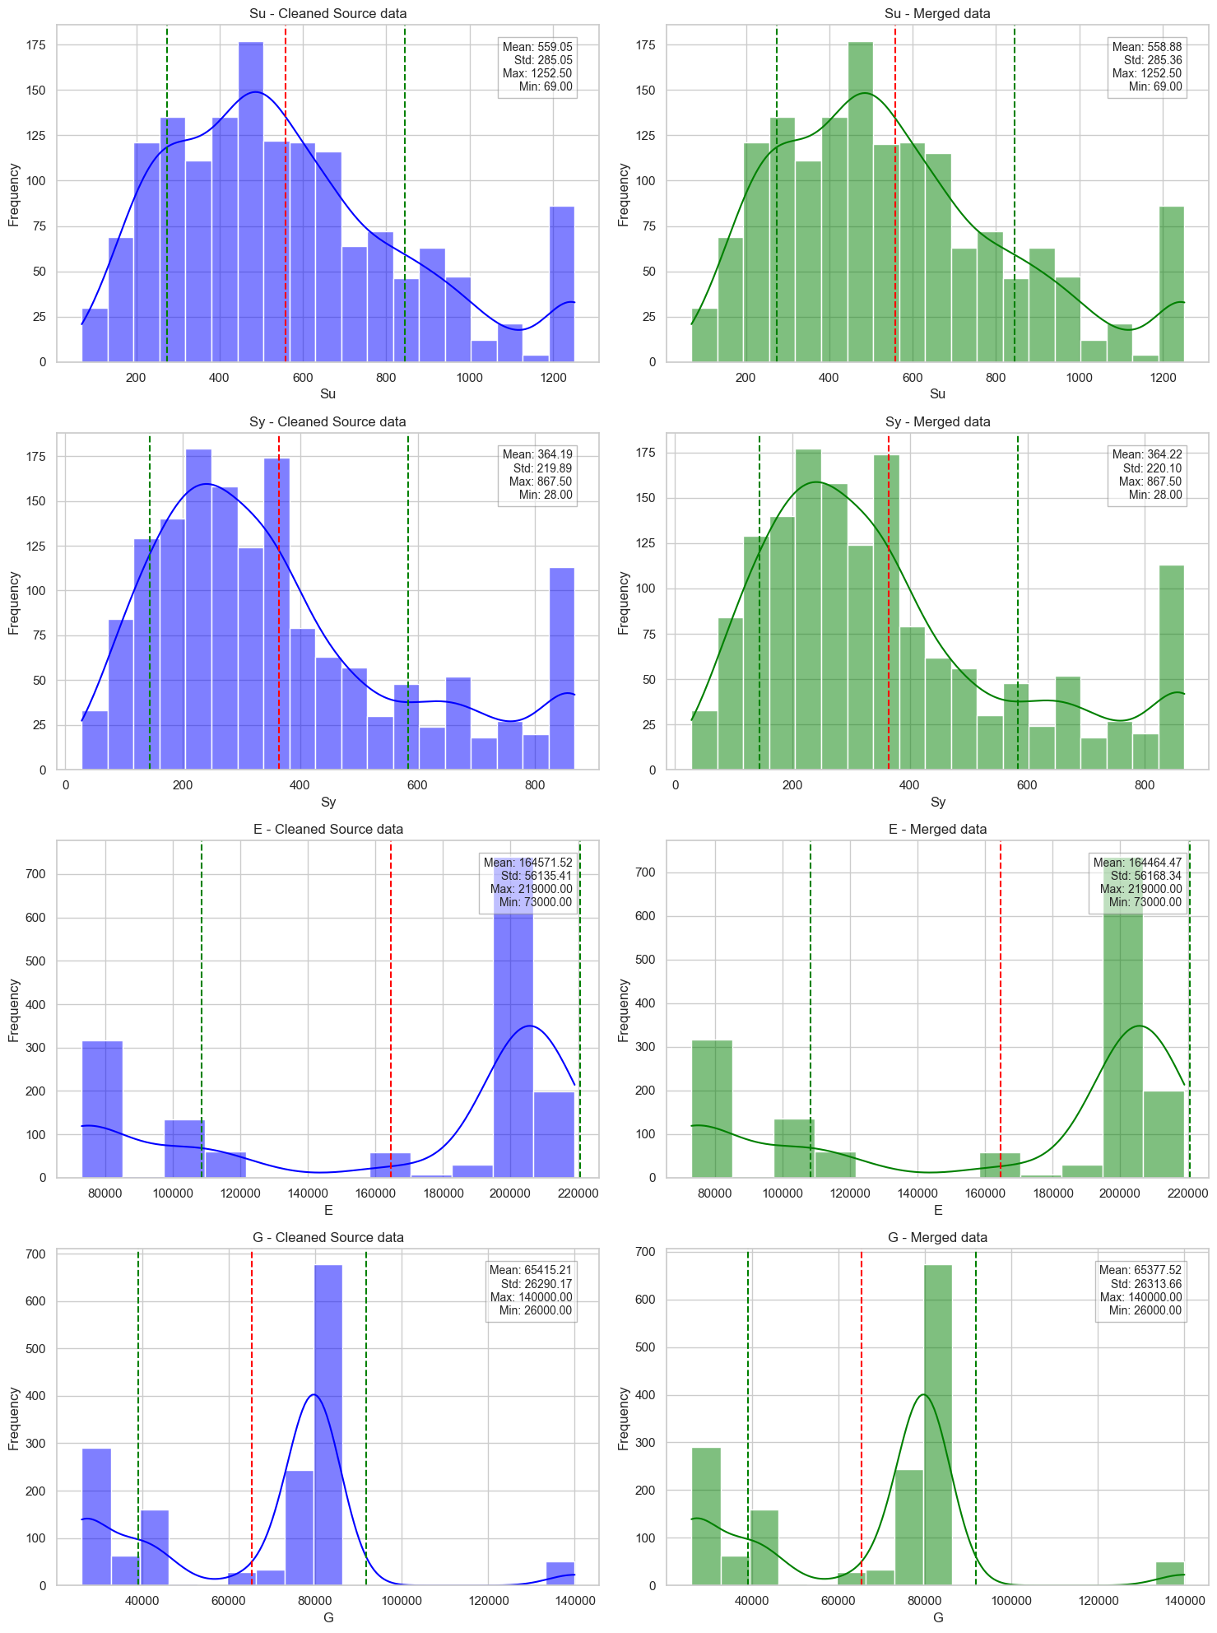
Side-by-side charts of Cleaned D1 vs Merged D2

Slide 18
Task 9 - Use-Case Suitability Mapping
"Use = True" materials prioritize:
Higher ductility (A5 mean: 20.60% vs 17.14%)
Higher elasticity (E mean: 205,422 vs 160,551)
Higher shear resistance (G mean: 79,578 vs 64,021)
Lower strength (Su mean: 457.7 vs 568.6)
"Use = False" materials favor higher strength but sacrifice ductility and elasticity.
Lower standard deviation in "Use = True" materials suggests more consistent performance.
 | Strength |  | Ductility | Resistivity
Use | Su | Sy | A5 | G | E
FALSE | 568.6 | 370 | 17.14 | 64020.8 | 160551.3
TRUE | 457.7 | 303.5 | 20.6 | 79577.8 | 205422.2

Slide 19
Task 10 - Material Ranking by Multi-Criteria Score
Balanced scoring formula:
0.35×Su_norm + 0.25×A5_norm + 0.15×Ro_norm + 0.15×pH_score - 0.10×mu_penalty
Top materials:
ANSI Steel SAE 30201 (annealed)
ANSI Steel SAE 30301 (annealed)
GOST Steel 12Ch25N16G7AR
Multiple ANSI Steel SAE 514xx series (tempered at 400°F)
Score prioritizes balanced strength, ductility, and weight characteristics.

Slide 20
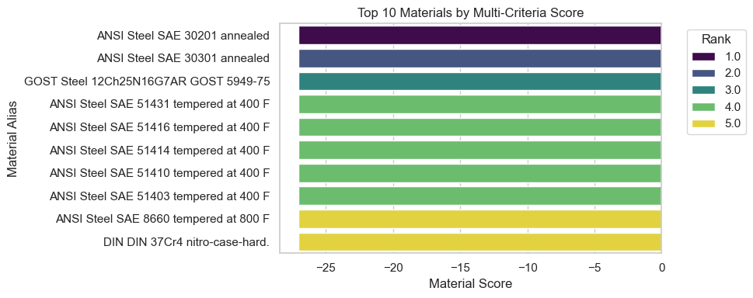
Top Materials by Multi-Criteria Score

Slide 21
Task 11 - Outlier Materials Identification
Identified materials with unusually high strength but very low ductility
No materials showed significant inconsistency between Vickers and Brinell hardness
Few materials showed extremely high resistivity beyond 95th percentile

Slide 22
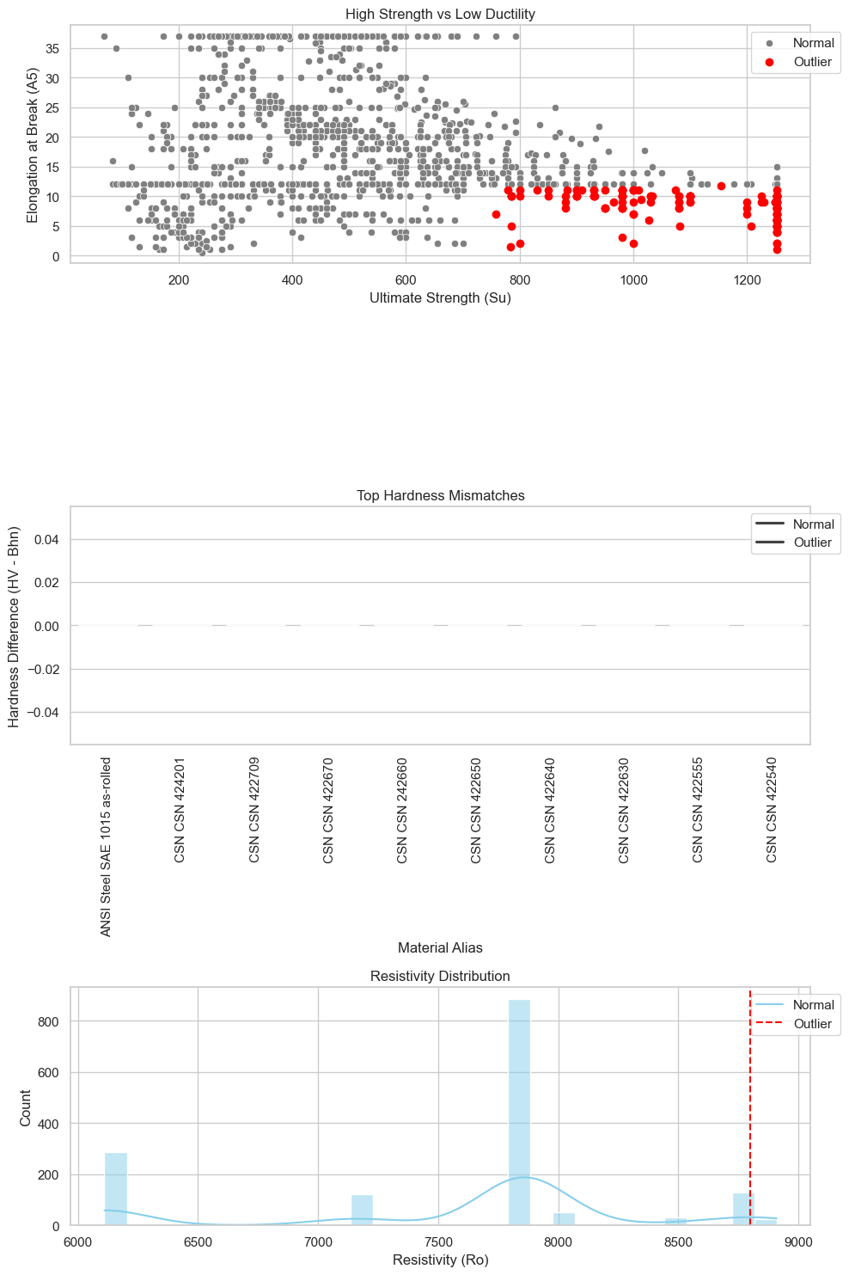
Scatter plot with outliers

Slide 23
Task 12 - Material Descriptor Analysis
No materials matched the "ductile" keyword descriptor
77 materials featured "hardening" in their description
Average properties: Su 812.84, Sy 582.62, A5 12.39
8 materials described as "Corrosion-resistant"
Average properties: Su 775.00, Sy 473.81, A5 24.00
Corrosion-resistant materials show better ductility but lower yield strength

Slide 24
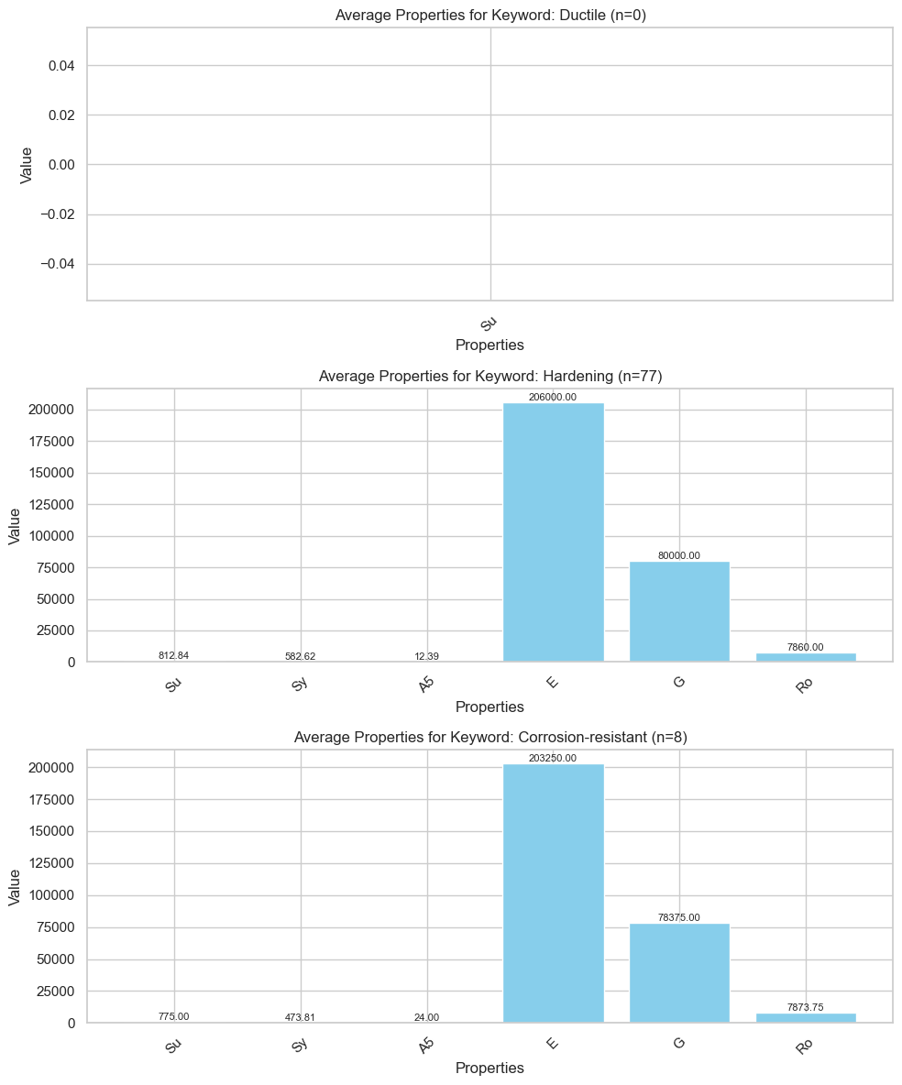
Average properties based on Descriptions

Slide 25
Conclusion & Recommendations
Primary Recommendations:
ANSI Steel SAE 30201/30301 (annealed): Best balance of properties. (High Strength and Ductility)
Steel SAE 51410 (tempered at 400°F): Excellent strength efficiency.
DIN X6CrNiTi1810 : High Ductile Efficiency.
Steel 20ChGNR: Superior strength-to-weight ratio.
Yellow brass C26800: High Hardness Efficiency.
Steel SAE 1141: High Strength to Hardness Ratio. (Ideal for Chassis)
Key Takeaways:
Material selection requires balancing multiple properties.
Heat treatment significantly impacts material performance.
Data-driven approach is very much required for material selection.

