Slide 1

Design and Implementation of Smart Car Seat Belt Accident Detection and Emergency Services in Smart City Environment
By
2111CS050024 S. Jhansi
2111CS050031 M. Madhu
2111CS050012 M. Aravind
Under the Guidance of
Mrs. N. Shalini
Assistant Professor
Department of Internet of Things
School of Engineering
Malla Reddy University
Hyderabad, Telangana, INDIA

Slide 2
Abstract
Delays in emergency response after road accidents significantly contribute to high mortality rates worldwide, including in Saudi Arabia. This project aims to develop an IoT-based solution to address this issue by designing a smart seatbelt equipped with sensors to detect accidents and alert emergency services.The system integrates a heartbeat sensor to monitor the driver’s vital signs and a vibration sensor to detect collisions. An Arduino-based microcontroller processes data from both sensors to determine whether an accident has occurred. If confirmed, the system uses GPS to pinpoint the exact location and GSM technology to send an alert message to pre-stored emergency contacts, including ambulance services.To enhance accuracy, a fingerprint sensor identifies the driver, ensuring the correct heart rate is monitored, even if the driver changes. The hardware is implemented using the Arduino platform, with programming done through Arduino IDE. By enabling faster emergency response, this system aims to reduce fatalities caused by delays in medical assistance.

Slide 3
1. Introduction
1.1 Problem Definition
1.2 Project Description
Delays in emergency response after accidents lead to preventable fatalities, often due to unreliable detection and reporting methods. Existing systems relying on impact sensors may be inaccurate, causing false alarms or missed incidents. An automated system integrating multiple sensors, including heartbeat and vibration sensors, can accurately detect accidents and immediately notify emergency services using GPS and GSM technology. This ensures faster medical intervention, reducing fatalities caused by delayed assistance.
The Smart Car Seat Belt Accident Detection System is an IoT-based safety solution designed for smart cities. It uses seatbelt, heart rate, sound, and accelerometer sensors to monitor driver safety and detect accidents in real time. Upon detecting an impact or abnormal vital signs, the system automatically sends an emergency alert with GPS coordinates via SIM808 GSM and MQTT to authorities or nearby responders. This ensures rapid assistance, reducing emergency response time and improving road safety.

Slide 4
1. Introduction
1.3 Objectives of the Project
Enhance Vehicle Safety .
Accident Detection
Real-Time Emergency Alert
Reduce Response Time
Smart City Integration
1.4 Aim
The project aims to develop an IoT-based accident detection system that monitors driver safety using seatbelt, heart rate, sound, and accelerometer sensors. In case of an emergency, it automatically sends GPS alerts via SIM808 GSM and MQTT, ensuring faster response and enhanced road safety in smart cities.

Slide 5
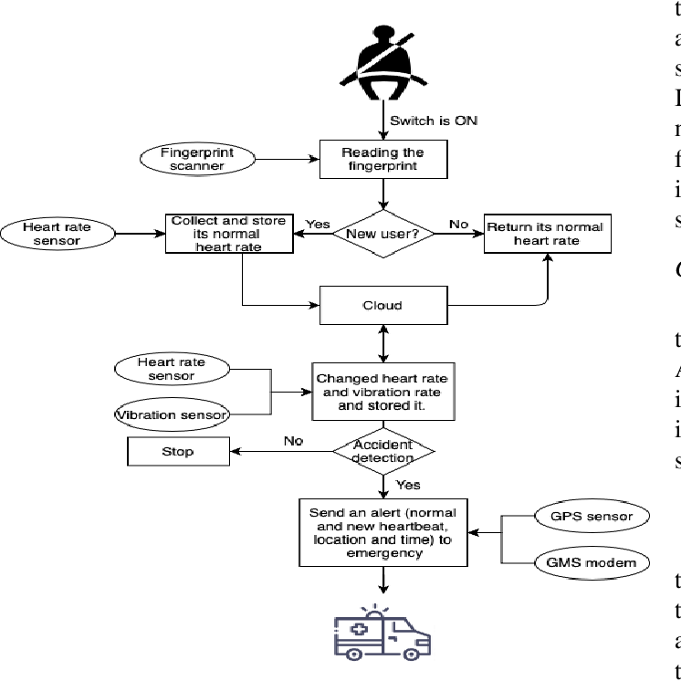



2. Methodology

Slide 6
3. Technologies(Hardware & Software required)
Hardware:
Raspberry Pi / Arduino
MPU6050 Accelerometer
IR Sensor
Heart Rate Sensor (Pulse Sensor)
Sound Sensor
SIM808 GSM & GPS Module
Power Supply (12V/5V)
Software:
Arduino IDE
MQTT server
GPS Tracking Software

Slide 7
4. System Analysis
Literature Survey
IoT-Based Vehicle Safety Systems
  Various research studies highlight the role of IoT in vehicle safety, integrating sensors and cloud platforms to detect accidents and send emergency alerts.
Seat Belt Monitoring Systems
  Studies emphasize the importance of seatbelt detection using IR sensors to ensure driver compliance and reduce injury risks in accidents.
Accident Detection Using Accelerometers
  Research on MPU6050 accelerometers demonstrates their efficiency in detecting sudden impacts and identifying crash severity.
Heart Rate and Vital Monitoring in Vehicles
  Studies suggest that heart rate sensors can detect abnormalities, helping identify unconscious or at-risk drivers before accidents occur.
Sound-Based Crash Detection
  Research supports the use of sound sensors for detecting high-impact noise levels, improving accident identification in low-speed or stationary crashes.
GSM and GPS for Emergency Alerts
  Existing systems use SIM808 GSM/GPS modules for real-time location tracking and emergency notifications, significantly reducing emergency response times.

Slide 8
4. System Analysis
4.2 Existing System
Current vehicle safety systems primarily rely on airbags, seatbelt warnings, and manual emergency calls in case of accidents. Some advanced systems use accelerometers and GPS modules for crash detection, while high-end vehicles integrate OnStar or eCall services for automatic emergency response.
Limitations of existing system
Delayed Emergency Response – Relies on manual notification, increasing response time.
Limited Accident Detection – Misses low-impact crashes due to reliance on airbags or accelerometers.
No Health Monitoring – Lacks driver vital tracking, such as heart rate.
Lack of Smart City Integration – Does not connect with IoT-based emergency networks.
No Sound-Based Detection – Fails to use sound sensors for crash identification.

Slide 9
5. System Analysis
5.3 Proposed System
The Smart Car Seat Belt Accident Detection System integrates IoT sensors to enhance road safety. It uses seatbelt sensors, accelerometers, heart rate monitors, sound sensors, and SIM808 GSM/GPS to detect accidents and send real-time emergency alerts. The system automatically transmits crash data and location to emergency services using MQTT-based cloud communication for faster response.
Advantages of proposed system
Faster Emergency Response – Automatic accident detection and real-time GPS alerts.
Enhanced Driver Safety – Monitors seatbelt usage, heart rate, and crash impact.
Multi-Sensor Detection – Combines accelerometer, sound, and health data for accurate accident identification.
Smart City Integration – Connects with IoT-based emergency services for quick assistance.
Automated Alerts – No manual intervention required for emergency notifications.

Slide 10
5. System Analysis
5.3 Proposed System
Key Features of proposed system
Seatbelt Detection – Ensures driver compliance for safety.
Heart Rate Monitoring – Detects abnormalities to prevent health-related accidents.
Sound Sensor – Identifies crash-related noises for better accident detection.
MPU6050 Accelerometer – Measures sudden impacts and motion changes.
SIM808 GSM & GPS – Sends emergency alerts with real-time location tracking.
MQTT Cloud Communication – Enables instant accident reporting to emergency services.

Slide 11
Thank you

