Slide 1
Project Title
Presented By:
PADALA ANIRUDH (210304124140)
NALLI DINESH DAS (210304124108)
CHAMAL KOWSHIK REDDY (210303124306)
NALAJALA GREESHMA (210304124106)
Guided By:
Faculty Name
Designation
CSE Department
PIET, Parul University
Internal Project Presentation 2024

Slide 2
Content
Introduction
Background study (Research Paper Summary in Table form – Format shared in the next slide)
Objectives of the Project
  What is exactly to be done?
  Why is this project selected?
  Where is the project is helpful?
  When it can be implemented?
  Who will be benefitted?
Project Team : Roles and Responsibilities
Schedule
UML Diagrams
Advantages of the System
Limitations of the System
Conclusion
Future Work
References
Project Presentation 2023

Slide 3
INRODUCTION
Project Definition
Develop a facial emotion detection and sentiment analysis system using computer vision and natural language processing techniques to accurately identify emotions from facial expressions and analyze sentiments in text.
Project Aim
Understanding and responding to user emotions through facial expressions is key for creating personalized and responsive systems. This project is motivated by the potential impact of facial emotion detection and sentiment suggestion in Human-computer interaction, mental health, etc...
Our main objective is to develop a facial emotion detection system that can recognize users' emotions in real-time and provide sentiment suggestions based on the detected emotions.
Project Presentation 2023

Slide 4
Research Papers studied
Sr. no | Paper Title | Publisher | Year | Take-away points
1. | "Deep Facial Expression Recognition: A Survey" | L. L. R. Prasath, A. Madan, and A. K. Bhuvaneswari | 2018 | It reviews deep learning techniques for facial expression recognition, highlighting the advancements, challenges, and potential future directions in the field.
2. | "Sentiment Analysis in the Age of Deep Learning: A Review" | S. Maity, S. Chakraborty, and S. Jana | 2019 | This provides an extensive review of sentiment analysis methodologies in the context of deep learning, covering various techniques, datasets, and challenges.
3. | "Real-time Facial Expression Recognition using Convolutional Neural Networks" | : A. Mollahosseini, D. Chan, and M. H. Mahoor | 2016 | The research introduces a real-time facial expression recognition system based on Convolutional Neural Networks (CNNs), achieving high accuracy in different conditions.
4. | "Sentiment Analysis and Opinion Mining: A Survey" | A. Gandomi and M. Haider | 2019 | This survey provides a comprehensive overview of sentiment analysis and opinion mining, covering techniques, offering insights into the evolving landscape of sentiment analysis research.
Project Presentation 2023

Slide 5
Objectives of the Project
1)Real-Time Emotion Detection:
Develop a real-time facial emotion detection system with high accuracy to recognize expressions like joy, sadness, and anger.
2)Sentiment Analysis Integration:
Integrate sentiment analysis algorithms for a comprehensive understanding, mapping facial emotions to sentiments such as positive, negative, or neutral.
3)Emotion-Sentiment Mapping:
Establish a coherent mapping between facial expressions and suggested sentiments, refining the system to accurately translate various emotions into appropriate suggestions.
4)Cross-Domain Applicability:
Design the system for cross-domain applicability, spanning human-computer interaction, mental health monitoring, and personalized content recommendations.
5)User-Friendly Interface:
Create a user-friendly interface for capturing diverse facial expressions, ensuring accessibility and ease of use.
Project Presentation 2023

Slide 6
Project Team : Roles and Responsibilities
Sr. no | Team member | Enrollment number | Role | Responsibility
1. | Padala Anirudh | 210304124140 | AI, CNN, Deep Learning | , Collect, Clean, and Preprocess Data, Optimize and Fine-tune ML algorithms.
2. | Nalli Dinesh Das | 210304124108 | ML, Flask, React/Vue.js | Develop Machine Learning Models Design and infrastructure for web applications, ensuring efficient data management.
3. | Chamala Kowshik | 210303124306 | NLP, TensorFlow/PyTorch, Keras | Create intuitive and engaging user interfaces for web applications using modern frontend technologies and frameworks.
4. | Nalajala Greeshma | 210304124106 | Computer Vision, MongoDB/PostgreSQL | Develop and manage Dara Bases and computer vision
Project Presentation 2023

Slide 7
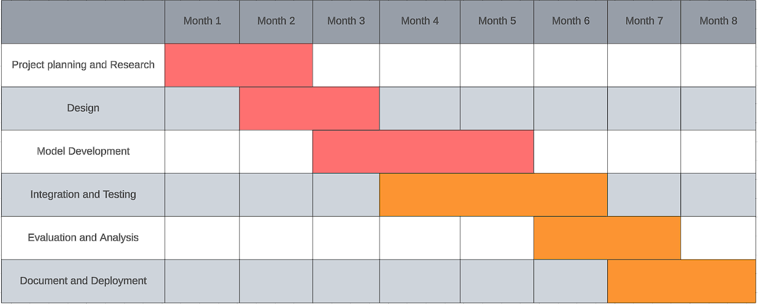
Time Line Chart - Schedule
Project Presentation 2023

Slide 8
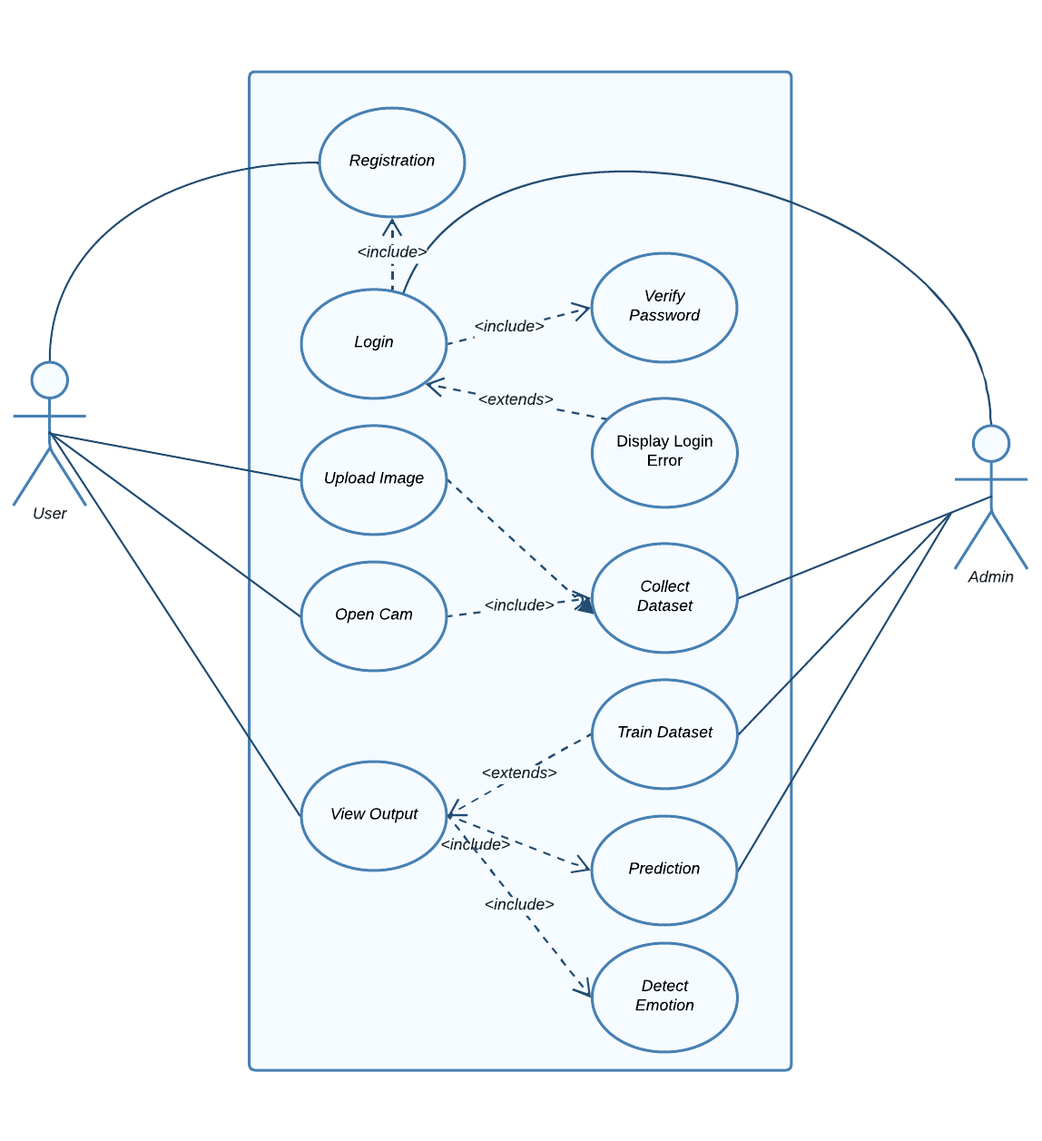
UML Diagrams
Project Presentation 2023

Slide 9
Advantages of the System
Human-Computer Interaction: Applications with improved human-computer interaction, such virtual reality environments, can offer a more immersive and engaging experience..
Improved Mental Health Monitoring: In healthcare applications, the project can contribute to monitoring and analyzing facial expressions to assess mental health, helping to identify and address emotional well-being issues.
Customer Feedback Analysis: In business and customer service, sentiment analysis can be applied to customer feedback, reviews, and comments, providing valuable insights for improving products and services.
Personalized Recommendations: The suggestion engine for personalized sentiment recommendations can contribute to more accurate recommendations in various domains, such as entertainment or e-commerce.
Project Presentation 2023

Slide 10
Limitations of the System
Limited Accuracy: Facial emotion detection may struggle to accurately interpret more complex emotional states or subtle variations, leading to potential misinterpretations.
Privacy Concerns: Collecting and processing facial data for emotion detection raises privacy concerns, necessitating robust measures to protect user data and ensure compliance with privacy regulations.
Emotion Dynamics Over Time: Emotions are dynamic and can change rapidly, making it challenging to capture and interpret the evolving emotional states of individuals accurately.
Facial Occlusions and Accessories: Facial accessories, masks, or occlusions may hinder accurate emotion detection by obscuring facial features, especially in situations like the ongoing use of face masks.
Project Presentation 2023

Slide 11
Conclusion
In conclusion, the implementation of the facial emotion detection and sentiment analysis project has been a significant endeavor with notable achievements and valuable insights.
The project aimed to develop a system capable of real-time emotion recognition from facial expressions and integrate sentiment analysis to enhance our understanding of user emotions in diverse contexts.
Project Presentation 2023

Slide 12
Future Work
Advanced Emotion Recognition Models: Explore and integrate state-of-the-art deep learning models enhance accuracy, especially in capturing subtle and complex emotional expressions.
Multimodal Integration: Investigate the integration of multiple modalities, such as voice and text, to create a more comprehensive understanding of user emotions and sentiments.
Cross-Domain Applications: Explore and adapt the system for cross-domain applications, such as mental health monitoring, human-robot interaction, and educational technology, to broaden its impact.
Privacy-Preserving Techniques: Research and implement advanced privacy-preserving techniques, such as federated learning or on-device processing, to address concerns related to user data privacy.
Enhanced Sentiment Analysis Algorithms: Improve sentiment analysis algorithms by considering context, sarcasm, and cultural nuances, enhancing the system's ability to accurately interpret and respond to diverse sentiments.
Project Presentation 2023

Slide 13
References
Huang, ZY., Chiang, CC., Chen, JH. et al. A study on computer vision for facial emotion recognition. Sci Rep 13, 8425 (2023). https://doi.org/10.1038/s41598-023-35446-4
J. Li, S. Fong, Y. Zhuang and R. Khoury, "Hierarchical Classification in Text Mining for Sentiment Analysis", 2014 International Conference on Soft Computing and Machine Intelligence, pp. 46-51, september. 2014.
Gathr Data Inc. (http://surl.li/qjloh)
Project Presentation 2023

Slide 14
Thank you
Project Presentation 2023

