Slide 1

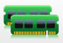




Virtual Machine #1
Virtual Machine #2
Virtual Machine #3
Hypervisor
Physical Server

Slide 2
Virtual Machine #1
Virtual Machine #2
Virtual Machine #3
Hypervisor

Slide 3
Virtual Machine #1
Virtual Machine #2
Virtual Machine #3
Hypervisor
Physical Server

Slide 4


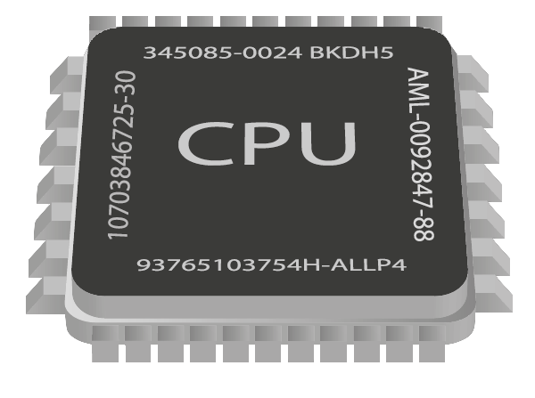

Slide 5
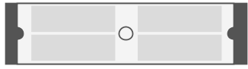

Guest Application
Guest Application
Unmodified Guest OS
Unmodified Guest OS
Virtual Hardware
Virtual Hardware
………
User-Space Applications (Host)
QEMU
QEMU
KVM
Linux Kernel
Server with Virtualization Capable CPU
(Intel VT-X or AMD – SVM)

Slide 6

Virtual Machine #1
Virtual Machine #2
Linux Process
Linux Process
Host Linux Kernel

Slide 7

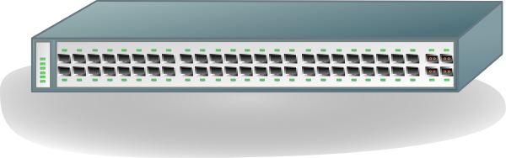
Emulated Devices
Virtual Machine #1
Virtual Machine #2
QEMU
QEMU
Tap
Tap
Host Linux Kernel
Bridge
Br0
Eth0
- - - - - - - - - - - - - - - - - - - - - - - -

Slide 8
Para-Virtualized Networking
Virtual Machine #1
Virtual Machine #2
QEMU
QEMU
Tap
Tap
Host Linux Kernel
Bridge
Br0
Eth0
- - - - - - - - - - - - - - - - - - - - - - - -

Slide 9
Para-Virtualized Internal Networking
Virtual Machine #1
Virtual Machine #2
QEMU
QEMU
Tap
Tap
Host Linux Kernel
Bridge
Br0
Eth0
- - - - - - - - - - - - - - - - - - - - - - - -

Slide 10
Device Direct Assignment
Virtual Machine #1
Virtual Machine #2
QEMU
QEMU
Host Linux Kernel
Eth0
Eth1
- - - - - - - - - - - - - - - - - - - - - - - -

Slide 11
Device Direct Assignment with SR-IOV
Virtual Machine #1
Virtual Machine #2
QEMU
QEMU
Host Linux Kernel
Eth0
Intel VT-X, VT-D
- - - - - - - - - - - - - - - - - - - - - - - -

Slide 12
Container #1
Container #2
………
User-Space Applications
Application
Application
Namespace
Namespace
LXC
(or) LibVirt
CGroups
Linux Kernel
Commodity Server Hardware
Running GNU/Linux

Slide 13
CPU
CPUSET
NET_CLS
NET_PRIO
MEMORY
cpu_hierarchy
net_hierarchy
mem_hierarchy
www_cgroup
www_cgroup
www_cgroup
db_cgroup
.
.
.
db_cgroup
.
.
.
.
.
.
.
.
.
.
.
.
.
.
.
Web Server
Database Server
Subsystems
Hierarchies
cgroups
containers

Slide 14
Dom0
PV Guest
HVM Guest
Control Interface
Application
Application
Management Tools
Native drivers
Para Virtual Drivers
Virtual Hardware
Xen-Enabled Kernel
Xen-PV Enabled Kernel
Unmodified Kernel
………
Xen Hypervisor
Server With/Without Virtualization
Capable CPU (Intel VT-X or AMD – SVM)

Slide 15
130.127.206.208
lbha1
192.168.1.131
192.168.1.112
192.168.1.113
192.168.1.220
bunny2-priv
bunny3-priv
bunnytemp-priv

Slide 16
130.127.206.201
130.127.206.202
mons1
mons2
192.168.1.124
192.168.1.125
RS1
192.168.1.115
192.168.1.116
RS2
mond1
mond2
192.168.1.118
192.168.1.221
192.168.1.120
192.168.1.221
monr2
files.ir.clemson
monr4
monitor.ir.clemson

Slide 31
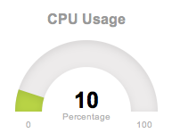
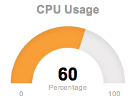
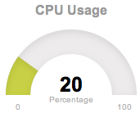

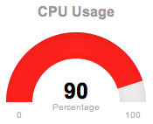
VM 1
VM 2
VM 3
Host

Slide 32
CPU Socket-0 , NUMA node-0
CPU Socket-1 , NUMA node-1
RAM
RAM
Core 0
Core 1
Core 0
Core 1
Cache
Cache
Core 2
Core 3
Core 2
Core 3

Slide 33
MongoDB performance

Slide 34
CPU Stress

Slide 35
Percentage increase execution time CPU

Slide 36
Memory Stress

Slide 37
Percentage increase execution time Memory

Slide 38
Disk I/O Stress

Slide 39
Percentage increase execution time disk

Slide 40
Network Bandwidth Stress

Slide 41
Percentage increase execution time network

Slide 42
STREAM

Slide 43
PYBENCH

Slide 44
PHPBENCH

Slide 45
MongoDB
Cluster
Triplestore
Cluster
RabbitMQ
Cluster
Observation Workers
(Java Application)
Load Balancer
(HAProxy)
Sensor Nodes
Middleware System

Slide 46
LINPACK

Slide 47
IOZONE

Slide 48
IOZONE

Slide 49
nginx

Slide 50
pgbench

Slide 51
Mongo Insert

Slide 52
Mongo find

Slide 53
Mongo update

Slide 54
Rabbit Pub

Slide 55
Rabbit Sub

Slide 56
3storeins

Slide 57
3storeret

Slide 58
obsw

