Slide 1

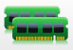




Virtual Machine #1
Virtual Machine #2
Virtual Machine #3
Hypervisor
Physical Server

Slide 2
Virtual Machine #1
Virtual Machine #2
Virtual Machine #3
Hypervisor

Slide 3
Virtual Machine #1
Virtual Machine #2
Virtual Machine #3
Hypervisor
Physical Server

Slide 4


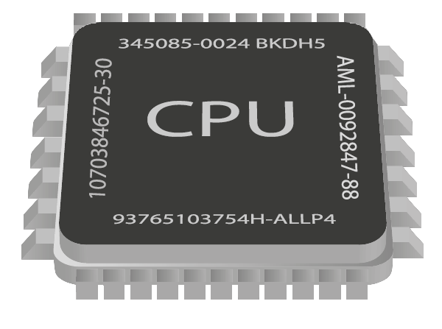

Slide 5
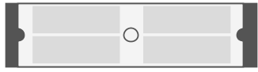

Guest application
Guest application
Unmodified guest OS
Unmodified guest OS
Virtual hardware
Virtual hardware
………
User-space applications (host)
QEMU
QEMU
KVM
Linux kernel
Server with virtualization capable CPU
(Intel VT-X or AMD – SVM)

Slide 6

Virtual Machine #1
Virtual Machine #2
Linux Process
Linux Process
Host Linux Kernel

Slide 7

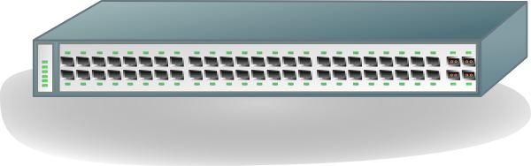
Emulated Devices
Virtual Machine #1
Virtual Machine #2
QEMU
QEMU
Tap
Tap
Host Linux Kernel
Bridge
Br0
Eth0
- - - - - - - - - - - - - - - - - - - - - - - -

Slide 8
Para-Virtualized Networking
Virtual Machine #1
Virtual Machine #2
QEMU
QEMU
Tap
Tap
Host Linux Kernel
Bridge
Br0
Eth0
- - - - - - - - - - - - - - - - - - - - - - - -

Slide 9
Para-Virtualized Internal Networking
Virtual Machine #1
Virtual Machine #2
QEMU
QEMU
Tap
Tap
Host Linux Kernel
Bridge
Br0
Eth0
- - - - - - - - - - - - - - - - - - - - - - - -

Slide 10
Device Direct Assignment
Virtual Machine #1
Virtual Machine #2
QEMU
QEMU
Host Linux Kernel
Eth0
Eth1
- - - - - - - - - - - - - - - - - - - - - - - -

Slide 11
Device Direct Assignment with SR-IOV
Virtual Machine #1
Virtual Machine #2
QEMU
QEMU
Host Linux Kernel
Eth0
Intel VT-X, VT-D
- - - - - - - - - - - - - - - - - - - - - - - -

Slide 12
Container #1
Container #2
Application
Application
User-space Applications
………
Namespace
Namespace
LXC
(or) LibVirt
CGroups
Linux Kernel
Commodity Server Hardware capable
of running GNU/Linux

Slide 13
CPU
CPUSET
NET_CLS
NET_PRIO
MEMORY
cpu_hierarchy
net_hierarchy
mem_hierarchy
www_cgroup
www_cgroup
www_cgroup
db_cgroup
.
.
.
db_cgroup
.
.
.
.
.
.
.
.
.
.
.
.
.
.
.
Web Server
Database Server
Subsystems
Hierarchies
Cgroups
Containers

Slide 14
Dom0
PV guest
HVM guest
Control Interface
Application
Application
Management Tools
Native drivers
Para Virtual drivers
Virtual Hardware
Xen-Enabled Kernel
Xen-PV enabled Kernel
Unmodified Kernel
………
Xen Hypervisor
Server with/without Virtualization
capable CPU (Intel VT-X or AMD – SVM)

Slide 15
130.127.206.208
lbha1
192.168.1.131
192.168.1.112
192.168.1.113
192.168.1.220
bunny2-priv
bunny3-priv
bunnytemp-priv

Slide 16
130.127.206.201
130.127.206.202
mons1
mons2
192.168.1.124
192.168.1.125
RS1
192.168.1.115
192.168.1.116
RS2
mond1
mond2
192.168.1.118
192.168.1.221
192.168.1.120
192.168.1.221
monr2
files.ir.clemson
monr4
monitor.ir.clemson

